Slide 1
Controls for Air and Nitrogen Systems
J. Lewis
Integration Meeting
17 July 2024
v1 – posted DD Month

Slide 2
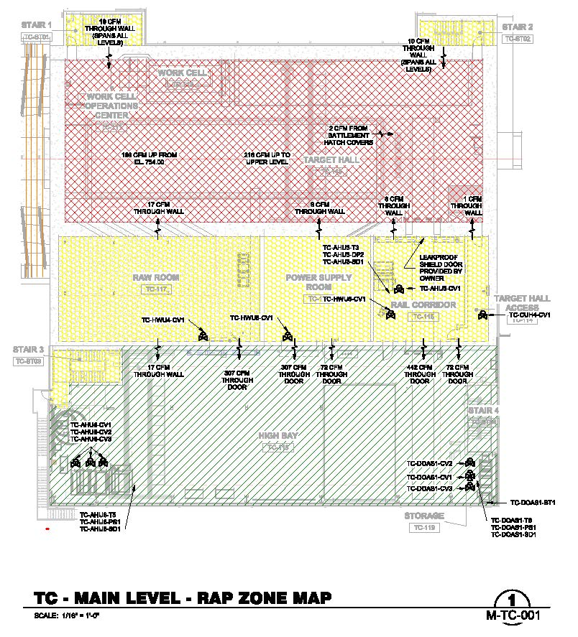
Overview
NSCF designing and installing all air and nitrogen handling systems
Includes cooling of target and absorber piles
Will use PLCs with HVAC communications standards
BACnet (ASHRAE 135)
Includes full suite of software for operations
ISD responsible for comfort systems and infrastructure
Won’t accept responsibility for process systems for program elements, i.e. Beamline cooling
AD must control Beamline systems and RAP
Hybrid ownership and control

Slide 3
System Types
Type | Owner | Beam-on Control | Shutdown control | Control Type | Network
NHUs | AD | AD | AD | PLC | AD
Absorber pile AHU | AD | AD | AD | PLC | AD
RAP AHU | ISD | AD | ISD | PLC | AD
Exhaust Fans for enclosures | ISD | AD | ISD | PLC | AD
RAP Exhaust (EE-EF1) | AD | AD | AD | PLC | AD
OPAV DOAS | ISD | AD | ISD | PLC | AD
High-bay AHU | ISD | ISD | ISD | DDC | ISD
RAW, HPS, Controls room cooling | ISD | AD | AD | DDC | AD
Air-cooled chillers | ISD | ISD | ISD | DDC | ISD
Hot and cold water pumps | ISD | ISD | ISD | DDC | ISD
Unit heaters | ISD | ISD | ISD | DDC | ISD
Evaporator System and condensate pumps | AD | AD | AD | PLC | AD
All systems are controlled over IP
Assign to networks based on beam-on control
Shutdown control in attached table is for purposes of maintenance, not day-to-day operation
Need information shared between networks
Examples:
AD needs temp of chillers from ISD network
ISD needs status of DOAS units from AD network
Require gateway to communicate between networks

Slide 4
System Maps
Graphical representation of system types for all three complexes (PB, TC, AC)
See DocDB-31413
Diagrams currently from 60%
To be updated soon
Spreadsheet is up to date
Key
PLC, AD owned
PLC, ISD owned
DDC, ISD owned

Slide 5
System Map: TC

Slide 6
System Map: AC

Slide 7
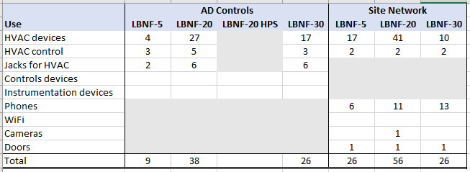
Networking
All network switches to be provided by lab to contractor
AD for ACNET
Connect beamline HVAC systems on isolated VLAN for commissioning
Per Tim Zingleman
CD site network for ISD
They also have a secure VLAN for building automation systems
Need port counts for all facilities
Complete table below!

Slide 8
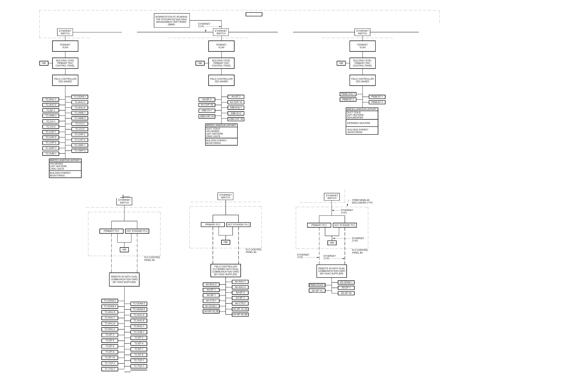
Network Diagram
Dedicated ISD vlan on site network
Gateway
Dedicated ACNET vlan on isolated AD network

Slide 9
Beam Permit
One permit signal for each PLC-based subsystem
Example: TC-NHU-1
Will be logical AND for all alarm tests for that subsystem
Require saving snapshot of all quantities when permit is dropped for a subsystem
Relay contact or TTL signal (TBD)

Slide 10
Control System Deliverables by NSCF Subcontractor
Complete controls systems using commercial software with a fully implemented Human Machine Interface (HMI)
Separate systems for PLC vs DDC based
Readonly access to data from other system via gateway
Includes servers and workstations
Question: Where to house servers and gateway?
Can run on any internet-connected computer
E.g. laptop
Subject to network security
Will include settings of all devices
NSCF commissioning agent will balance all systems prior to AUP
Beamline should bring them back to update settings once TSP, horns, and absorber pile are fully installed
Will include sequences for different operations conditions
Beam-on, NHU access, bunker nitrogen fill, etc.
Complete listing of all BACnet I/O variables
Includes settings and alarm levels
Can integrate with ACNET/ACORN using EPICs interface

Slide 11
Control System Issues
Standalone system delivered at AUP
Less than ideal for MCR
Need to integrate to ACNET?
At what level?
Routine monitoring only
Include all monitoring and control functions
Can effectively function as an alternative workstation reading or setting values
Issue for ACORN, Ops?
I would keep software off LBNF project
What is desired complexity of sequences?
Include all three complexes in each sequence?
Need small-group discussion. Volunteers?

Slide 12
Action Items
Validate equipment control/ownership
Include commissioning agent prior to beam startup
Update network counts
Schedule installation of AD network devices during NSCF construction
Review operations sequences

