Slide 1
GridPix with Pasive Bipolar Grid in high Magnetic Field
E Shulga (SBU), J. Kaminsky (Bonn), A. Milov (WIS)
SBU & BNL Gas-Detector Lab

Slide 2
Ion Blocking by the Passive Bipolar Grid
Fraction of ions going back
Fraction of electrons
Results show that IBF can be suppressed down to 0 with a cost of 45% of primary electrons @ B≥1.2 T
Comparison to simulations have been performed, better measured gases provide better results, improvement could be obtained in the future
Beam test was performed @ the Argon National Laboratory to increase magnetic field
Garfield++ simulations have shown good results for Ar/CH4
arXiv:2007.13616
IEEE:9279256

Slide 3
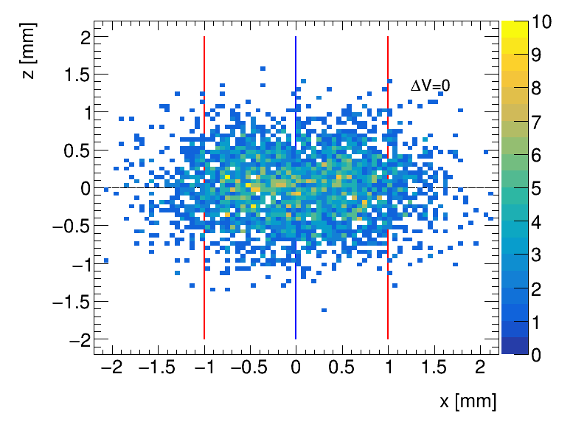
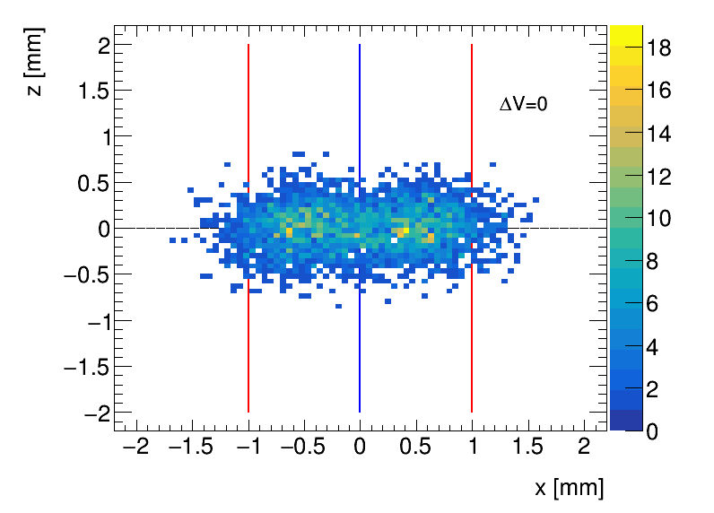
BPG effect on the drift of electrons
Garfield++ Simulations Ar/CH₄ (90:10): 55 µm binning
No magnetic field
With magnetic field
B=0
B=1.2 T
Linear bias corresponding to Lorentz angle
Designed a setup with GridPix detector (from Bonn group) to measure the bias

Slide 4
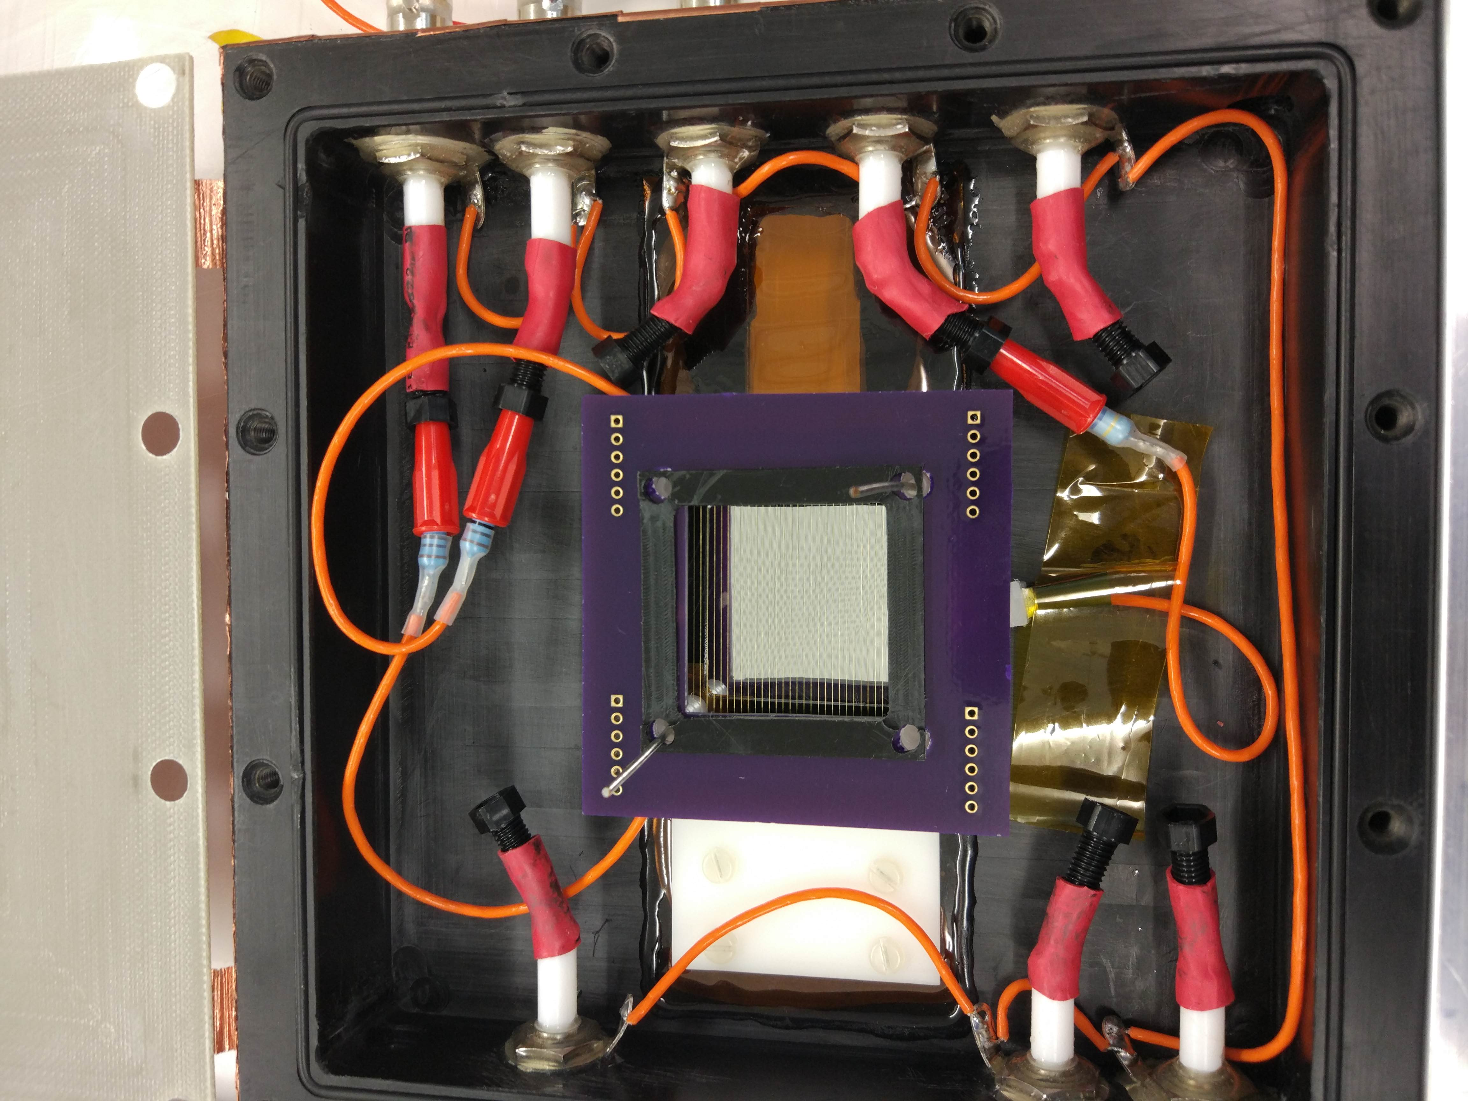
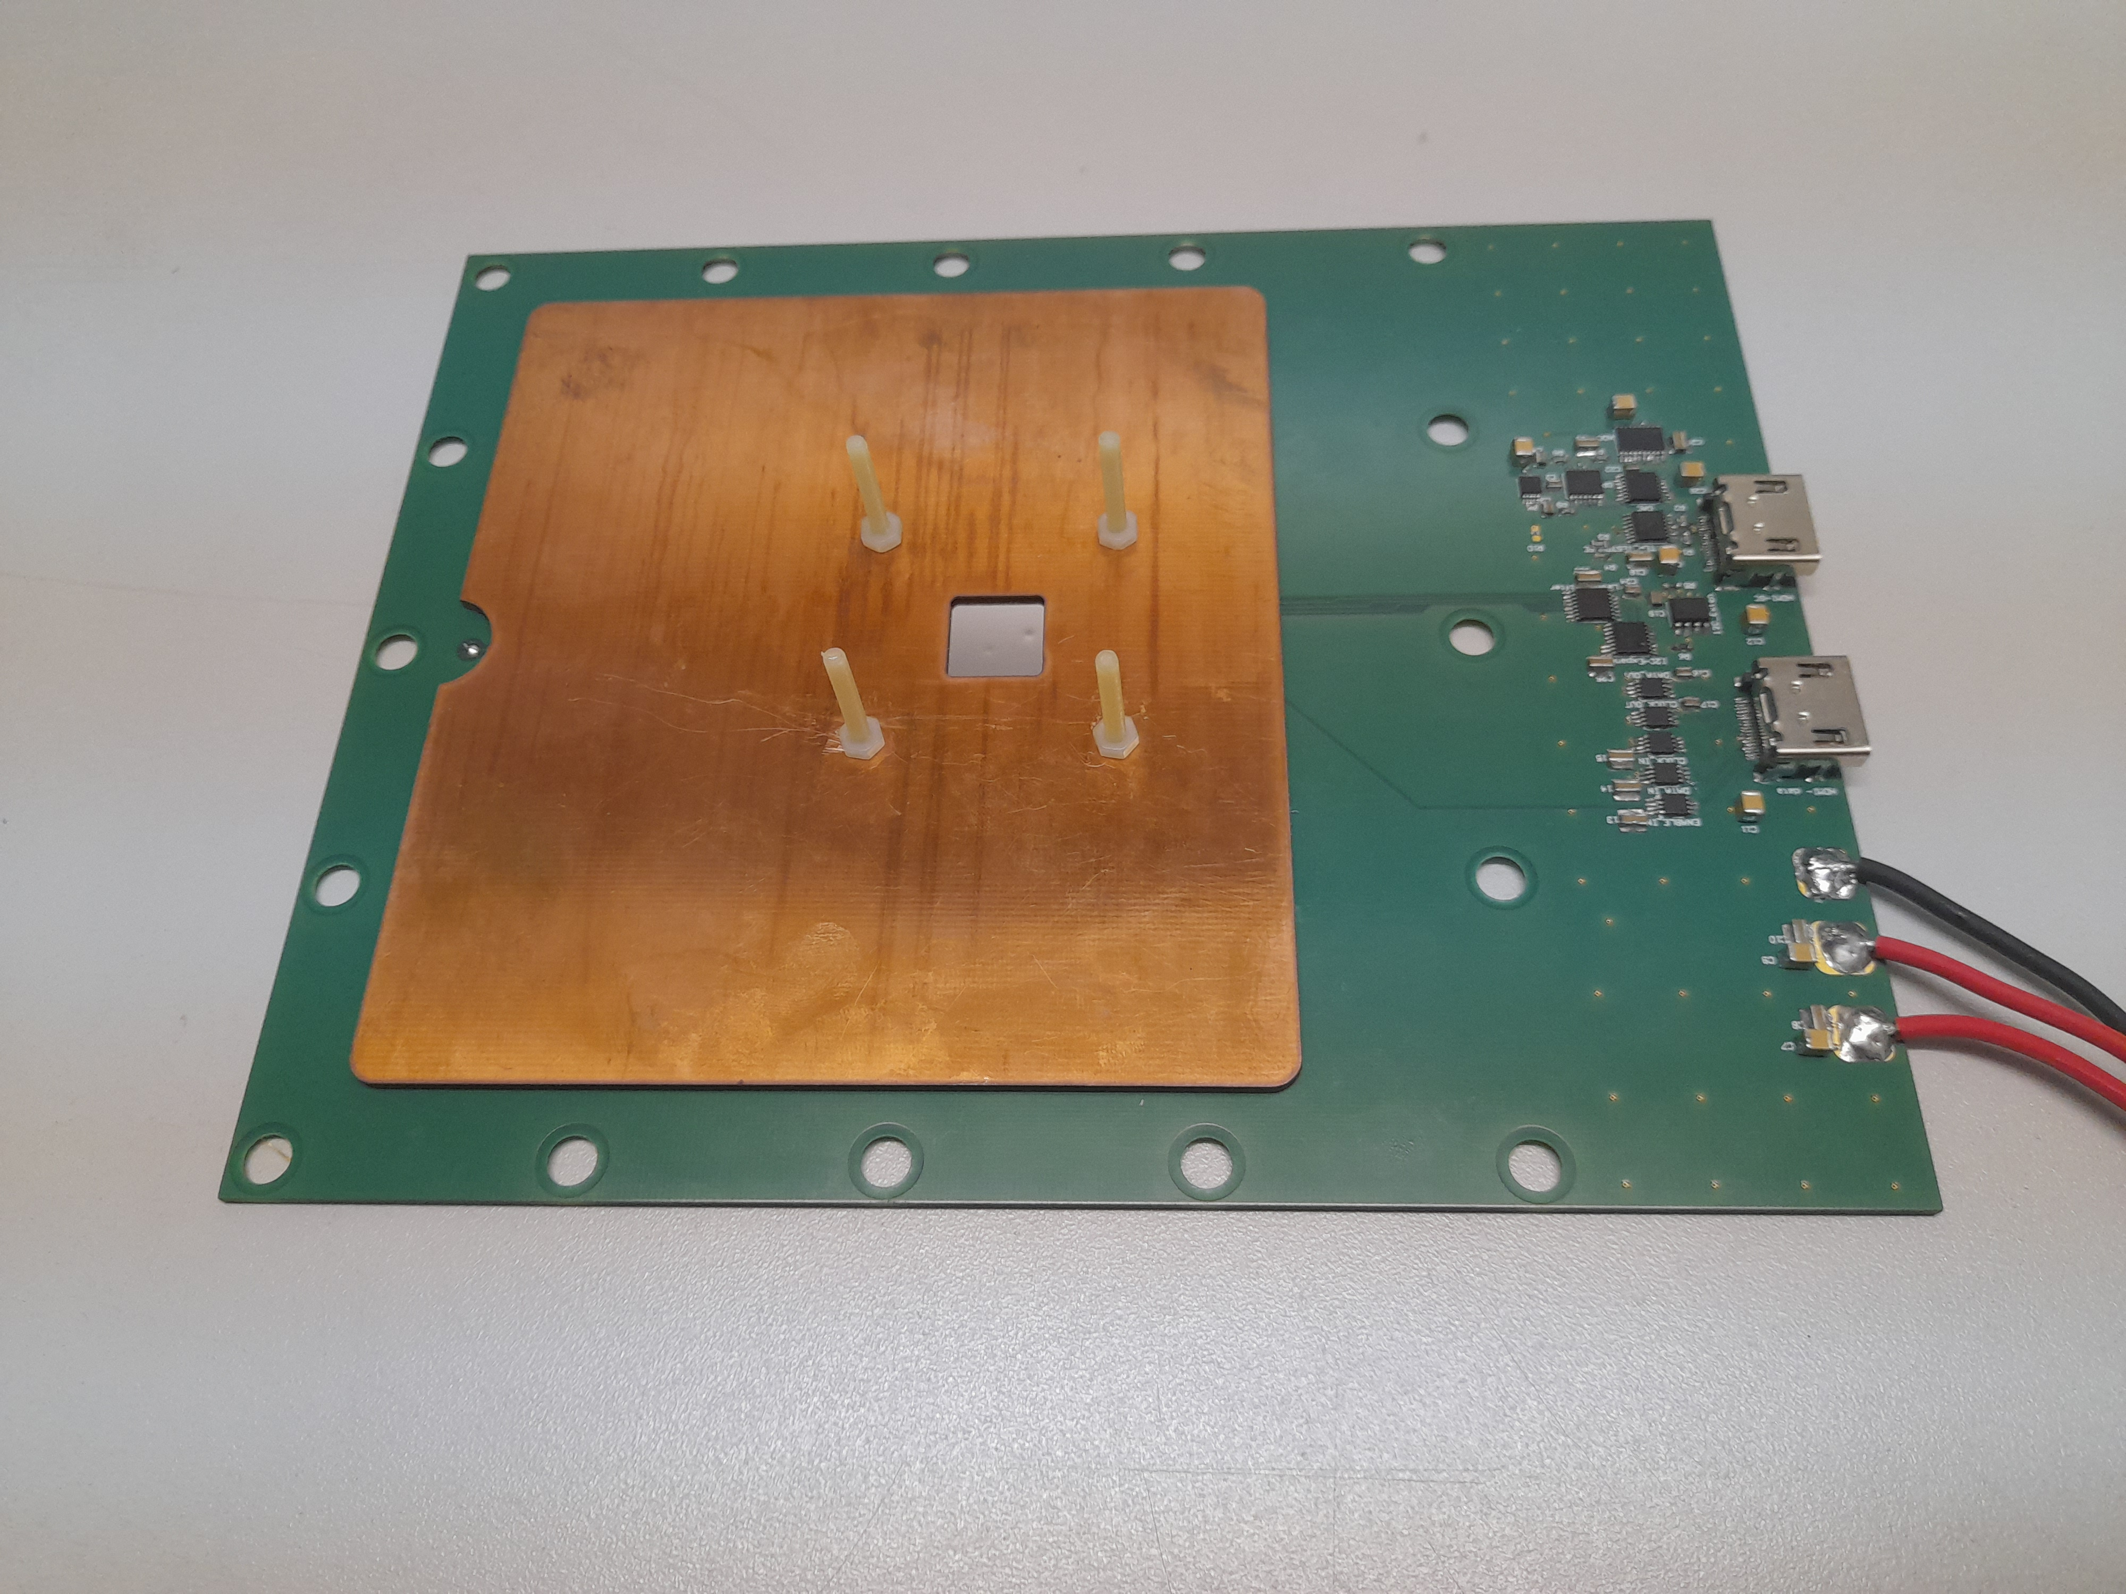
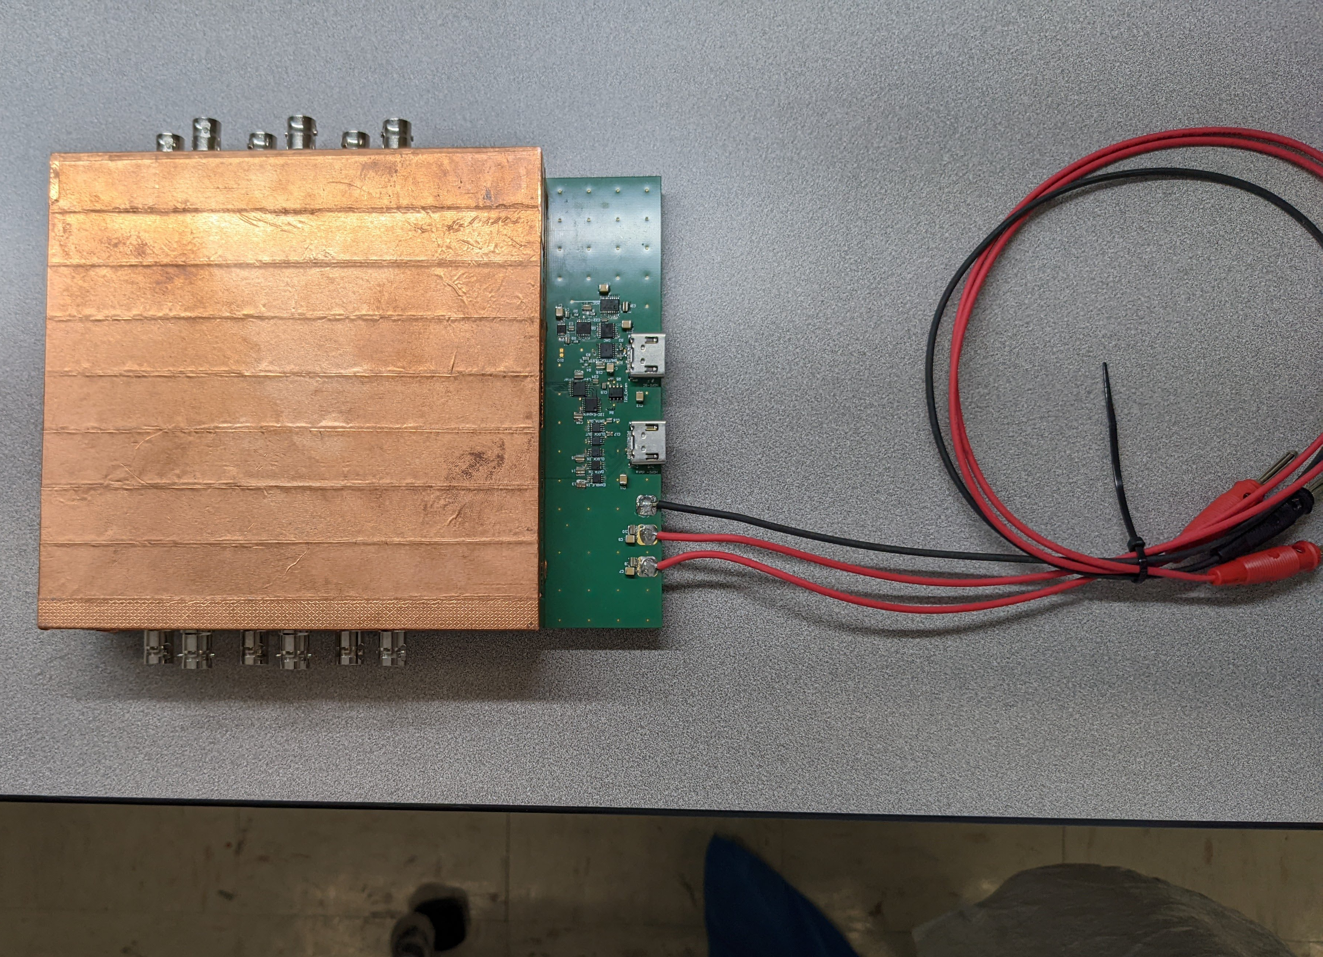
BPG effect on the drift of electrons
Setup is at SBU (designed by Me and J. Kaminsky produced @ Weizmann & Bonn)
Setting up DAQ system (SRS)
Plan to perform measurements @ BNL or ANL with >1 T magnetic field

