Slide 1
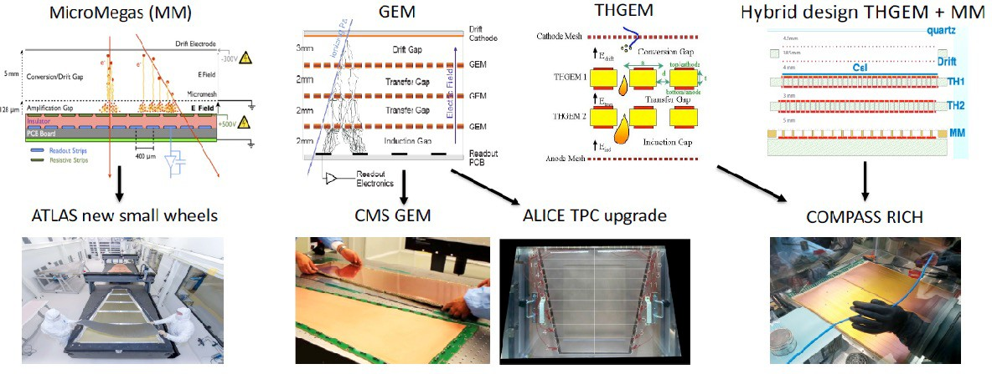
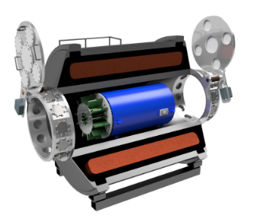
Large variety of MPGD architectures: originally developed for HEP, spread to other fields, including NP, rare event search, etc…
RDC6 - Gaseous Detector
Project Title: Advanced gas amplification structures
Scope: develop novel gaseous avalanche detector schemes (e.g., MPGDs) to advance instrumentation for experiments at the forefront of particle/nuclear physics & support US science mission.
,
Work Plan:
Train a postdoctoral fellow to work on designing innovative gaseous avalanche architectures to address challenges of future experiments (HEP, NP, rare event search, …)
Milestones:
-) Identify technical challenges, define specifications and requirements for a class of different experiments ➔ RD6 collaborative effort
-) Develop expertise/skills in radiation detector physics and simulation tools (GEANT4, electric field finite element analysis, GARFIELD++, etc.) ➔ @ FRIB
-) Design effective solutions () to achieve performance goals & mitigate identified challenges/problems ➔ RD6 collaborative effort
-) Prototyping and testing ➔ RD6 collaborative effort
Significance of the Project:
-) Advance the gaseous detector technologies and applications
-) Create bridges between the different RDC6 groups.
-) Training next generation of experts in radiation detector physics.
Problem: each application has unique requirements
➔ MPGD versatility allows readout scheme designed to meet the needs of specific situations
Multi-layer THGEM
FRIB AT-TPC
Example: M-THGEM for TPC operated in Active-Target
Operation in pure elemental gas providing 5 times higher luminosity

