Slide 1
9 AM Meeting
Keymonty Bullock
MCR Crew Chief
Monday, June 17, 2024

Slide 2
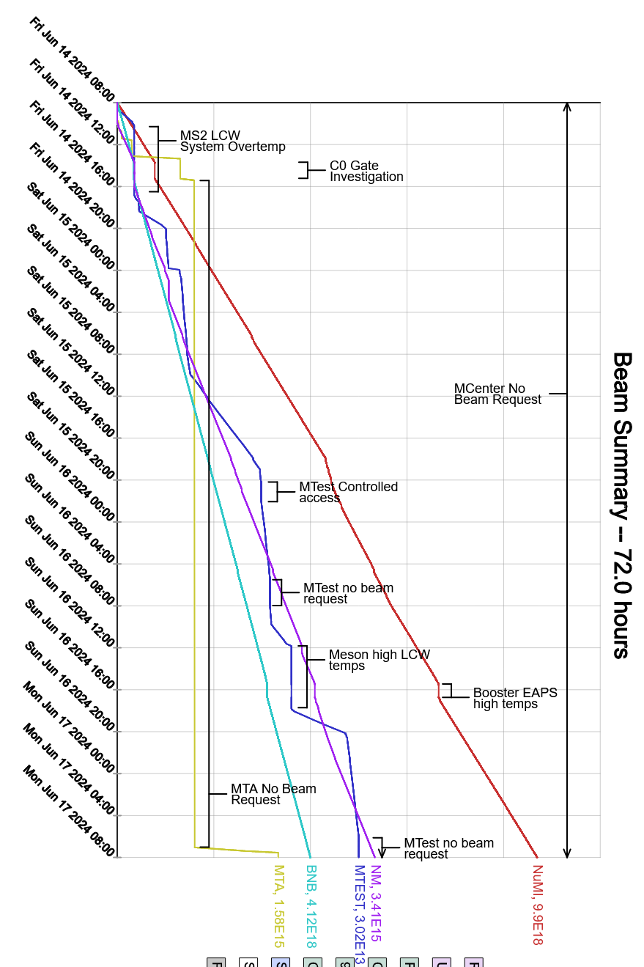
Since Friday…
Beam to Meson halted due to LCW temperature issues (Friday and Sunday)
BRF02 and BRF09 issues
Experts are troubleshooting today
MIRF11 SOLA Transformer issues resulted in reduced intensity for NuMI
RF Techs will be looking into it today
Booster EAPS tripped on Room Overtemp
Resumed beam once temperatures came down in the day
Beam to NuMI, BNB, Mtest, and SpinQuest

