Slide 1
LBNF project introduction
Patrick Hurh, LBNF Targetry Technical Manager
Target Exchange System Technical Design Review
24-25 June 2024

Slide 2
Presenter Background
P. Hurh
Target Systems Department (FNAL)
LBNF Beamline Level 4 Technical Manager for Targetry
Project Engineering Group Leader
34+ years at Fermilab
Mechanical Support Department Head (2005 – 2015)
Target Systems Department Deputy (2015 – 2020)
24+ years with Target Facilities
RaDIATE collaboration program coordinator (2013 – 2020)
Fermilab HPT R&D program leader (2012 – 2020)
NuMI-NOvA target liaison with RAL
Anti-proton target facility (AP-0) lead engineer
Lead engineer on AP-0 SEM, Target, Lithium Lens and Pulsed Magnet

Slide 3
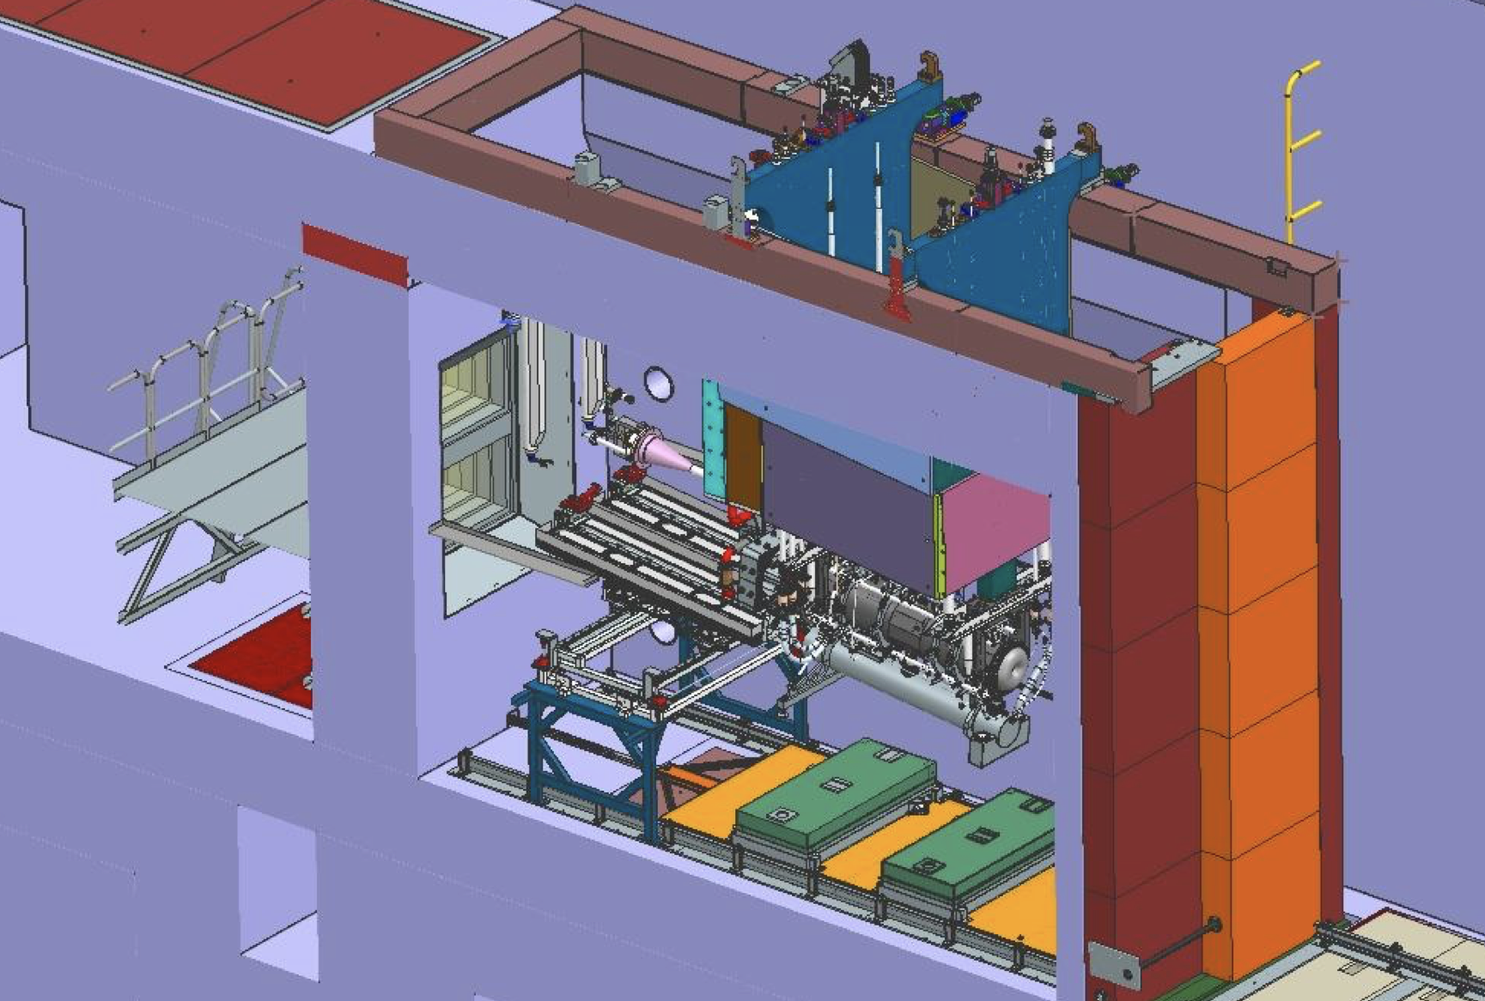
Outline
LBNF Targetry Scope Division
Interface Documentation
Questions

Slide 4
Targetry WBS Scope Division
Note: Formal RAL Scope Listed in Project Planning Document (PPD) – Part 2
RAL Contribution
Target
Mounting Supports to Horn A
Prototype and Production Targets
Target Position Thermometer
Features for Beam-based Alignment (“Bafflette”)
Target Exchange System
Manipulators
Target Container
Remote connections
Target He Gas Cooling System
Design and Major Components (e.g. Compressors, Heat Exchangers)
Shielded pipe feedthrough (in Target Utility Block)
Instrumented Baffle
Baffle Carrier
LBNF-FNAL
Horns WBS
Horn A
Horn A module + TUB
Baffle Module
Nu Beam Instrumentation WBS
Beam–based Alignment
Read-out for Target Position Thermometer
Remote Handling WBS
Workcell support
Interface to Workcell CF WBS (manipulators, Pb glass window)
Targetry WBS
He Gas Cooling Piping and Engineering Notes
He Gas Instruments and Controls (including PLC programming)

Slide 5
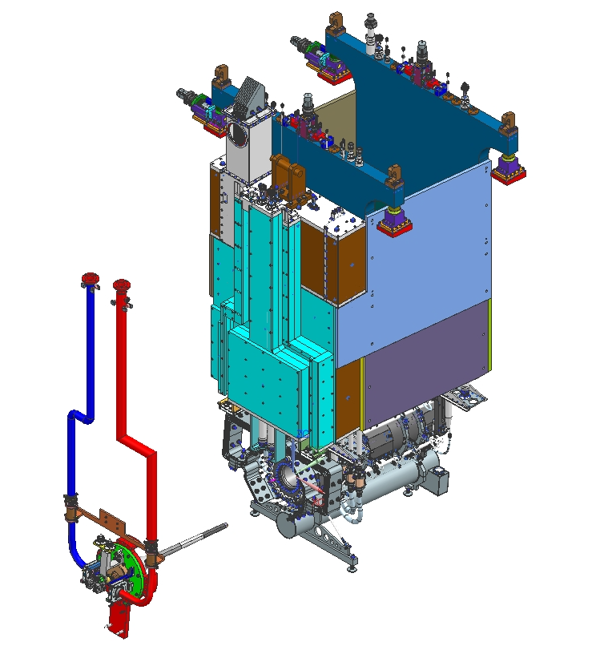
Interfaces – RAL <-> FNAL
High Level In-Kind Contribution Definitions are set forth by the Project Planning Document, agreed to by both Fermilab and UKRI
LBNF Beamline Project maintains Interface Control Documents (ICD) which are accessed through a master LBNF Beamline Interface Matrix spreadsheet maintained on the LBNF Sharepoint site
LBNF <-> RAL interfaces for the Target Exchange System are documented via the ICD’s with LBNF Targetry (FNAL) <-> UKRI Targetry (RAL) interfaces listed as part of the Targetry <-> Remote Handling ICD (ICD31)

Slide 6
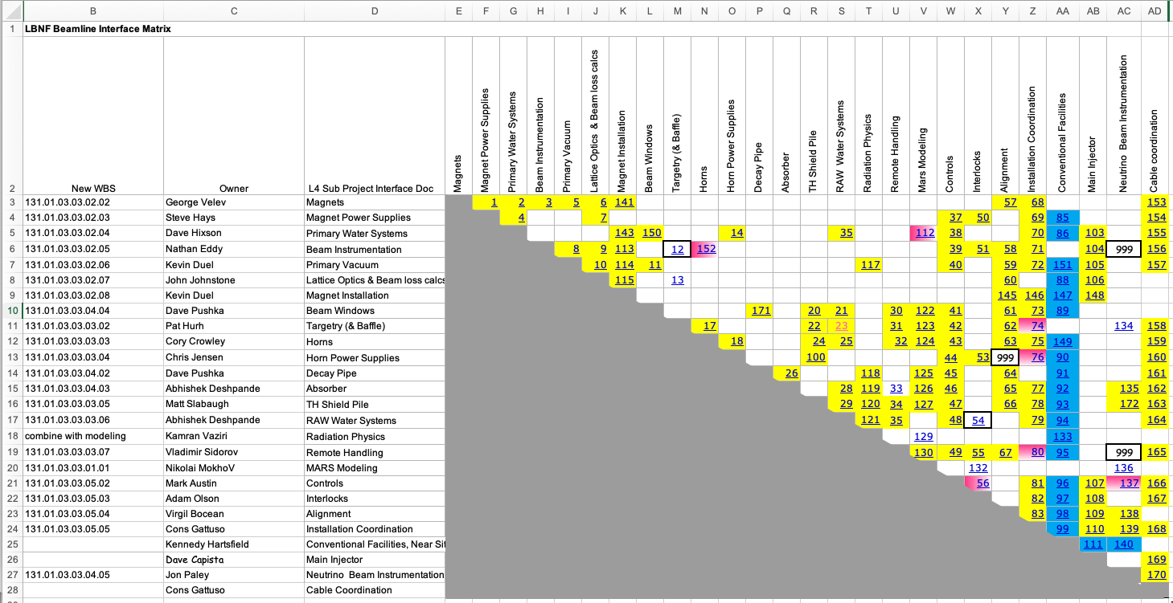
LBNF Beamline Interface Matrix
Interactive Spreadsheet that includes Interface Control Documents

Slide 7
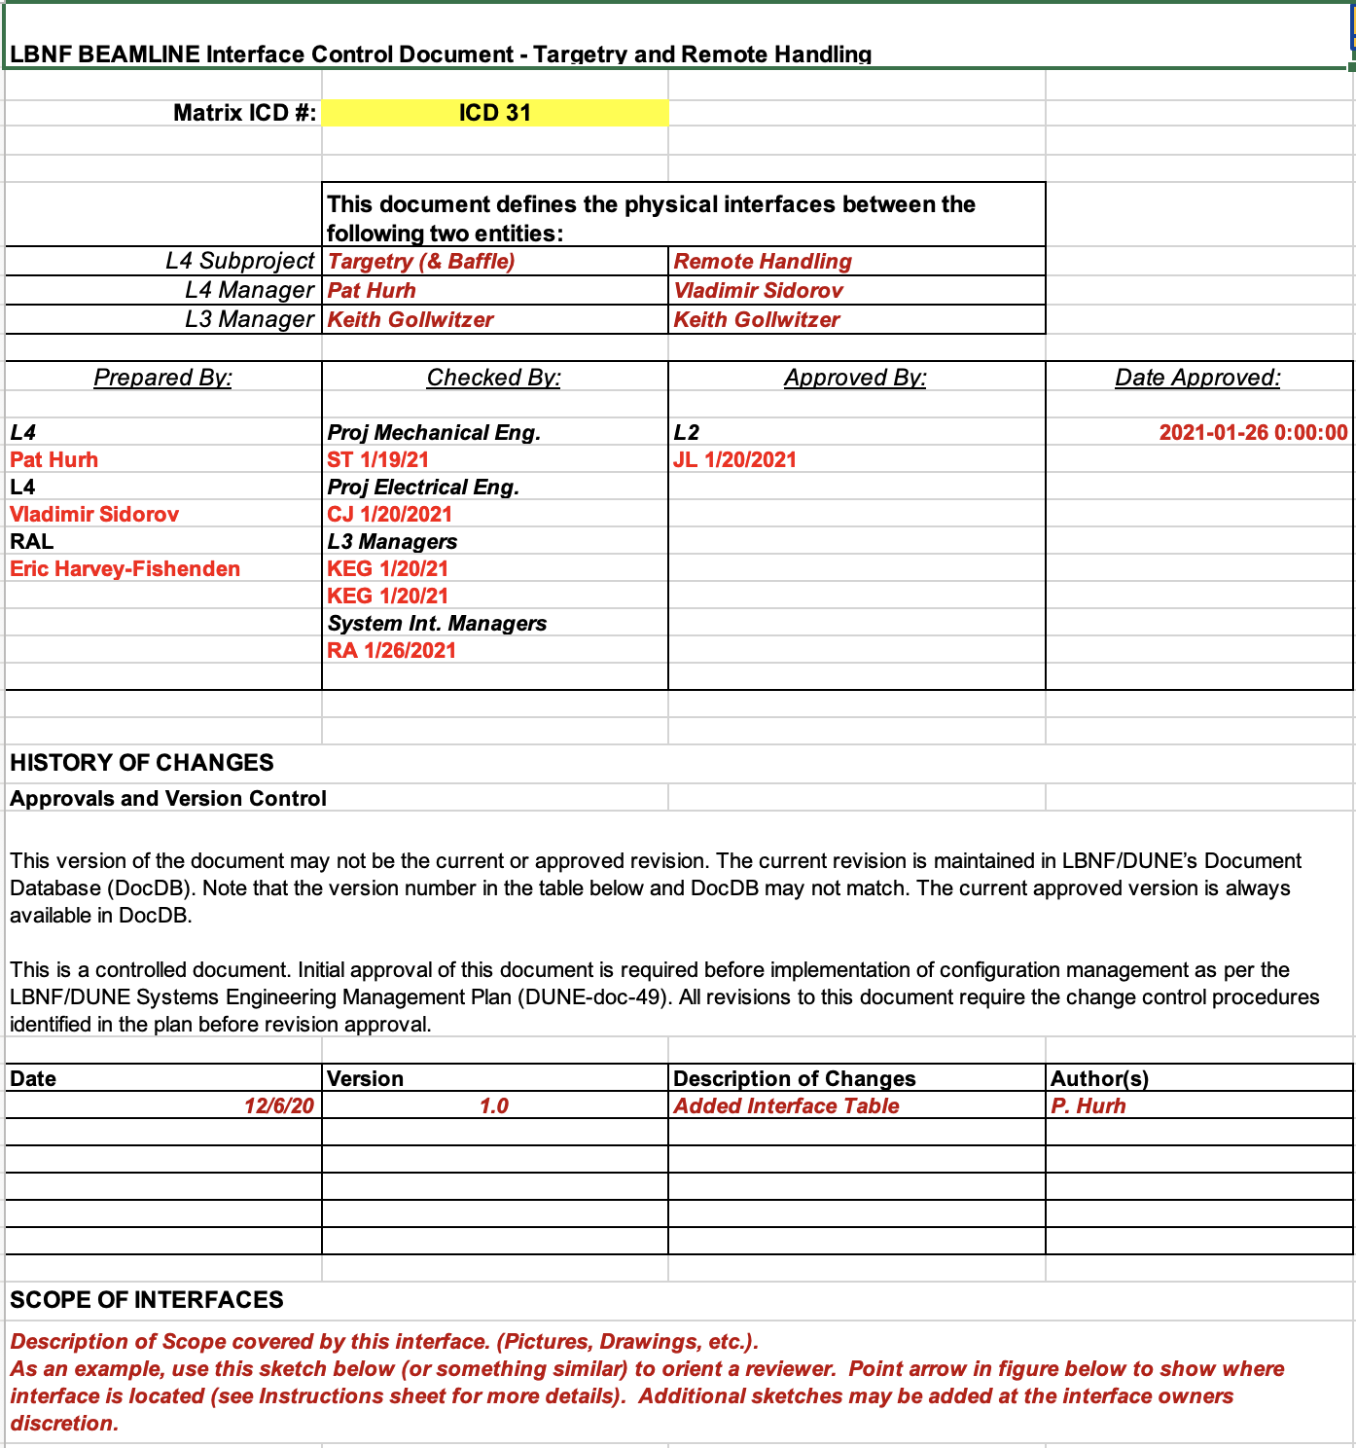
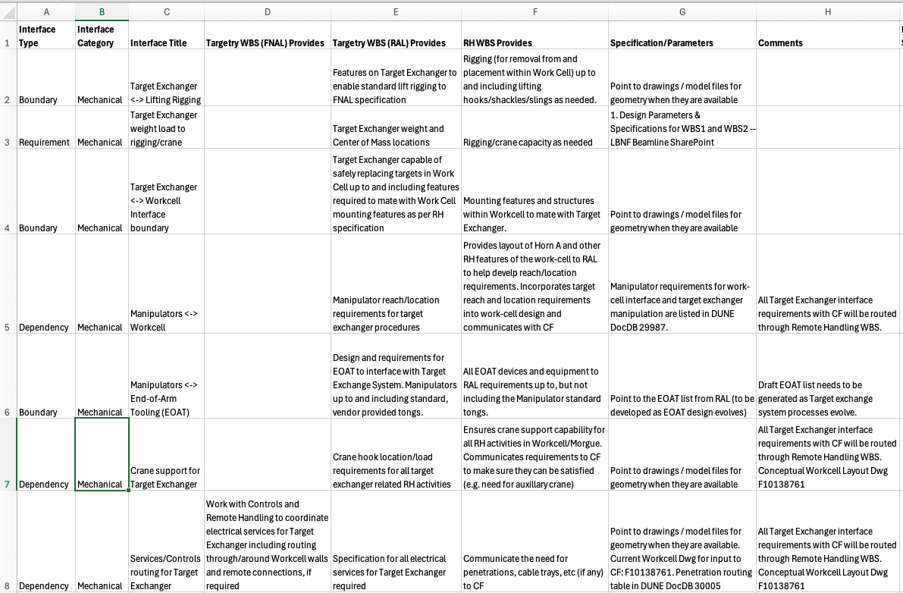
Interface Control Documents
Main ICD related to this Review: Targetry <-> Remote Handling (ICD31)

Slide 8
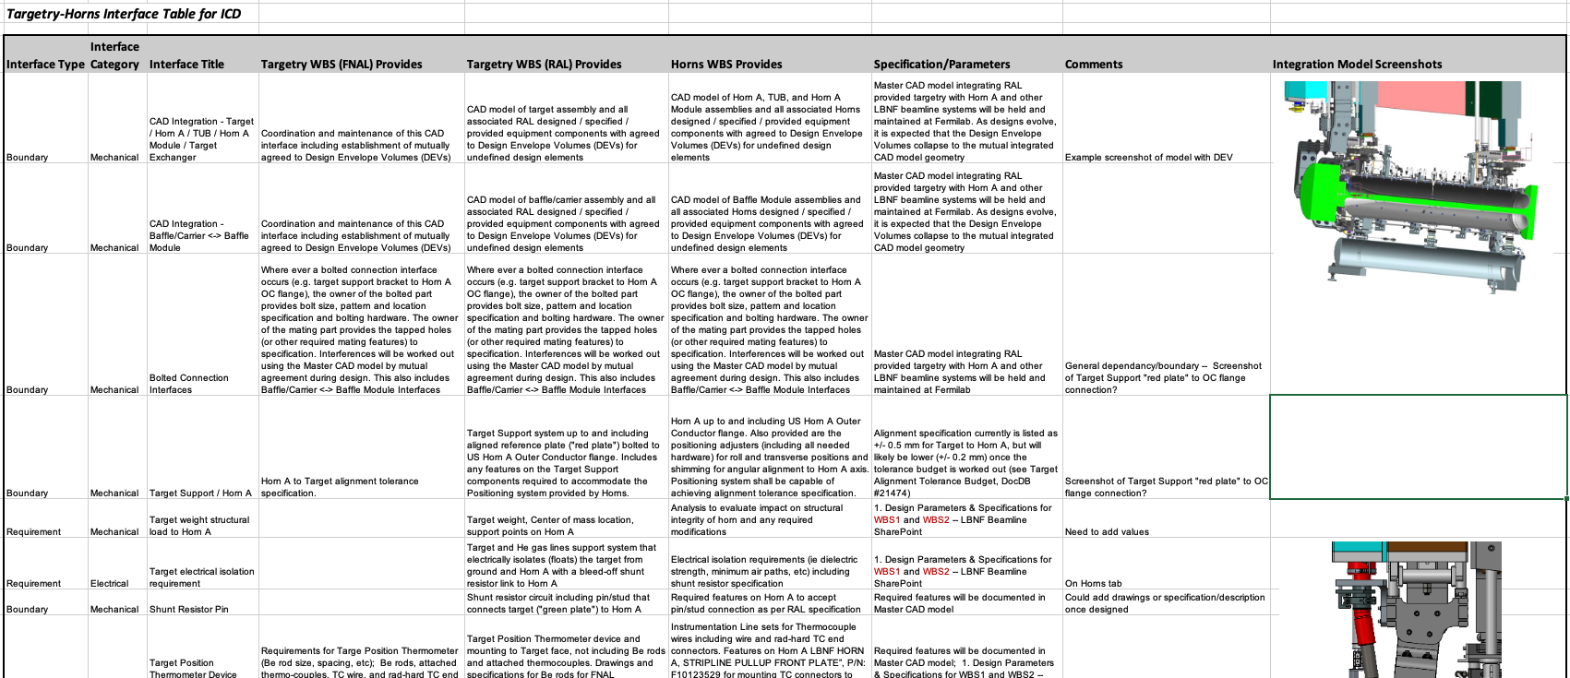
ICD interface table defines boundaries and points to specification and parameter documents for interface details
Interface Matrix
Interface Control Documents
Specification Documents
Specification Documents
ICD’s and Specification documents are under development. For Target Exchange System:
Boundaries and dependency/requirement relationships have been established
Values for specification documents are being finalized and have been updated with latest values
Currently, the Interface Matrix file and main Parameters & Specification Document resides on Sharepoint

Slide 9
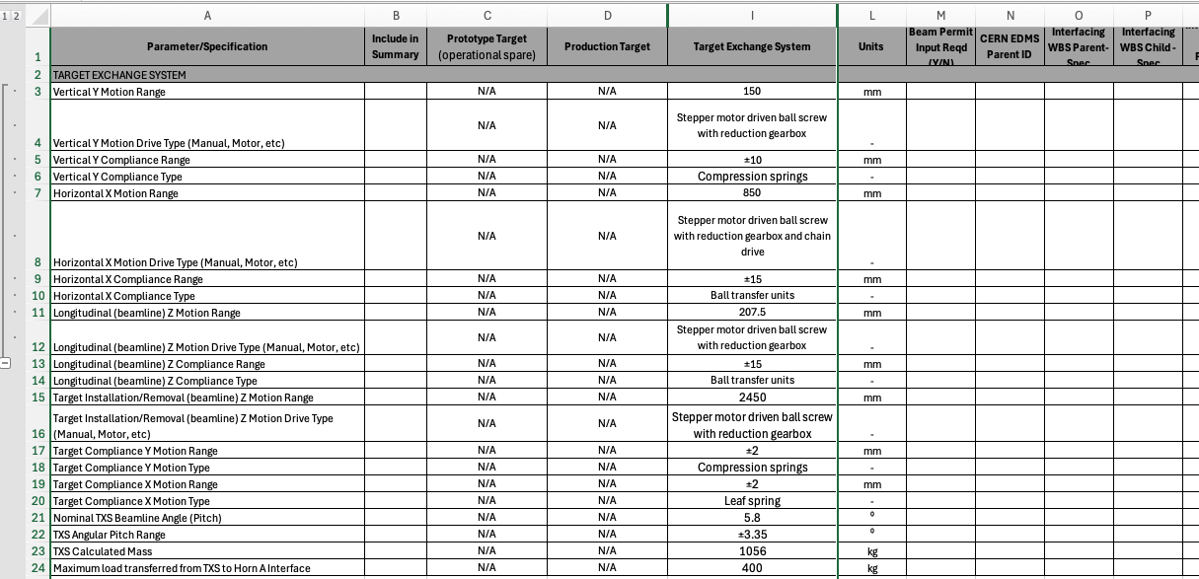
Beamline Parameters and Specifications Table contain specifications

Slide 10
Questions?

