Slide 1
LBNF Target Hall and Work Cell Video System
Vladimir Sidorov
October 17, 2023

Slide 2
LBNF Target Hall Video system
All radioactive components are moved in the target hall remotely during the horns, target and upstream window
replacement procedures. The Target Hall video system provides the visualization all moving steps in the target hall,
morgue and work cell. Three types of cameras is planned to use in the Target Hall. All cameras are connected to the video center
located in the Target Hall Operation center. The video center is equipped with monitors and keyboard controller for use
with analog cameras.
Target Hall Video System Components
Surveilancevideo.com
Item | Price | Qty | Subtotal
Pelco SD423-SMW-1 Spectra IV SL NTSC Dome System with DD423, BB4-SMW, LD53SMW-1 SD423-SMW-1 by Pelco | $1,165.59 | 4 | $4,662.36
Pelco SD4-B1 Spectra Indoor Dome System, Black, Clear Bubble, NTSC, 10X Lens SD4-B1 by Pelco | $1,070.23 | 14 | $14,983.22
Pelco SP-ES4136-5NS 540 TVL Analog Outdoor PTZ Camera, 36X Lens SP-ES4136-5NS by Pelco | $2,893.45 | 12 | $34,721.40
Orion 17RTCLD 17-inch Premium Ultra Bright LED Monitor, 1280x1024 17RTCLD by Orion | $1,440.57 | 12 | $17,286.84
Pelco KSC-3000U Fixed/Variable Speed, PTZ Control, Direct Mode Only KSC-3000U by Pelco | $462.79 | 2 | $925.58
 |  | Subtotal | $72,579.40

Slide 3
SD4-B1 Features
Familiar Spectra Camera Menu Structure
Single Model for Surface Mount and In-Ceiling Applications
Autofocus, High-Resolution Integrated Color Camera/Optics Package
80X Zoom (10X Optical, 8X Digital)
Zone Blanking
64 Presets
0.5° Preset Accuracy
140°/second Pan Speed
Rotating Discreet Liner
1 Pattern
1 Dynamic Window Blanking Area
Proportional Pan and Tilt
Programmable Zoom Speeds
Multilingual Support
Integral, Autosensing, Multiprotocol Receiver
Auto Flip Dome Rotation
Integrated UTP Circuit
Quick Connect Cable for Power, Video (Coaxial or UTP), and Data
Available with Smoked or Clear Dome
DD4-B Features
High Resolution (470 TV Lines)
80x Zoom (10x Optical, 8x Digital)
Programmable Zoom Speeds
Zone Blanking
LD4B-1 Features
Clear
For Black Camera
Work Cell Camera
Pelco SD4-B1 Spectra Mini Clear Dome Black NTSC. Consists of DD4-B and LD4B-1. The Spectra Mini incorporates many well-known features from Pelco’s SD4-B1 full-size Spectra dome system
into a cost-effective, small form factor. The easy-to-install dome system
can be mounted to the surface of ceilings or recessed into hard ceilings and suspended tile ceilings.
A high-resolution camera transmits the video over coaxial cable or unshielded twisted
pair (UTP) wires. When paired with active UTP receivers, Spectra Mini is capable of transmitting high-quality
video across distances of up to 4,000 ft (1,219 m). Pan/tilt operation can be
performed with Pelco's controllers that transmit Pelco D, Pelco P, or Coaxitron® protocols. For non-Pelco
controllers, a translator board can be installed. On-screen programming allows
easy setup of the miniature dome‘s many features. The Pelco DD4-B Spectra Mini Dome Drive is the camera module component. It can be used for both domestic
and commercial video surveillance applications.
With autofocus, 80x Zoom, zone blanking, and 64 different preset, it ensures effective monitoring. The camera
offers efficient PTZ functions, programmable zoom speeds, and a multilingual menu. The Pelco LD4B-1 Spectra Mini Lower Dome is a replacement lower dome (bubble) for a Spectra Mini Dome
PTZ camera system.

Slide 4
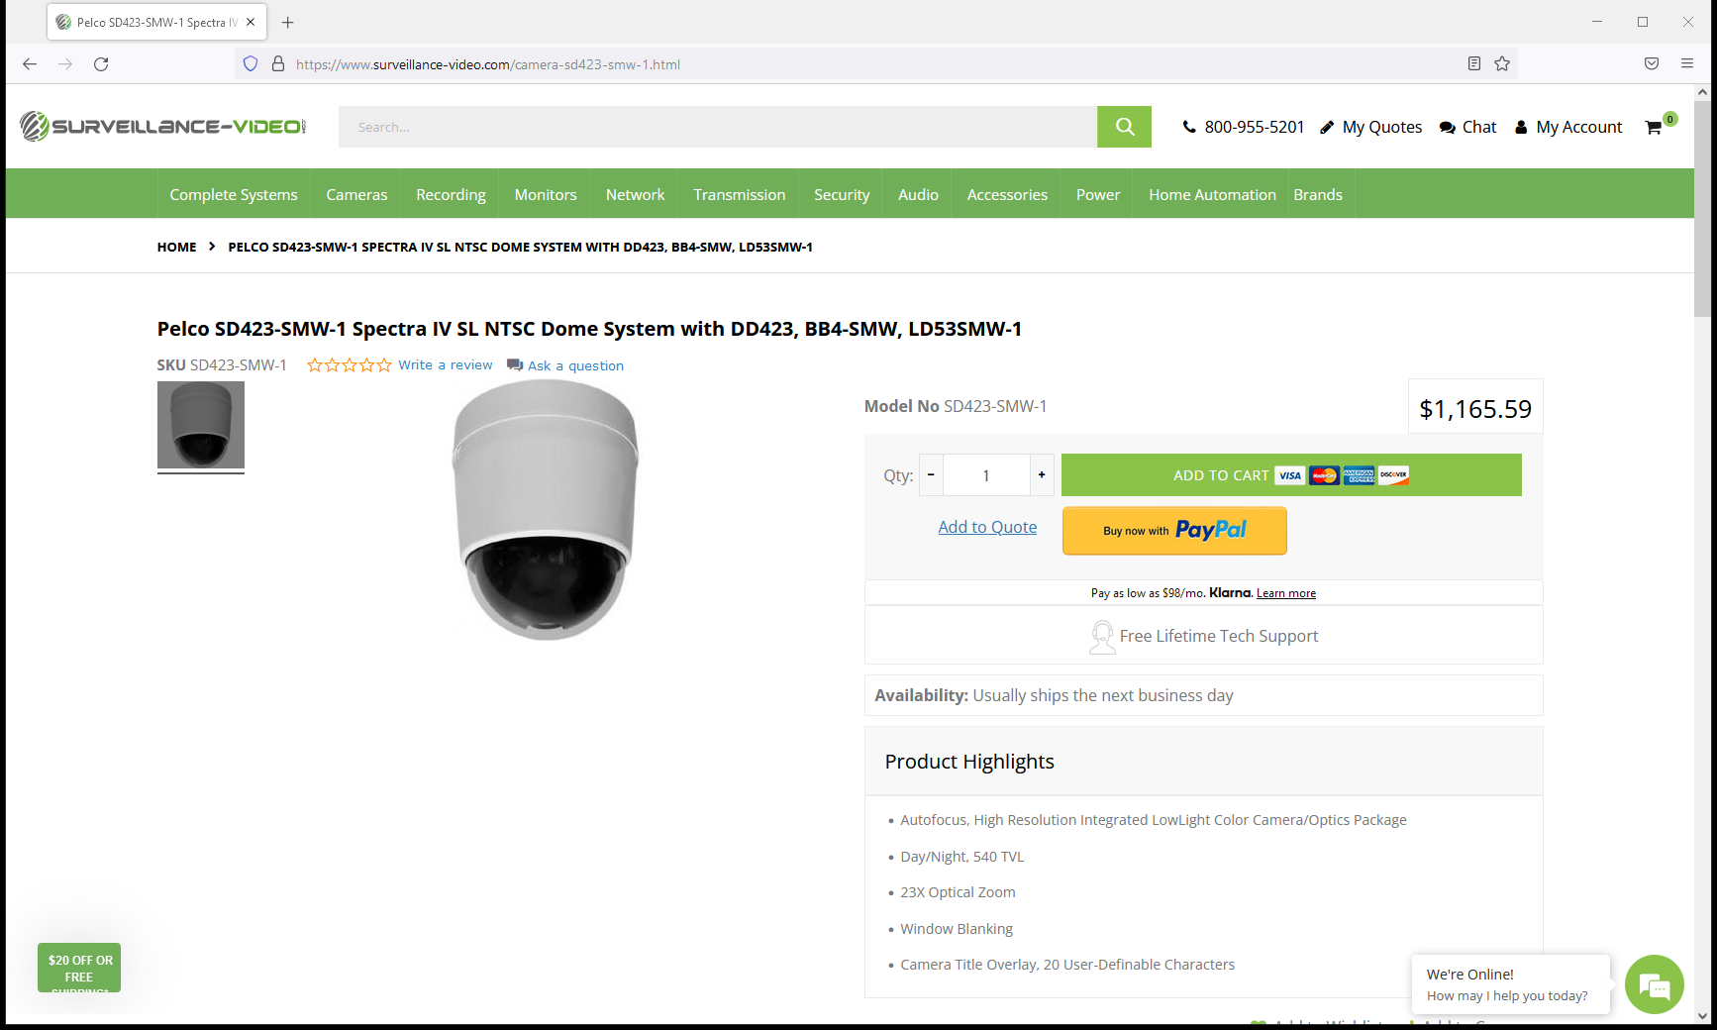
The SD423-SMW-1 from Pelco is a Spectra IV SL Dome System (Back Box, Clear Lower Dome)
includes a surface mount indoor white back box, a clear lower dome,
and a DD423 Day/Night camera. The surface mount indoor back box can be easily installed
to any type of ceiling. An integrated passive UTP circuit located on the door
allows seamless transmission of videos via twisted pair wire. Additionally, for transmission
over a single-mode or multimode fiber, Pelco fiber modules can be attached to
the door assembly. The Spectra IV SL dome drive’s integrated optics package incorporates
many advanced features that allow the system to produce high quality video in t
he most difficult environments. The camera features 23X optical zoom and 12X digital zoom.
Spectra IV SL dome drives feature an EXview HAD imager for increased sensitivity
and LowLight technology to compensate for scenes where minimal light is present.
The camera also offers freeze frame between presets and window blanking. A passive UTP circuit is located on the door assembly for convenient video transmission through
twisted pair wire. For added flexibility,
Pelco fiber modules can also be attached to the door assembly for transmission over single-mode
or multimode fiber.Special consideration was taken when designing the
Spectra IV SL lower dome bubble to ensure that an optimal optical relationship between the lens
and bubble was achieved, providing crystal clear video at long focal lengths.
DD423 Features
Autofocus, High Resolution Integrated LowLight Color Camera/Optics Package
Day/Night, 540 TVL
23X Optical Zoom
Window Blanking
Camera Title Overlay, 20 User-Definable Characters
On-Screen Compass and Tilt Display
Password Protection
Freeze Frame During Presets
Built-in Surge and Limited Lightning Protection
Integrated Passive Unshielded Twisted Pair (UTP) Circuit
Camera on crane

Slide 5
Internal Scheduling Clock
Ability to Add IP Network Capability by Purchasing Optional TXB-N Module
64 Presets
±0.1° Preset Accuracy
Multilingual Menus (English, Spanish, Portuguese, Italian, French, German, Russian, Polish, Turkish, and Czech)
RJ-45 Data Port for Software Update and Setup
On-Screen Compass, Tilt, and Zoom Display
Password Protection
400°/sec Pan Preset Speed and 200°/sec Tilt Preset Speed
Rotating Discreet Liner with Sealed Fixed Bubble
8 Zones (configurable in size) Can Be Labeled with up to 20 Characters Each or Set to Output Blank Video
Configurable Locations of Labels and On-Screen Displays
Patterns: 1 On-Screen, User-Defined Configurable Pattern; Includes Pan, Tilt, Zoom, and Preset Functions
Proportional Pan/Tilt: Continually Decreases Pan/Tilt Speeds in Proportion to Depth of Zoom
Variable Scan Speed: Scan Speed Can Be Configurable Between 1 to 40°/sec
Pan Motion Allows 0.1 to 150°/sec Pan Speed
Configurable Limit Stops for Auto/Random/Frame Scan Modes
Auto-sensing Protocol (Coaxitron, RS-422 Pelco P and Pelco D, Sensormatic, Vicon); Accepts Other Control Protocols with Optional Translator Card
Digital Position and Zoom Control and Feedback Using D Protocol
Built-in Menu System for Setup of Configurable Functions
“Auto Flip” Rotates Dome 180° at Bottom of Tilt Travel
Window Blanking: Up to 4 Four-Sided, User-Defined Shapes
1 Alarm Input
1 Auxiliary (Form C) Relay Output
Freeze Frame Between Presets
BB4-SMW Features
Available in White Finish
Installs Quickly and Easily to Any Type of Ceiling
Quick Disconnect to Dome Drive
Injection-Molded Plastic

Slide 6
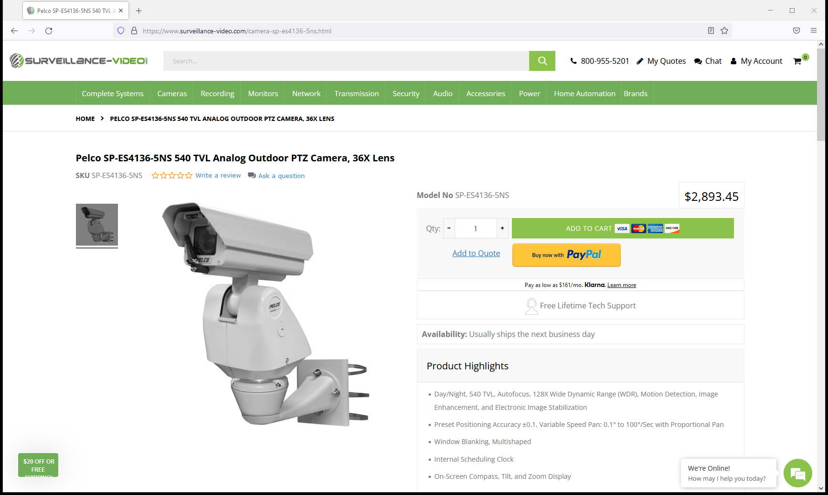
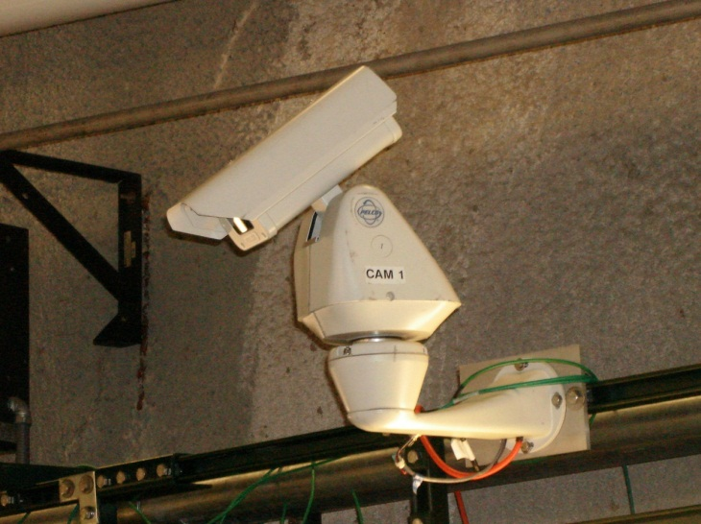
Pelco’s Positioning System features a receiver, pan/tilt, enclosure.
The variable pan and tilt speeds range from 0.1 to 40 degrees per
second in manual pan mode, and 0.1 to 20 degrees per second in
manual tilt. Pan preset and turbo speeds are 100 degrees per second
in wind speeds of 80 kph (50 mph) and 50 degrees per second
in the 145 kph (90 mph) wind-speed profile. Tilt preset speed
is 30 degrees per second. Capable of 360 degrees of continuous pan
rotation. The tilt range allows for horizontal viewing of +36 to –85 degrees.
Configurable preset positions with a preset accuracy of 0.1 degree.
Features
Day/Night, 540 TVL, Autofocus, 128X Wide Dynamic Range (WDR),
Motion Detection, Image Enhancement, and Electronic Image Stabilization
Preset Positioning Accuracy ±0.1, Variable Speed Pan: 0.1° to 100°/Sec with
Proportional Pan
Window Blanking, Multishaped
Internal Scheduling Clock
On-Screen Compass, Tilt, and Zoom Display
Auto tracking
Tilt Range of +36° to –85° from Horizontal
Password Protection
Camera in Target Hall

Slide 7
The ORION Images LCD w/ LED BLU (backlight unit) 17 inch 17RTCLD Ultra Bright LED displays are
a truly professional experience in next generation technology using eco-friendly material
(no mercury or halogen). This technology exceeds the NTSC color gamut standard of 100%
with the LED BLU at 123% to provide a wider range of colours than ever before - you will see
colors on screen as you see them in real world.
Features
Ultra Bright LED Monitor
1280 x 1024 Resolution, 1000 Nits, 1000:1 Contrast
PIP / PBP Multi Display Function
3D Comb Filter, Deinterlace, Noise Reduction
BNC Video 2 In / 2 Out, S-Video 1 In / 1 Out, DVI 1 In, HDMI 2 In, Component 1 In, VGA 1 In, Audio 3 In,
PC Stereo 1 In
1W x 2 Built in Speaker
Mount Options: Wall or Ceiling and Rack

Slide 8
The KSC-3000U is a USB keyboard controller for use with Pelco’s analog cameras (Pelco D and P Protocol)
including the Spectra Mini (SD5 Series), Spectra IV, and Esprit SE. The KSC-3000U is capable of half and full
duplex mode with two RS-485 ports. The KSC-3000U can be used as a mouse, keyboard, or joystick
for a PC or network video recorder without external driver installation. Alphanumeric characters’ input
is supported through the numeric keypad in Keyboard Mode. Mouse scroll and sensitivity setting
is supported in Mouse Mode. All hotkeys for the PC applications can be supported with the controller’s shortcut keys in Hotkey Mode.
Create and modify shortcut keys using the system controller. All buttons on the KSC-3000U can be used
as the joystick buttons and are programmable except for ESC (when exiting from HID mode)
and USB HID (when changing from three different HID modes). The KSC-3000U features a built-in 3-Axis proportional joystick, LCD, rubber buttons, and Jog Shuttle
for ease of operation.
Features
All-In-One mouse, keyboard, joystick
Two RS-485 ports
Shortcut keys
Provides a variety of add-ons
More than 16 built-in protocols
Built-in Jog shuttle, joystick for user convenience
*Does not include a power supply. Recommend power supply

Slide 9
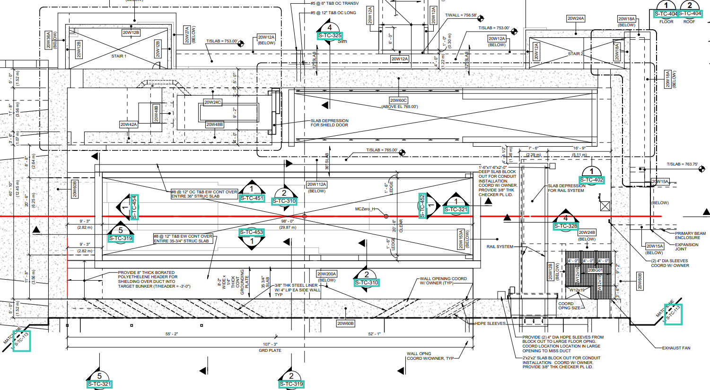
Target Hall Cameras location
SD4-B1
SD423-SMW-1
SP-ES4136
SP-ES4136
SP-ES4136
SP-ES4136

Slide 10
Target Hall Cameras location
The Target Hall cameras location will be finalized during the remote handling dry rans.
SP-ES4136
SD4-B1
SP-ES4136

Slide 11
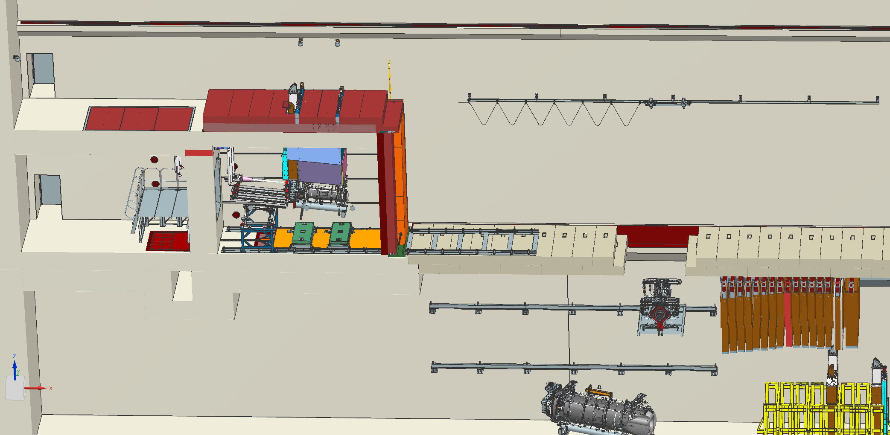
Target Hall Cameras location
SP-ES4136
Traveling SP-ES4136 cameras
SD423-SMW-1

Slide 12
Target Hall Cameras location
SP-ES4136
SP-ES4136
SP-ES4136
DOWNSTREAM

Slide 13
Target Hall portable cameras in Horn C location
The portable camera is attached to the telescopic post and can be installed in the target hall at any location.
It can be installed close to the bunker to view the module removing and installation.
Portable camera

Slide 14
Target Hall cameras in Horns A,B,C location
Horn A SD4-B1
Horn B SD4-B1
Horn C SD4-B1

Slide 15
Target Hall cameras in Horns A,B,C location
SP-ES4136
SD4-B1
Horn C
Horn B
Horn A
Baffle

Slide 16
Work Cell Cameras location
The work cell cameras with attached unistrut is bolted to the embedded into the concrete wall unistruts.
The camera has the vertical and horizontal adjustments.
SD423-SMW-1
SD423-SMW-1

Slide 17
Proposed Features for LBNF-20 Work Cell – Left of Lead Glass (Equipment removed for clarity)
T-8 Fixture
Three T-8 Lighting Fixtures
Placed Underneath Korbel, not to cause interference on lifting/lowering equipment
Have Unistrut (1 -5/8”) Running the Length of the Work Cell – Between the Penetrations
Need to confirm with RSO if embedding the Unistrut into the shielding concrete possible
Four Outlets – 4 120V
Near Floor of Work Cell
All are Independently Switched?
Unistrut
Camera
Camera Unistrut
Added Lights
Added Lights
4 – 120V
Outlet
Cabling – Power and Control for Lights and Outlets to be routed to Work Cell Operations Center thru this penetration

Slide 19
Proposed Features for LBNF-20 Work Cell – Right of Lead Glass (Equipment removed for clarity)
Camera Unistrut
Unistrut
T-8 Fixture
Lead Glass
Frames
Three T-8 Lighting Fixtures
Placed Underneath Korbel, not to cause interference on lifting/lowering equipment
Have Unistrut (1 -5/8”) Running the Length of the Work Cell – Between the Penetrations
Need to confirm with RSO if embedding the Unistrut into the shielding concrete possible
Unistruts not to interfere with Lead Glass Frames
Four Outlets – 4 120V
Near Floor of Work Cell
All are Independently Switched?
4 – 120V
Outlet
Added Lights
Camera

Slide 23
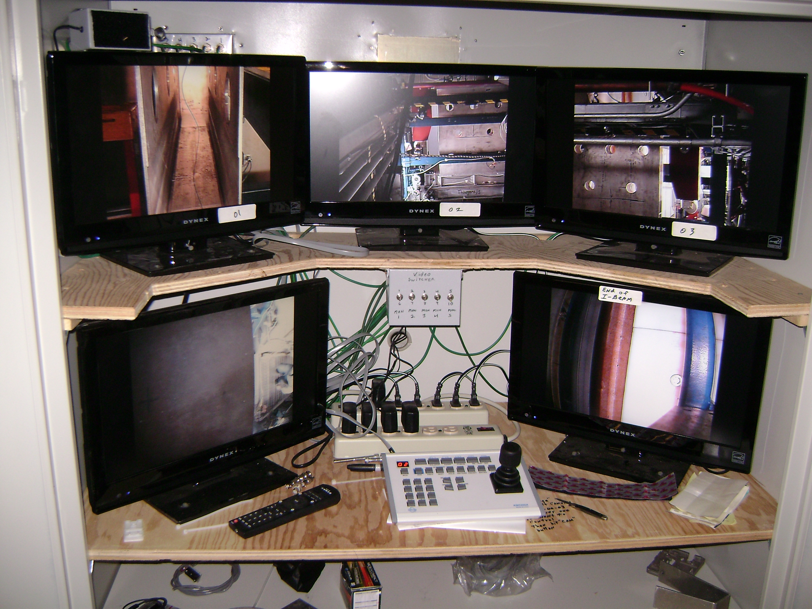
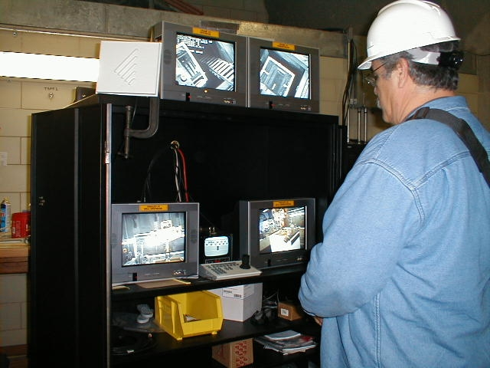
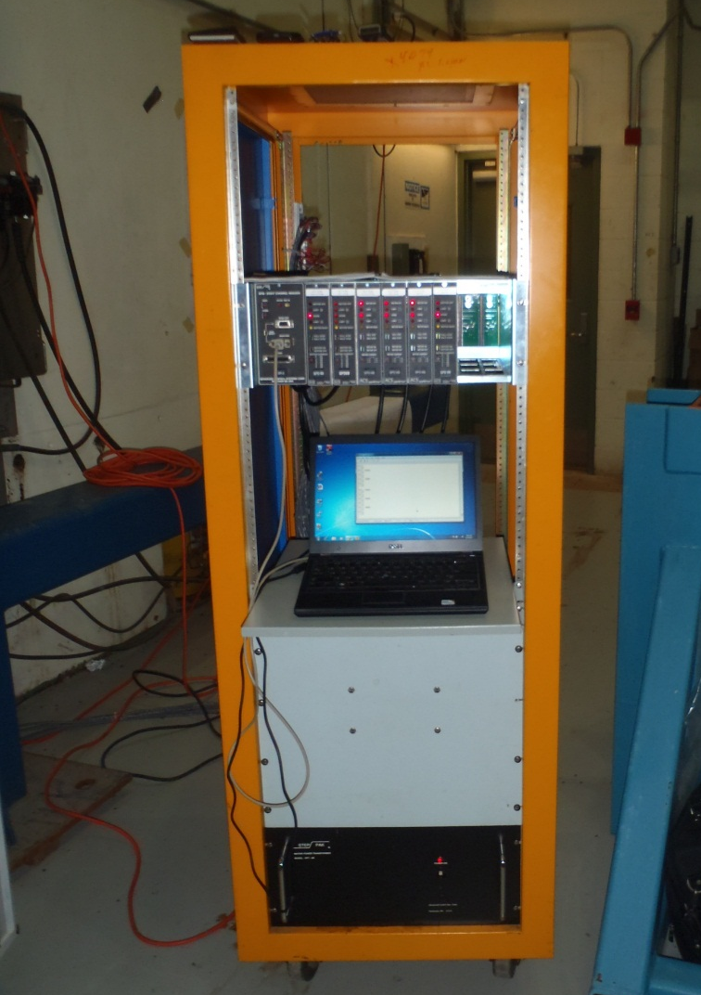
All cameras of the video system located in the work cell and target hall are connected to the video center installed in the operation center. All drive mechanisms motors are operated by the control system located in the operation center.
Video Center and Motors Control system
Video Center
Motors control system

Slide 24
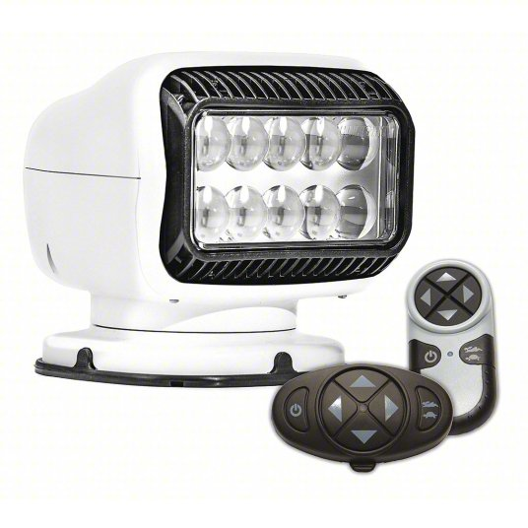
Addition lights can be used in the Target Hall during the remote handling operations.
GOLIGHT Spotlight: Dual Wireless - Remote Controlled, 40 W Watts, 12V DC, 3.5 A Amps, 410,000, LED
Item 55AV64 Mfr. Model 20074GT
Product Details
Brand GOLIGHT
Type Dual Wireless - Remote Controlled
Watts 40 W
Voltage 12V DC
Amps 3.5 A
Lamp Type LED
Candle Power 410,000
Number of Heads 1
Vertical Axis Rotation 135 °
Horizontal Axis Rotation 370 °
Cable Length 1 ft
Height 7.5 in
Width 7.25 in
Depth 6-7/10 in
Body Color White
Body Material ASA Plastic
Product Description:
Remote Controlled Vehicle Spotlights are available in halogen, HID, LED, PAR 36, and PAR 46 types.
They mount on the outside of vehicles to help provide additional visibility in low-light and dark conditions.
With wireless or hardwired remote controls, the spotlights can easily be aimed wherever visibility is needed.
Choose from a variety of watts, voltage, amps, and candle power options.

Slide 25
