Slide 1
TXS Motion Control System
Thomas Kelly
Electrical Designer

Slide 2
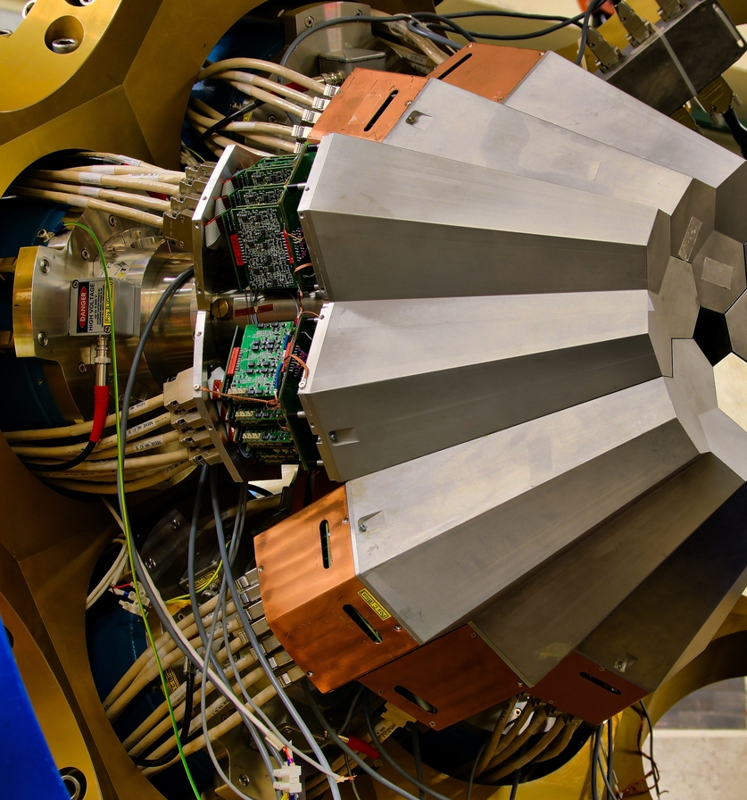
Contents
1 System Requirements
Consideration of design
2 Trio
Motion equipment rundown
3 Hardware Selection
Interconnection, equipment choices and containment.
4 Cabling
Connectors, patch panel, routing and drag chains.

Slide 3
Requirements
Dedicated motion system

Slide 4
Key requirements for system
Flexible and modular system that can fit current needs and expand for future.
Lightweight and easy to transport.
Durable and suitable for the environmental conditions.
Operation with buttons and a touch screen interface.
Commercial, off the shelf components for simple maintenance.

Slide 5
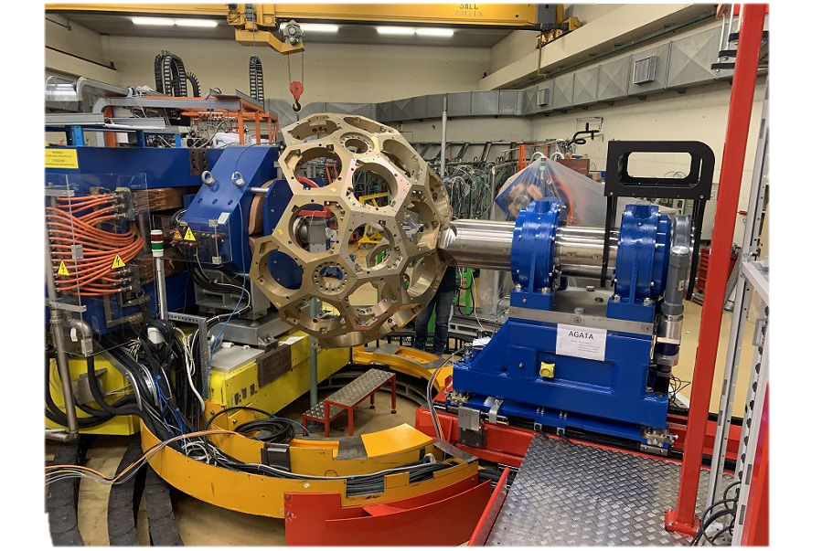
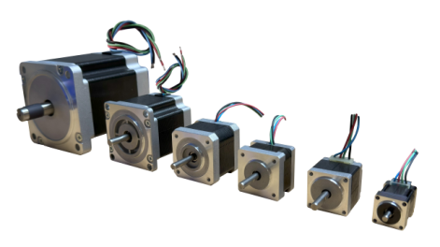
McLennan Servo Supplies
Trusted suppliers with a long-standing track record working on complex motion for scientific applications.
Distributor and supplier for many world leading motion control products.
ISO9001:2015 accreditation.
Offer support across all areas (Specification, programming, technical support etc).
McLennan Servos supplied motion control equipment for the 7.5T STFC AGATA sensor array system.

Slide 6
Trio Motion
High performance motion technology

Slide 7
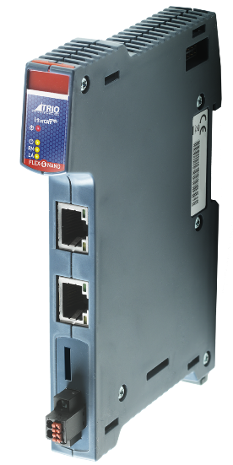
Trio X Nano
Dual core 1GHZ Arm Processor
2 - 64 Axes
256Mb of internal memory for data such as Programs, and tables
Built in EBUS Coupler for Direct Access to Trio’s flex-slice devices
Fast cycle times with flexible topology and simple configuration
Image © STFC John Dawson

Slide 8
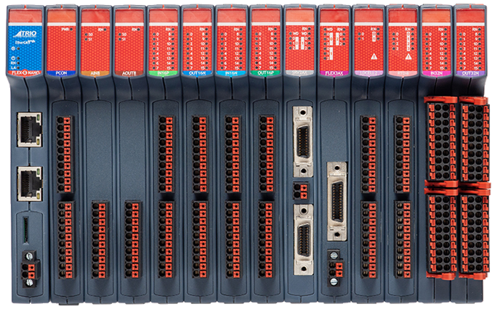
Trio X Nano Integrated Flexslice
Fast modular, scalable and flexible expansion for motion applications. Din-rail mounted modules with EtherCAT comms, units clip-together with quick release locks for mechanical integrity.
Digital inputs and outputs
Analog inputs and outputs
EtherCAT couplers
Thermocouples
Power distribution

Slide 9
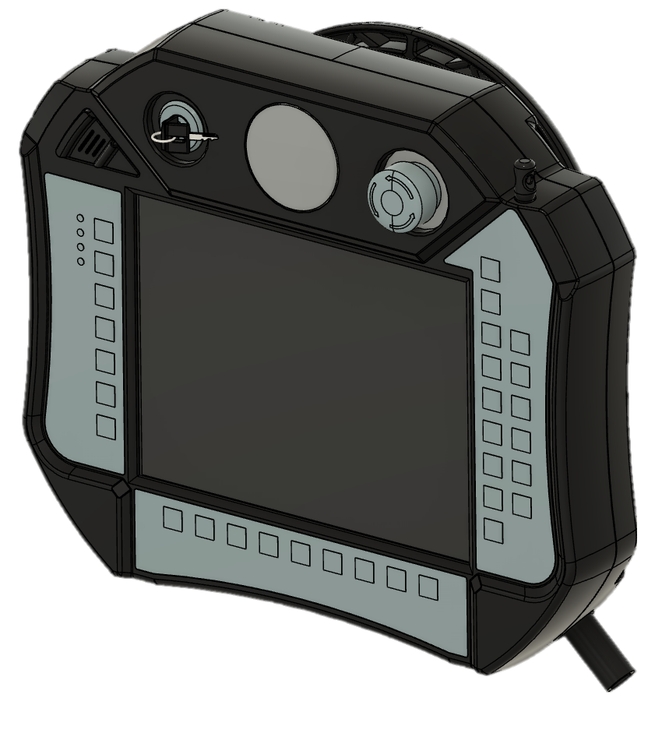
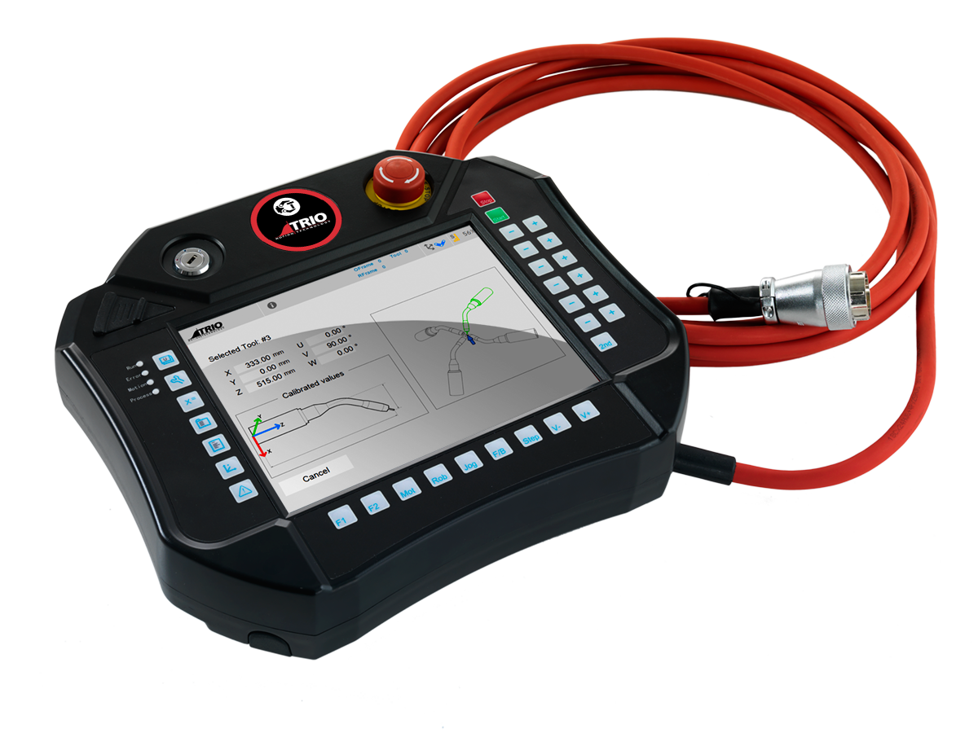
Trio Teach Pendant
Using off the shelf Trio Teach pendant
Compact and lightweight handheld 8in touch screen.
Durable and IP65 rated
Interfaces directly with motion controller.
Built in 5m (16ft) cable to allow user flexibility.
Customizable with 31 user defined buttons, integrated key switch and emergency stop button.

Slide 10
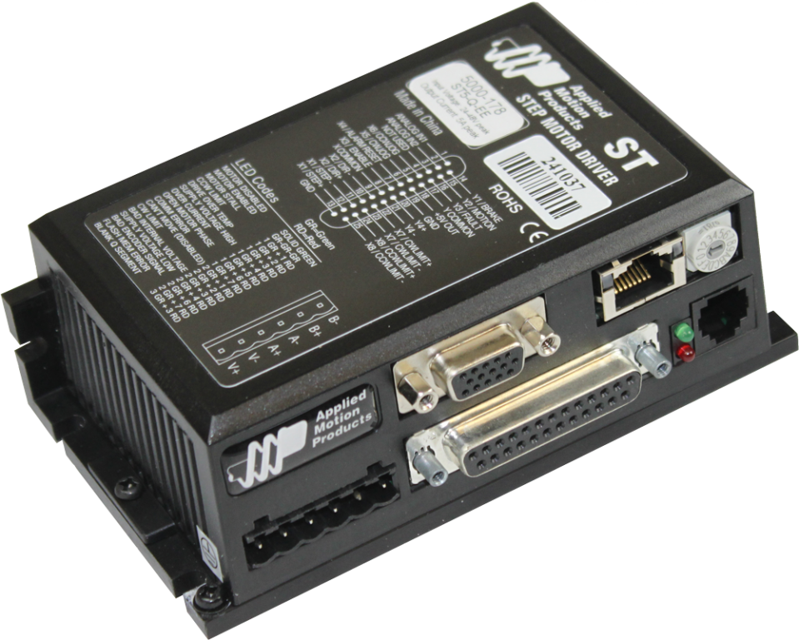
Applied Motion Drive amplifiers
Applied motion ST10 stepper motor drives.
Fine micro stepping control.
Can be configured in seconds
Expected protections: Over-Voltage
Under-Voltage
Over-Temp
Motor Shorting
Motor Open Phase

Slide 11
Hardware selection
High performance motion technology

Slide 12
Hardware
Part Number | Qty
Flex X Nano – P662 | 1
16-in PNP – P372 | 2
16-out PNP – P371 | 1
8 Analogue In – P379 | 2
3 Axis Step Pulse – P375 | 2
Applied Motion Drives | 7
Power Supply | 1
Signal Conditioner (LVDT’s) | 6
Signal Amplifier (Load Cell) | 4

Slide 13
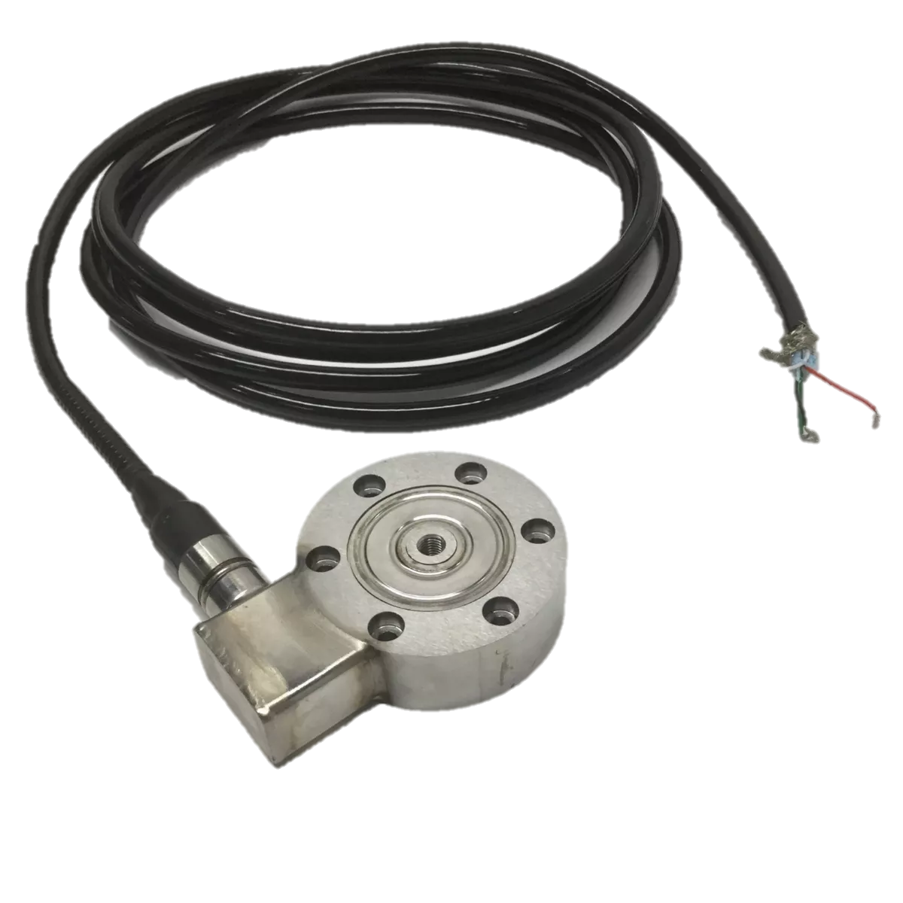
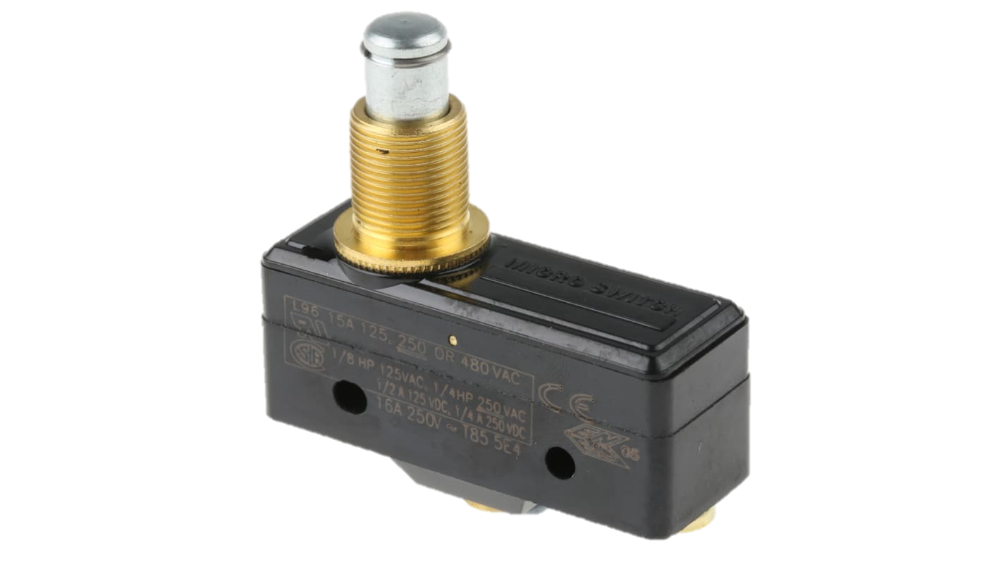
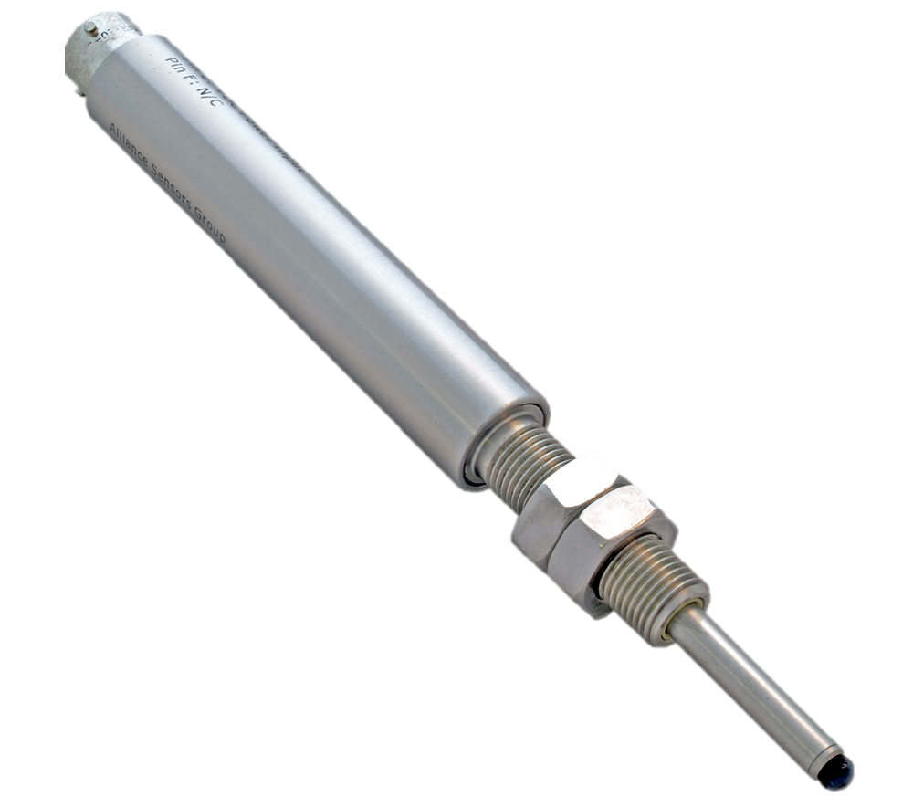
Input hardware
Compliance Switches
LVDT’s
Load Cells

Slide 14
Controller Parameters
Trio Card | IO Type | Channel | Tag | Device | Voltage/Current | Location | Description
1 - P372 | Digital In | 1 | LIMX+ | Namco EA180 | 24V | X-stage | Roller Limit Switch Positiive
1 - P372 | Digital In | 2 | LIMXA- | Namco EA180 | 24V | X-stage | Roller Limit Switch Approach Negative
1 - P372 | Digital In | 3 | LIMX- | Namco EA180 | 24V | X-stage | Roller Limit Switch Negative
1 - P372 | Digital In | 4 | MIDX |  | 24V | X-stage | Precision Limit Switch Mid Travel
1 - P372 | Digital In | 5 | LIMY1+ | Namco EA180 | 24V | Y-stage Front | Roller Limit Switch Positiive
1 - P372 | Digital In | 6 | LIMY1- | Namco EA180 | 24V | Y-stage Front | Roller Limit Switch Negative
1 - P372 | Digital In | 7 | MIDY1 |  | 24V | Y-stage Front | Precision Limit Switch Mid Travel
1 - P372 | Digital In | 8 | LIMY2+ | Namco EA180 | 24V | Y-stage Rear | Roller Limit Switch Positiive
1 - P372 | Digital In | 9 | LIMY2- | Namco EA180 | 24V | Y-stage Rear | Roller Limit Switch Negative
1 - P372 | Digital In | 10 | MIDY2 |  | 24V | Y-stage Rear | Precision Limit Switch Mid Travel
1 - P372 | Digital In | 11 | LIMZ1+ | Namco EA180 | 24V | Z-stage 1 | Z-stage 1 limit Positive
1 - P372 | Digital In | 12 | LIMZ1A+ | Namco EA180 | 24V | Z-stage 1 | Z-stage 1 Limit Approach Positive
1 - P372 | Digital In | 13 | LIMZ1- | Namco EA180 | 24V | Z-stage 1 | Z-stage 1 limit Negative
1 - P372 | Digital In | 14 | LIMZ2+ | Namco EA180 | 24V | Z-stage 2 | Z-stage 2 limit Positive
1 - P372 | Digital In | 15 | LIMZ2A+ | Namco EA180 | 24V | Z-stage 2 | Z-stage 2 Limit Approach Positive
1 - P372 | Digital In | 16 | LIMZ2- | Namco EA180 | 24V | Z-stage 2 | Z-stage 2 limit Negative
2 - P372 | Digital In | 1 | LIMTS1A+ | Namco EA180 | 24V | Target Stage 1 | Roller Switch Limit Approach Positive
2 - P372 | Digital In | 2 | LIMTS1A- | Namco EA180 | 24V | Target Stage 1 | Roller Switch Limit Approach Negative
2 - P372 | Digital In | 3 | LIMTS1- | Namco EA180 | 24V | Target Stage 1 | Roller Switch Limit Negative
2 - P372 | Digital In | 4 | LIMTS2+ | Namco EA180 | 24V | Target Stage 2 | Roller Switch Limit Approach Positive
2 - P372 | Digital In | 5 | LIMTS2A- | Namco EA180 | 24V | Target Stage 2 | Roller Switch Limit Approach Negative
2 - P372 | Digital In | 6 | LIMTS2- | Namco EA180 | 24V | Target Stage 2 | Roller Switch Limit Negative
2 - P372 | Digital In | 7 | LIMBTU1Z+ | Honeywell BZ-2RQ1-A2 | 125-250V | BTU Stage 1 R | Compliance Limit Indicator Positive
2 - P372 | Digital In | 8 | LIMBTU1Z- | Honeywell BZ-2RQ1-A2 | 125-250V | BTU Stage 1 R | Compliance Limit Indicator Negative
2 - P372 | Digital In | 9 | LIMBTU1FX+ | Honeywell BZ-2RQ1-A2 | 125-250V | BTU Stage 1 F | Compliance Limit Indicator Positive
2 - P372 | Digital In | 10 | LIMBTU1FX- | Honeywell BZ-2RQ1-A2 | 125-250V | BTU Stage 1 F | Compliance Limit Indicator Negative
2 - P372 | Digital In | 11 | LIMBTU1RX+ | Honeywell BZ-2RQ1-A2 | 125-250V | BTU Stage 1 R | Compliance Limit Indicator Positive
2 - P372 | Digital In | 12 | LIMBTU1RX- | Honeywell BZ-2RQ1-A2 | 125-250V | BTU Stage 1 R | Compliance Limit Indicator Negative
2 - P372 | Digital In | 13 | LIMBTU2Z+ | Honeywell BZ-2RQ1-A2 | 125-250V | BTU Stage 2 R | Compliance Limit Indicator Positive
2 - P372 | Digital In | 14 | LIMBTU2Z- | Honeywell BZ-2RQ1-A2 | 125-250V | BTU Stage 2 R | Compliance Limit Indicator Negative
2 - P372 | Digital In | 15 | LIMBTU2FX+ | Honeywell BZ-2RQ1-A2 | 125-250V | BTU Stage 2 F | Compliance Limit Indicator Positive
2 - P372 | Digital In | 16 | LIMBTU2FX- | Honeywell BZ-2RQ1-A2 | 125-250V | BTU Stage 2 F | Compliance Limit Indicator Negative
3 - P371 | Digital Out | 1 | LIMBTU2RX+ | Honeywell BZ-2RQ1-A2 | 125-250V | BTU Stage 2 R | Compliance Limit Indicator Positive
3 - P371 | Digital Out | 2 | LIMBTU2RX- | Honeywell BZ-2RQ1-A2 | 125-250V | BTU Stage 2 R | Compliance Limit Indicator Negative
3 - P371 | Digital Out | 3 to 16 | SPARE
3 - P379 | Analogue In | 1 | LVDTSC1 | Omega LDX-D | ±10Vdc | Control Unit | Target stage A docking proximity sensor signal conditioner
3 - P379 | Analogue In | 2 | LVDTSC2 | Omega LDX-D | ±10Vdc | Control Unit | Target stage A docking proximity sensor signal conditioner
3 - P379 | Analogue In | 3 | LVDTSC3 | Omega LDX-D | ±10Vdc | Control Unit | Target stage A docking proximity sensor signal conditioner
3 - P379 | Analogue In | 4 | LVDTSC4 | Omega LDX-D | ±10Vdc | Control Unit | Target stage B docking proximity sensor signal conditioner
3 - P379 | Analogue In | 5 | LVDTSC5 | Omega LDX-D | ±10Vdc | Control Unit | Target stage B docking proximity sensor signal conditioner
3 - P379 | Analogue In | 6 | LVDTSC6 | Omega LDX-D | ±10Vdc | Control Unit | Target stage B docking proximity sensor signal conditioner
3 - P379 | Analogue In | 7 | Spare |  |  | re Stage p S | Compliance Spait Inancator Negative
3 - P379 | Analogue In | 8 | Spare |  |  | re Stage p S | Compliance Spait Inancator Negative
4 - P379 | Analogue In | 1 | LCAmp1 | Omega TXDIN1600S | -10 to +10V | Control Unit | Target stage 1 front load cell amplifier
4 - P379 | Analogue In | 2 | LCAmp2 | Omega TXDIN1600S | -10 to +10V | Control Unit | Target stage 1 rear load cell amplifier
4 - P379 | Analogue In | 3 | LCAmp3 | Omega TXDIN1600S | -10 to +10V | Control Unit | Target stage B front load cell amplifier
4 - P379 | Analogue In | 4 | LCAmp4 | Omega TXDIN1600S | -10 to +10V | Control Unit | Target stage B rear load cell amplifier
4 - P379 | Analogue In | 5 | Spare |  |  | re Stage p S | Compliance Spait Inancator Negative
4 - P379 | Analogue In | 6 | Spare |  |  | re Stage p S | Compliance Spait Inancator Negative
4 - P379 | Analogue In | 7 | Spare |  |  | re Stage p S | Compliance Spait Inancator Negative
4 - P379 | Analogue In | 8 | Spare |  |  | re Stage p S | Compliance Spait Inancator Negative
At present 14 Digital Outputs & 4 Analog in’s spare but can easily expand in future.
Image © STFC John Dawson

Slide 15
Block Diagram
Inputs
Processing
Outputs

Slide 16
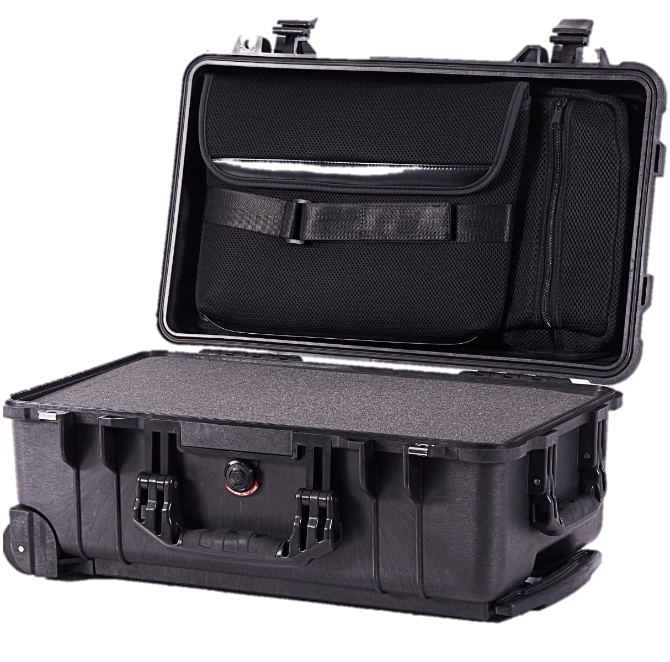
Example Containment
Working design has been formed around
Pelicase 1510, Final design must be durable,
transportable and wheeled.
2 Systems to be produced for online and
offline use.

Slide 17
Cabling
Selection of cabling, cable management and connectors.

Slide 18
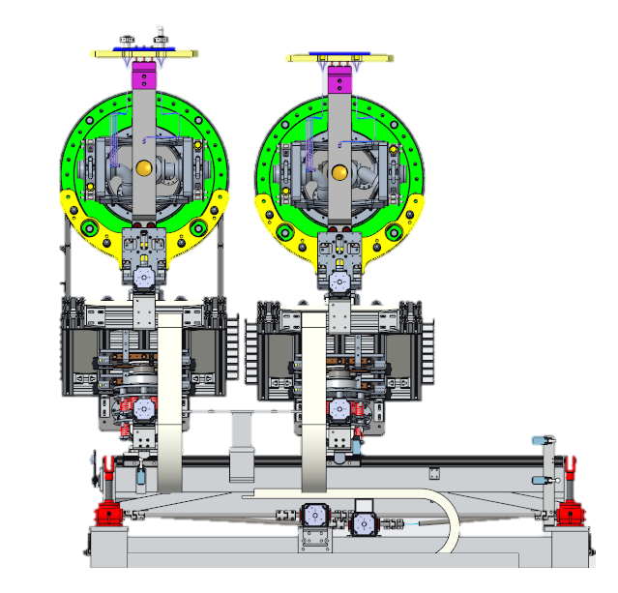
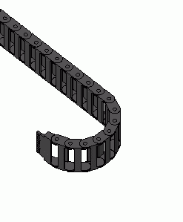
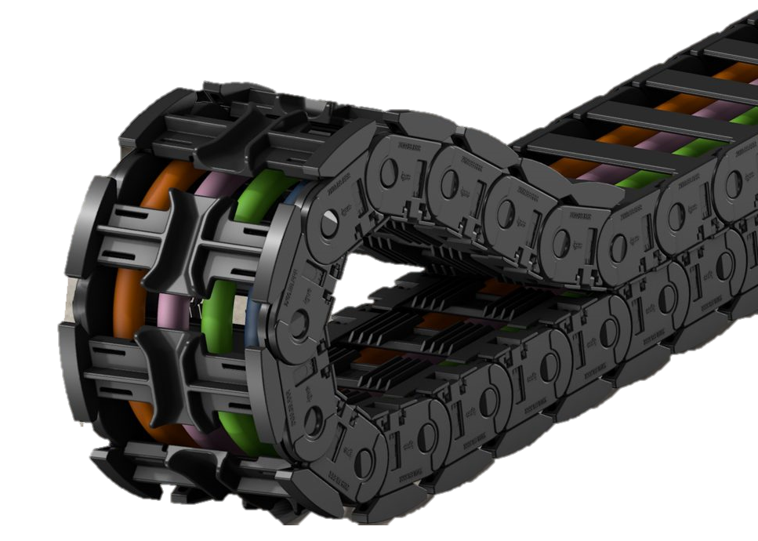
Cable Routing
Igus Cable Chain
Used to guide and protect cabling on sliding assemblies.
Provides strain relief to prevent abrasion, binding and cable damage.
Radiation tolerance calculated, has been used in similar environments before and shown minimal degradation.

Slide 19
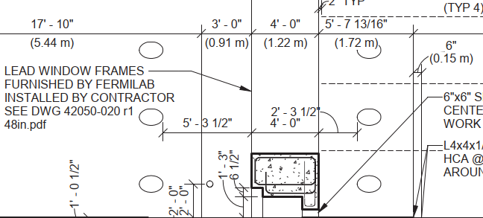
Cable Routing
Cabling through 2, 12” cable passageways
Duct #1
Motors
Switches (Compliance, Limits, Approach)
Duct #2
LVDT’s and Load Cells
Cable will be appropriately shielded to prevent interference between devices.

Slide 20
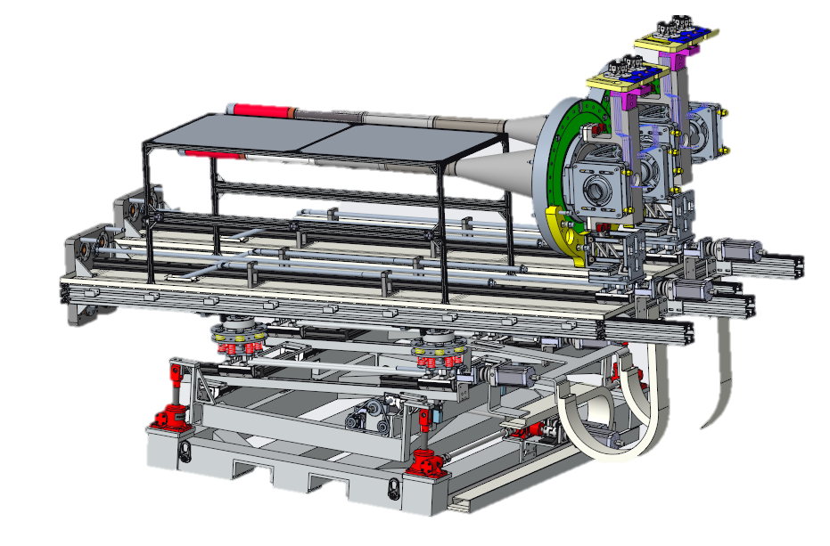
Connectors
Local patch panel.
Heavy duty industrial locking connectors
with ≥IP5x rating.
Connections available through telehandlers.
Patch Panel to be located near the rear left screwjack. Design and model to follow
Alignment Dowels
`
Electrical Connectors
Securing Fastener

Slide 21
Next Steps

