Slide 1
RAL Remote Handling Mock-Up Area
Angus Mackley
(STFC Rutherford Appleton Laboratory)
LBNF Target Exchange System Technical Design Review 24-25 June 2024

Slide 2
Presenter Background
Angus Mackley
Graduate Mechanical Engineer
High Power Targets Group at STFC
Started in September 2023
Notes:
Would be very quick

Slide 3
Presentation Outline
Mock-Up Area Overview
Horn A Mock-Up
Brief, Features in Detail & Current Progress
Dummy Target
Brief & Current Concept
Questions
Notes:
Also quick, but gives an overview

Slide 4
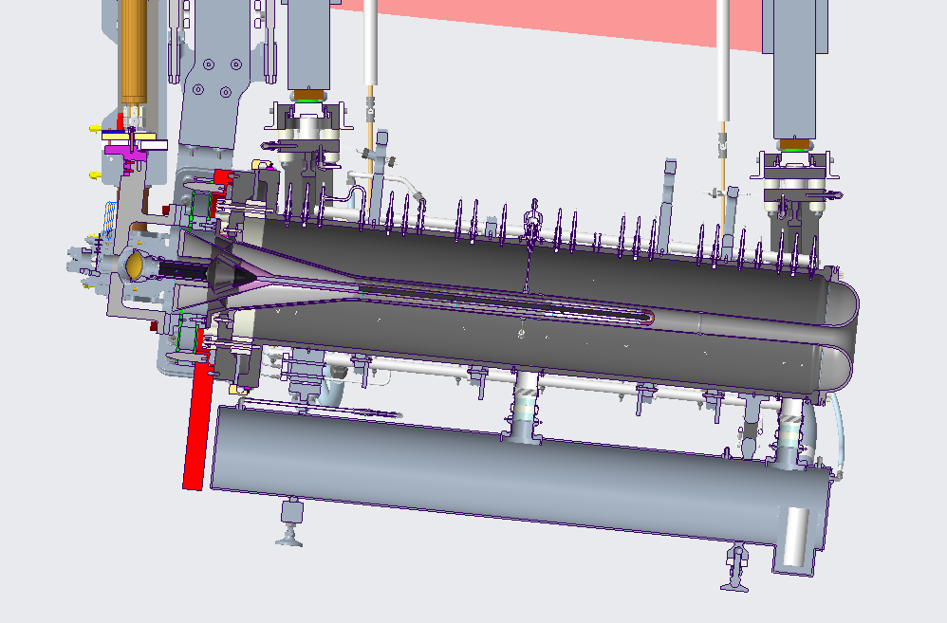
Mock-Up Area Overview
Offline test area for development of target remote handling equipment
Replica of important interfaces and components

Slide 5
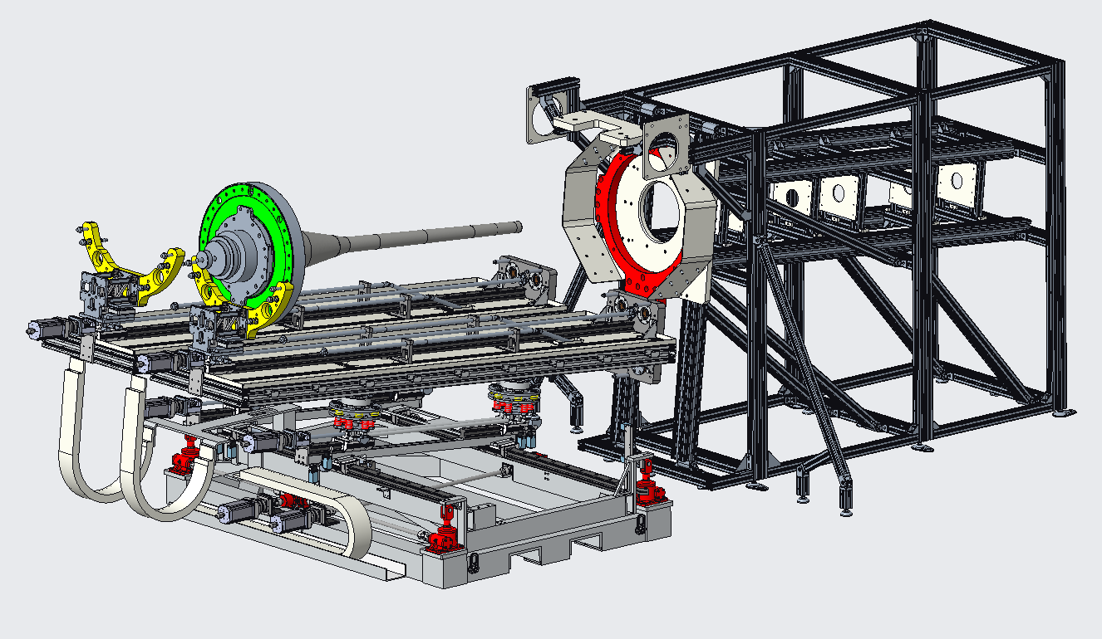
Mock-Up Area Overview
Dummy Target
Horn A Mock-Up
Target Exchange System

Slide 6
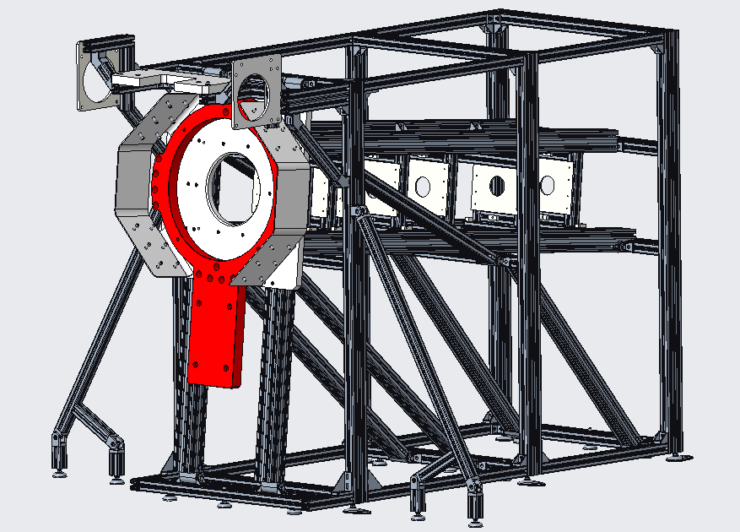
Horn A Mock-Up – Brief
Represents the internal geometry of Horn A.
Test target insertion with the TXS.
Nominal clearance varies between 5.1mm and 12.1mm.
Recreate the interface connections.
Target supports (red plate), also helium line connectors and instrumentation connections.
React mechanical loads introduced from TXS.
Beamline (z)
Axis | Required Accuracy (±)
X | 0.1mm
Y | 0.1mm
Z | 2mm
Roll | Minimal effect on thin parts
Pitch | 5.789° ± 0.5
Yaw | No affect as axisymmetric

Slide 7
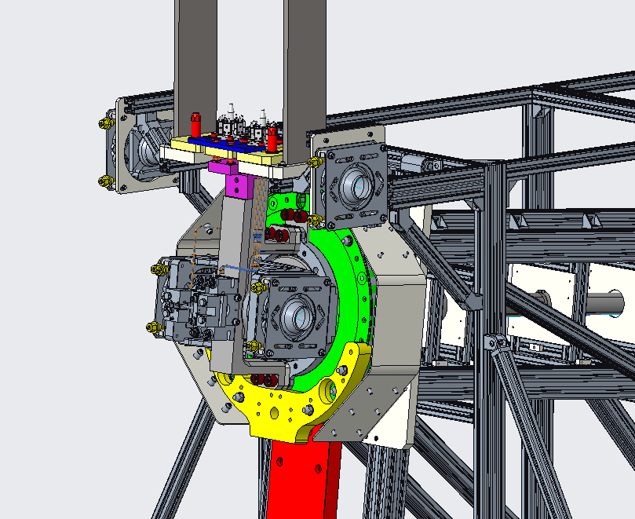
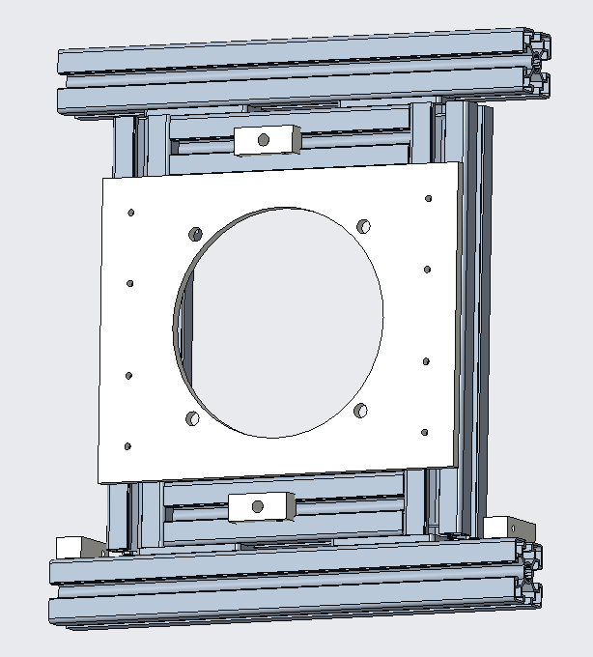
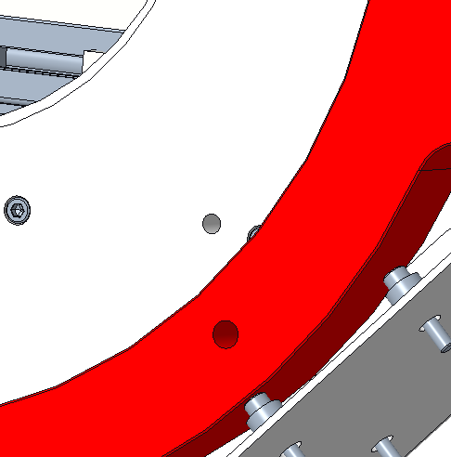
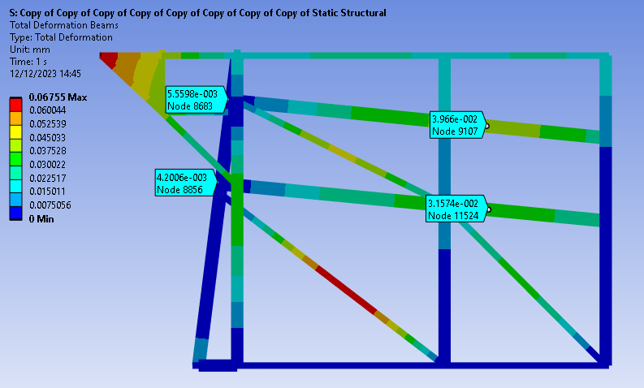
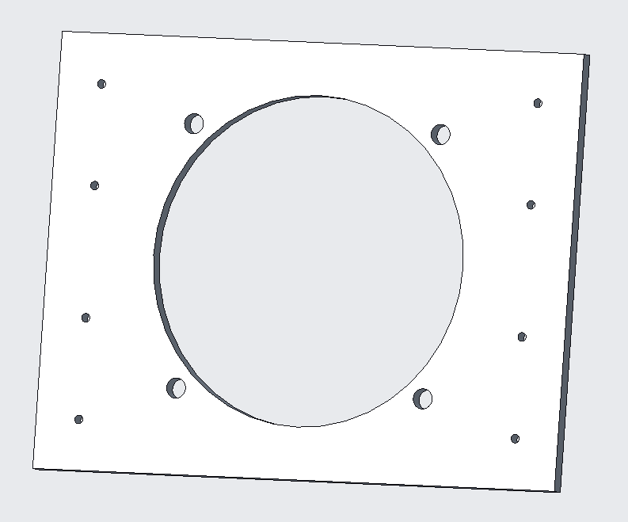
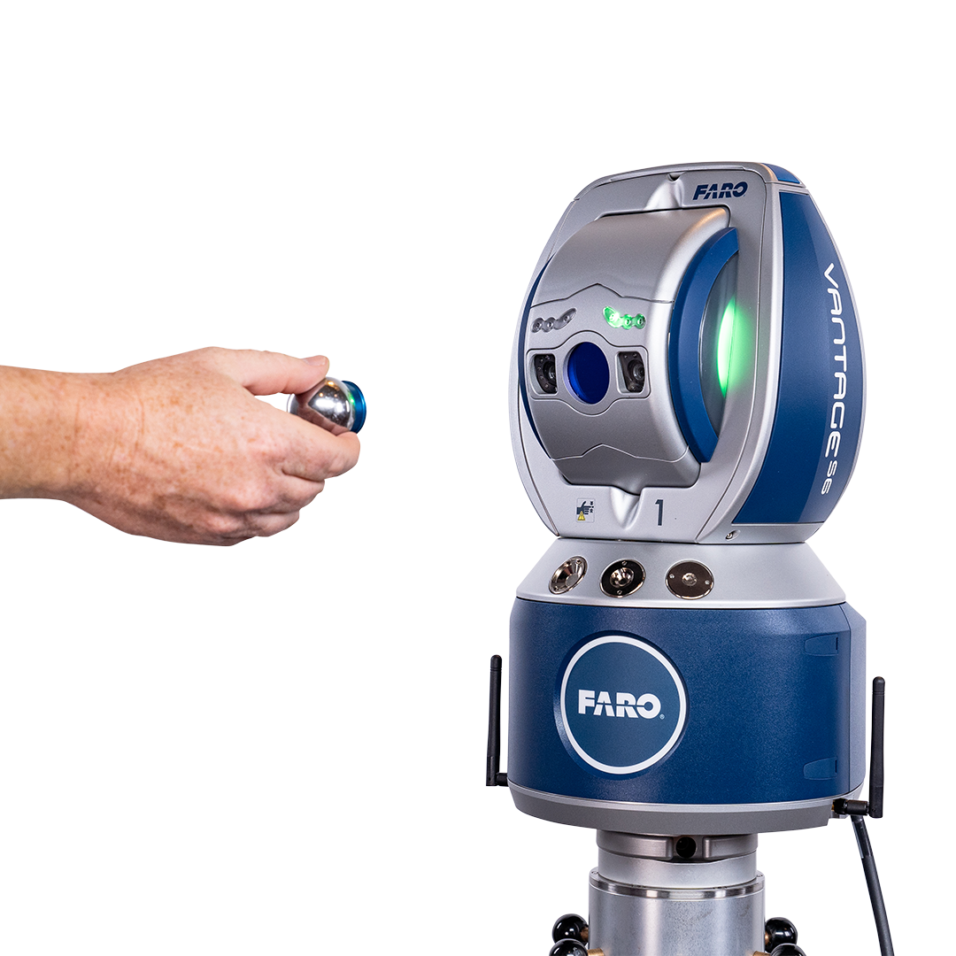
Horn A Mock-Up – Features in Detail
Connecting Interfaces
XY stages for initial alignment
Optimised Frame – Parametric FEA Study
Fiducial Points for alignment

Slide 8
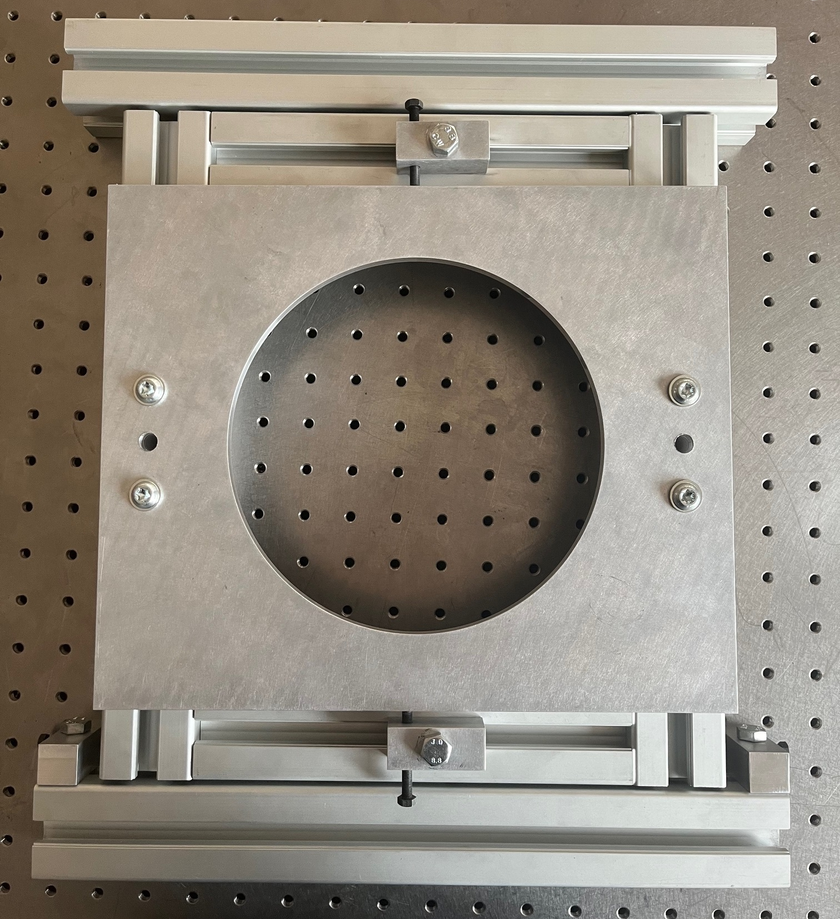
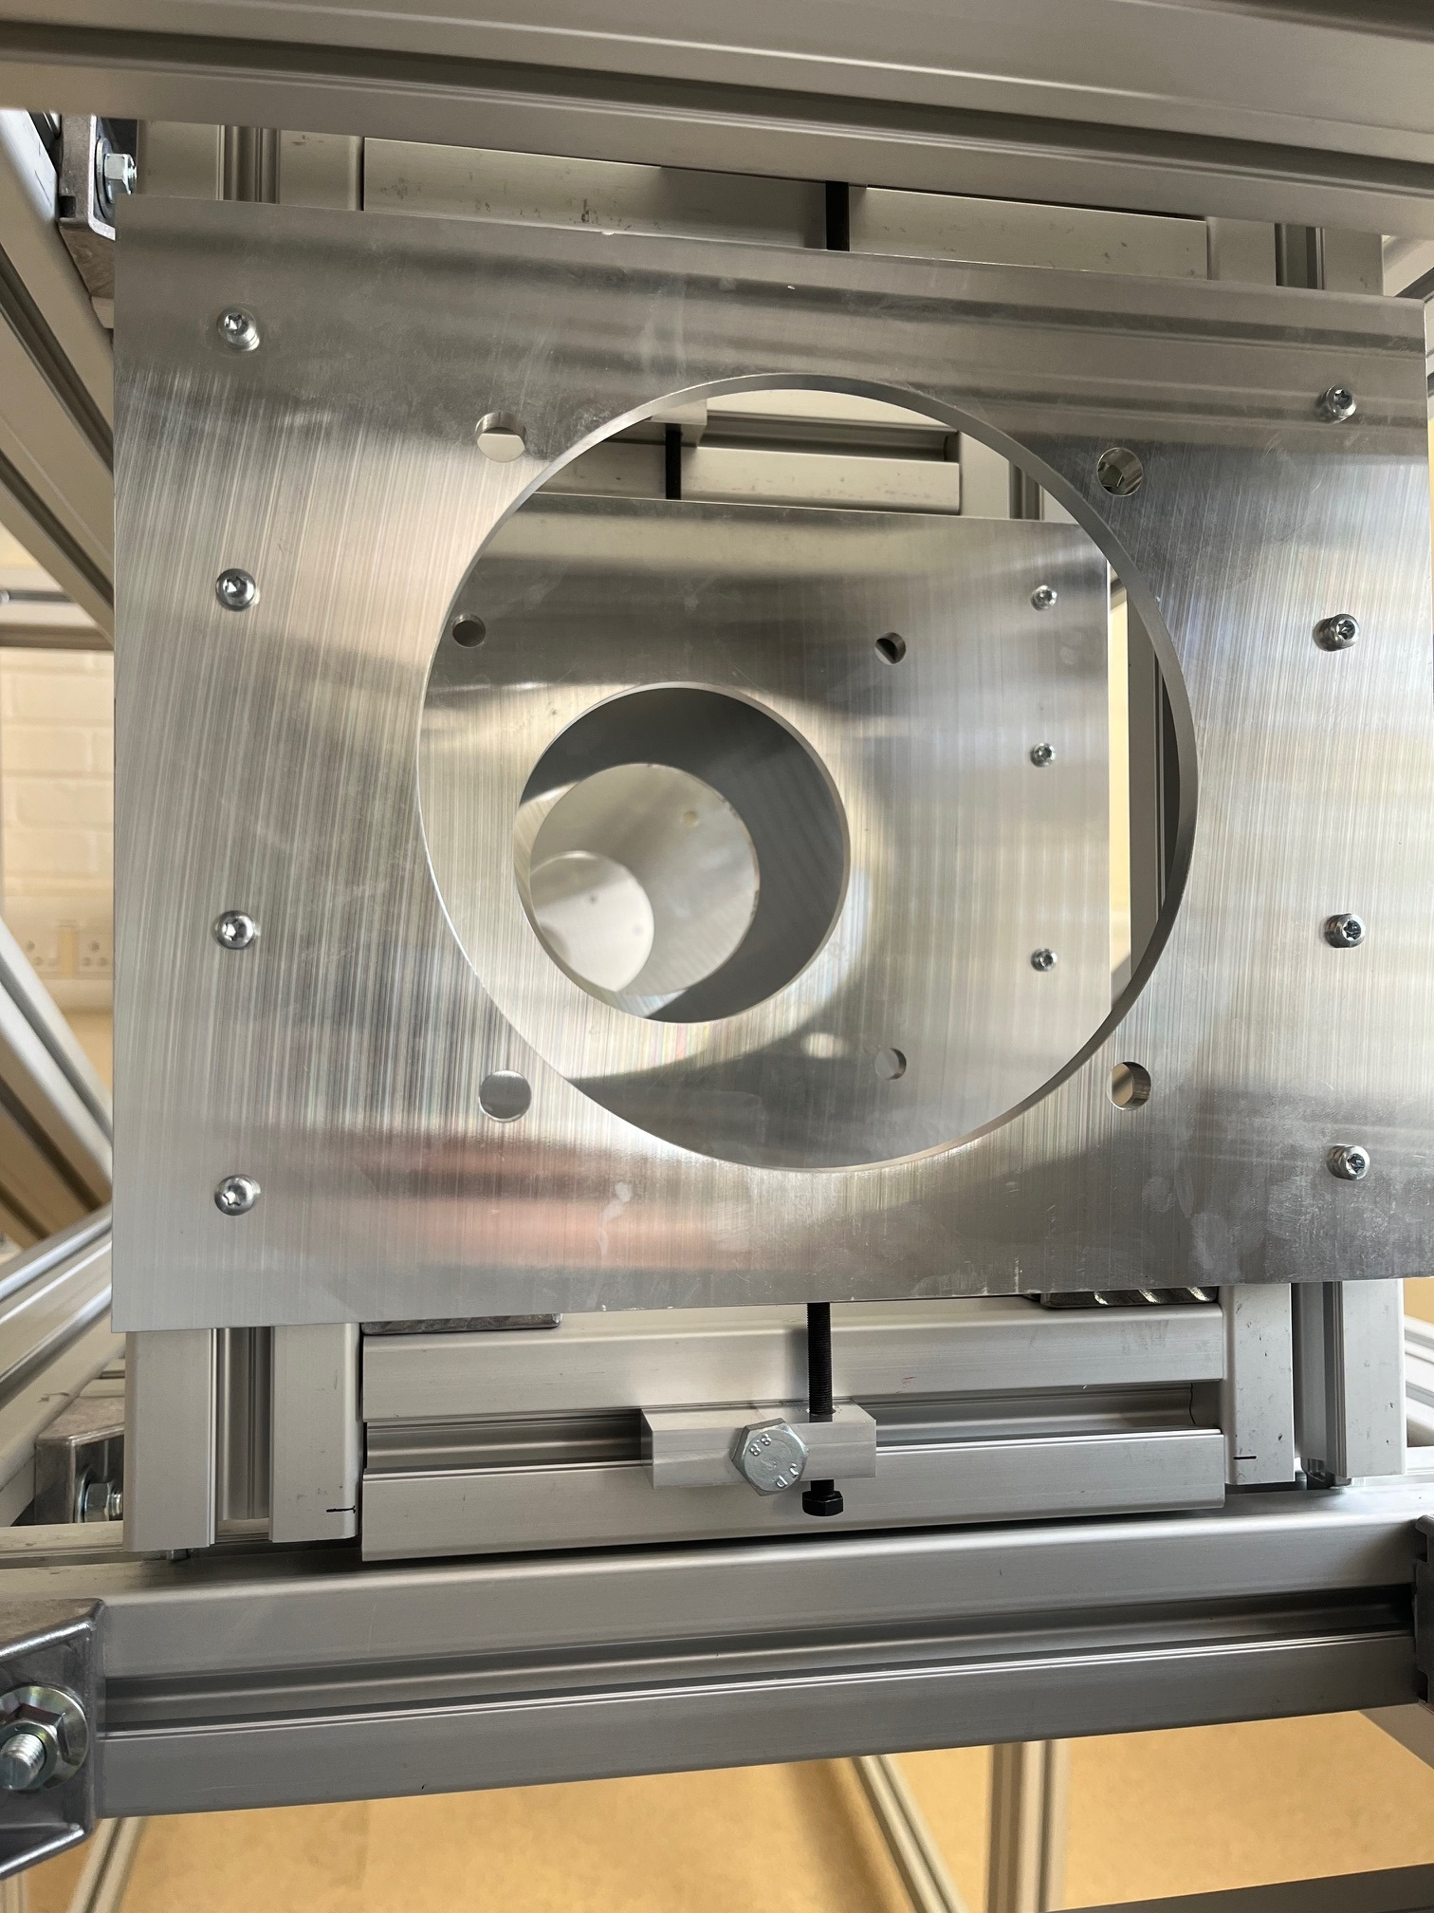
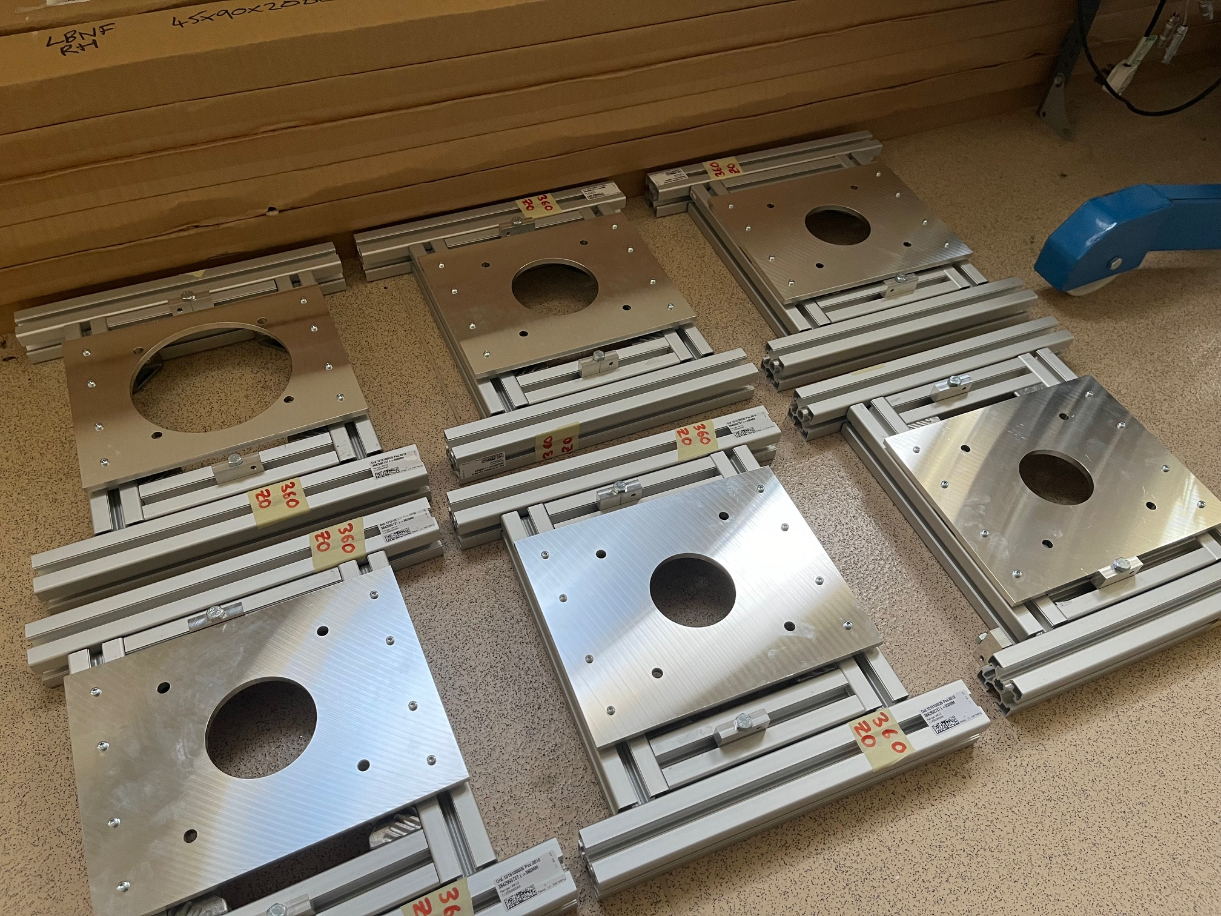
XY Adjustment Stages
Series of cross-sectional “profile” plates – work like XY stages.
Have adjustment in X and Y from M5 fine pitch screws.
Allow easy adjustment to meet tight positional tolerance.
Include fiducial locations for ISIS laser tracker.

Slide 9
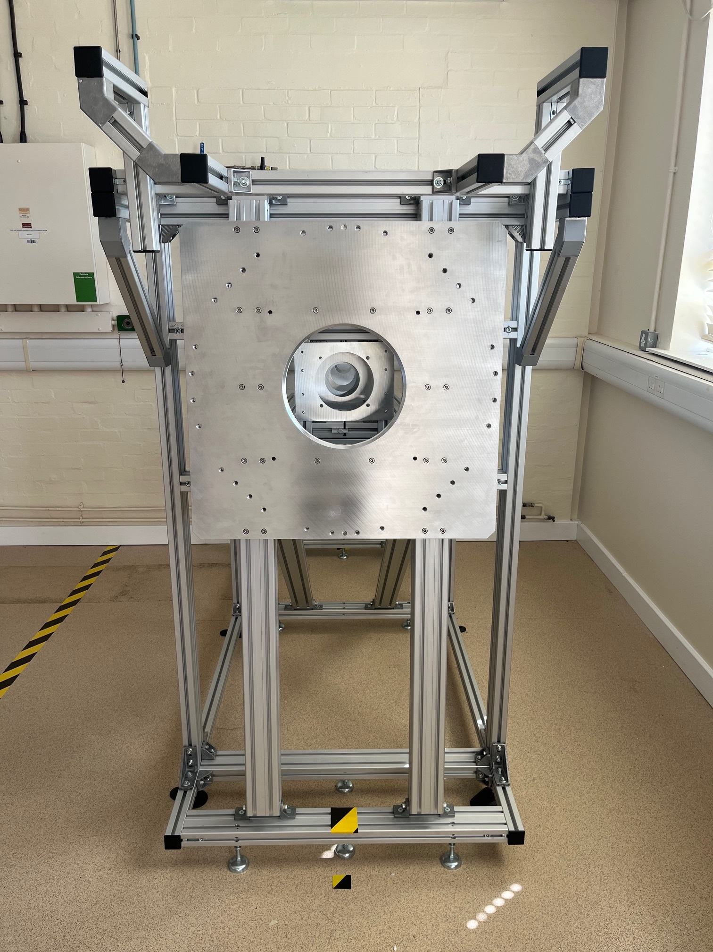
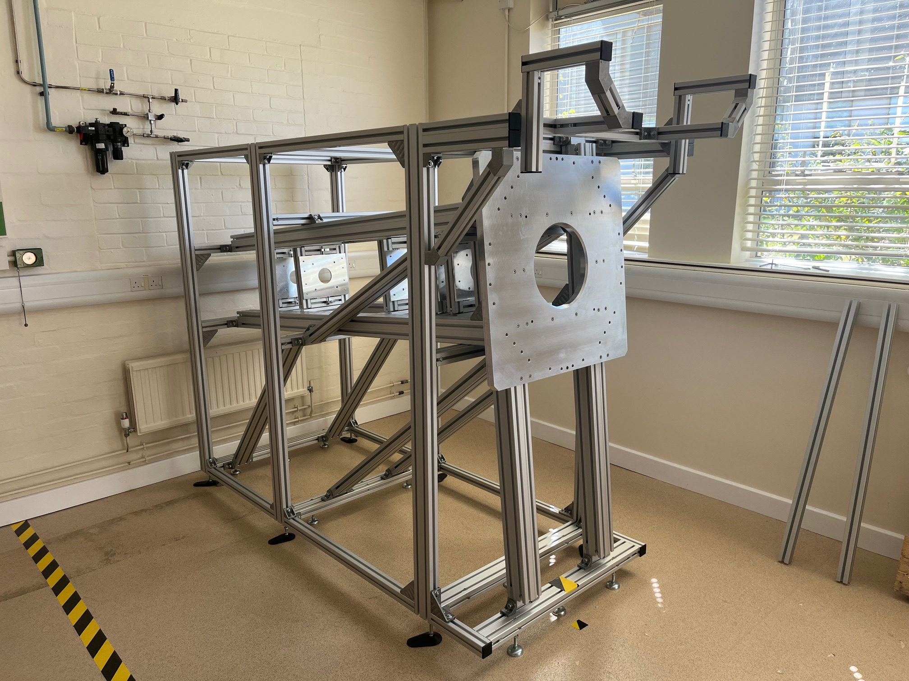
Horn A Mock-Up – Current Progress

Slide 10
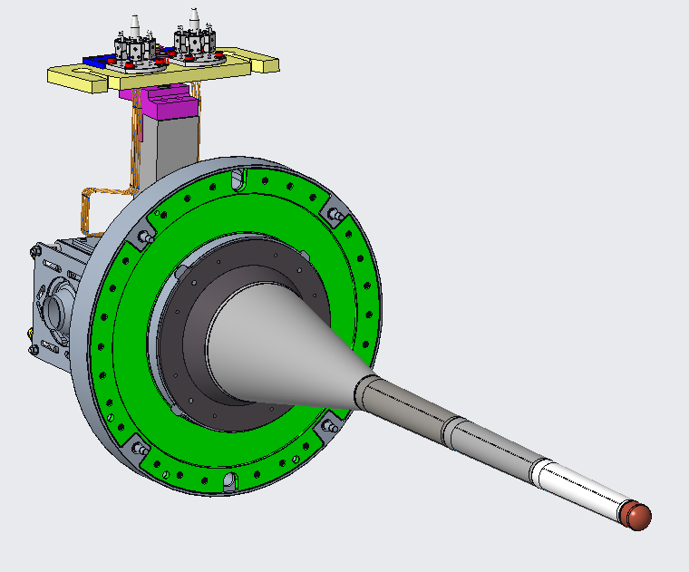
Dummy Target - Brief
Replicate the geometry and mass of the LBNF target and remote connections.
Representative form (straightness) as LBNF target weldment
Representative mass and COG
Replica of key interfaces (flexibly, when required).
Target support
TXS
Instrumentation connections
Helium cooling inlet/outlet connections
Requirement | Acceptable Range
Deflection (gravity sag) | 0.5mm
Form Accuracy | 0.5mm
Mass | 123kg ± 5%
CoG (X, Y, Z) | Nominal ± 10%

Slide 11
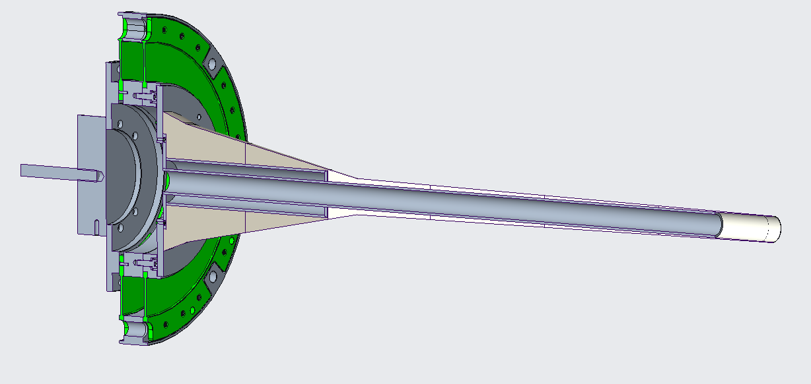
Dummy Target - Concept
Attaches to TXS and bracketry in same way.
3D printed casing for form.
Potential to attach laser tracker at downstream end.
Barbell for flexible mass attachment.
Stiff concentric aluminium in core structure.

Slide 12
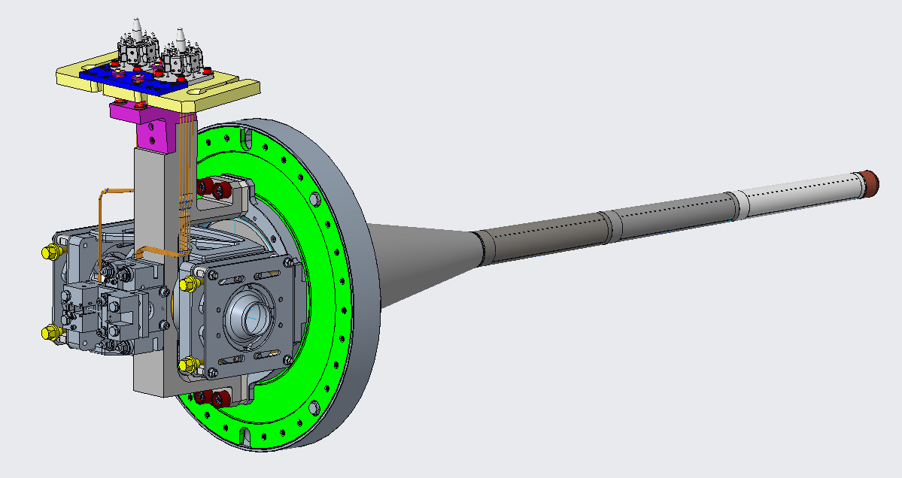
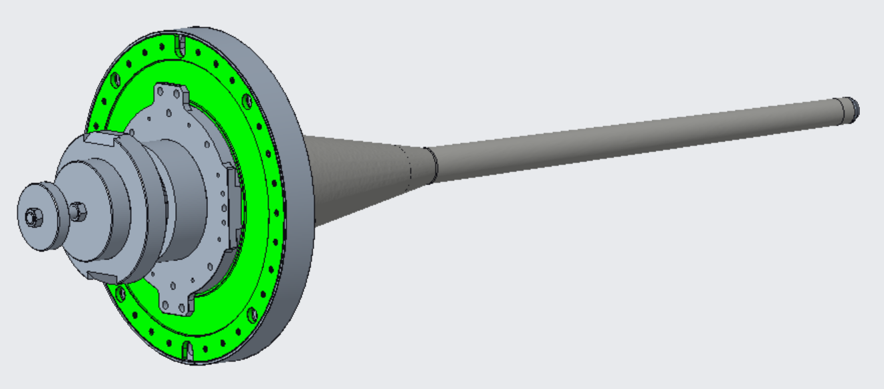
Dummy Target – Mass Configurations
Each part on the real assembly has a “dummy” counterpart.
Individually replicates their mass and CoG.
Can be replaced as real components are manufactured.
5
3
2
1
6
4
1 | Target Weldment | = | Dummy Target Weldment
2 | Green Plate | = | Green Plate
3 | Ring Bracket | = | Ring Bracket
4 | Suitter Clamps + Bracing | = | Mass A
5 | Alu Bracket + Tub | = | Mass B, C
6 | Hylen Device | = | Mass D
3
2
4
1
5
6
*Potential solution

Slide 13
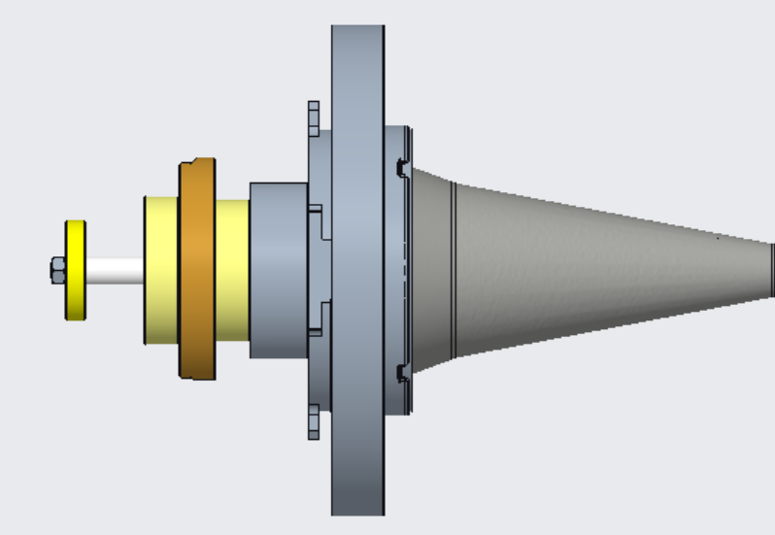
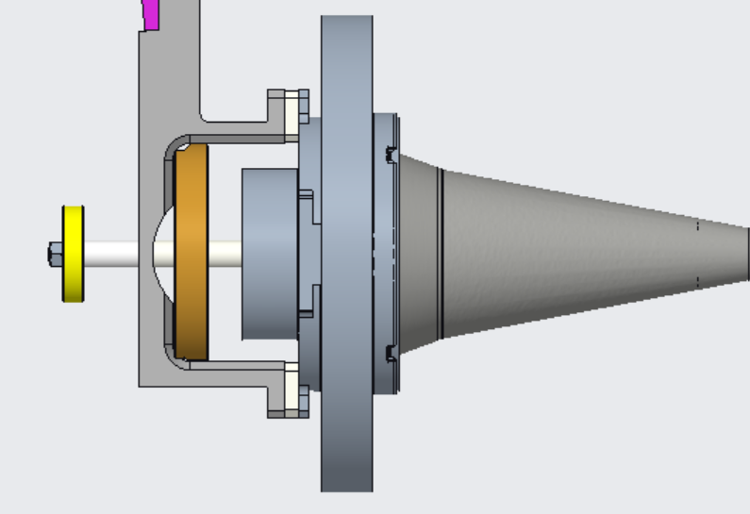
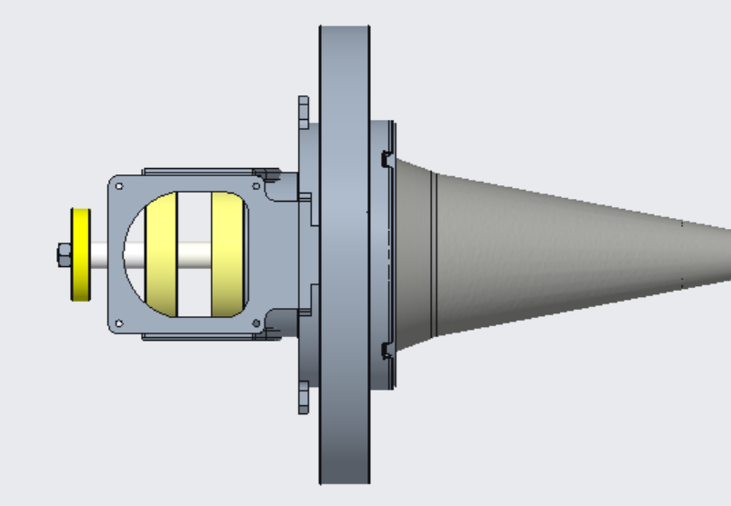
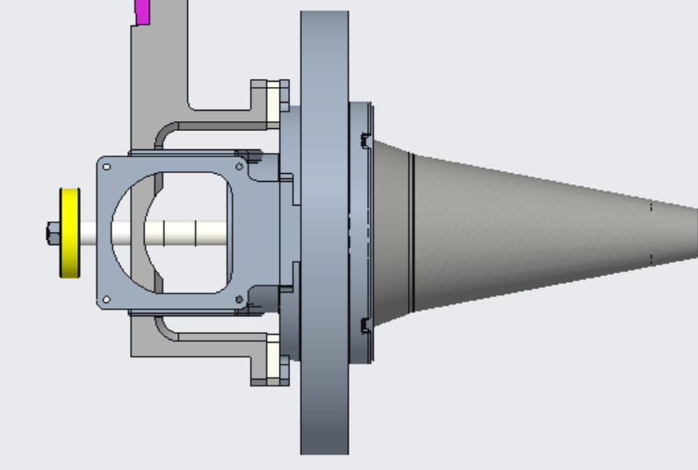
Dummy Target – Mass Configurations
Full Dummy
Instrumentation Connections
Suitter Clamps & Bracketry
Instrumentation & Suitter
Clamps not added for visibility

Slide 14
