Slide 1
DUNE FD VD Mockup
Updates
Gajendra Gurung on behalf of UTA HV Team
Brad Brown, Samuel Blanchard, Akash Behanan & Rohit Raut

Slide 2
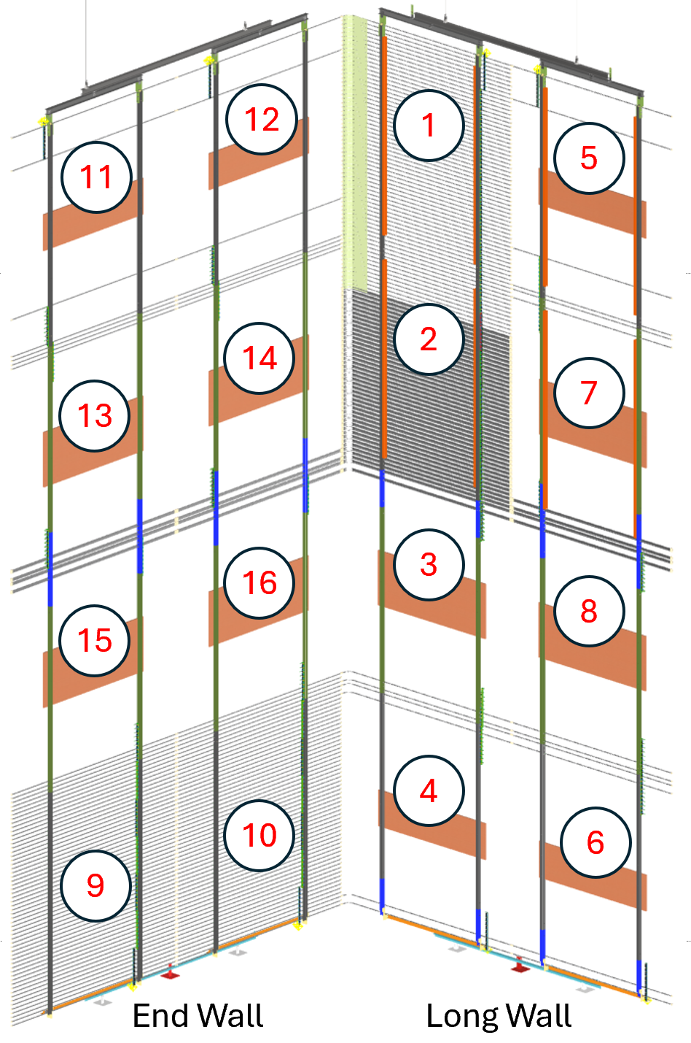
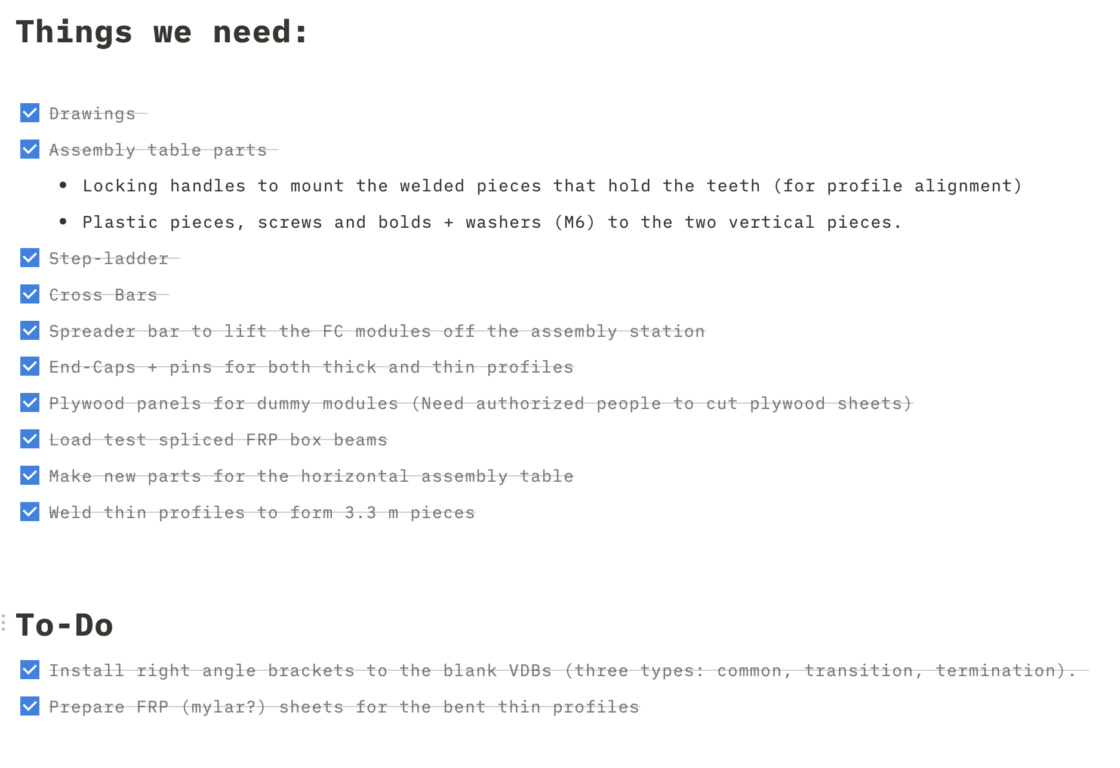
Module naming scheme

Slide 3
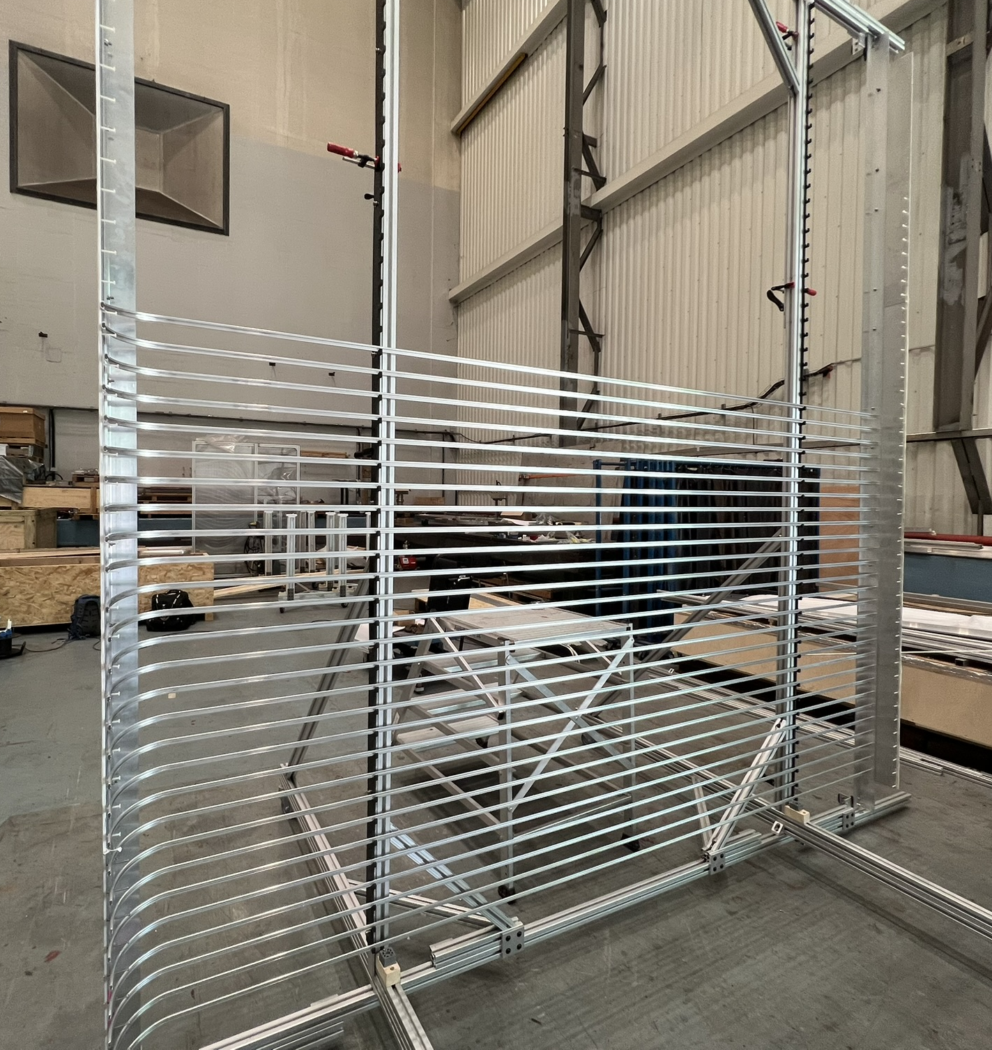
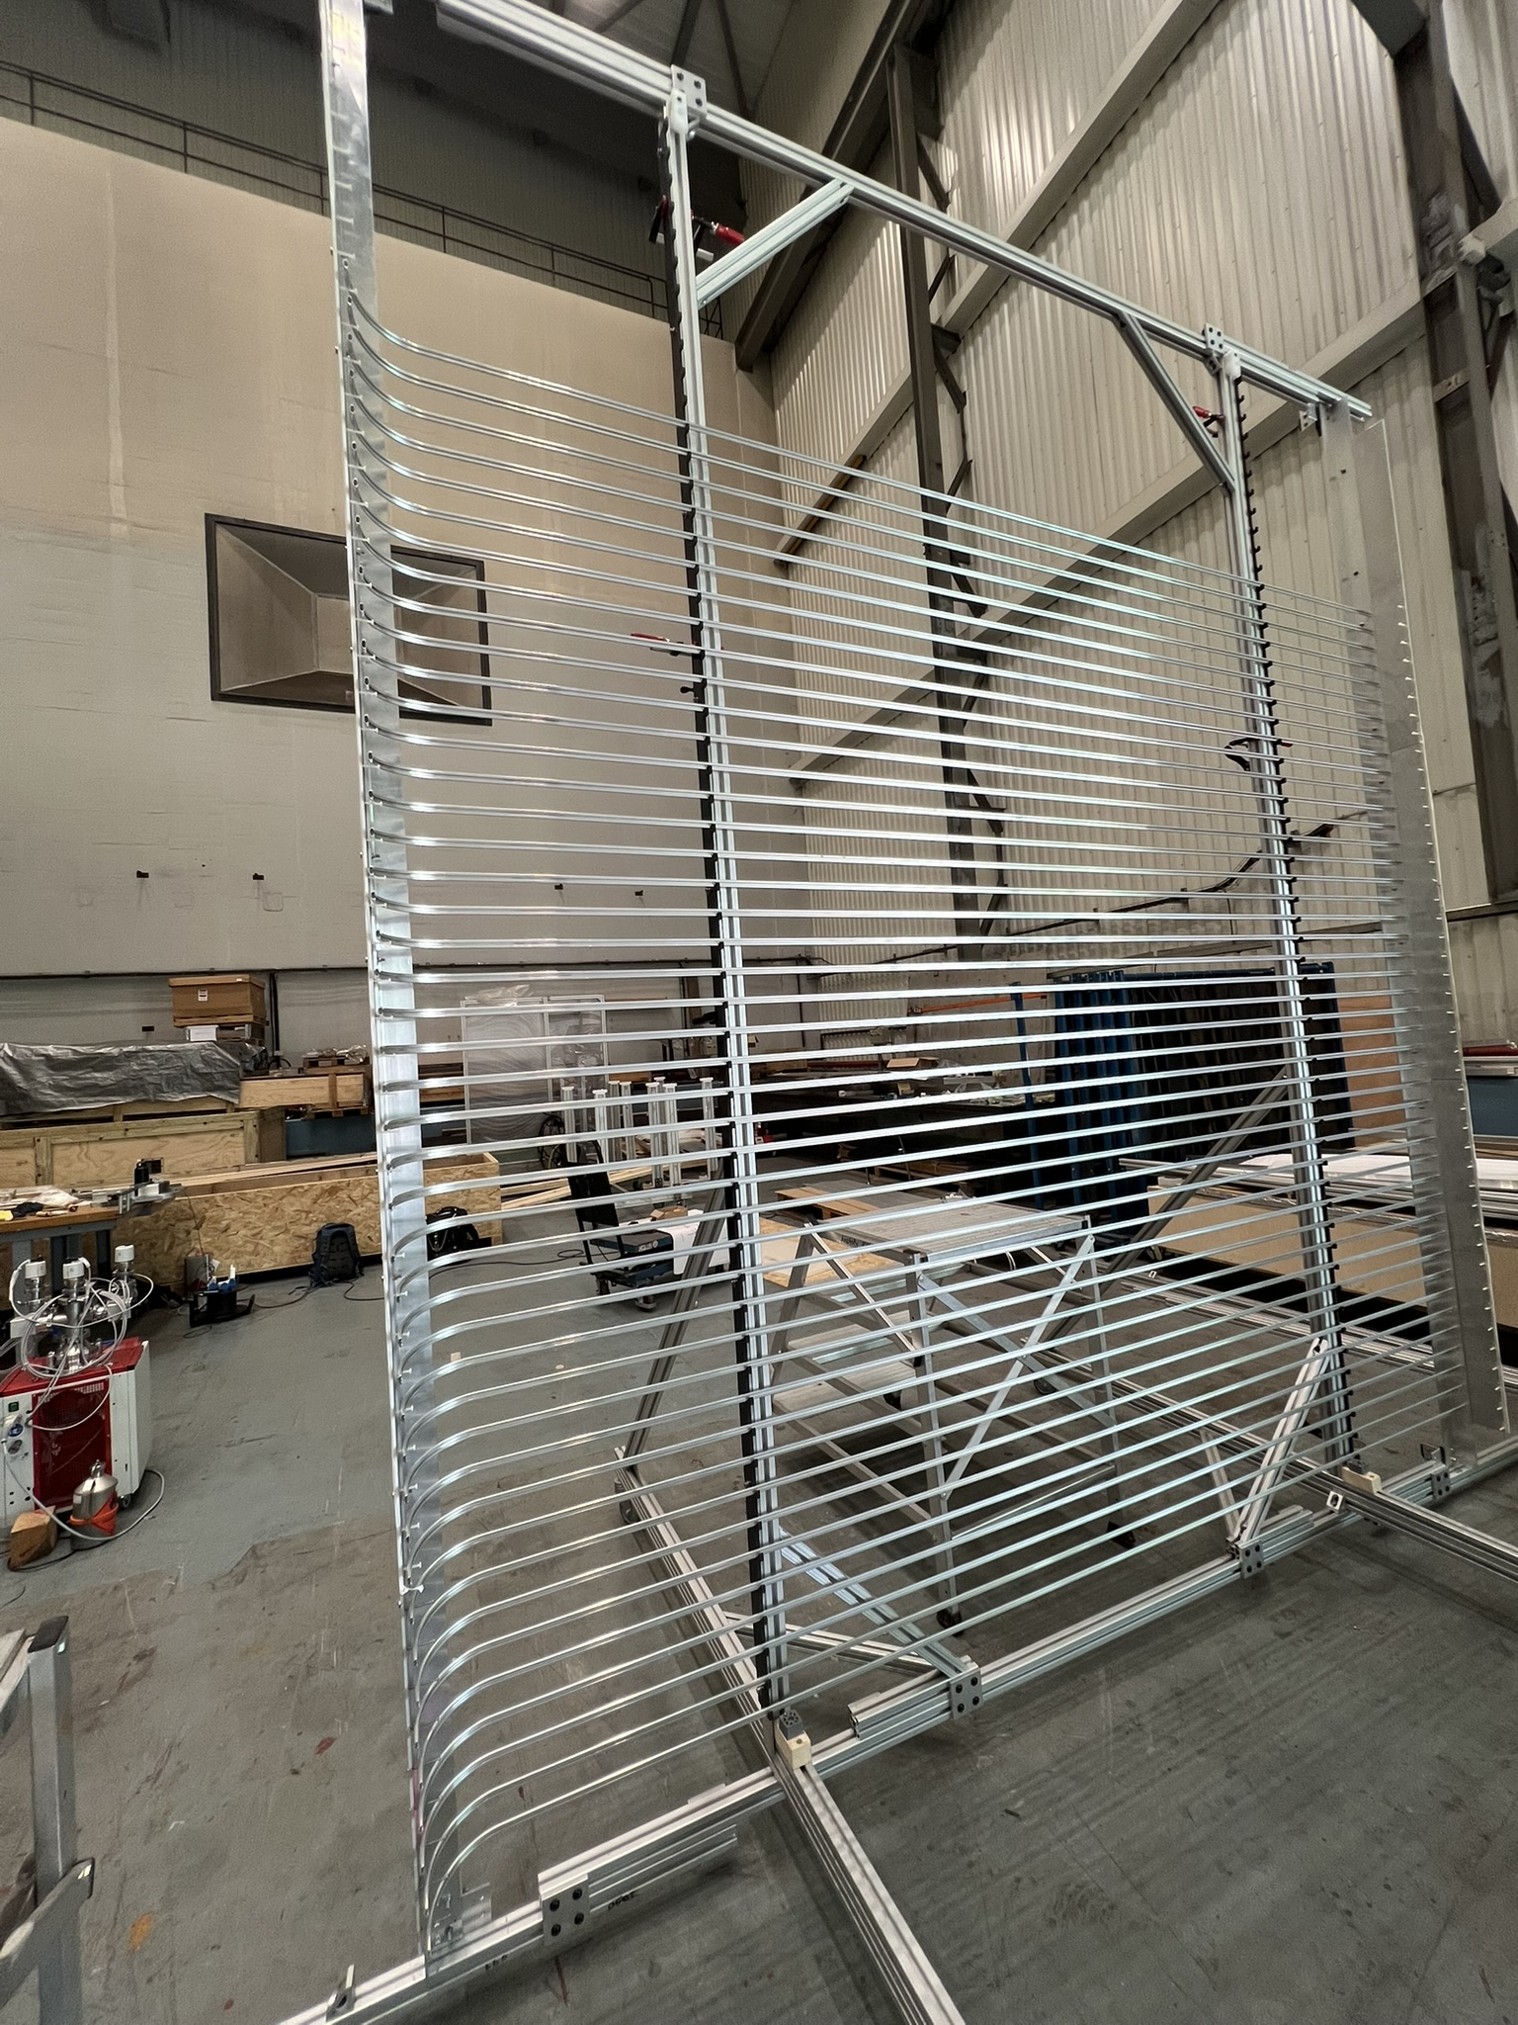
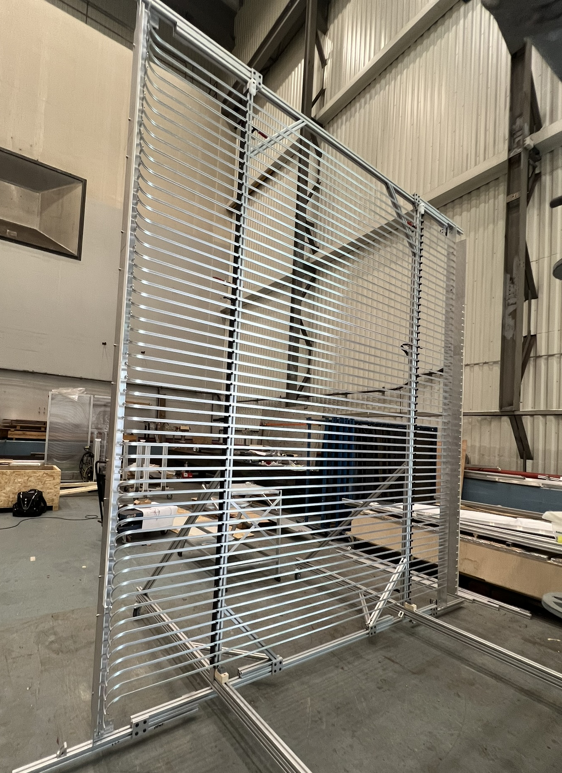
Module building: Module 1
Done in 3 stages: Ground level, Stairs and Scaffolding

Slide 4
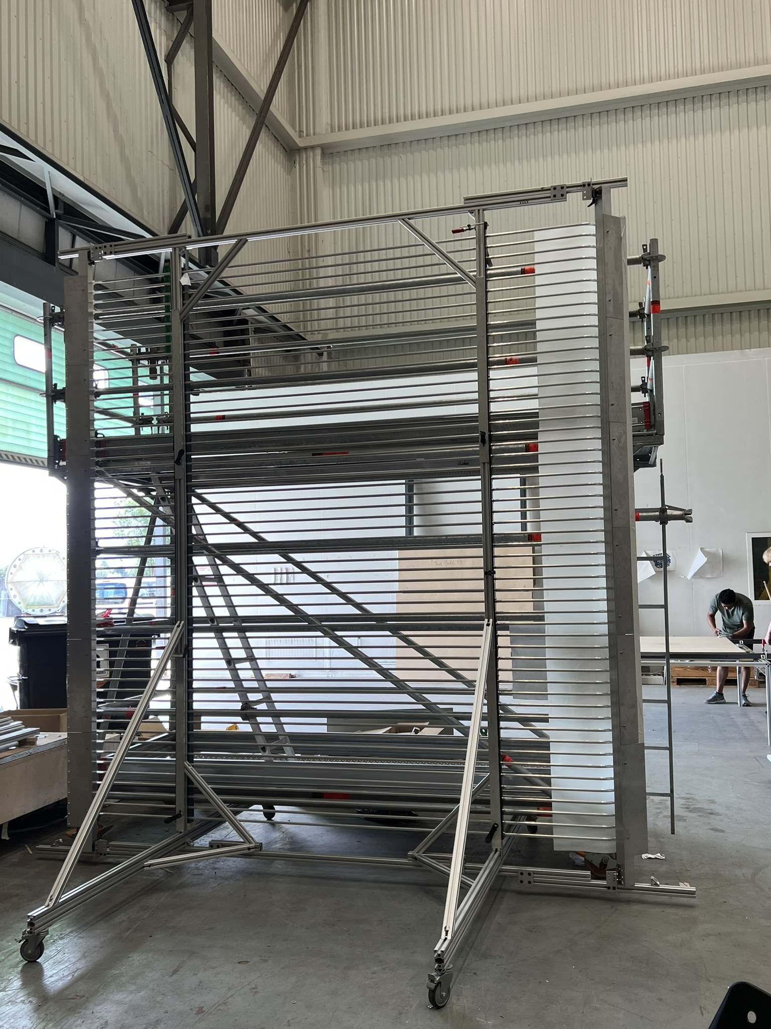
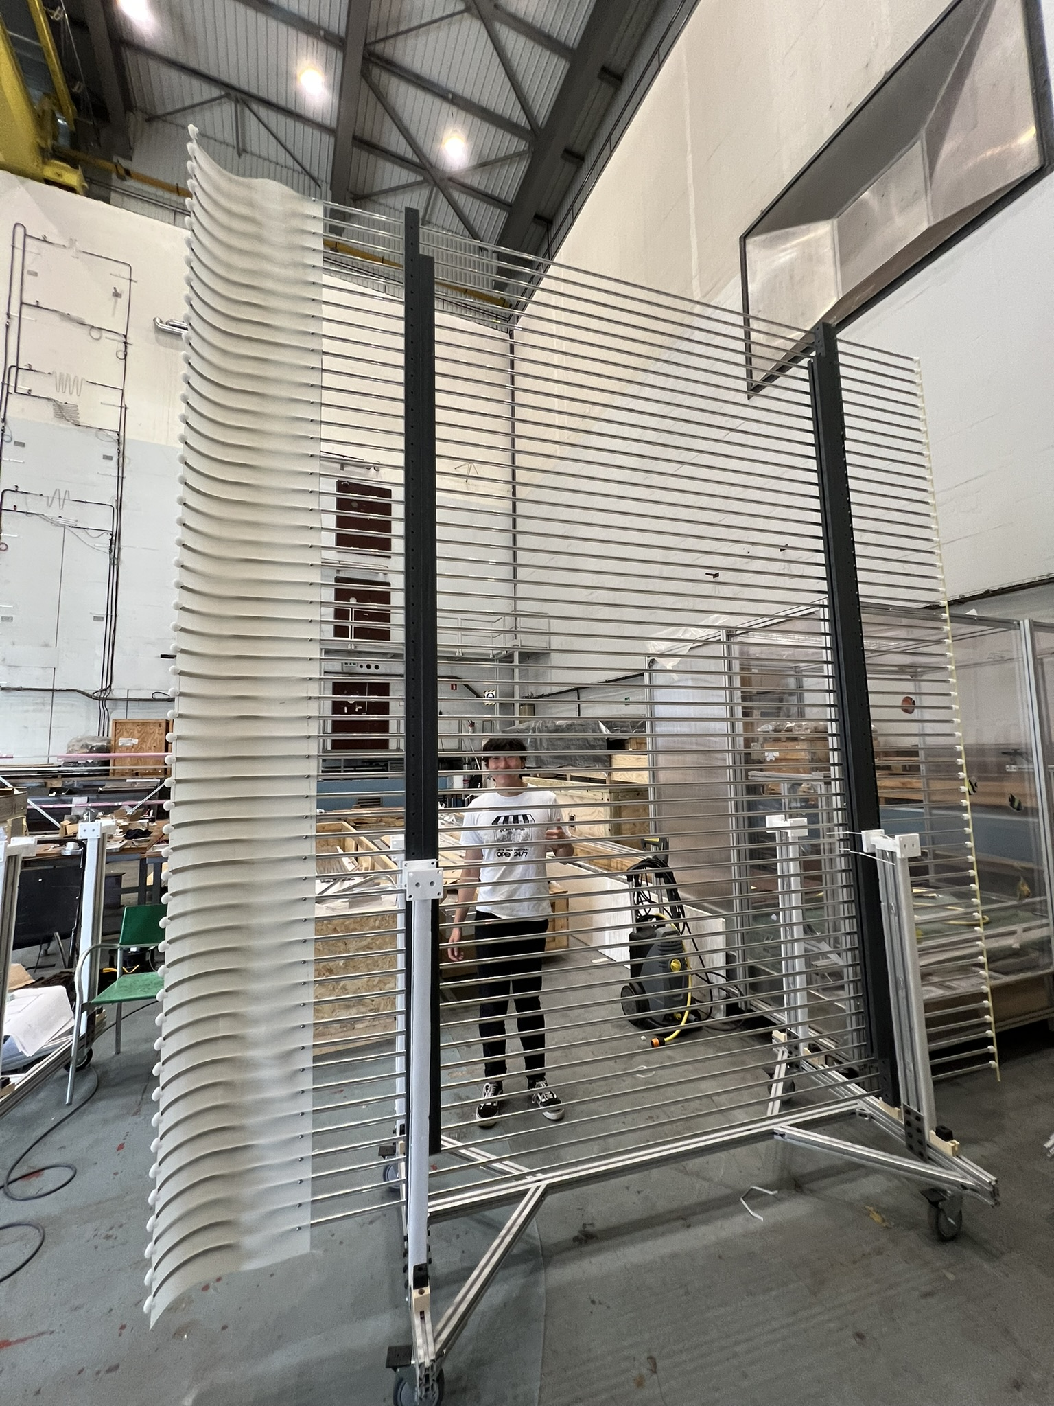
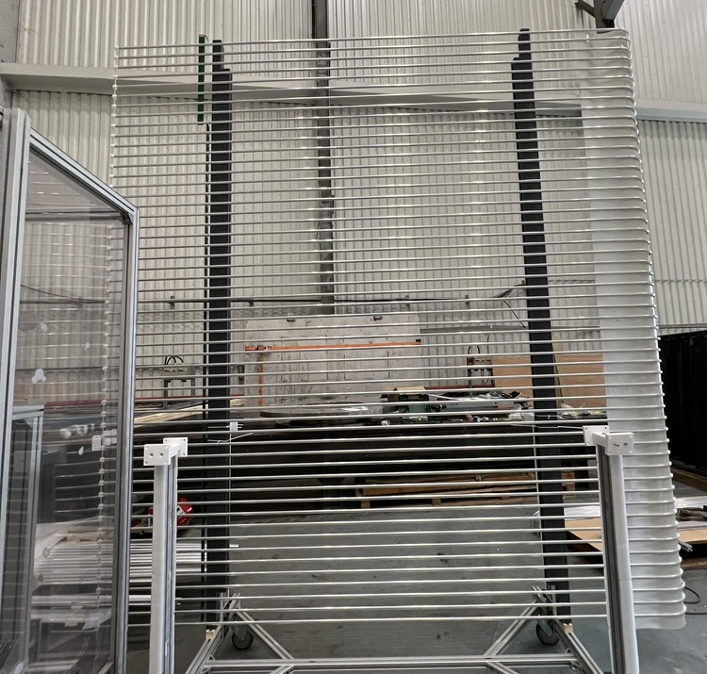
First module production completion
Module 1 (Longwall Corner top)

Slide 5
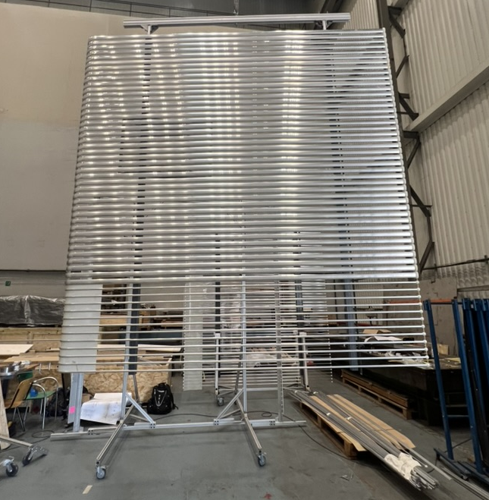
Completed Module 2

Slide 6
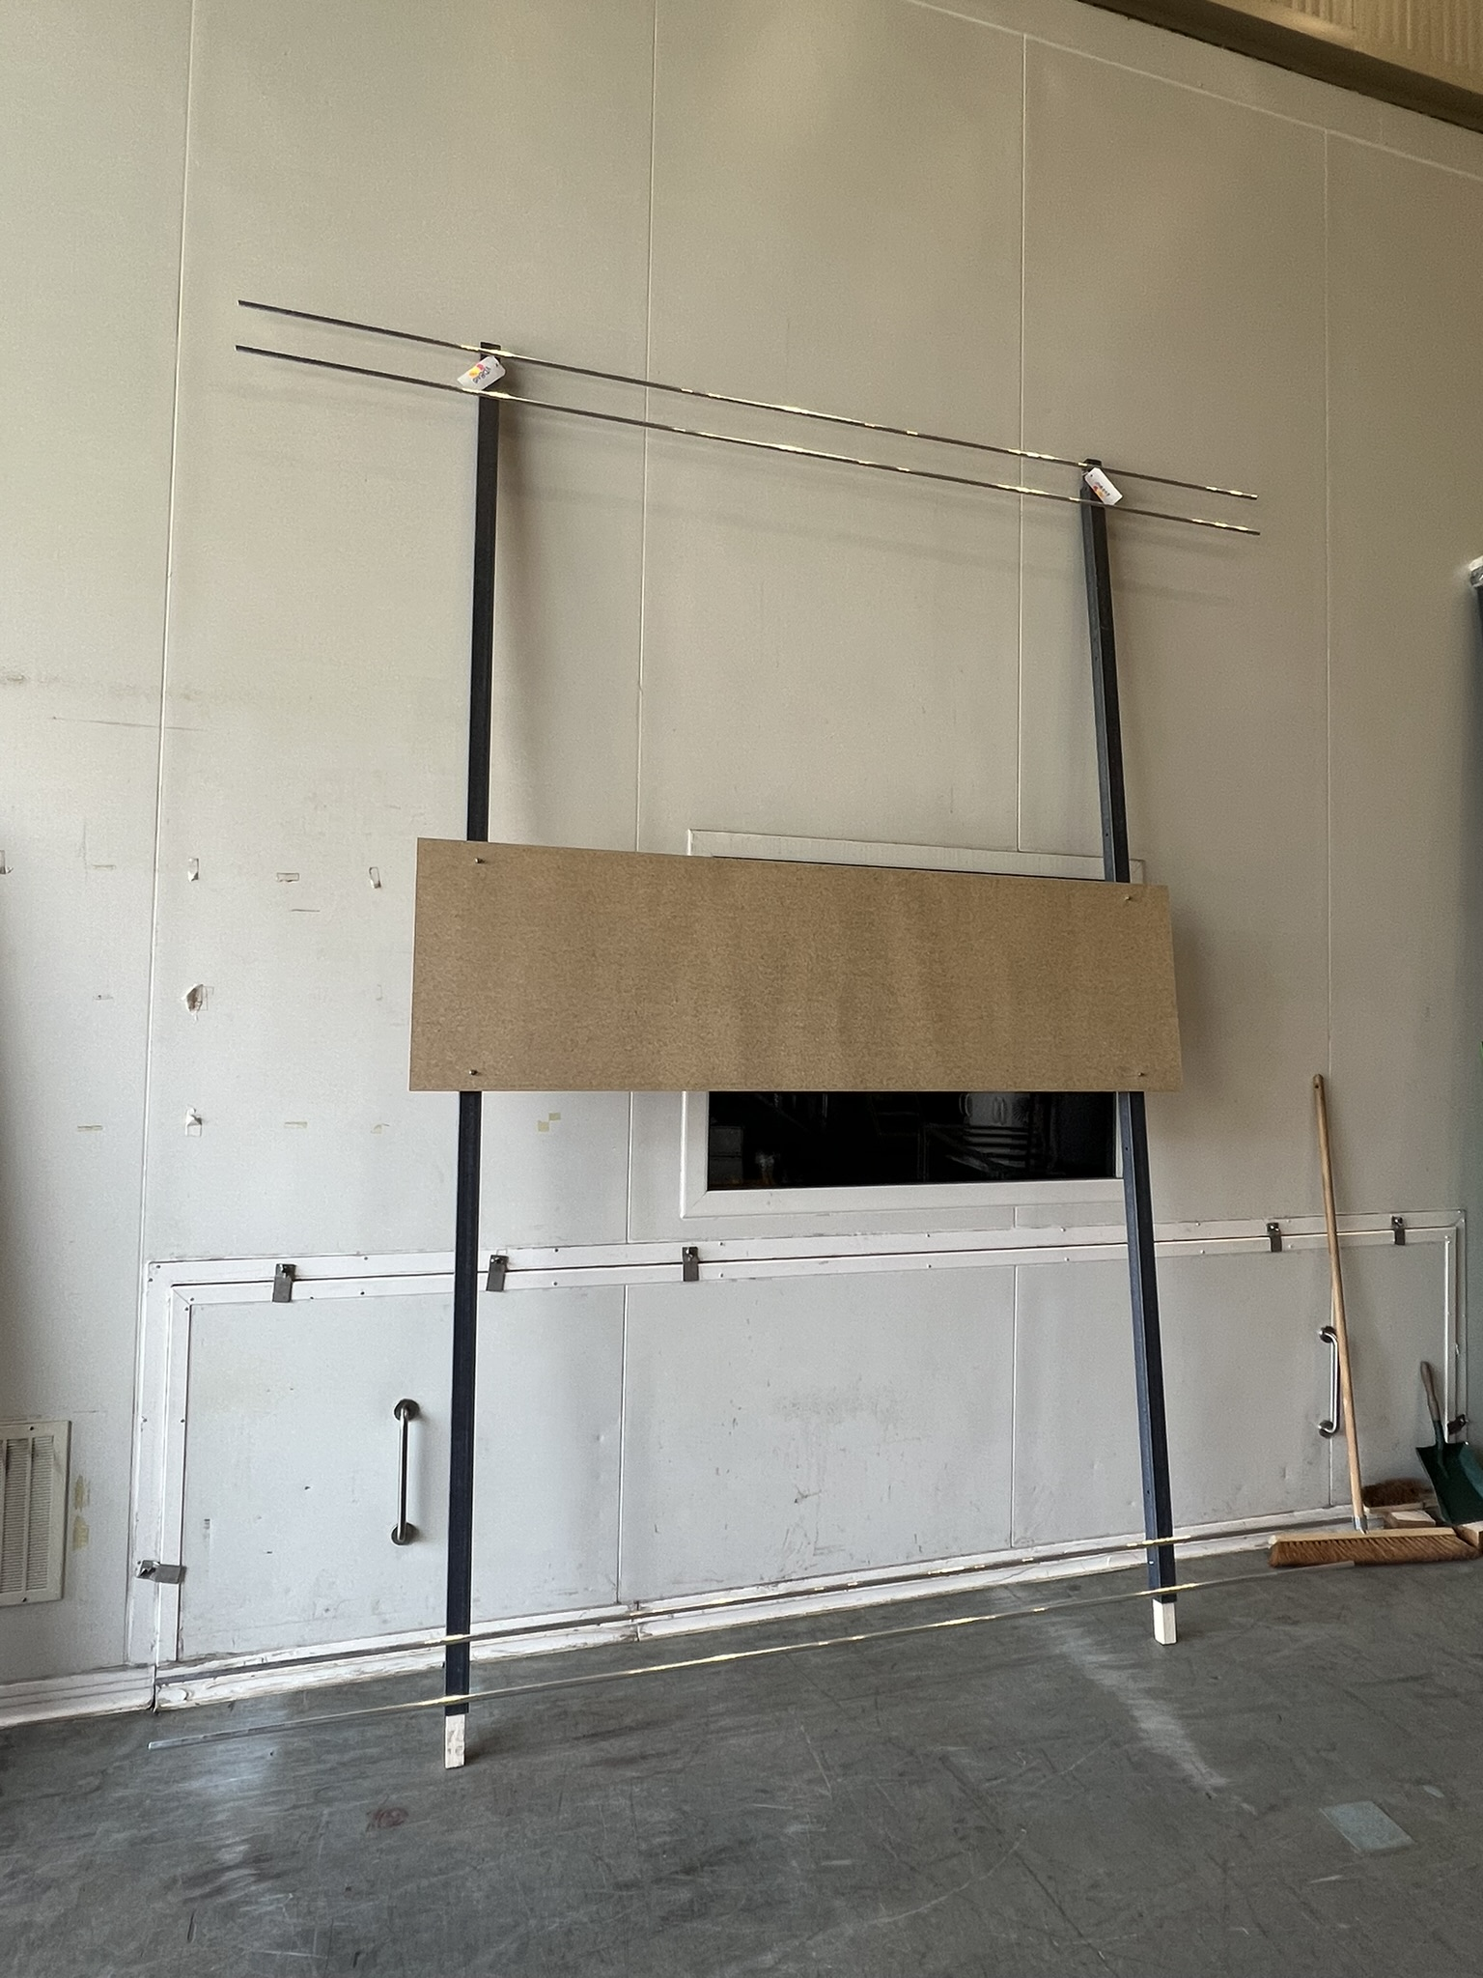
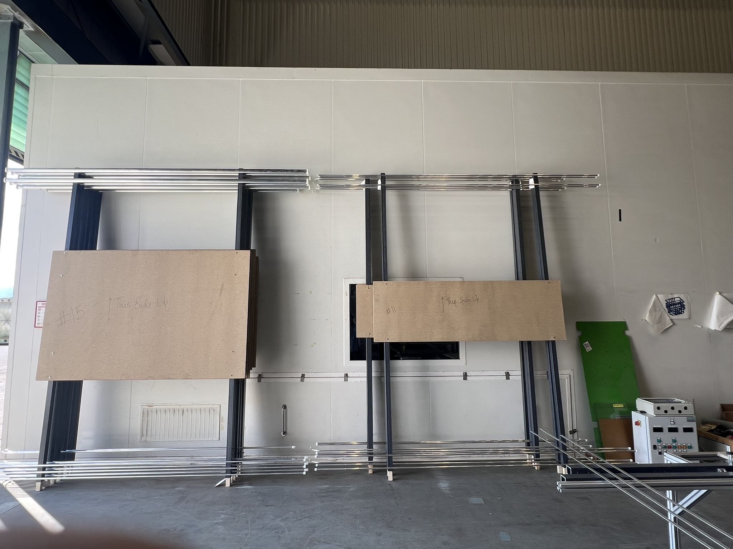
Dummy modules in preparation
All 16 dummy modules have been prepared

Slide 7
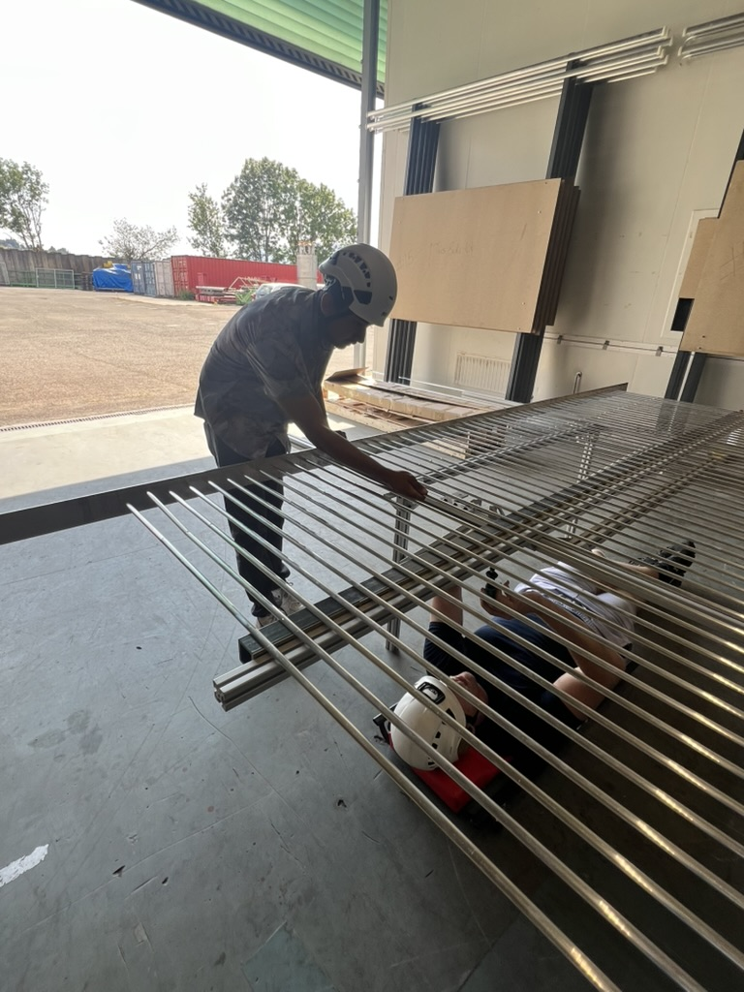
Full Modules 9 & 10
Module 9 build on the vertical assembly table
Module 10 build on the horizontal assembly table
Module 9: 3.8 hrs
Module 10: 3.4 hrs
Advantages of HA table
- Ease to align the profiles using the HA table
- Do not need to go up and down the stairs/scaffolding
Disadvantages of HA table
- Neck and arms fatigue

Slide 8
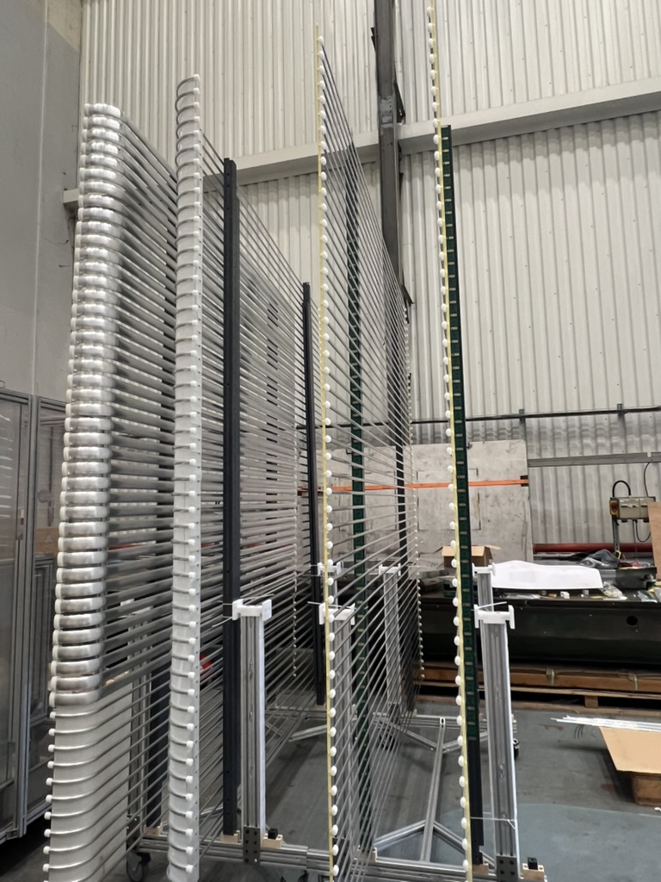
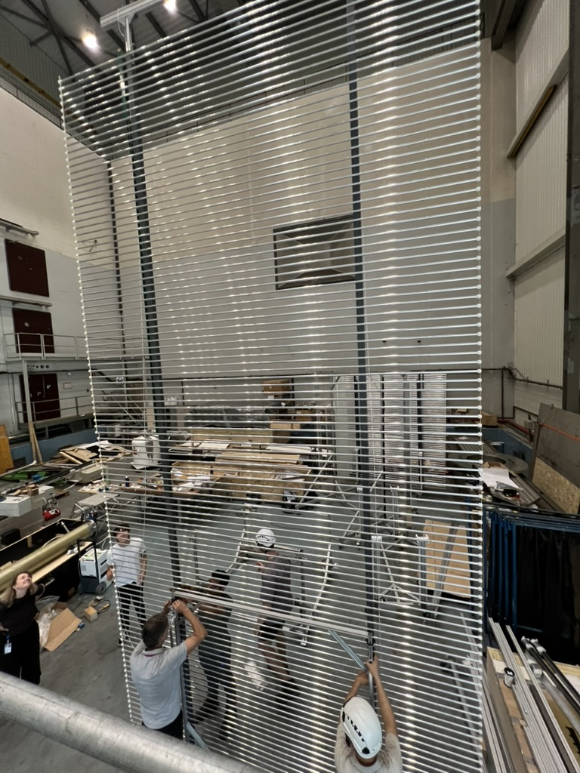
Attaching Full Modules 9 & 10
Demonstrate the use
of installation cart
Installation cart
All 4 full modules in storage carts

Slide 9
Summary
Processed all the profiles (cut, clean and bent) required for the Mock-up
Build 12 dummy modules
Build 4 full modules
Demonstrated the flipping of a module
Demonstrated building a module using Horizontal Assembly Table
Demonstrated the two modules can be attached using the Installation Cart

Slide 10
Deliverables
Lessons Learnt document
https://docs.google.com/document/d/1q2v2d6fsp_MMXrPjXjuGS9hczuISkoPJEDIRgfr2BDc/edit?usp=sharing
Module Assembly Procedure
https://docs.google.com/presentation/d/1bNxj-ZcECNrxS7pglqA2FsFYKRL3yEOXTX-e1hi6PR0/edit?usp=sharing

Slide 11
Back up – old slides

Slide 12
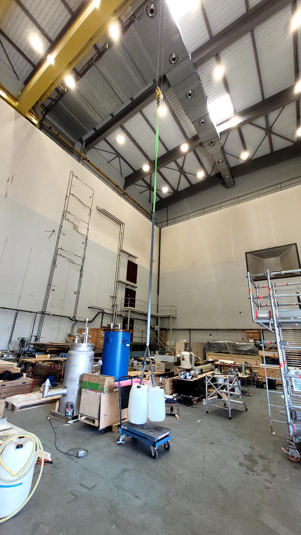
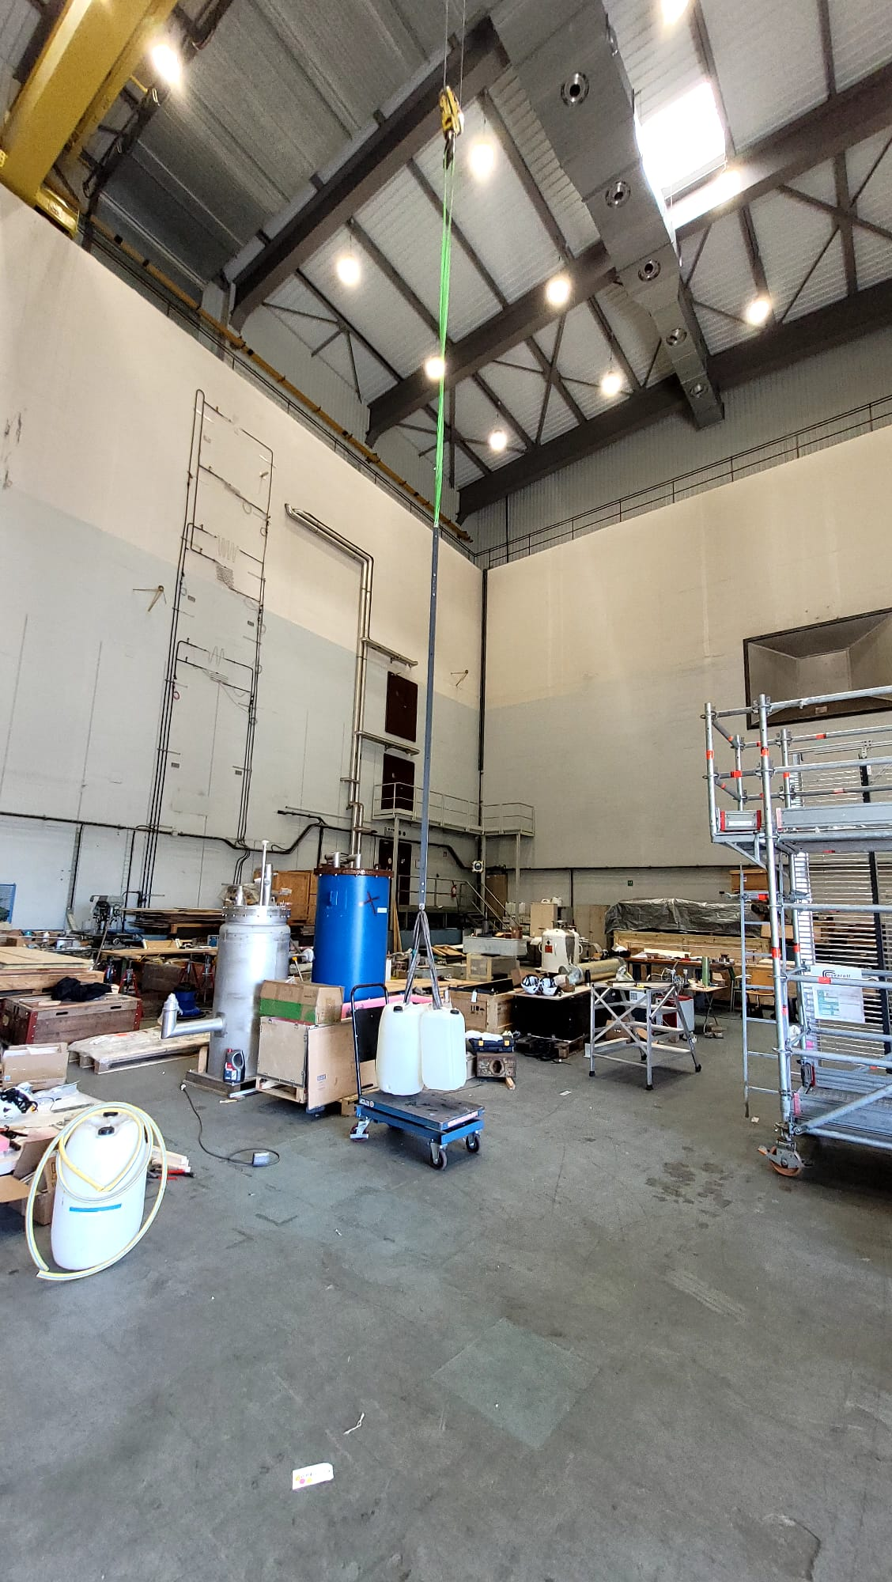
Load test spliced FRP box beams
After 15 mins

Slide 13
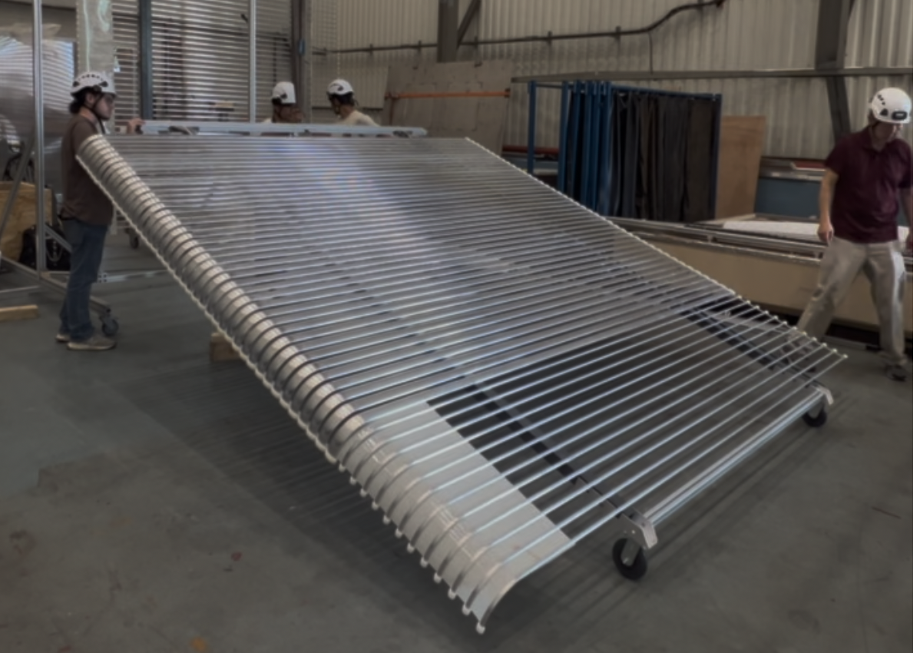
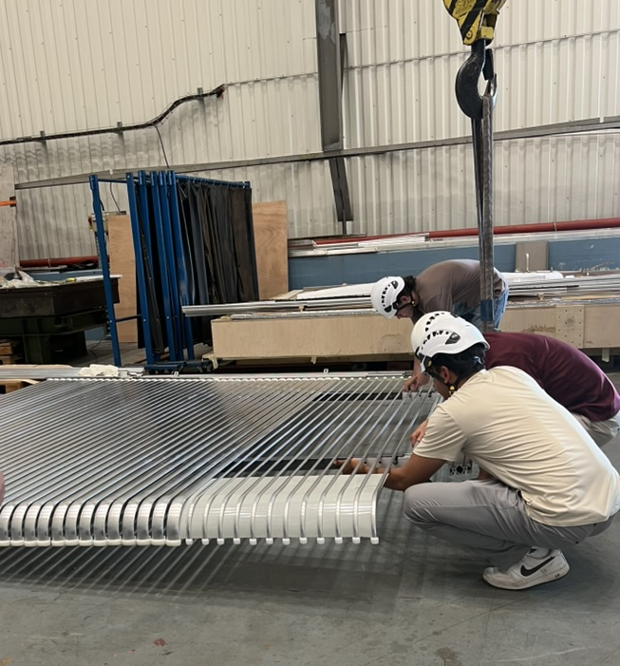
Flipping the module
Using the vertical assembly table some modules need to be build upside
down. We practiced flipping the module using a wheeled attachment

Slide 14
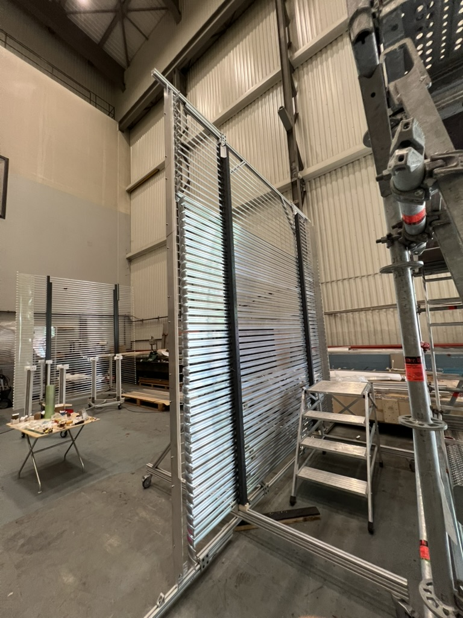
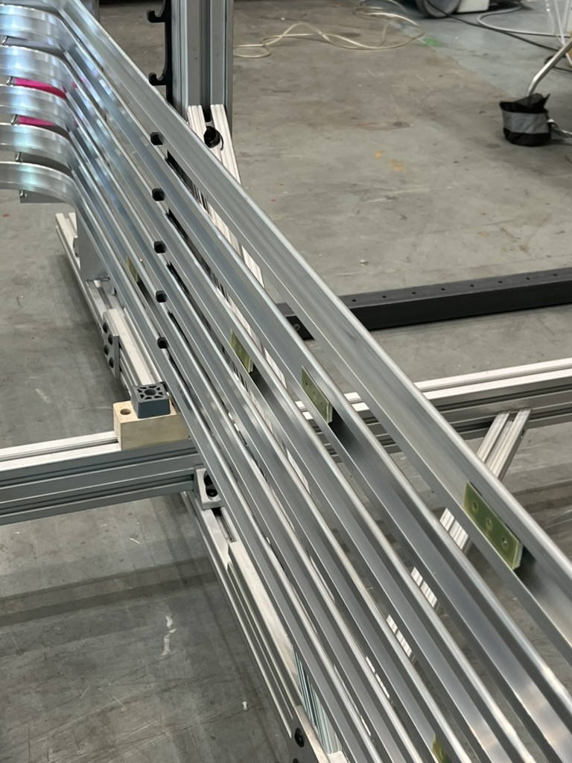
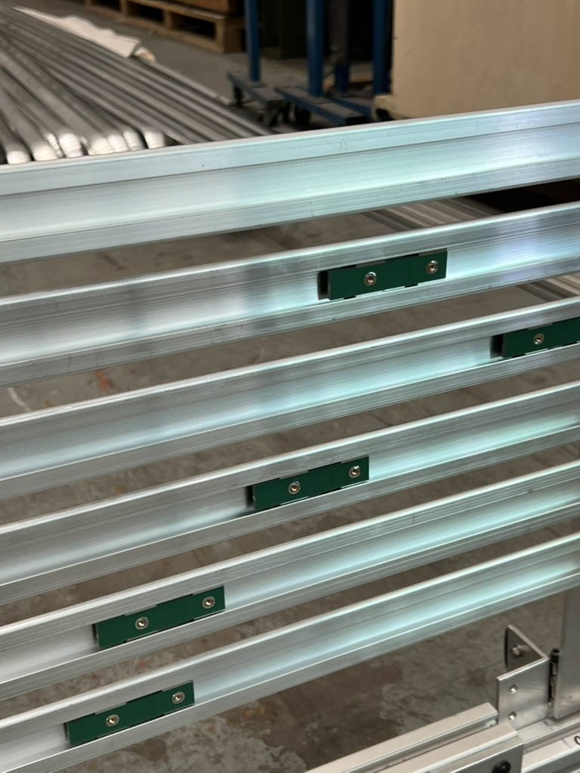
Module building: Module 2
Visual QC of profiles
Insert slip-nuts of the correct kind in the correct order
Place it on the Assembly Station
Done in 3 stages: Ground level, Stairs and Scaffolding

Slide 15
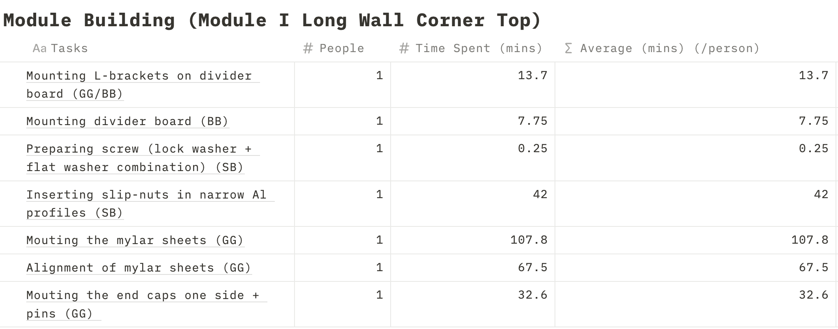
Time Cost Study

Slide 16
Time Cost Study
Full module assembly takes around 5 hours (could be improved)

