Slide 1
Analysis of MQXFA17 Vertical Test NCR
Summary of contributions from all MQXF team members
MQXFA Mtg
June 4, 2024

Slide 2
Outline
Quench History
Quench Start location
Voltage Signals analysis
Strain Gauges analysis
Quench Antenna analysis
Coil 239 DRs and Fabrication data
MQXFA17 Assembly data and NCRs

Slide 3
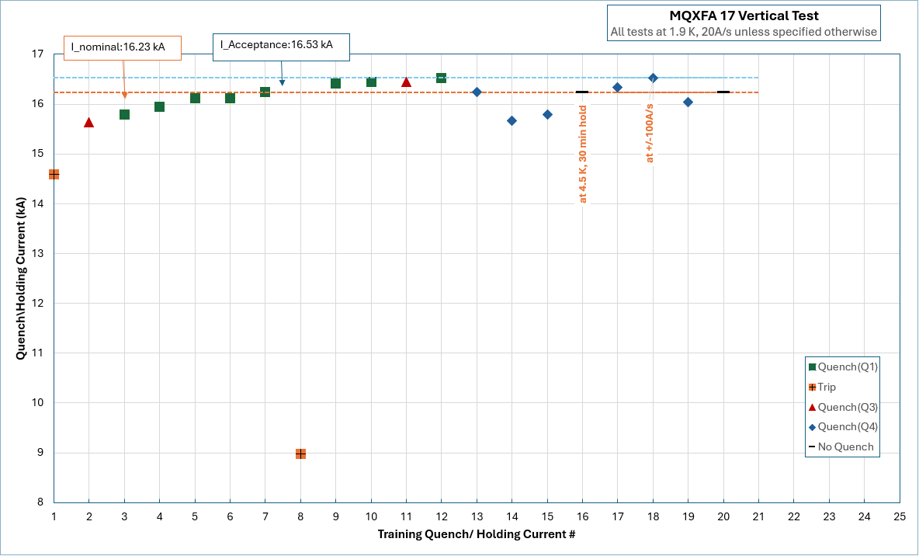
Quench History

Slide 4
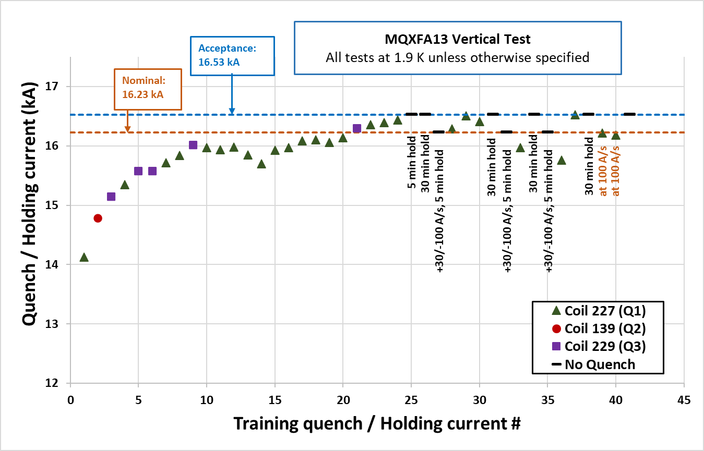
Quench History

Slide 5
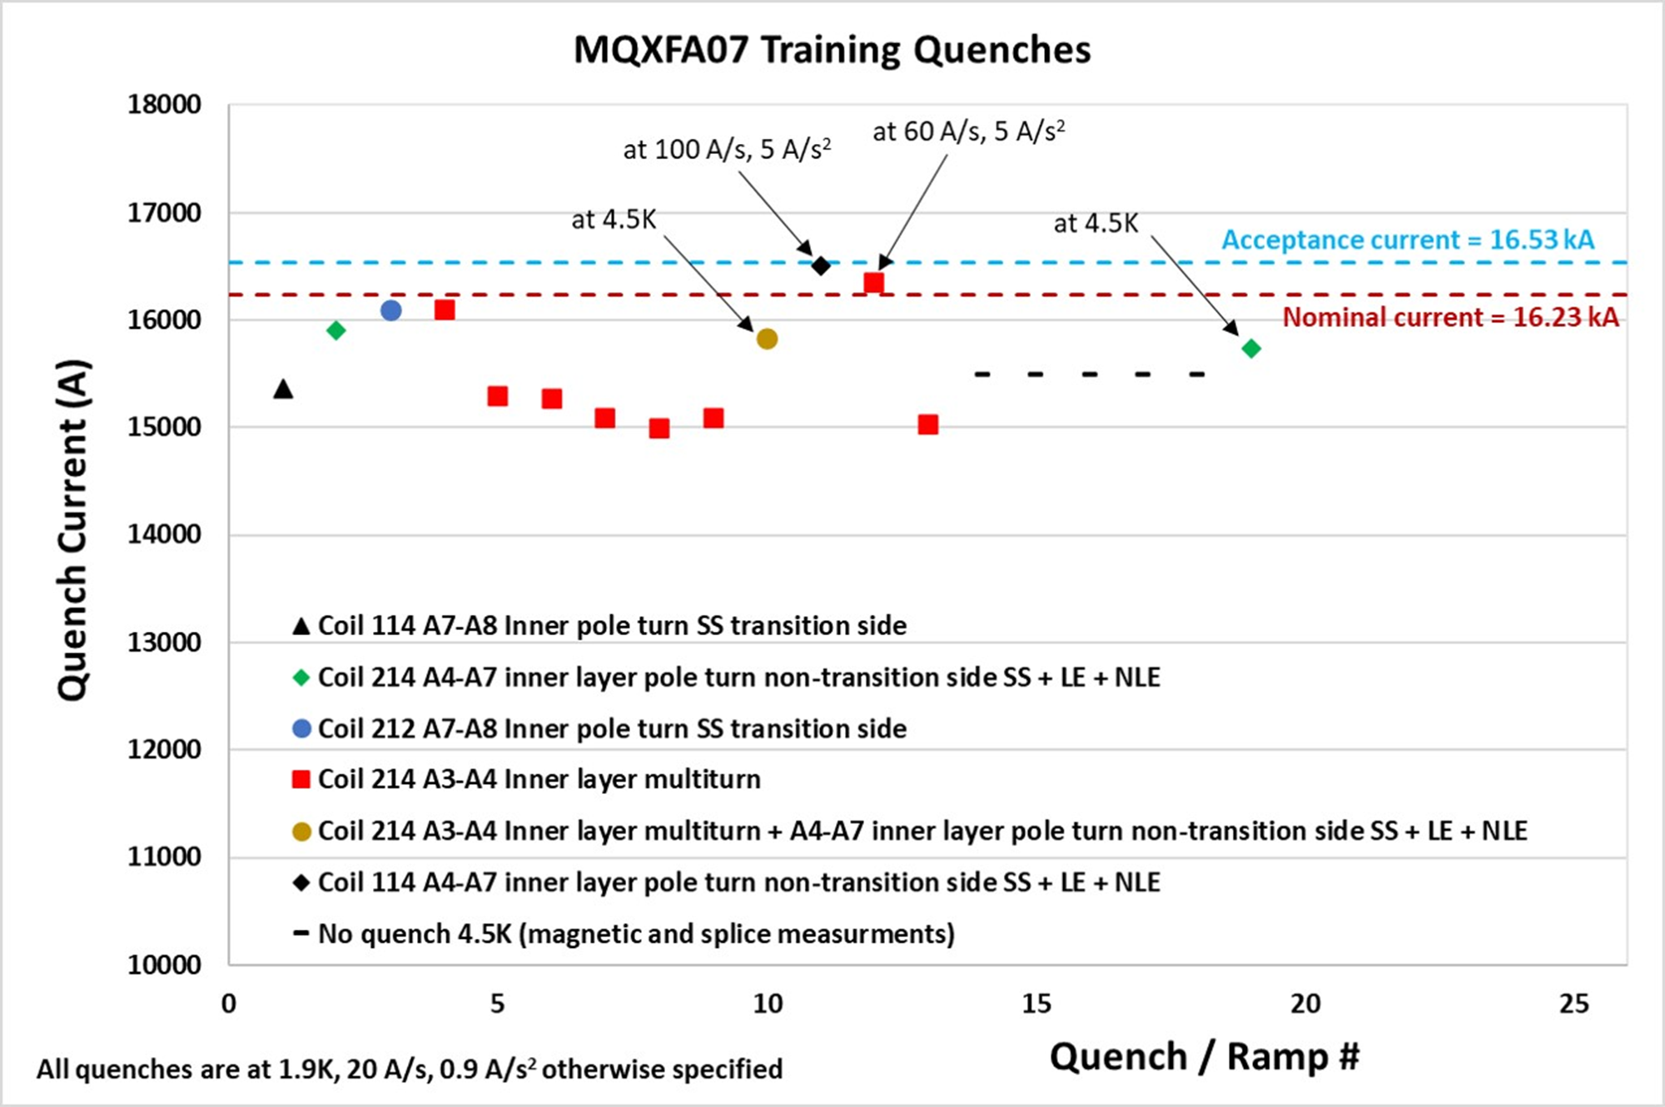

Slide 6
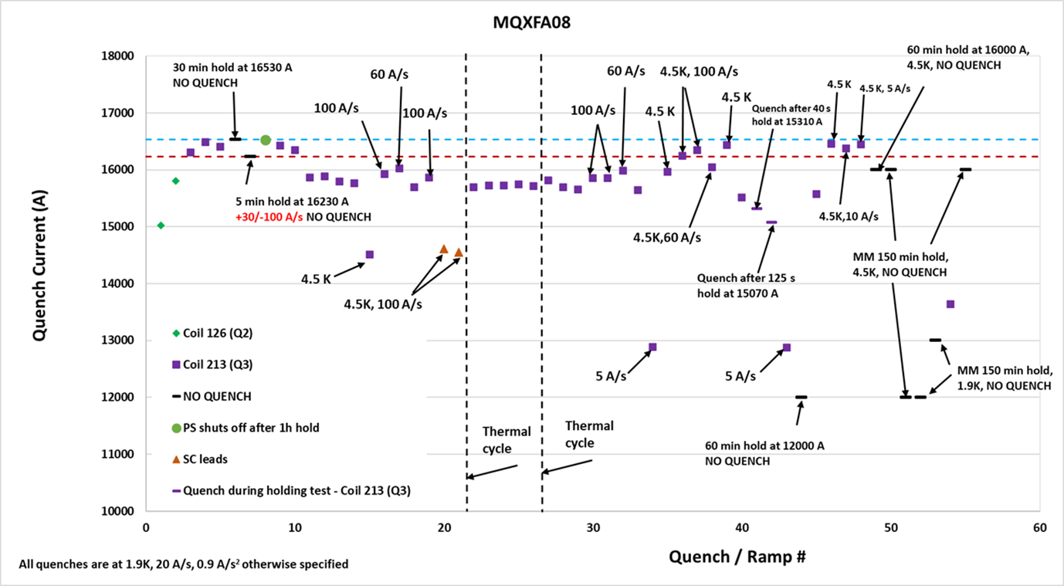

Slide 7
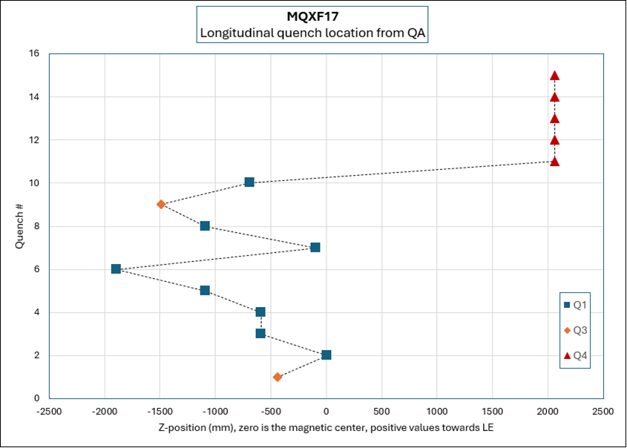

MQXFA17 Quench Location

Slide 8
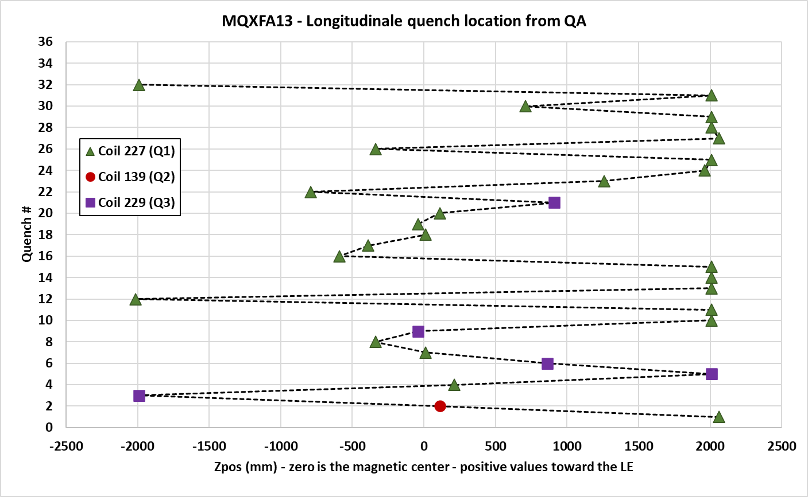
Quench Location from Quench Antenna

Slide 9
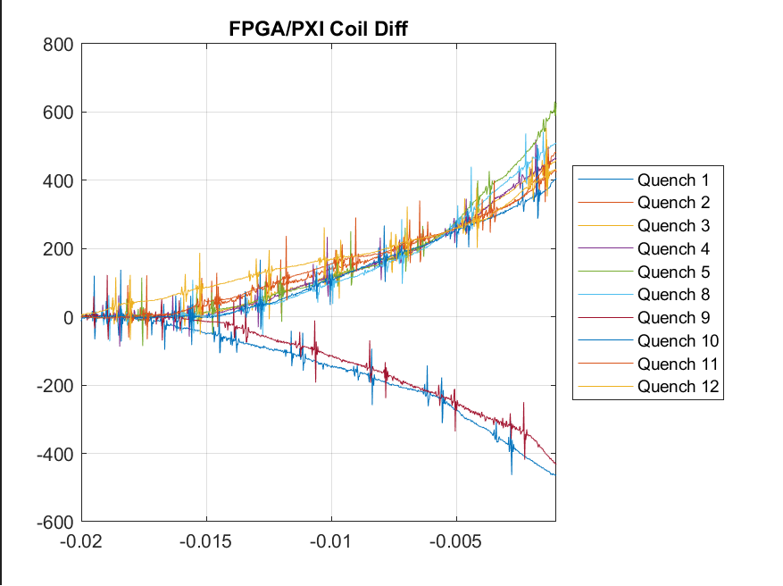
MQXFA17 Voltage Signals
(Vittorio)

Slide 10
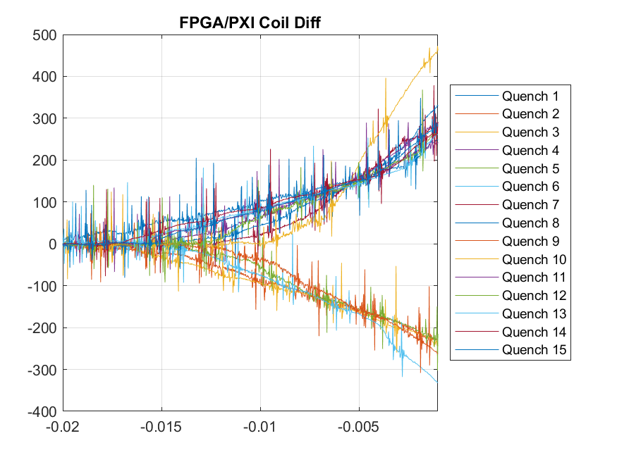
MQXFA13 Voltage Signals
(Vittorio)

Slide 11
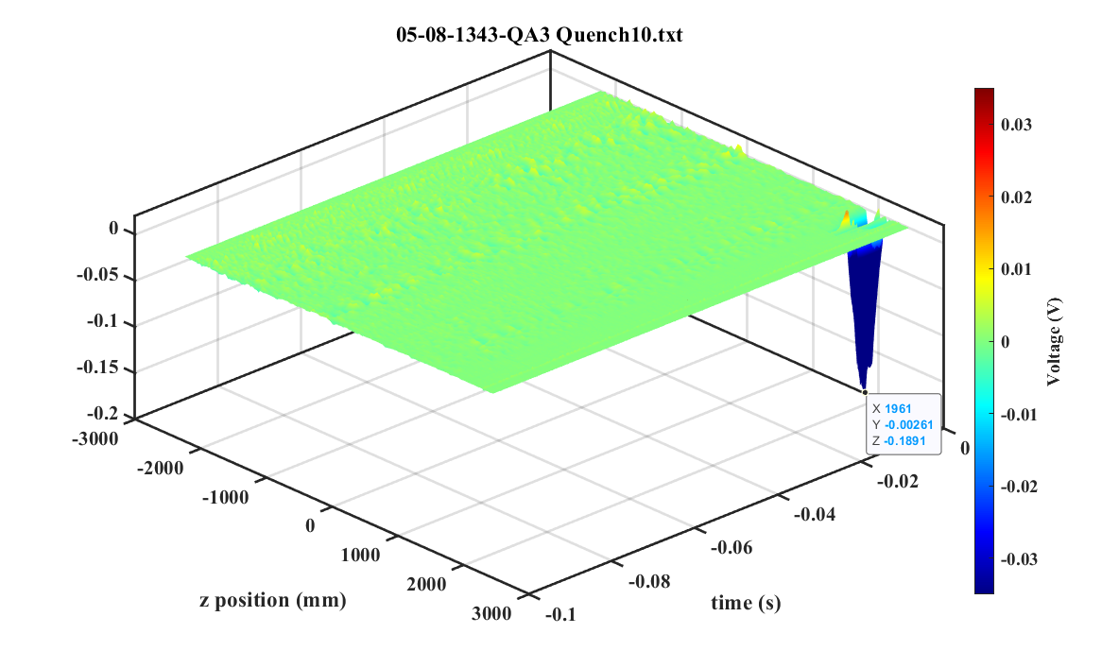
(Anis)

Slide 12
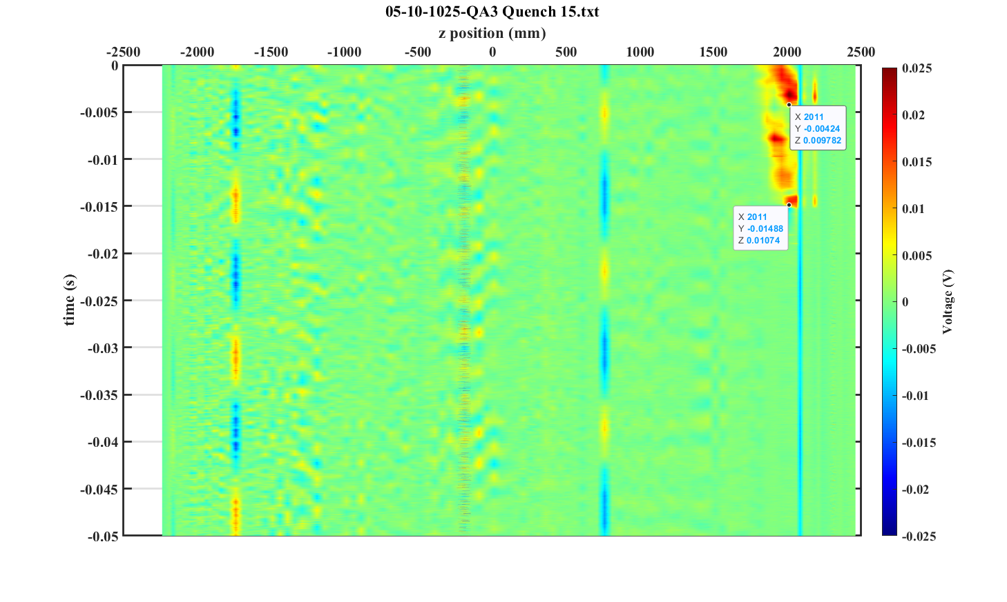
Quench 15
(Anis)

Slide 13
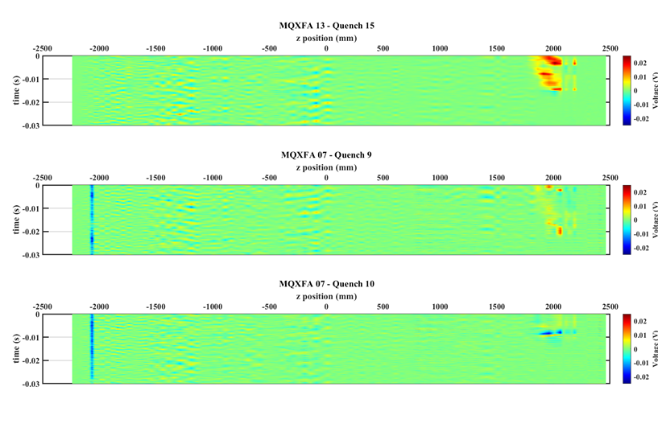
MQXFA13
MQXFA07

Slide 14
Locations on Coil 227
Coil CAD model with quench locations
  “Calibration” is in progress
(Miao)

Slide 15
Coil 239 Fabrication Data
Coil 239 Travelers and DRs are in FNAL Vector and BNL system:
  Vector link to Coil 239 Interface Travelers and DRs:
  https://vector-onsite.fnal.gov/GenerateTravelerRequest.asp?qsDocID=34203
Presented at MQXFA17 and MQXFA13b Coils Acceptance Review:
  MQXFA17 and MQXFA13b Coils Acceptance Review (October 6, 2023) · INDICO-FNAL (Indico)

Slide 16
Cable QC Summary
All cables passed the required quality control testing per US-HiLumi-Doc 74
There were No Critical DRs
No impact on coil 239

Slide 17
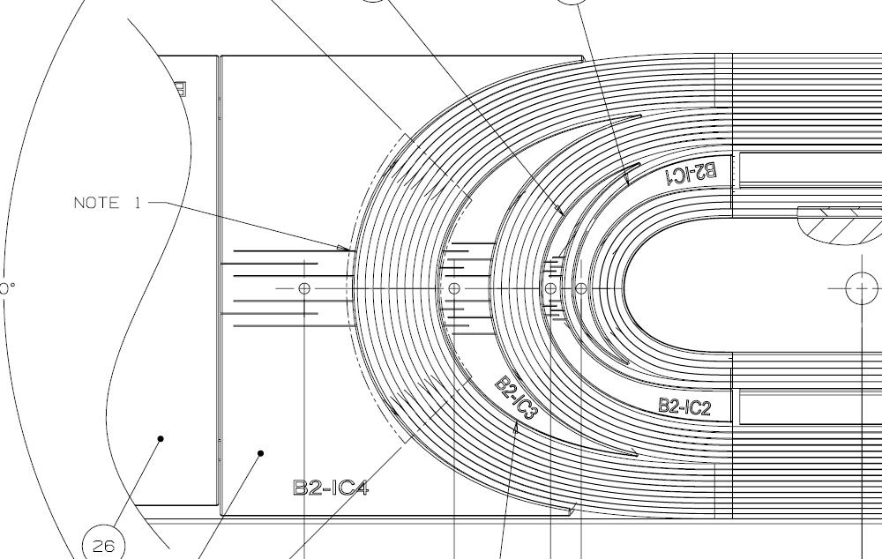
QXFA239 - DRs
DRs posted to interface traveler.
Critical = Affecting Form, Fit or Function
(as found)

Slide 18
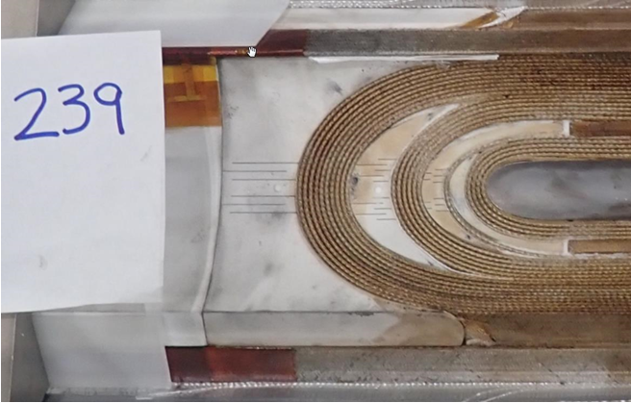

Slide 19
MQXFA17 Assembly Data and NCRs
MQXFA17 Structure and Shims Review:
  MQXFA17 Structure & Shims Review (October 18, 2023) · INDICO-FNAL (Indico)
  MQXFA17 NCRs:
    #593 – Coil 239 accelerometer issues upon arrival
    #601 – Proud pin on Coil 239 at 1365 mm from LE (modified alignment key)
MQXFA17 Specs Mtg:
  MQXFA17 Spec Meeting (March 15, 2024) · INDICO-FNAL (Indico)
  “MQXFA17 load keys are smaller than target because a coil reached 120 MPa” (Paolo)
MQXFA17 Fabrication Report:
  US-HiLumi-doc-5151
  Critical NCR for Overheated splice
  Critical NCR caused axial-preload unloading twice

Slide 20
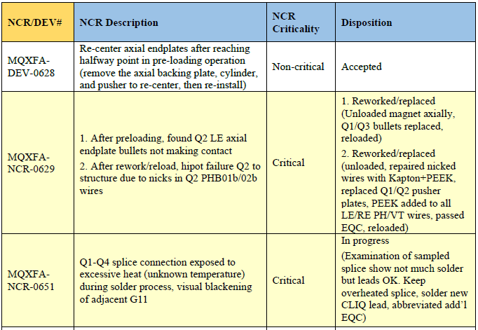
MQXFA17 Critical NCRs

Slide 21
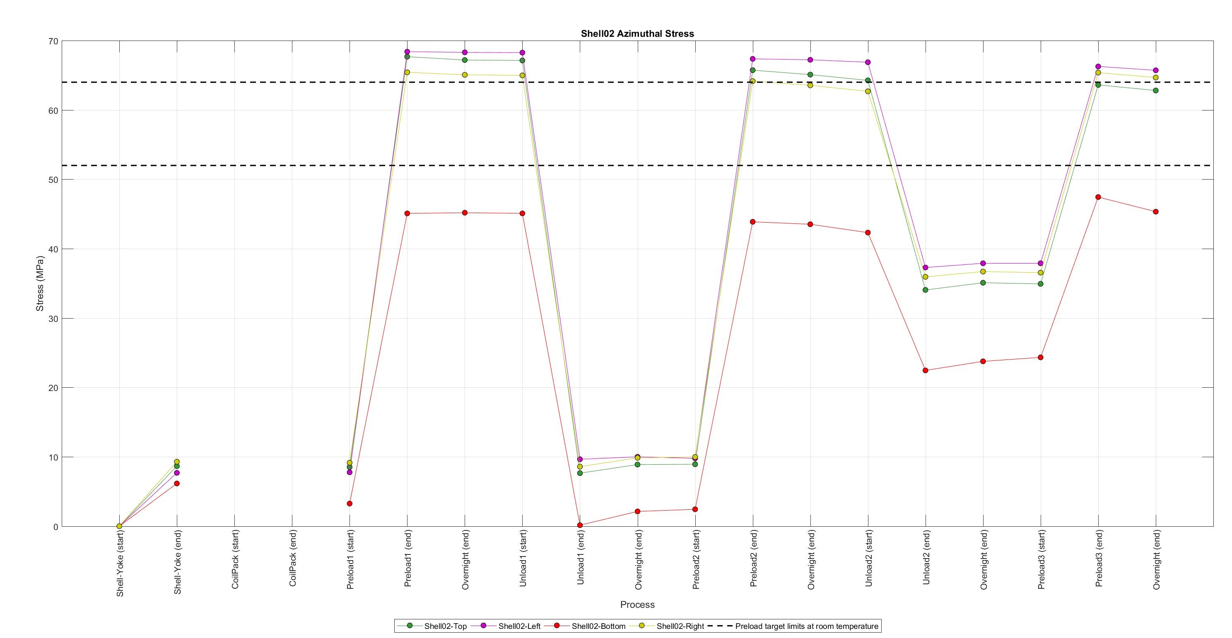
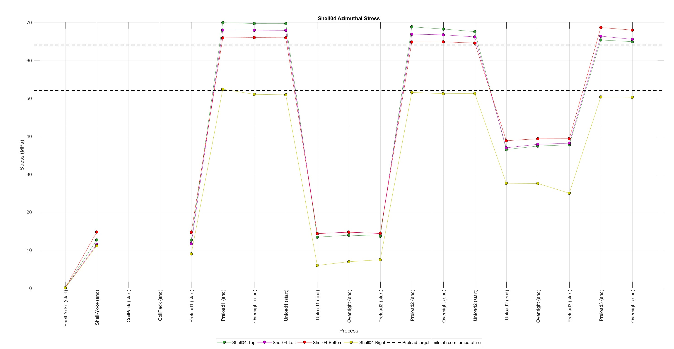
Magnet assembly and loading
Specifications (shells)

Slide 22
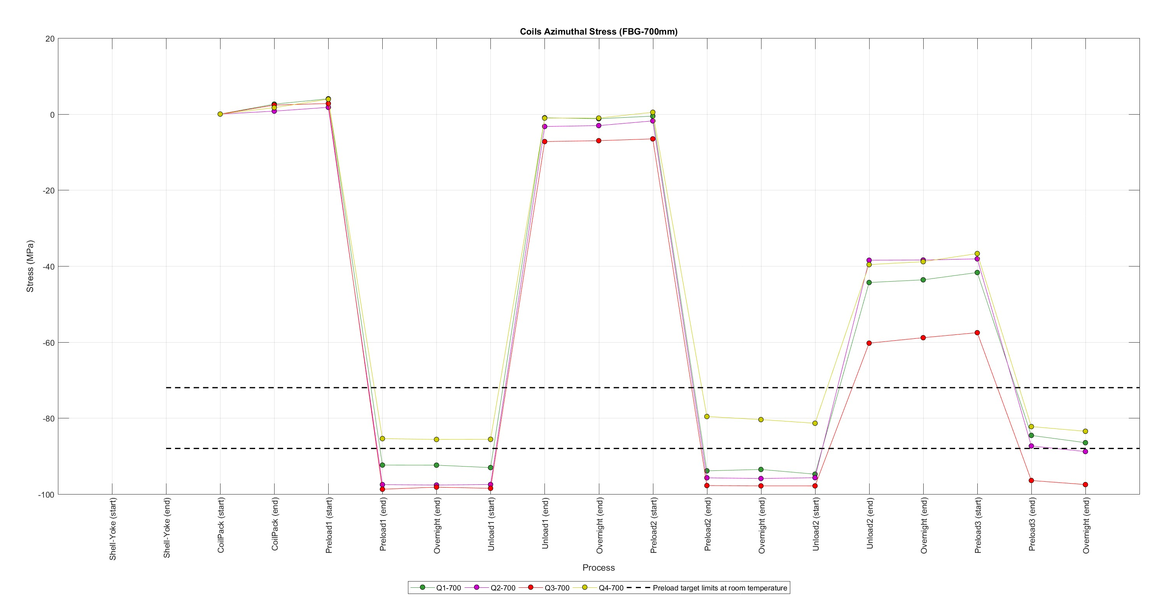
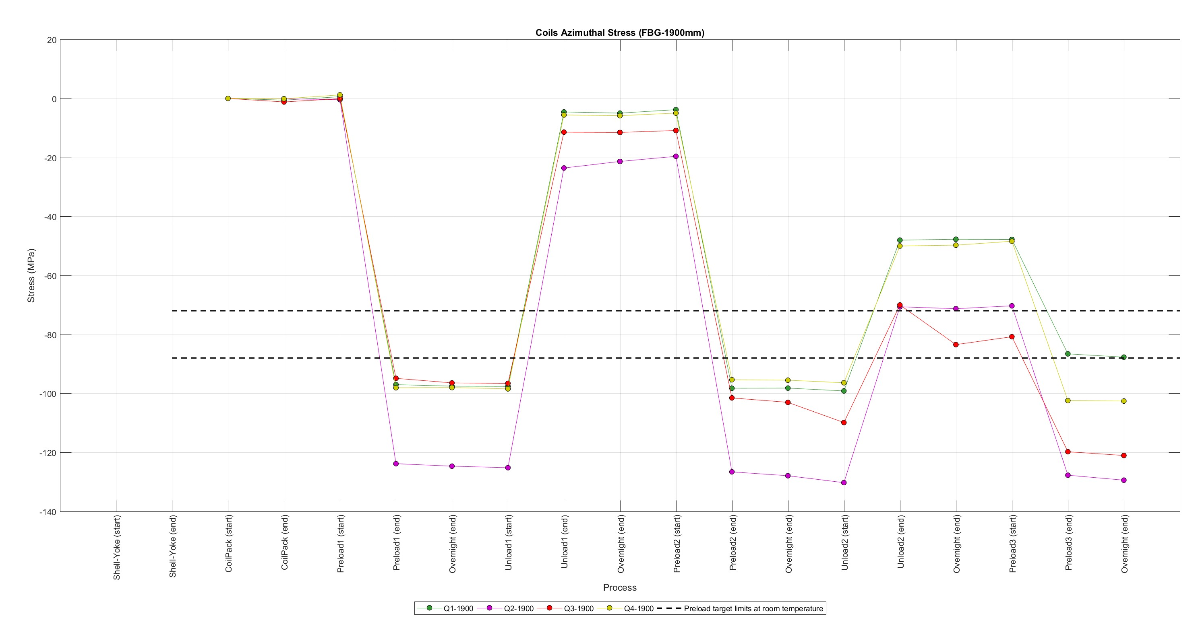
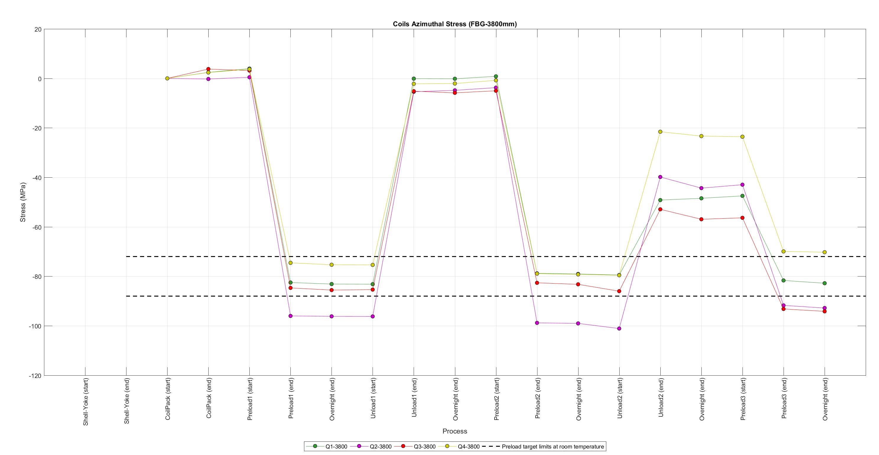
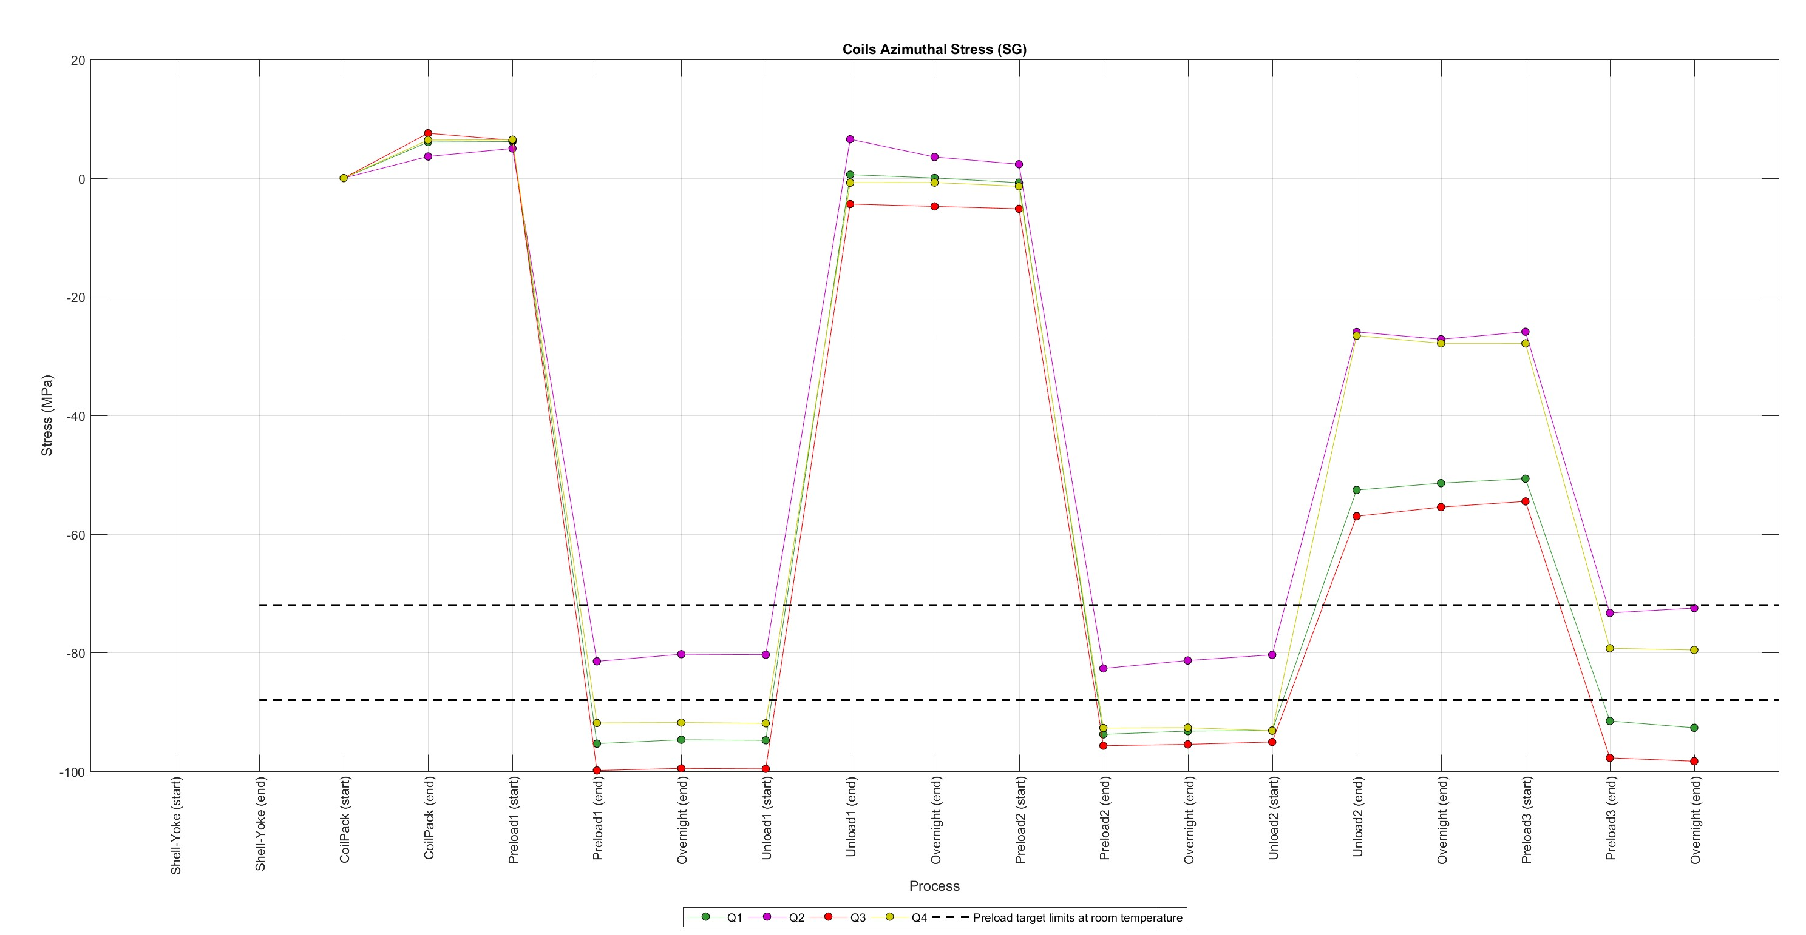
Magnet assembly and loading
Specifications (coils)
FBG @ 700 mm
FBG @ 1900 mm
FBG @ 3800 mm
SG

Slide 23
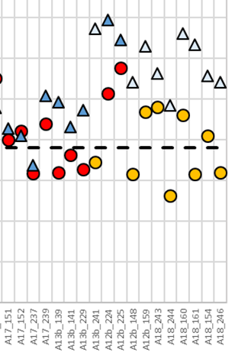
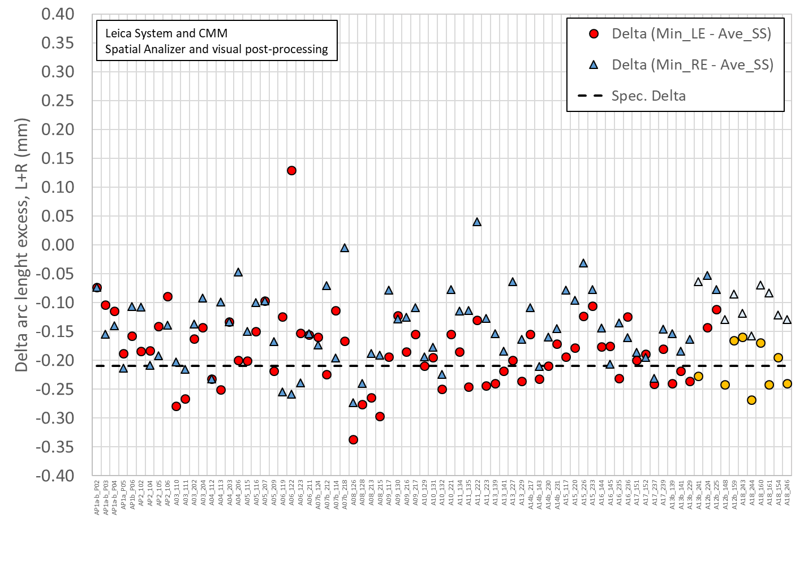
Delta between arc length excess straight section and spacer-wedge transition
Red & dark blue markers: measured at 207 mm and 4426 mm
Orange & light blue markers: measured at 260-300 mm and 4340-4380 mm

Slide 24
Target loading key shim
For final loading key shim size reached during the pre-load operations, the following target is set:
At the end of the pre-loading operation, the sum of the loading shim size and the coil-pack radial dimension deviations in straight section, LE and RE shall be within the range achieved in magnets MQXFA14b and MQXFA05
  If, with such load key shim, the coil stress measured in 2+ strain gauges at the end of the loading or during bladder inflation is above the coil stress spec., priority should be given to keeping the coil stress within the specs.

Slide 25
Summary and proposal
 | Ave ss | Key | Shim | Shim | Ave ss + shim
 | mm | mm | mils | mm | mm
A17 up | -0.004 | 13.84 | 43 | 1.092 | 1.088
A17 low | -0.004 | 13.77 | 40 | 1.016 | 1.012
 | LE | Key | Shim | Shim | LE + shim
 | mm | mm | mils | mm | mm
A17 up | -0.134 | 13.84 | 43 | 1.092 | 0.959
A17 low | -0.134 | 13.77 | 40 | 1.016 | 0.882
 | RE | Key | Shim | Shim | RE + shim
 | mm | mm | mils | mm | mm
A17 up | -0.125 | 13.87 | 44 | 1.118 | 0.992
A17 low | -0.125 | 13.82 | 42 | 1.067 | 0.941
Proposed target
  Aiming at a shim of 42 mils, with the possibility of going to 42-44 mils depending on SG data

Slide 26
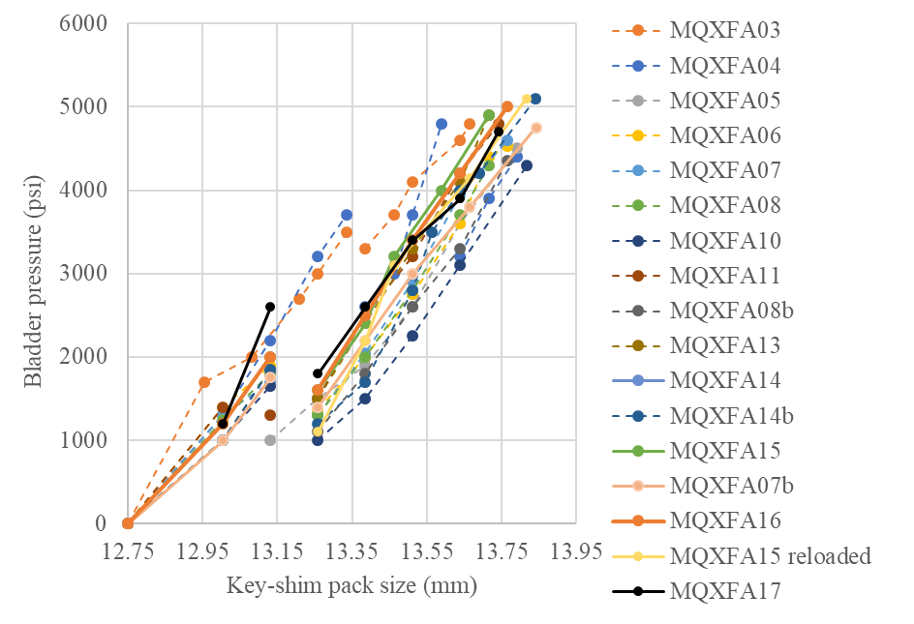
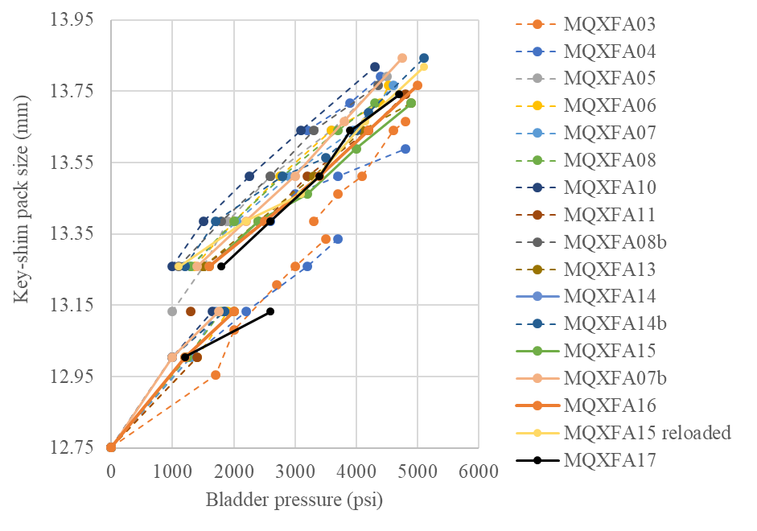
Key-shim size vs. bladder pressure

Slide 27
Magnet assembly and loading
Specifications (coils)
For the maximum stress reached during the pre-load operations:
  During the entire pre-load operation, the maximum compression measured on each coil shall never exceed -120 MPa
Peak stress on coils (MPa)
Electrical SGs
CQ1 | CQ2 | CQ3 | CQ4
-110 | -91 | -120 | -100
FBGs
CQ1-700 | CQ2-700 | CQ3-700 | CQ4-700 | CQ1-1900 | CQ2-1900 | CQ3-1900 | CQ4-1900 | CQ1-3800 | CQ2-3800 | CQ3-3800 | CQ4-3800
-86 | -89 | -98 | -83 | -88 | -129 | -121 | -103 | -83 | -93 | -94 | -70

Slide 28
Magnet assembly and loading
Specifications (shells)
For the pre-load targets at the end of the pre-load:
  The target average measured stress on coils, shells and rods at the end of the loading (after at least 24 h) shall be
    Shell average azimuthal stress: +58 ±6 MPa
Channel | SC02TT | SC02RT | SC02BT | SC02LT | Average
Preload (end) | 64 | 65 | 47 | 66 | 61
Overnight (end) | 63 | 65 | 45 | 66 | 60
Channel | SC04TT | SC04RT | SC04BT | SC04LT | Average
Preload (end) | 65 | 50 | 69 | 66 | 63
Overnight (end) | 65 | 50 | 68 | 65 | 62
Channel | SC07TT | SC07RT | SC07BT | SC02LT | Average
Preload (end) | 61 | 67 | 71 | 66 | 66
Overnight (end) | 60 | 67 | 71 | 65 | 66

Slide 29
Magnet assembly and loading
Specifications (coils)
For the pre-load targets at the end of the pre-load:
  The target average measured stress on coils, shells and rods at the end of the loading (after at least 24 h) shall be
    Coil (winding pole) average azimuthal stress: -80 ±8 MPa
Channel | CQ1T | CQ2T | CQ3T | CQ4T | Average
Preload (end) | -92 | -73 | -98 | -79 | -86
Overnight (end) | -93 | -72 | -98 | -80 | -86

Slide 30
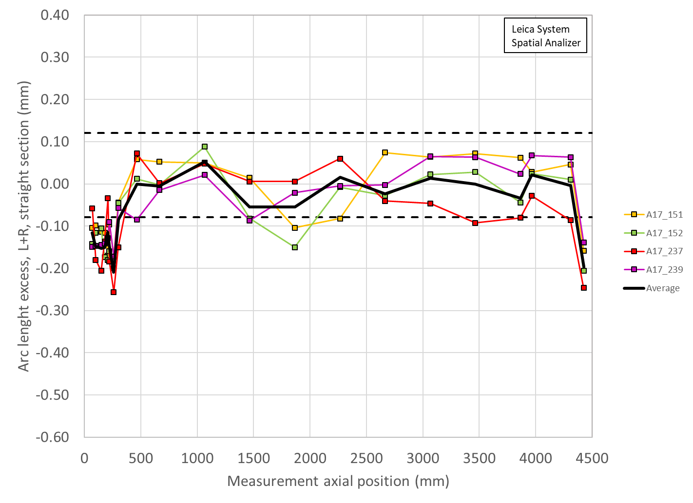
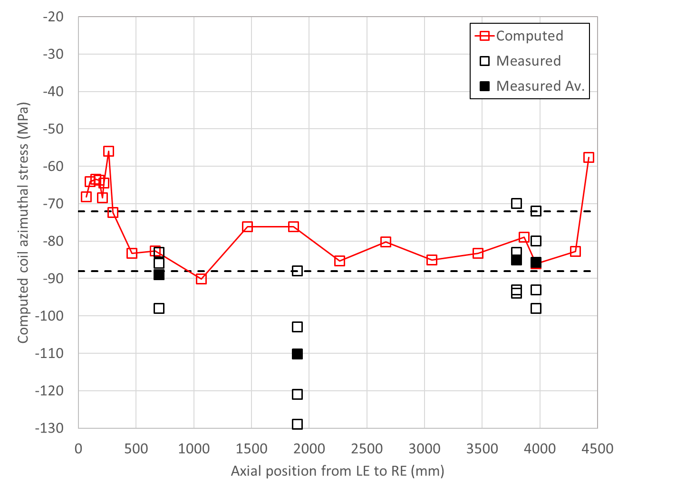
A17
Coil arc length and coil stress measurements
Av straight section = -0.006 mm (465-4310 mm)
Min LE = -0.210 mm (260-300 mm)
Min RE = -0.197 (4426 mm)
Computed on SG loc = SG data

Slide 31
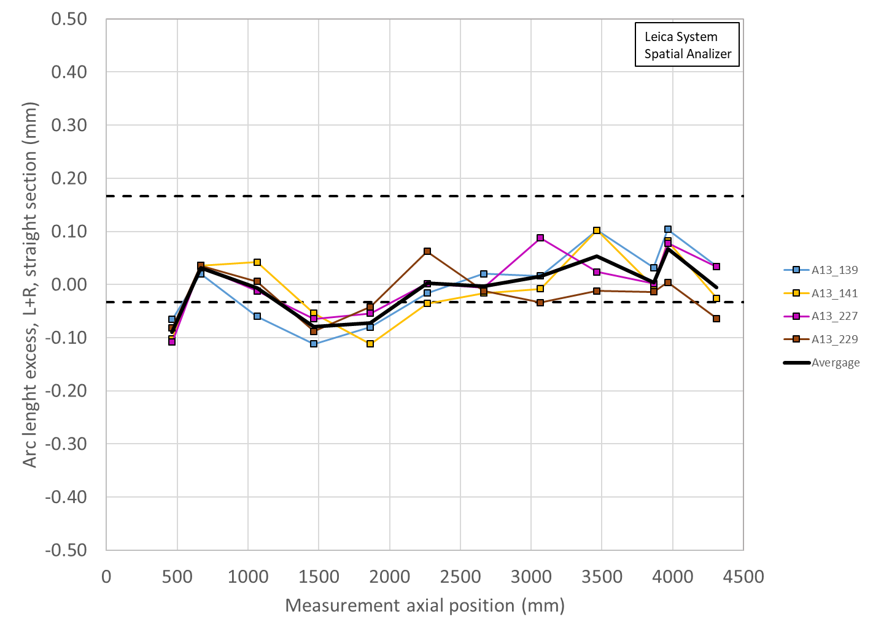
Coil arc length shimmed
A13

Slide 32
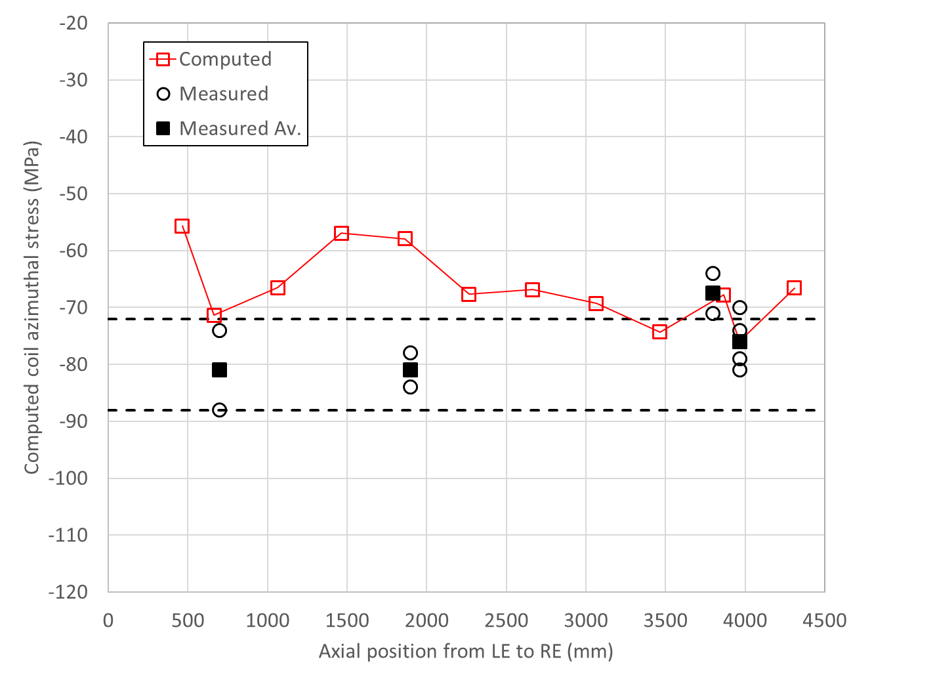
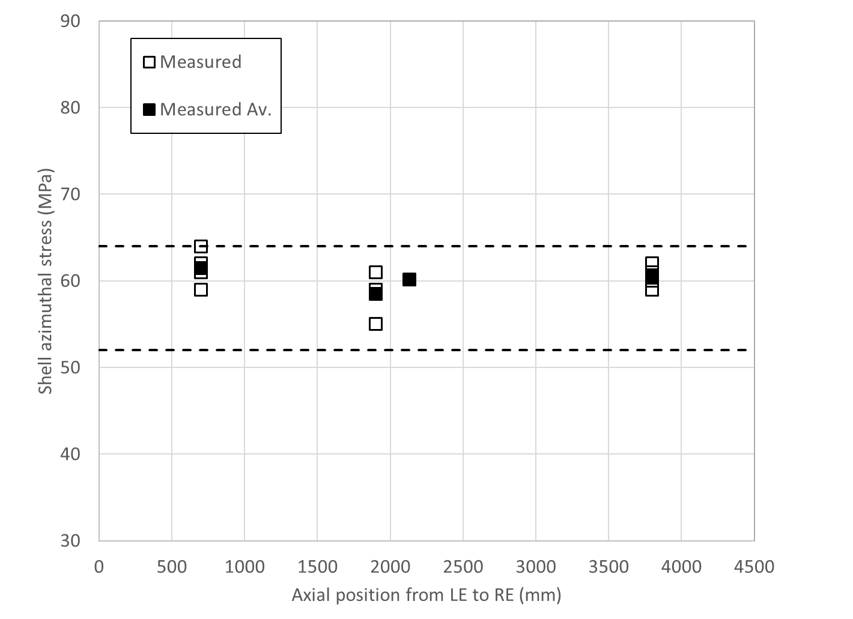
Coil and shell stress A13
Measured and computed (based on arc length shimmed)
SG at 3965 mm
FPG at 700 mm
FPG at 1900 mm
FPG at 3800 mm

Slide 33
MQXFA17 Strain Gauge Data
Strain Gauge data analyzed by Dan
Small anomaly: Kink in axial rod (Q1) at low current

Slide 34
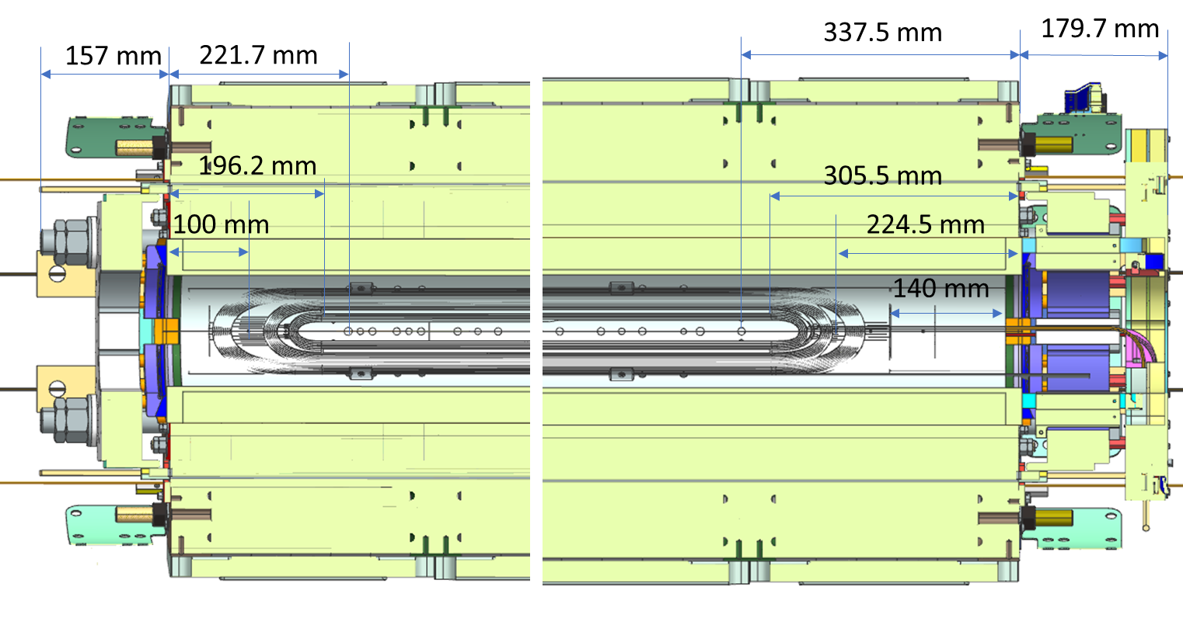
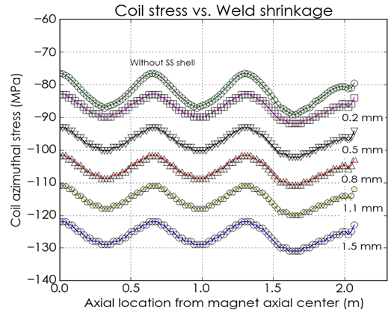
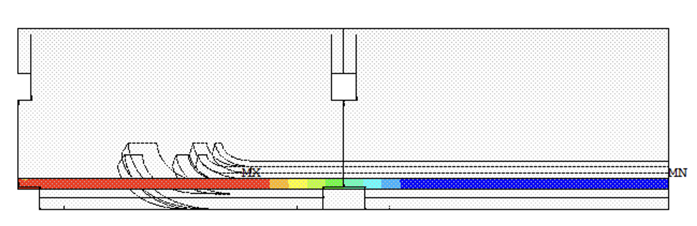
Lead End vs Return End

Slide 35
Iron to Stainless Steel

Slide 36
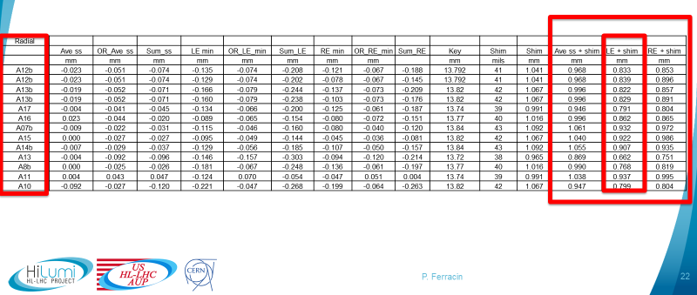

Slide 37
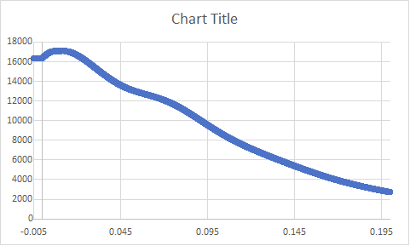
CLIQ
CLIQ add current to coils in Q2 and Q4
  ➔ shorter training in these coils
  Possible higher risk of damage in these coils during quench above nominal current?
  (Stoyan and Sandor)
Magnet 13, quench 22, current in Q2/Q4:
CLIQ boost based on 14126 A (quench 1 current) and peak current of 15000 A : 874 A
CLIQ boost based on 16362 A (quench 22 current) and peak current of 17106 A : 744 A

Slide 38
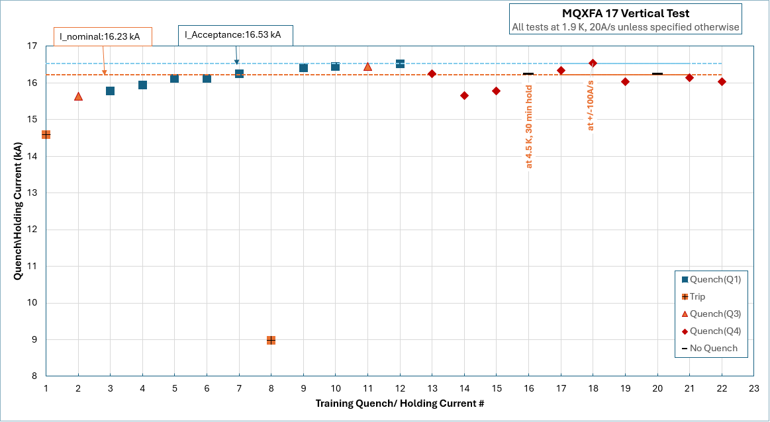

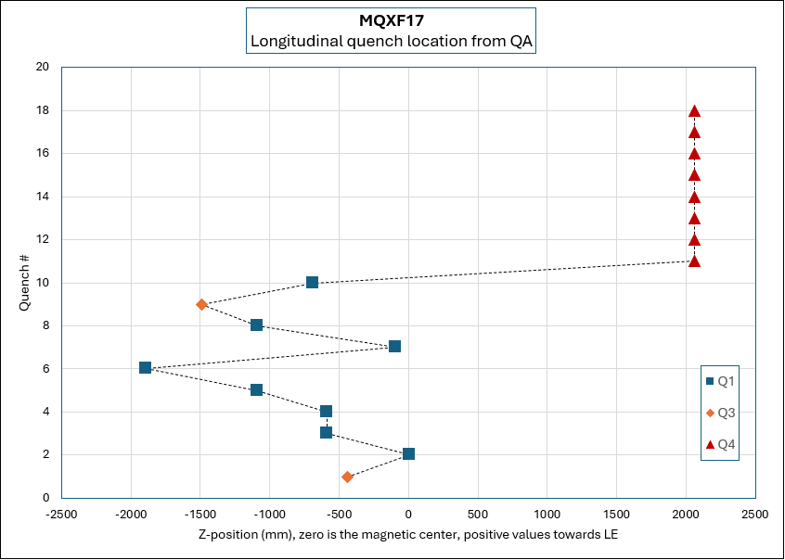
Delta I = - 283 A
Q4 coil

Slide 39
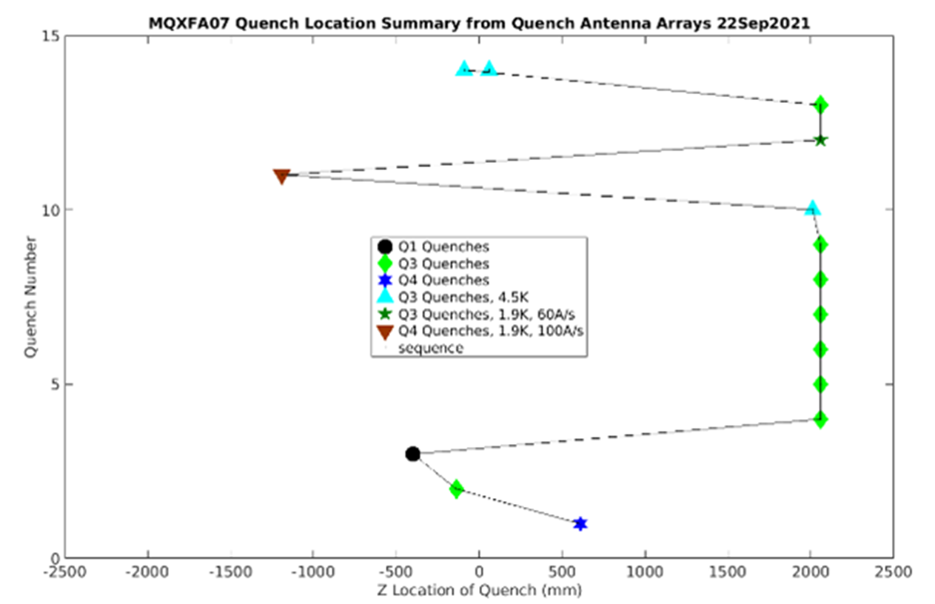
Delta I = - 7 A
Q3 coil

Slide 40
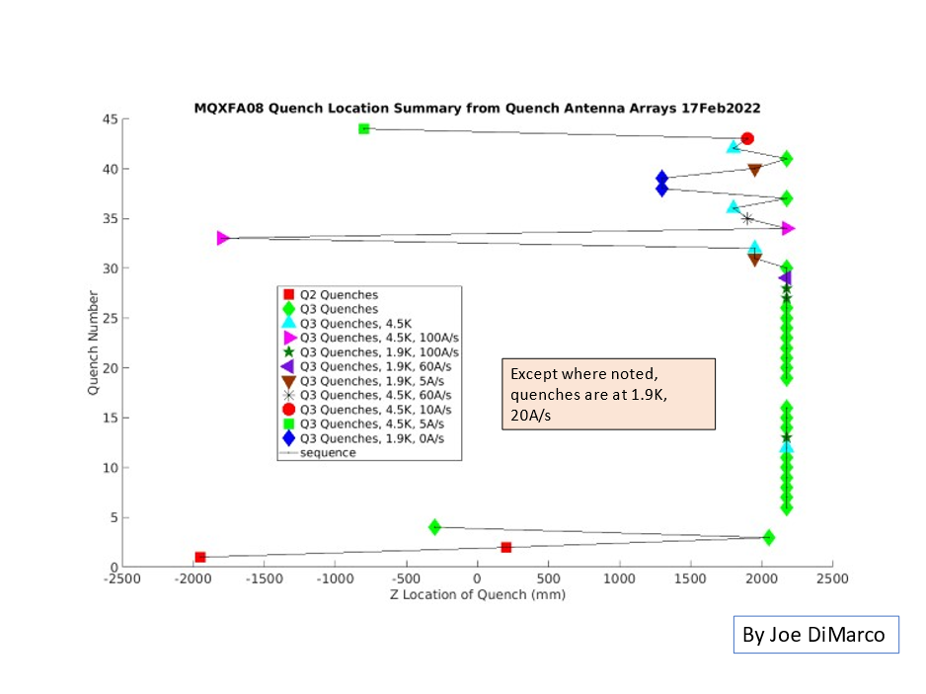
Delta I = - 80 A
Q3 coil

Slide 41
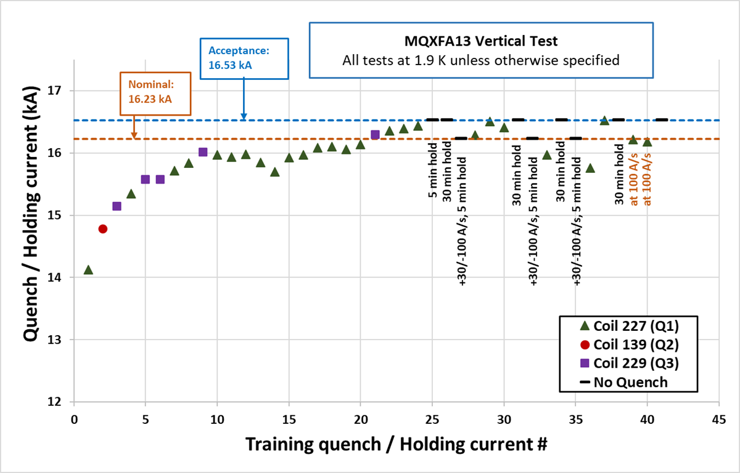
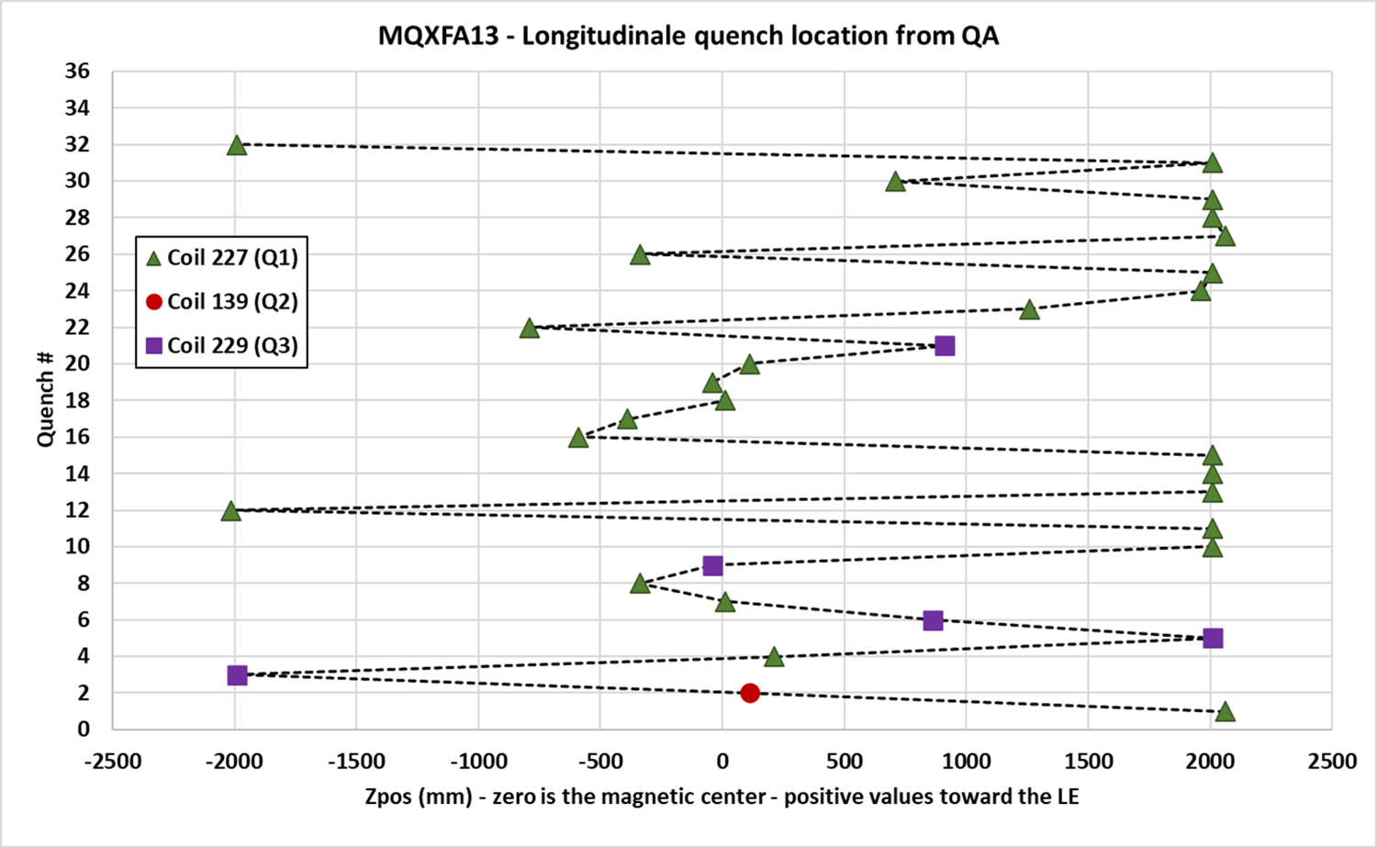
Delta I = - 45 A
Q1 coil

Slide 42
Magnet | Quadrant | # previous quenchs at higher current | Delta current wrt last previous quench (A) | Previous quenches in same coil & close-by position | All previous quenches in same coil
MQXFA17 | Q4 | 4 | -283 | 0 | 0
MQXFA07 | Q3 | 0 | -7 | 0 | 1
MQXFA08 | Q3 | 1 | -80 | 1 | 2
MQXFA13 | Q1 | 1 | -45 | 1 | 4

Slide 43
Coils in MQXFA magnets
 |  | CLIQ + |  | CLIQ + |  |  | Lead End arc length + loading shim
Magnet | Q1 | Q2 | Q3 | Q4 |  |  | mm
MQXFA03 | 204 | 110 | 202 | 111
MQXFA04 | 203 | 113 | 206 | 112
MQXFA05 | 207 | 116 | 209 | 115 |  |  | 0.862 | Passed endurance test
MQXFA06 | 122 | 119 | 211 | 123
MQXFA07 | 212 | 124 | 214 | 114 |  |  | Closed pole-key gaps
MQXFA07b | 212 | 124 | 218 | 114 |  |  | 0.932
MQXFA08 | 215 | 126 | 213 | 128 |  |  | Closed pole-key gaps
MQXFA08b | 215 | 126 | 219 | 128 |  |  | 0.768 | 750-800 range
MQXFA10 | 132 | 221 | 131 | 129 |  |  | 0.799 | 750-800 range
MQXFA11 | 223 | 222 | 134 | 135 |  |  | 0.937
MQXFA13 | 227 | 139 | 229 | 141 |  |  | 0.662 | lower than 700
MQXFA14b | 217 | 230 | 143 | 231 |  |  | 0.907
MQXFA15 | 233 | 226 | 220 | 117 |  |  | 0.922
MQXFA17 | 151 | 237 | 152 | 239 |  |  | 0.791 | 750-800 range
MQXFA13b | 150 | 139 | 229 | 141 |  | NOT tested yet
MQXFA16 | 144 | 235 | 145 | 236 |  | NOT tested yet
MQXFA12b | 224 | 159 | 225 | 148 |  | NOT tested yet

Slide 44
Back-up Slides

Slide 45
Summary for MQXFA13
No major DRs/NCRs
Coil 227 has the smallest arc length among tested coils, although it was shimmed
It has also a small arc length in the lead end, similarly to other coils that met requirements
MQXFA13 had small key shims, similarly to other magnets that met requirements

Slide 46
Change to MQXFA Series Magnet Production Specification (-110 MPa peak stress during loading)
Paolo Ferracin, G. Ambrosio, Dan Cheng, Laura Garcia Fajardo, Giorgio Vallone
on behalf of the MQXF collaboration
AUP Meeting
LBNL, USA
July 21st, 2023

Slide 47
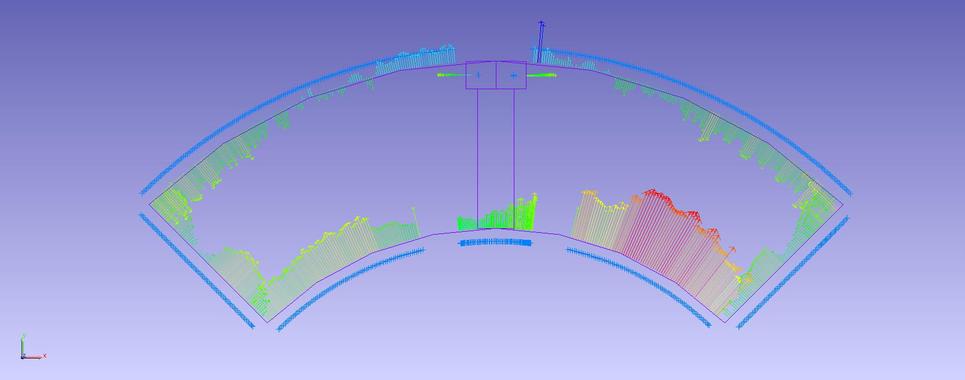
Arc length excess

Slide 48
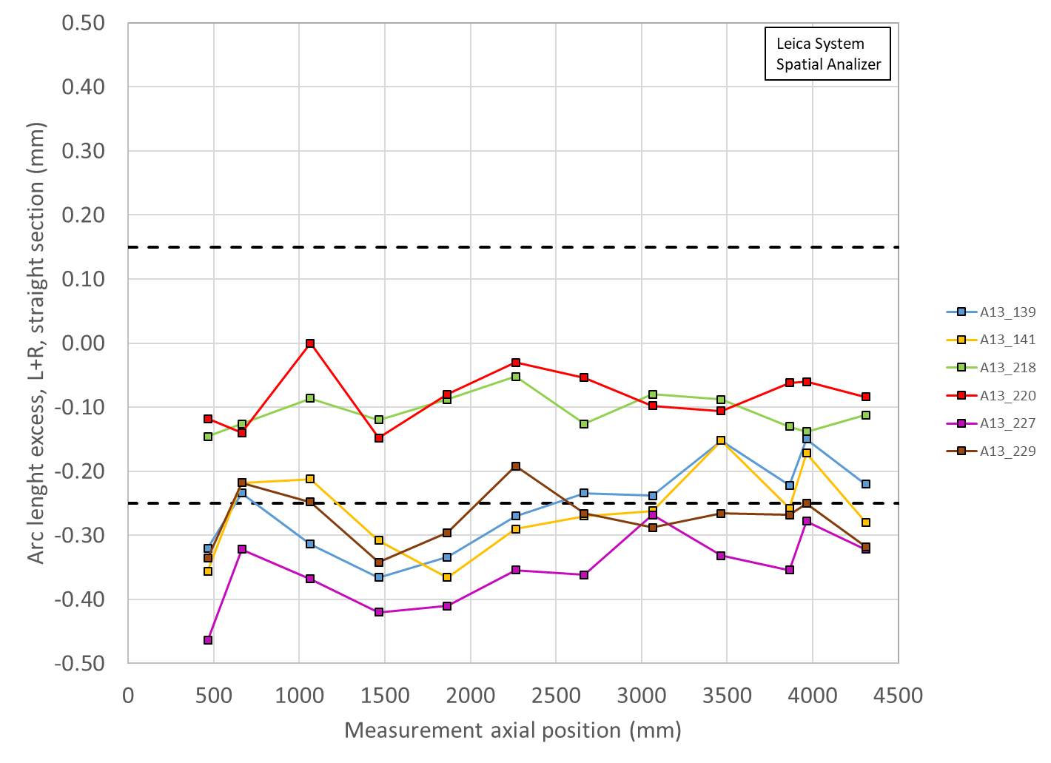
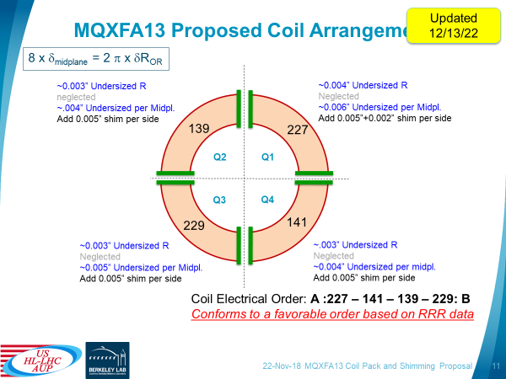
A13 coil size: unshimmed vs shimmed

Slide 49
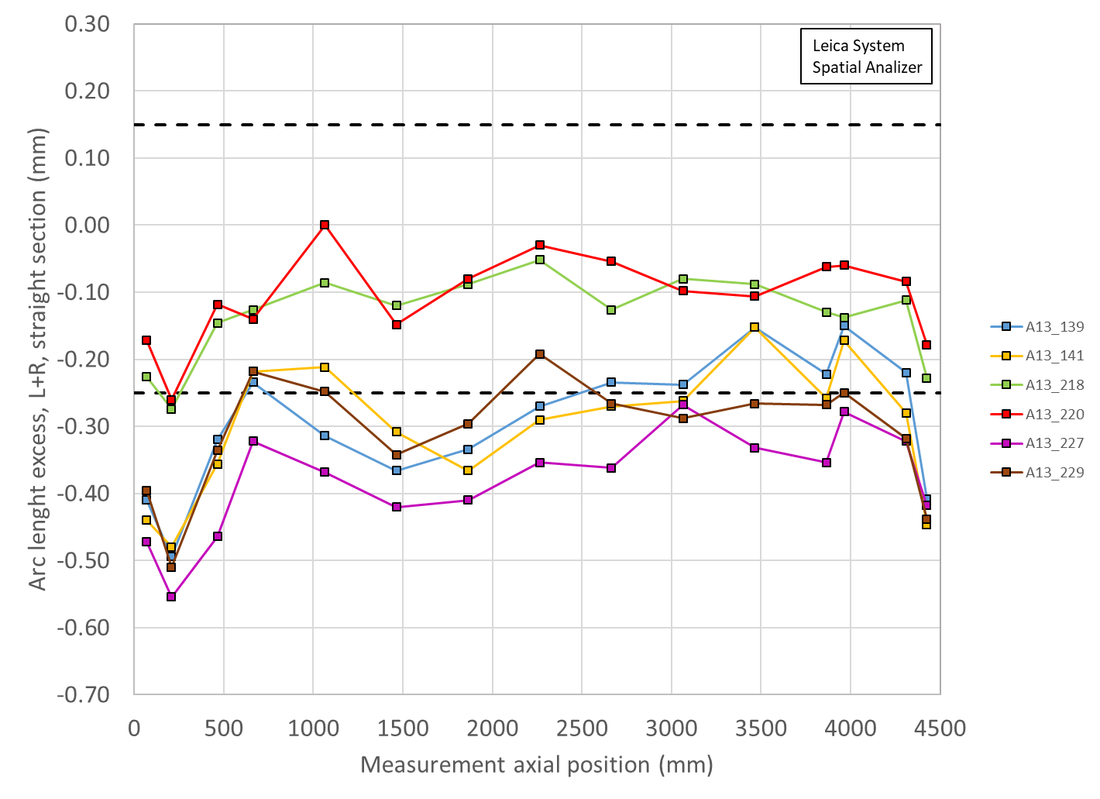
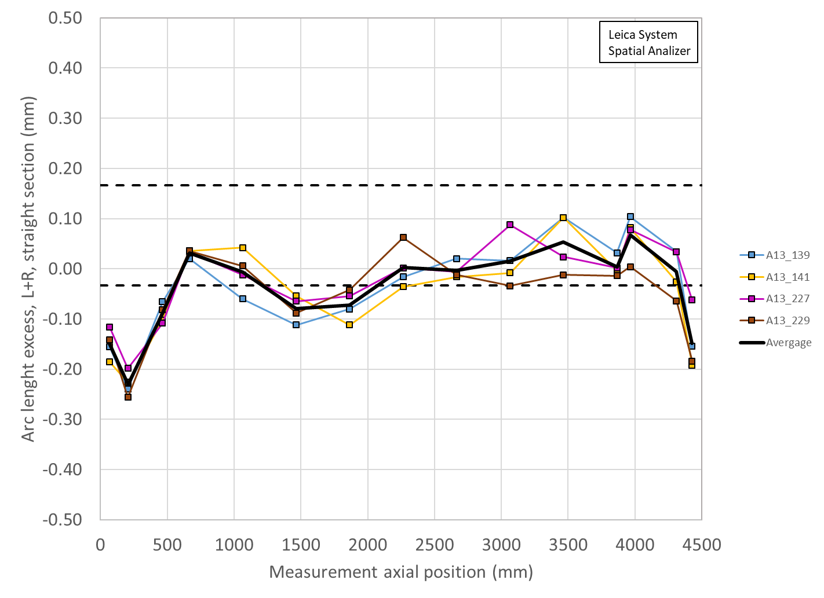
A13 coil size: unshimmed vs shimmed
Including ends

Slide 50
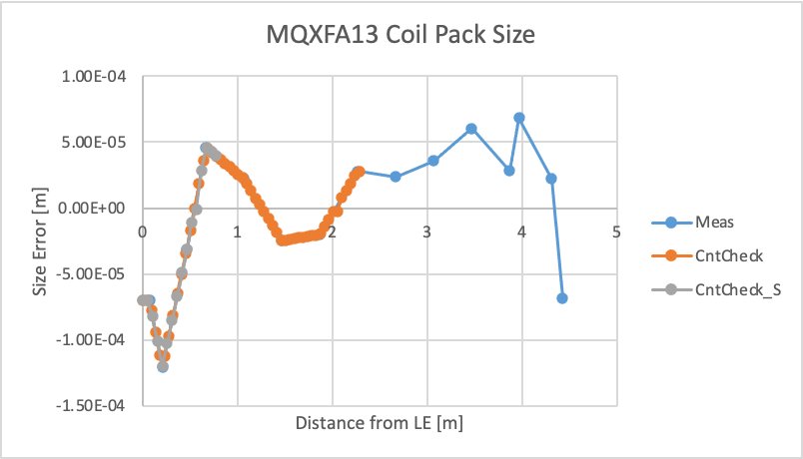
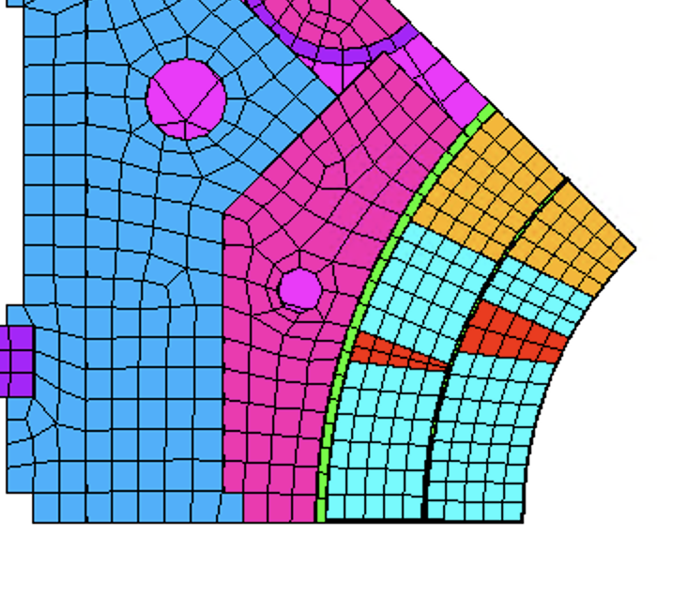
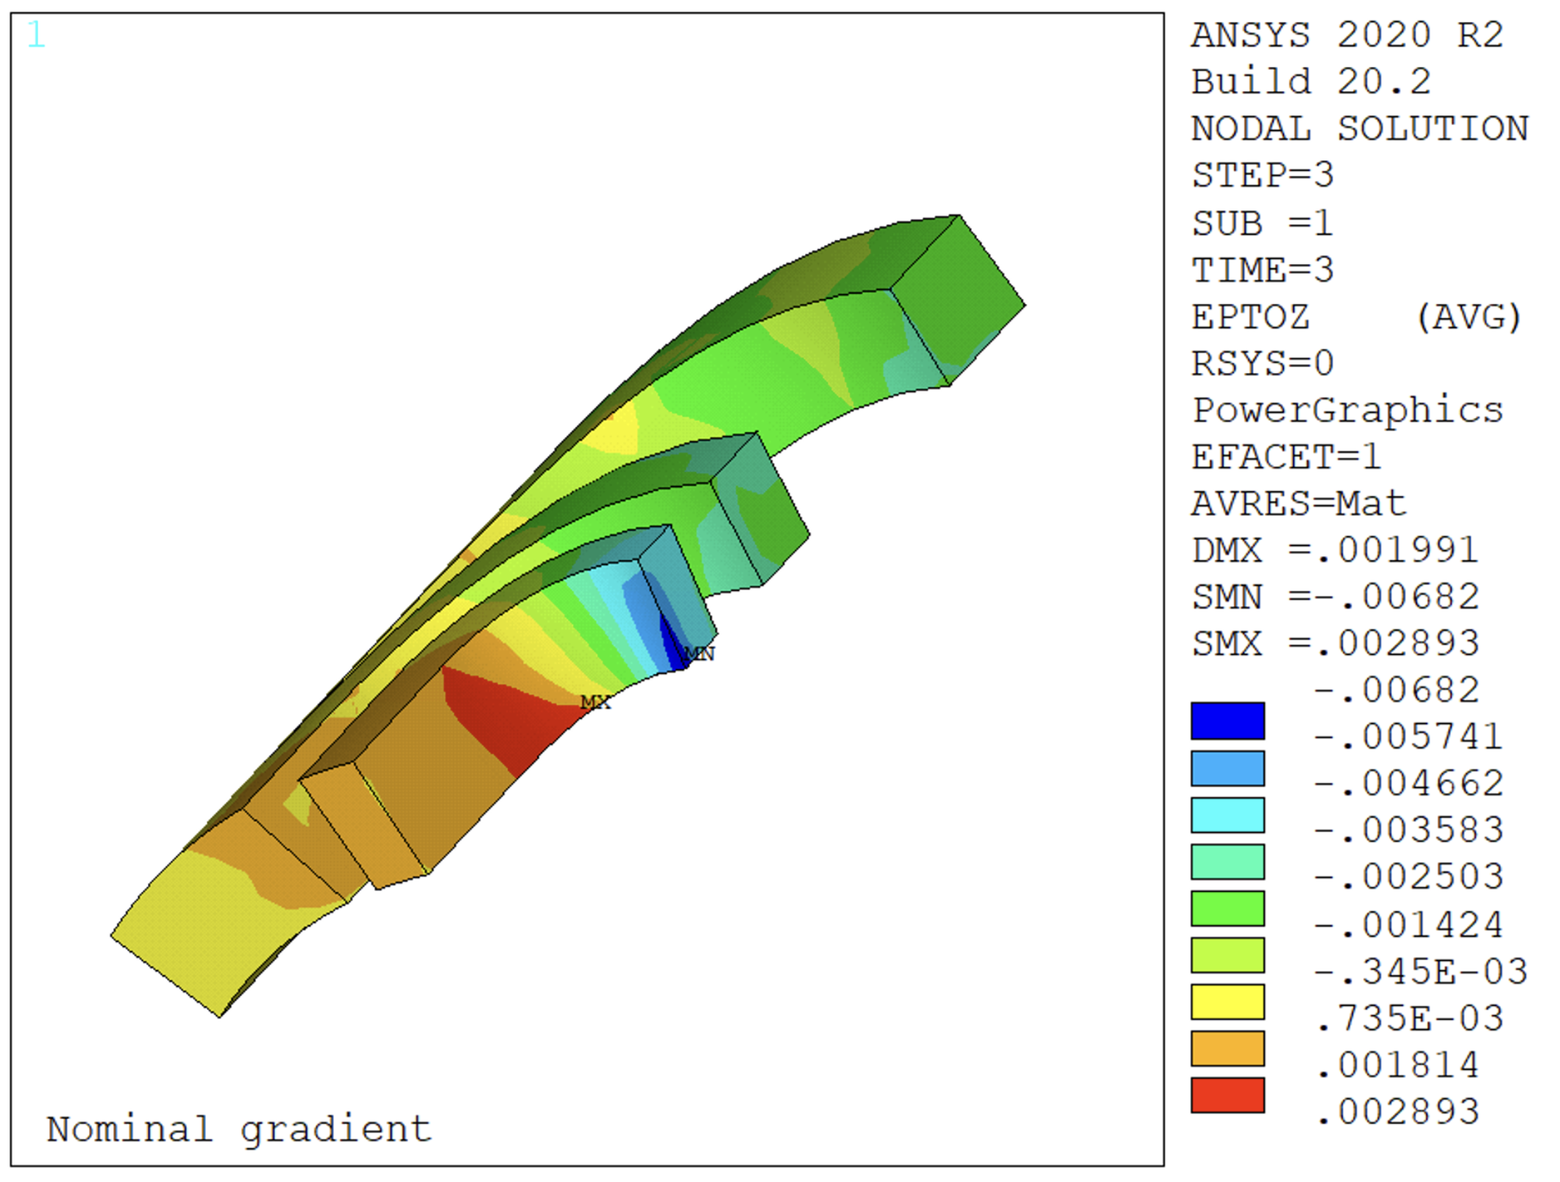
Finite element analysis
Impact of the coil pack size on the coil strain, in particular in the ‘wedge/end-spacer transition’ region

Slide 51
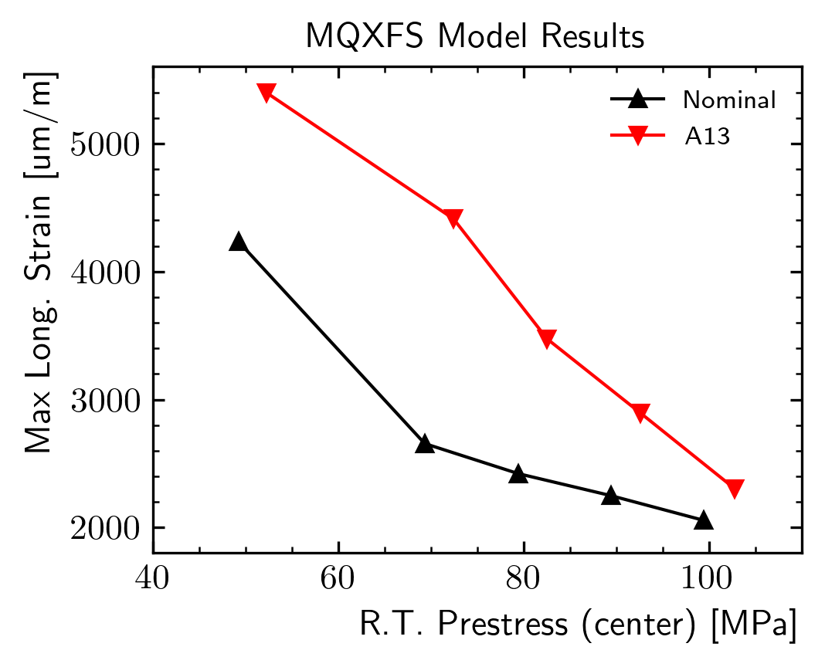
Maximum Long. Strain
The peak strain is a function of the applied prestress
  Clearly the distance between the red and black line will be different for each coil pack shape

Slide 52
Increase pre-load proposal
Nominal
Minimum
Maximum
We could define an unique criteria on the required minimum prestress at room temperature
  E.g. limit strain = 0.3%
  For MQXFA13, this would require a prestress of ~90 MPa

Slide 53
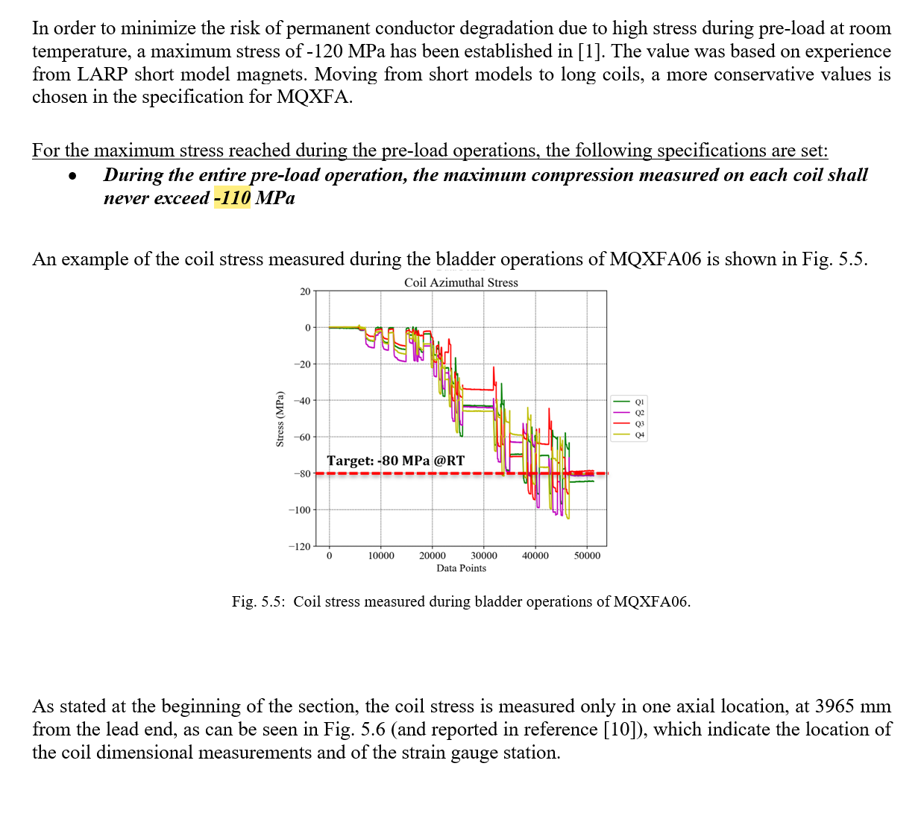
Proposal: max allowable stress during pre-load from 110 to 120 MPa
-120

Slide 54
Comparison with previous magnets:
Delta coil arc length and key size
Magnet | Average ss | LE min | RE min | LE delta | RE delta | Key
 | mm | mm | mm | mm | mm | mm
A15 | 0.001 | -0.156 | -0.070 | -0.157 | -0.071 | 13.72
A14b | -0.011 | -0.203 | -0.167 | -0.192 | -0.156 | 13.84
A13 | -0.007 | -0.230 | -0.148 | -0.223 | -0.141 | 13.72
A8b | -0.001 | -0.285 | -0.214 | -0.284 | -0.213 | 13.77
A11 | 0.006 | -0.196 | -0.074 | -0.201 | -0.079 | 13.74
A10 | -0.145 | -0.348 | -0.313 | -0.203 | -0.168 | 13.82
A8 | -0.046 | -0.340 | -0.269 | -0.294 | -0.223 | 13.72
A7 | -0.055 | -0.218 | -0.179 | -0.164 | -0.125 | 13.77
A6 | -0.072 | -0.217 | -0.279 | -0.145 | -0.207 | 13.72
A5 | -0.037 | -0.241 | -0.165 | -0.205 | -0.129 | 13.79

Slide 55

Delta stress due to coil arc length and key size
Computation of the delta stress in the LE of each magnet with respect to a “nominal magnet” with
  Coil end with nominal dimensions
  Loading keys of 13.76 mm (average of all magnets)
Based on sensitivity analysis (computation and measurements)
  +0.100 mm of coil outer radius increase
    -20 MPa of coil stress variation
    +12 MPa of shell stress variation

Slide 56
Delta stress due to coil arc length and key size
Magnet | LE min | Δr LE | Key | Δkey (wrt 13.76 mm) | Δr+Δkey | Δσ
 | mm | mm | mm | mm | mm | MPa
A15 | -0.156 | -0.099 | 13.72 | -0.041 | -0.140 | 28
A14b | -0.203 | -0.129 | 13.84 | 0.079 | -0.050 | 10
A13 | -0.230 | -0.146 | 13.72 | -0.041 | -0.187 | 37
A8b | -0.285 | -0.181 | 13.77 | 0.009 | -0.172 | 34
A11 | -0.196 | -0.125 | 13.74 | -0.021 | -0.146 | 29
A10 | -0.348 | -0.222 | 13.82 | 0.059 | -0.163 | 33
A8 | -0.340 | -0.216 | 13.72 | -0.041 | -0.257 | 51
A7 | -0.218 | -0.139 | 13.77 | 0.009 | -0.130 | 26
A6 | -0.217 | -0.138 | 13.72 | -0.041 | -0.179 | 36
A5 | -0.241 | -0.153 | 13.79 | 0.029 | -0.124 | 25

Slide 57
Shimming and Understanding

Slide 58


MQXFA13
Coil Size Analysis
G. Vallone, G. Ambrosio, D. Cheng, P. Ferracin, L. Garcia Fajardo
July 12, 2023
AUP-CERN Structure WG Meeting

Slide 59
Introduction
Contact
Offset
We want to test the impact of the coil pack size on the coil strain, in particular in the ‘wedge/end-spacer transition’ region
  Plot is the error (distance from the average) on the coil size (radial, computed from L+R measurements)
Included in the MQXFS octant model introducing an offset on the coil/filler contact
  All components bonded, separation allowed between the wedge and the spacer, and the coil and the winding pole
    In this configuration we see a large strain spike in MQXFA07
  Double checked that the contact gap is as expected at the start of the simulation

Slide 60

Coil Strain – Nominal Interference
Nominal
Including Size Error
Peak longitudinal strain increases from 2249 µm/m to 2893 µm/m

Slide 61
Local Size/Prestress Modifiers (1)
Increasing the prestress on the whole magnet might ‘push’ the coil stress over the project-defined limits
Alternatively, we could act on ‘local’ modifiers:
  Shimming the coil pack in the coil ends
    Only feasible as ‘radial shimming’, as ‘steps’ on midplanes could damage the leads (see MQXFA09 ‘Kapton fold’ analysis)
  Increasing the key size in the coil end region
    The coil is not sensitive to ‘steps’ in the key size (see missing key analysis during bladder operation, e.g. MQXFA12)

Slide 62


Local Size/Prestress Modifiers (2)
Coil/Collar Shimming
Key Shimming
FE analysis considering:
  Radial shimming (100 µm) in the end-shoes
    Available shimming region relatively small, as we do not want steps over the cable
  Key size increased (100 µm) along the whole ‘short’ shell

Slide 63

Local Size/Prestress Modifiers - Results
Radial shimming in the end-shoes goes in the wrong direction
    Very short shimming space available
    To be understood – probably LQ effect + blocking long. prestress
Key shimming can remove completely the effect of the undersized coil ends (considering the A13 case)

Slide 64

7/25/2023
What if in the previous computations we look at:
Azimuthal prestress on the pole at the longitudinal location of the wedge-spacer interface

Slide 65


➔ The longitudinal strain depends on the azimuthal prestress at cold at the same location

Slide 66

Mechanism
The local azimuthal pre-stress generates/contributes to local axial pre-stress by Poisson effect
When the magnetic forces exceed the axial pre-stress the coil is less rigid ➔ kink

Slide 67

Coil 157 CMM in Lead End
Average of transition and non-transition sides
X-sections in addition to 70 and 207 (standard locations)
Distance from LE | NT side | T side | Average
mm | um | um | um
70 | -121 | -117 | -119
100 | -125 | -121 | -123
150 | -140 | -134 | -137
180 | -155 | -148 | -151.5
207 | -179 | -167 | -173
220 | -171 | -155 | -163
260 | -139 | -136 | -137.5
300 | -102 | -96 | -99

Slide 68
Back up Slides

Slide 69


From Specs Mtg

Slide 70

MQXFA07
Analysis of voltage rise (by V. Marinozzi) came to conclusion that quench #10 (at 4.5 K) started very close to voltage tap A4
  This info can be use to “calibrate” position of Quench Antenna elements wrt coil 214
This analysis confirmed that limiting quenches in coil 214 are starting in the Lead End area

Slide 72
Inspection Plan
Before MQXFA07 dis-assembly:
Magnetic measurements at LBNL
After MQXFA07 dis-assembly:
Coil visual inspection
  Compare coil 214 to other MQXFA07 coil
  Compare MQXFA07 coils to prototype coils
Other tests:
  Heater-Coil Hipot
Lead end + some Straight Section, and Return end will be cut and sent to CERN for tomography
  Picture analysis looking for conductor issues
  Compare to prototype coil P06 and MQXFB coils
Coil sections at locations highlighted by tomography
  Micrographic inspection looking for broken sub-elements

Slide 73

MQXFA training

Slide 74




CABLE SECTIONS FOR WHICH FIELD IS SHOWN IN NEXT SLIDES
TURN 2 (INNER LAYER B1)
TURN 4 (LAST FULL TURN POLE BLOCK)
A04-A03
A05
A04
A04-A03
TURN 5 (TRANSITION B1 to B2)
TURN 6 (FIRST FULL TURN B2)
A03

Slide 75





TURN 4 (LAST FULL TURN POLE BLOCK)
At 15.31 kA

Slide 77

“The collapsed cable was on the 5th turn from the pole tip at the LE (between spacers B2-IC1 and B2-IC2), so the area is included in the A3-A4 multiturn block. A sketch showing the area is attached.
The issue noted the next morning was the same area. Before resuming in the morning it was noted that the strands were out of place a bit so we unwound the ½ turn to put them back in position before continuing.”
Info by Jesse

Slide 78
Quench Antenna analysis
According to Anis the QA shows that the quench location (QL) is at 2010.8 mm from magnetic center toward the lead end.
  “I redid the calculation using the updated drawing. The quench location in coil 214 (QA channel Z4300) is at z=2010.8 mm (toward the LE) from the magnetic center (512.2 mm from the top surface of the splice box).”
  Center of QA element wrt bottom edge is 50 mm
According to Joe the QA shows that the quench location (QL) is at ~2060 mm from magnetic center toward the lead end.

Slide 79

Quench Start Location Computation
 | Coordinates (mm)
Top surface of the splice box in magnet | 0
Top surface of the magnet yoke | 179.7
QXFA 214 Quench location (from top surface of the splice box) | 512.2
QXFA 214 Quench location (from top surface of the magnet yoke) | 332.5
Length from top yoke to bottom yoke | 4563
Measured length of QXFA 214 | 4525.4
QXFA coil length in CAD model | 4523
Shim thickness at QXFA 214 coil each end | 18.8
The center of that QA element is 50 mm toward the lead end. | 50
QXFA 214 Quench location (from QXFA 214 lead end splice block) | 263.7

Slide 80

Updated Plot
Nominal distance coil end to first pin hole at LE: 319.3 mm
“Yes, measurement for coil 214 was 319.8 from coil end to first pin hole at LE” (Jesse)

Slide 81
Slides by Joe DiMarco
J. DiMarco
07Sep2021
Summary of QA data on Q#9 and Q#10
Quench #9 (and the other quenches like it) seems to show large flux redistribution relatively early wrt when the quench detection threshold is exceeded (i.e. start at -22ms). There seems to be one main location (ZQA at z=2000; i.e. signal Z4300) which shows large slow rising redistribution (V=18mV) while other ZQA are much less affected, and neither does the activity seem to ‘spread’ very much to them. This gives an ‘asymmetric’ look to the ‘heat map’ representations of the flux/voltage events. The azimuthal location of Z4300 may be particularly oriented to pick up the flux redistribution event, or it may just be very local and relatively somehow slow spreading (?). The TQA location affected most is the the Q3 transition-side antenna (T150), with good symmetry with the neighboring T120 and T180 QA. The flux excursion is seen to be a relatively slow oscillation.
Quench #10 shows some small redistribution (<5mV) but very quickly followed by a large (~25mV), fast redistribution that is seen simultaneously in several ZQA with similar amplitude. The quench detection threshold is exceeded within 10ms. The largest amplitude is in the antenna at Z=1900 (signal Z4200), which is shifted slightly compared to Q#9. The Z4300 antenna has different character than it did in Q#9 and the amplitude of three antennas are pretty similar in this event (Z4150, Z4200, Z4300) and the activity seems more symmetric. The TQA location affected most is T180 with a bit of asymmetry that actually shows the T210 (Q4) more active than the T150. Since the voltage taps don’t show a shift in quench location towards midplane, this may instead indicate a difference in the direction of flux redistribution (see next page). The TQA flux excursion here is much faster (and of a bit larger amplitude) than that of Q#9.
The TQA having largest signal (T180) in Q#10 also had large ‘noise’ (pickup of mech. vibrations?) – this was not seen in this signal on any other quench (two previous quenches (Q#6 and Q#7) showed 4kHz and 2kHz noise on a different signal (T240)). This noise was roughly of frequency 12kHz, but was broad and did not really look like electrical pickup).

Slide 82



A07
Q9
Slides by Joe DiMarco, 11/11/2021

Slide 83

A07
Q10
Slides by Joe DiMarco, 11/11/2021

Slide 84


Slide 85


Magnet Bottom
Magnet Top

Slide 86

Slides by Anis
Z=0 is the magnetic center (position determined from the MM measurement and the drawing at the end of the MM test plan)
MQXFA07 Quench #10 4.5 K , 20 A/s, 0.9 A/s² I_{Q} = 15832 AQI = 24.3 MIIts
Location = Coil 214 (Q3) A3-A4 + A4-A7

Slide 87

Z=0 is the magnetic center (position determined from the MM measurement and the drawing at the end of the MM test plan)

Slide 88
Back up Slides

Slide 89




TURN 1 (INNER LAYER POLE)
At 15.31 kA

Slide 90
TURN 4 (LAST FULL TURN POLE BLOCK)
At 15.31 kA

Slide 92



QXFA239 – Length, Gaps
Coil length within spec.
(207 error in initial pole gap setting)

Slide 93
QXFA239 - Reaction
Temperatures and dwell times all within spec.

Slide 94

QXFA239 - Electrical
Final electrical checks – all passed

Slide 95

QXFA239 - Electrical

