Slide 1
MQXFA17 and CLIQ
Summary of contributions from all MQXF team members
MQXFA Mtg
June 12, 2024

Slide 2
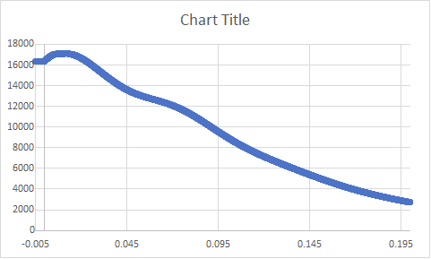
CLIQ
CLIQ add current to coils in Q2 and Q4
➔ shorter training in these coils
Possible higher risk of damage in these coils during quench above nominal current?
(Stoyan and Sandor)
Magnet 13, quench 22, current in Q2/Q4:
CLIQ boost based on 14126 A (quench 1 current) and peak current of 15000 A : 874 A
CLIQ boost based on 16362 A (quench 22 current) and peak current of 17106 A : 744 A

Slide 3
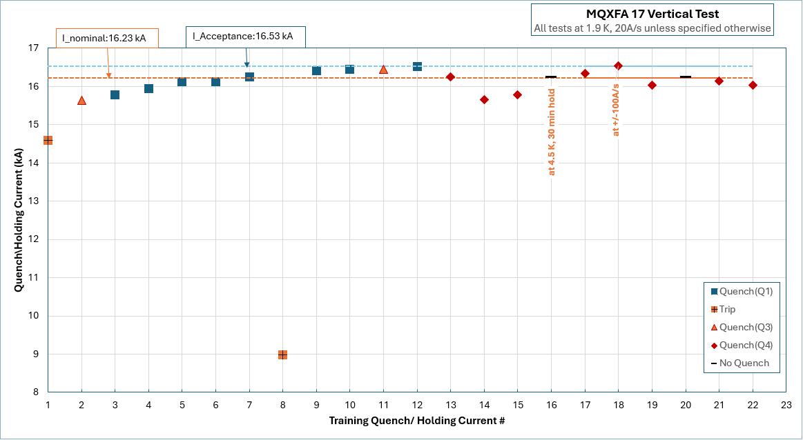
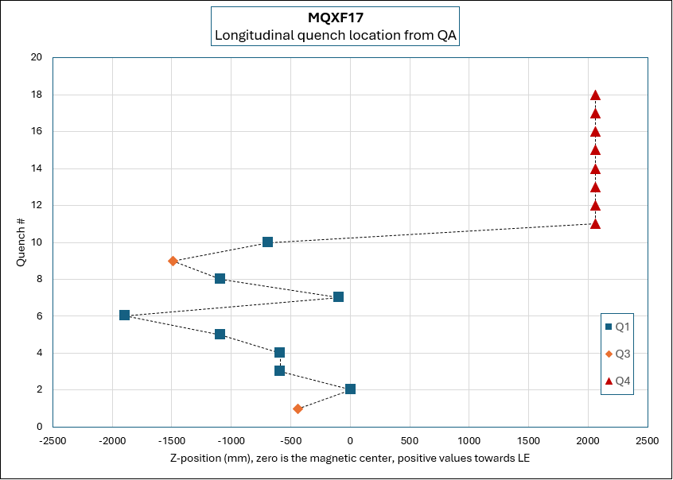
Delta I = - 283 A
Q4 coil

Slide 4
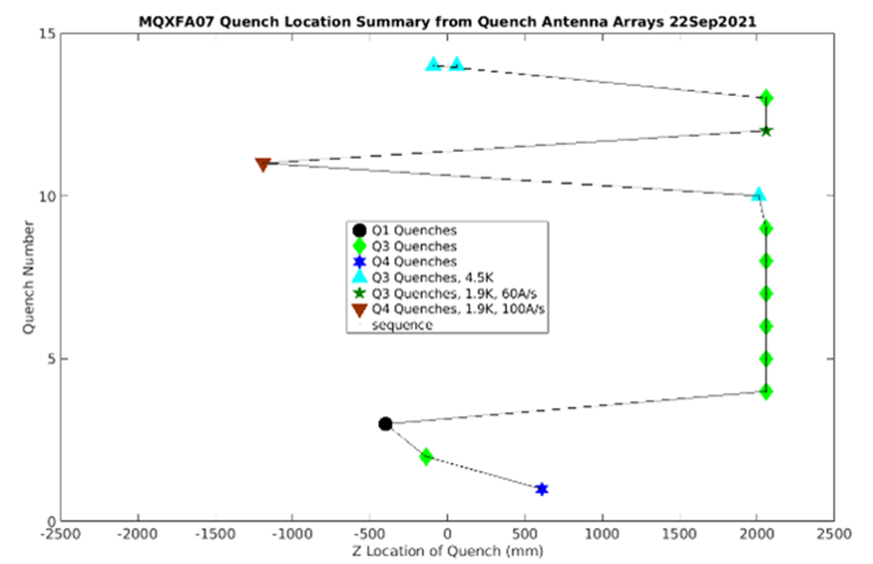
Delta I = - 7 A
Q3 coil

Slide 5
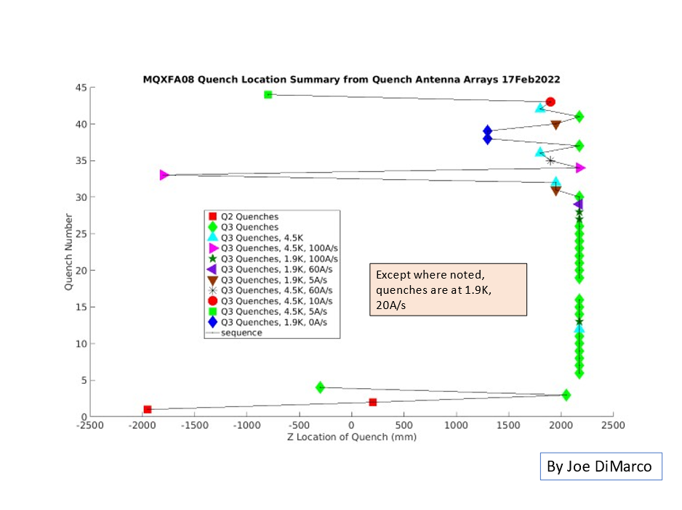
Delta I = - 80 A
Q3 coil

Slide 6
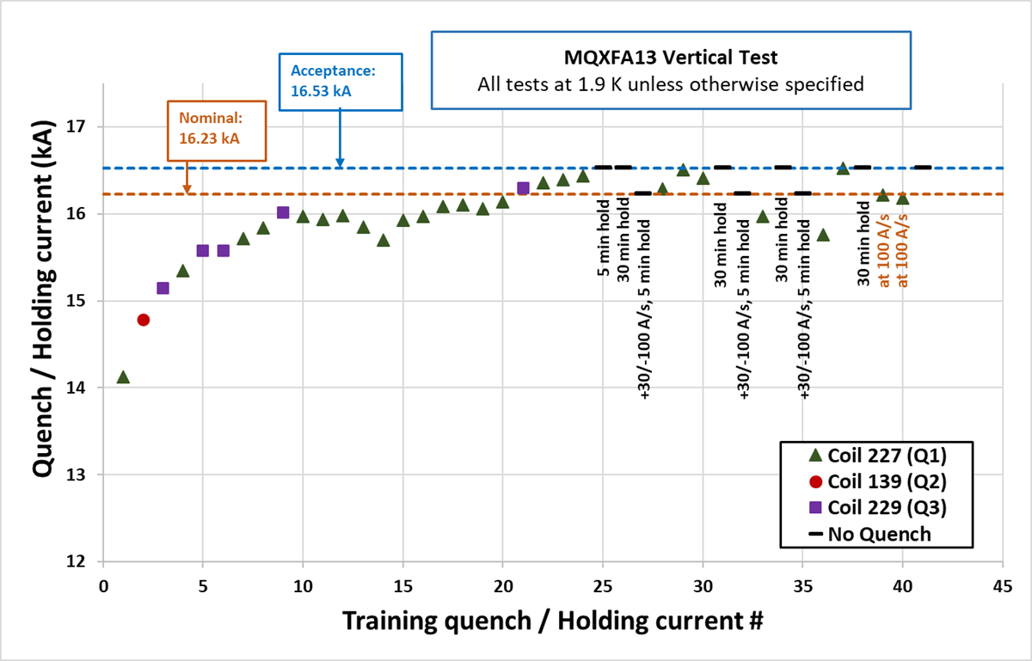
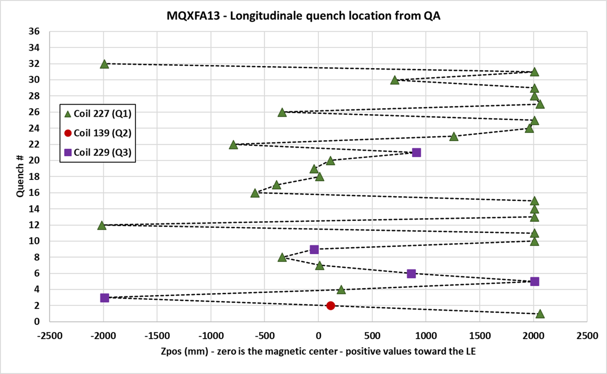
Delta I = - 45 A
Q1 coil

Slide 7
Magnet | Quadrant | # previous quenchs at higher current | Delta current wrt last previous quench (A) | Previous quenches in same coil & close-by position | All previous quenches in same coil
MQXFA17 | Q4 | 4 | -283 | 0 | 0
MQXFA07 | Q3 | 0 | -7 | 0 | 1
MQXFA08 | Q3 | 1 | -80 | 1 | 2
MQXFA13 | Q1 | 1 | -45 | 1 | 4

Slide 8
Coils in MQXFA magnets
 |  | CLIQ + |  | CLIQ + |  |  | Lead End arc length + loading shim
Magnet | Q1 | Q2 | Q3 | Q4 |  |  | mm
MQXFA03 | 204 | 110 | 202 | 111
MQXFA04 | 203 | 113 | 206 | 112
MQXFA05 | 207 | 116 | 209 | 115 |  |  | 0.862 | Passed endurance test
MQXFA06 | 122 | 119 | 211 | 123
MQXFA07 | 212 | 124 | 214 | 114 |  |  | Closed pole-key gaps
MQXFA07b | 212 | 124 | 218 | 114 |  |  | 0.932
MQXFA08 | 215 | 126 | 213 | 128 |  |  | Closed pole-key gaps
MQXFA08b | 215 | 126 | 219 | 128 |  |  | 0.768 | 750-800 range
MQXFA10 | 132 | 221 | 131 | 129 |  |  | 0.799 | 750-800 range
MQXFA11 | 223 | 222 | 134 | 135 |  |  | 0.937
MQXFA13 | 227 | 139 | 229 | 141 |  |  | 0.662 | lower than 700
MQXFA14b | 217 | 230 | 143 | 231 |  |  | 0.907
MQXFA15 | 233 | 226 | 220 | 117 |  |  | 0.922
MQXFA17 | 151 | 237 | 152 | 239 |  |  | 0.791 | 750-800 range
MQXFA13b | 150 | 139 | 229 | 141 |  | NOT tested yet
MQXFA16 | 144 | 235 | 145 | 236 |  | NOT tested yet
MQXFA12b | 224 | 159 | 225 | 148 |  | NOT tested yet

