Slide 1
302.4.01 Magnets Vertical Test at BNL Test Summary
Febin Kurian
17-June-2024

Slide 2
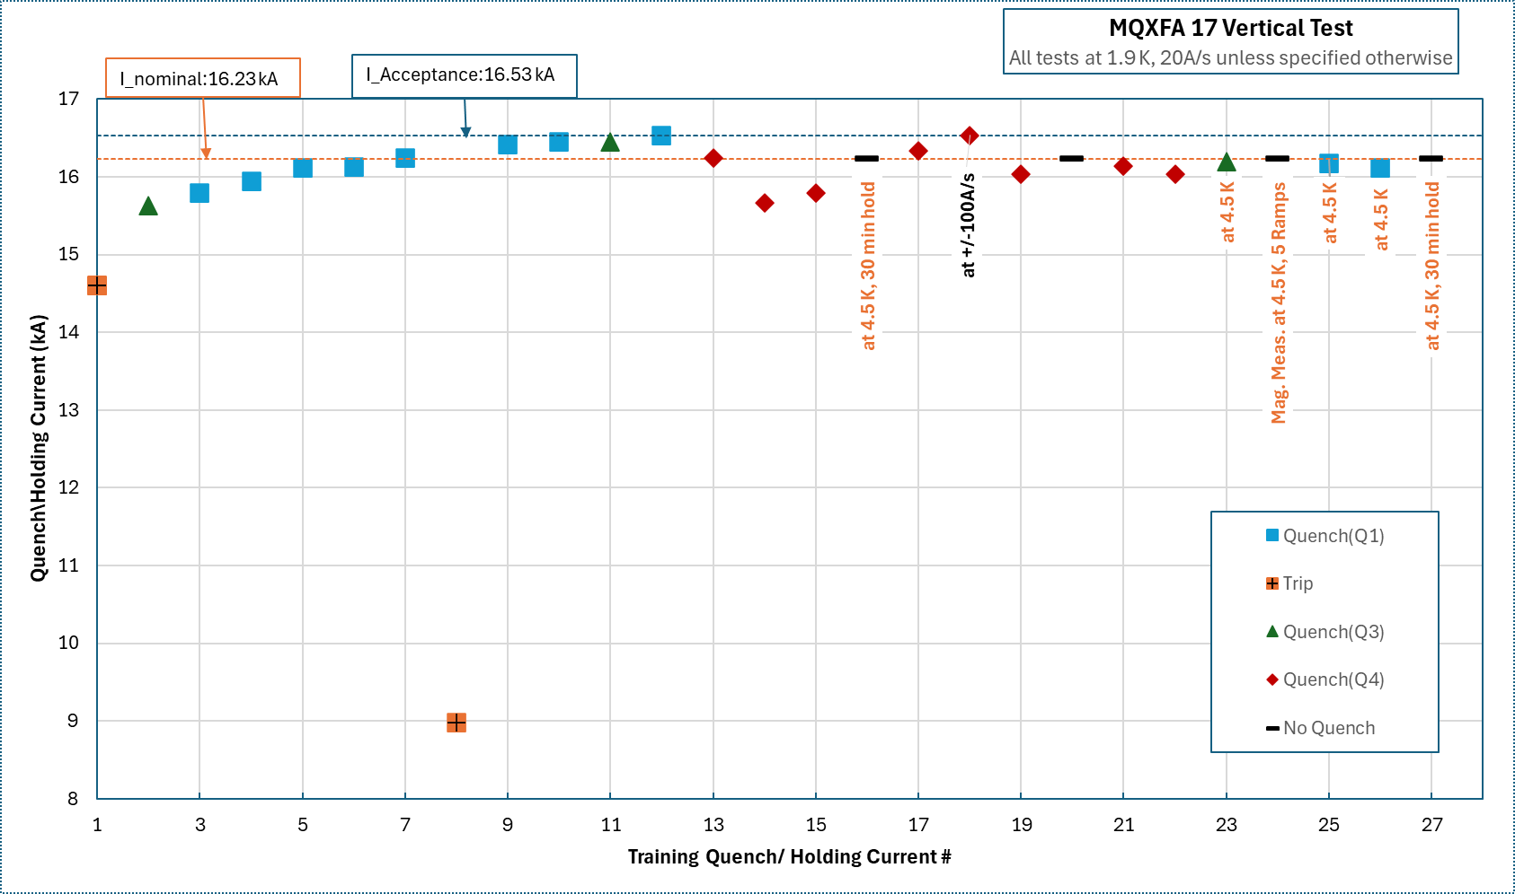
MQXFA17
Magnet is currently being warmed up
Training summary

Slide 3
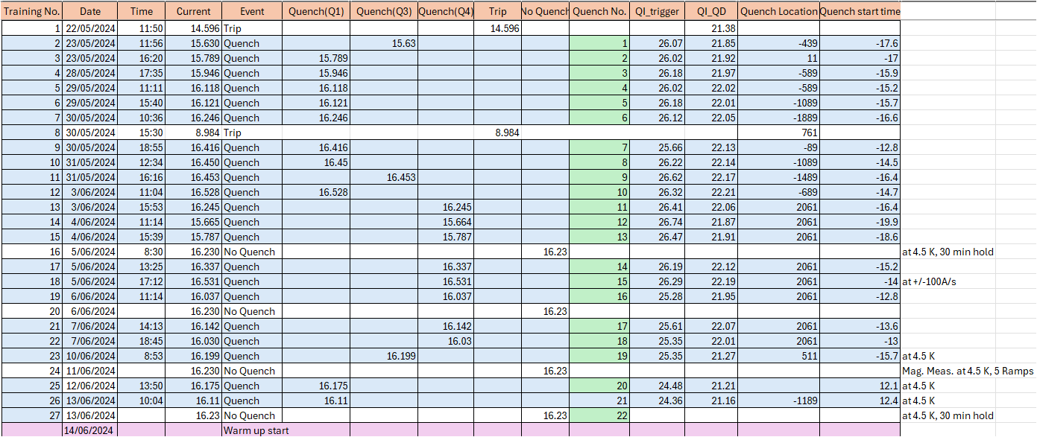
MQXFA17
Training summary

Slide 4
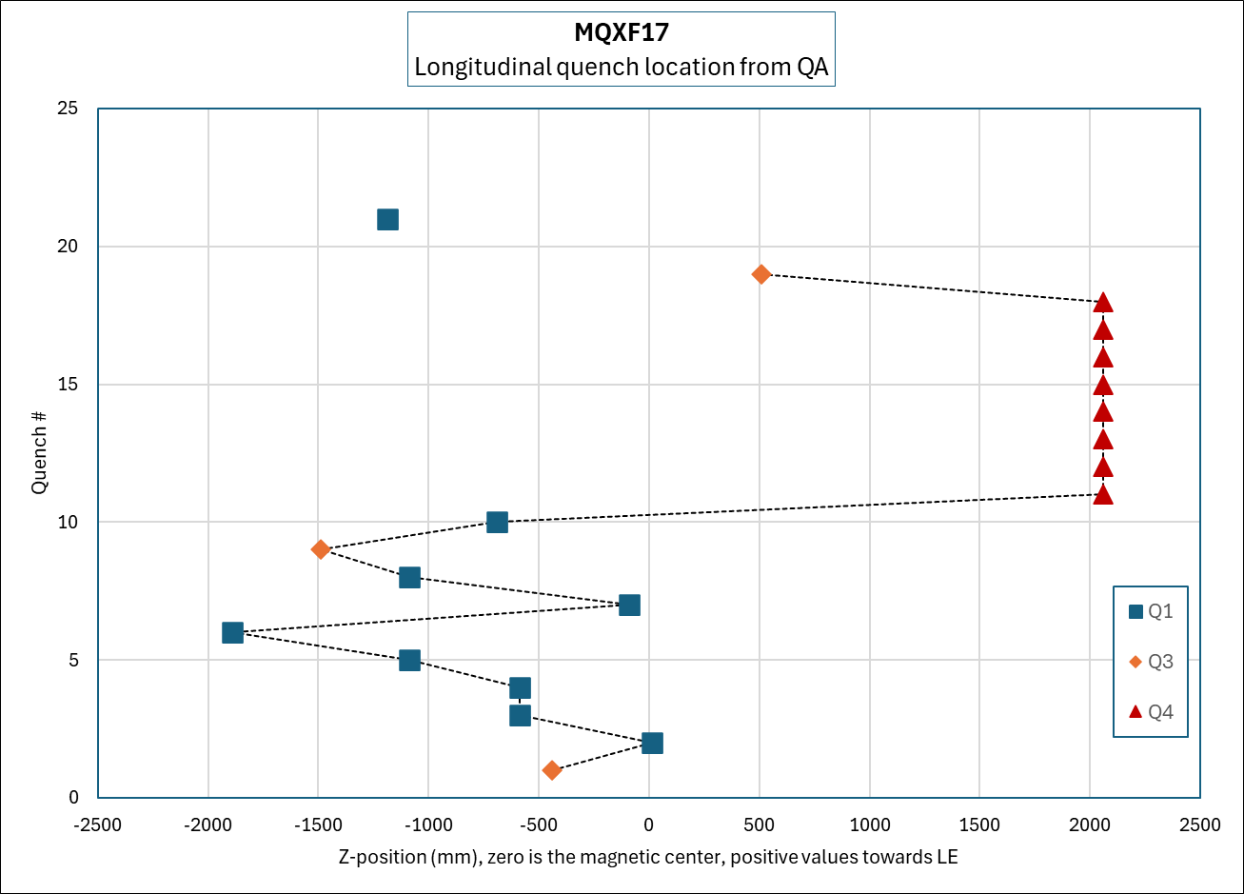
MQXFA17
Quench Location Summary

