Slide 1


302.2 - MQXFA Magnets Fabrication
G. Ambrosio - FNAL
HL-LHC AUP DOE IPR – July 23rd–25th 2024

Slide 2
Outline
Scope, Interfaces, Dependencies & Team
Status since Rebaseline Review
Procurement Status
Schedule
Cost and Schedule Performance
BCRs since Rebaseline Review
Estimate at Completion and EAC Manual Adjustments
Risks
QA/QC
ES&H
Summary

Slide 3
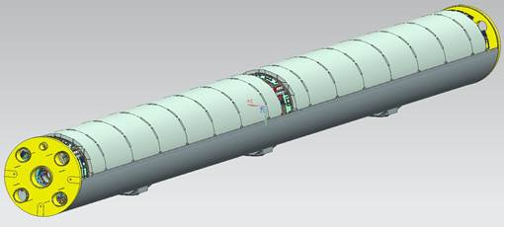
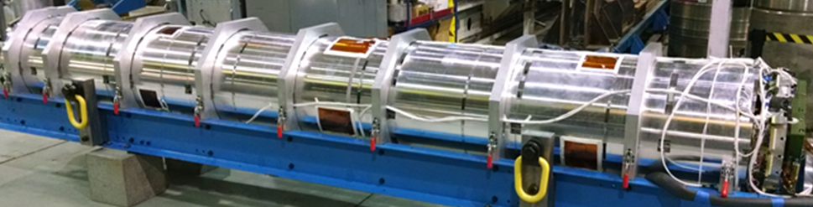

302.2 WBS Deliverables
Charge #2, #3
20+1 Magnets
  16 magnets for 8 Q1/Q3 to be installed in LHC tunnel
  4 magnets for 2 Q1/Q3 commissioning spares
  1 magnet to CERN for acceptance of CA01
  (assuming: 5 re-assemblies = post test re-work)
Magnet
(MQXFA)
Cold Mass
(LMQXFA)
Cryo-assembly
(LQXFA)

Slide 4
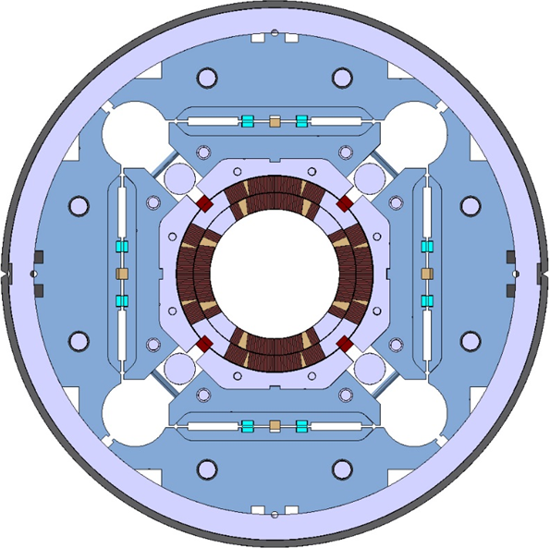
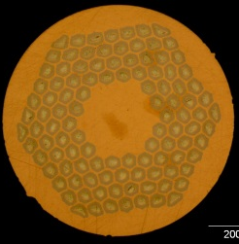
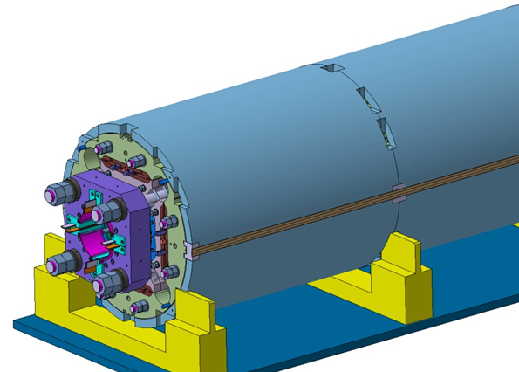
MQXFA Design
Parameter | Unit | MQXFA
Coil aperture | mm | 150
Magnetic length | m | 4.2
N. of layers |  | 2
N. of turns Inner-Outer layer |  | 22-28
Operation temperature | K | 1.9
Nominal gradient | T/m | 132.2
Nominal current | kA | 16.23
Peak field at nom. current | T | 11.3
Short Sample Limit |  | 76%
Stored energy at nom. curr. | MJ/m | 1.15
Diff. inductance | mH/m | 8.26
Strand diameter | mm | 0.85
Strand number |  | 40
Cable width | mm | 18.15
Cable mid thickness | mm | 1.525
Keystone angle |  | 0.4
Design stable since Jan 2016
with a few minor DCRs approved
Nb₃Sn Conductor
B-OST RRP
P. Ferracin et al., “Development of MQXF, the Nb₃Sn Low-β Quadrupole for the HiLumi LHC ” IEEE Trans App. Supercond. Vol. 26, no. 4, 4000207
G. Ambrosio et al., “First Test Results of the 150 mm Aperture IR Quadrupole Models for the High Luminosity LHC” NAPAC16, FERMILAB-CONF-16-440-TD

Slide 5
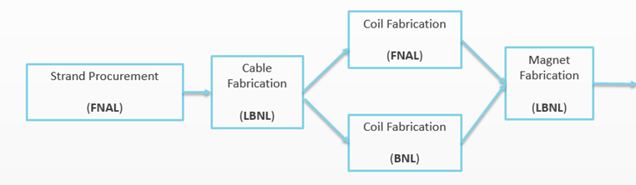


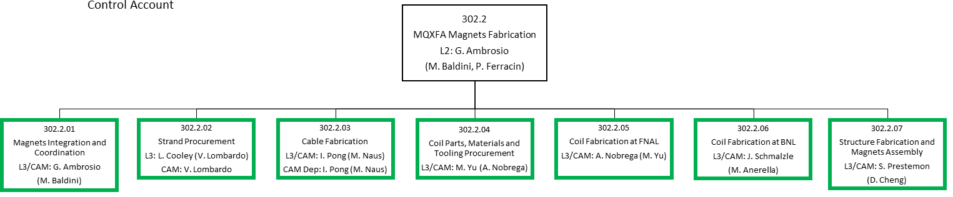
MQXFA Production Plan & Org Chart
Charge #2
(US-HiLumi-doc-138)
Coil Parts (FNAL)
All discrete activities complete
~
Discrete activities almost complete
(US-HiLumi-doc-104)

Slide 6
MQXFA Status Summary
Charge #1
Control Account | Component Status*
Strand procurement & QC (FNAL, FSU) | ~100% complete
Cable fabrication & insulation (LBNL) | 100% complete
Coil part procurement (FNAL) | 98% complete
Coil fabrication (FNAL) | 99+% complete
Coil fabrication (BNL) | 100% complete
Total coil yield
Magnet assembly (LBNL) | ~60% complete
Magnet yield after cold test
*% of components completed ≠ EDMS

Slide 7
MQXFA Status Summary
Charge #1
Control Account | Component Status* | Actual Yield | Yield in Baseline
Strand procurement & QC (FNAL, FSU) | ~100% complete
Cable fabrication & insulation (LBNL) | 100% complete | 95.6% | 90% at start
Coil part procurement (FNAL) | 98% complete
Coil fabrication (FNAL) | 99+% complete
Coil fabrication (BNL) | 100% complete
Total coil yield |  | 74.2% | 75.7%
Magnet assembly (LBNL) | ~60% complete
Magnet yield after cold test |  | 79.0% | 84%
Magnets tested in vertical cryostat (by 302.4.1): 14 8
Met requirements: 10 6
Did not meet requirements: 4 2
  Affected by Covid restrictions: 2 2
  Met requirements after replacing the limiting coil: 2 0
  To be tested after replacing the limiting coil: 2 2
@
rebaseline
review
*% of components completed ≠ EDMS

Slide 8
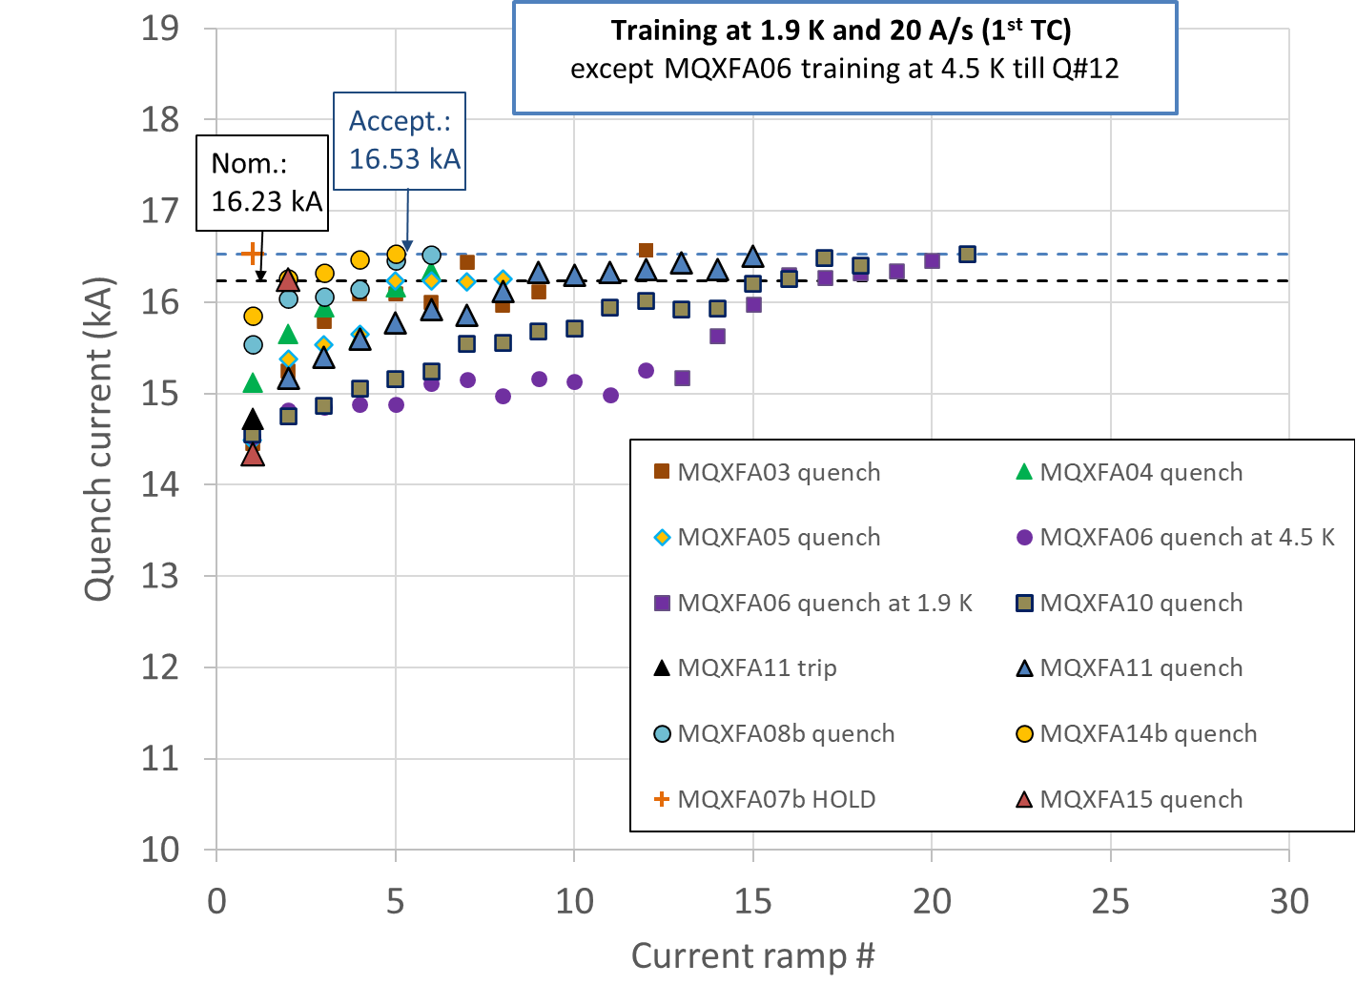
302.2.01: Magnet Integration & Coordination
Coil and Magnet shipments:
  90+ shipments: no coil/magnet damage
  Accelerometer data analysis for all shipments
Magnet Post-Test Analysis:
  10 magnets met requirements during vertical test
  4 magnets (MQXFA07/8/13/17) did not meet requirements:
    ➔ Design changes and specification changes (more details below)
    67% COVID attribution for MQXFA07/8 issues
  MQXFA07b and 08b met requirements after changing the limiting coil
  MQXFA05 passed the Endurance Test
  MQXFA11 demonstrated resilience (after highway crash)
Talk “Magnets 302.2.01 - Integration, Coordination, and Shipments” in magnet Bk 1a session
Talk “MQXF Results and Status” in magnets Bk 1a session
Magnet test yield: 71.4%
Test yield w/o Covid impact: 79.0%
Original yield in Baseline: 83.3%
Yield of future magnets (BL & EAC): 84.6%

Slide 9
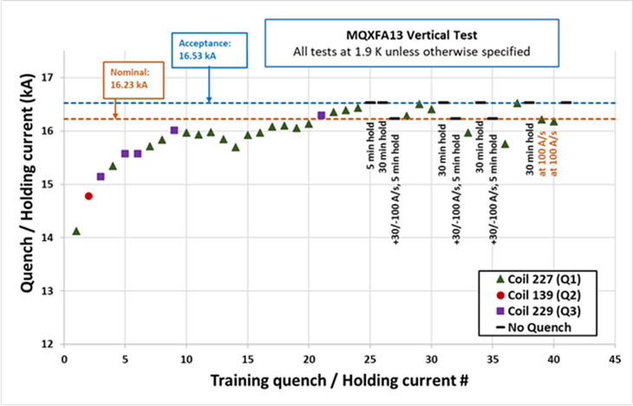
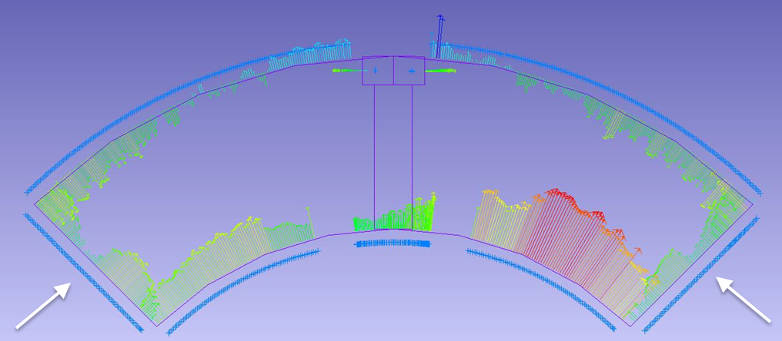
MQXFA13 NC analysis
MQXFA13 showed issues in a coil during vertical test
  Test was stopped to prevent damage to the other coils
Non-conformity analysis including metallographic analysis by CERN team is complete
  Broken Nb₃Sn filaments found at wedge-spacer interface
  Lesson learned: if coil ends are “too small” ➔ risk of excessive strain with low pre-stress
➔ Preventive actions:
  Added spec for coil dimensions in the critical region
  Added spec for loading shims, and increased max acceptable stress during preload
doc-4958 and on review website
  Dedicated presentation in Magnet parallel session
Coil CMM example
MQXFA13 Test sequence

Slide 10
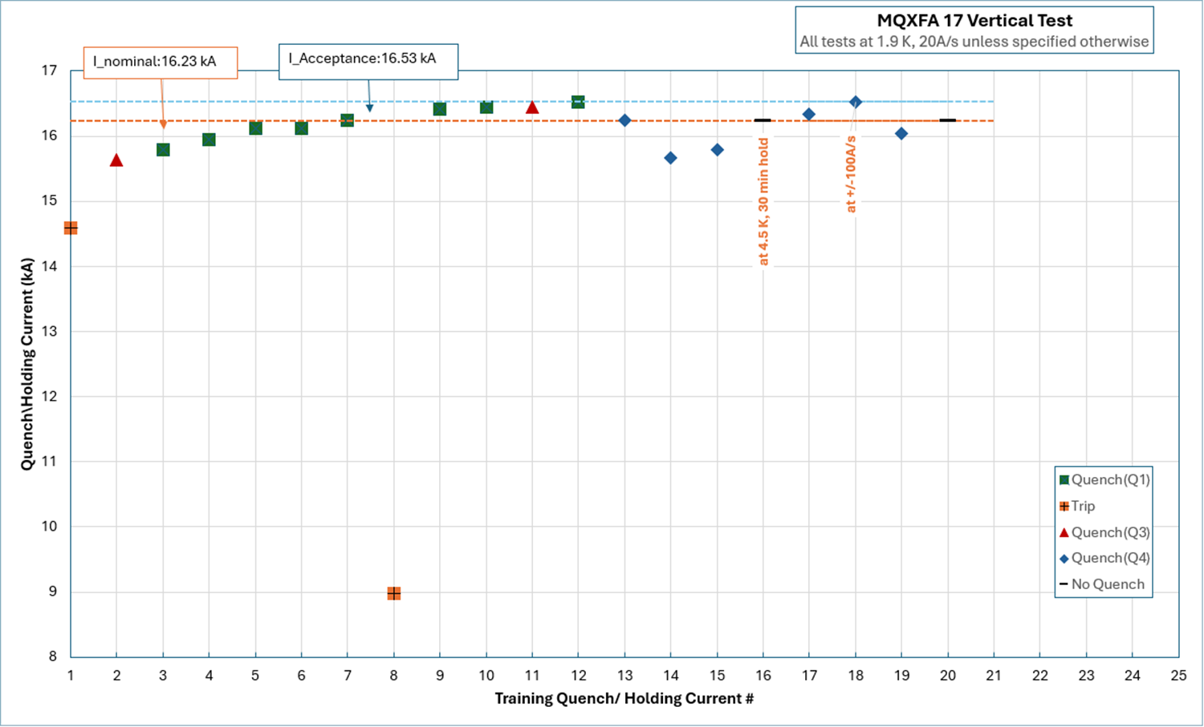
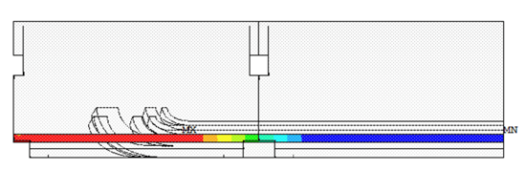
MQXFA17 NC analysis
MQXFA17 showed detraining and degradation in a coil during vertical test
  Quench location (Lead End) similar to previous magnets
  Inverse temperature and ramp-rate dependence
Non-conformity analysis is in progress
  Main hypothesis: low prestress in lead end because we could not use the target loading shims due to spec on max stress during bladder operation
➔ Preventive actions (hypothesis):
  Use tapered loading shims in the lead end of all future magnets
  Dedicated presentation in Magnet parallel session
Loading shims
+ 100 μm + 0 μm
MQXFA17 Test sequence
Tapered loading shims in Lead End

Slide 11
302.2.02/03: Strand & Cables
All past strand procurements are ~complete:
  60 km (for 3 cables) returned to B-OST and to be replaced by end of July/Dec 2024 (for 2/1 cables)
40 km (for 2 cables) REQ on hold
  No vendor can give us a quote
Cable fabrication:
  100% complete (113 out of 113 cables)
  Yield is 95.6% vs. 90% assumed in Baseline at AUP start
Present inventory: 1 cable + strand for 1 cable

Slide 12
302.2.05/06: Coil Fabrication at FNAL/BNL
Simple Coil Fabrication Yield
  Coils on hold: The number of coils on hold expected to be used is the sum of the probabilities of using each coil on hold (0%, 25%, 50%, 75%).
  **Integration and test yield computed after removing Covid impact
MQXFA15 has 3 coils that were previously on hold

Slide 13
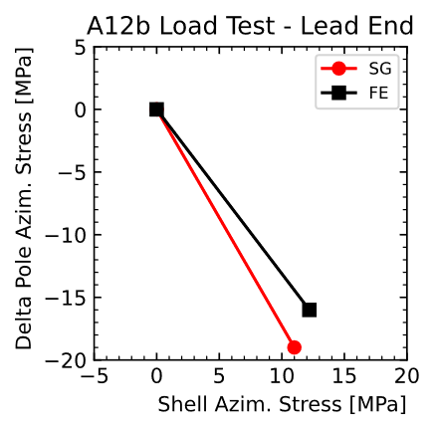
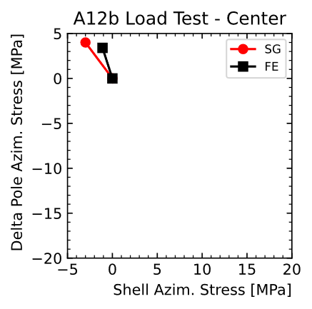
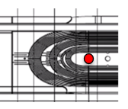
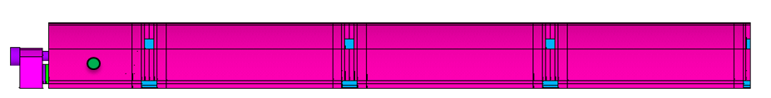
302.2.07: MQXFA Structures and Assembly
Structure procurement is complete. Magnet assembly is at peak production with two assembly lines fully operational
19 MQXFA magnets assembled (MQXFA03-17, 7b, 8b, 13b, 12b):
  MQXFA12b: used to test insertion of tapered loading keys
    Tapered loading keys were inserted at the Lead End and removed at ½ preload to test procedure, and record data
    Data from additional gauges were analyzed ➔ very good agreement with FE
    CAPA after MQXFA17: Tapered loading keys will be inserted at the Lead End
  MQXFA16 is at FNAL
  MQXFA13b is at BNL
Delta stress on gauges @ pole tip:
measured (SG) vs computed (FE)
W/o tapered keys
Delta stress on gauges @ magnet center
W tapered keys
Notes:
Failure Mode Analysis
Magnet disassembly and reassembly needed to meet the requirements
- Structure Fabrication and Magnet Assembly Threat RT-302-2-07-007 Magnet disassembly and reassembly needed to meet the requirements If after a magnet is assembled, and the magnet does not meet requirements then disassembly and
reassembly are needed, which will increase labor cost and cause delay to the schedule

Slide 14
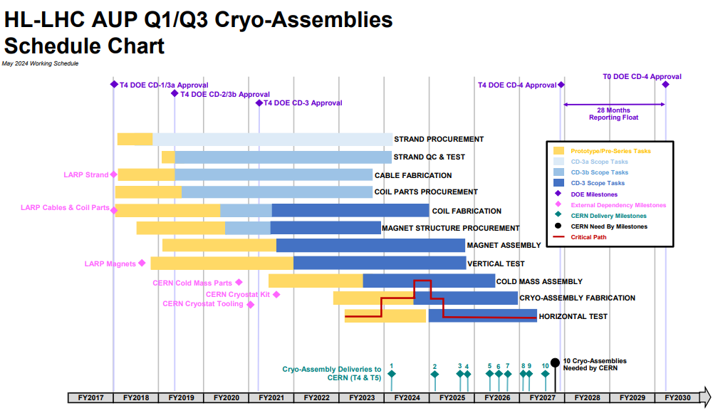
WBS 302.2 Schedule
Charge #2

Slide 15
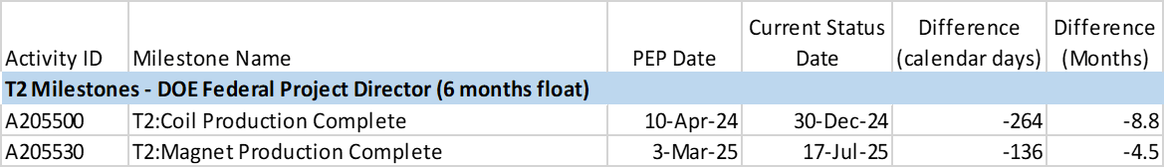
WBS 302.2 Milestones
Coil Production Complete:
  2 coils added for coil yield
  5 coils added for the additional magnet to be shipped to CERN for CA-01 acceptance
  Slow coil production rate at FNAL to keep the line active for longer time
Magnet Production Complete:
  1 magnet rework added for magnet yield
  MQXFA15 rework to increase preload (Lesson Learned from QMXFA13)
  Critical DR on MQXFA17
  Re-assemblies of MQXFA13b for field quality

Slide 16
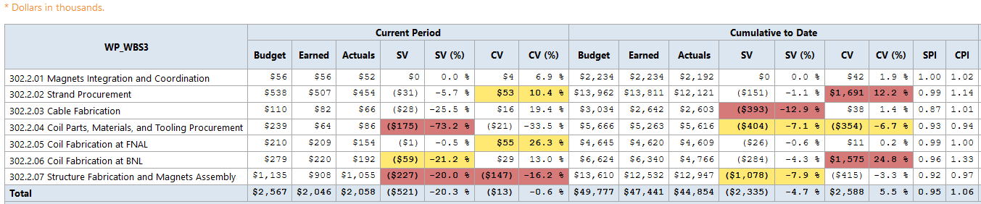
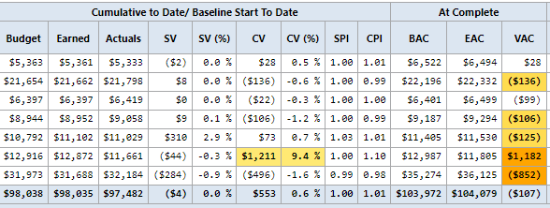
WBS 302.2: Cost & Schedule Perform.
Charge #2
All control accounts are on schedule and ~within budget
MQXFA variance at complete is -$107k
Total 302.2 BCRs cost impact: -$3.87M

Slide 17
302.2. Risk Management
Charge #6
All risks have been identified, analyzed, and are managed on monthly basis
open risk | high | medium | low | total
threats | 1 | 5 | 2 | 8
MQXFA threats with largest impact:
Mitigation for risk of additional coil/magnet failures:
  Spare conductor for 5 coils
  Spare parts for 4 coils
RI-ID | Title | Risk Rank
RT-302-2-01-003 | Series magnets fail to meet yield assumption in baseline | 3 (High)
RT-302-2-01-004 | FNAL coils fail to meet specification and are rejected | 2 (Medium)
RT-302-2-01-005 | BNL coils fail to meet specification and are rejected | 2 (Medium)
RT-302-2-01-008 | Magnet fabrication issue causes component rework and schedule delay | 2 (Medium)
AUP risks presented in talk: Management 302.1 - AUP Risks
302.2 risks presented in talk: Magnets 302.2.01 - Integration, Coordination, and Shipments”

Slide 18
Quality Assurance
All significant documents are under revision control
All travelers are being used, and updated as needed
Per CERN requirements, the project utilizes:
  Manufacturing & Inspection Plans (MIP), which describe all manufacturing and inspection steps.
    All MIPS approved by AUP & CERN: US-HiLumi-doc-794/758/1705/2011
  CERN EDMS/CDD (CERN Drawing Directory) system for models and drawings
  CERN Manufacturing & Test Folder (MTF) tool to report manufacturing and test data for AUP deliverables.
    Coils and magnets data updated monthly
More details in talks by L3s & J. Blowers (AUP QA manager)

Slide 19
ES&H
Charge #5
No major ES&H issue at 94% complete
  AUP Hazard Analysis Report (HAR) is complete and approved (US-HiLumi-doc-1121)
    Addresses all MQXFA hazards: Material Handling, Hazardous Materials, Mechanical Hazards, Fire Hazards, Pressure Hazards, Electrical Hazards, Cryogenic Hazards, …
    None is uncommon for these labs
  All L3s have performed hazard analyses and are following policies and procedures of their laboratory
More details in talk by Amy Pavnica (ES&H Coordinator) and in L3 presentations

Slide 20
WBS 302.2: Summary
Magnet scope is 94% complete
Major procurements are complete
Several CAs have completed discrete activities
Magnet assembly is at peak production rate
Coil yield is slightly lower than in Baseline
  We have conductor and parts for adding coils if needed
Magnet yield is lower than in Baseline
  We are implementing lessons learned and did several design changes
Cost and schedule are under control
Risks are under control
We are confident to complete magnet scope within cost and schedule

Slide 21
Backup Slides

Slide 22
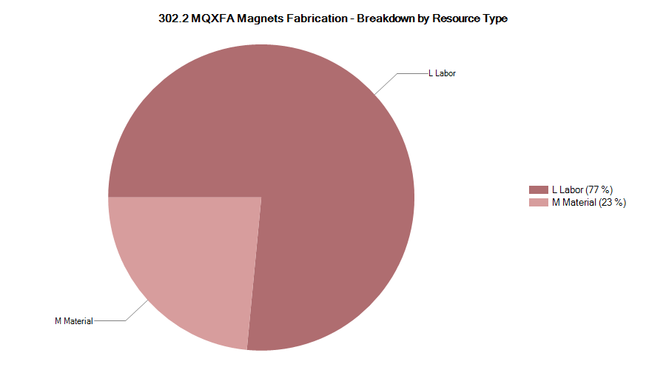

302.2 Resource Type Breakdown
Lab
Logo

Slide 23
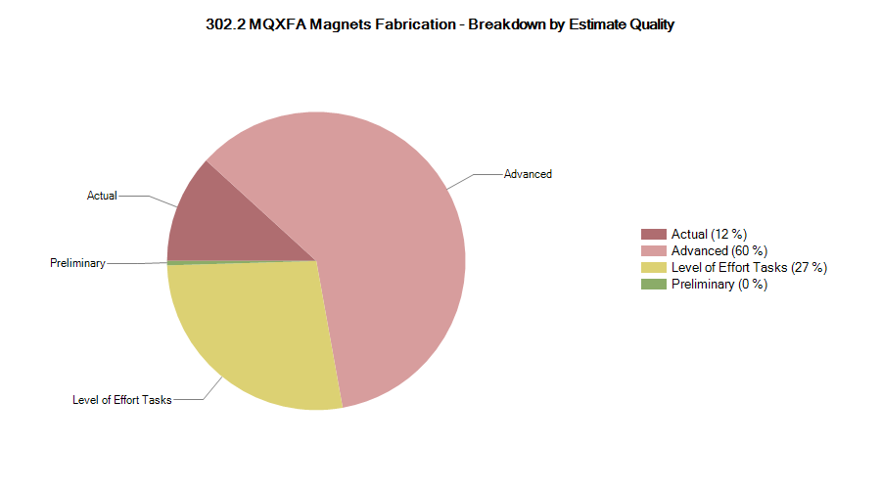
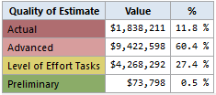
302.2 Estimate Quality

Slide 24
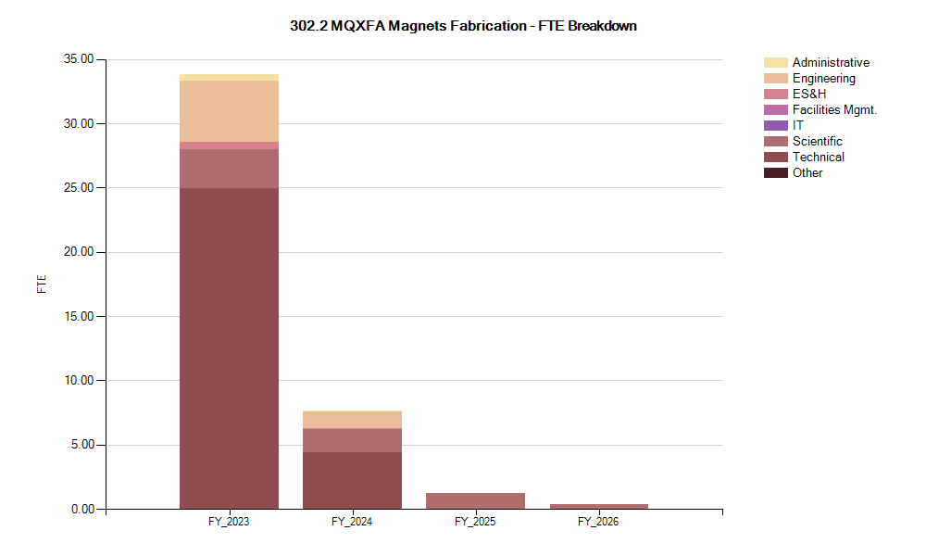
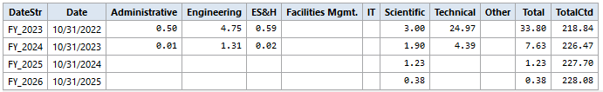
302.2 FTE Breakdown

Slide 25
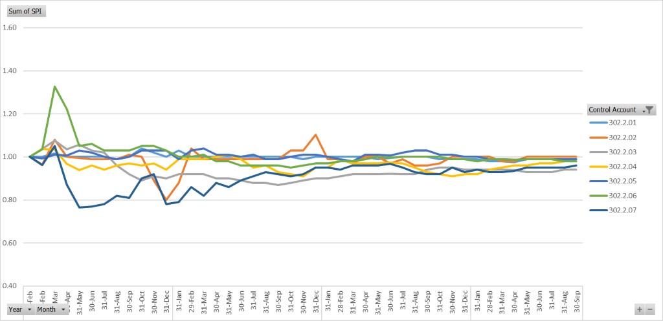
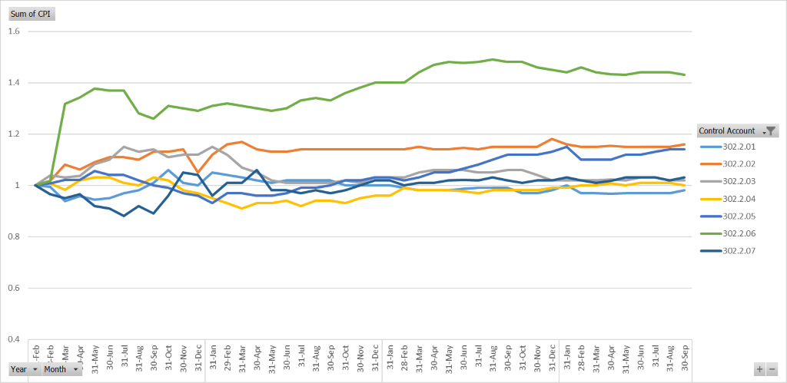
302.2 CA SPIs & CPIs

Slide 26
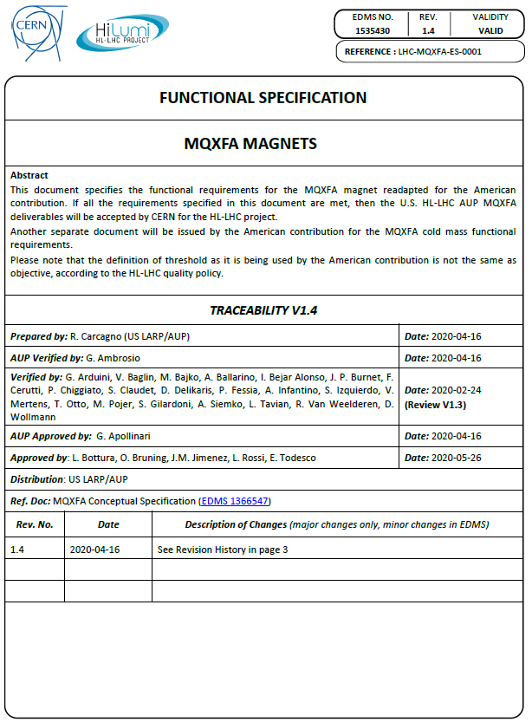
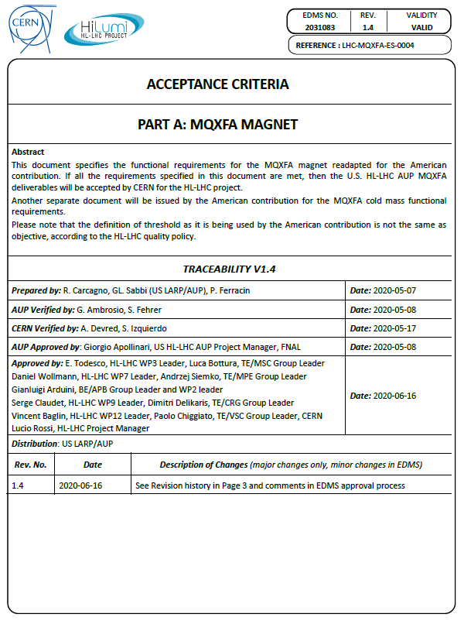
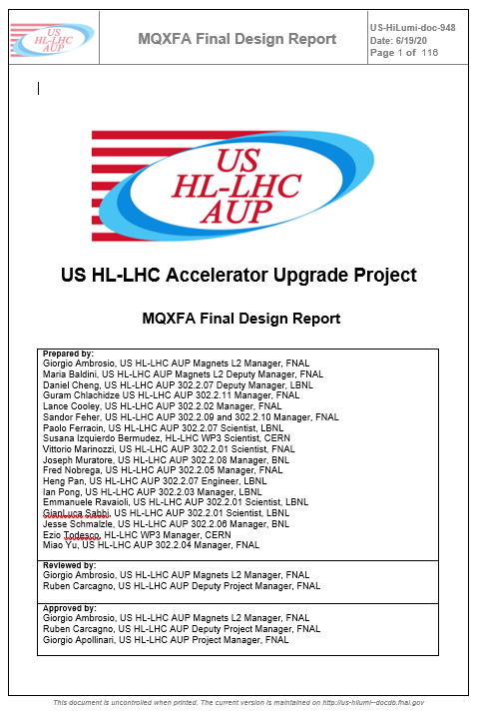
Requirements, Acceptance Criteria, FDR
All complete and approved
US-HiLumi-doc-36
US-HiLumi-doc-1103
US-HiLumi-doc-948

Slide 27
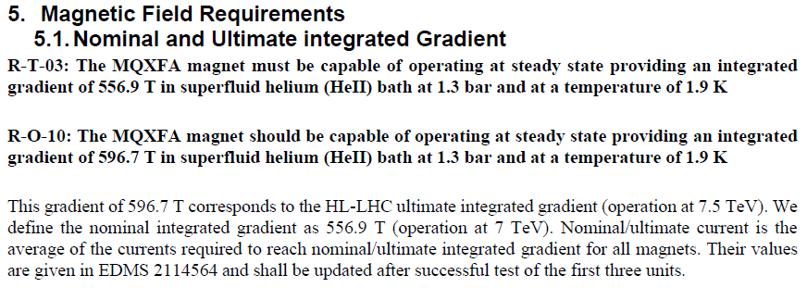
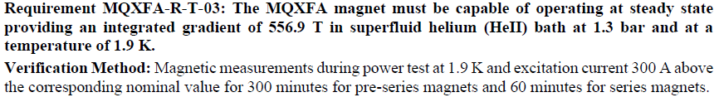
Most Demanding Requirement
Charge #9
MoSTTTT
All complete and approved
Functional Requirements Specification (US-HiLumi-doc-36)
Acceptance Criteria (US-HiLumi-doc-1103)
MQXFA03/04/05/06/10/11 met this requirement; MQXFA07/08 did not

Slide 28
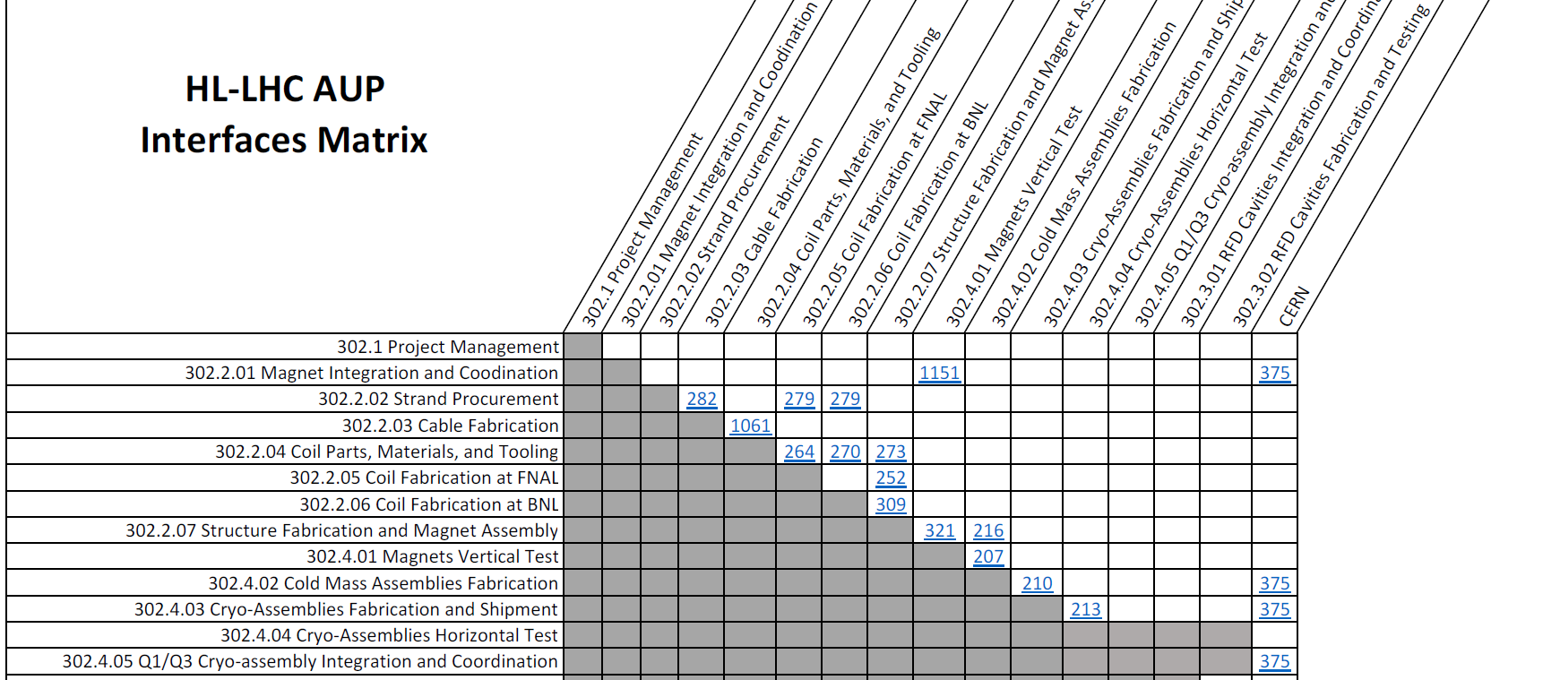
Interfaces
  Project Integration Plan: US-HiLumi-doc-1166
  Interface Control Matrix: US-HiLumi-doc-219
  Interface Control Document for each interface
    Approved by L3s, L2s, System Integrat. Engineer and Project Office
    They were reviewed during Production Readiness Reviews
  No external dependency left
Interfaces description in L3 talks
All Q1/Q3 Interfaces with CERN in a single document

Slide 29
Magnet Interface Specification
Charge #9
US-HiLumi-doc-1674
CERN-EDMS-2031177
Interfaces between Magnet and Cold-mass
  Mechanical (including Cold-mass welding and cooling)
  Electrical
Interfaces with CERN systems through the Cold-mass
  Quench protection
  Instrumentation

Slide 30
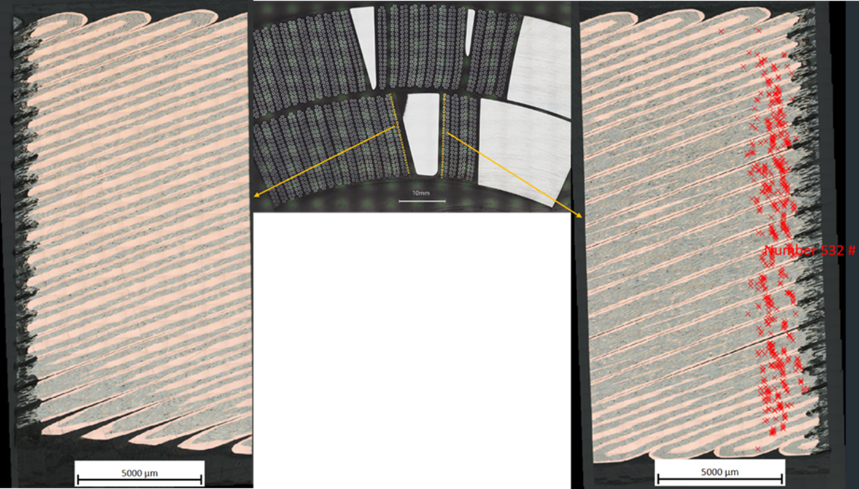
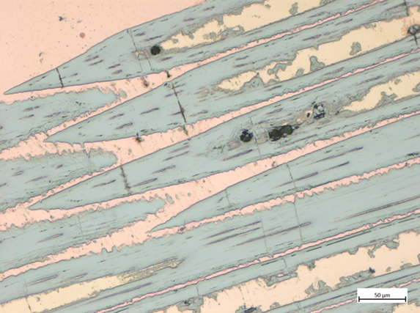
MQXFA07 and MQXFA08 NC analysis
MQXFA07 and MQXFA08 non-conformity analysis is complete
  MQXFA07 analysis is available (in doc-4293 and on review website)
  Smoking gun (broken Nb₃Sn filaments) was found through metallographic analysis by CERN team
  Two lessons learned
  Four causes, three of them COVID related
  ➔ COVID attribution: 67% (explanation in RCA document)
  Dedicated presentation in Magnet parallel session
All causes have been addressed for future magnets
Cable sections with broken filaments (red marks)

Slide 31
Technical Status @ end of September
Charge #5
All major procurements are complete
  A few parts/spools were rejected and are to be returned∗
Most CAs have completed all/major discrete activities
  % complete is based on EVMS (includes procurement)
Actual yield (*includes COVID impact) vs. yield in Baseline:
WBS element | % complete | Yield in BL | Actual yield
Strand procurement | 100%∗ | - | -
Cable fabrication | 100% | 90% | 95.6%
Coil part procurement | 95.7% | - | -
Coil fabr. at FNAL | 96.1% | - | 82.4%
Yield after test | - | 82.4% | 78.9%*
Coil fabr. at BNL | ~100% | - | 88.0%
Yield after test | - | 82.4% | 80.0%*
Structures and Magnets | 88.8% | - | -
Yield after test | - | 83.3% | 75.0%*
As of end of October

Slide 32
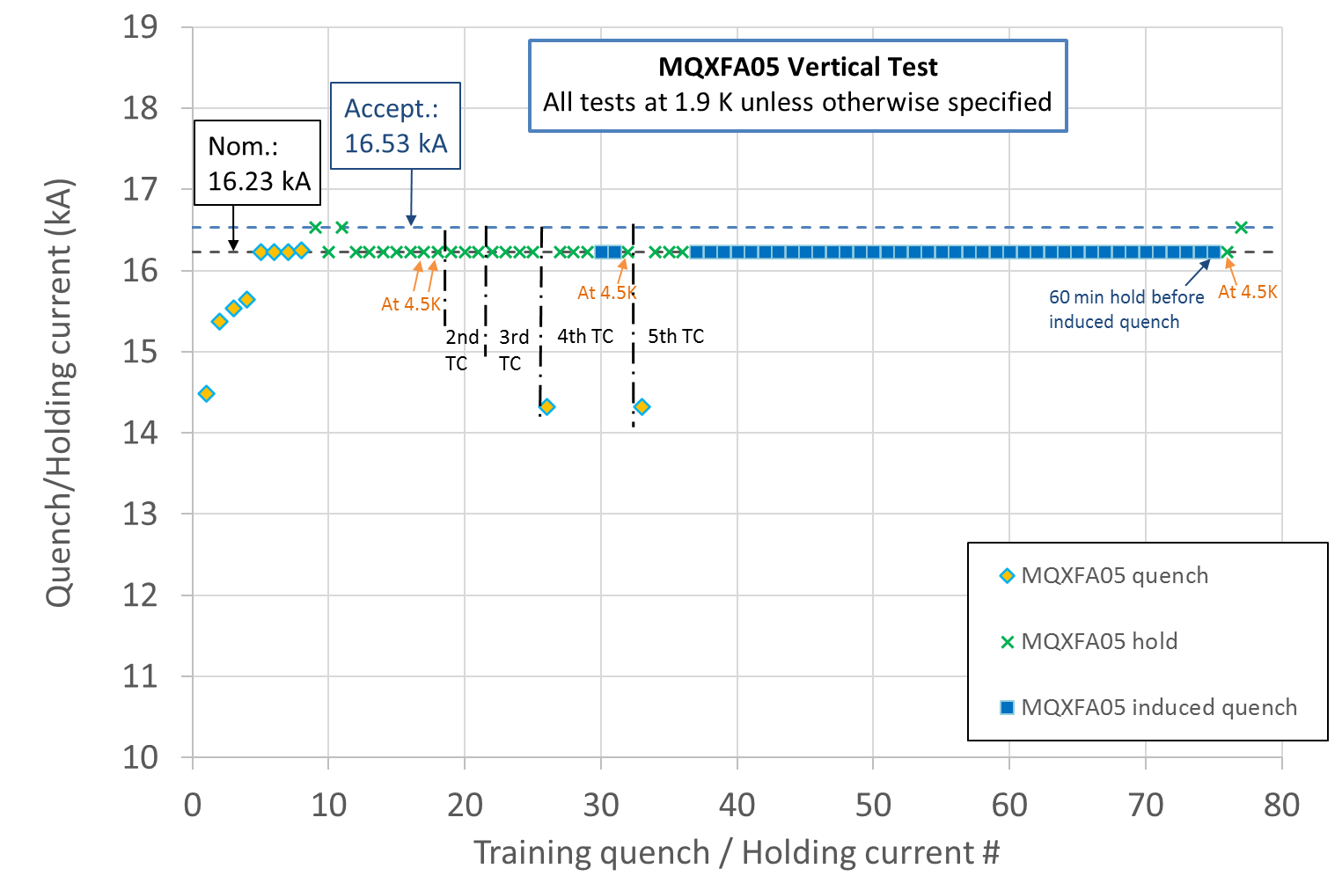
Endurance Tests
Previous endurance tests were successfully performed on short models
MQXFA05 met requirements after 5 thermal cycles, 52 quenches and 79 powering cycles
5 Thermal cycles
52 quenches (10 spontaneous + 42 induced)
79 power cycles (52 quenches + 27 cycles w/o quench) above 10 kA.

Slide 33
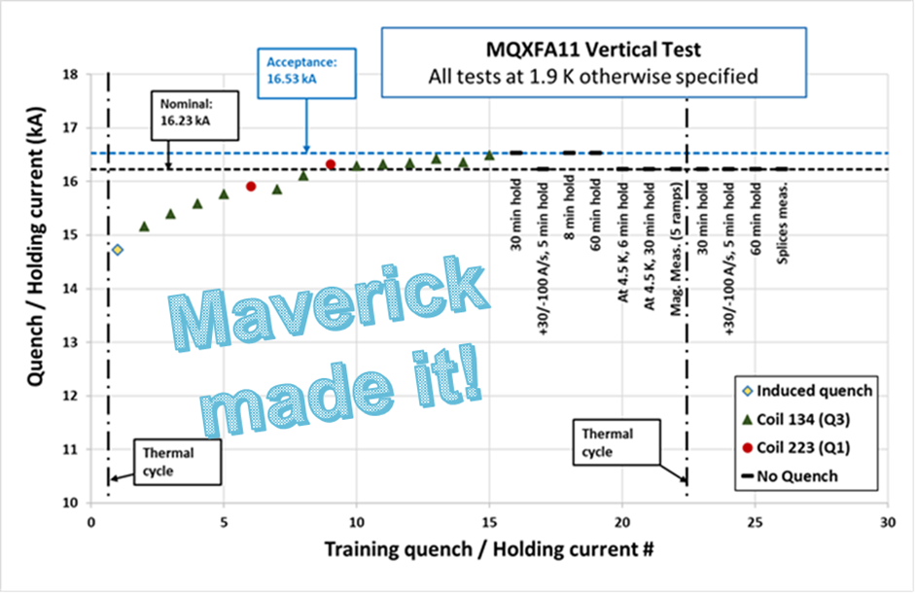
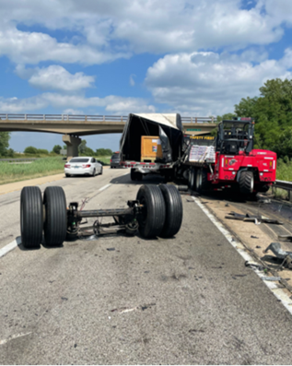
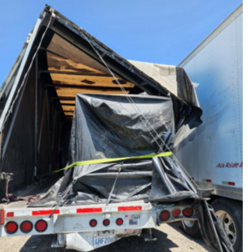

MQXFA11 truck incident
The truck transporting the MQXFA11 magnet from LBNL to BNL was rear ended by another truck on 7/20/22.
The main hit took place on the right back corner. During the incident the truck rear axle disengaged as displayed below.
The magnet was moved to FNAL on 7/28/22. Upon arrival a visual inspection was performed followed by electrical checkout, metrology survey, analysis of the fiber optic sensors and accelerometer data analysis
  Max shock: 6 or 10 g vertical (depending on the device in the same accelerometer unit)
  Duration: 5 ms
All tests and analyses were OK. Magnet was shipped to BNL
No Personal Injury to driver

