Slide 1


SATIF-16 Workshop Highlights
Dali Georgobiani
MARS Group – AD / TSD
TSD Topical Meeting
18 July 2024

Slide 2
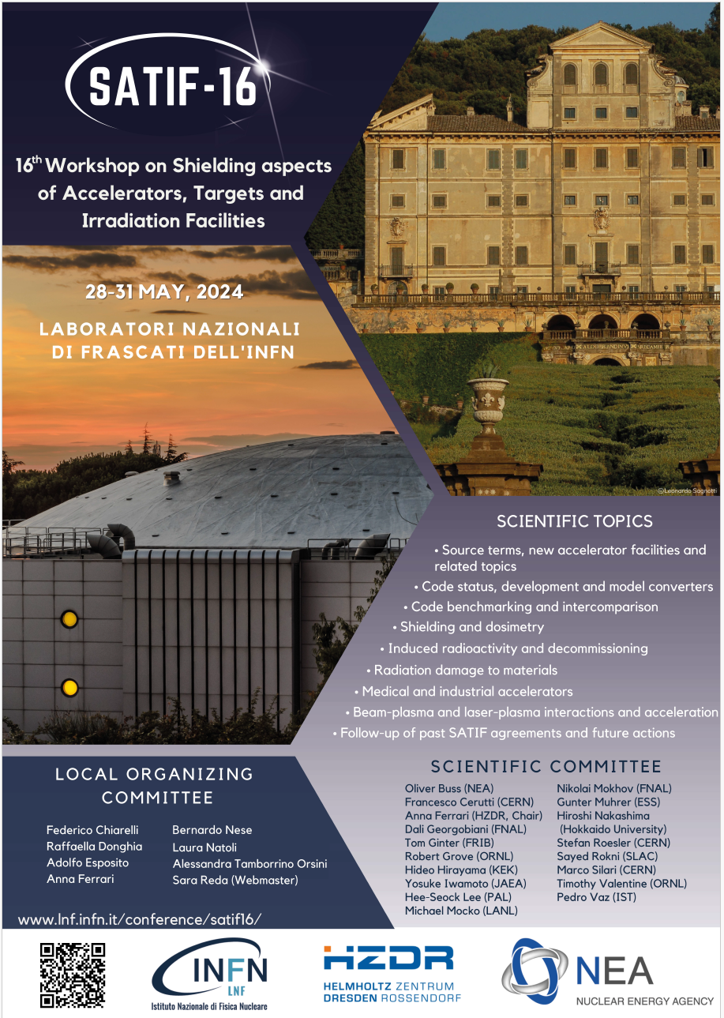
SATIF Workshops
SATIF objectives are:
To promote the exchange of information among
experts in the field of accelerator shielding
and related topics;
To identify areas where international cooperation
can be fruitful;
To create task forces in order to
achieve progress in specific priority areas.
SATIF workshops have been held once every
two years since 1994, alternating between
the US, Europe, and Asia. In addition to
organizing these workshops, the SATIF group
also coordinates analysis and
proposes action items.
Dynamic environment, exchange of ideas,
discussions, new collaborations formed

Slide 3
SATIF Topics
SATIF topics are:
Source terms, new accelerator facilities and related topics
Code status, development and model converters
Code benchmarking and intercomparison
Shielding and dosimetry
Induced radioactivity and decommissioning
Medical and industrial accelerators
Beam-plasma and laser-plasma interactions and acceleration
Radiation damage to materials
Follow-up of past SATIF agreements and future actions
SATIF-1 was held 30 years ago, in 1994, in Texas, USA
During SATIF-16, a Special Session: Thirty years of SATIF was organized by Anna Ferrari
Long-time SATIF member Hideo Hirayama (KEK) gave a talk. Hirayama-san participated
in all 16 SATIF workshops as a member of the SATIF SOC and a session chairman!
Nikolai Mokhov (the MARS code creator, FNAL – retired), also a long-time
SATIF member and the SATIF SOC member, gave a speech remotely.

Slide 4
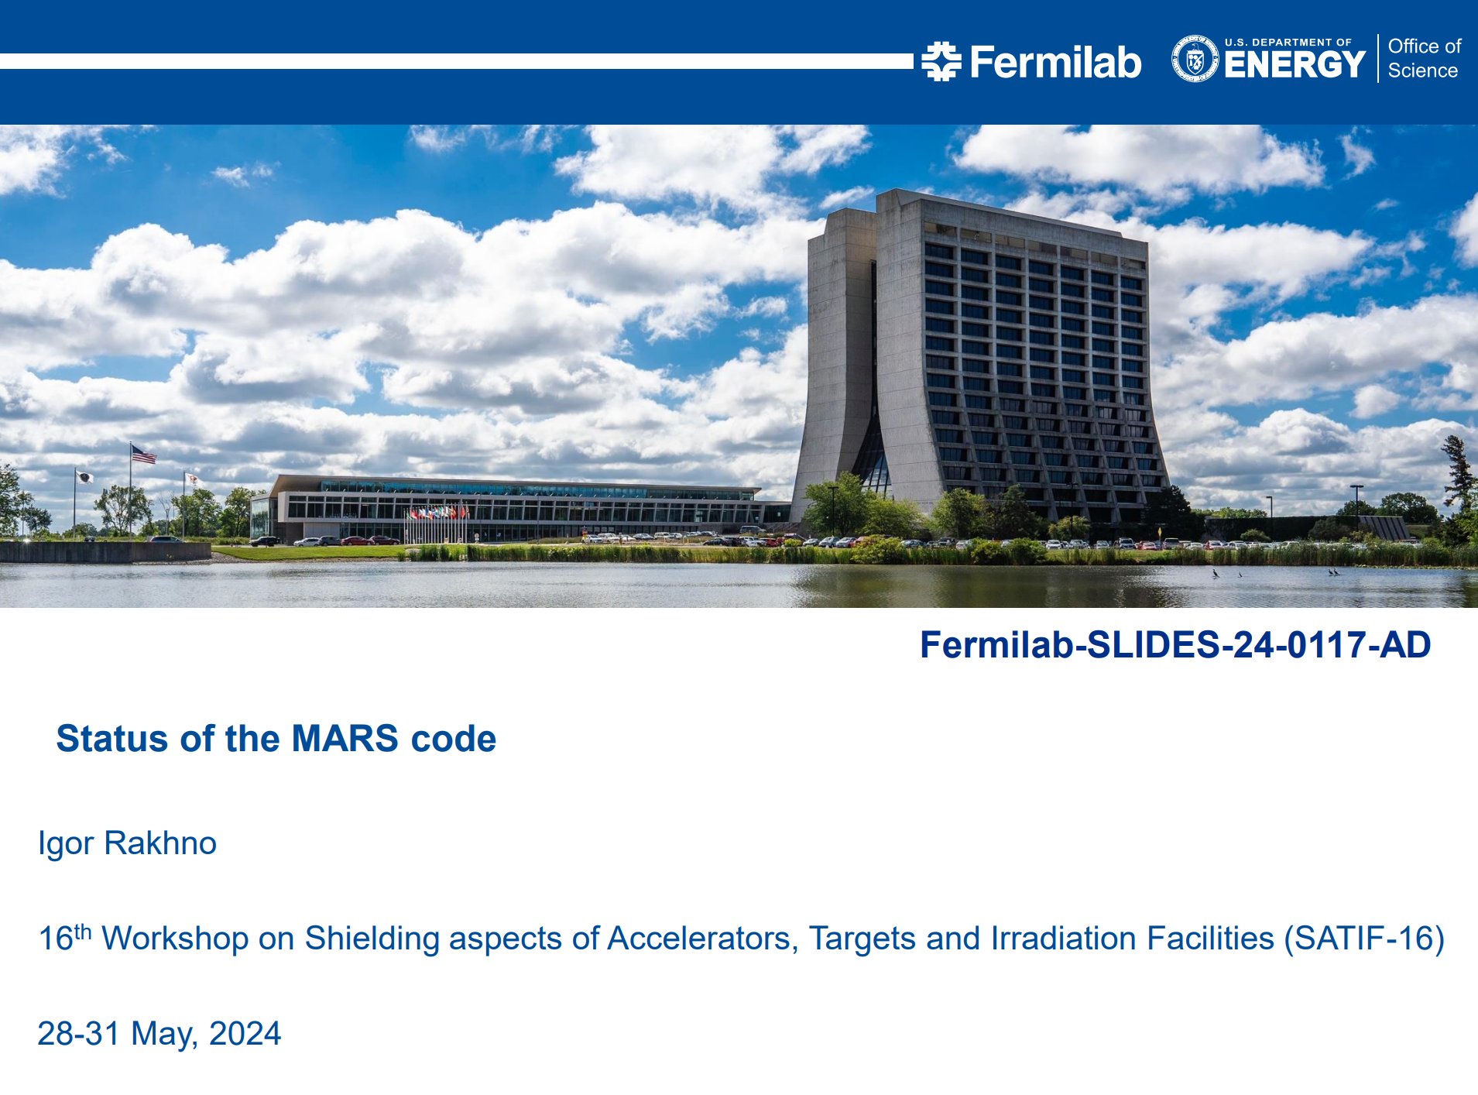
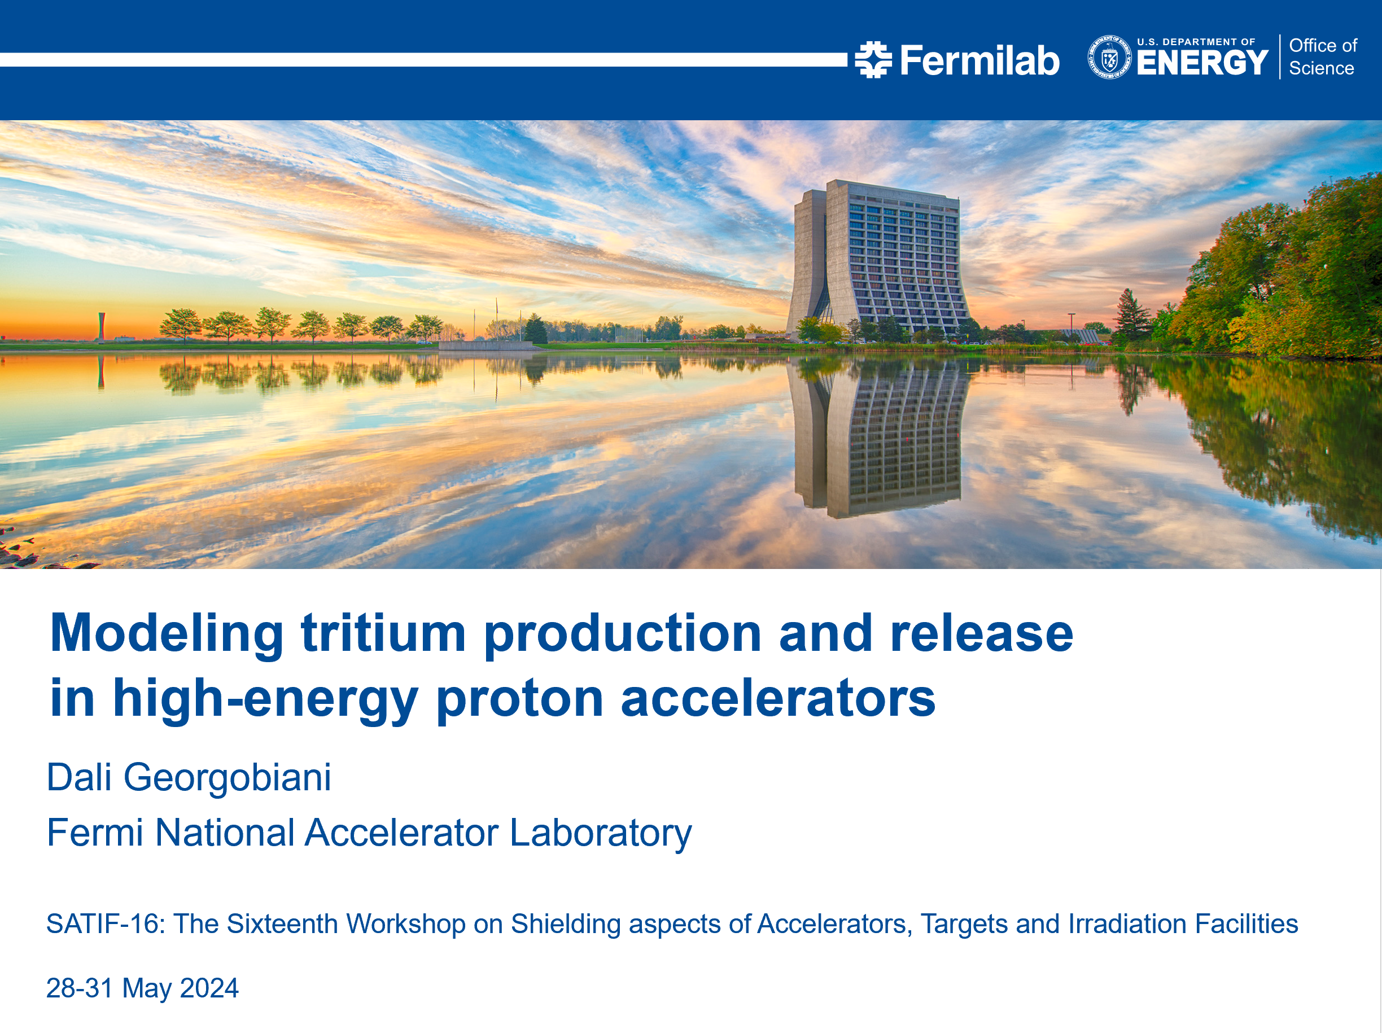
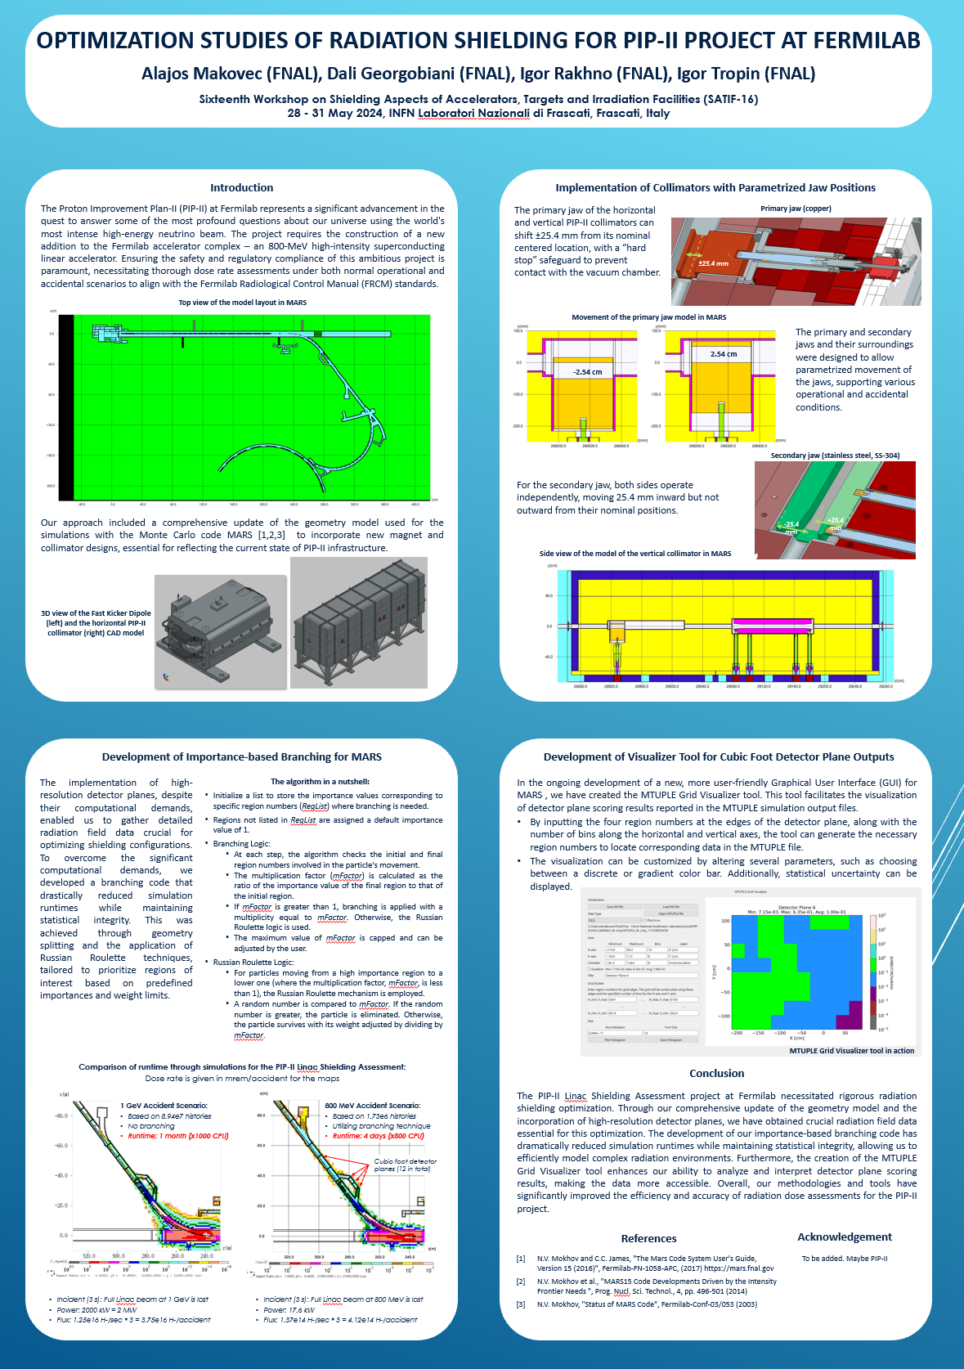
FNAL MARS Group: 2 Talks + 1 Poster
Session #.Talk # → 1.1
2.7
Poster
1.2
IR and DG participated in-person
IT participated remotely
All MARS group member talks were
collaborative efforts among the group

Slide 5
Workshop Highlights [1]
Discussion of the advancements and applications of the major rad transport codes is one of the most important aspects of SATIF
Experts of FLUKA and MARS presented code development progress,
new features and modules
Surprisingly, there was no general PHITS-code development talk
  On the other hand, there were talks showcasing some PHITS updates and revisions (e.g., Treatment of low-E heavy particle fusion reactions in PHITS, H. Iwase et al)
As usual, MCNP developers didn’t participate; on the other hand, MCNP applications, presented by both LANL and ORNL experts, demonstrated powerful techniques, particularly variance reduction implementation
  MCNP team organizes annual MCNP User Symposia (LANL, hybrid mode – next on August 19-22, 2024); also, MCNP + various modules are available on GitHub
Lasers; medical; multitude of code applications at various facilities
Material radiation damage studies & tests, rad effects on electronics

Slide 6
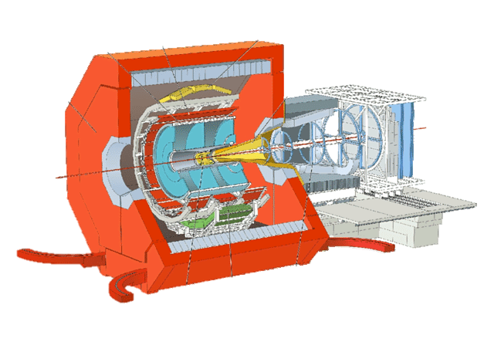
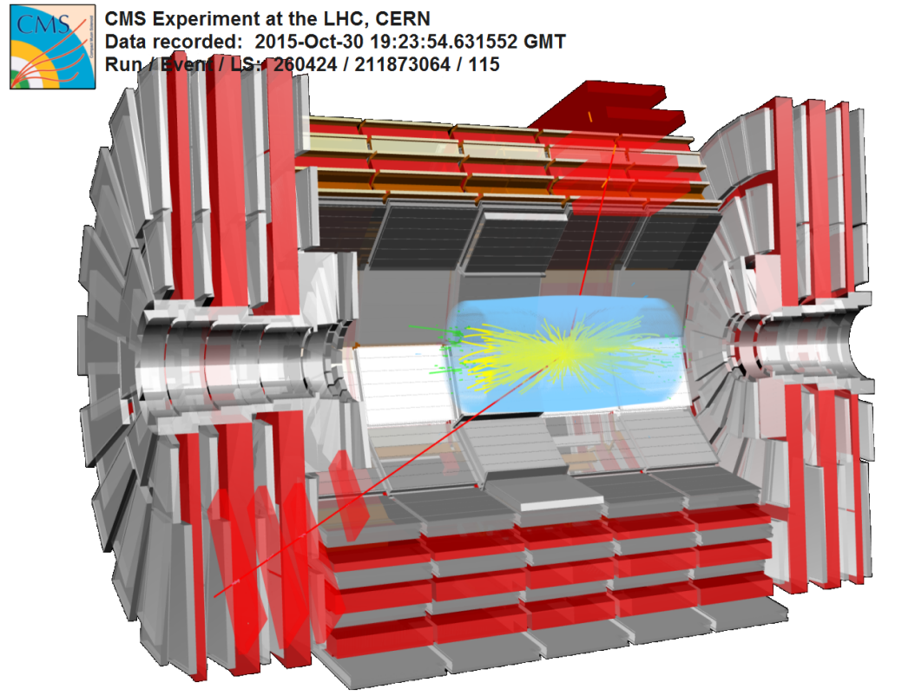
Workshop Highlights [2]
Newcomers to SATIF: heavy ion facilities (FRIB)
Electron facilities presenting a challenge of high-power electron beams
(LCLS-II at SLAC; XFEL at DESY; ELBE at HZDR; NSLS-II at BNL; SLS at PSI)
Development of new or improved
neutron and photon dosimeters
  Tetra-Ball at INFN-LNF
Nuclear data libraries; measurements of nuclide production cross-sections
(details in Igor Rakhno’s talk)
Overwhelming presence & participation of the CERN colleagues (LHS, CHARM, …)
FLUKA benchmarking with measurements:
LHC residual doses (Vasco Mendes, CERN) –
highly complex FLUKA models with all the
LHC beam elements; very good agreement
between the calcs and measurements

Slide 7
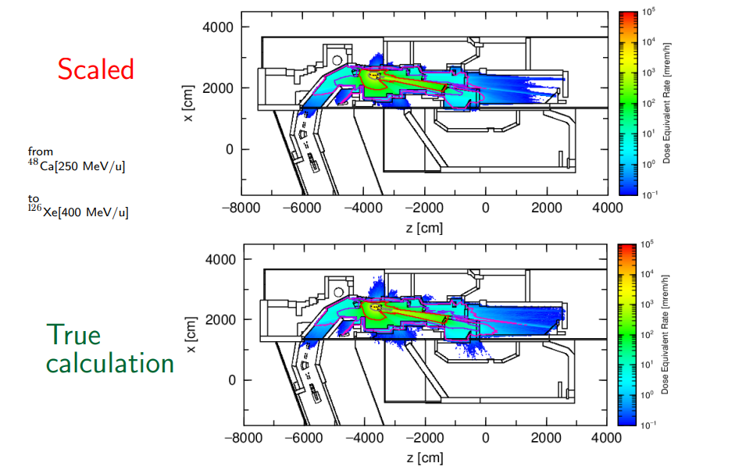
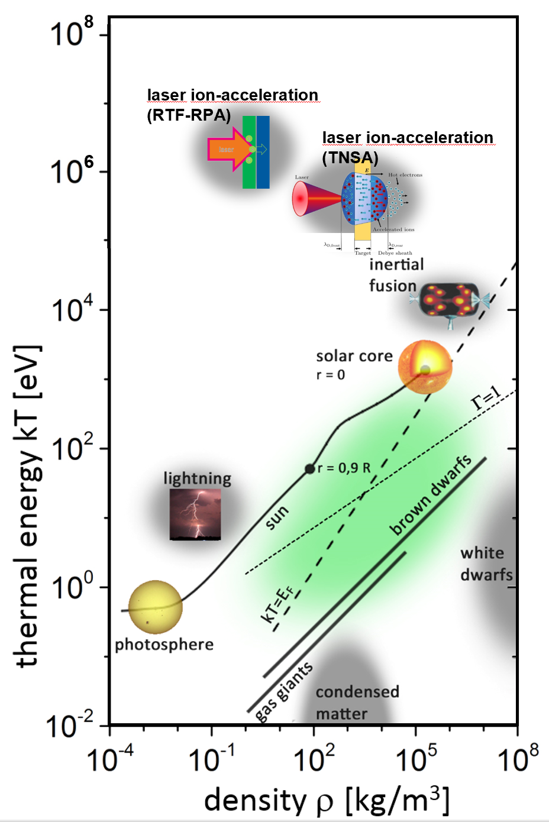
Workshop Highlights [3]
AI/ML application
  Bayesian Uncertainty Quantification
  for RT Calcs at FRIB (Juan Zamora, FRIB)
  Application of ML in Rad Shielding
  at FRIB (Raj Chowdhury, FRIB)
Laser-plasma interactions
  Ultra-intense, high-power lasers generate matter
  under extreme conditions
  Lasers used to build compact particle accelerators
  Ionizing radiation from laser – target matter interactions
  State-of-the-art talks by Anna Ferrari (HZDR),
  Sayed Rokni (SLAC), Thomas Kluge (European XFEL),
  Roberto Versaci & David Horvath (ELI Beamlines)

Slide 8
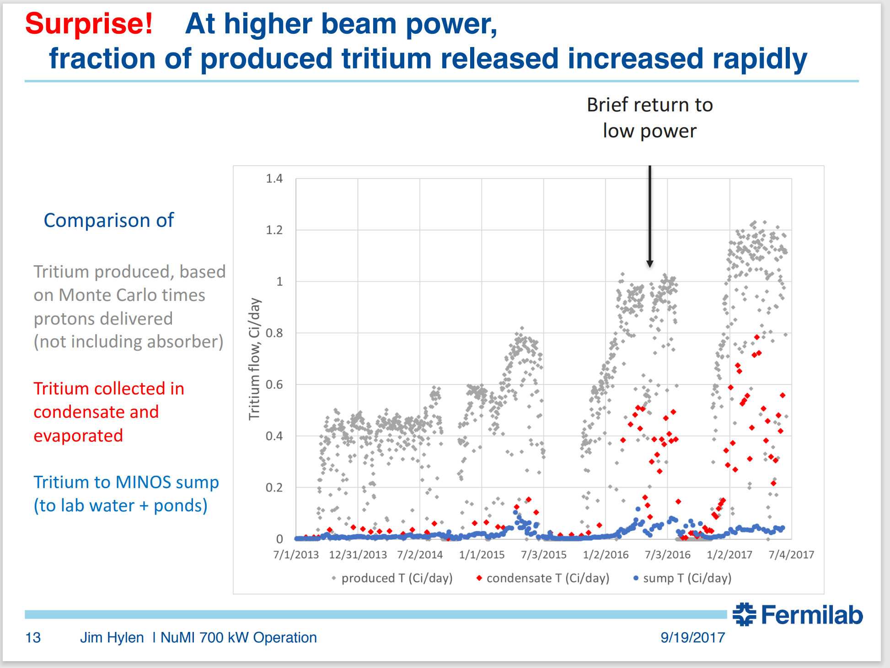
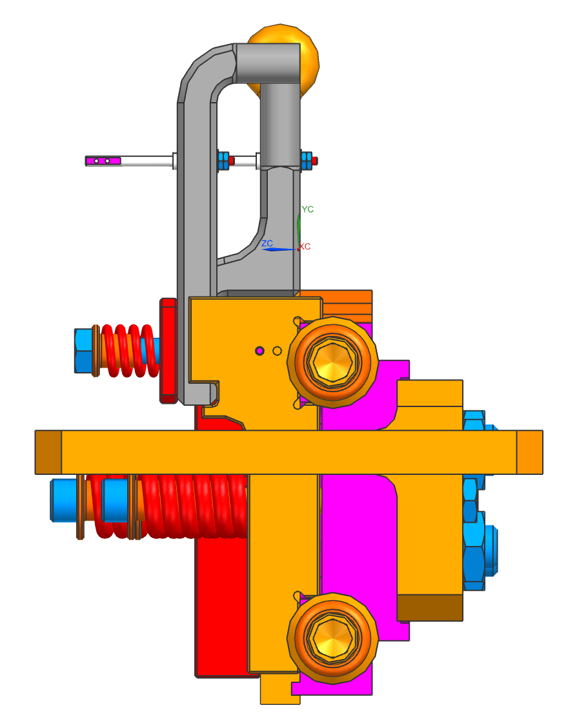
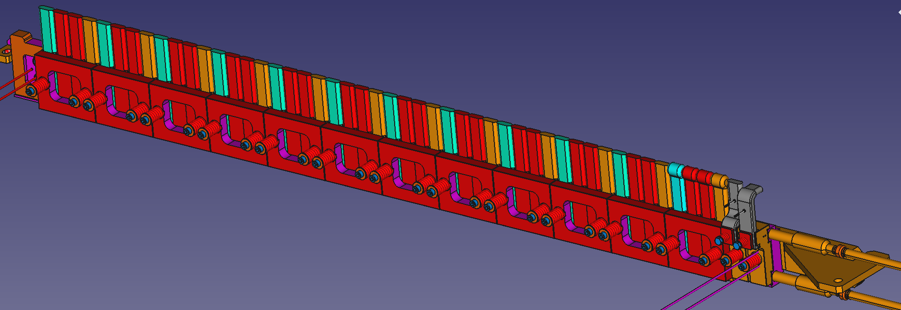
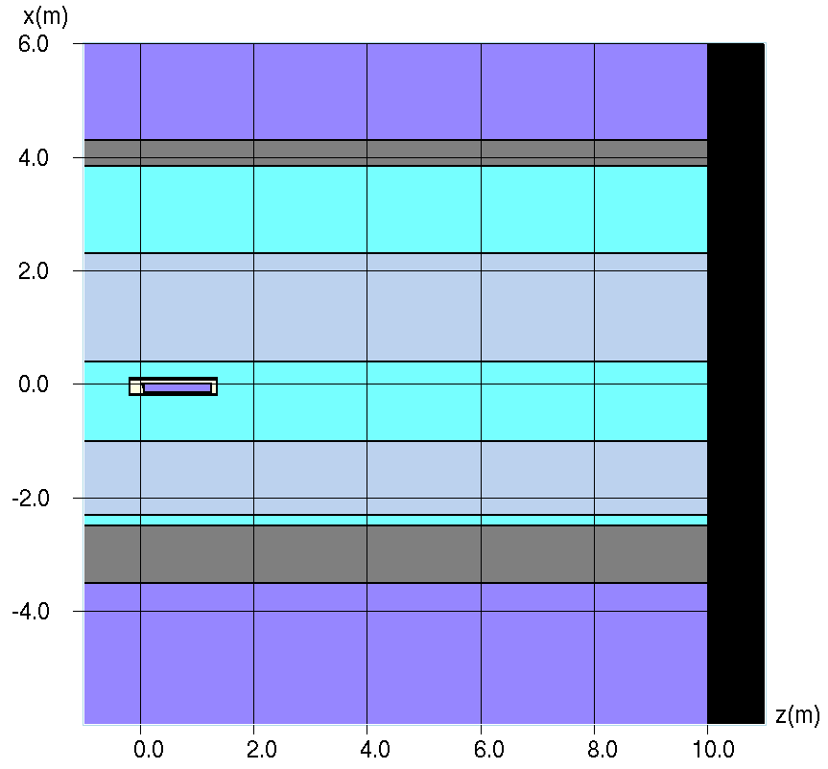
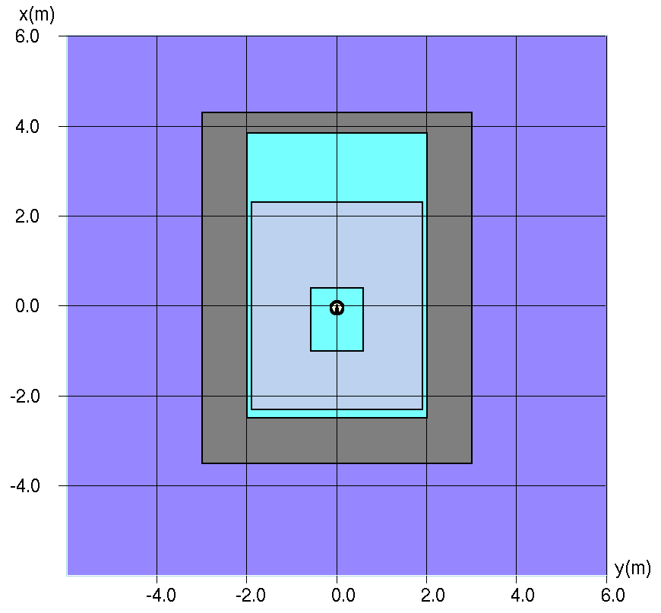
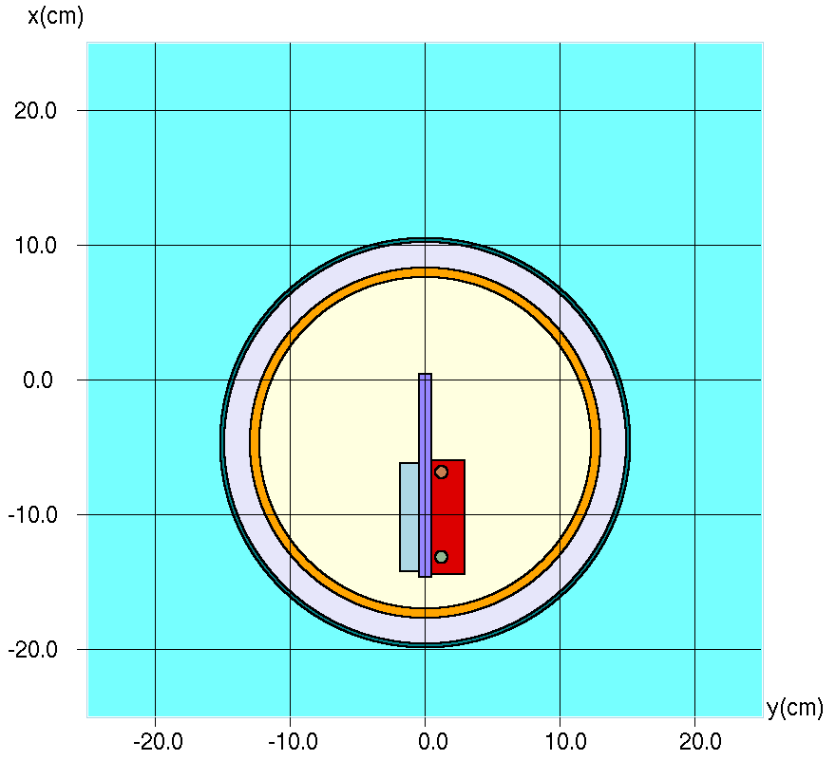
Modeling Tritium Production & Release in High-Energy Proton Accelerators [1] Dali Georgobiani, FNAL
1.2
Solution, Part 1: Tritium Production
Problem
Starting with NuMI target…
Simple model for 3H production estimate
Using 3 major Monte-Carlo rad codes:
FLUKA (Alajos), MARS (Dali),
PHITS (Tom Ginter, FRIB)
(Code intercomparison wrt H3 production!)
Input: 120 GeV/c protons, 1.1 MW (ideally),
effective intensity 5.25e13 pps
Output: 3H production rates, activation
(1y beam on; instant and 1y beam off)
NuMI target ME model, front view
Simple MARS model of the NuMI target components and shielding
Elevation view
Cross-section
Air
Graphite
NuMI target: graphite fins
in aluminum (ME model)
Steel
Water
Beam
Target
He
Concrete
Al

Slide 9
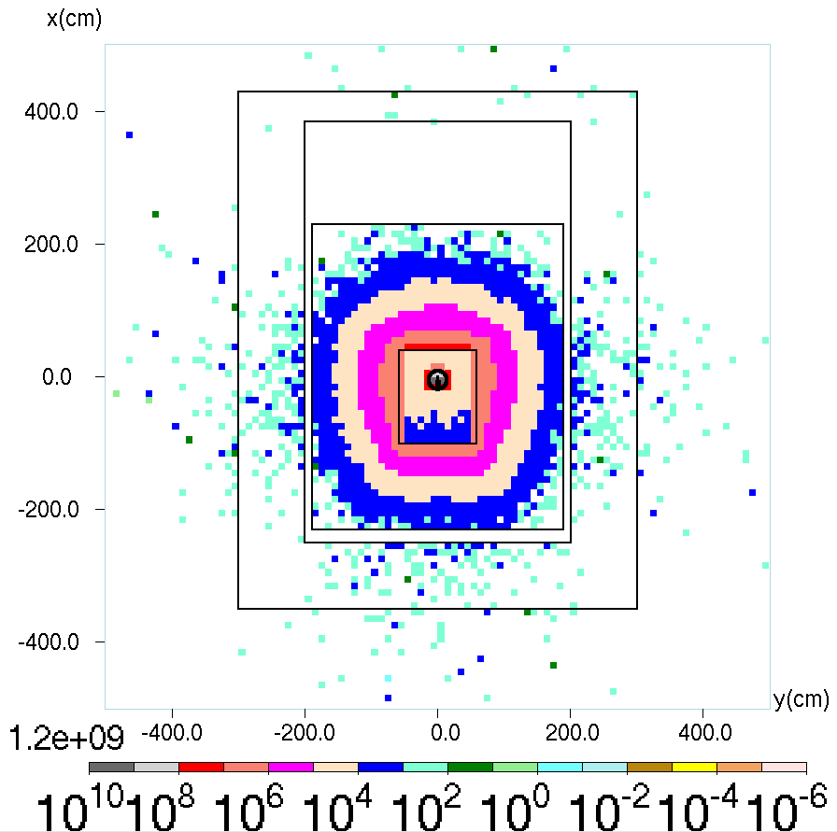
Modeling Tritium Production & Release in High-Energy Proton Accelerators [2]
Solution, Part 1: Tritium Production
Tritium production rates
What could cause
the differences?
Let’s compare the HE hadron fluxes.
3H production rate (3H/cm2/s)
High Energy Hadron Flux in Components
Using a calculated tritium
production cross section to estimate production rates from HE hadron fluxes for each code.
Total HE hadron fluxes are almost identical in graphite across the 3 codes.
Therefore, it’s the tritium production cross section difference that makes
the tritium production rates different between these codes.
Indeed, the production rates estimated from the cross sections are the same between the 3 codes

Slide 10
Modeling Tritium Production & Release in High-Energy Proton Accelerators [3]
Solution, Part 2: Tritium Release
NuMI: at higher beam power, fraction of produced tritium release increased rapidly
  Best explanation: steel shielding temperature increase
  Release amount would always be capped by the production rate
  If all produced tritium would have been instantaneously released into the air, this would represent a worst-case scenario
In reality, tritium is released from different materials on different diffusion lengths and scales
We use activation equation augmented with diffusion term to estimate tritium release
Production rates for release estimates are calculated using MARS
  An example of the diffusion calculation setup:
After 1 year irradiation, 90% of the tritium produced in iron shielding is diffused
After 1 year irradiation and 1 year cooling, 97% of the produced tritium is diffused from iron
At a lower beam power, iron shield T is lower → Diffusion coefficients are lower → Less tritium is diffused from materials
E.g., in the same setup at a room temperature, only 46% of the produced tritium would be released from iron shielding.

Slide 11
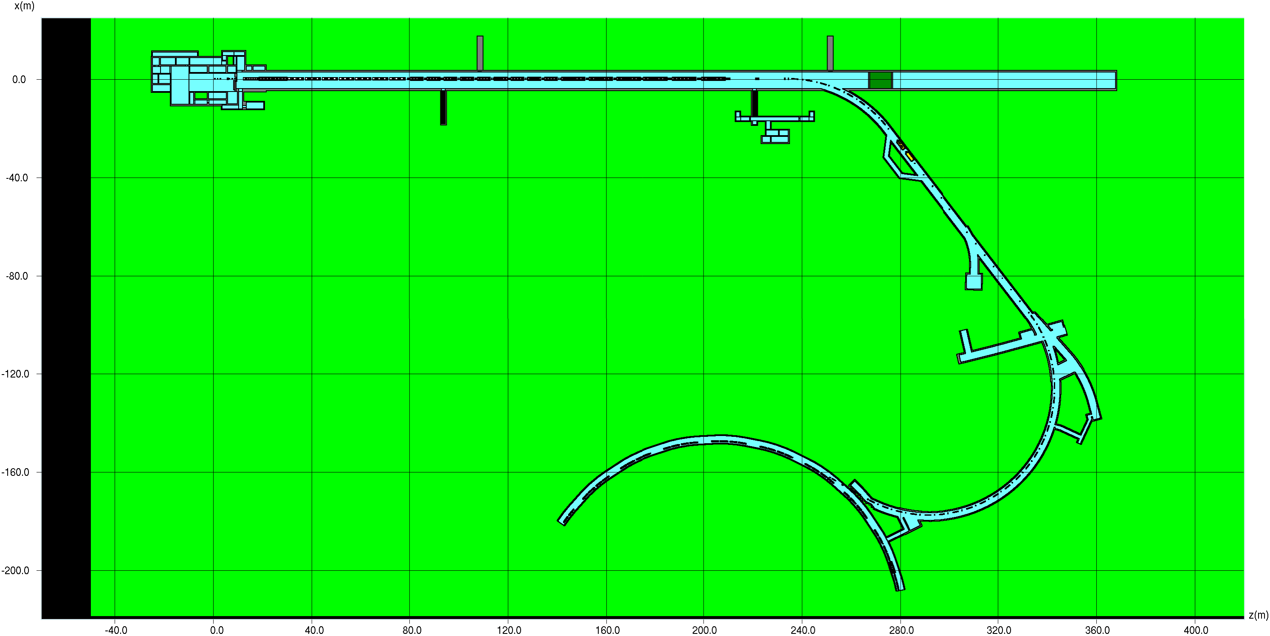
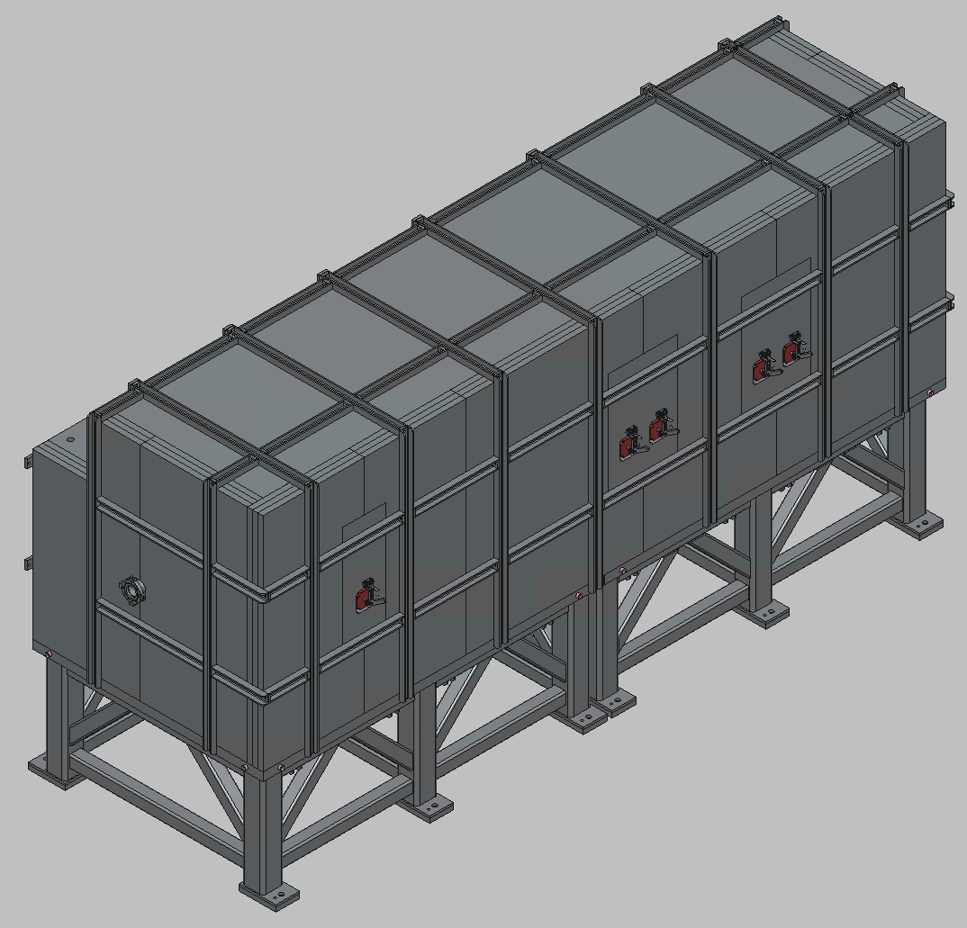
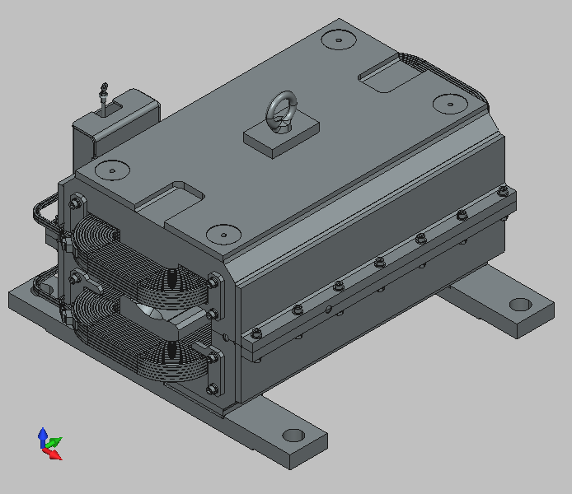
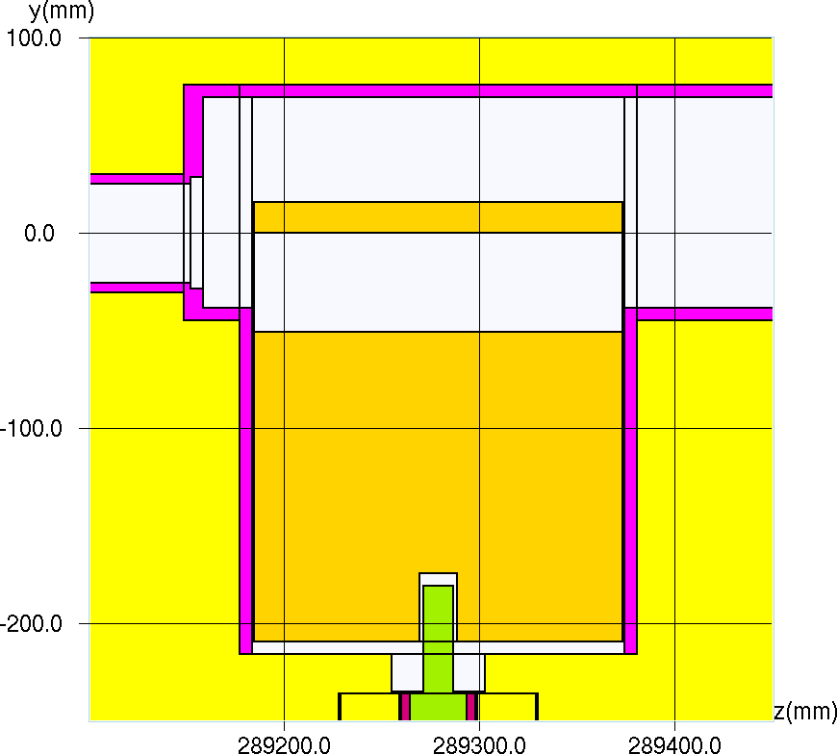
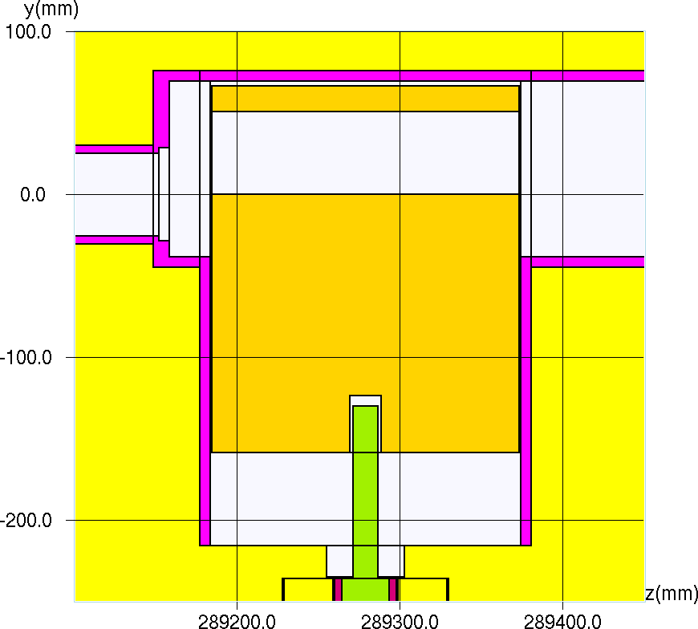
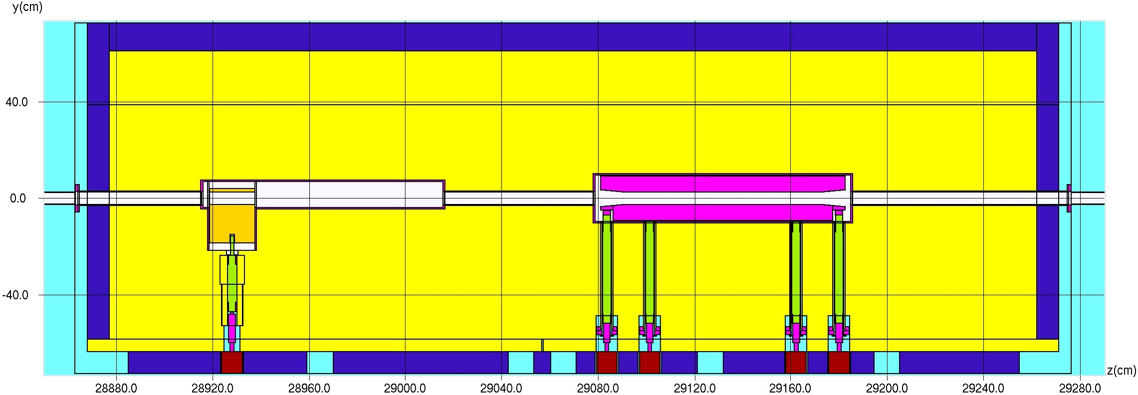
Optimization Studies of Radiation Shielding for PIP-II
Project at Fermilab [1] Alajos Makovec, FNAL
Poster
Addition of new magnet and collimator designs to the existing sophisticated MARS geometry model.
Top view of the beamline model layout in MARS
3D view of the Fast Kicker Dipole (left) and the horizontal PIP-II collimator (right) CAD model
The primary and secondary jaws and their surroundings were designed to allow parametrized movement of the jaws, supporting various operational and accidental conditions.
Movement of the primary jaw model in MARS
Side view of the model of the vertical collimator in MARS
2.54 cm
-2.54 cm

Slide 12
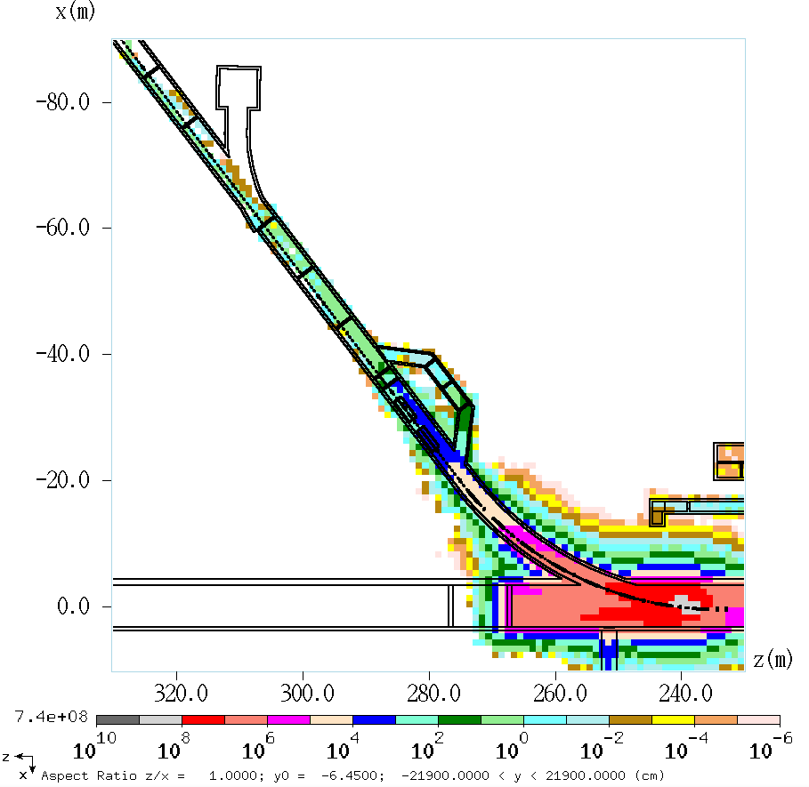
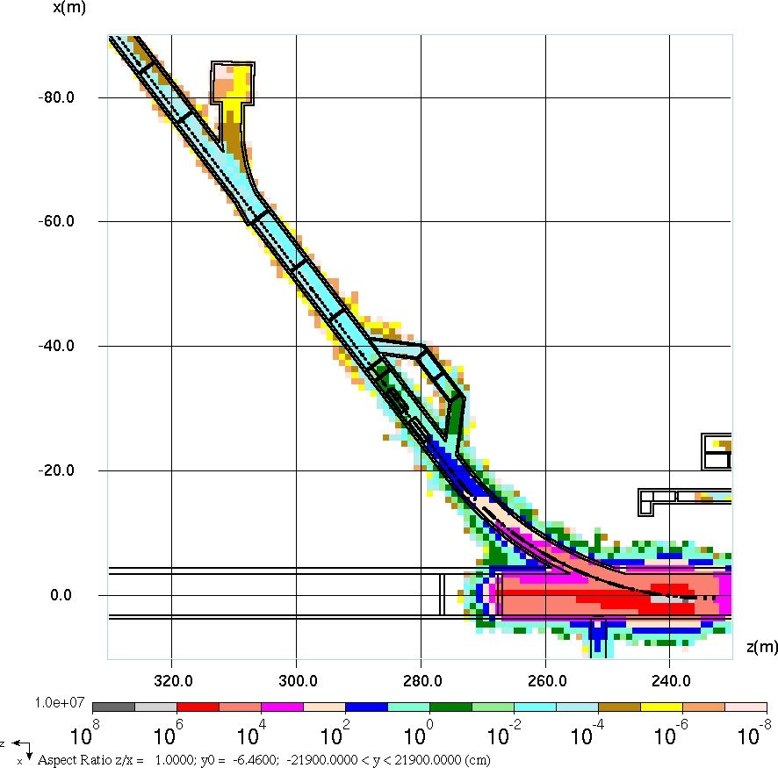
Optimization Studies of Radiation Shielding for PIP-II
Project at Fermilab [2]
The implementation of high-res detector planes enabled us to gather detailed radiation field data crucial for optimizing shielding configurations. To overcome the significant computational demands, we developed a branching code that drastically reduced simulation runtimes while maintaining statistical integrity. This was achieved through geometry splitting and the application of Russian Roulette techniques, tailored to prioritize regions of interest based on predefined importances and weight limits.
1 GeV Accident Scenario:
Based on 8.94e7 histories
No branching
Runtime: 1 month (x1000 CPU)
800 MeV Accident Scenario:
Based on 1.73e6 histories
Utilizing branching technique
Runtime: 4 days (x800 CPU)
Cubic foot detector planes (12 in total)
Incident (3 s): Full Linac
beam at 1 GeV is lost
Power: 2000 kW = 2 MW
Flux: 1.25e16 H-/sec * 3
= 3.75e16 H-/accident
Incident (3 s): Full Linac
beam at 800 MeV is lost
Power: 17.6 kW
Flux: 1.37e14 H-/sec * 3
= 4.12e14 H-/accident
The advantage of branching is not just a faster result (4 days vs 30 days); it provides better statistics (cf. top left corners in both pictures), therefore making branching application even more efficient.

Slide 13
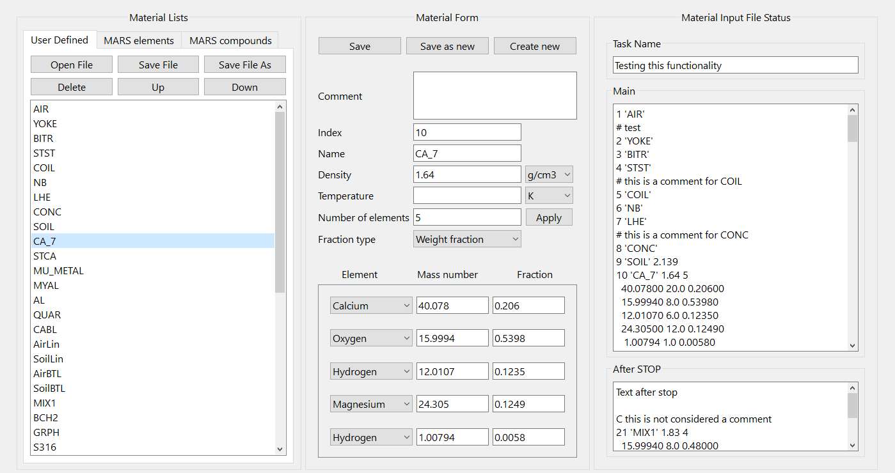
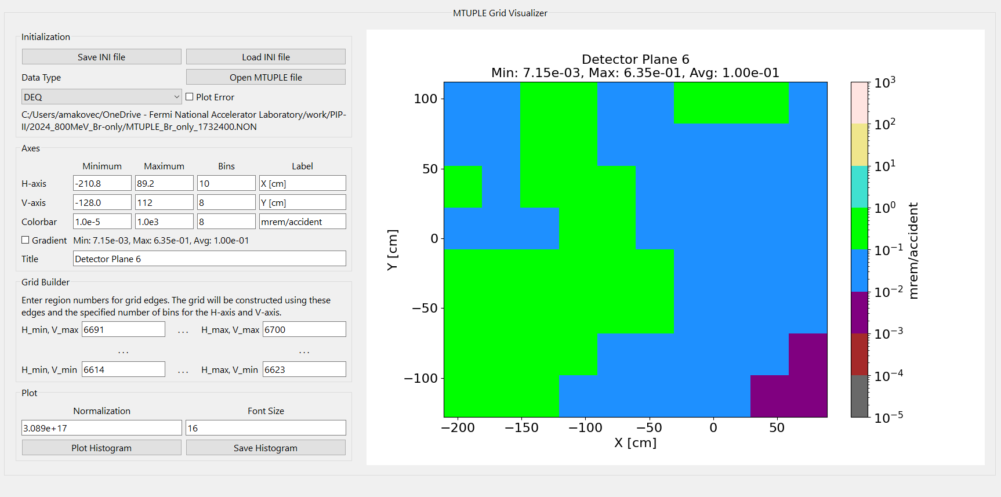
Optimization Studies of Radiation Shielding for PIP-II
Project at Fermilab [3]
Development of a new MARS GUI
The Main Window was created to facilitate switching among different features.
The first fully realized feature is the Material Window, which allows users to:
  Browse predefined MARS elements and compounds.
  Clone or copy these into the current material input.
  Import and export material input files.
  GUI features include visualization and editing of compounds, with conversions between mass and atomic ratios, and temperature conversions between Kelvin and Celsius.
Additional tools developed:
  MTUPLE Grid Visualizer: A tool for visualizing detector plane scoring results from MTUPLE simulation output files.
  Particle Distribution Analyzer (PDA): For visualizing particle distributions from source files.
  Energy Spectra Analyzer (ESpA): For visualizing energy spectra from various sources.
Demonstrated features, to be added:
  Fast (real-time) 2D visualization of geometry for interactive cross-sectional views.

Slide 14
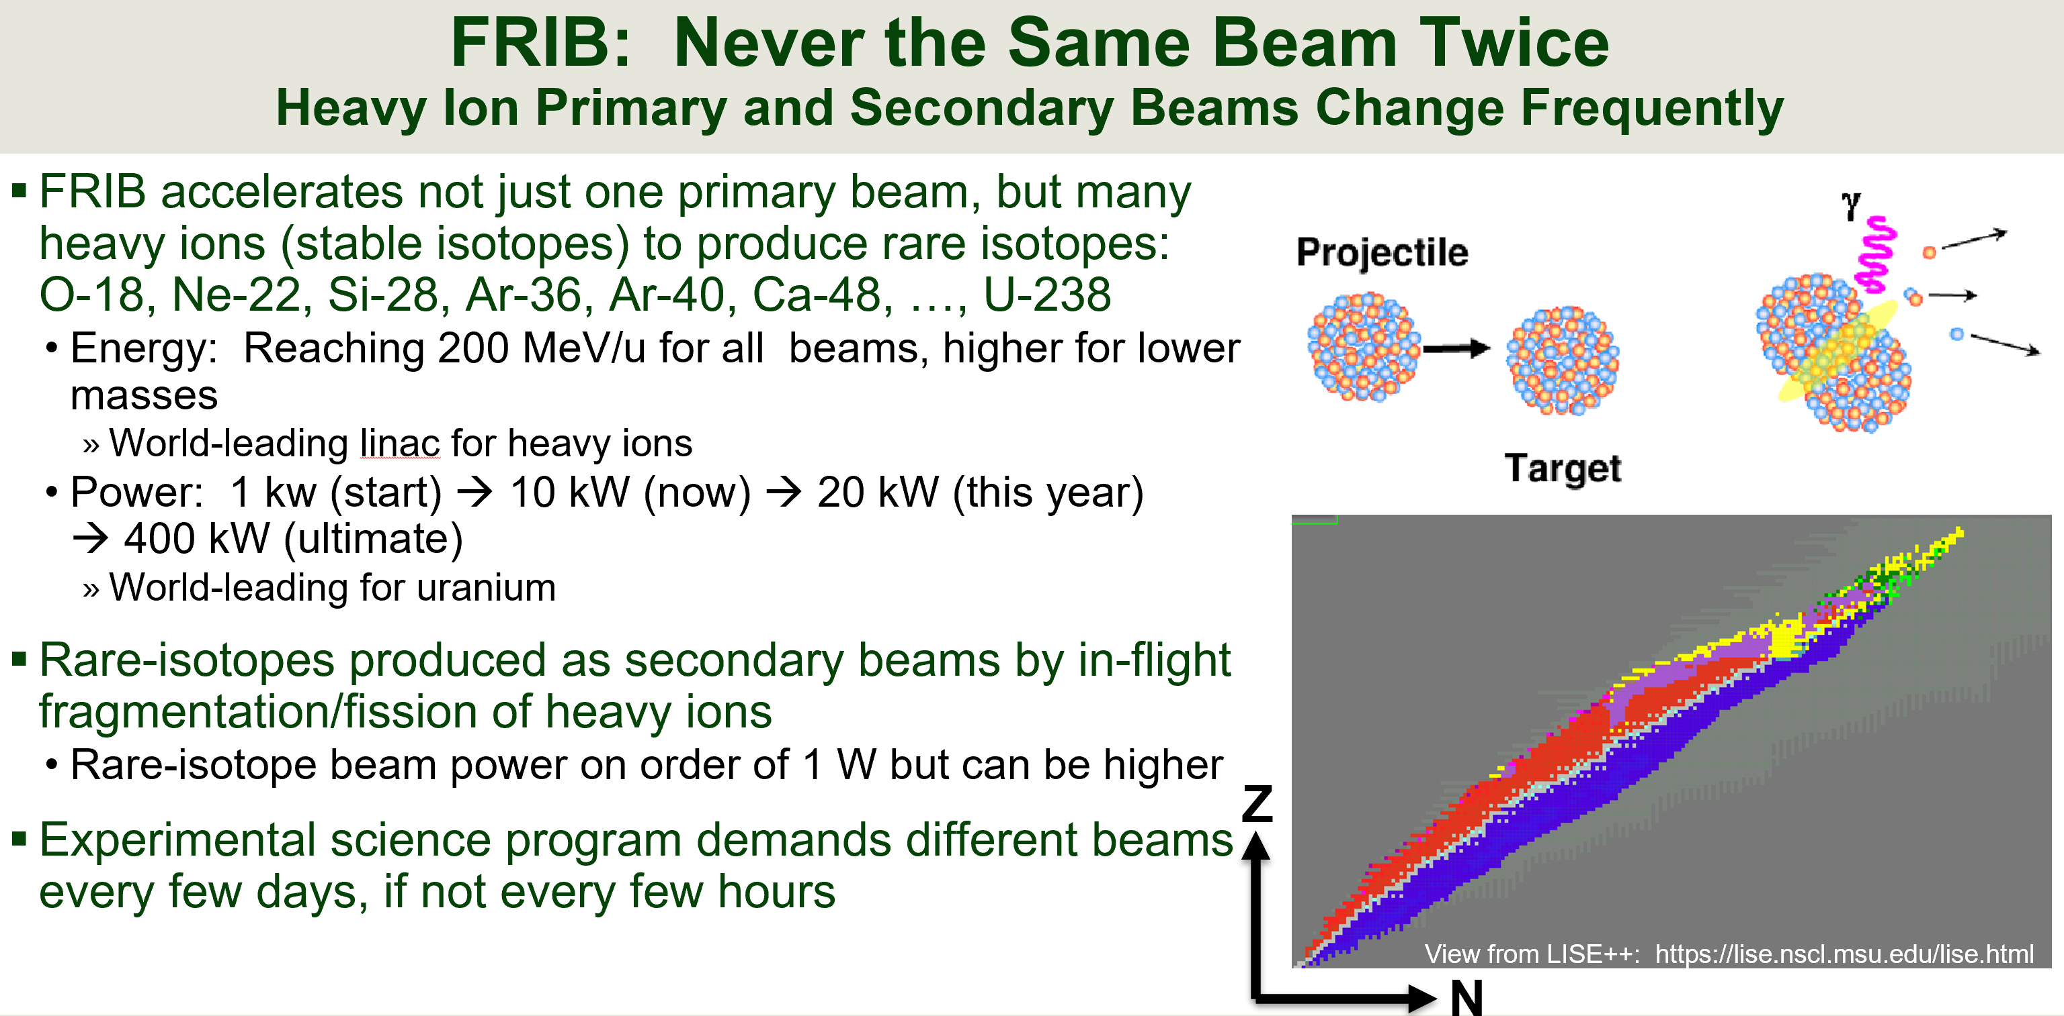
FRIB: Never the Same Beam Twice [1]
Tom Ginter, FRIB
1.1
FRIB – Facility for Rare Isotope Beams at Michigan State U

Slide 15
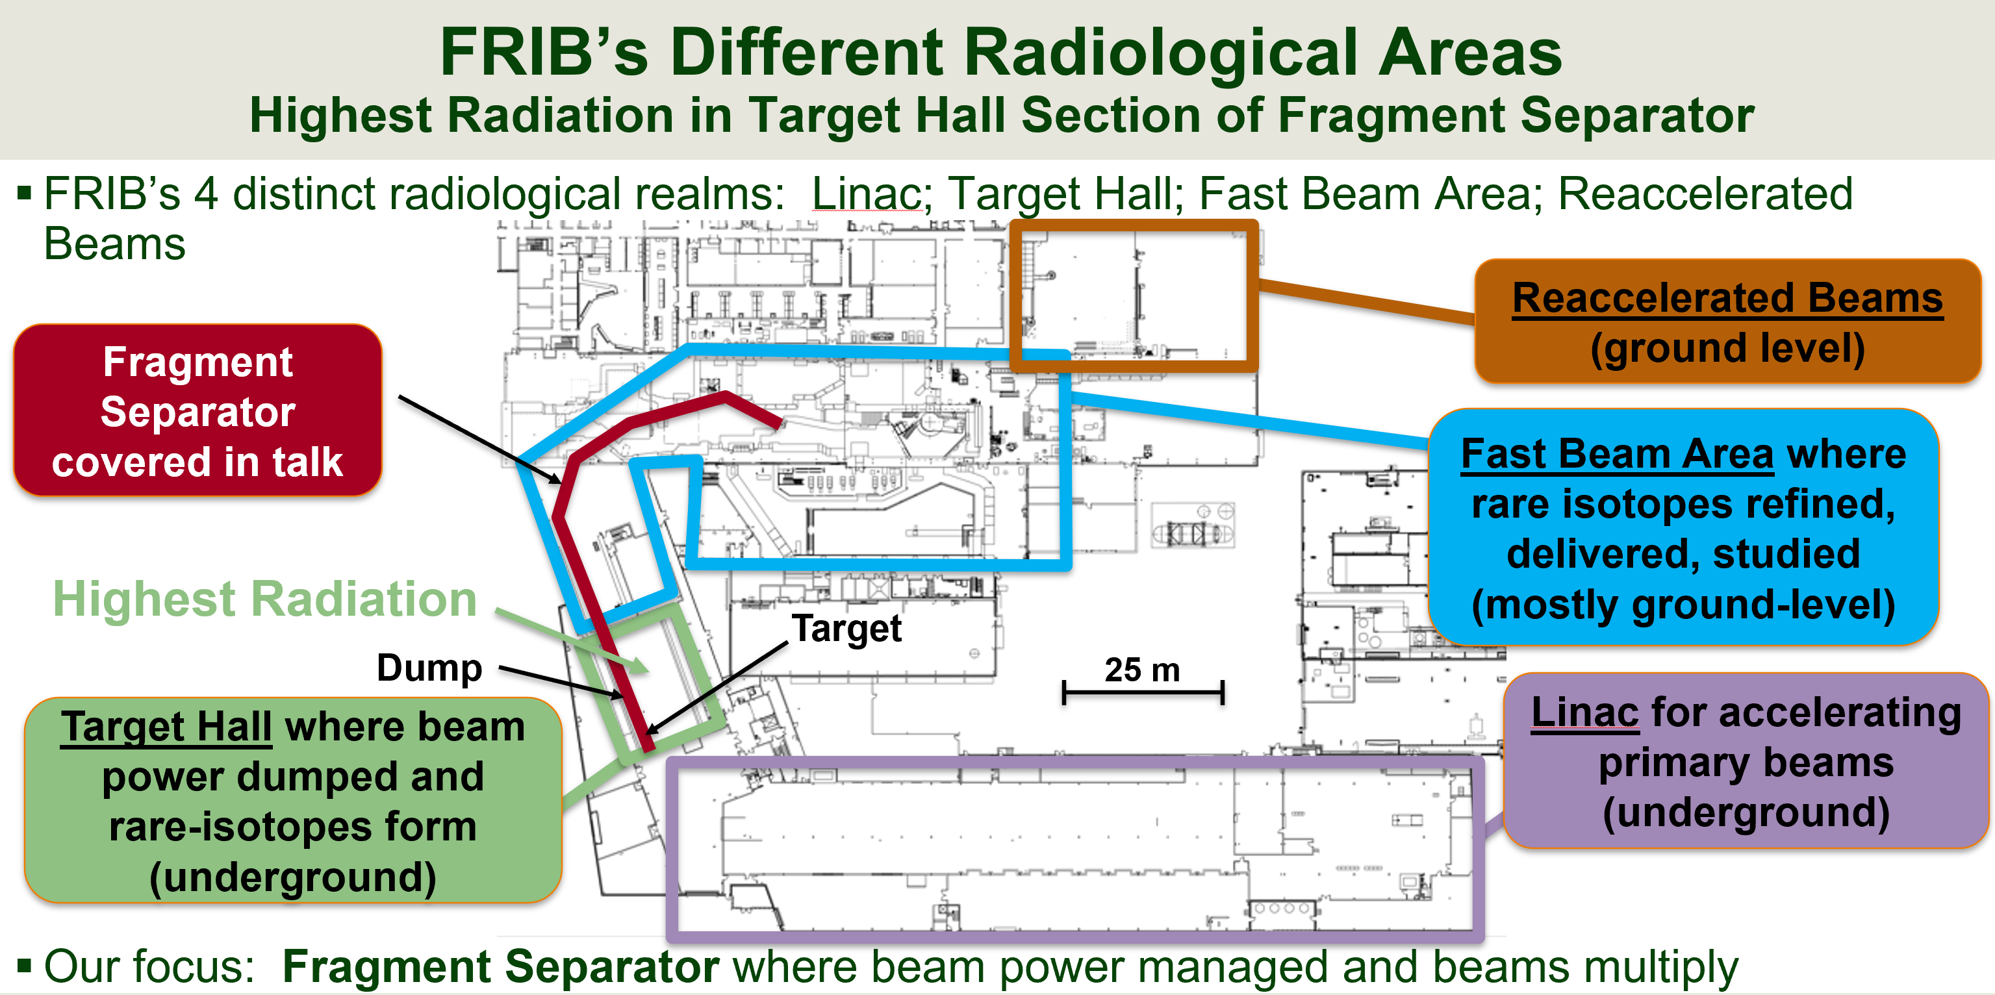
FRIB: Never the Same Beam Twice [2]

Slide 16
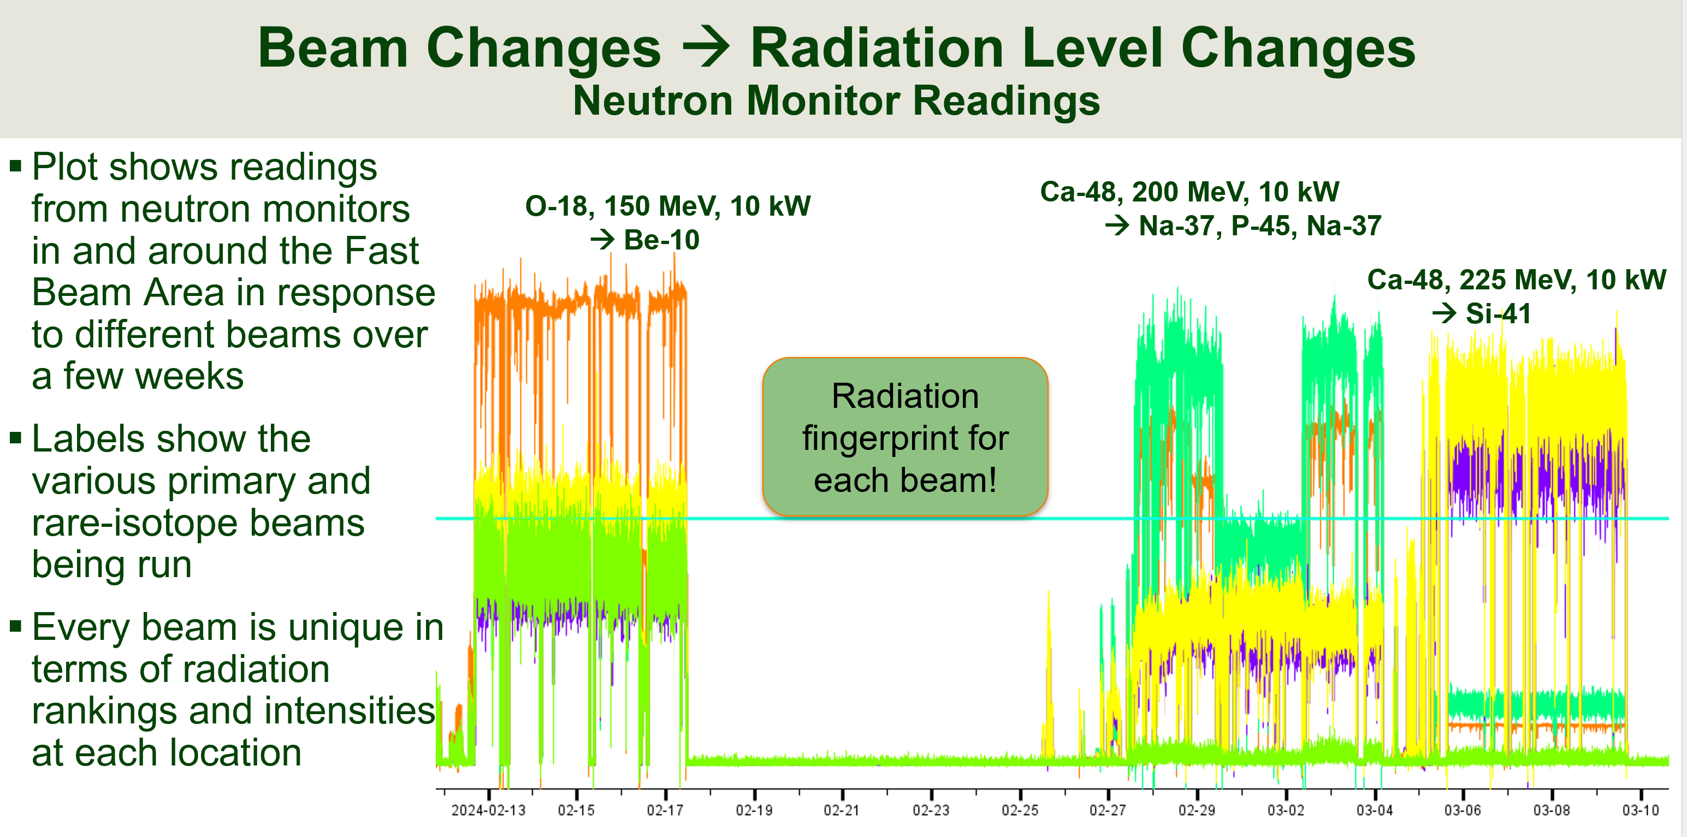
FRIB: Never the Same Beam Twice [3]

Slide 17
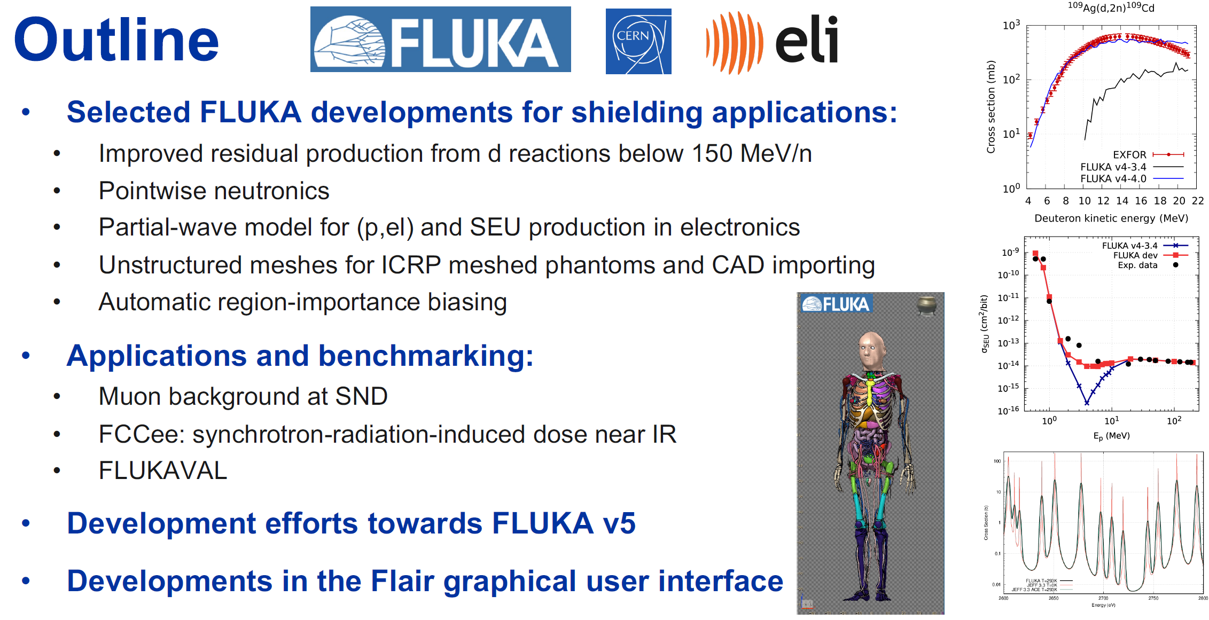
Developments of the present and future FLUKA generations [1] Francesc Salvat Pujol, CERN
2.1

Slide 18
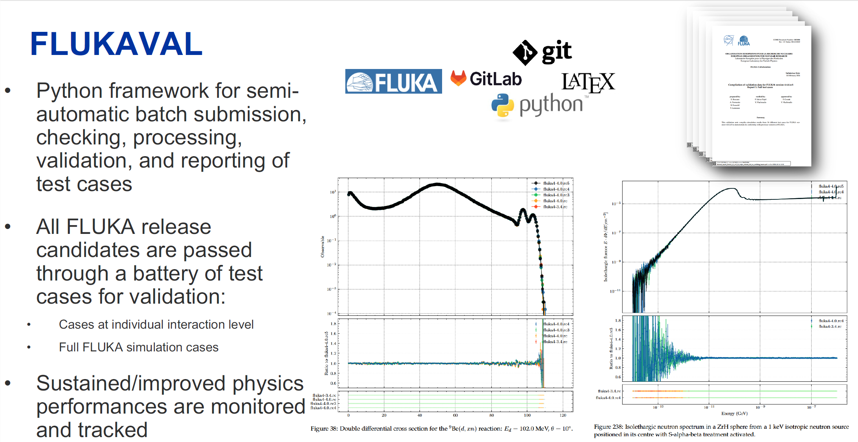
Developments of the present and future FLUKA generations [2]

Slide 19
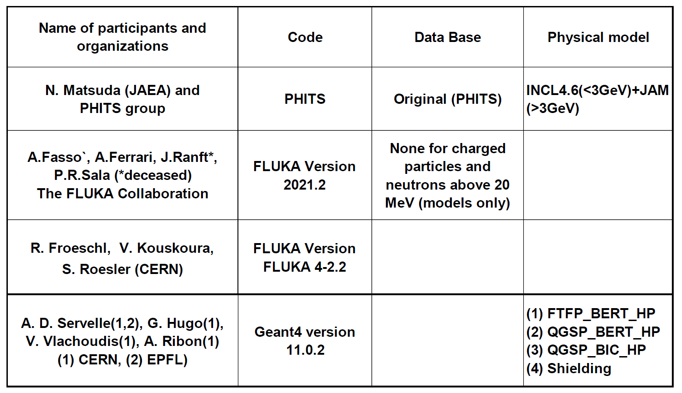
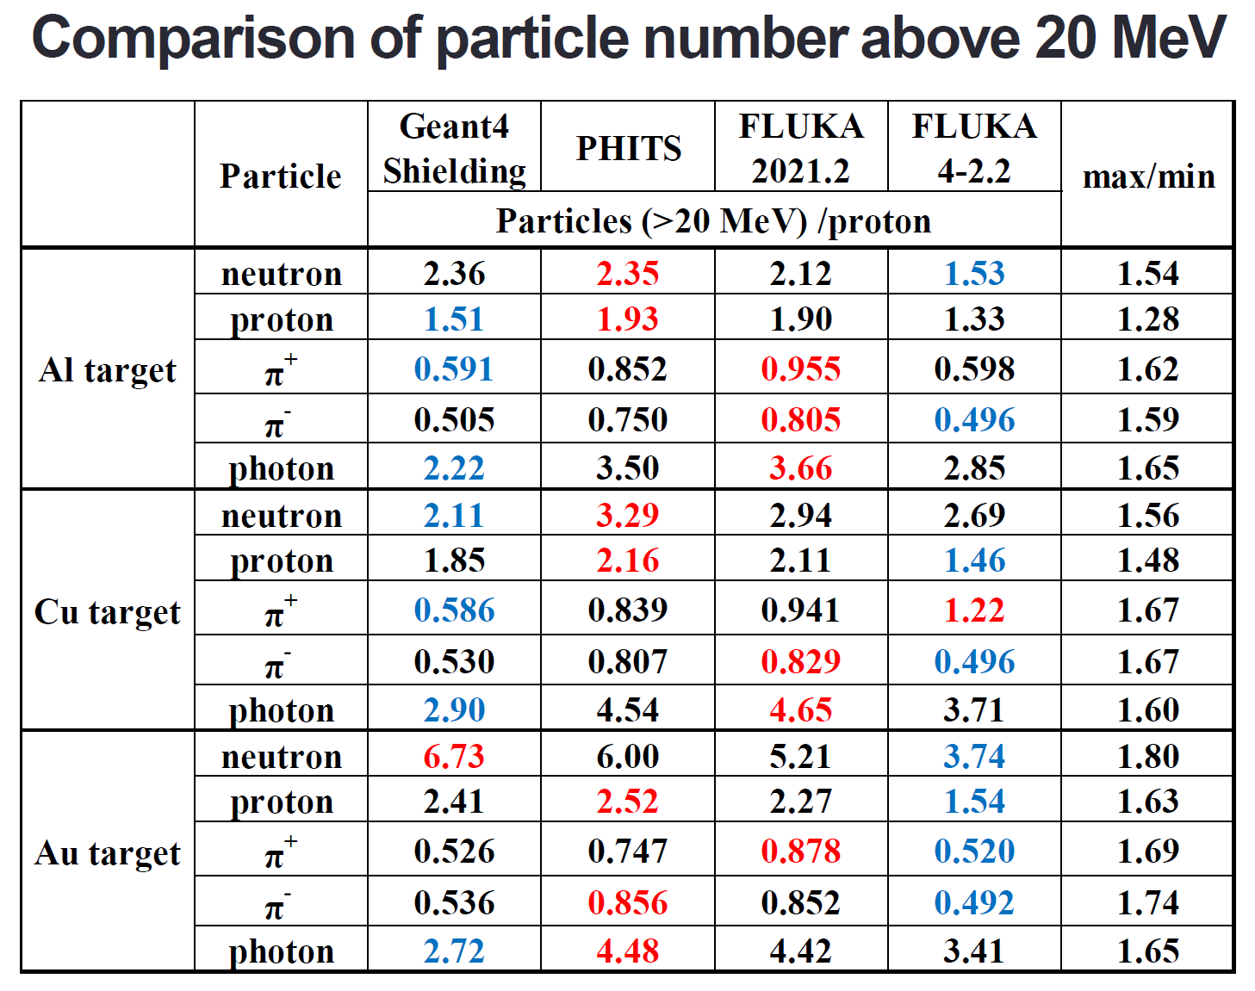
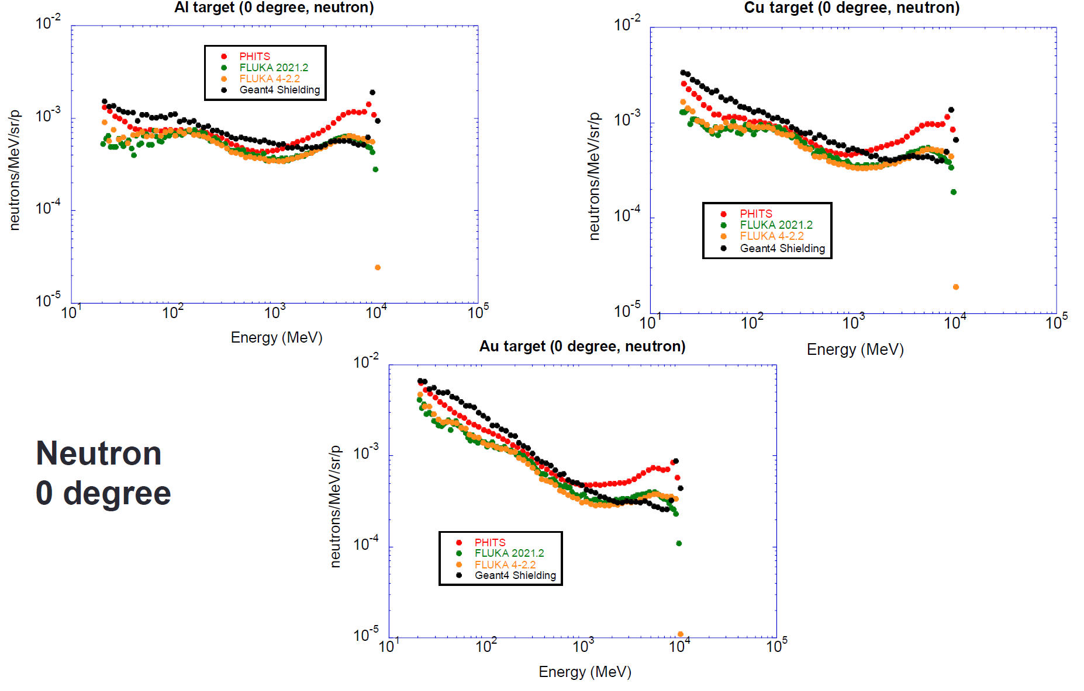
Inter-comparison of particle production (5) Hideo Hirayama, KEK
3.1
Simple cylinder target,
3 materials (Al, Cu, Au);
10 GeV proton beam
  Particles – n, p, γ, π+, π-
  Quantities – spectra above 20 MeV,
  angular distribution, integral spectra,
  energy integral fluence
Example of code-to-code comparison

Slide 20
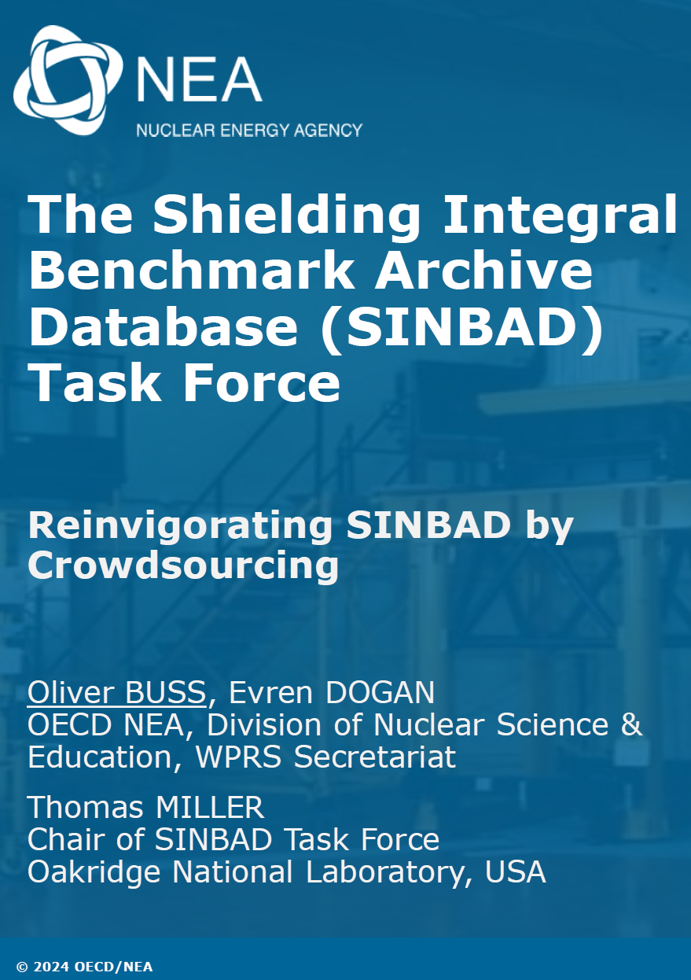
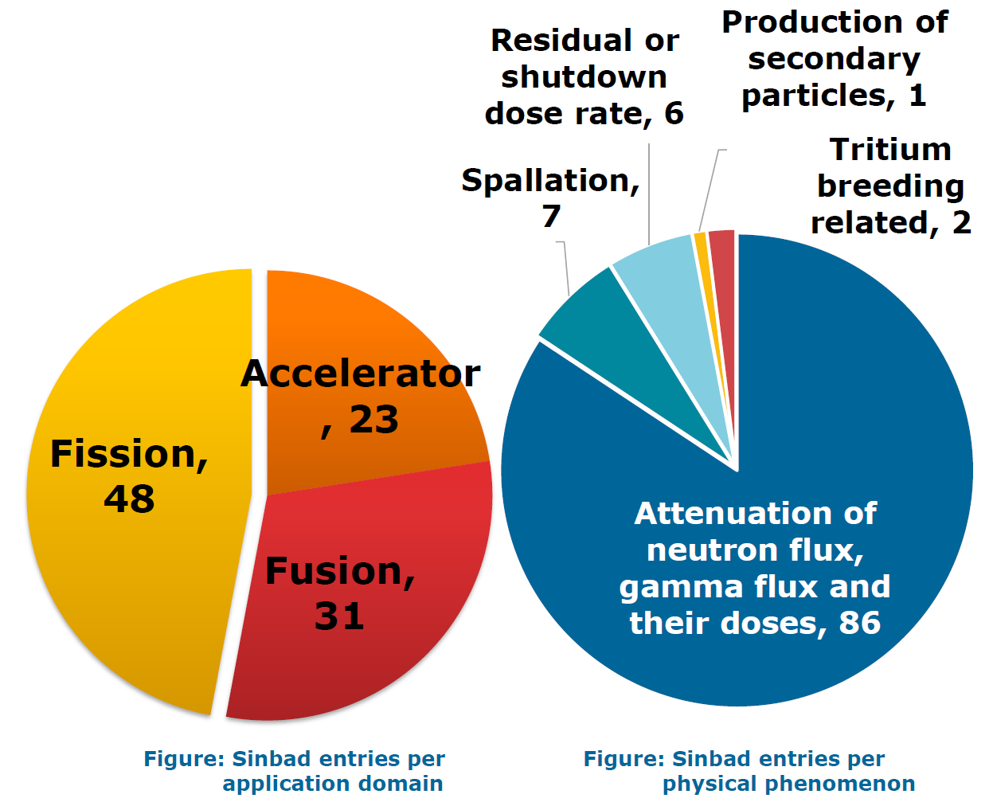
The SINBAD Task Force [1] Oliver Buss, NEA
3.6
https://oe.cd/nea-sinbad
Joint work by the US Rad Safety Information Computational Center (RSICC) and Nuclear Energy Agency (NEA)
Started in 1992 by OECD/NEA & ORNL/RSICC)
Modernizing the database: new software tools,
migration to GitLab for improved version control
+ easy for users to provide feedback and get involved
in development process

Slide 21
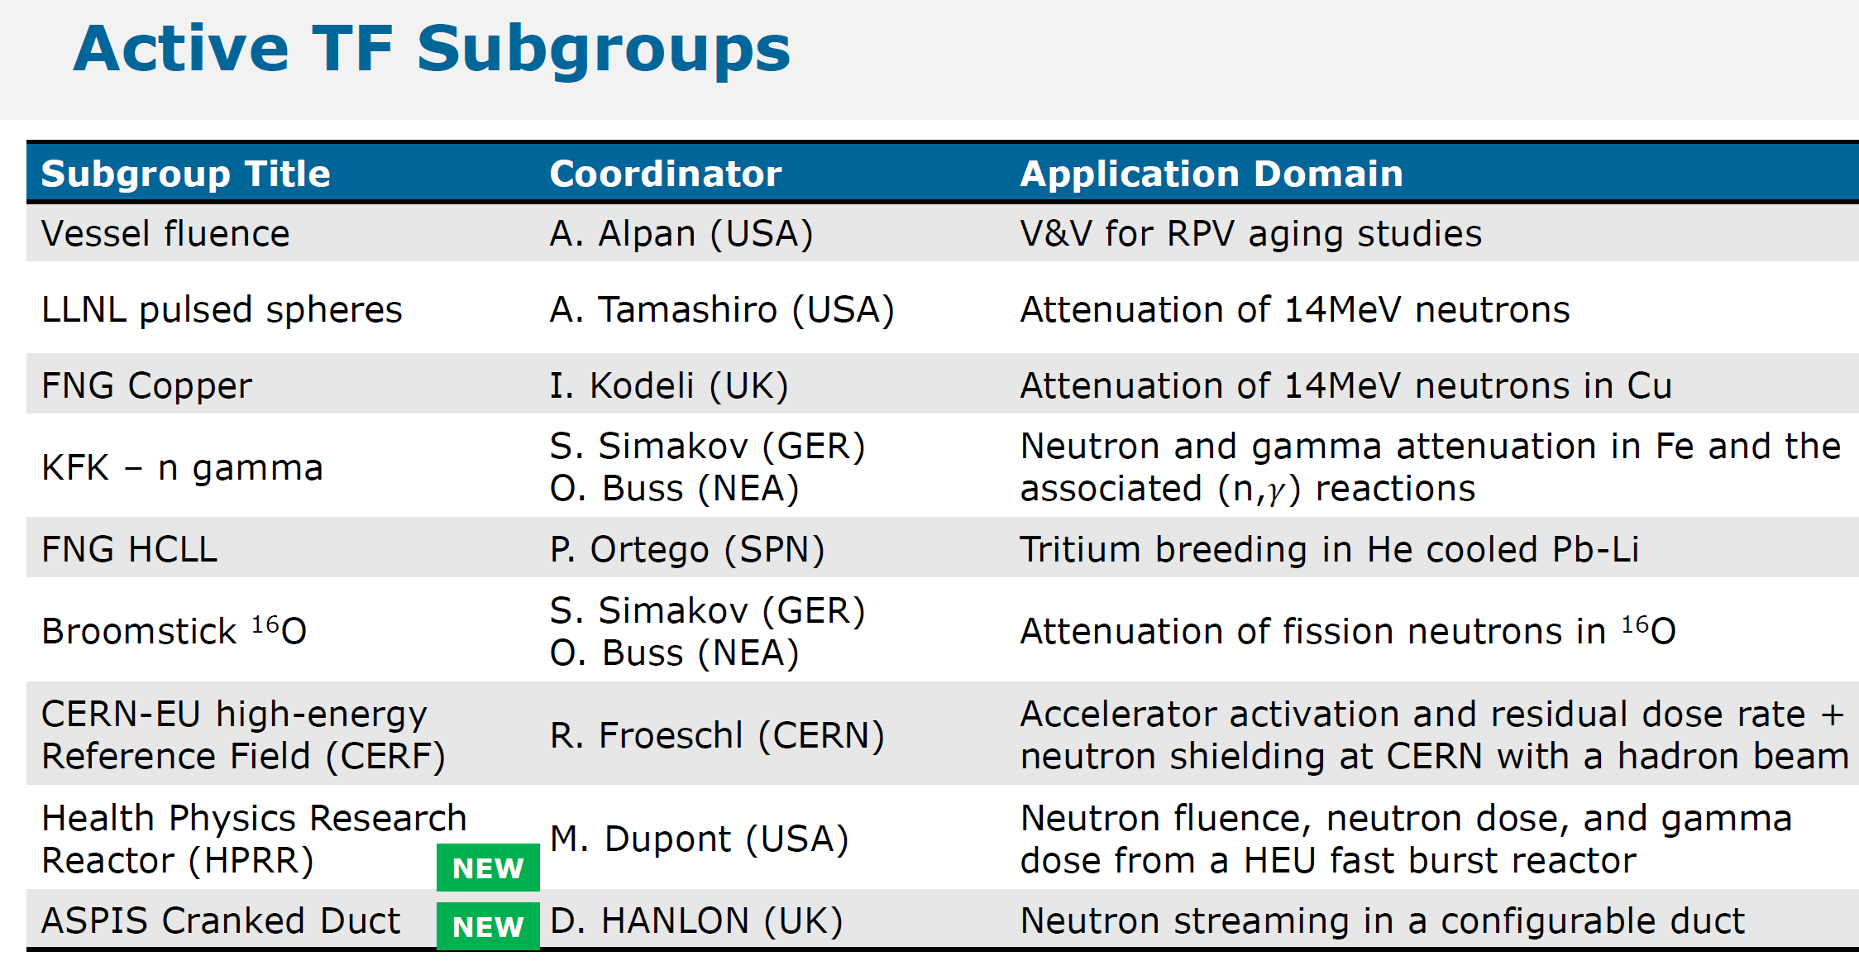
The SINBAD Task Force [2]

Slide 22
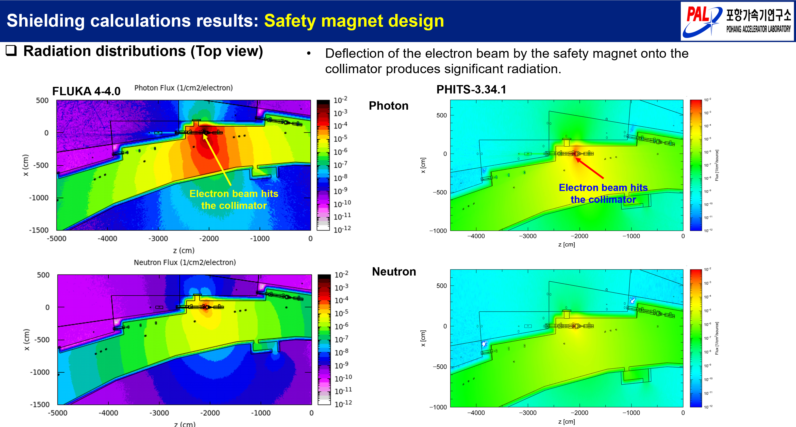
Rad Shielding Analysis for Synchrotron Radiation Beamlines of 4th Generation Storage Ring in Korea Mahdi Makhtiari, PAL
4.4
Example of code-to-code comparison

Slide 23
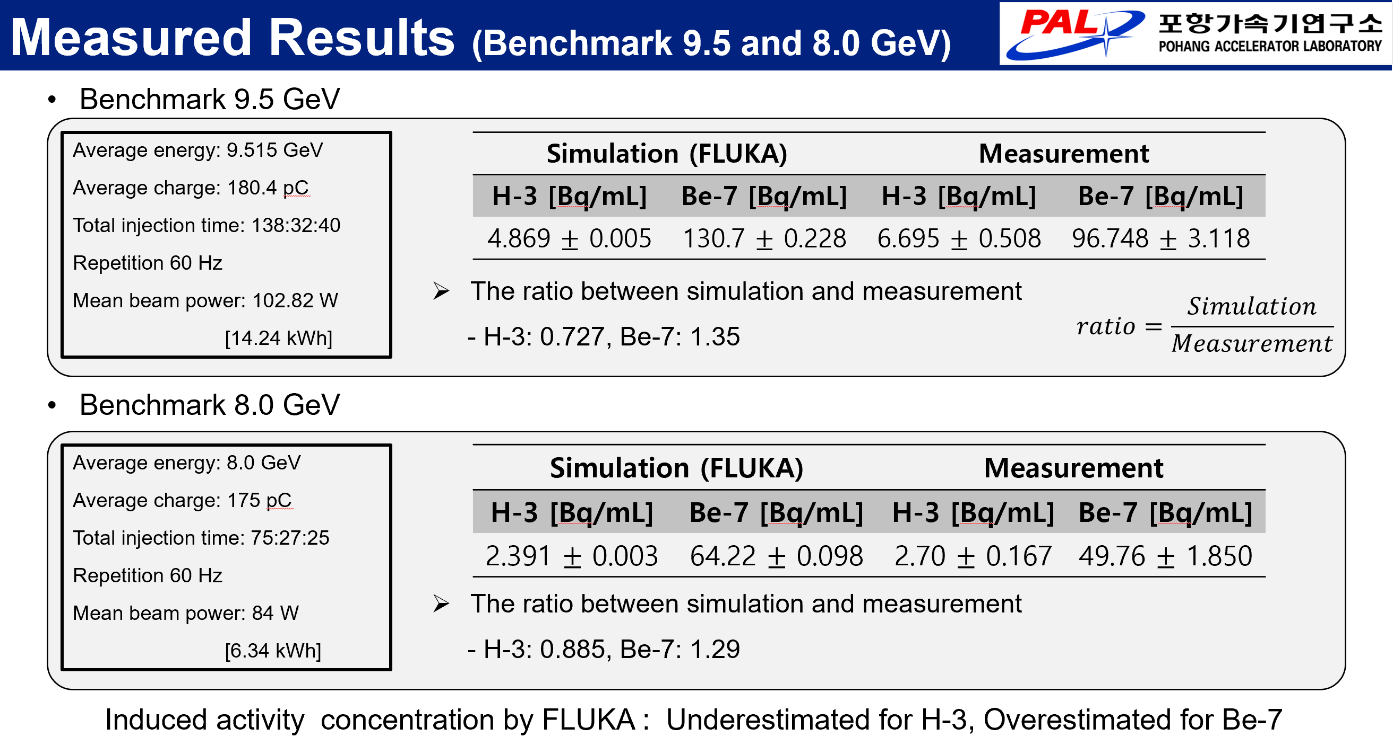
Benchmarking study on induced activity of H-3 and Be-7 in water target at PAL-XFEL UkJae Lee, PAL
5.8
Example of code benchmarking

Slide 24
Evaluation of decommissioning of proton therapy centers based on the selection of shielding materials at the building stage of the facility Gonzalo Fernandez, UPM
5.11
Radiation fields
SuperMC
CAD
PHITS

Slide 25
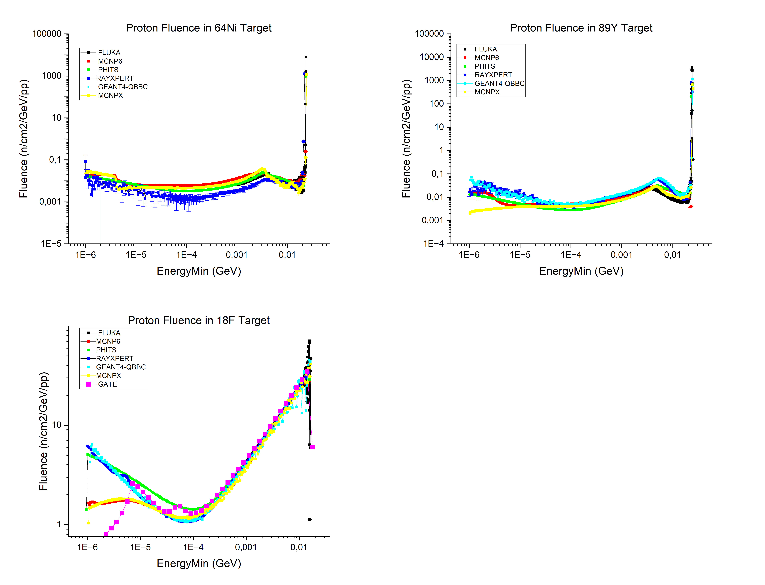
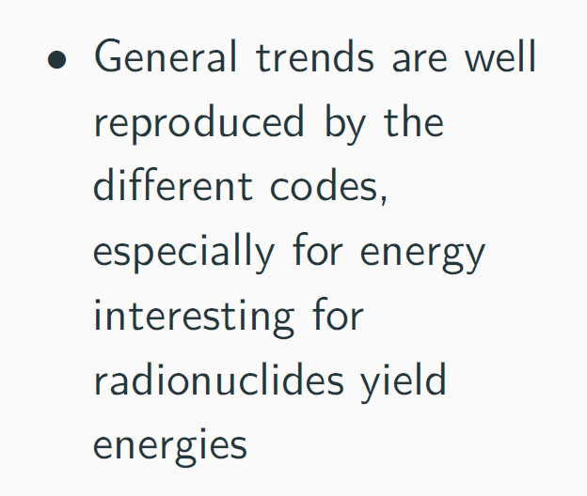
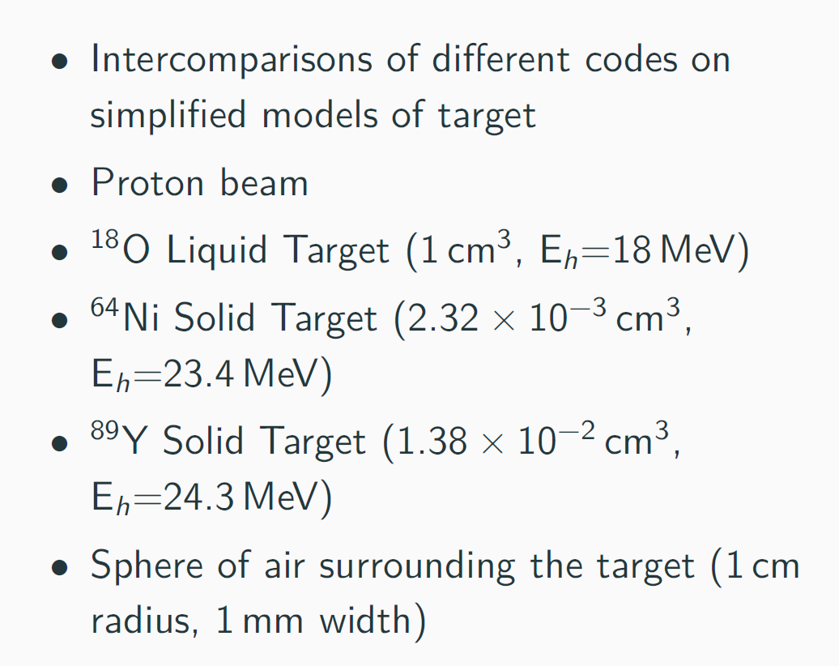
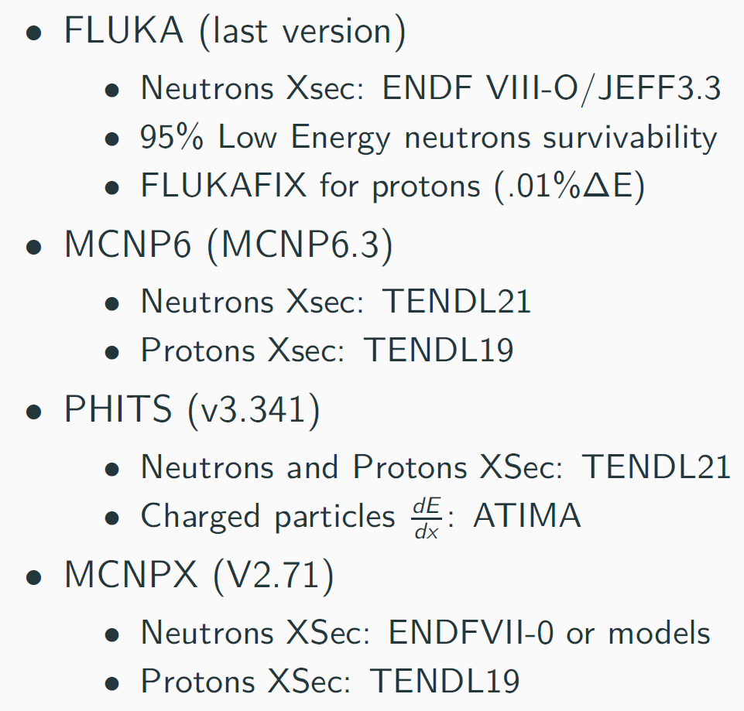
Simβ-AD study: Using active neutron detection and Monte-Carlo codes to improve radioactive waste management from cyclotron facilities J-M Horodynski, iRSD
5.12
Consortium of French facilities
Working packages:
  Numerical simulations (benchmarking of MC codes / cross-section libraries)
  Real-time and compact active 4D detectors development
Example of code-to-code comparison

Slide 26
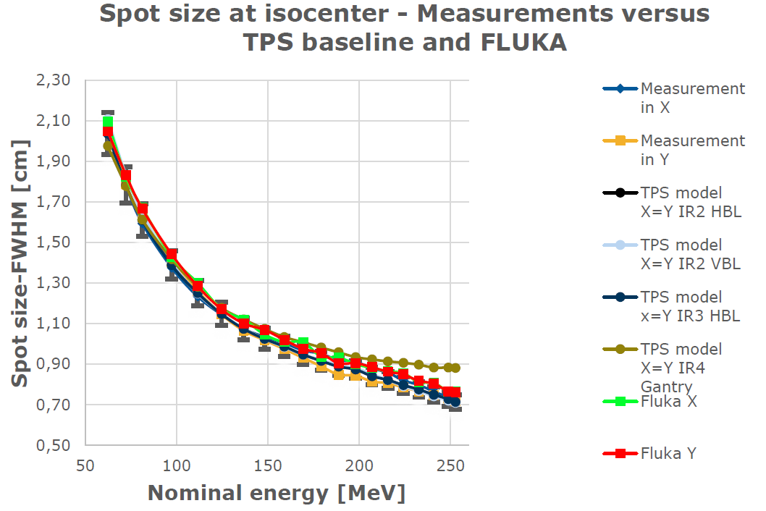
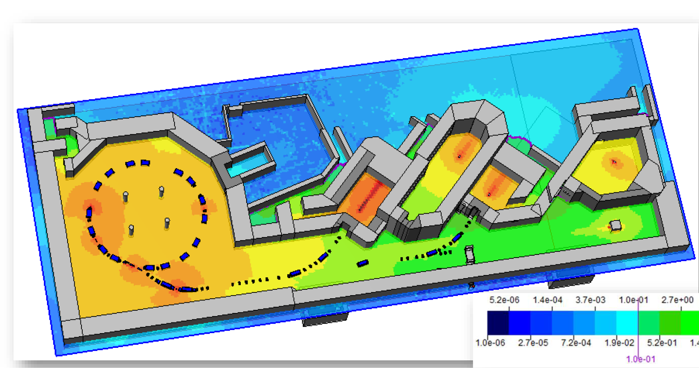
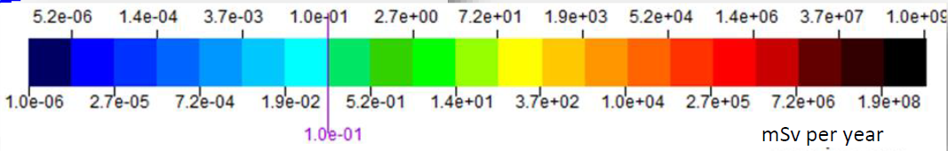
Monte-Carlo Applications @ MedAustron
Lukas Jagerhofer, MedAustron
6.1
Hadron Therapy Facility MedAustron (Austria)
Operating since ~2016
Cooperations with CERN and other facilities
Another talk from MedAustron (Claudia Lenauer) discussed the shielding and operation optimization
Example of code benchmarking

Slide 27
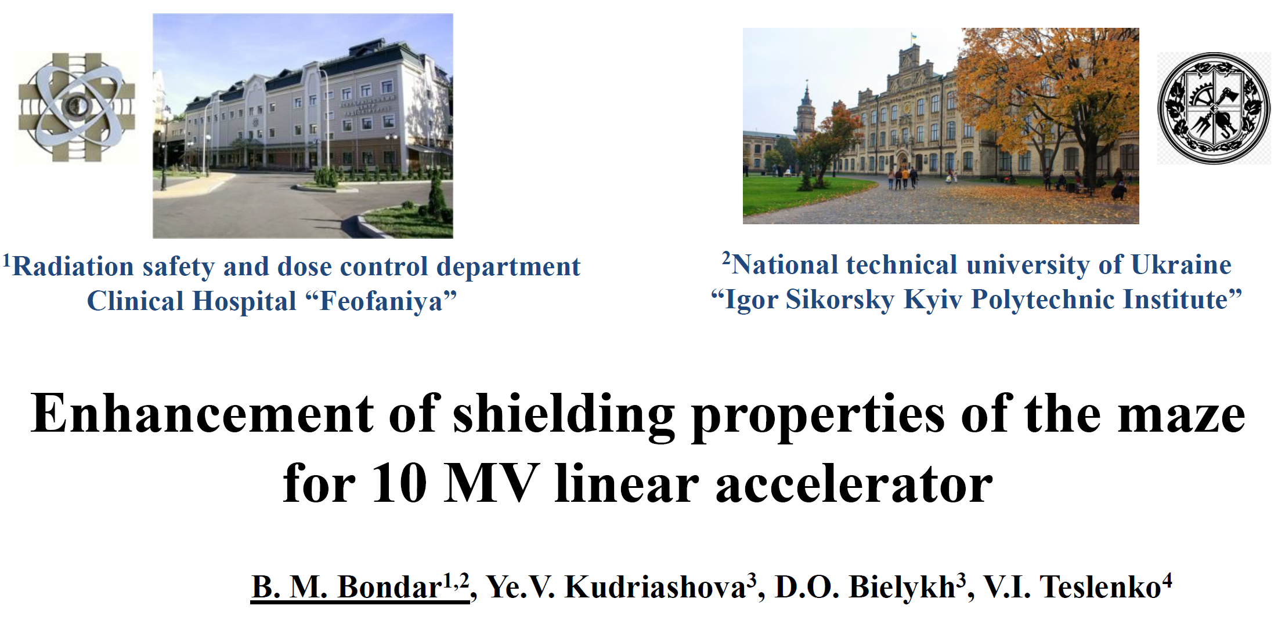
Enhancement of shielding properties of the maze for 10 MV linear accelerator Boris Bondar, NTU Ukraine
6.3
Medical facility shielding optimization based on radiation measurements and MCNP calcs

Slide 28
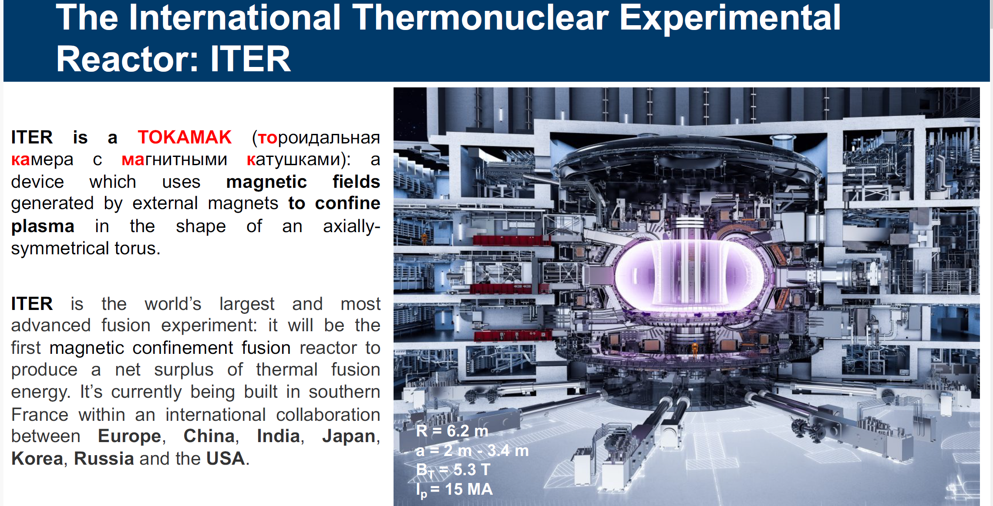
Nuclear design of a shielded cabinet for electronics: the ITER Radial Neutron Camera Case Study Fabio Moro, ENEA
8.5
Protecting electronics from fast and thermal neutrons, gamma rad fields, static magnetic field and transient electromagnetic fields

Slide 29
Future Actions
SATIF-17 will take place in South Korea (PAL) in the Fall 2026
Workshop proceedings were usually hosted and published by NEA; this time the plan is to publish them in the EPJ Web of Conferences journal
  Open Access proceedings in Physics & Astronomy
  EPJ Web of Conferences (epj-conferences.org)
Various collaborations were discussed, some new, others continuing
DG suggested to form a Tritium Task Force – CERN, FRIB, and ORNL colleagues expressed their interest – the format and activities are being discussed
Thank you for your attention!

Slide 30
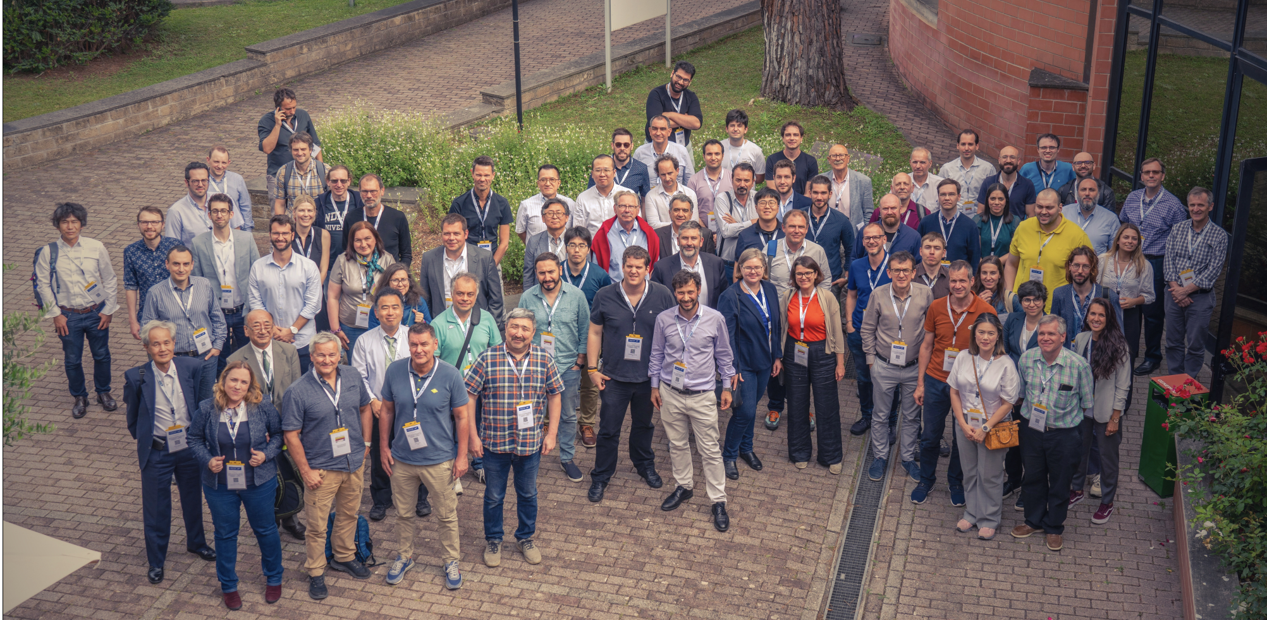
Group Photo

Slide 31
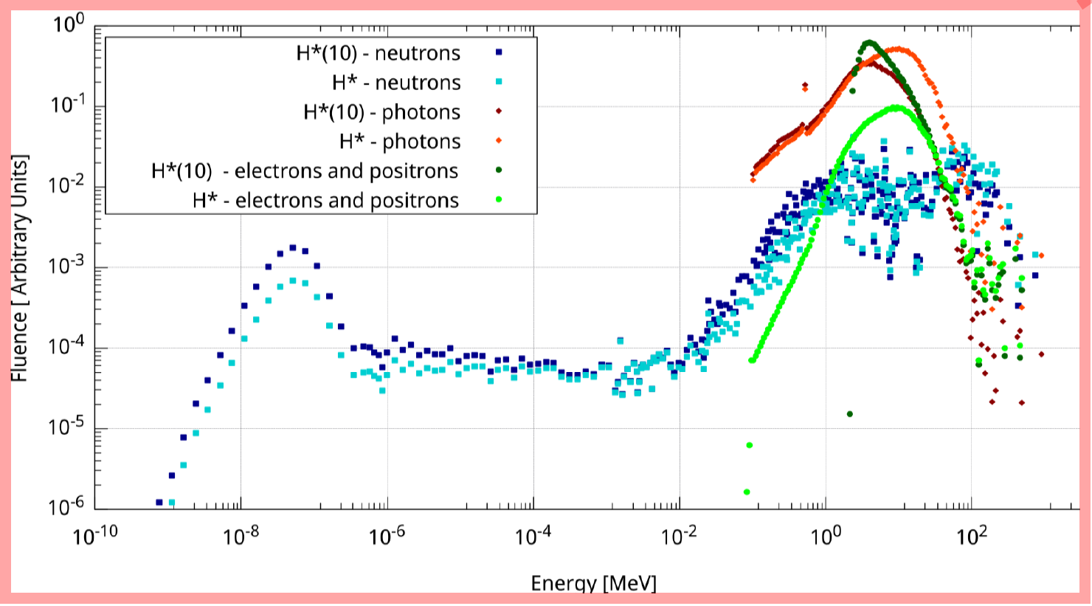
Recent radiological studies at NSLS-II using FLUKA
Ricardo Augusto, BNL
4.5
Dose estimates: H* vs H*(10) – a tale of two dosimetry quantities
  According to ICRP116, H* tends to be more severe for higher E (GeV range) for photons, and to a lesser extent for electrons. But at E below a few tens of MeV, the tendency is slightly reverted and H*(10) appears to be the most stringent quantity

