Slide 1
SATIF-16 Shielding Workshop Recap II
Igor Rakhno
16th Workshop on Shielding aspects of Accelerators, Targets and Irradiation Facilities (SATIF-16)
28-31 May, 2024

Slide 2
Outline
Status of the MARS code
Geometry models, beamlines and transport in EM fields
Meshes & scoring
Residual dose – spatial distributions
Update to TENDL-2023
Work in progress
“Code status, Developments and Converters” – 3
“Radiation damage to materials” – 1
“Code benchmarking and intercomparison” – 1
“Induced radioactivity” – 1

Slide 3
MARS code status
Igor Rakhno, Igor Tropin, Dali Georgobiani, Alajos Makovec

Slide 4
Introduction
MARS code is a general purpose radiation transport Monte Carlo code with an emphasis on accelerator applications. Its development started by Nikolai Mokhov at the Institute for High Energy Physics (IHEP, Protvino, Russia) in early 1970s.
In addition to a basic constructive solid geometry (CSG), the CERN ROOT geometry package is used. The latter is especially effective for complex geometry models.
For accelerator applications, a beam line builder based on MADX is very helpful.
Import of geometry models in GDML format is possible when the ROOT geometry is used.
Structured and unstructured meshes can be used for scoring purposes. The scoring meshes can overlap.
A recently implemented method to deal with residual radiation allows us to calculate 3D residual dose distributions in a single run without an intermediate source.
At lower energies, an update to the most recent TALYS-based evaluated nuclear data library (TENDL 2023) is underway.

Slide 5
Introduction (2)
Development of a new Python-based GUI is underway. Current GUI based on Tcl/Tk is about 25 years old.
Work on replacement of obsolete features and improved modularity is ongoing.

Slide 6
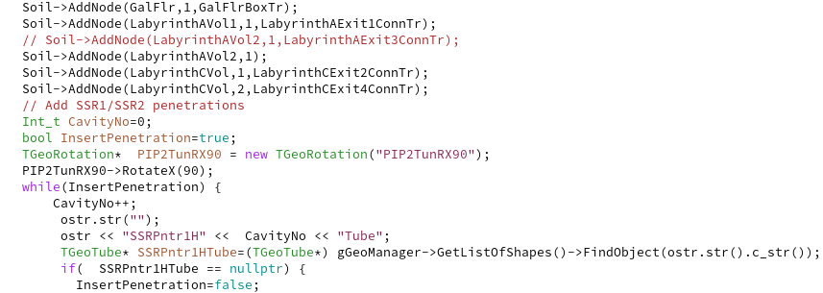
Geometry models, beam lines & transport in EM fields
The ROOT geometry package features about twenty basic shapes (primitives) that allow us to build complex geometry models as well as perform particle tracking and visualization.
Composite shapes can be built out of the primitives using various translation and rotation matrices as well as Boolean operations.
The shapes can be divided into slices, and replicated at other locations.
In order to create such geometry models, users need to work with source code in C++ (no input file or GUI options in MARS).
Visual geometry development is provided, e.g., by FreeCAD.

Slide 7
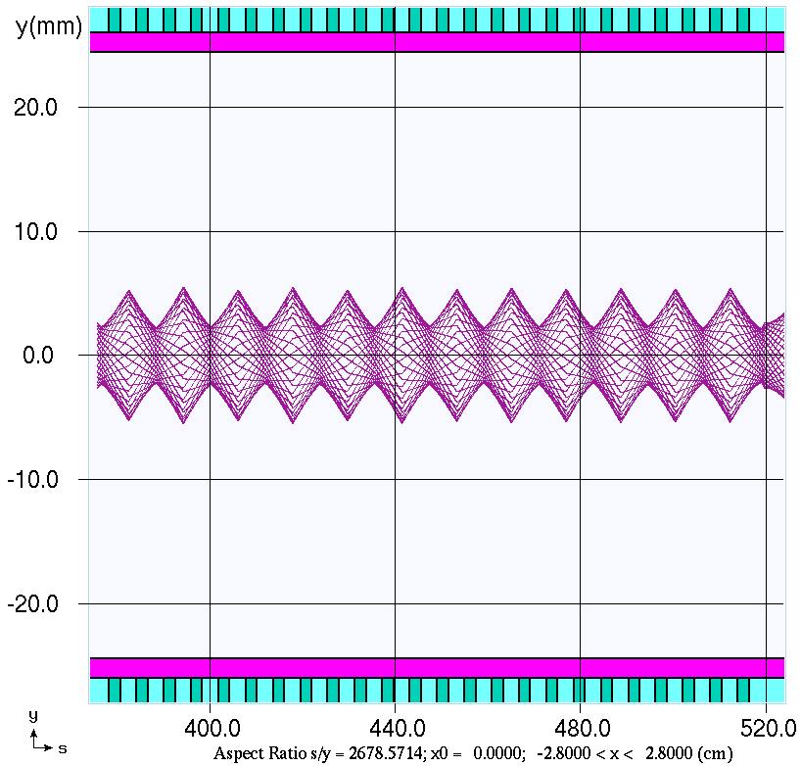
Geometry models, beam lines & transport in EM fields(2)
For accelerator applications, an essential feature is a possibility to build models around realistic – often 3D – beam lines.
In MARS code, a beam line builder has been
developed which employs information from MADX
input (usually supplied by beam physicists who
design the beam line).
All the components of the geometry model (tunnel,
penetrations, …) are tied to the beam line itself which
serves as a driver in the model.
Distribution of electromagnetic field in beam line
magnets allows us to perform precise particle
tracking whenever necessary.

Slide 8
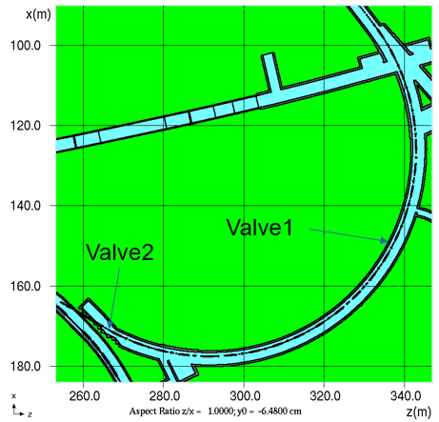
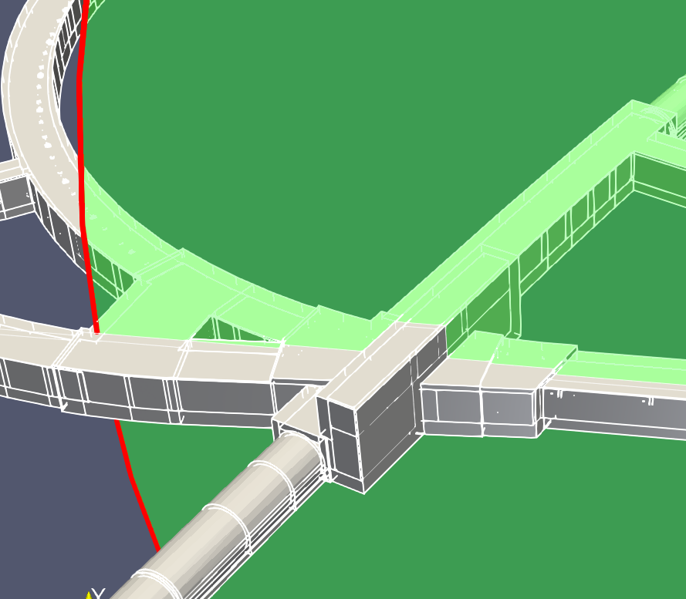
Geometry models and beam lines (3)
2D 3D

Slide 9
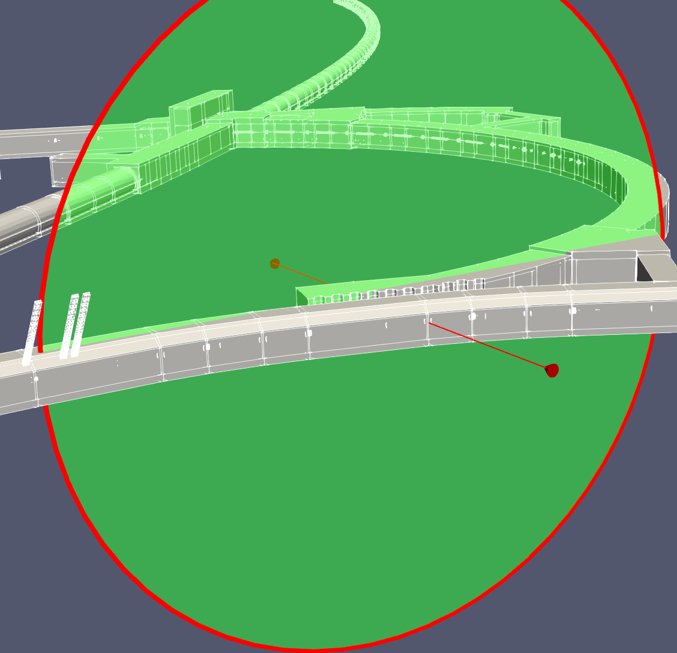
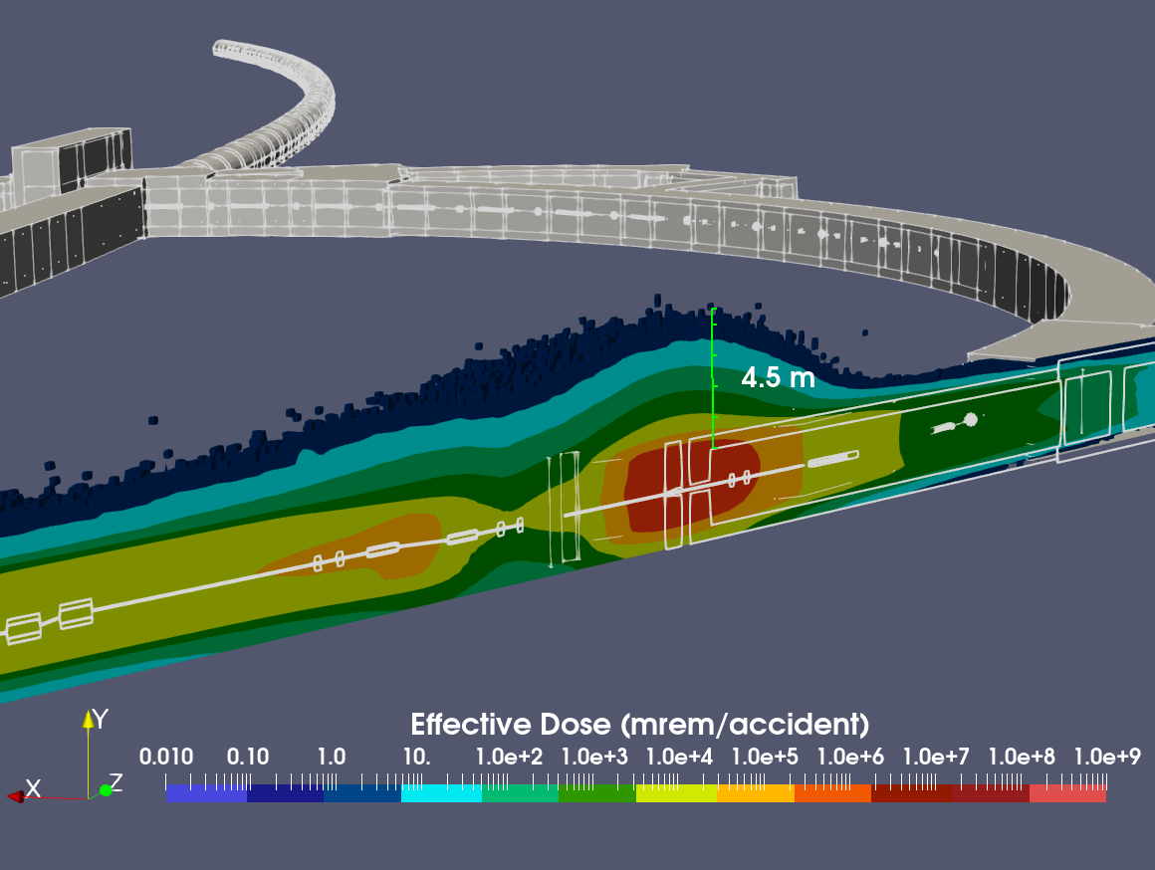
Geometry models and beam lines (4)

Slide 10
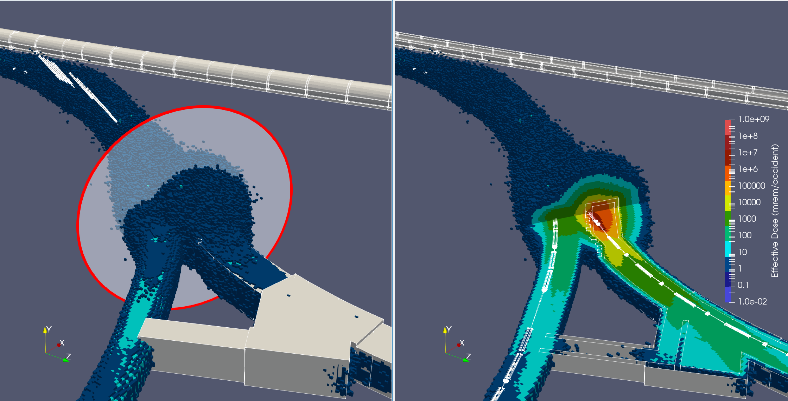
Geometry models and beam lines (5)

Slide 11
Geometry models and beam lines (6)
Historically, the following geometry types exist in MARS code: (i) standard (axially symmetric cylindrical) geometry; (ii) extended (basic CSG geometry); (iii) non-standard geometry; (iv) ROOT geometry as an instance of non-standard geometry.
Combinations of the geometry types are possible as well as a conversion from extended into ROOT geometry.
Also, a conversion from ROOT to VTK format is possible using an in-house utility.
The non-standard geometry option allows us to implement parametric additions and/or corrections to an initial complex model developed with any other geometry.
Import of geometry models in GDML format is possible with proper extraction of information on materials employed in the GDML model.

Slide 12
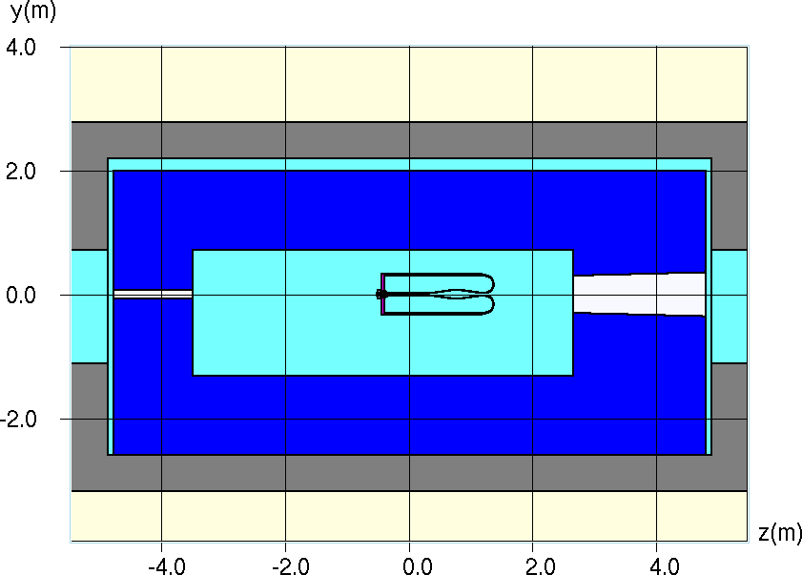
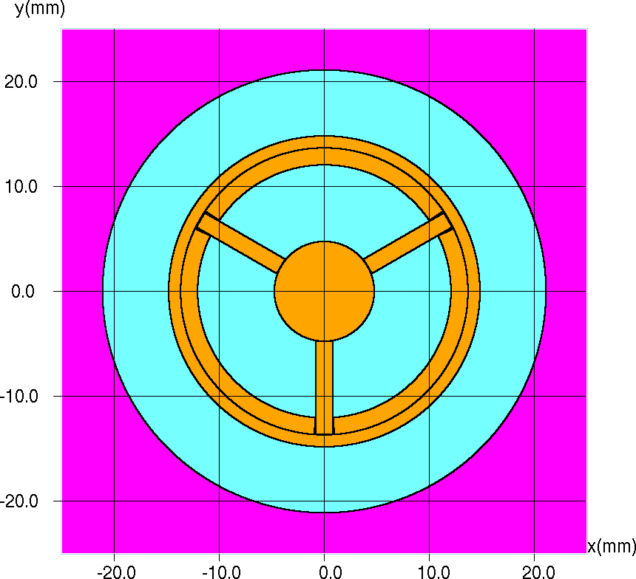
Meshes and scoring
Both 2D (hbook, root) and 3D (VTK/ParaView) meshes can be used (independently of geometry).
Target hall: MiniBooNE horn surrounded by shielding
Target hall, MiniBooNE pulsed horn, and horn shielding.
MiniBooNe target assembly.
An 8-GeV proton beam.
Zoomed-in sections: detail view of MiniBooNe target assembly
Upstream slug locator and locator fins

Slide 13
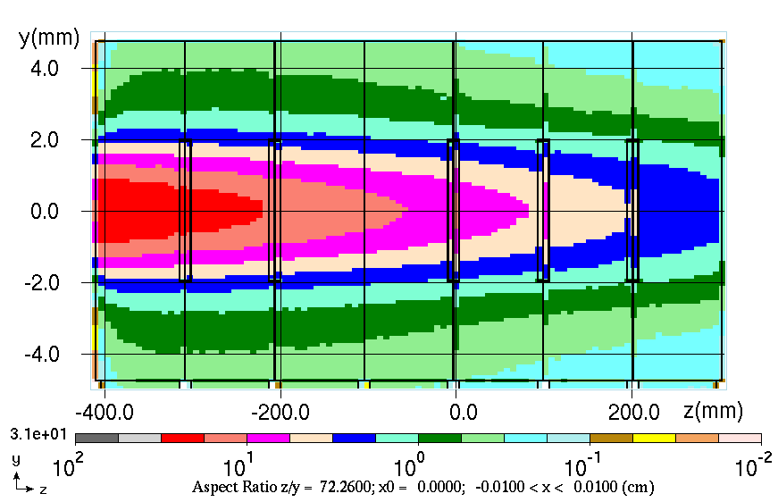
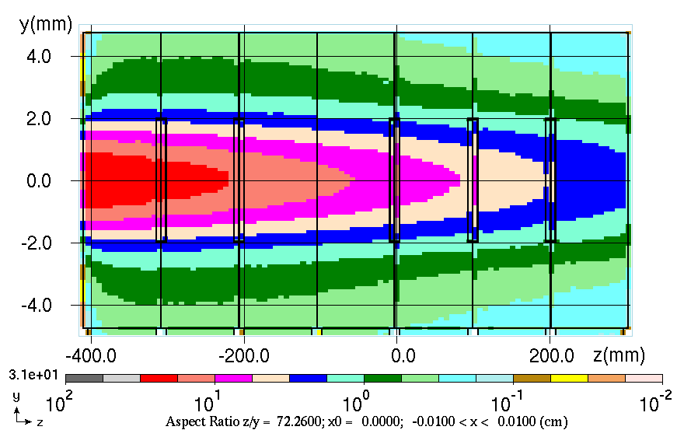
Meshes and scoring (2)
Energy deposition density (J/cm³/pulse) in the target calculated with MARS histograms
HBOOK ROOT
Distributions obtained by means of built-in MARS estimators were used to validate results obtained on unstructured ANSYS mesh.

Slide 14
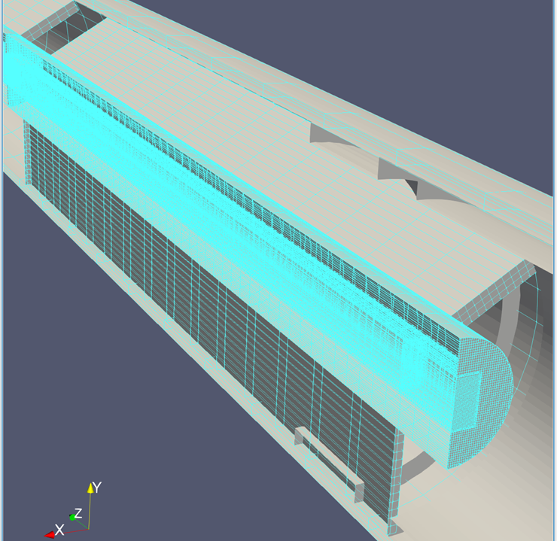
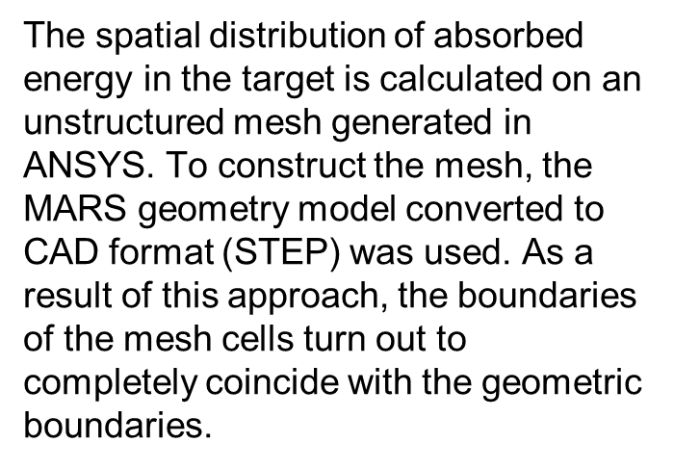
Meshes and scoring (3)
A mesh superimposed on geometry model
MARS code
app
Root
STEP
Mesh
CGNS
ANSYS

Slide 15
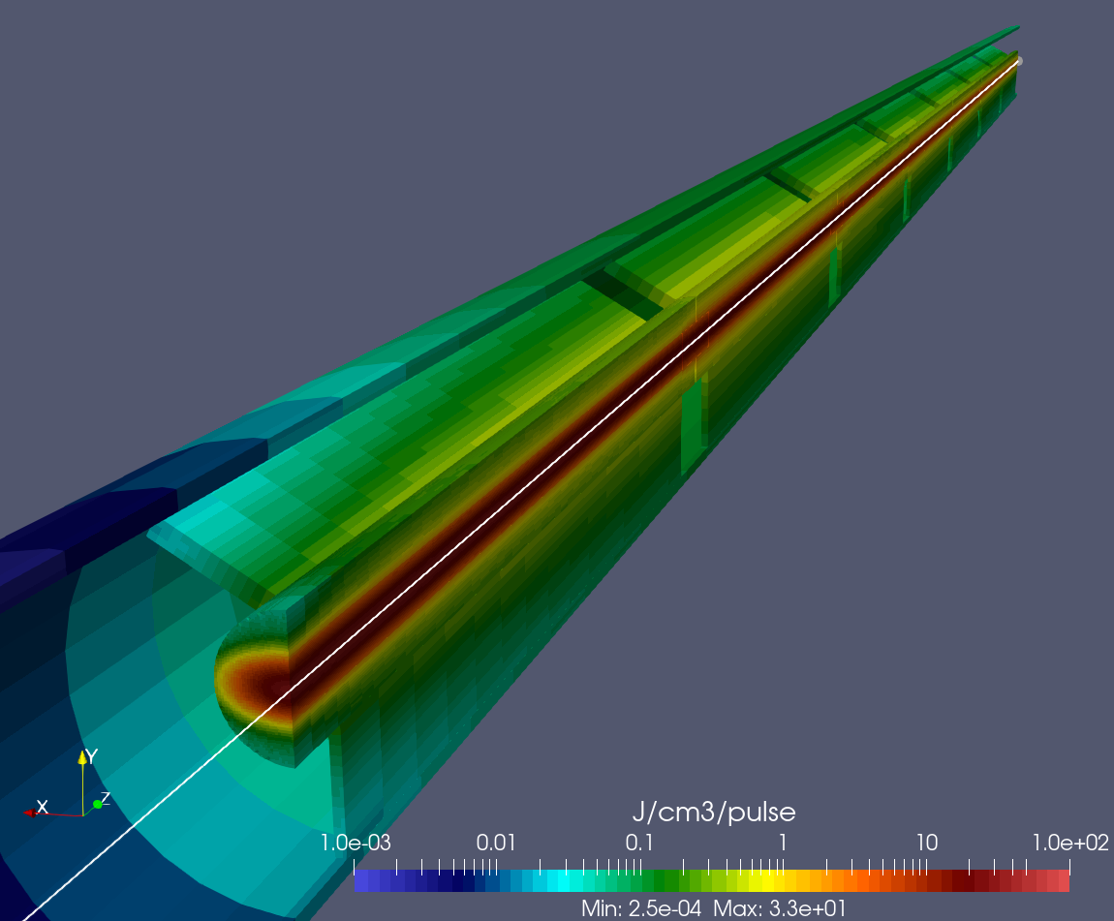
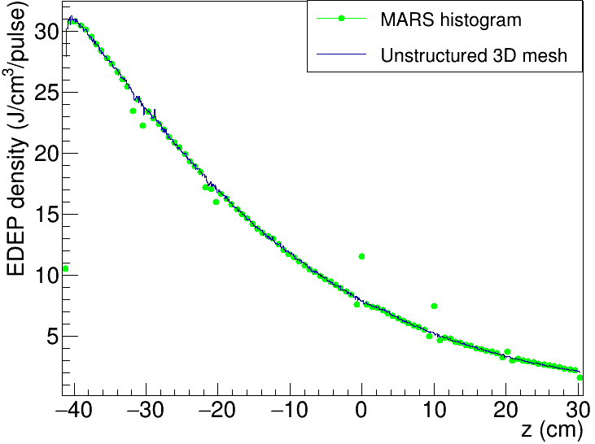
Meshes and scoring (4)
Spatial distribution of the energy deposition density in target assembly obtained on ANSYS unstructured grid, visualization in ParaView.
Energy deposition density in target along beam axis is compared with built-in MARS estimators (HBOOK/ROOT 2-D histogram).

Slide 16
Residual dose distributions
Recently, a method has been implemented to deal with residual radiation that allows us to calculate 3D residual dose distributions in a single run without an intermediate source.
It can be done in the same run for cases when irradiation and cooling geometries are different.
The previously used contact residual dose option is also kept.
SandiaDecay library has been used to simulate decay and generation of residual radiation.
A detailed comparison with FLUKA as well as with SINBAD experimental data has been done (A. Makovec and I. Tropin, NIM A1064, 169423, 2024).

Slide 17
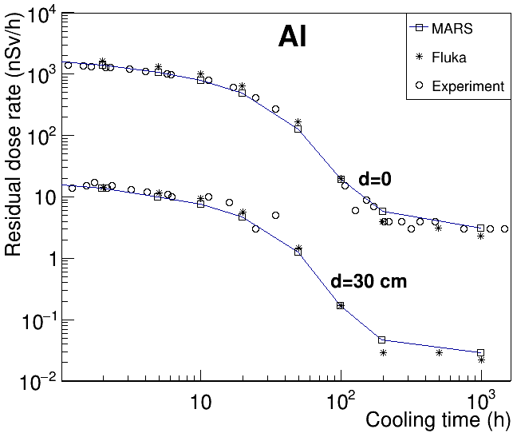
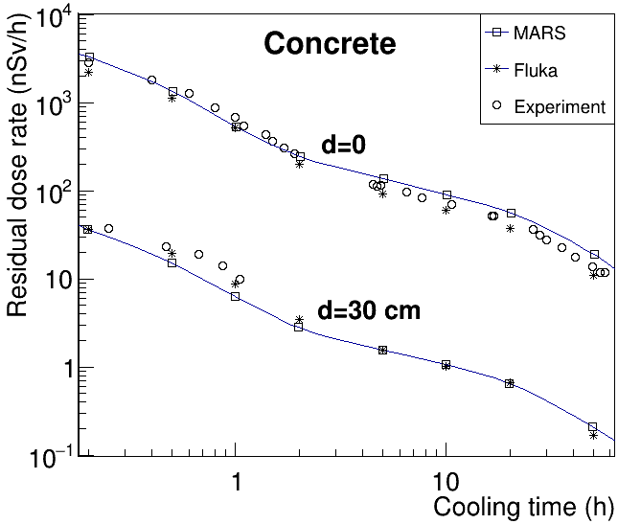
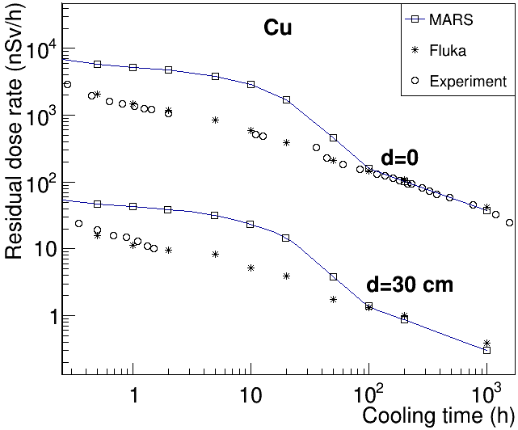
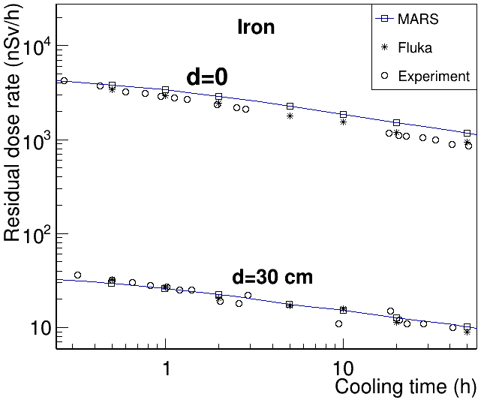
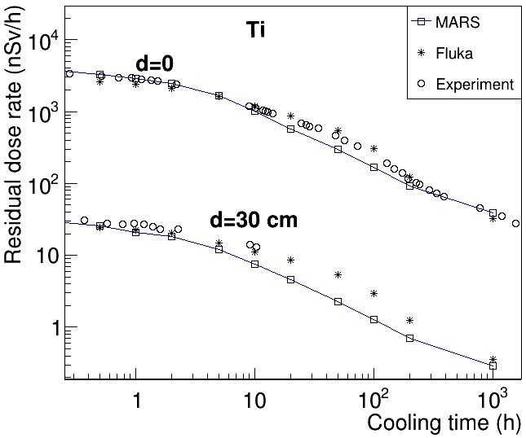
Residual dose distributions (2) – comparison with Sinbad

Slide 18
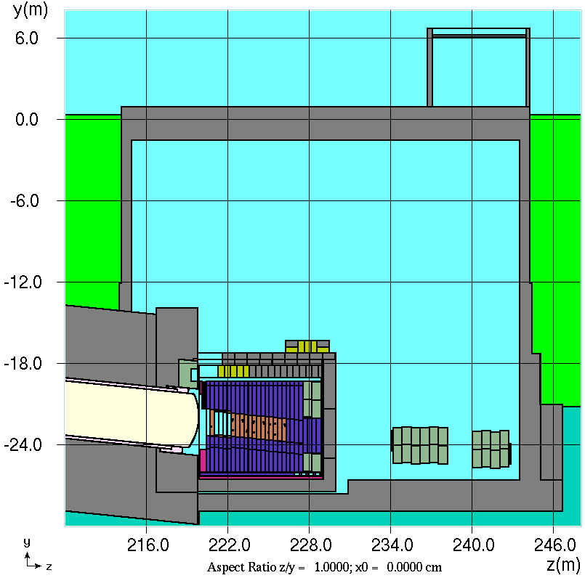
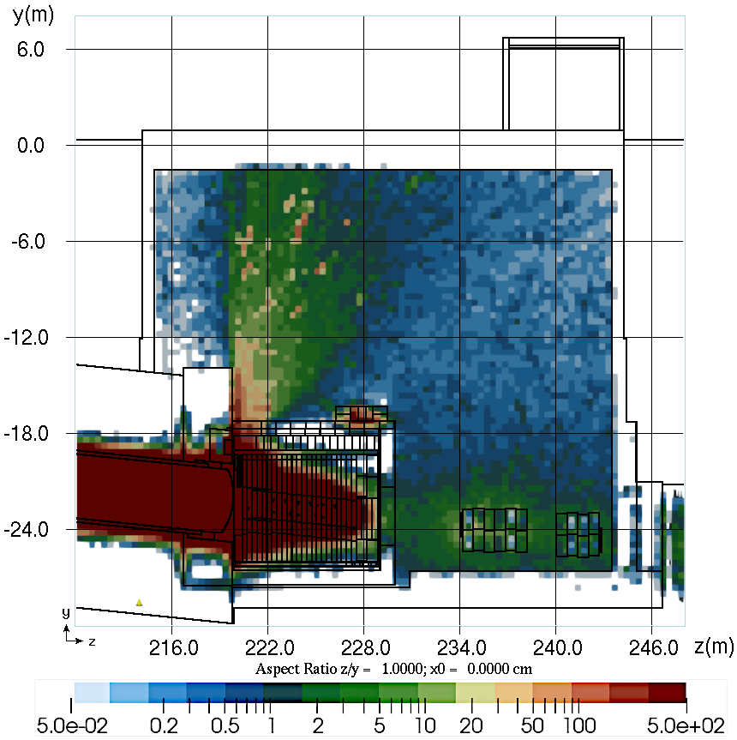
Residual dose rate distributions (3)
Calculated residual dose rate (mrem/hr) distribution around LBNF Hadron Absorber for a scenario “200 days irradiation followed by 1 day cooling with removed concrete shielding blocks”.

Slide 19
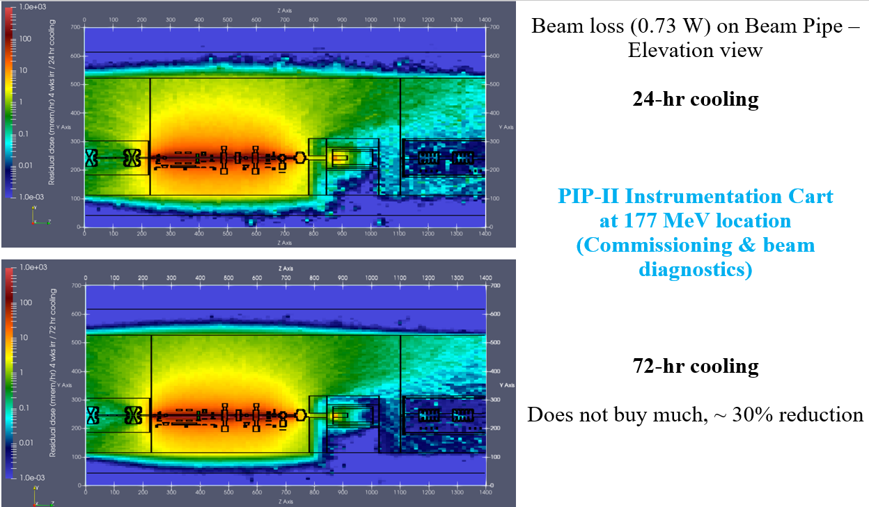
Residual dose rate distributions (4)

Slide 20
Residual dose rate distributions (5)

Slide 21
Update to the most recent library TENDL-2023
Lower energy region 0.25 – 200/600 MeV.
7 projectiles: p, n, d, t, ³He, ⁴He, γ,
Energy-angle distributions of all secondaries (p, n, d, t, ³He, ⁴He, γ as well as residual nuclei) are taken into account.
Initial version of our in-house processing software and low energy event generator was developed in 2014 (SATIF-12). Inclusive version.
This activity was driven, first of all, by Proton Improvement Plan-II (PIP-II).
The update means, in fact, that we need to replace the TENDL-2021 source files (endfb) with newer ones.
However, some tests are needed to make sure there are no surprises (for some projectile/target/secondary particle cases in the 2021 version, the secondary energies were too high – well beyond the region allowed by kinematics).
The inclusive option (s0) – from 0.25 to 200 MeV – is being tested currently. The exclusive option is planned to be implemented soon.

Slide 22
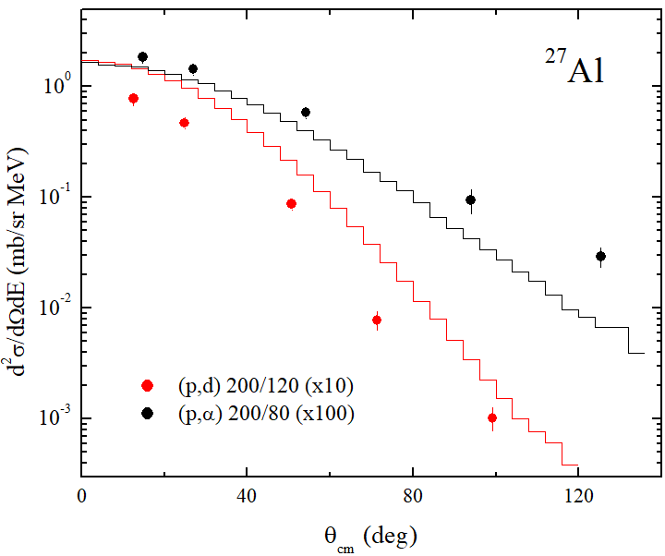
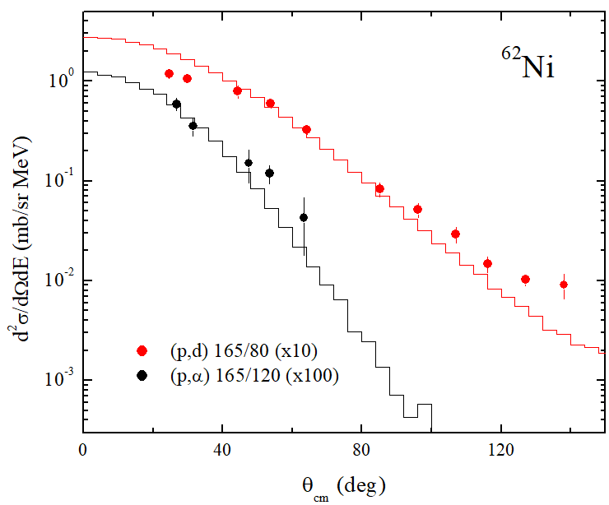
Update to the most recent library TENDL-2023 (2)
Lines – TENDL-2023, symbols – experimental data, projectile/secondary energies
are given in MeV

Slide 23
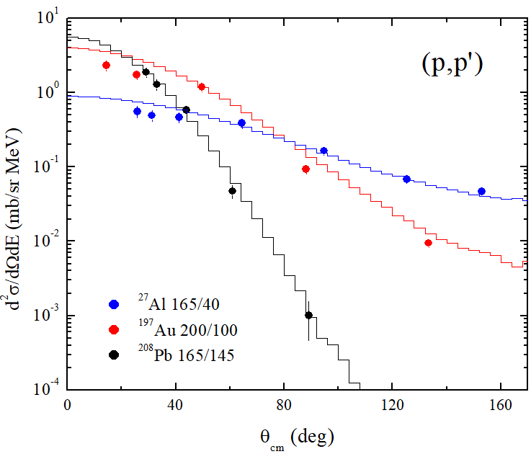
Update to the most recent library TENDL-2023 (4)

Slide 24
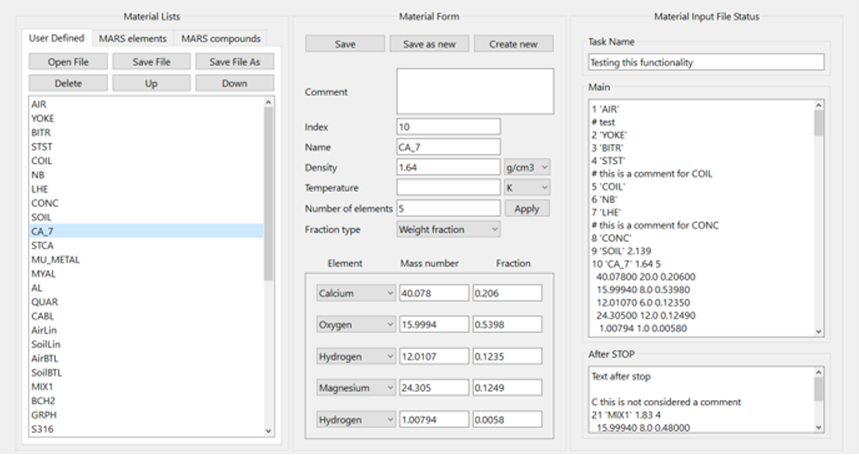
Ongoing development of a new more user friendly GUI
This work is in an initial stage.
The main window facilitates switching between different windows.
The material window (see the screenshot below) allows users to browse built-in elements and compounds, copy these into a material input file, import and export material input files, edit data for the compounds and so on.
Tools to visualize data from MTUPLE output files, particle distributions from source files and so on.
Demonstrated features to be added soon: 2D visualization geometry for interactive cross-sectional views.

Slide 25
Replacement of obsolete features and improved modularity
A mixture of Fortran, C and C++.
CERNLIB replacement with ROOT and VTK.
Removal of COMMON-blocks.
Improvement of the code structure (modules). Removal of global static data.
Obsolete Fortran 4 features need to be removed (GO TO, BLOCK DATA, ...).

Slide 26
Code status, developments and converters

Slide 27
Code status, developments and converters

Slide 28
Code status, developments and converters

Slide 29
Code status, developments and converters

Slide 30
Code status, developments and converters

Slide 31
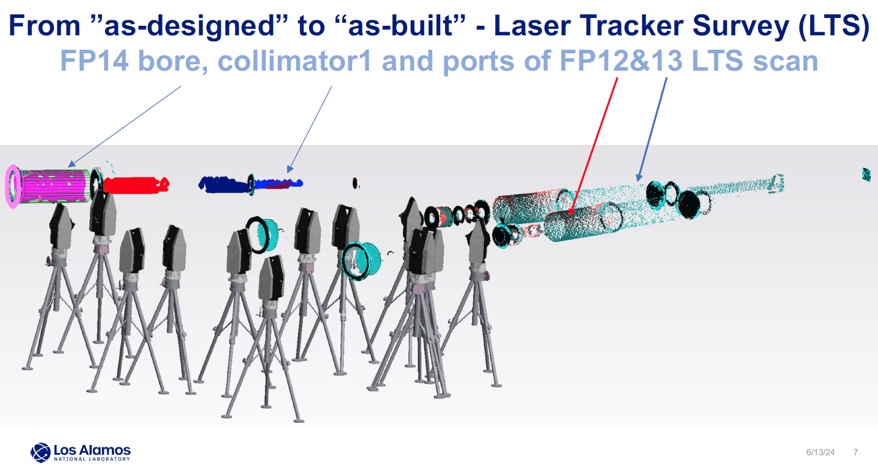
Code status, developments and converters

Slide 32
Code status, developments and converters

Slide 33
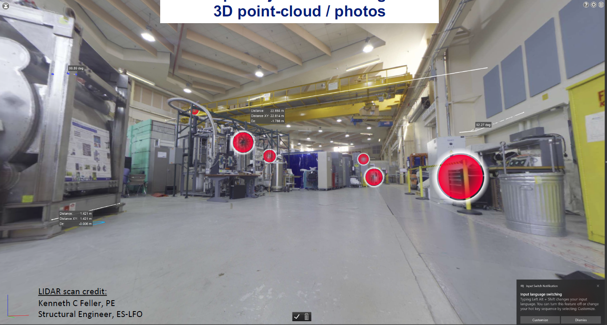
Code status, developments and converters

Slide 34
Code status, developments and converters

Slide 35
Code status, developments and converters

Slide 36
Code status, developments and converters

Slide 37
Code status, developments and converters

Slide 38
Code status, developments and converters

Slide 39
Code status, developments and converters

Slide 40
Code status, developments and converters

Slide 41
Code status, developments and converters

Slide 42
Code status, developments and converters

Slide 43
Code status, developments and converters

Slide 44
Code status, developments and converters

Slide 45
Code status, developments and converters

Slide 46
Code status, developments and converters

Slide 47
Code status, developments and converters

Slide 48
Code status, developments and converters

Slide 49
Code status, developments and converters

Slide 50
Code status, developments and converters

Slide 51
Code status, developments and converters

Slide 52
Code status, developments and converters

Slide 53
Code status, developments and converters

Slide 54
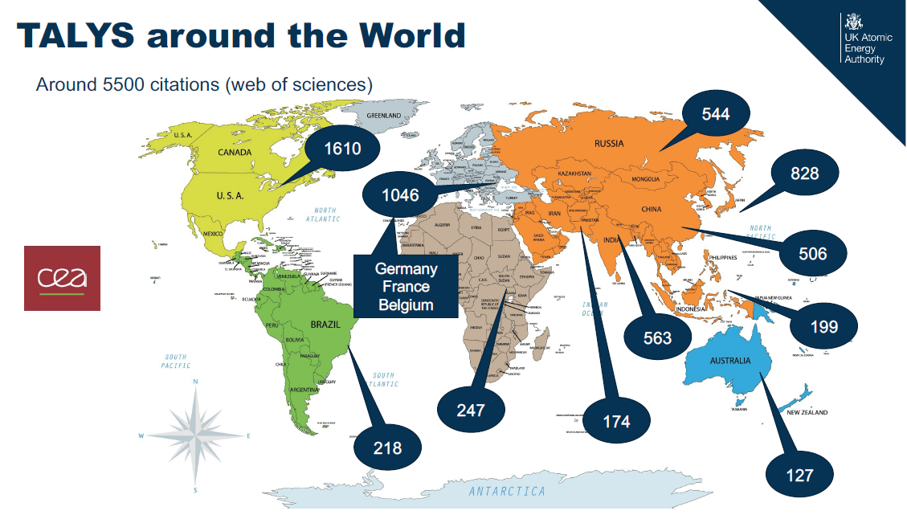
Code status, developments and converters

Slide 55
Code status, developments and converters

Slide 56
Code status, developments and converters

Slide 57
Code status, developments and converters

Slide 58
Radiation damage to materials

Slide 59
Radiation damage

Slide 60
Radiation damage

Slide 61
Radiation damage

Slide 62
Radiation damage

Slide 63
Radiation damage

Slide 64
Code benchmarking and intercomparison

Slide 65
Code benchmarking and intercomparison

Slide 66
Code benchmarking and intercomparison

Slide 67
Code benchmarking and intercomparison

Slide 68
Code benchmarking and intercomparison

Slide 69
Code benchmarking and intercomparison

Slide 70
Code benchmarking and intercomparison

Slide 71
Code benchmarking and intercomparison

Slide 72
Induced radioactivity

Slide 73
Induced radioactivity

Slide 74
Induced radioactivity

Slide 75
Induced radioactivity

Slide 76
Induced radioactivity

