Slide 1
Notes from ProtoDUNE-HD first week of beam
Steven Timm – Fermilab
CRAB meeting

Slide 2
Beam:
Beam started on 19 June at 18:00 CERN time, will continue to 26 June
Have run mostly stable for last 2 days with 7 GeV/c beam while beam instrumentation, Cerenkov counters, etc, are checked out.
In general SPS has been on most of the time.
Now have mechanism to change energy and taking our first +1GeV/c run.
As of 13:30 this afternoon 94TB of beam data written to date.

Slide 3
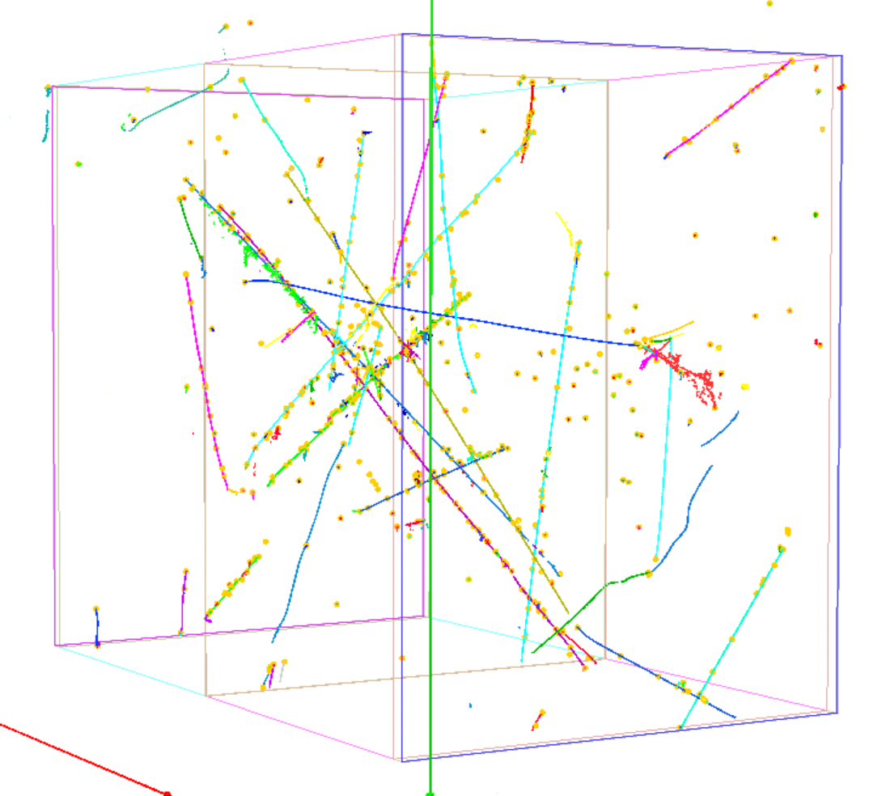
Reco plot
Thanks to Leigh Whitehead who says
“A (pretty well) reconstructed 7 GeV pion (blue track) interaction that happens at the back of APA2 from last night”
Leigh informs me these changes have been merged into Pandora and should be available in a tagged version of Larsoft next week.
At which time significant keep-up processing will commence to catch up to the 300-some TB taken the week before beam and the 200-some TB we will generate this week.

