Slide 1
IOTA Proton Injector Update
Dean (Chip) Edstrom
06/21/2024

Slide 2
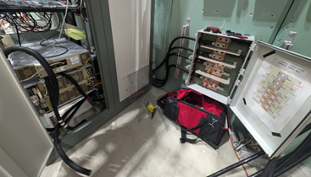
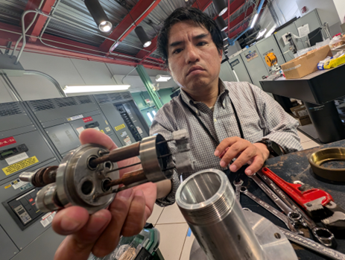
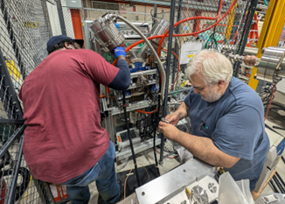
Source Status: 60μA @ 10keV, 450μA @ 50keV
But what have you done for me this week?
S300 LEBT Solenoid
Power Cables Terminated to the Test Cage
Lead covers?
Connection Tinning?
ACNET Control Re-estailshed (N:S300)
Water Cooling Implementation in Progress
H/V300 Corrector Package
ZUPs will be used temporarily
Pursuit of new coating
Test filament in Bell Jar

Slide 3
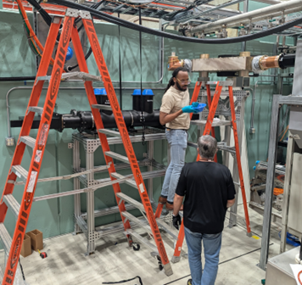
Gallery
HLRF (Daniel & Trey)
Component Testing / Evaluation / Mounting
✔ 180 Deg Hybrid
✔ Circulator Mounted
✔ Variable Coupler Mounted*
…
LCW Progressing…
Time to run cable to the PLC
Run switch readbacks to Modulator VME
180 Deg Hybrid Installation
Still coming up…
Electrical Contract for Misc Items (600A Disconnect Test Points)

Slide 4
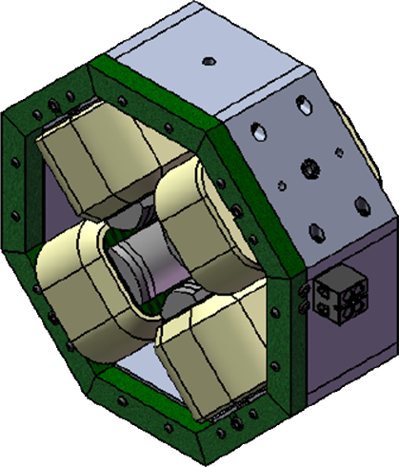
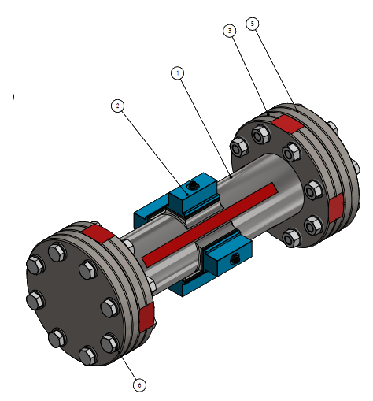
Beamline Installation…
Alignment
RFQ / Quads / Bend Dipoles
Vacuum Crosses / Ion Pumps
!!! Do Not Move These !!!
BPMs
Connectors ‘fit’ but maybe too snug
G10 Shaved… Clearance/Alignment issue?
Full-Aperture Crosses (x315 / x332 / x343)
Turbo Pump Fore Vacuum Carts
Sub-D Connector terminated in Cave
RJ-45 Connectors terminated in RR915

