Slide 1
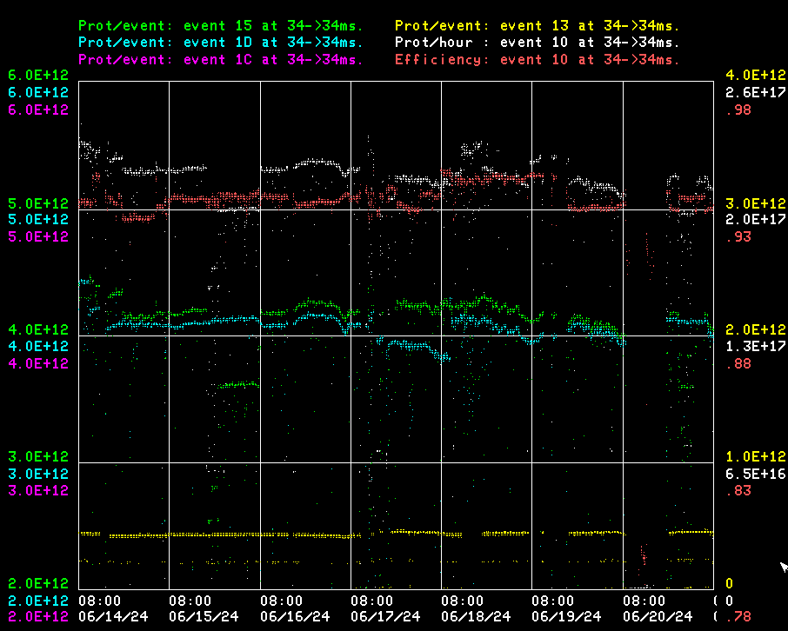
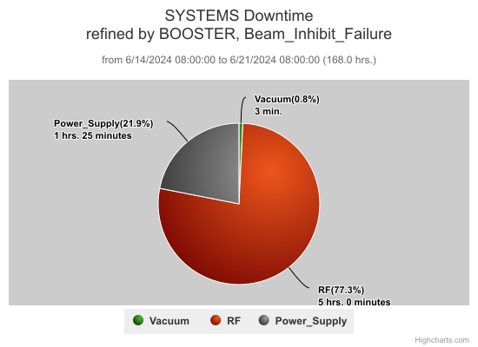
Booster Operations / June 14 - 21
Current conditions:
93% efficiency, 2.0e17 p/hr
$15: 4.0e12 p/p
$1D: 4.0e12 p/p
MI Access
EAPS temp trip
EAPS temp trip $ MKS07 airflow trip
EAPS temp trip
Flat Inj Studies
DT : ~6.5hrs.

Slide 2
Summary
Friday into weekend: Minor RF trips but lost BRF19 and BRF2 over weekend. EAPS trips due to high outdoor temps on Sunday.
Monday: RF experts recovered BRF2 and BRF19.
Tuesday: EAPS cubicle temperature trips on hot days this week. RF experts reduced voltage to see if it helps bring down temps. PESD provided temp alarm feature to allow to turn off before trips to begin cool down periods.
Wednesday: EAPS Temp trip and Kicker MK07 cooling fan flow switch replacement.
Thursday: Performed dedicated Flat injection studies. Resumed beam later after MI access.
Intensity and throughput down this week due to overall complex running conditions.
Thanks to Ops for maintaining Booster beam operations

Slide 3
Booster Studies-2024
Proposed

