Slide 1
Main Injector / Recycler at The Nine
A.P. Schreckenberger 2024-06-07

Slide 2
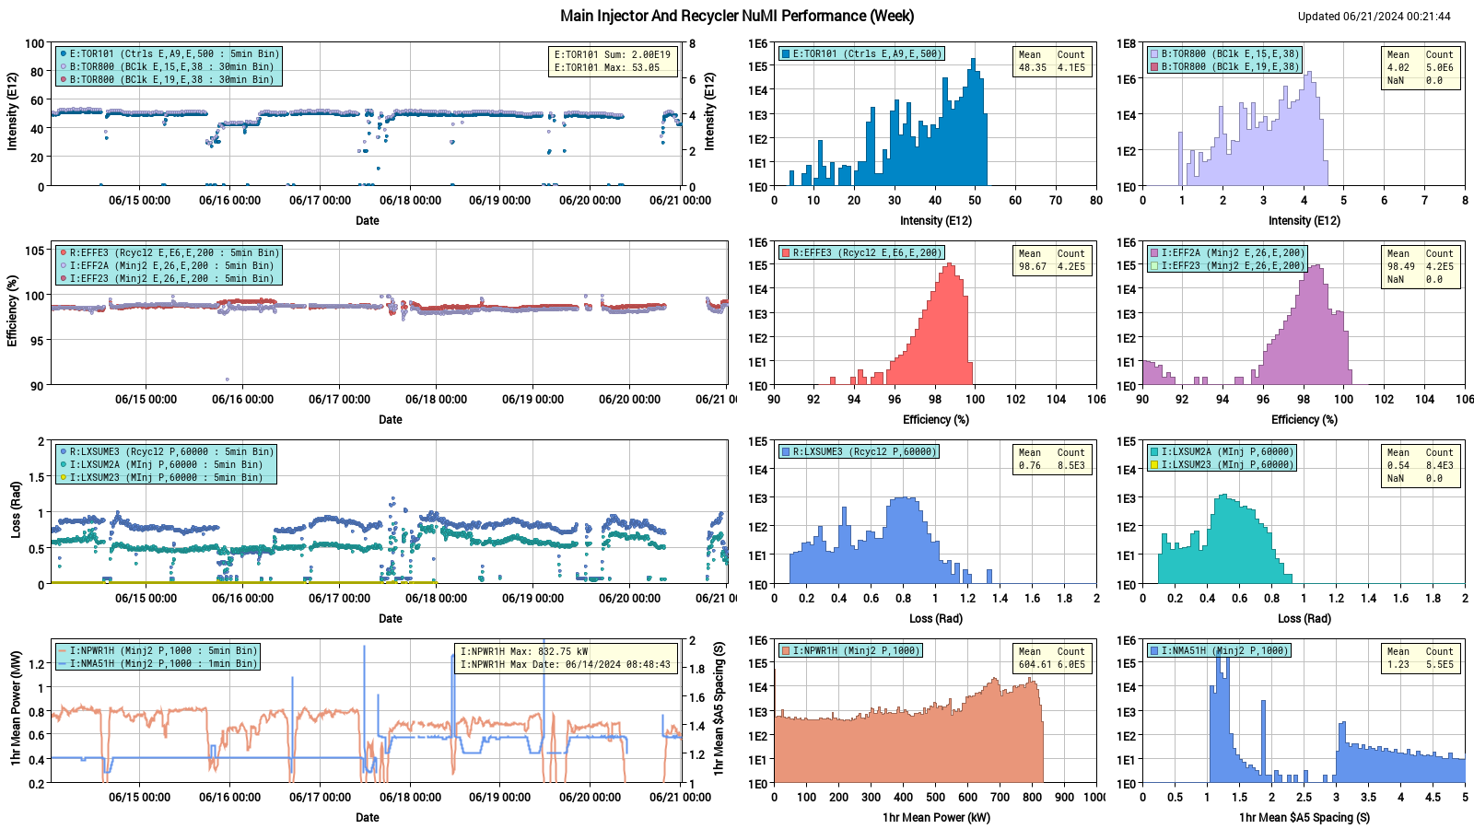
Week in Review – NuMI Performance Plots

Slide 3
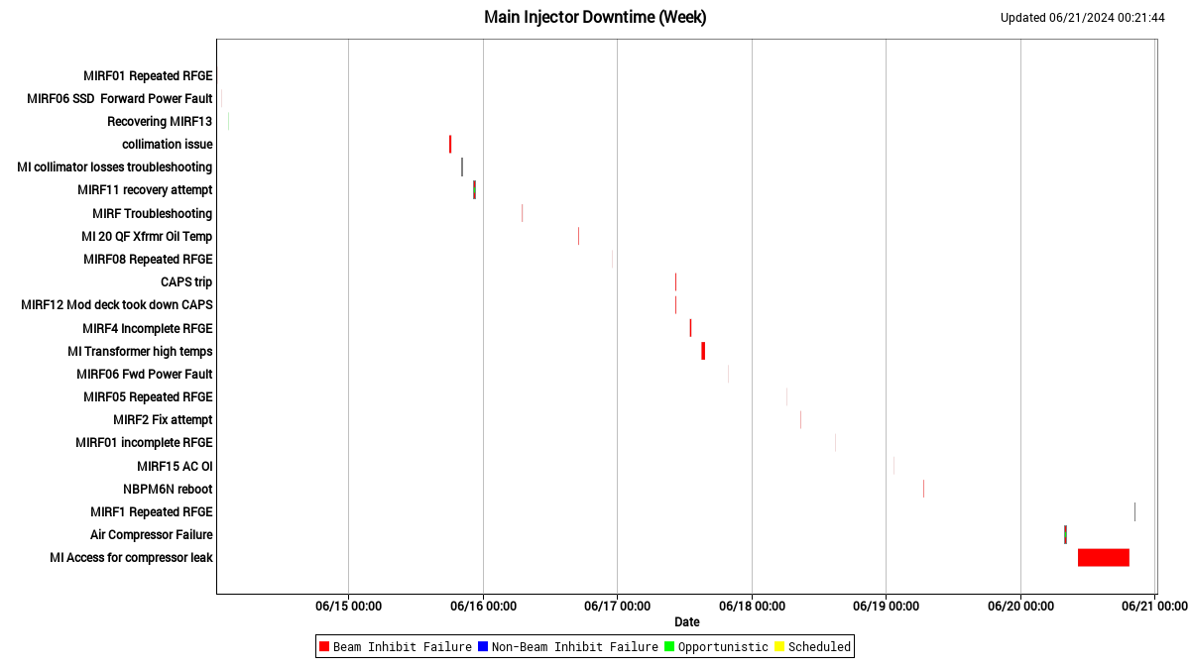
Week in Review – MI Downtime ☹

Slide 4
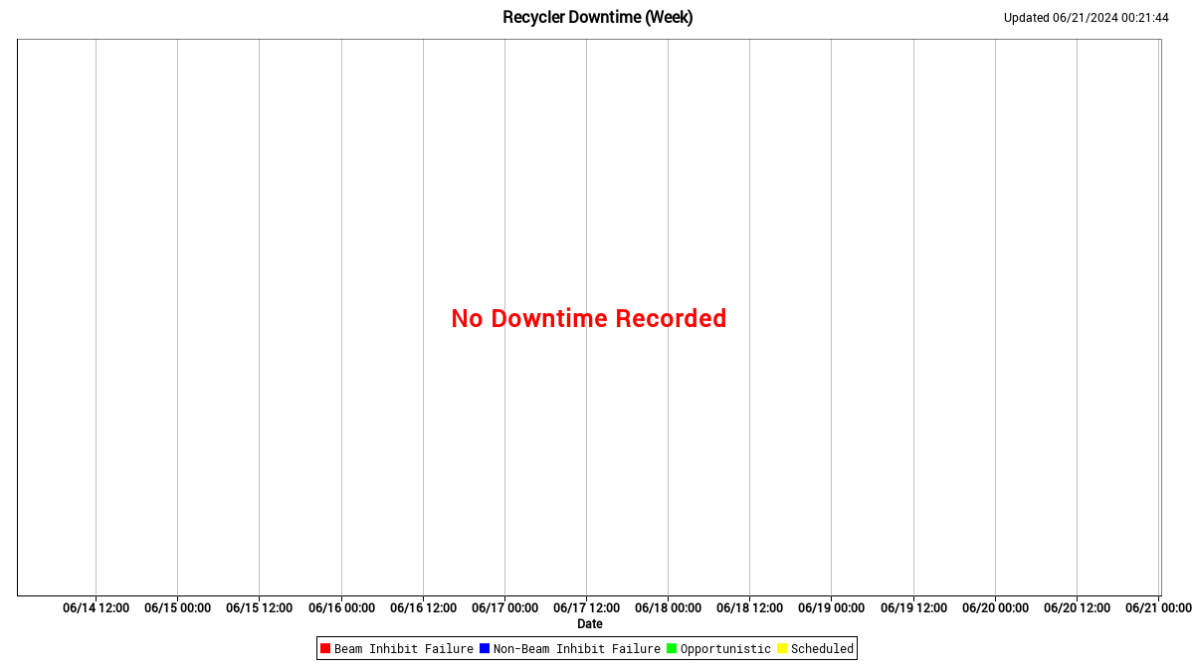
Week in Review – RR Downtime ☹ … Wait ☺!!

Slide 5
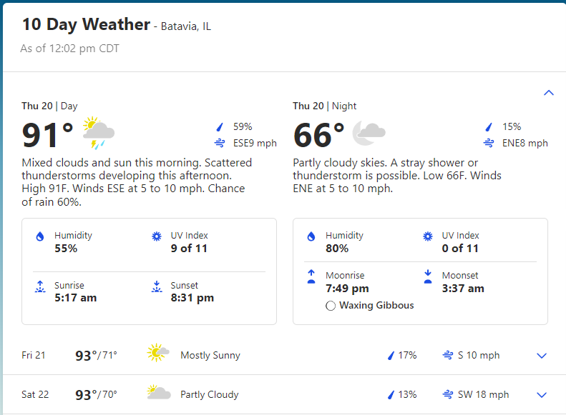
Tuning into the Weather Channel… Summer in the City

Slide 6
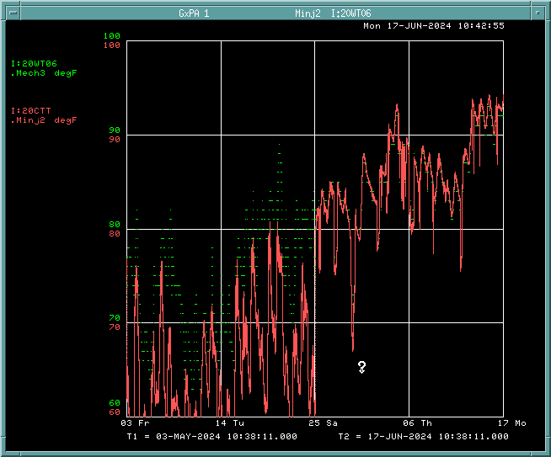
Tuning into the Weather Channel… Summer in the City
Monday started with concerns regarding high temperatures
Instructions provided regarding LCW Supply Temps
Double-checked alarms, found a cooling tower off since May 25th
Duty Electrician and Duty Mechanic dispatched to MI-20 for recovery
Wren found that relevant ponds were 3ºF warmer than other ponds
MI-20 kicker room AC trip
MI-30 Pump #3 recovered

Slide 7
More Updates Regarding Upset Things
MI RF Station 11 came back up Monday afternoon
Dry-type transformers at various MI locations had their temps taken
RF Station 2 tripped off and signs pointed to sparking
Matt elected to turn the station off, recovered later
RF Station 4 also bypassed on Monday, recovered Thursday
Then lost RF Station 1 to trip… RFGE Fault

Slide 8
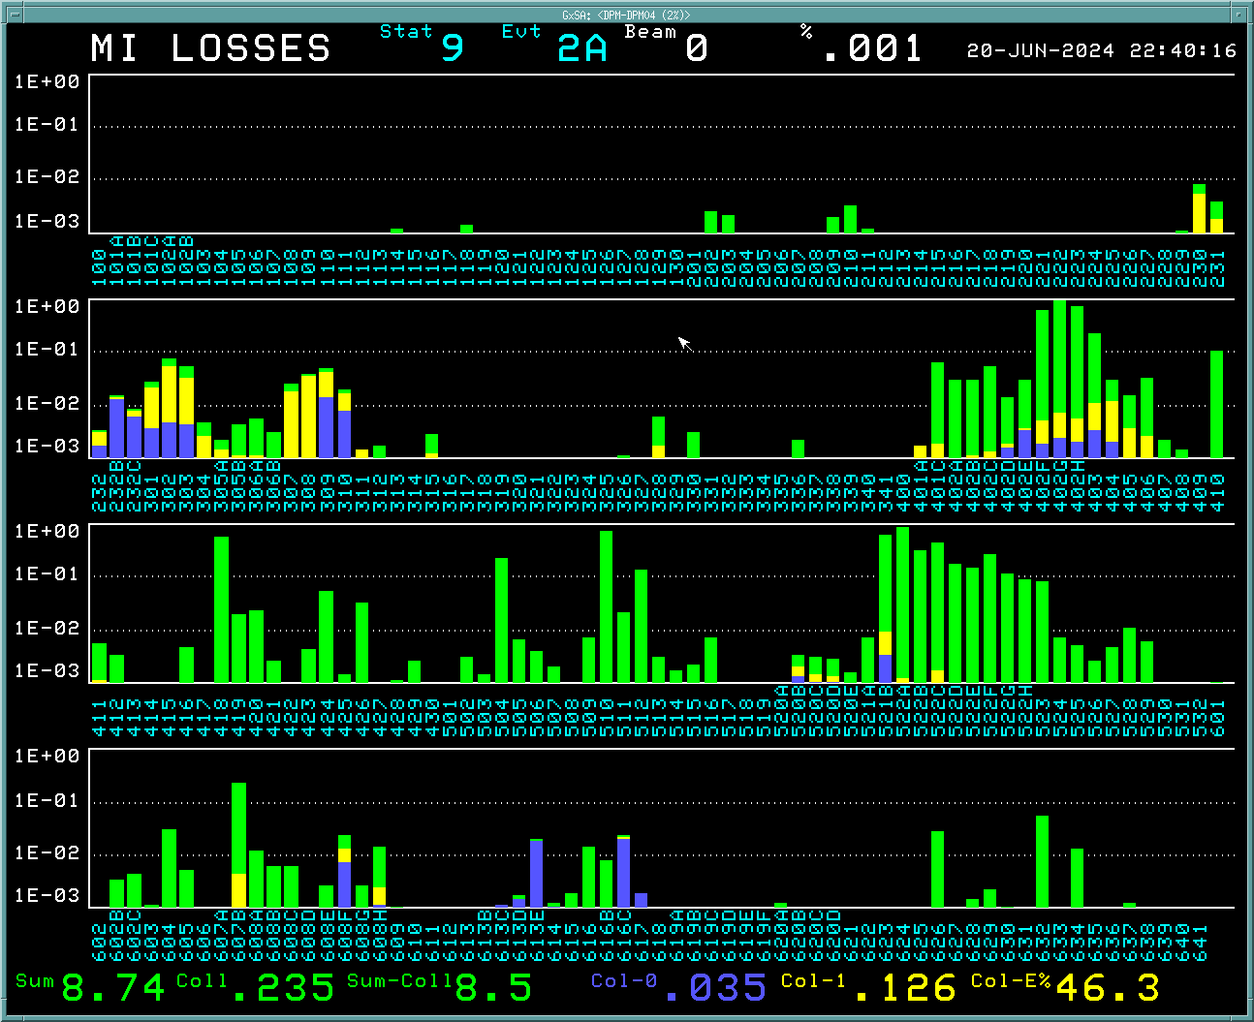
More Updates Regarding Upset Things
I:LXSUM20 started reading higher than usual
Pinned to a readback issue tied to DUE32 reboot
Air compressor at MI60S tripped, beam valves started closing
Investigated during Booster studies and then some
Losses in 40-60 region started overnight… invaded the MCR

Slide 9
More Updates Regarding Upset Things
Losses in 40-60 region started overnight… invaded the MCR
Longitudinal, points to a cavity, started 23 minutes after Station 1 gap envelope noise reported in elog…

Slide 10
In Pursuit of Science
Limited authorization to attempt 1-MW operation
Planning this is on the agenda…
ACNET parameter pages implemented to control the new MI/RR scope trigger box
2 RR scopes connected along with one MI Tek scope
Cris examining data readout from RR
Adam looking at stripline data through MI transition crossing
Matilda and Randy “RTK!” did commissioning work on electron gun profile scanner at MI-62
Oh, I also hid a haiku, so no worries! Happy Friday!

