Slide 1
Project Activities for MSD
Mayling Wong-Squires
AD Operations Friday 9am Meeting
21 June 2024

Slide 2
PIP-II Vacuum Systems Updates Lucy Nobrega (L3/CAM), Sherese Humphrey (Interim CAM), Alex Chen (Lead Vacuum Engineer), Rich Andrews (Chamber design), Eric Pirtle (Design)
Working on
Procurement of Warm Front End and Superconducting Linac vacuum equipment
Writing travelers and finalizing handoff documentation
Final design for Beam Transfer Line and Beam Absorber line
Detail BTL/BAL Vacuum CAD model and magnets interspaces configurations with input from stakeholders: MagPS, BI, BTL/BAL Installation
Vacuum chamber design for dipole magnets (quantity 40) in coordination with MagPS
Final design of interfaces with Beam Instrumentation devices, Booster vacuum, Beam Absorber Line
Validation of equipment selection with vacuum pressure and structural simulations
Addressing review recommendation: review of vacuum analysis (K Duel)
Finalizing designs of laserwire UHV chamber, commissioning cart, wide aperture BPM’s (D Krokosz)
Finalizing design of laserwire optics and adjustment stages (T Price)
Department resources needed
Vacuum technician for acceptance testing and vacuum cart assembly (starting October)
Fabrication Procurement: BTL dipole & septum chambers
Design/Drafting: BTL design & integration (E Pirtle)

Slide 3
PIP-II Vacuum Systems Updates (cont’d)
Vacuum Systems, Machine Protection, LLRF, and HPRF System Interfaces Signal Diagram from Integrated Vacuum Systems Final Design Review (completed May 7, 2024)

Slide 4
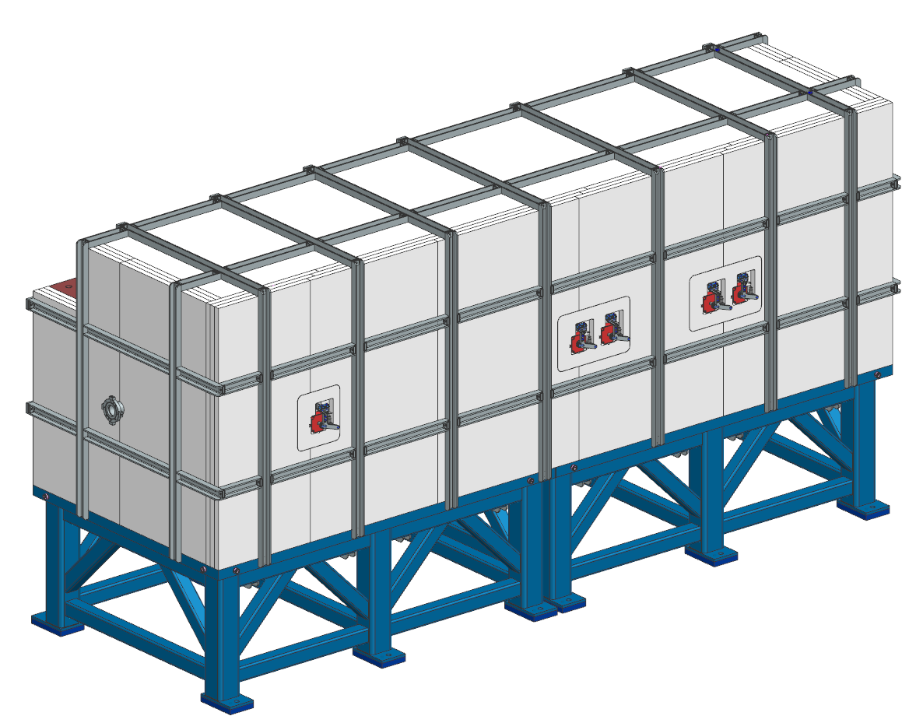
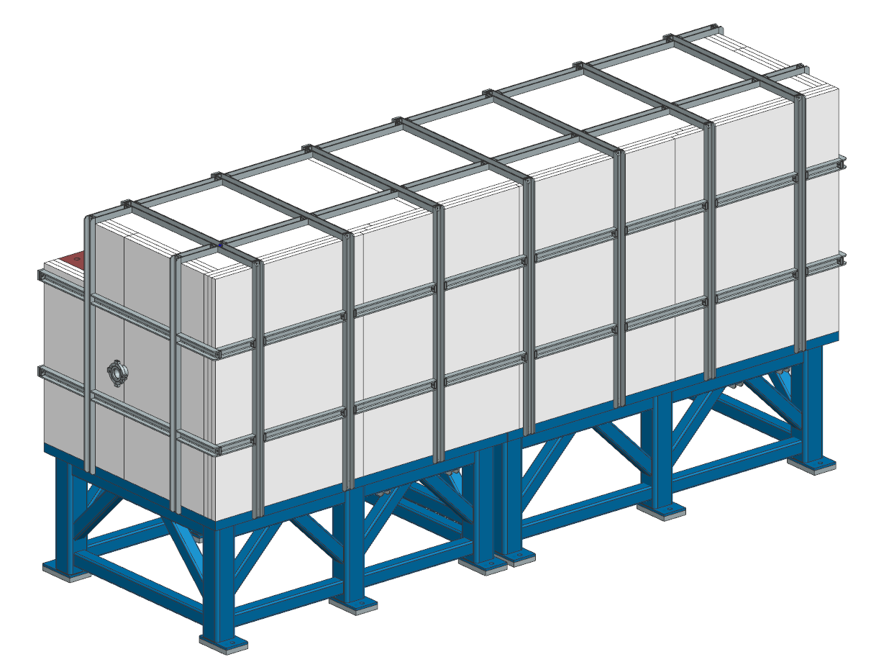
PIP-II BTL Collimators
MSD personnel involved
Bob Donahue – engineering
JP Walano – drafting
Kevin Duel – drawing approver
Christine Ader – engineering note reviewer
PRR deliverables are complete
Engineering note approved and released
All drawings released
Upcoming:
PRR in July
Initiate procurements/fabrications after PRR complete
Horizontal collimator
Vertical collimator

Slide 5
LBNF Primary Vacuum and Magnet Installation Kevin Duel, Ty Funk, Monika Sadowski, Jason Morin, Matthew Volante, Peggy Jones, James Williams
Primary Vacuum
Beamline vacuum drawings released and working on magnet beam tube drawing releasing and assembly structure
Kicker ceramic beam tube TiN coating outgassing tests completed in May and results are acceptable
Coating specific outgassing rate determined to be 3x10⁻¹⁰ Torr-L/s/cm²
Waiting for 12” long tube samples from vendor
Vendor tested process with glass tubes and results were satisfactory
Meeting with MI again soon to finalize relocation of components the LBNF beamline interferes with at MI-10
Magnet Installation
Multiwire stand drawings and engineering note approved and released
Quad installation procedure writing in process
Corrector magnet installation fixture design engineering note writing in process

