Slide 1
Switchyard & Meson Report
Michael K. Olander
AD 9:00 Meeting
7 June 2024

Slide 2
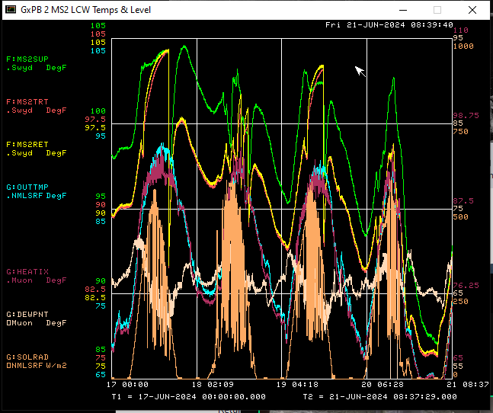
MS2 LCW Temperature
Running two air towers, three operational fans out of four.
LCW Temperature trip the power supplies at 105°F.
Downtime averaging around seven hours a day.
Thanks to MSD for cleaning the air towers Tuesday & Thursday. (Cottonwood buildup)

Slide 3
Current Plans
Run.
Would like to run to MCenter today for beamline checkouts.

