Slide 1
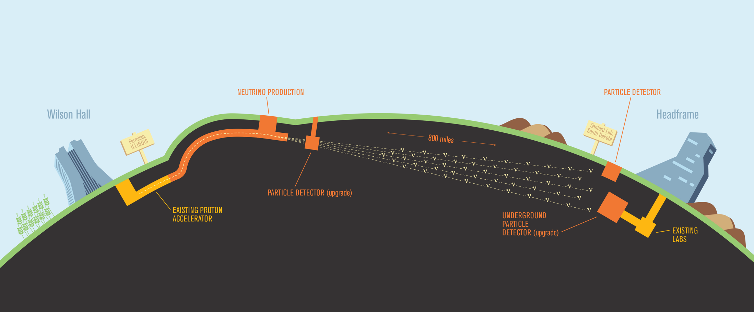
APAs in ProtoDUNE-2
Justin Evans, Pip Hamilton & Brian Rebel
24th June 2024
11th May 2012

Slide 2
ProtoDUNE-2
We have four APAs in ProtoDUNE-2
Two upper APAs and two lower APAs
All APAs were tested in the cold box prior to installation into ProtoDUNE-2
Pip Hamilton (Imperial) is our APA consortium lead on ProtoDUNE-2
Most of the information in this talk is provided by him
APA 2
upper
APA 4
lower
Cathode
APA 1
upper
APA 3
lower
Beam

Slide 3
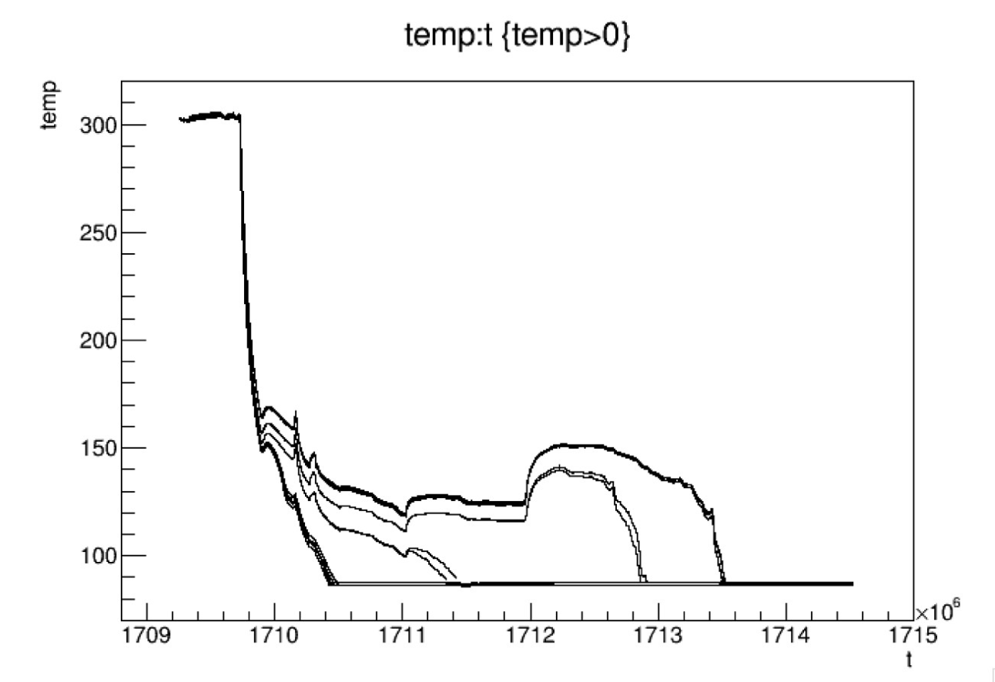
APA cooldown
APA cooldown went smoothly with the temperature difference between top and bottom of any APA not going above 60º C
Our requirement is to keep this below 100º C
Traces from various temperature sensors on APAs
Sensors at the bottom cool down first

Slide 4
Disconnected channels
In total ~34 channels of 10,240 have had some kind of issue (although some have recovered)
This is 0.3%, which is well within our 1% requirement
Possible causes for channels that disconnect during cool-down
Insufficient plating of the through holes for the Mill-Max pins such that the pin does not contact the sides of the hole well
Poor insertion of the Mill-Max pins (hard to come up with a scenario for this)
Problem with the CR board to CE adapter board connection
Problem with the CE adapter board connector solder joints for those channels (done by hand at PSL for these boards; now being done by selective solder machine)
Insufficient contact between the FEMB and CE adapter board connectors for those channels

Slide 5
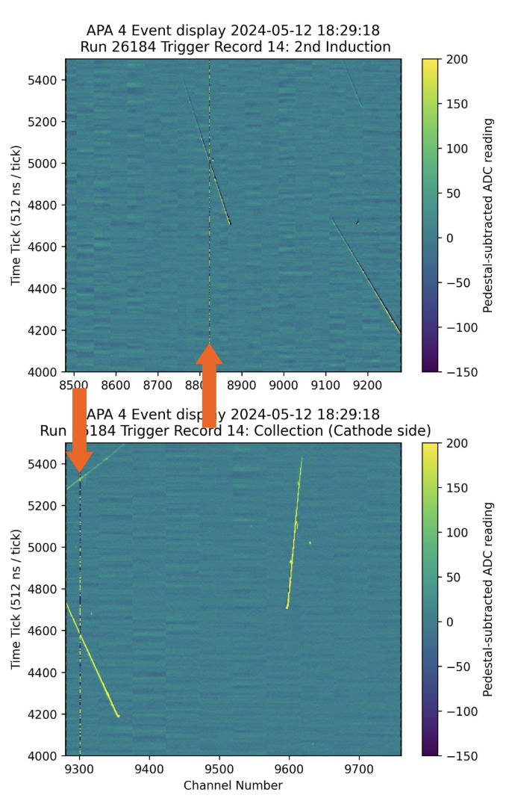
Possible loose material in TPC
Intermittent shorts are being observed
Move around in the detector
Appear and reappear on timescales of days, with some correlation to circulation and field ramps
Sometimes between channels, sometimes whole layers
Currently the APA 1 G layer and the APA 4 U layer are shorted to ground
Drawing μA currents, which does not stop us from operating
Hypothesis is some small amount of conductive debris in the detector
Important to focus on minimizing the risk of any debris from our construction and installation

Slide 6
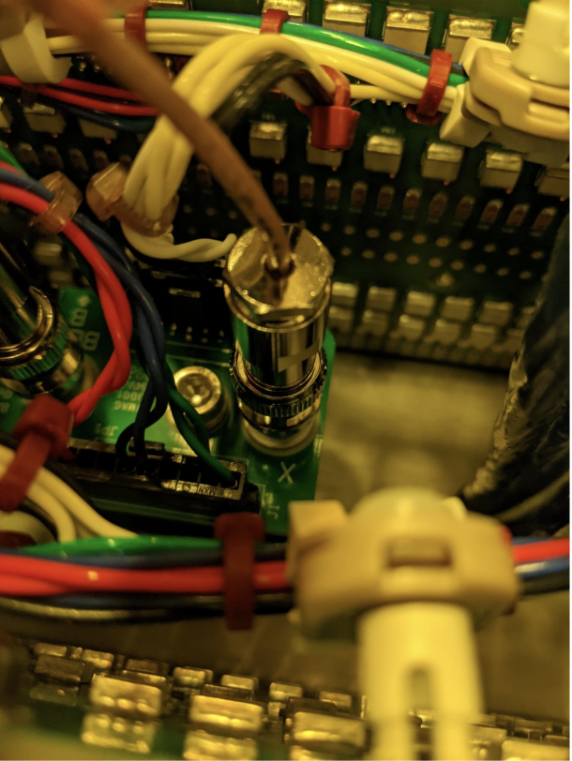
APA 1 collection-layer bias
There is no bias voltage on the collection layer of APA 1
This means the last induction layer (V) is acting as the collection layer with unipolar signals, and there is very little signal on the collection (X) layer
Impedance measurements from the flange show that the loss of connection is between the HV cable and the APA itself
Potentially a bad SHV connection into the SHV board
Installation procedures will be reviewed to make the SHV connection step easier and add additional QC testing
Leave the CR board immediately in front of the SHV board off the APA until the SHV connection has been made
Add an additional visual QC step to this connection, and use impedance measurements to check the connection
A redundant X-layer SHV connection is being considered, but this has associated electrical and mechanical issues

Slide 7
Summary
APAs 2, 3 and 4 are working well
APA 1 has an issue with the collection-layer bias voltage coming in
Issue is in between the HV cable and the APA itself
Disconnected channels are well within our requirements and will be monitored over the run
Possible conductive debris in the TPC

