Slide 1
Adding Observability to the Managed Tokens Service
Shreyas Bhat
Scientific Computing Monitoring Workshop
July 24, 2024

Slide 2
What is the Managed Tokens Service?
Store production vault tokens in condor credds
Push production vault tokens to interactive nodes, keep them refreshed
Written in Go (performant, easy/safe concurrency, avoid Python “dependency hell”)

Slide 3
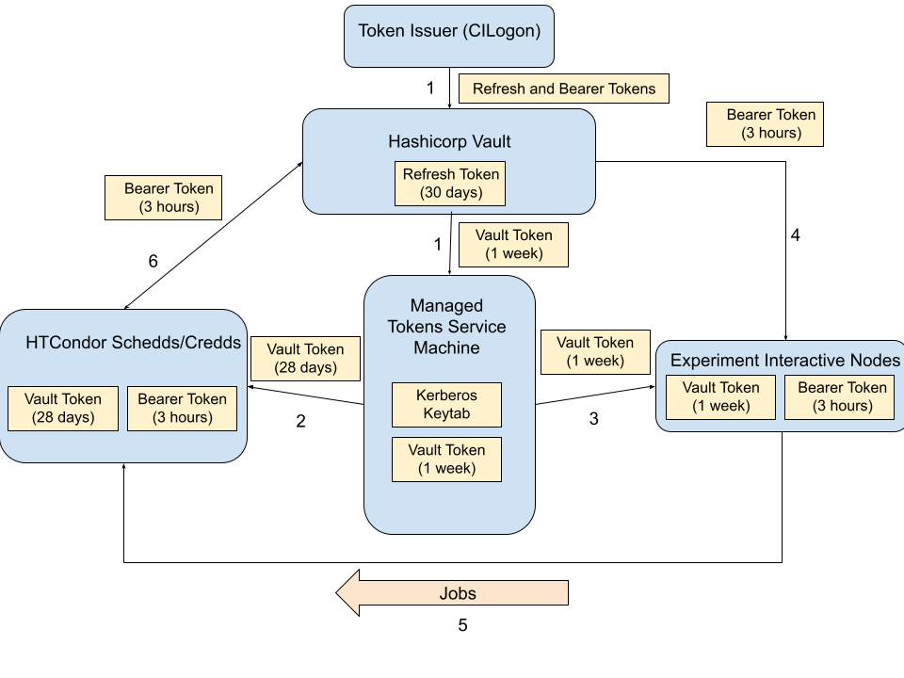
Where the service fits in

Slide 4
Executables of Managed Tokens Service
token-push:
Stores vault token in HTCondor credd for experiment/role combination and push copies of vault token to interactive nodes
Notifies experiment stakeholders and operators if there is any error
Runs every hour.
refresh-uids-from-ferry:
Queries FERRY to pull down the applicable UIDs for the configured UNIX accounts
Runs daily each morning
run-onboarding-managed-tokens:
Onboards a new experiment or experiment account to the Managed Tokens Service
Run as needed

Slide 5
Normal operation of token-push
Uses a kerberos service principal to authenticate to the Hashicorp vault server
Sets appropriate credkey in HTGETTOKENOPTS based on kerberos principal → Lets condor_vault_storer/htgettoken know where the refresh token is in the vault
condor_vault_storer
Resets the refresh token in the vault and obtains a vault token
Stores this vault token in the HTCondor credd
Pushes this vault token to experiment interactive nodes
Notifies experiment stakeholders and/or operators if there is any error in any of the previous steps

Slide 6
Components to keep track of
All of the operations on the last slide plus:
Configuration parsing
Local sqllite database reads/writes
Notification generation/sending
Most of these operations (with exception of condor_vault_storer) are done concurrently
How do we monitor all of this?

Slide 7
Logs with Loki
Standard logs at /var/log/managed-tokens on managed tokens machine
One regular log, one debug log per executable
But searching through those can be tedious: Send logs to Loki
Queryable log store FE via LogQL:
{app="managed-tokens",command="token-push"} | json | experiment="gm2" AND role="production"
Simply required adding a configured Loki hook to existing logging library - INFO and higher-level logs are sent to Loki

Slide 8
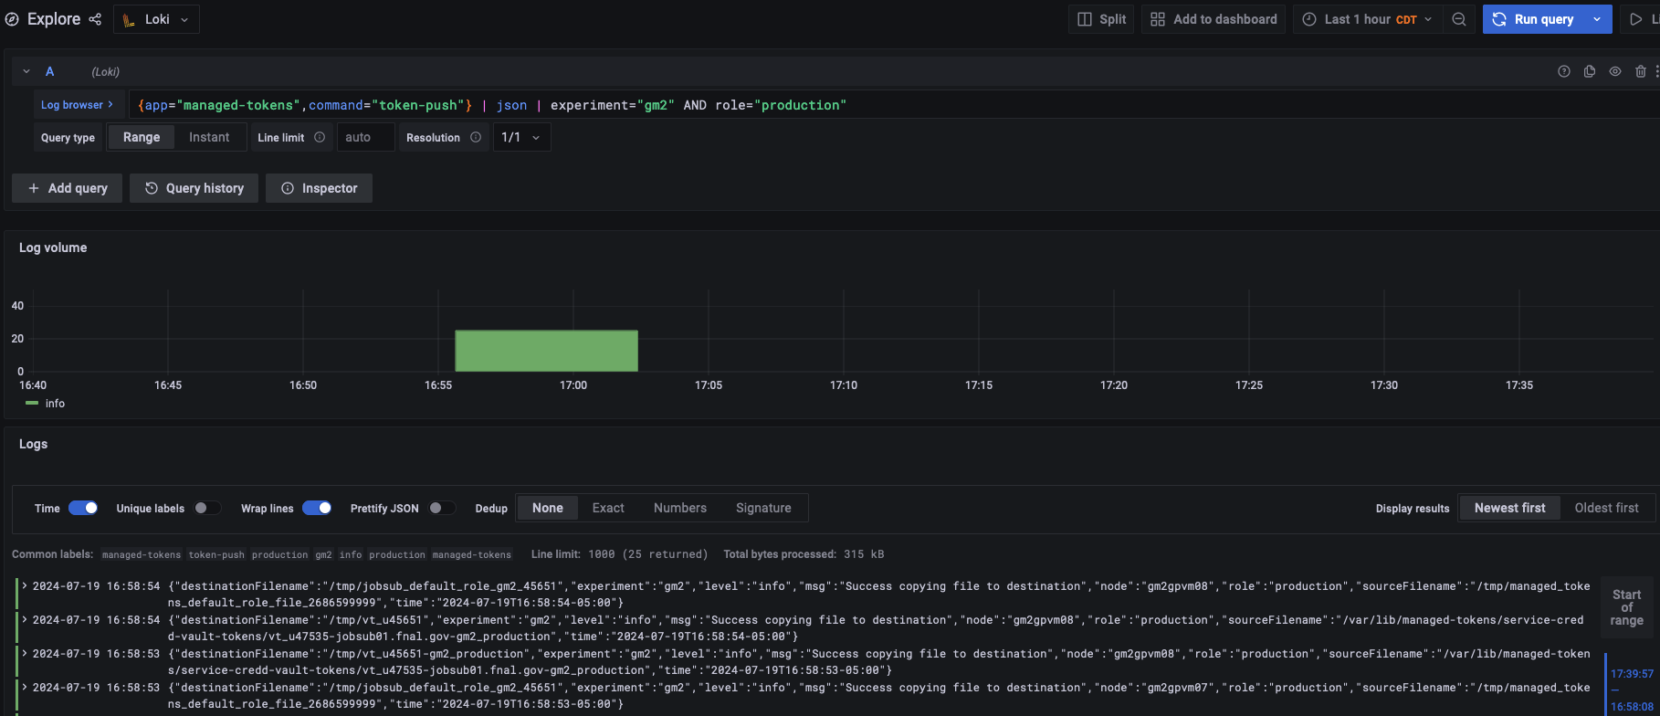
Logs with Loki (2)

Slide 9
Metrics
Prometheus metrics pushed each run to a Landscape pushgateway
Standard prometheus setup is for web services; for batch processes like this, need to use pushgateway: extra webserver that can receive metrics, then serves them to normal Prometheus server
Metrics
managed_tokens_stage_duration_seconds: Per executable, per stage (setup, processing, cleanup). How long each stage took to run.
managed_tokens_last_ferry_refresh: Timestamp of when refresh-uids-from-ferry executable last got information from FERRY.
managed_tokens_failed_services_push_count: Count of how many services registered a failure to push a vault token to a node in the current run of token-push. Basically, a failure count.
managed_tokens_last_token_push_timestamp: Timestamp of when token-push last pushed a particular service vault token to a particular node.
Managed_tokens_last_token_store_timestamp: Timestamp of when token-push last stored a particular service vault token in a particular credd.
And more!

Slide 10
Metrics (2)

Slide 11
Tracing
While metrics and logs give great insight into issues that crop up, traces help visualize WHERE in the program flow something went wrong
Serve as a visual index rather than grepping through the logs
Then, for more details, you can go to the logs if needed
We added OpenTelemetry tracing that gets sent to Landscape Jaeger Tracing collector
For example: https://landscape.fnal.gov/jaeger/trace/0eee23d1cfd43126e6dc3d2d184f9007

Slide 12
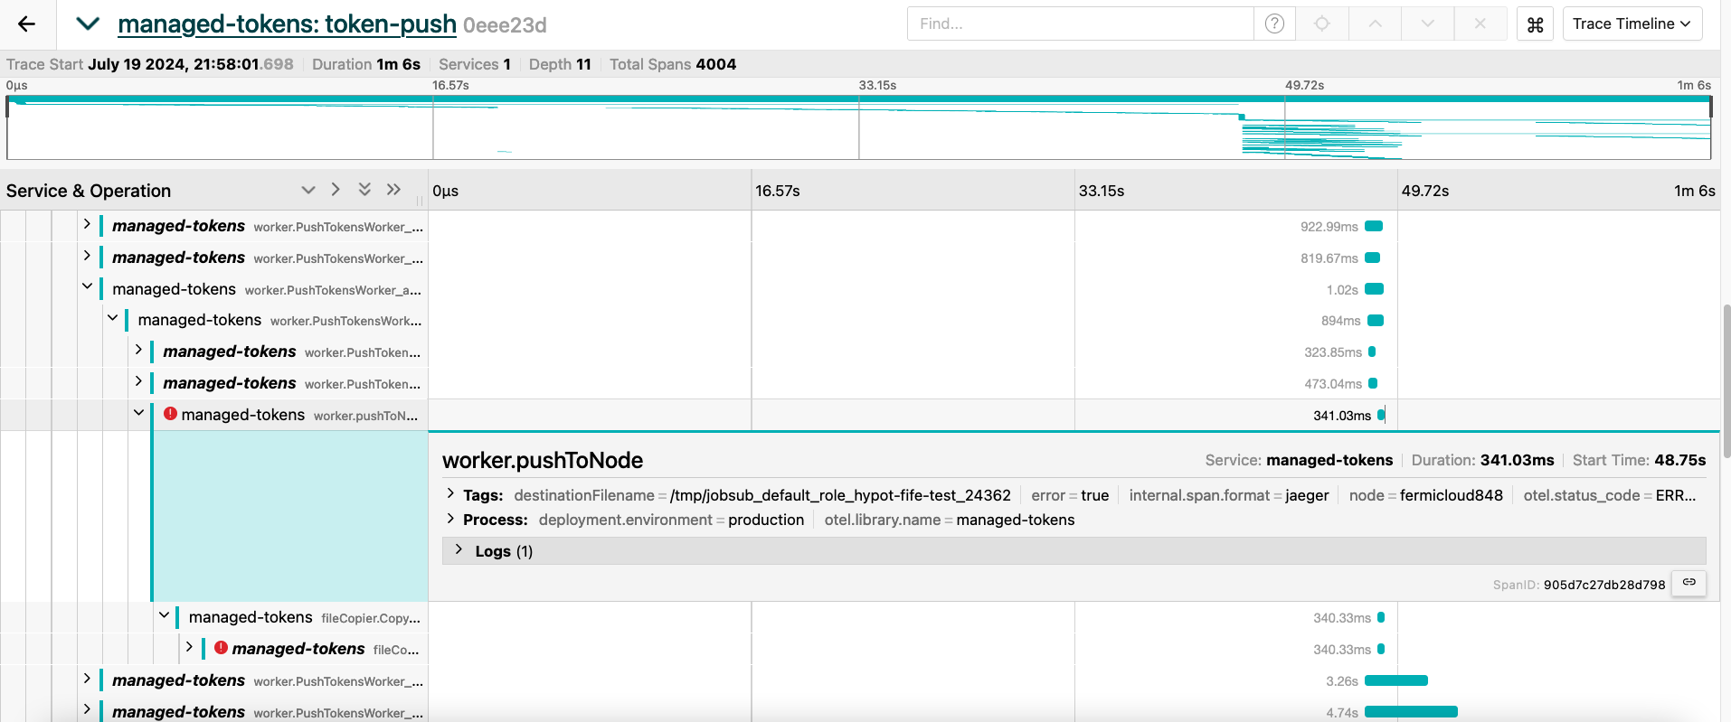
Tracing (2)

Slide 13
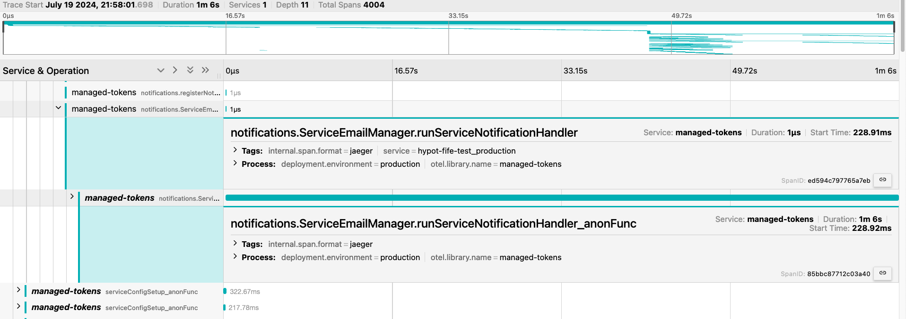
Tracing to visualize concurrency (3)
We can see here that a hypot-fife-test_production ServiceNotificationHandler is launched concurrently and stays alive for almost the entire run - waiting for messages, like the one the previous slide’s error would have generated - you can SEE the concurrency!

Slide 14
Dashboards
Fifemon dashboards:
Last token push by service/node: https://fifemon.fnal.gov/monitor/d/QOV9N_iIz/managed-tokens-service-time-since-last-token-push?orgId=1
Last token store in credd by service/credd (with alerts after 3 hrs of failure): https://fifemon.fnal.gov/monitor/d/w4mAD_iIk/managed-tokens-service-time-since-credd-store
Service Health Dashboard: https://fifemon.fnal.gov/monitor/d/bGDwH9mSz/managed-tokens-service-service-health

Slide 15
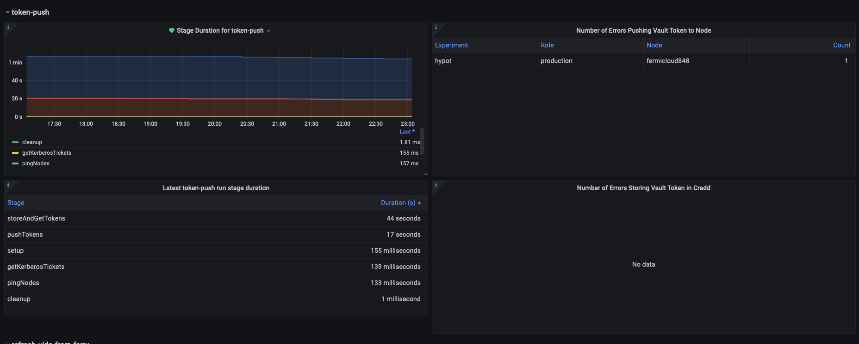
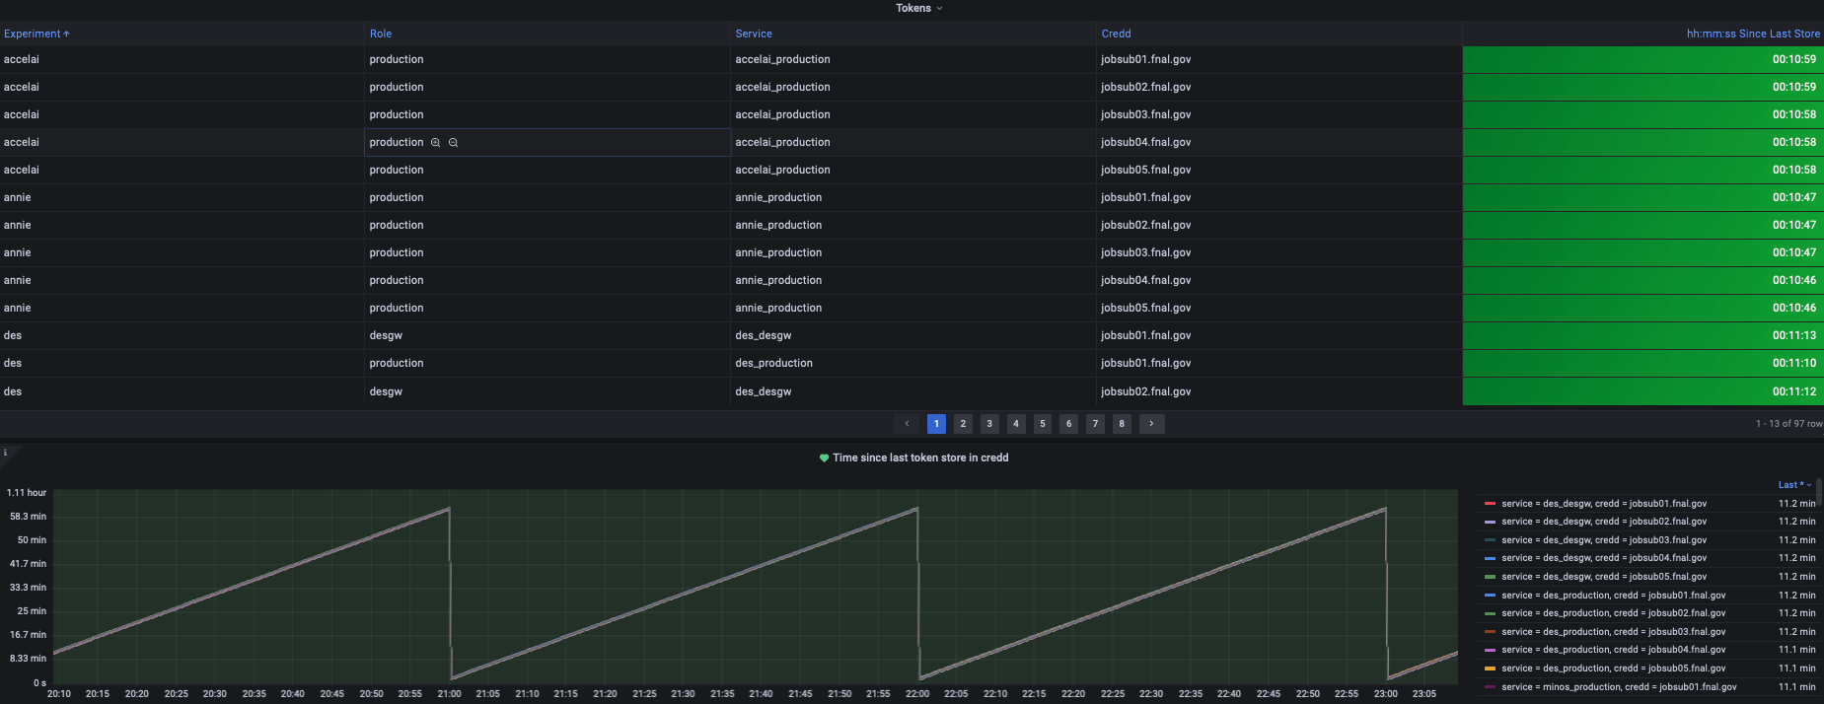
Dashboards (2)

Slide 16
Alerting
Use dashboards to send alerts to #fifealerts Slack channel
Time since a token was stored in condor credd > 3 hrs
Any stage from refresh-uids-from-ferry takes > 5 min
Time since UIDs refreshed from FERRY > 2 days
Also, original notifications from token-push itself:
Emails to stakeholders, FIFE
Abridged version sent to #fifealerts

Slide 17
Future
Pretty much done - no major work left in adding observability
TODO: Export traces to new Landscape OpenTelemetry collector rather than current Landscape Jaeger collector
One function change, since library APIs between Jaeger/OpenTelemetry are nearly-identical
Then rest of tracing code in managed tokens should seamlessly plug-in

Slide 18
Summary
Managed tokens service executables are multi-threaded with numerous concurrent operations running at any time
Adding observability has helped us pinpoint issues very quickly when they occur:
Alerting/dashboards fed by metrics tells us that something went wrong
Traces show us very quickly in which components of which executable the issue occurred
Logs sent to Loki (INFO level) let us quickly find the exact operation within the relevant component that went wrong
Debug logs on the deployment machine can help us look at details of faulty operation
All of these components working together has saved a LOT of troubleshooting time

Slide 19
Resources
Github repo: https://github.com/fermitools/managed-tokens
Wiki page: https://fifewiki.fnal.gov/wiki/Managed_Tokens_Service
Loki: https://grafana.com/docs/loki/latest/
Prometheus: https://prometheus.io/
Prometheus Pushgateway: https://prometheus.io/docs/practices/pushing/
Using Metrics in Grafana: https://prometheus.io/docs/visualization/grafana/
OpenTelemetry Tracing: https://opentelemetry.io/docs/

Slide 20
Thank you!

Slide 21
Extra Slides

Slide 22
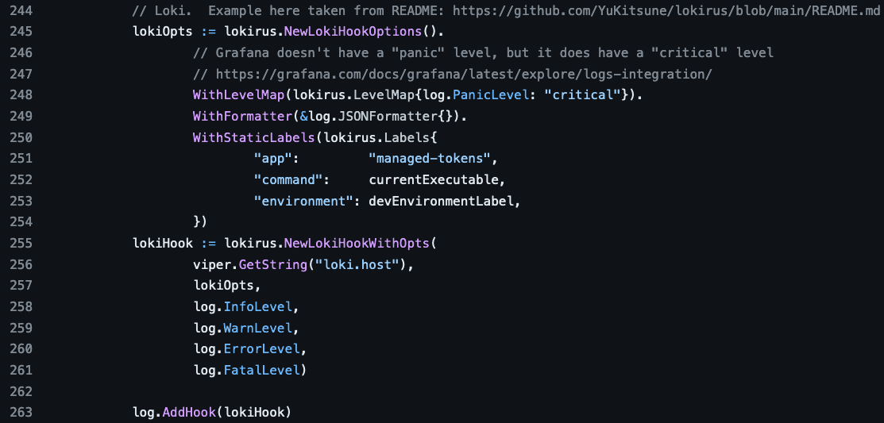
Loki Configuration with logrus
Code to add loki hook to logrus logging library
Link to code on Github
Configuration for loki in managed tokens config file

Slide 23
Prometheus configuration
Configuration to push metrics to pushgateway at http://fifelog.fnal.gov:9091
Set up MetricsRegistry using prometheus Go client library and prometheus Go pushgateway library
Set up metrics in each executable, like this (link to Github)

Slide 24
Tracing configuration
Configuration to export all traces to https://landscape.fnal.gov/jaeger-collector/api/traces : note - there is now an OpenTelemetry-compatible trace collector that should be used instead
Set up TracerProvider to export traces (example)
Set up executables to use this TracerProvider when creating new spans (see here)
In each operation/function, start a new span (example)

