Slide 1
Distributed tracing for jobs: jobsub and beyond
Shreyas Bhat and Marc Mengel
on behalf of the Jobsub Team
Scientific Computing Monitoring Workshop
July 24, 2024

Slide 2
Intro to jobsub_lite
Software for job submission and monitoring
Tried to keep the most-used pieces of jobsub_client, strip out unnecessary parts
Client-only, installed on experiment interactive nodes
For more info:
https://fifewiki.fnal.gov/wiki/Getting_started_with_jobsub_lite

Slide 3
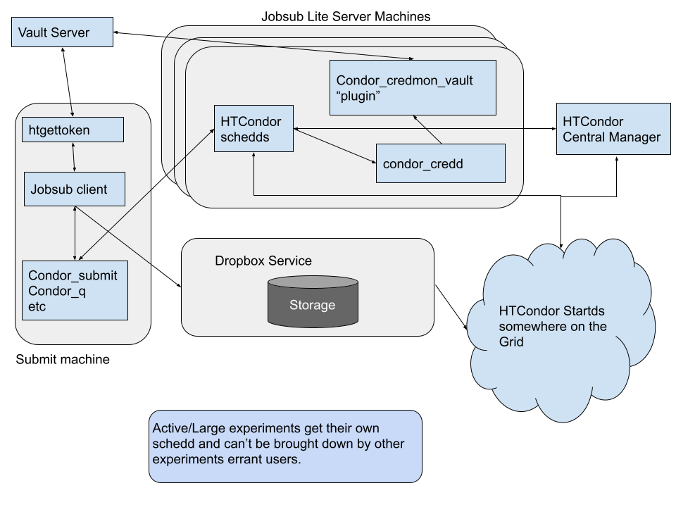
jobsub_lite Layout
Original Image Credit: J. Boyd

Slide 4
What happens
jobsub_lite takes user command, converts it to HTCondor submission file (Job Definition File), and uses HTCondor python bindings to submit the job to a remote schedd
Following sub-operations handled by jobsub CLI:
Authentication
File upload
Job submission
Job management

Slide 5
Then vs. now
In previous client/server setup, had copious server logs
Now, no logs on client to help troubleshoot
Debug mode can only take you so far
If submission goes wrong - where in submission did error occur?

Slide 6
Enter tracing!
In jobsub_lite 1.4, we instrumented the jobsub_lite code to enable tracing of jobsub_lite functions
While clear error messages can be helpful, for troubleshooting, much easier to see a picture:
https://landscape.fnal.gov/jaeger/trace/58702552abacbdd980d89ff34ac7c63c
Can see job submission processes
We can see that job actually submitted, but all sandbox files didn’t get transferred properly (canned example where we Ctrl-C-ed)
Cool!

Slide 7
What if something fails INSIDE our job?
Might get trace that looks like this:
https://landscape.fnal.gov/jaeger/trace/a026cabdc37613c3c0f7933aa5c53a4d
But job sandbox shows:
So what went wrong? Can we look inside the jobs some other way than doing
ifdh cp -D exelogs /pnfs/myexpt/scratch/users/mylogs

Slide 8
Tracing INSIDE jobs?!?
In all jobsub_lite jobs, we set an environment variable TRACEPARENT that holds a special Trace ID and Span ID for the jobsub_submit command that launched the job
If we can get our job executable to use that TRACEPARENT, can we continue the previous traces INTO the job? Yes!!
export OTEL_EXPORTER_OTLP_TRACES_ENDPOINT to “https://landscape.fnal.gov/otlp/v1/traces” - tell any underlying instrumentation code where to send traces
“Distributed tracing lets you observe requests as they propagate through complex, distributed systems” - (Source: https://opentelemetry.io/docs/concepts/observability-primer/#understanding-distributed-tracing)

Slide 9
Tracing INSIDE jobs!
To demonstrate, here is test job that works…until it doesn’t. What happened??
Job log stdout:
Job log stderr:

Slide 10
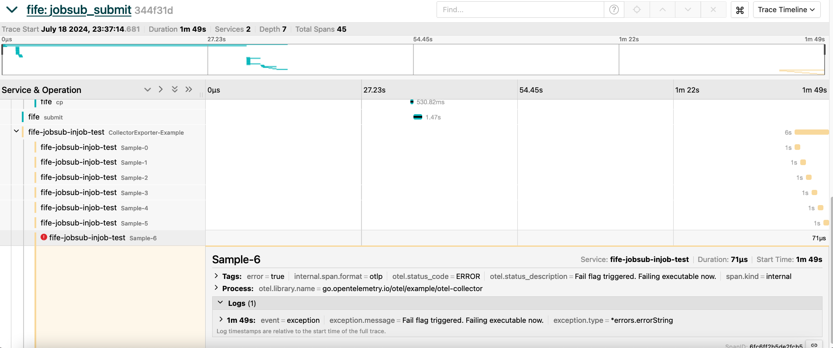
Tracing INSIDE jobs! (2)
https://landscape.fnal.gov/jaeger/trace/344f31d50a7c0c07f85f7bdd97f72f92

Slide 11
Tracing INSIDE jobs! (3)
Allows us to see:
Exactly where job failed
Any logs associated with that failure specifically
Duration of failed function (i.e. was there a bottleneck/timeout that caused the failure?)
Users/software developers can decide what is important to track/log
Limit log noise
Can see entire flow of job workflow from submission through to job execution - very powerful

Slide 12
Future
This demonstration was done using a shell script that runs a Go executable (with the former setting ENVs and tracing instrumentation inside the latter)
Jobsub team will work on recipe to do this within pure shell scripts, subject to effort availability
Outside of that, we’re happy to share as much knowledge as we’ve got with anyone who’s interested

Slide 13
Resources
Github repo: https://github.com/fermitools/jobsub_lite
Roadmap: https://cdcvs.fnal.gov/redmine/projects/jobsub/wiki/Jobsub_lite_Tasks
Getting Started: https://fifewiki.fnal.gov/wiki/Getting_started_with_jobsub_lite
OpenTelemetry Tracing: https://opentelemetry.io/docs/

Slide 14
Thank you!
The jobsub project team:
Shreyas Bhat, Vito Di Benedetto, Lisa Goodenough, Marc Mengel, Nick Peregonow, Kevin Retzke

Slide 15
Extra Slides

Slide 16
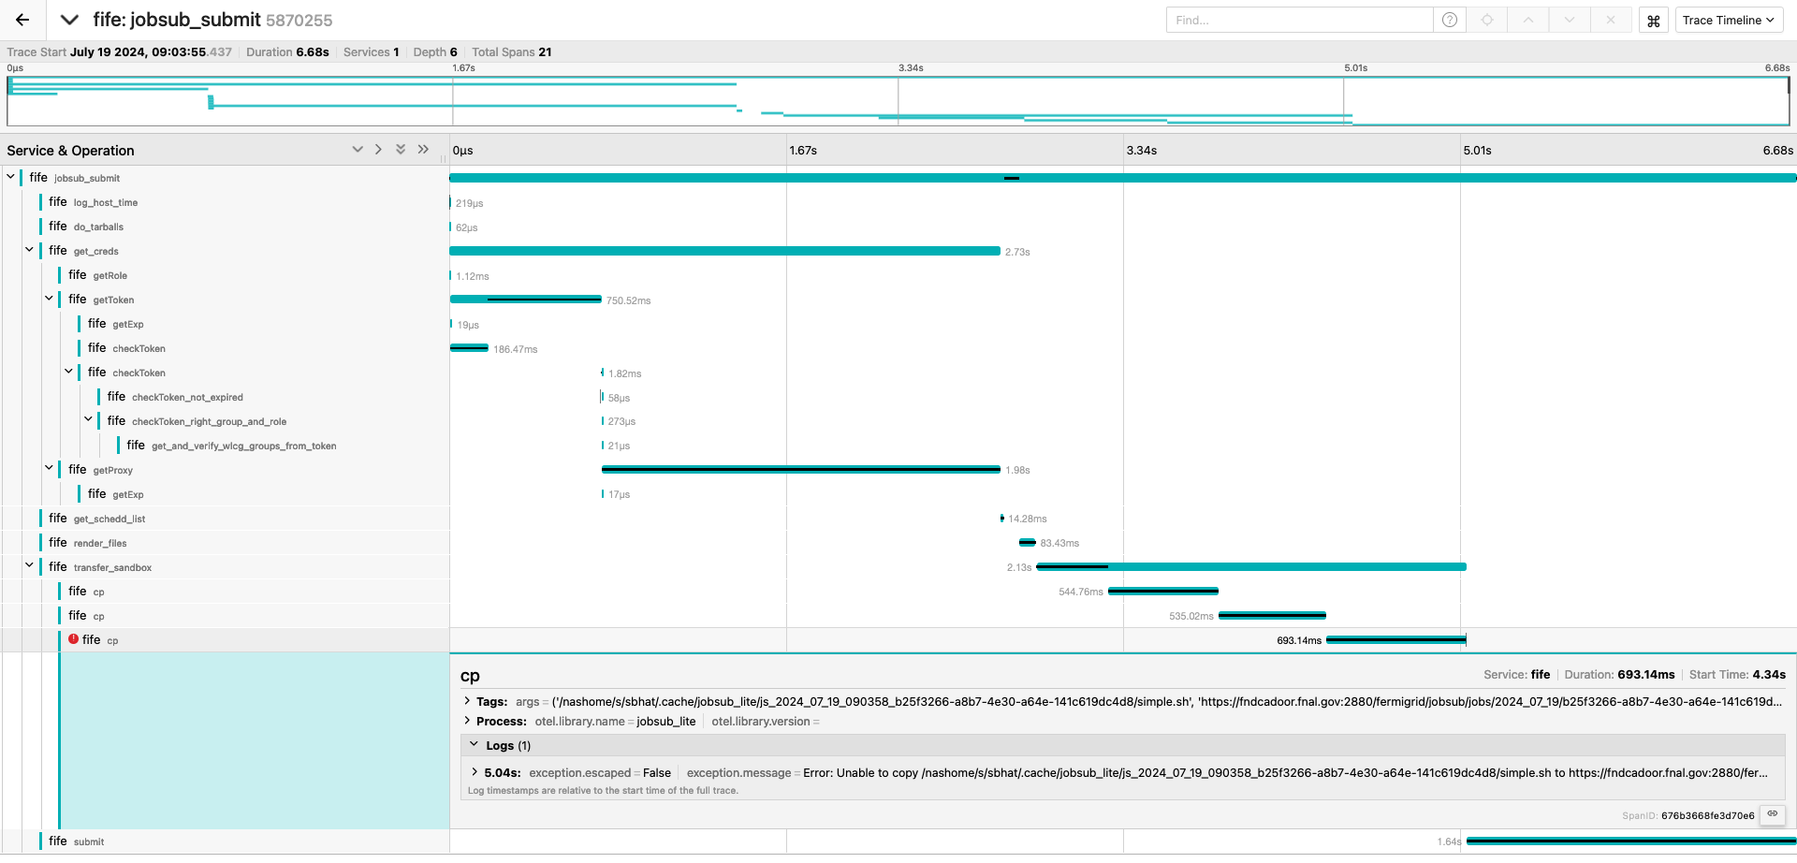
jobsub_submit tracing - failed sandbox file copy

Slide 17
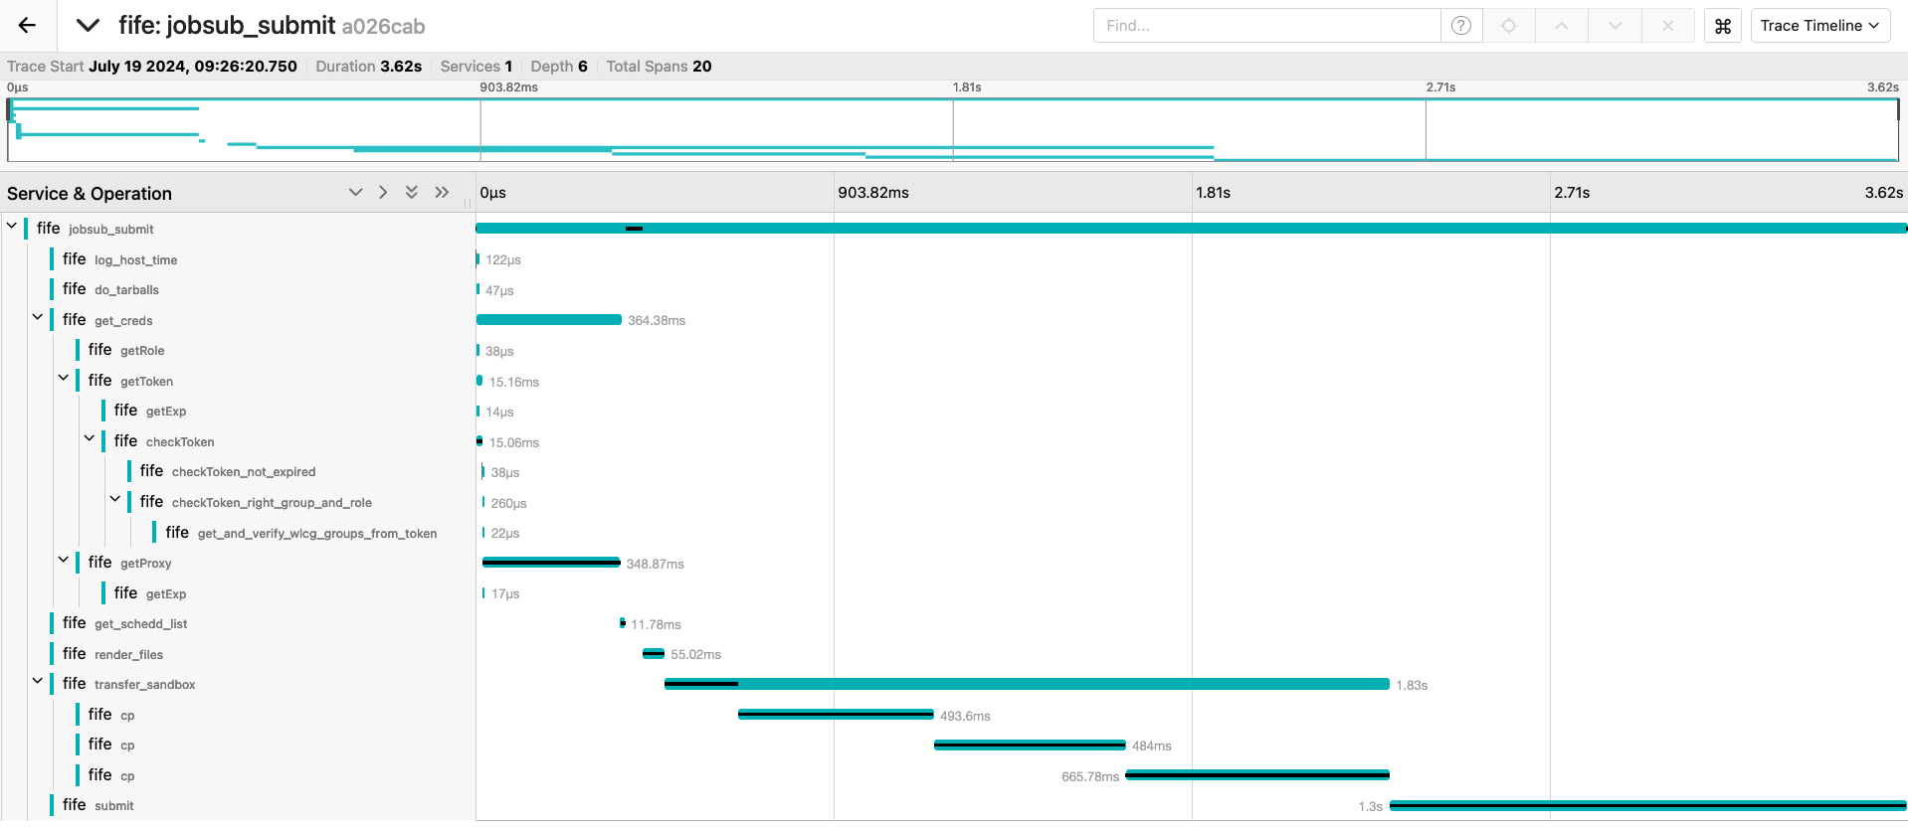
jobsub_submit tracing - good submit but bad job

