Slide 1


302.4.04 – Cryo-assemblies Horizontal Test
Weekly status report
Guram Chlachidze
Jun 24th, 2024

Slide 2
CA02 test preparations
Cryo-improvements at TS4 are complete, check details here:
  TS4 action item list - 11_30_2023.xlsx (sharepoint.com)
Stand 4 ORC/Operation status
  Cooldown permit is obtained
  Addendum to the electrical ORC has been initiated for the helium line heater operation
Helium line heater installation is complete
  All work completed - including installation of heaters and shelves for the heater controllers, running AC power, grounding the shelves and performing bond tests on them. The heaters will be insulated after safety walkthrough (if necessary)
Stand 4 documentation
  LQXFA/B-02 horizontal test traveler (464759) has been released
  Test plan is ready for sign-off

Slide 3
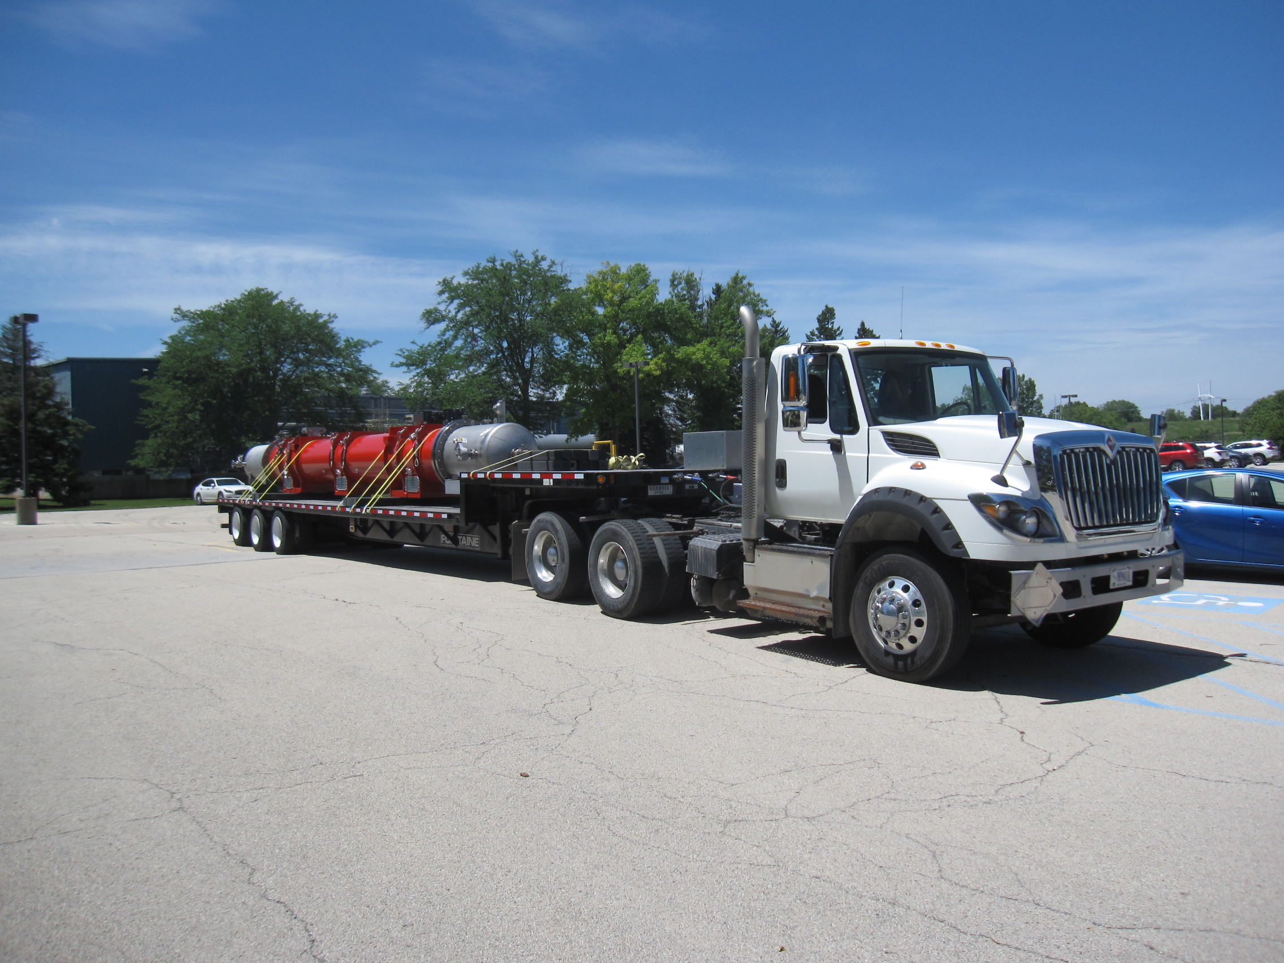
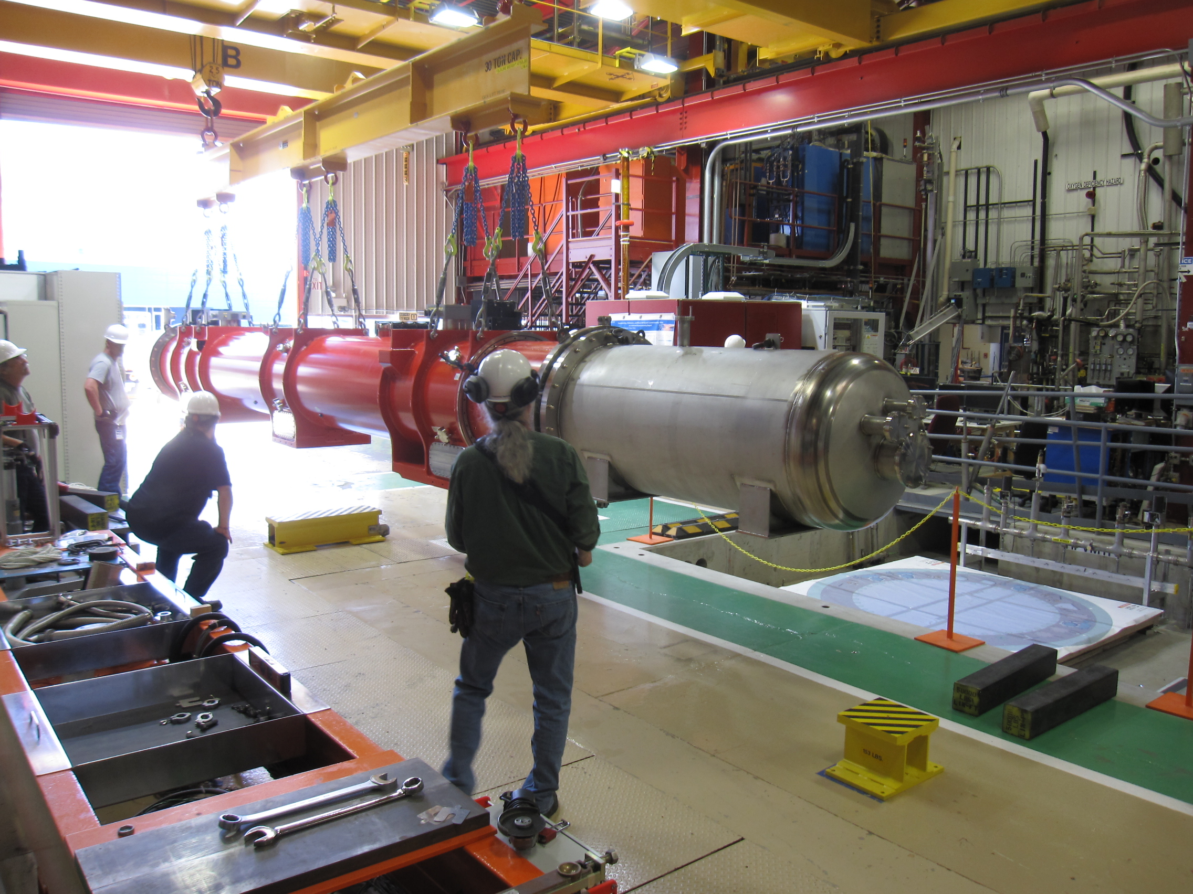
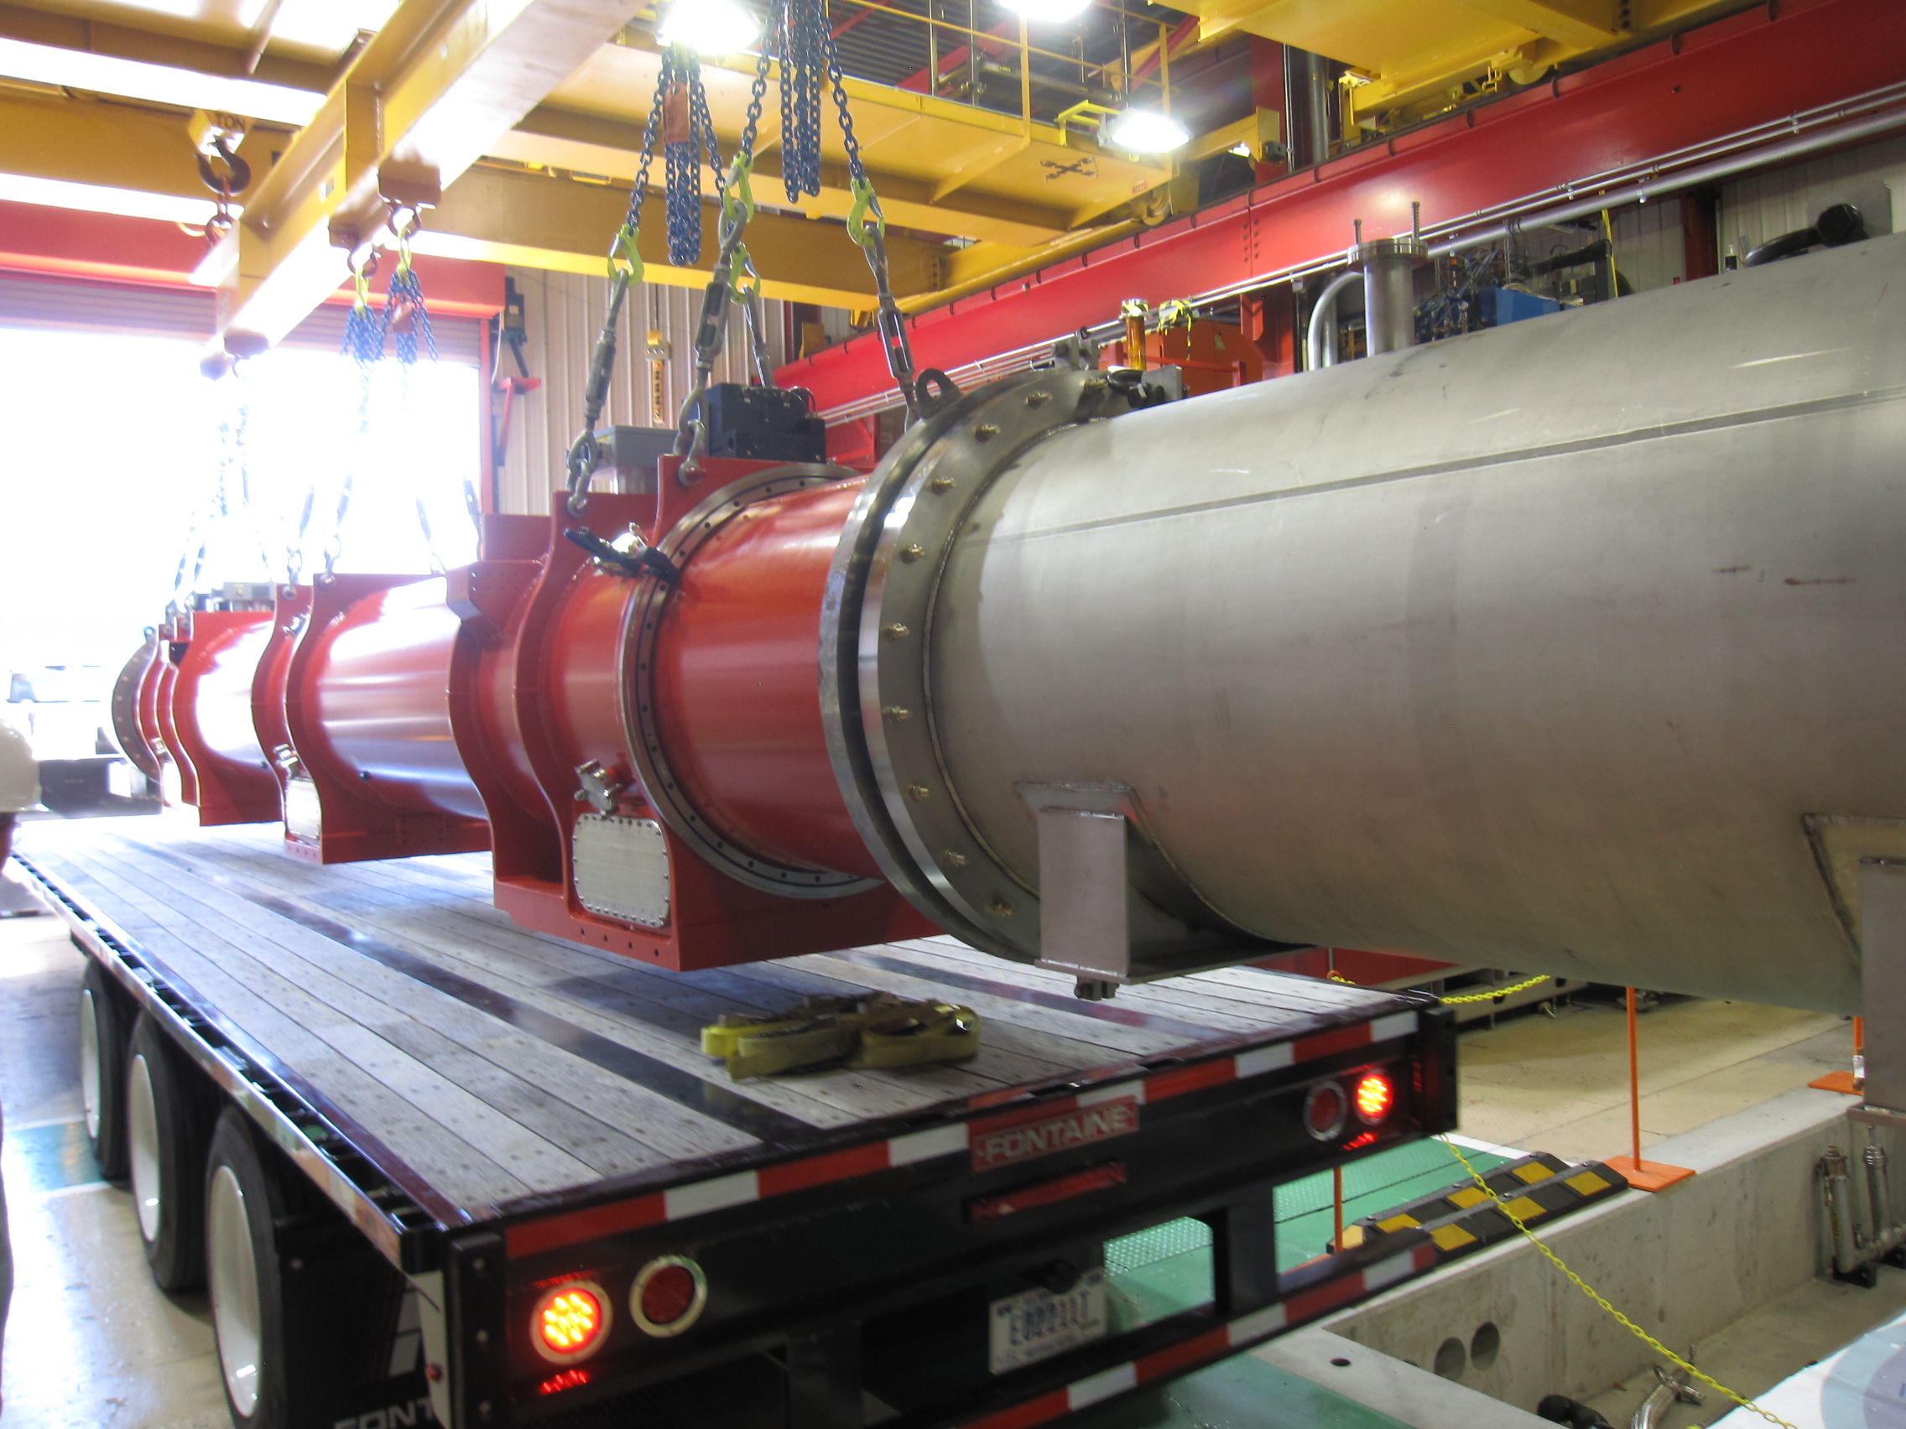
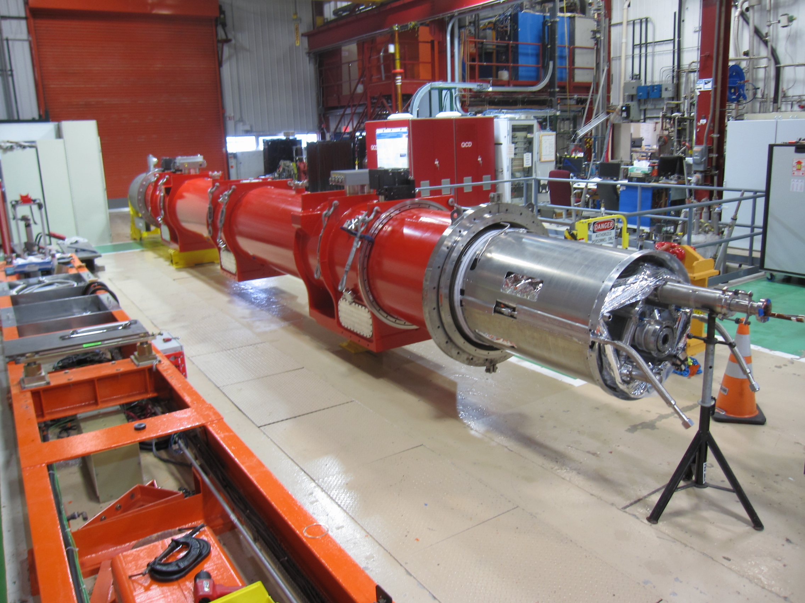
CA02 transportation from ICBA to IB1

Slide 4
Preparation work at Staging area in IB1
Power leads trimmed to the required length; voltage taps installed on the leads
Verified location of sealing surfaces in the interconnect area
  No spacers - double-side CF flanges are required in CA-02
Verified vacuum around the warm finger
Final electrical checkout, includes Hi-potting test at room temperature, checkout of the voltage taps, RTDs, protection heaters
Vacuum sleeve installed

Slide 5
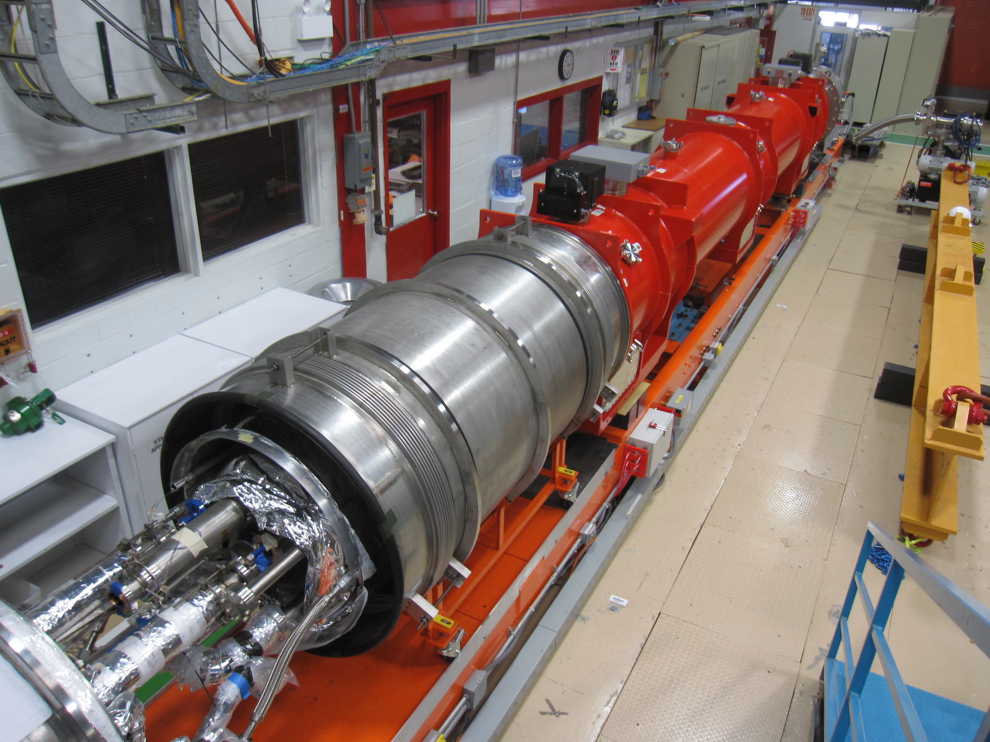
Installation on Stand 4

Slide 6
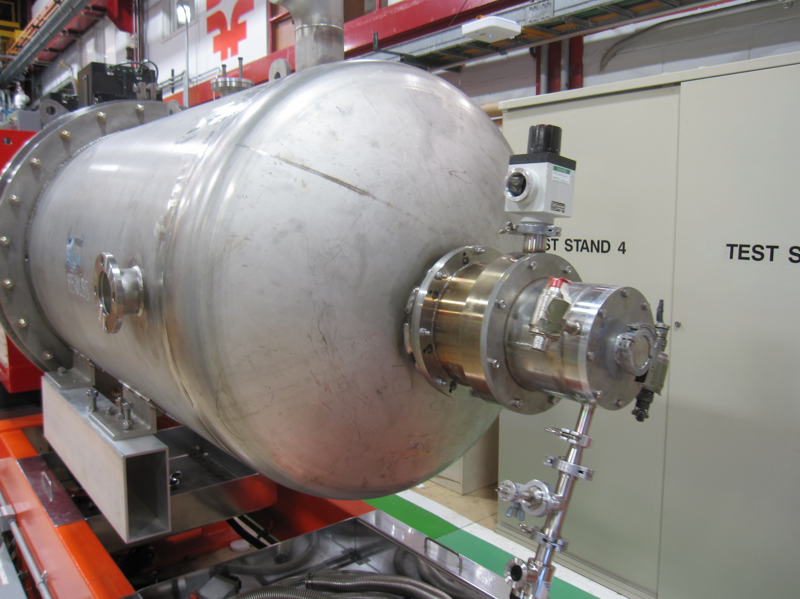
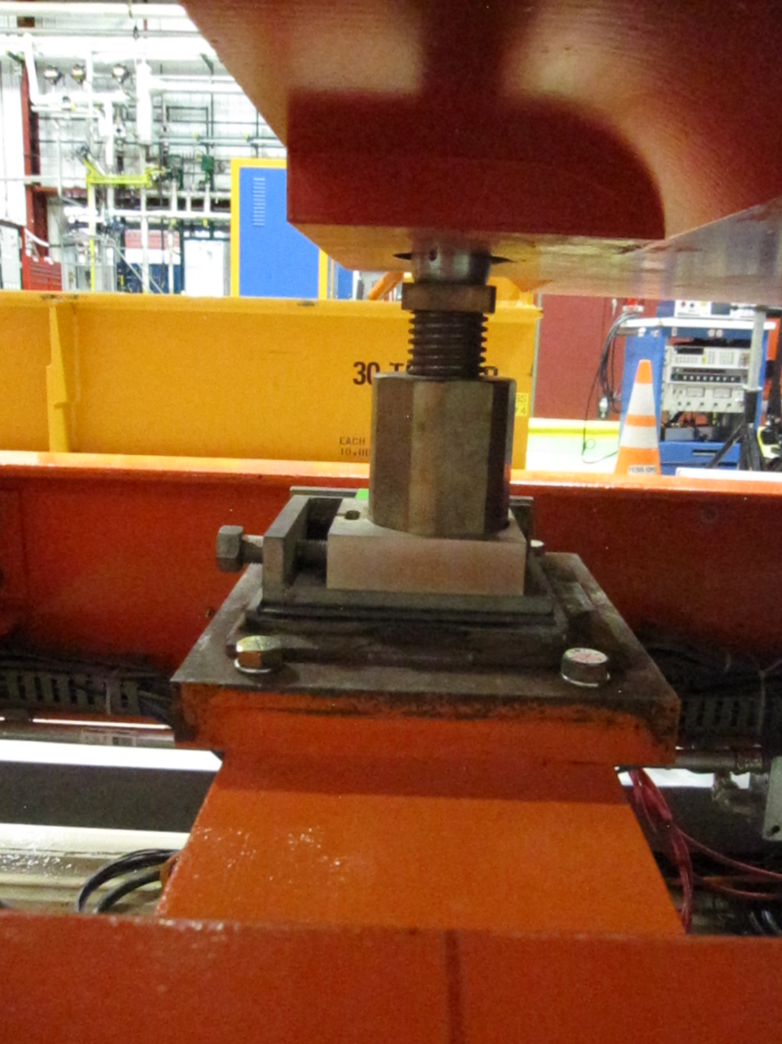
Installation on Stand 4 (2)

Slide 7
Next Steps
Final alignment at Stand 4 – Done
  We have verbal confirmation only, survey report not received yet
Splicing leads, closing interconnect joints, installation of the thermal shields, closing insulating vacuum – In progress
Final electrical checkouts at room temperature
Pump and backfill the helium lines, inspect the seals
Pump out of the insulation vacuum, verification of the quench detection setup (could be done in parallel)
Room temperature magnetic measurements
Controlled cooldown

