Slide 1
72 Hour Summary
Patrick Dowdle
MCR Crew Chief
June 24, 2024

Slide 2
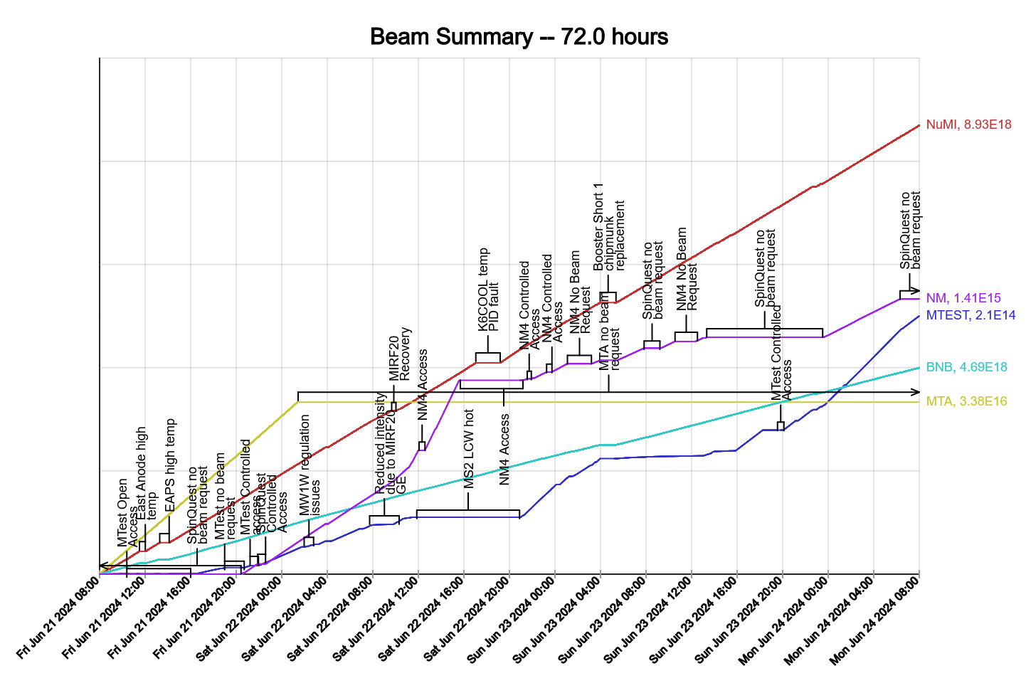
Summary
In general:
  Tuning up the machines
  Supporting studies
  Turning off Meson when temps get too high
Friday:
  EAPS room high temp, heat exchanger cleaned
Saturday:
  F:MW1W regulation issue, PESD walked Ops through exercising the switches
  Lost MIRF20 due to AC OI on the bias supply which was swapped out by the RF group who then tuned up the cavity
  BRF14 showed signs of an issue, no noticeable effect on beam but swapped to BRF19
  NuMI kicker fluorinert skid PID controller blew a fuse causing temperatures to spike and the kicker to lose regulation, PESD came in and replaced the controller
Sunday:
  Booster S1 Rad Trips, chipmunk showed erratic behavior coincident with the storm, we prepared Booster for access, Rad Safety came in and changed out the detector
  BLM’s on MBLM6N showing pedestals, instrumentation looking into it
Today:
  E:HT117 tracking error, seems to follow reference
  LRF2 trips
  Chiller 2 at Cub tripped, 4 came on in its place
  BRF18 bias supply leak, station is down
Currently:
  Beam to NuMI, BNB and MTest.

