Slide 1
CERN general updates
Wallison Campanelli
Advisors: Dr. José Maneira (LIP), Prof. Dr. Fernando Barão (IST/LIP)
FCUL – Faculdade de Ciências da Universidade de Lisboa.
LIP - Laboratório de Instrumentação e Física Experimental de Partículas
June 05, 2024

Slide 2
Overview
Laser system;
Check data;
Shifts.

Slide 3
Laser System

Slide 4
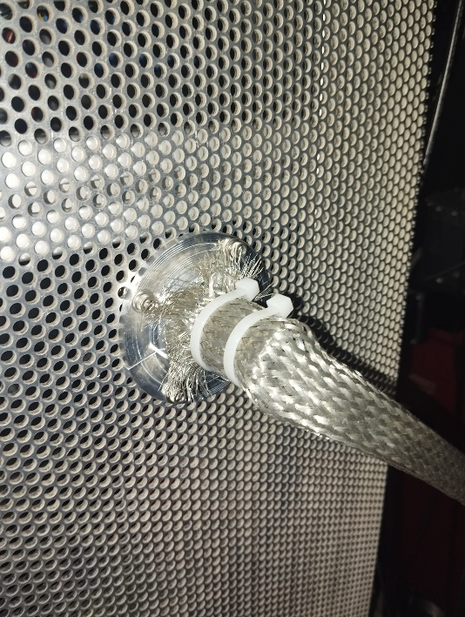
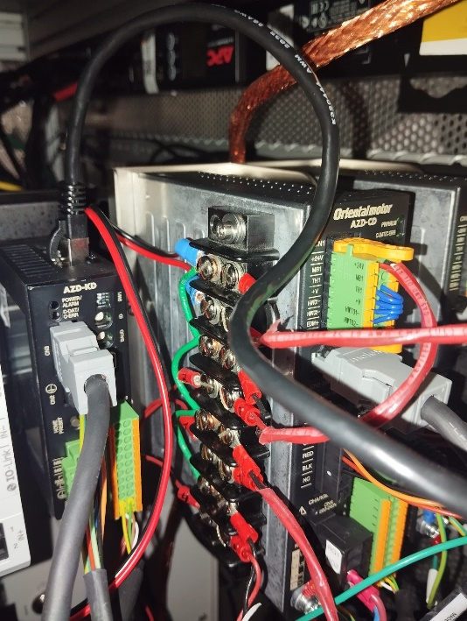
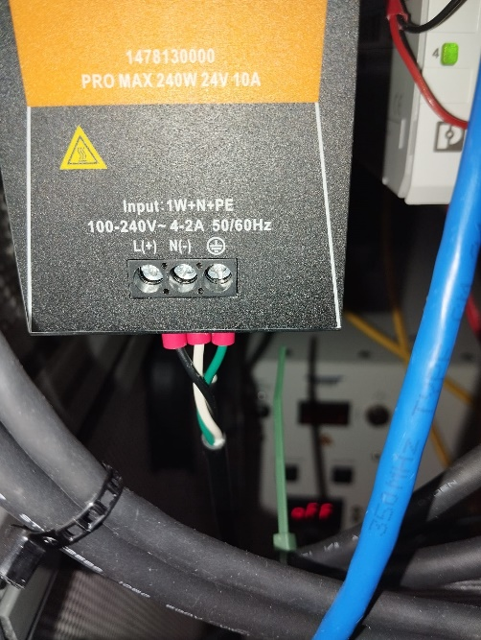
Updates
1
2
There was supervision at ProtoDUNE.
It’s necessary to put metallic clamp in the shields of motor cable (done ✅);
It’s necessary to put a cover under the connection in the motor driver.
The cable is under stress.
3

Slide 5
Updates
Filippo asked to remove a plenty of boxes from the top of ProtoDUNE;
I had a meeting with Wesley to learn how to see the laser tracks.

Slide 6
Check data

Slide 7
How to see tracks
Login to lxplus:
ssh username@lxplus7.cern.ch
Login to server inside the lxplus: ssh -K np04-srv-015.cern.ch (can be changed depending on the run);
Run the command: source ~np04daq/bin/web_proxy.sh (everytime you enter);
run this program to setup: /nfs/sw/dunedaq/create_dqm_area.sh fddaq-v4.4.2 (one time in each server)
enter in the new folder: source env.sh (everytime you enter)
It’s necessary to run the program to find some track:
dqm_plotter.py --imgtype png /nfs/rscratch/np04daq/DQM_DATA/NP04/np04hd_raw_run026960_4136_dataflow0_datawriter_0_20240613T131941.hdf5 ./

Slide 8
How to see tracks
if you need to do some modification in the file, you need to access:
cd /dunedaq-fddaq-v4.4.2-dqm/sourcecode/dqmtools/scripts
modify: dqm_plotter.py,
save and run this command: dbt-build
To find a specific file you need to know the run number, so It’s necessary to ask to the DAQ experts (The folders may change depending on the run)
You can try to use rucio also.

Slide 9
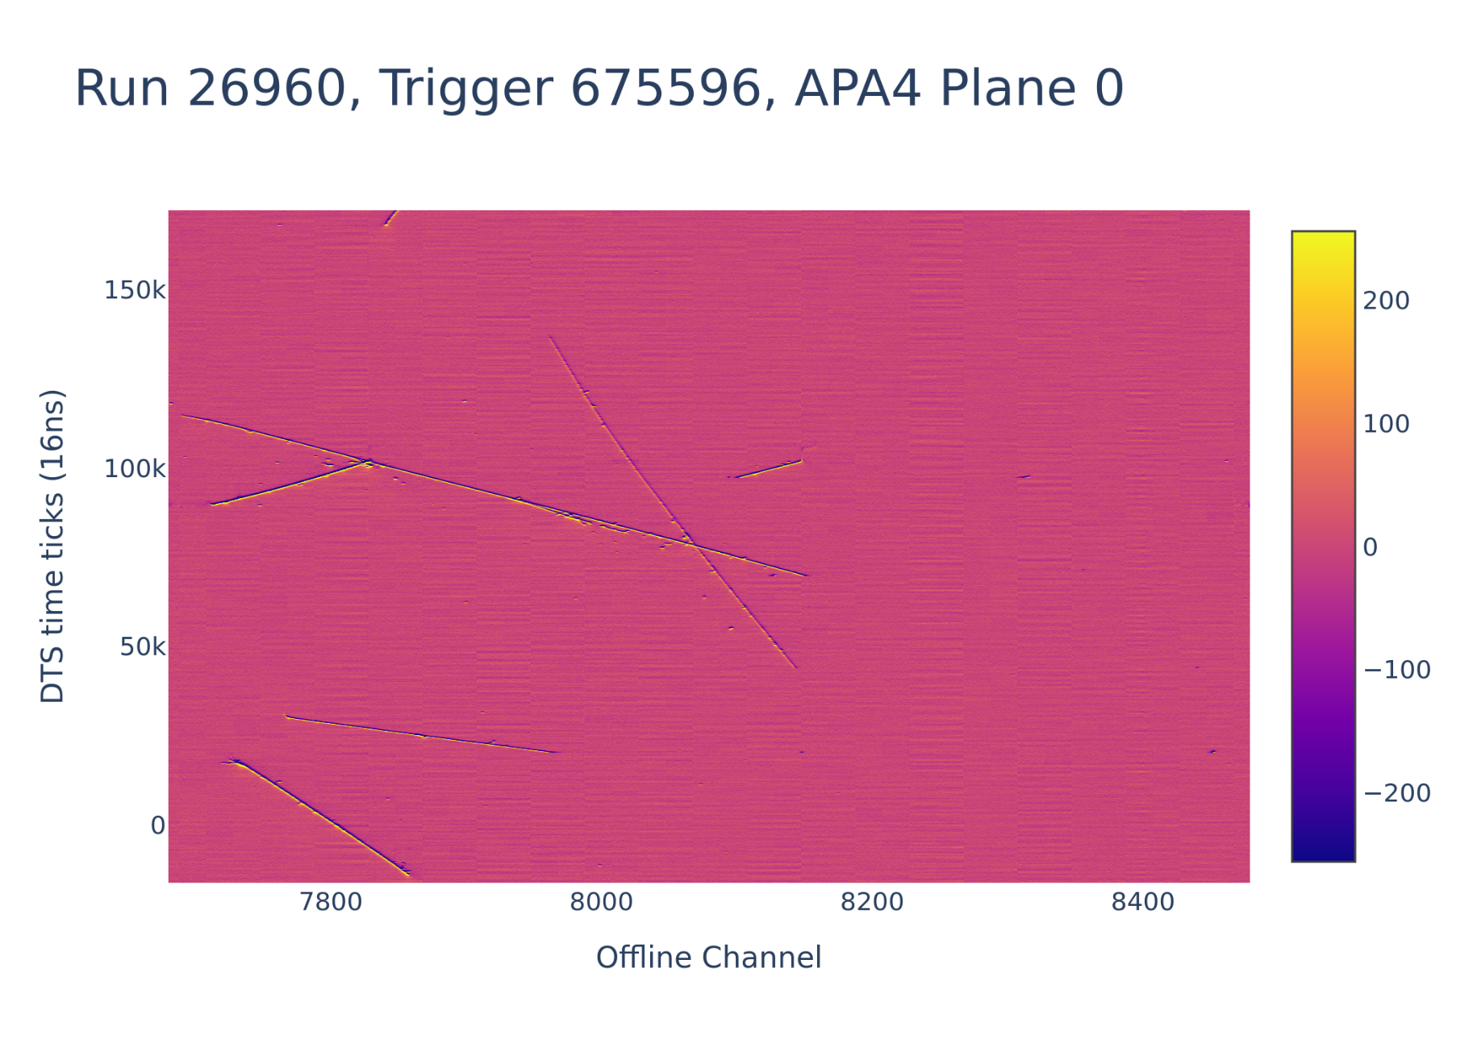
How to see tracks

Slide 10
Shifts
3 shifts:
8:00 – 16:00
16:00 – 00:00
00:00 – 08:00
My first shift with the beam was Saturday: 22/06/2024

Slide 11
Shifts
In shifts we need to set-up the beam and the run (Saturday it was necessary to change each 30 minutes);
The beam energy range was (-7 to +7 GeV) and the collimator position (10,20,30 mm).
Shifters | Beam Energy (GeV) | Collimator position (mm) | Run number | Time Start | TriggerStatus: General Trigger Count (at begin of run) | Run OK after at least 30 minutes? | Elog info complete? | Link to start run in elog
Steve Timm and Rohit Raut | 1 | 20 | 27338 | 21.06.24 13:08 | 1.20E+02 | Yes | Yes | https://pdsp-elog.app.cern.ch/elisa/display/24257?logbook=ProtoDUNE-SP
Steve Timm and Rohit Raut | 1 | 10 | 27343 | 21.06.24 15:40 | 6.90E+01 | Yes | Yes | https://pdsp-elog.app.cern.ch/elisa/display/24270?logbook=ProtoDUNE-SP
Aleksandar R and Wallison C | -5 | 30 | 27373 | 22.06.24 08:31 | 3.97E+02 | Yes (with x16 prescale) | yes | https://pdsp-elog.app.cern.ch/elisa/display/24339
Notes:
To create low energy particles they use pions, kaons, protons.
In the detector will arrives: pions, protons, neutrons, kaons,, eletrons e positons, muons.

Slide 12
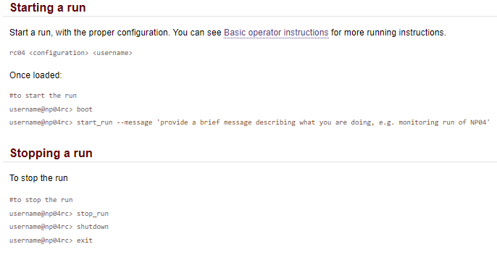
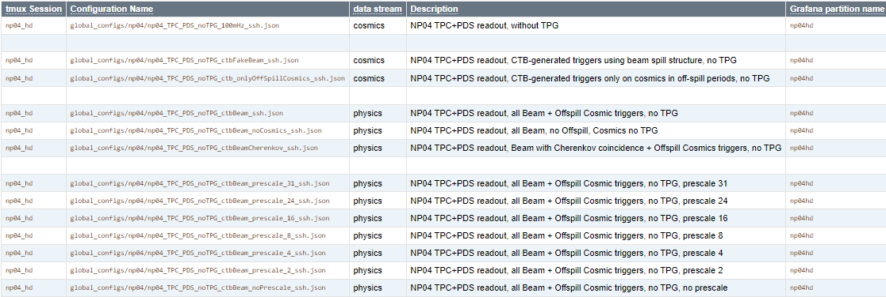
Shifts

Slide 13
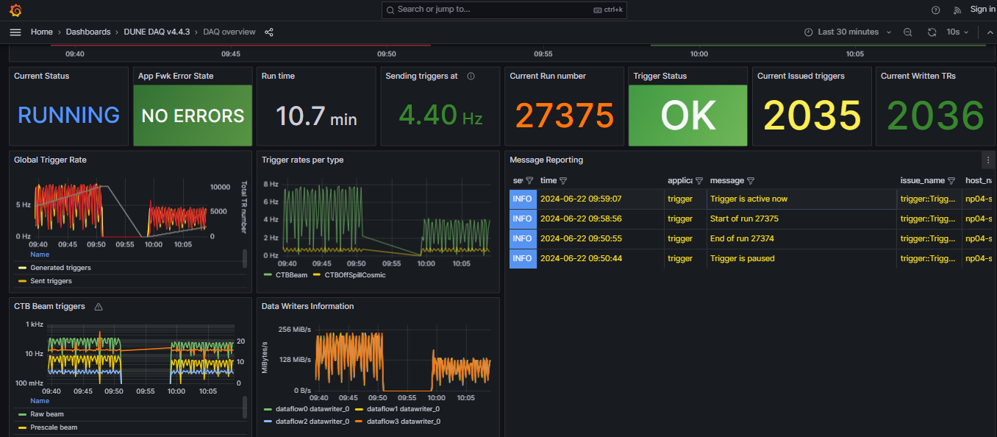
Shifts

Slide 14
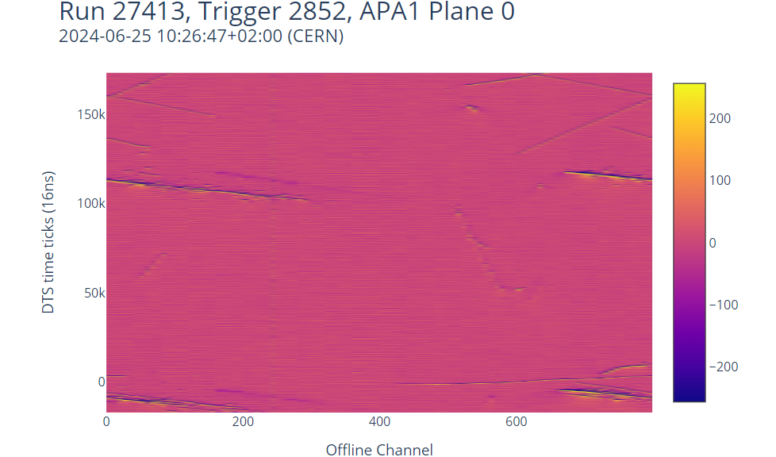
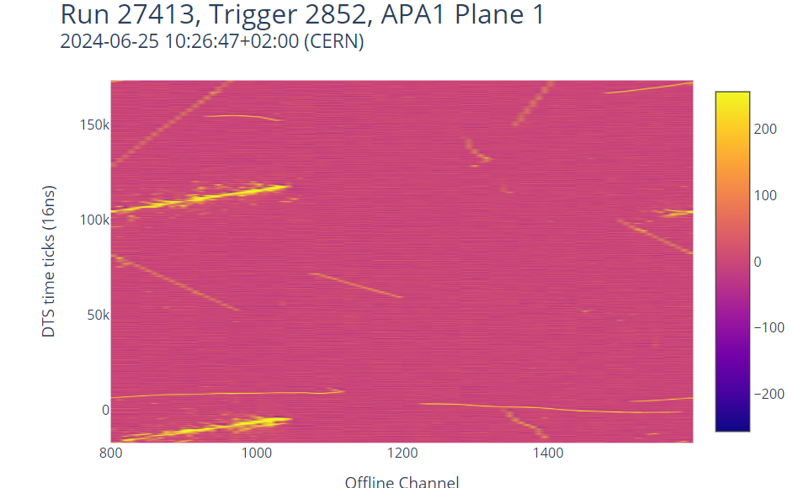
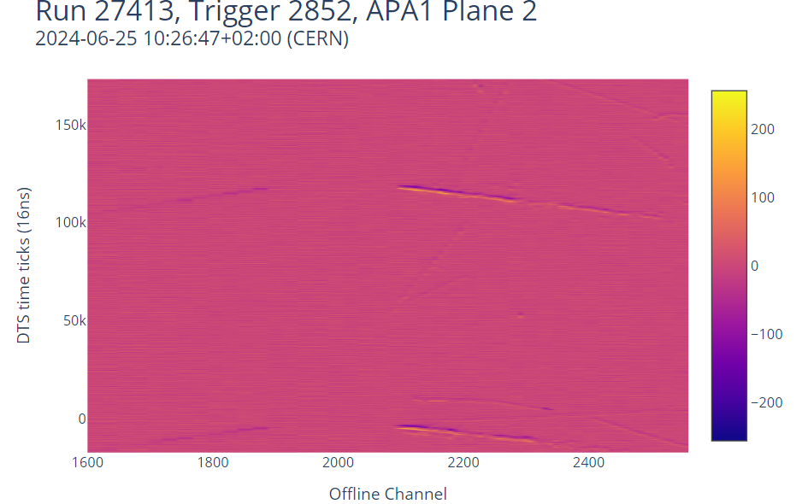
Shifts

Slide 15
Thank you!
Notes:
The neutrino oscillations is attributed to the mixing of neutrino flavors . This occurs due to the combination of Left-Handed (LH) flavor neutrino fields, which consist of three or more neutrino fields with nonzero masses. The equation below represents the Pontecorvo-Maki-Nakagawa-Sakata (PMNS) Neutrino Mixing Matrix:

Slide 16
Links
Shifts tutorial: https://twiki.cern.ch/twiki/bin/view/CENF/MonitoringRuns
Events display: http://np04-srv-015.cern.ch:8005/event_display/apa1
DAQ Overview dashboard: http://np04-srv-017:31023/d/v4_4_3-overview/daq-overview?orgId=1&refresh=10s&var-influxdb=ffedc550-6555-4a16-a113-aabf2b980c30&var-postgresql=c7e9e333-25c9-49e7-b209-b9492f70d419&var-partition=np04hd&var-hsi_series=&var-hsi_field=&var-run_time=630&var-trigger_type=All
Beam article: https://journals.aps.org/prab/pdf/10.1103/PhysRevAccelBeams.22.061003
Notes:
The neutrino oscillations is attributed to the mixing of neutrino flavors . This occurs due to the combination of Left-Handed (LH) flavor neutrino fields, which consist of three or more neutrino fields with nonzero masses. The equation below represents the Pontecorvo-Maki-Nakagawa-Sakata (PMNS) Neutrino Mixing Matrix:

Slide 17
Links
Rucio tutorial: https://github.com/DUNE/data-mgmt-ops/wiki/Using-Rucio-to-find-Protodune-files-at-CERN
Notes:
The neutrino oscillations is attributed to the mixing of neutrino flavors . This occurs due to the combination of Left-Handed (LH) flavor neutrino fields, which consist of three or more neutrino fields with nonzero masses. The equation below represents the Pontecorvo-Maki-Nakagawa-Sakata (PMNS) Neutrino Mixing Matrix:

