Slide 1
ICEBERG: Status and Plan
Shekhar Mishra
Neutrino Division, Fermilab
06/26/2024

Slide 2
ICEBERG: Study Plan
Measure Individual Channel Linearity (INL) using pulser data. (Data Taken)
Determine the precision of individual channel gain (LArASIC + ColdADC; e-/LSB) using pulser data. (Data Taken)
Measure and decide the optimal gain setting: 14 mV/fC or 7.8 mV/fC or 25 mV/fC(Data Taken)
Determine optimal baseline for collection plane: 200+ mV (Done)
Study shaping time effect on ENC (1 μsec vs 2 μsec vs 3 usec) (Data Taken)
Measure cross talks. (14 mV/fC, DAC 15, single and diff pulse) DAC 0 – 63 (32 for 25 mV/fC)
/nvme/dunecet/dropbox/*.hdf5
/nmve2/dunecet/decoded-hdf5
Determine optimal ColdADC V_{ref} settings. (Done)
Learn to use particle interaction in LAr to determine absolute calibration of the TPC + Electronics response (MeV/LSB-tick)
  MIP dE/dX
  Michel electrons
  Ar-39
DUNE-FD2-PD: Integration of DAPHNE-V3 in Ethernet DUNE-DAQ
  Spy-Buffer (Data Taken and Analyzed)
  Starting on FELIX DAQ

Slide 3
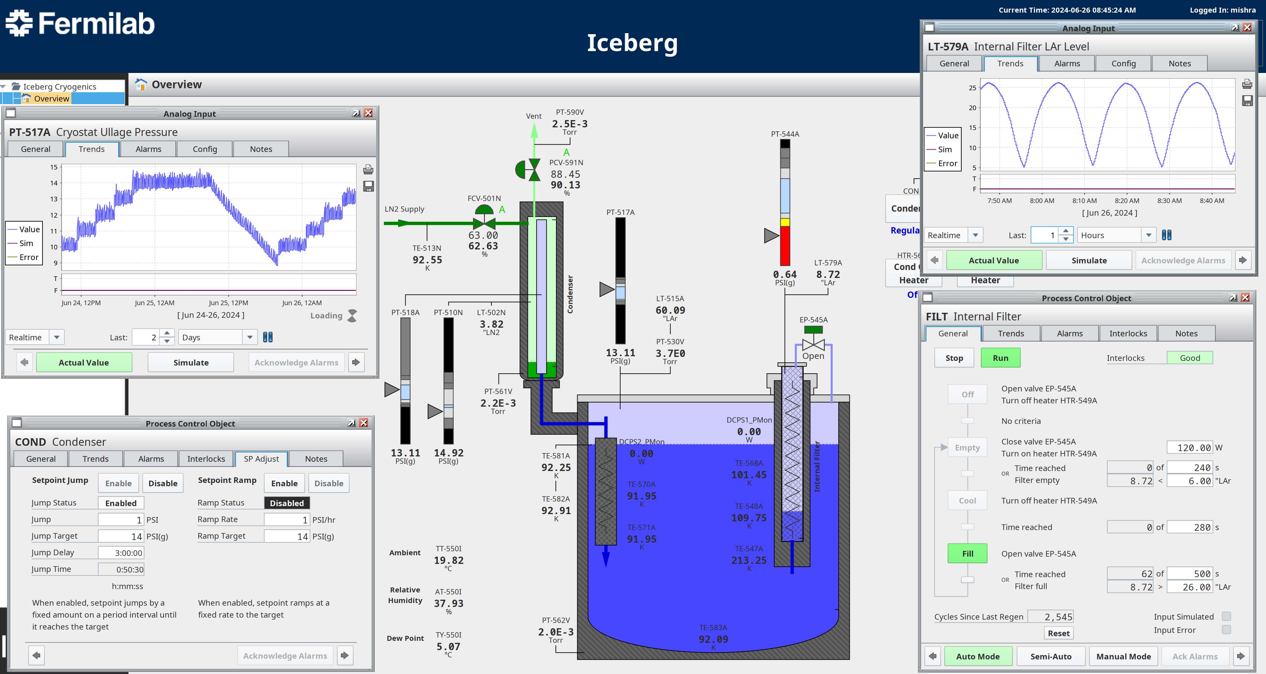
ICEBERG: Cryogenic Cycle

Slide 4
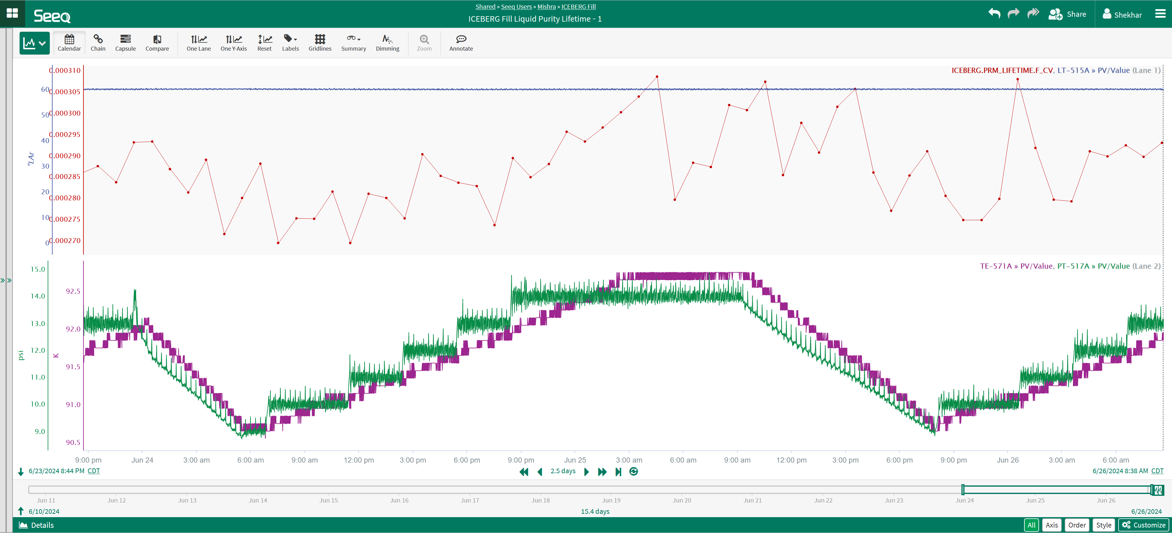
ICEBERG LAr Lifetime

Slide 5
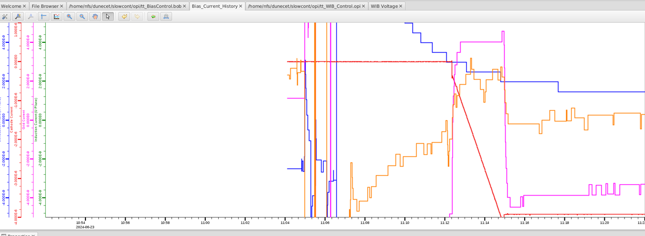
ICEBERG:TPC Power Turn ON

Slide 6
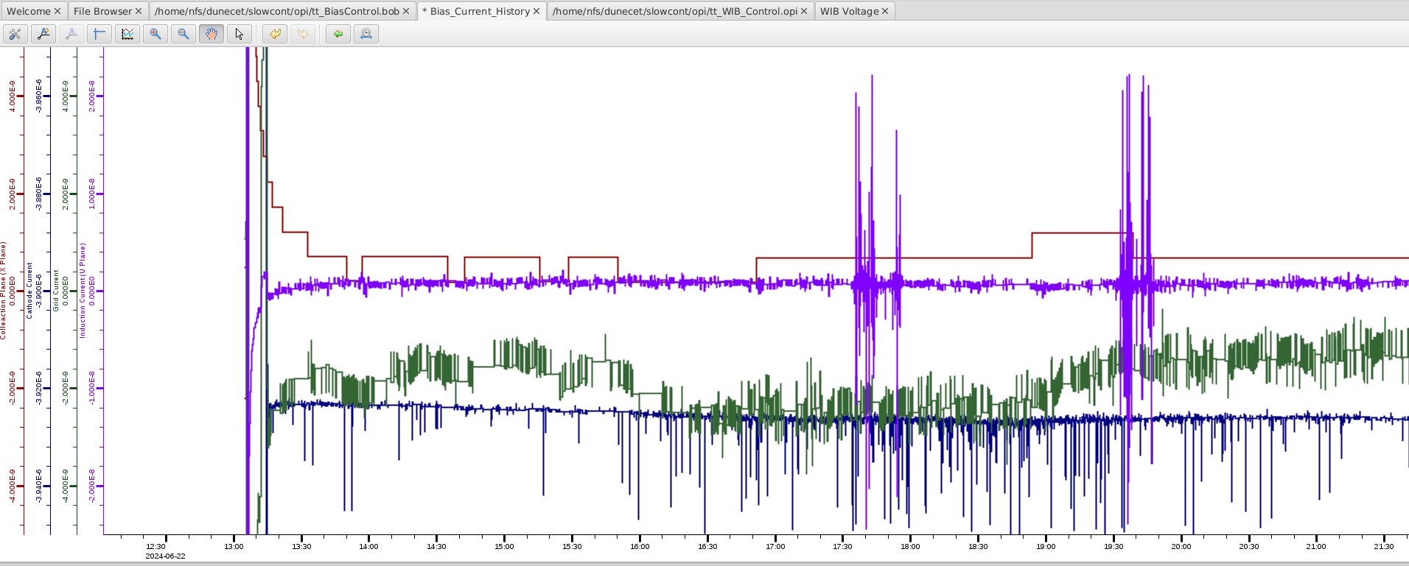
ICEBERG: TPC Current

Slide 7
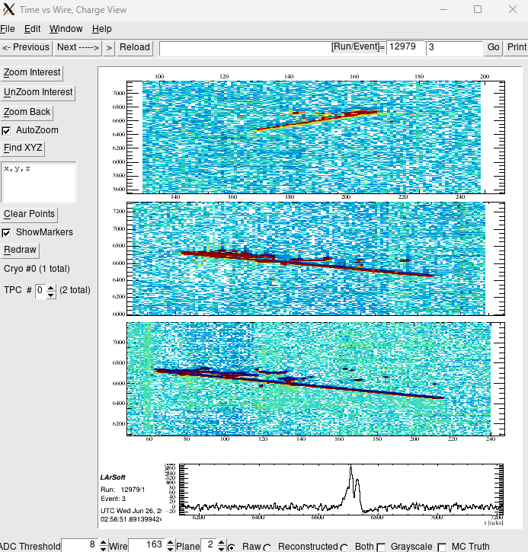
ICEBERG: Cosmic Track

Slide 8
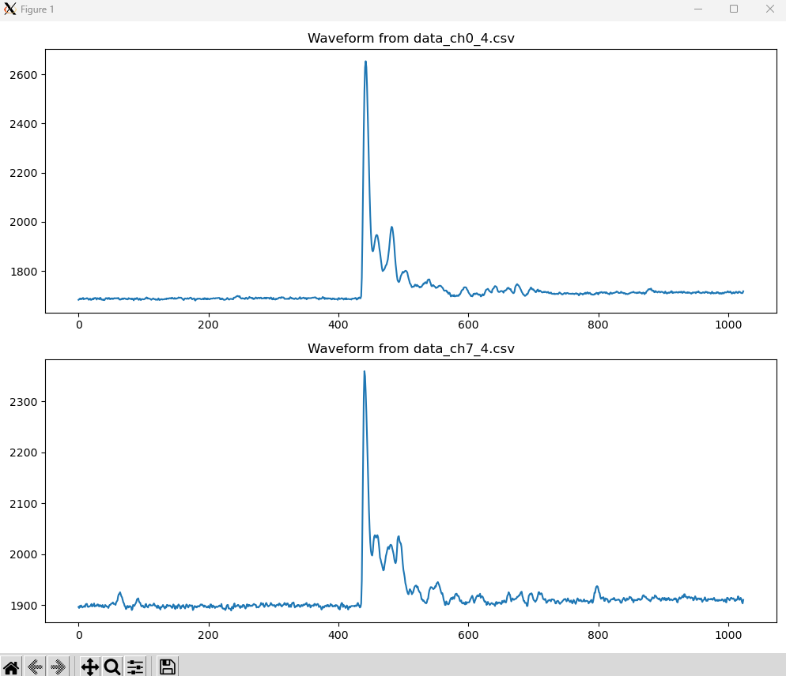
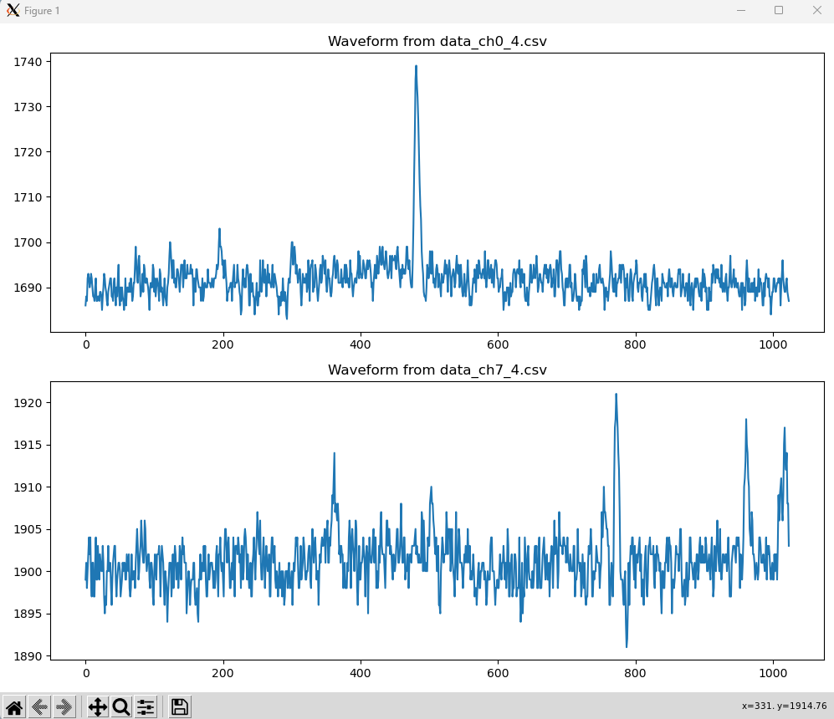
ICEBERG: Photon

Slide 9
Determine Optimal ColdADC Vref settings
Goal: Expand dynamic range to 1.8V and changes 200 mV to about 2000 for both single ended and differential without moving 900mV.
Study: Adjust Vcmi, Vrefp and Vrefn
Summary: Adjust only Vrefp and Vrefn
  coldadc_settings": {
  "reg_0": 35,
  "reg_24": 240, (223)
  "reg_25": 34, (51)
  "reg_26": 137,
  "reg_27": 103,
  "reg_29": 39,
  "reg_30": 39,
  "reg_4": 59
  },
This is accmoplised by editing iceberg_wib.json before the nanorc configuration generation.

Slide 10
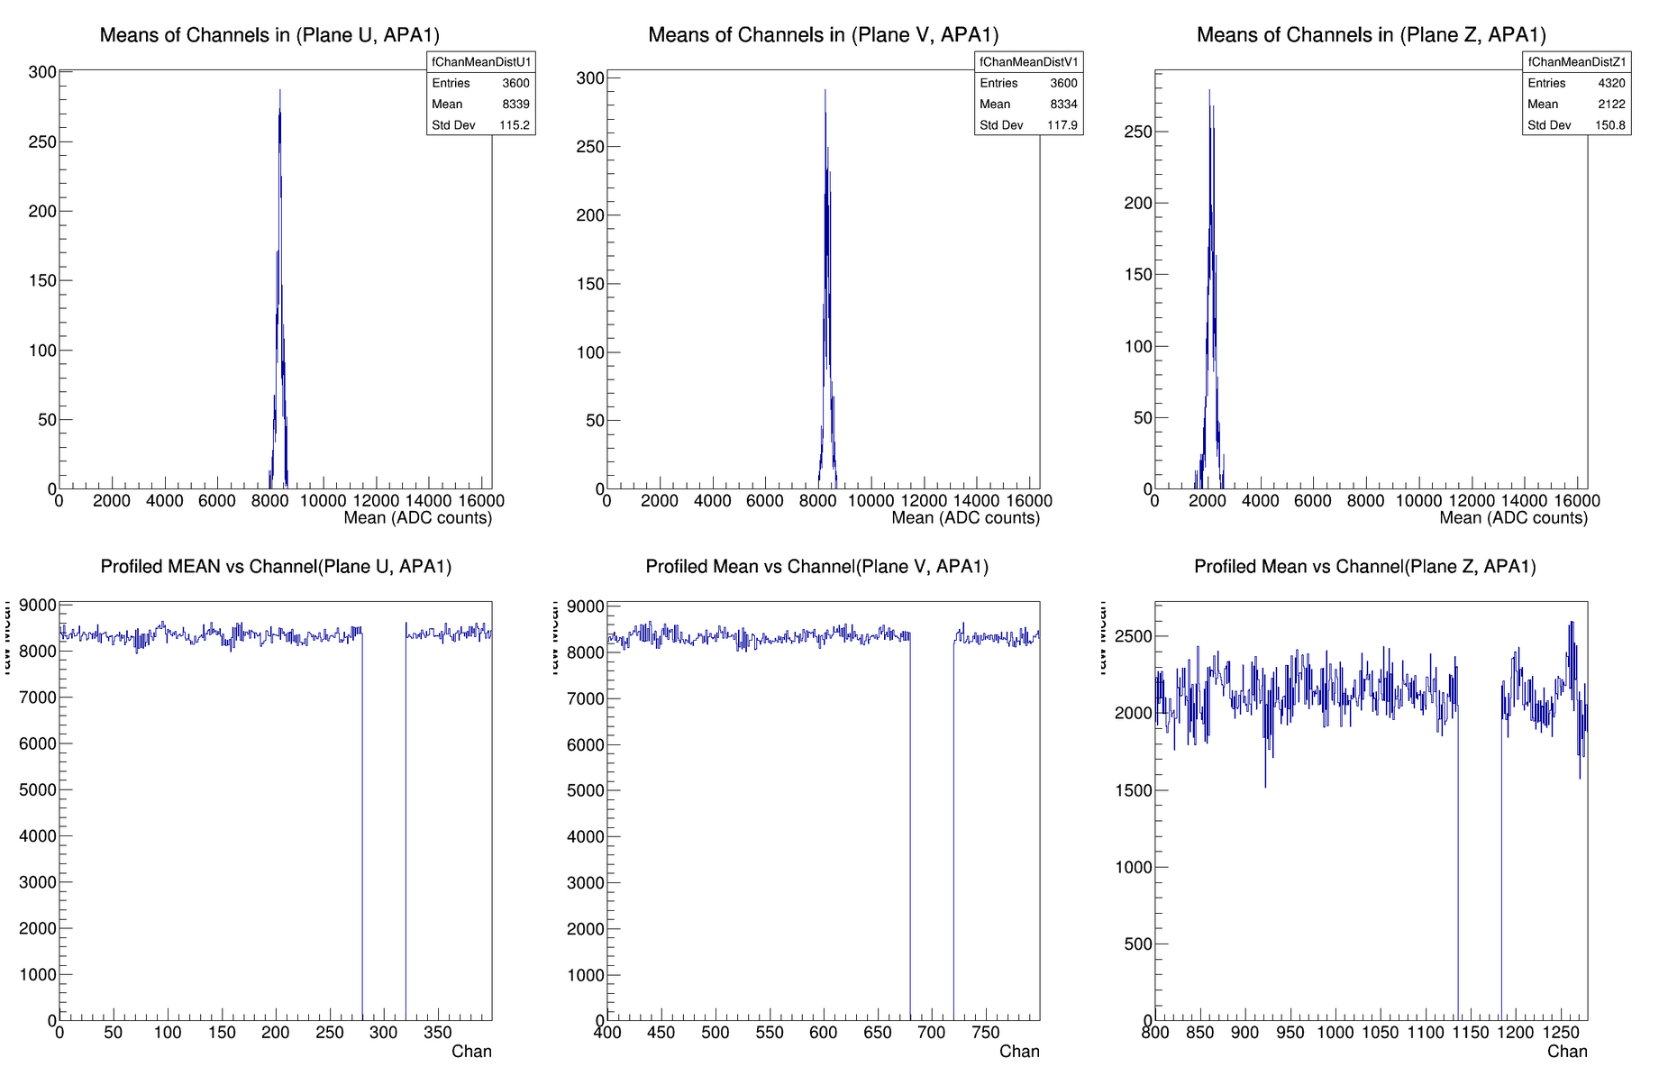
Adjusted V_{refp} and V_{refn}

Slide 11
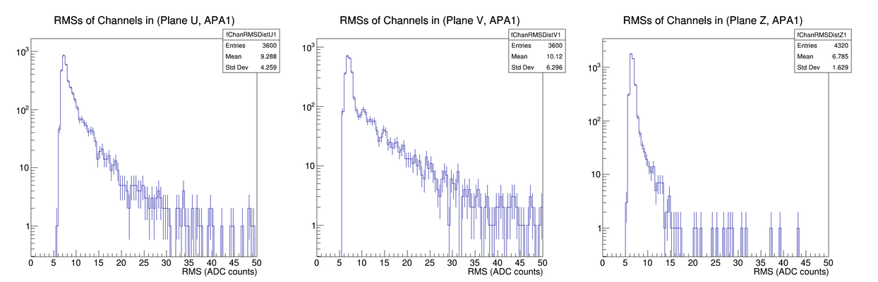
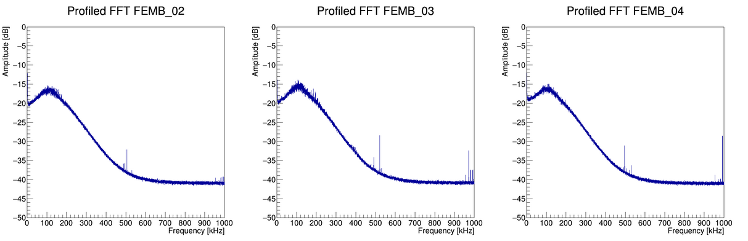
Cosmic Event

Slide 12
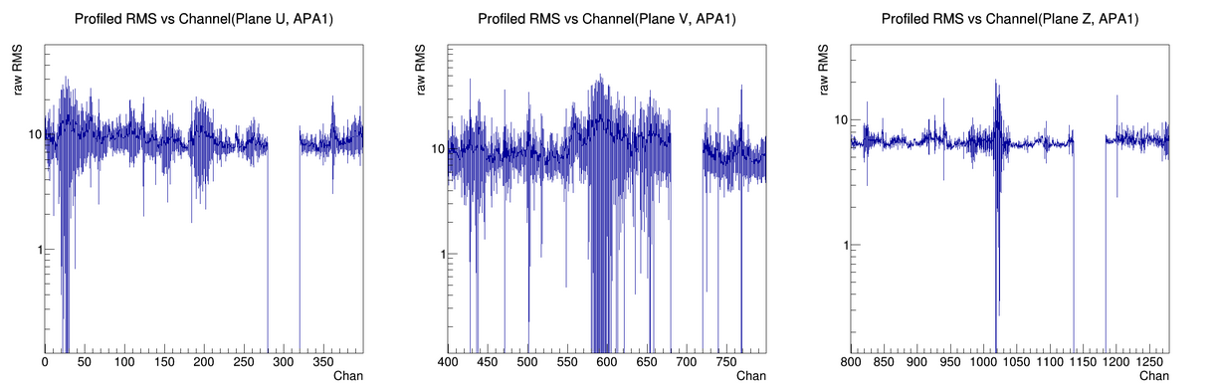
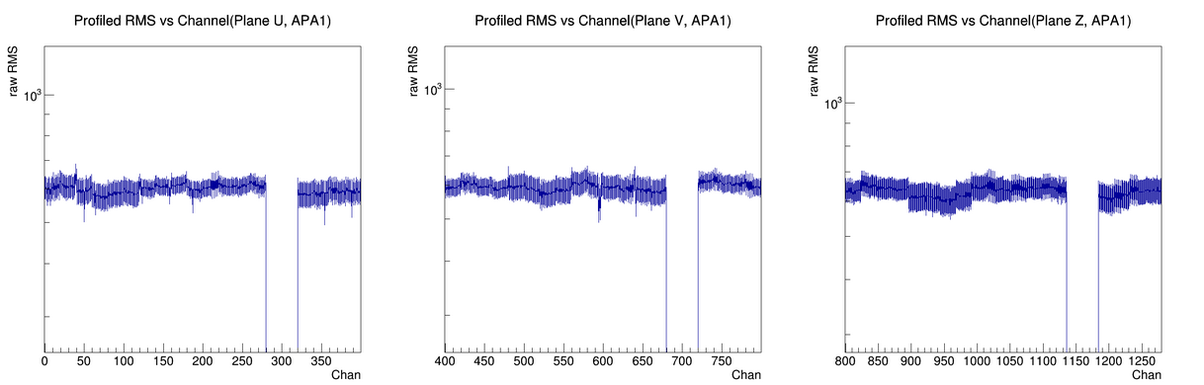
Cosmic, Pulser Run

Slide 13
Pulser Settings
,,"Pulser (DAC=0x00 to 0x3F in 1-bit steps)",7.8 mV/fC,Single-ended,1 us,0.5 nA,Split
,,"Pulser (DAC=0x00 to 0x3F in 1-bit steps)",7.8 mV/fC,Single-ended,2 us,0.5 nA,Split
,,"Pulser (DAC=0x00 to 0x3F in 1-bit steps)",7.8 mV/fC,Single-ended,3 us,0.5 nA,Split
,,"Pulser (DAC=0x00 to 0x3F in 1-bit steps)",14 mV/fC,Single-ended,1 us,0.5 nA,Split
,,"Pulser (DAC=0x00 to 0x3F in 1-bit steps)",14 mV/fC,Single-ended,2 us,0.5 nA,Split
,,"Pulser (DAC=0x00 to 0x3F in 1-bit steps)",14 mV/fC,Single-ended,3 us,0.5 nA,Split
,,"Pulser (DAC=0x00 to 0x20 in 1-bit steps)",25 mV/fC,Single-ended,1 us,0.5 nA,Split
,,"Pulser (DAC=0x00 to 0x20 in 1-bit steps)",25 mV/fC,Single-ended,2 us,0.5 nA,Split
,,"Pulser (DAC=0x00 to 0x20 in 1-bit steps)",25 mV/fC,Single-ended,3 us,0.5 nA,Split

