Slide 1
72 Hour Summary
Colin T. Barrett
MCR Crew Chief
July 1, 2024

Slide 2
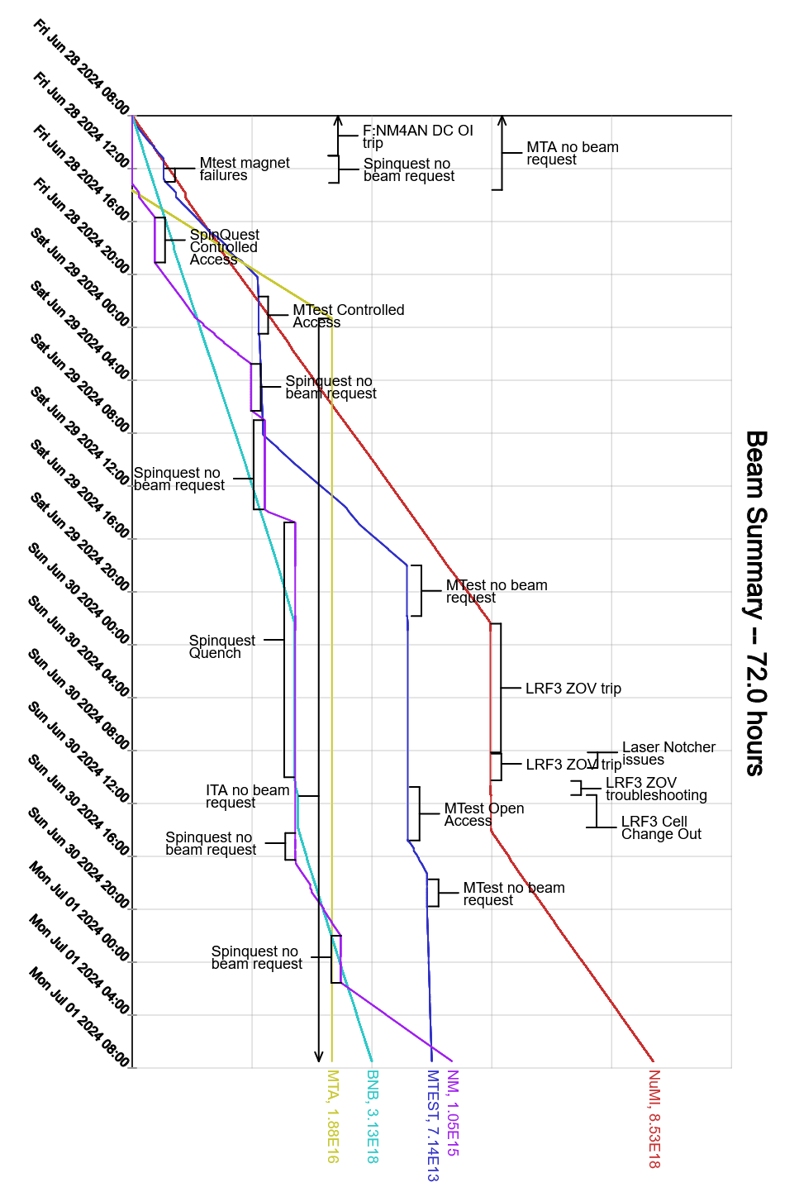
Summary
In general:
Tuning up the machines
Responding to alarms
Friday:
Supported studies
Sent beam to users
Saturday:
MIRF01 pulling NuMI permit, station currently off
SpinQuest Magnet quench
Various service building temperature issues
Sunday:
Linac laser notcher PC issues, experts resolved
LRF3 ZOV cell issues, PESD and Linac experts resolved
Today:
Ops continue to tune machines
Currently:
Beam to NuMI, BNB, SpinQuest and MTest.

