Slide 1
Running Experiments:
NP02
TDE re-installed (moved from chimney test area to NP02)
data links from crates to DAQ room tested, all up and running.
Noise mitigation campaign starting next weeks
NP04
PDS Firmware development continues but not fully integrated
CRT readout tested last week with all 4 modules, some failures but not on the readout side, throughput testing at 10, 30, 40 and 50 Hz within the beam frame with significant difficulties (how much missing data is seen in the offline?).
HV and LV ramped down for Cold Electronics to take calibrations Monday
Beam comes back on 10 July at 1800 CERN time .
coordination meeting tomorrow at 1500 CERN time.
2x2/Minerva
Charge and light readout now going to tape. Fermilab beam ends on July 12.
Iceberg
Pending modifications of metadata script to generate their metadata

Slide 2
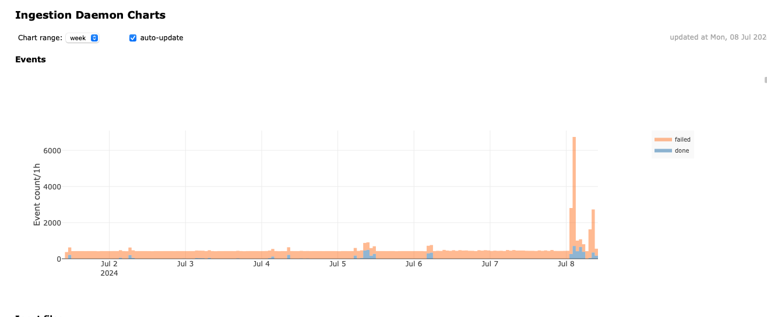
Data Management
Problems with EHN-1 to EOS transfer ongoing. Ticket open

