Slide 1
UPDATES – Steel and Coils
Wes Craddock
Corrected and Revised July 22, 2024

Slide 2
Steel Plates
I propose that we select Nucor Steel for our steel plates and have the plates water jet cut by a separate company.
Nucor Steel is a good choice for steel. It is the largest steel company in the US by market capitalization and almost certainly the most modern.
Nucor Steel has three plate mills in the US. They are in Tuscaloosa AL, Hertford NC, and Brandenburg KT.
The Kentucky plant should be our choice. It is the most modern (it is still in the process of being fully commissioned) and the closest to Fermilab. They have a railroad track adjacent to their property, and they routinely ship to Chicago.
They can do ½ ASTM steel spec and a fair chance of ¼ ASTM steel spec in a year or so.

Slide 3
Steel Plates
Their budgetary price is $63/100 wt, and trucking to Chicago is $3.75/100 wt
Estimating an extra 2” of steel on each side of the plate for water jet cutting (Ayers) the following weights and prices are obtained: (1006 Steel Density = 7872 kg/m³)
15 mm plate = 2135 lb (1.07 T)= $1345 + $80 shipping
40 mm plate = 5693 lb (2.85 T) = $3587 + $214 shipping
160 15 mm plates = $215,200 + $12,800 shipping
240 40 mm plates = $1,366,300 + $51,360 shipping
Total = $1,581,500 + $64,160 shipping
Total = $1,645,660

Slide 4
Steel Plates
The raw steel plate price does not include any extra steel in a given heat that couldn’t make a full plate. Each heat ~ 90 Ton. So we would have:
90 T/1.07 T per 15 mm plate = 84.1 plates
160 plates/84 plates = 1.9 heats – Need 2 heats
15 mm plate waste = .1 heat X 90 T X 2000 lbs X .63 = $11,340
90 T/2.85 T per 40 mm plate = 31.6 plates
240 plates/31 plates= 7.74 heats – Need 8 heats
40 mm plate waste = .3 heat X 90 T X 2000 lbs X .63 = $34,020
Now these waste numbers merely give an example of extra steel that might need to be purchased. 90 T heat lots are only approximate. However, we might be able to make shorter length plates that could be used for iron bridges at the top of the iron Plates
Contacts: Dale Murzyn (district manager)
Christine Colburn (metallurgist)
Other Possible Steel Plate Sources: NLMK Farrell PA
Total w/ waste and shipping:
$1,691,020

Slide 5
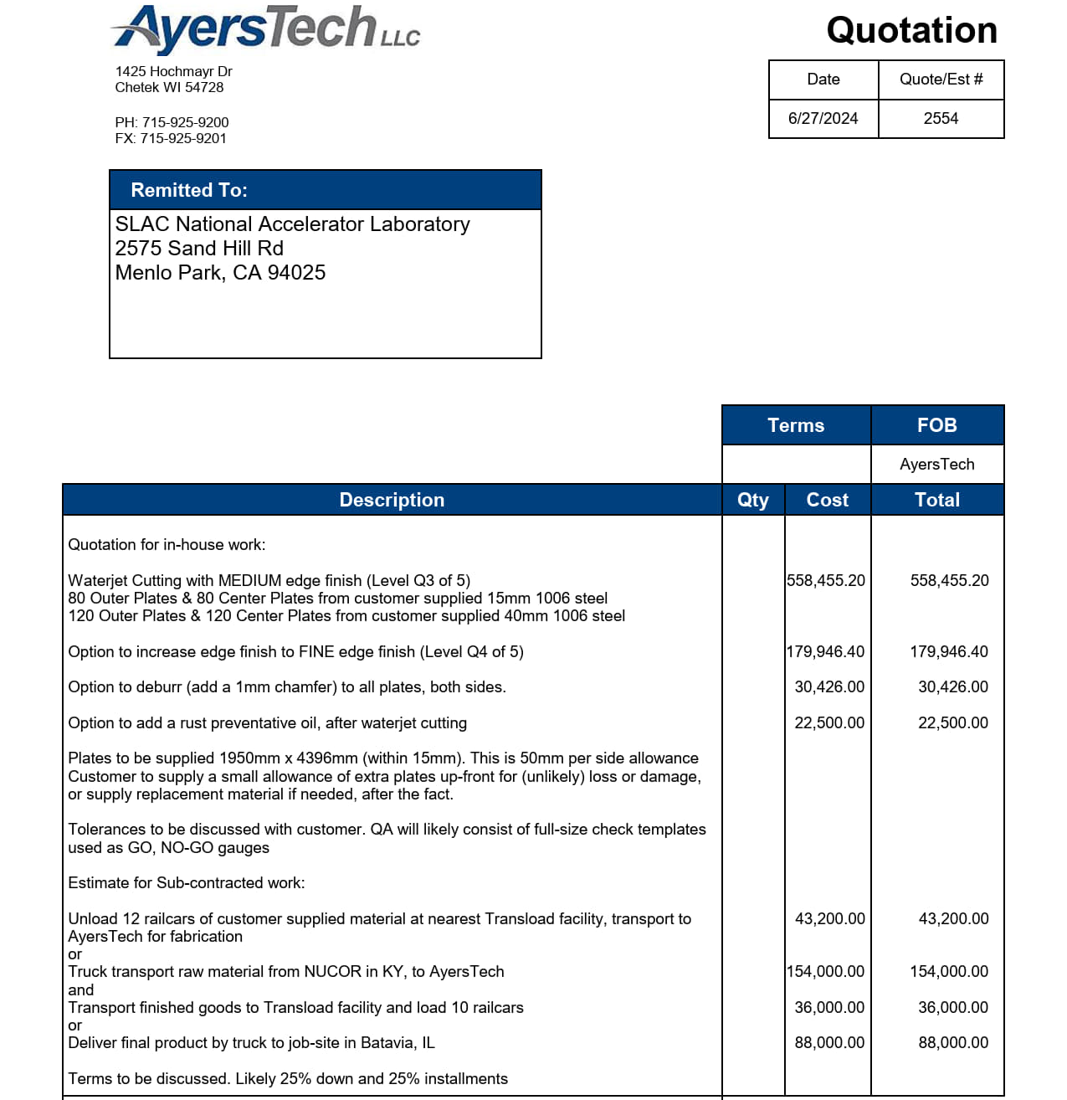
Water Jet Cutting
Contact: Schawn Ayers CEO
$558,455.20
$22,500.00
$43,200.00
$36,000.00
Total Cost:
$666,155
Medium Edge Finish Level Q3 is the standard cut. Cut finish depends on cutting speed.

Slide 6
Water Jet Cutting
Other Choice: North Shore Steel Co. Houston TX
Quote: $662,160
Farther away than AyersTech, but has railroad yard 2 miles to plant.
Need to get shipping costs
Water jet cutting tables with sufficient length and width are scarce. Nucor Steel is also looking for big table sizes in the Kentucky to Chicago area.
Contacts: Tristan Sandoval

Slide 7
Steel Plate Summary
Raw Plate Cost = $1,626,860
Total = $1,626,860 + $64,160 shipping
Total Raw Plate Cost = $1,691,020
Water Jet Cost = $666,500
Total NUCOR/AYERS Plate Cost = $2,357520
Ryerson Quote (LBNF/DUNE BOE – 6/10/2022)
$3,556,000 for plasma cut plates
Original BOE Reduced to $1,422,000 by magical accounting
Nucor steel plates are 35.5” shorter and 4” greater in width
Minos steel plates took 2 man years of work for grinding off slag.

Slide 8
Coil Manufacture and Design
PROPOSED BASIC CONCEPT – Modification of Minos
Use solid ETP 110 copper instead of water cooled aluminum
Use Marco’s dimensions for overall size (six conductor wide X 8 layers tall with each conductor 1” X 1.5”)
Form the long length planks from 6 bars. These bars will have rounded corners and will be skip tack welded together. They may also be connected by several bolts going through all 6 bars.
1/8” Thick G-10 sheets between layers (This may go down to 3/32” thick G-10)
Joints will be pressed bolted contacts with silver plating.
Aluminum cooling plates down the length of the 12 long sections will replace the water cooled bars in MINOS. Right now only one water cooled plate per long length is expected.
The whole conductor pack will be joined with discrete connections (bands) as per Marco’s concept. The cooling plates will be integral with these connection pieces.

Slide 9
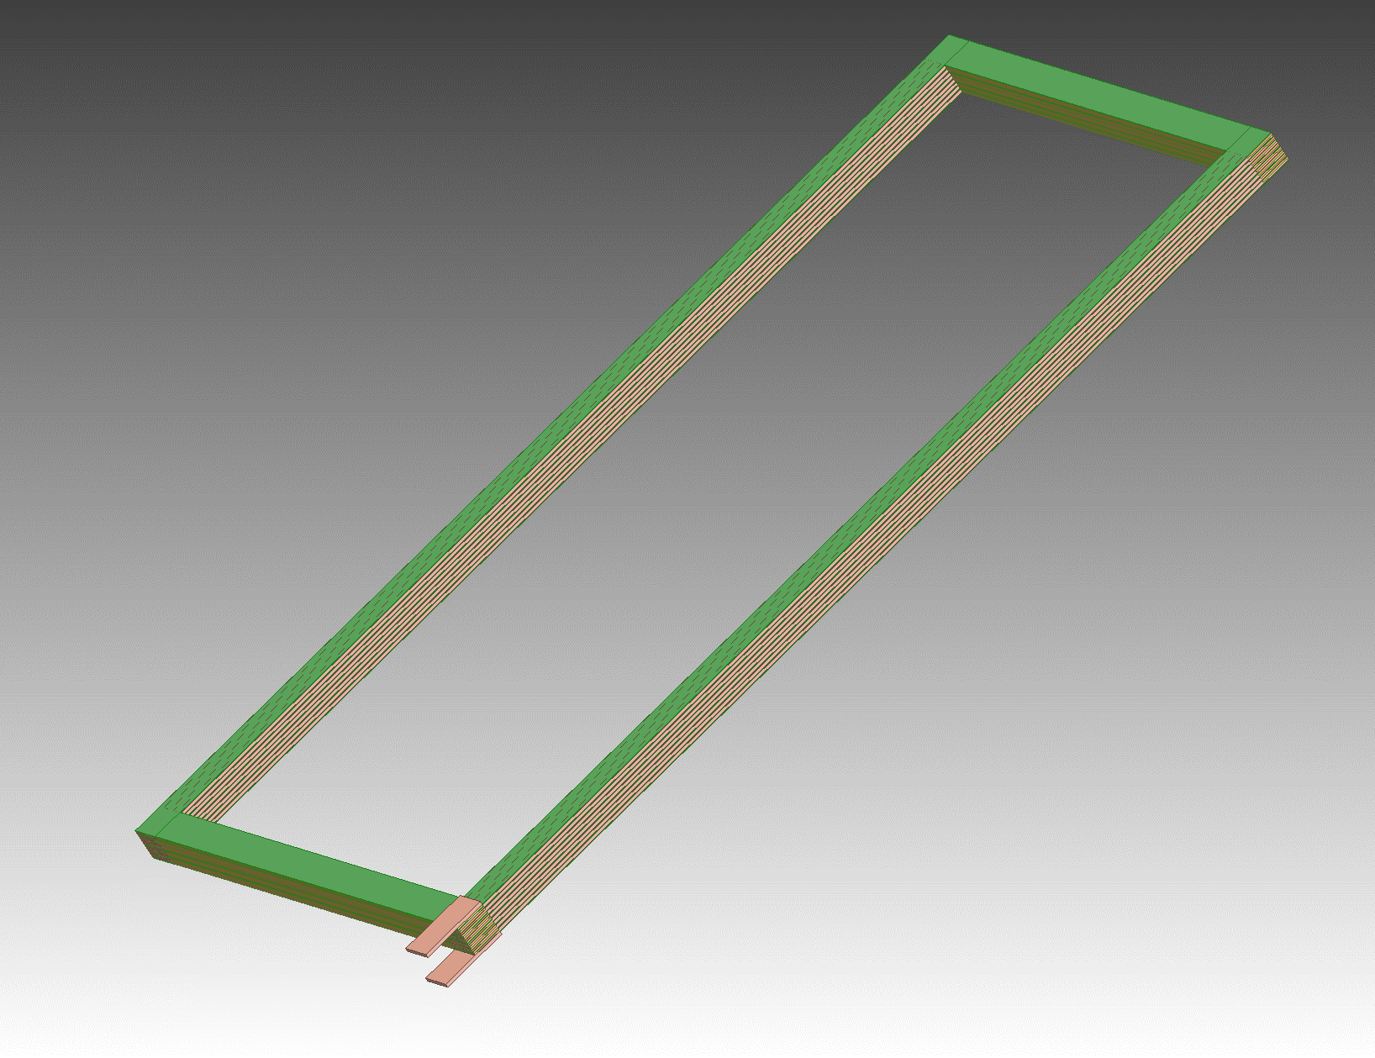
Coil Manufacture and Design
No Corner Transition Pieces Direct Plank to 6 Bar Plank Connections
Green is G-10
Input and Output Terminals

Slide 10
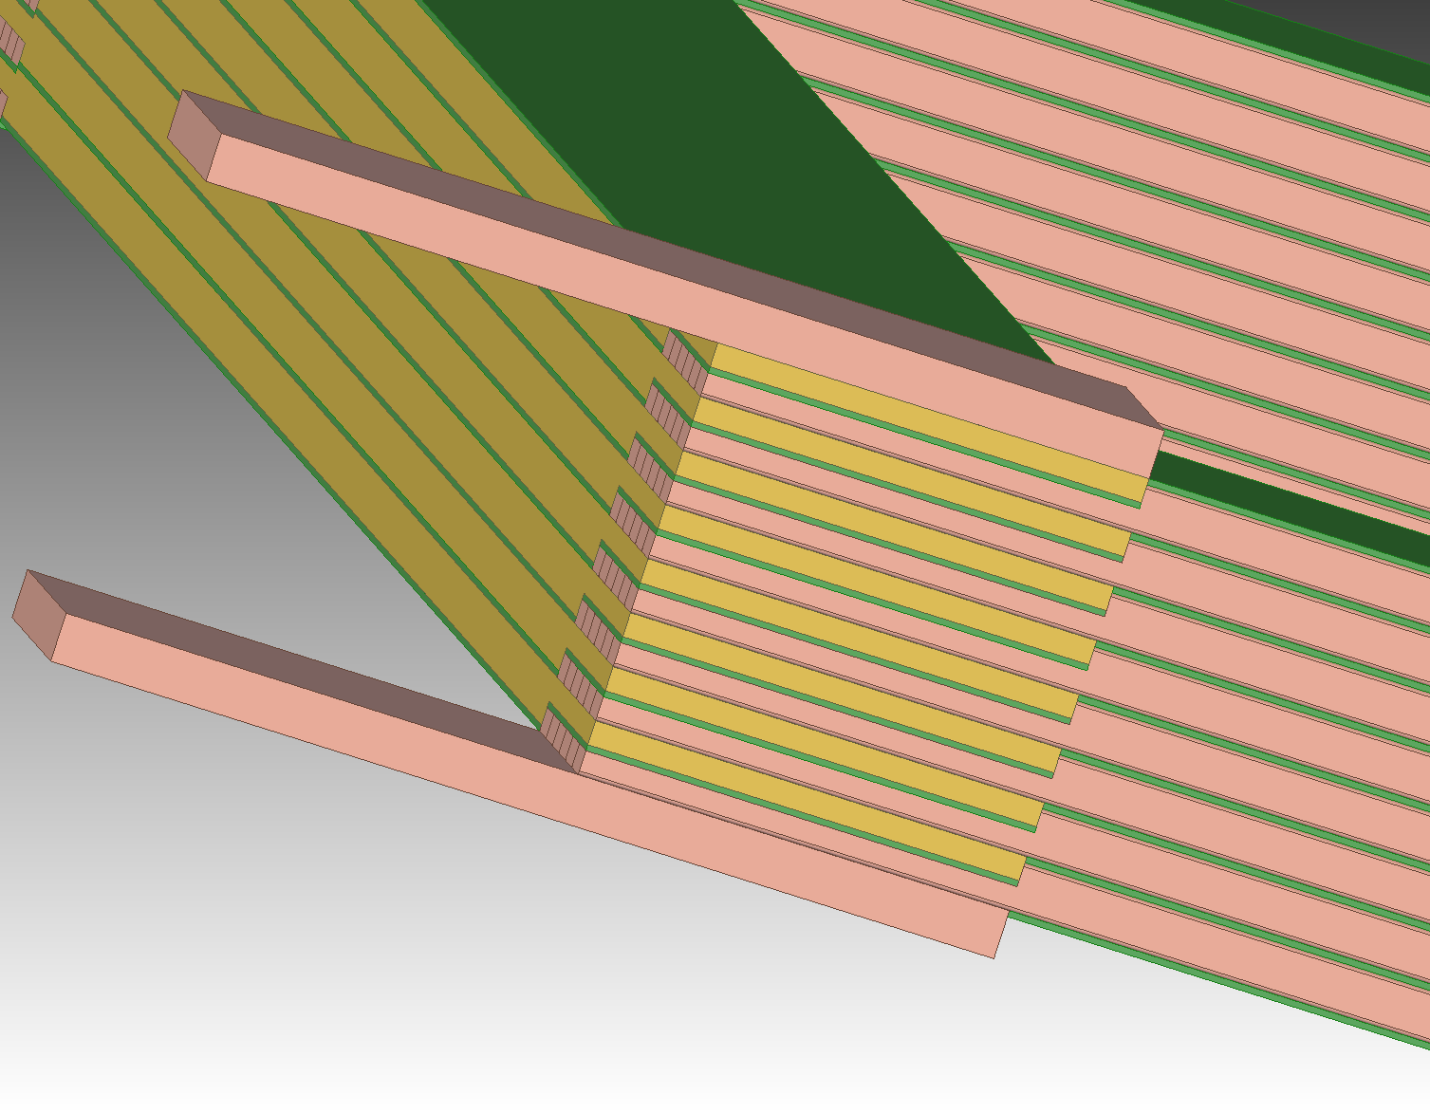
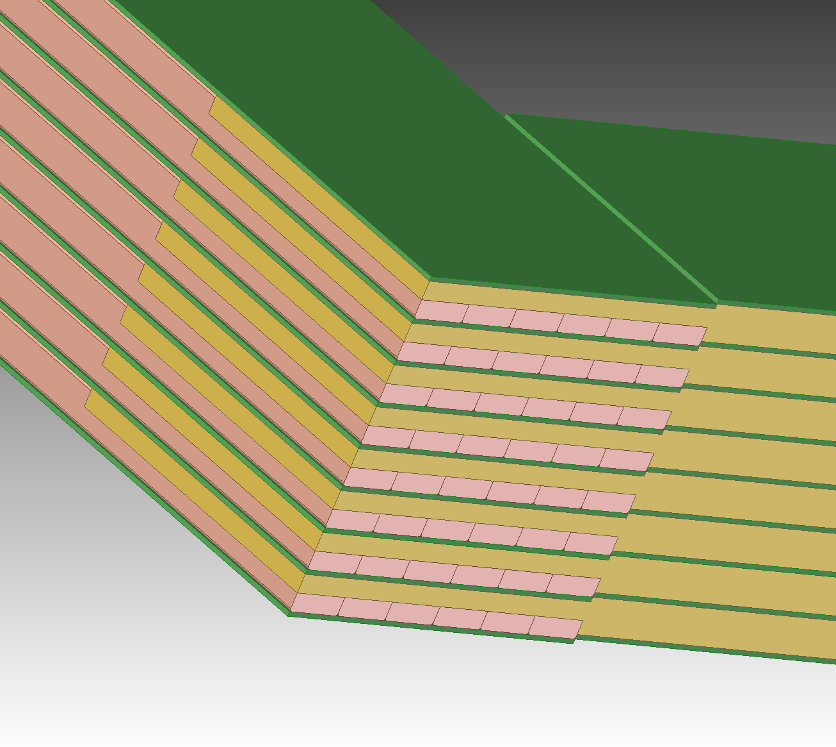
Coil Manufacture and Design
Current Corner Detail
(opposite from Current In/Out)
Current Input/Output Corner Detail
Notice double sided machining on plank end and G-10 step mismatch

Slide 11
Coil Manufacture and Design
Bar Machined End At Both Ends – Bolt holes not shown
Bars Formed Into Plank (Skip welds not shown)
Input and Output Terminals

Slide 12
Need 32 Plates 1” X 9.17” X 71” long
Need 16 Plates 1” X 9.17” X 144” long
Plate Machined End At Both Ends – Bolt holes not shown
Typical at both ends of bars

Slide 13
Coil Manufacture and Design
End Plates at Cross Over on End Opposite to Current Input/Output End
Need 32 Plates 1” X 9.17” X 71” long
Need 16 Plates 1” X 9.17” X 144” long
Plate Machined End At Both Ends – Bolt holes not shown

Slide 14
Coil Manufacture and Design
End Plates at Cross Over on Current Input/Output End
Need 32 Plates 1” X 9.17” X 71” long
Need 16 Plates 1” X 9.17” X 144” long
Need 32 Plates 1” X 9.17” X 71” long
Need 16 Plates 1” X 9.17” X 144” long
Plate Machined Ends
Bolt holes not shown
Typical at other end of bar
Typical at Current In/Out end of bar

Slide 15
Required Plates for 6 Coils
Two Center Coils:
Outside Length = 7.5 m, Inside Length = 7.1 m
Outside Width = 3.65 m, Inside Width = 3.29 m
Need 32 plates 1” X 295” and 32 plates 1” X 144”
4 Outer Coils
Outside Length = 7.5 m, Inside Length = 7.1 m
Outside Width = 1.8 m, Inside Width = 1.44 m
Need 64 plates 1” X 295” and 64 plates 1” X 71”
Total Plates Needed
96 plates 1” X 295” 576 bars
32 plates 1” X 144”
64 plates 1” X 71”
Total Mass of All Plates = 50,480 kg = 111,130 lbs

Slide 16
Coil Manufacture and Design
Vendor for Copper Planks and Bars for Planks:
Copper and Brass Sales -- Division of TKMNA, Thyssenkrup
Copper and Brass Sales functions like a Ryerson -- Sourcing materials from manufacturers and machining from outside vendors (Some in house machining?)
Bulk ETP copper price = $7.50 /lb
Total Bulk Copper Price = $833,500
G10-FR 3/32” thick sheets = $29,799 Interstate Plastics
Waiting for finished machined bar and plank prices from Copper and Brass Sales
Can only supply in ETP copper bars without purchasing oversees. Length is the issue.
Will supply end planks in ETP copper. Maybe possible to get OFHC in US through Revere. Revere is the big gorilla for copper in the US.
No luck in contacting Luvato for OFHC Copper. I never had luck in contacting Luvato.
Contacts: Glenn Kreis (local and very eager to get this PO)

Slide 17
Coil Manufacture and Design
ETP vs OFHC
ETP copper is 90% of the electrical copper used in the US.
ETP is much easier to get
ETP has the same electrical conductivity as OFHC
OFHC is much easier to weld and braze
ETP is a bit easier to machine than OFHC
ETP has oxygen in it. This makes welding and brazing more difficult. A TIG welding/brazing method will be used. Silicon-bronze and other alloys are recommended.
Need to buy ETP samples with different filler rods and have Bob Conley try them out. Material cost ~ $400 and 1 day of Bobs time.

Slide 18
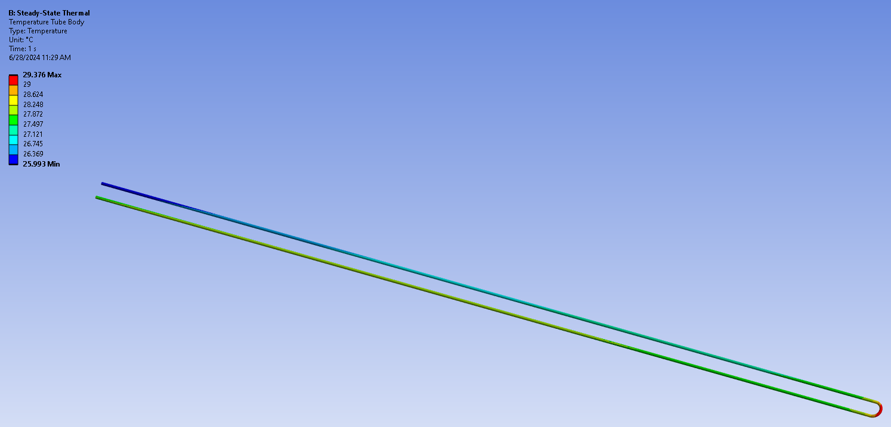
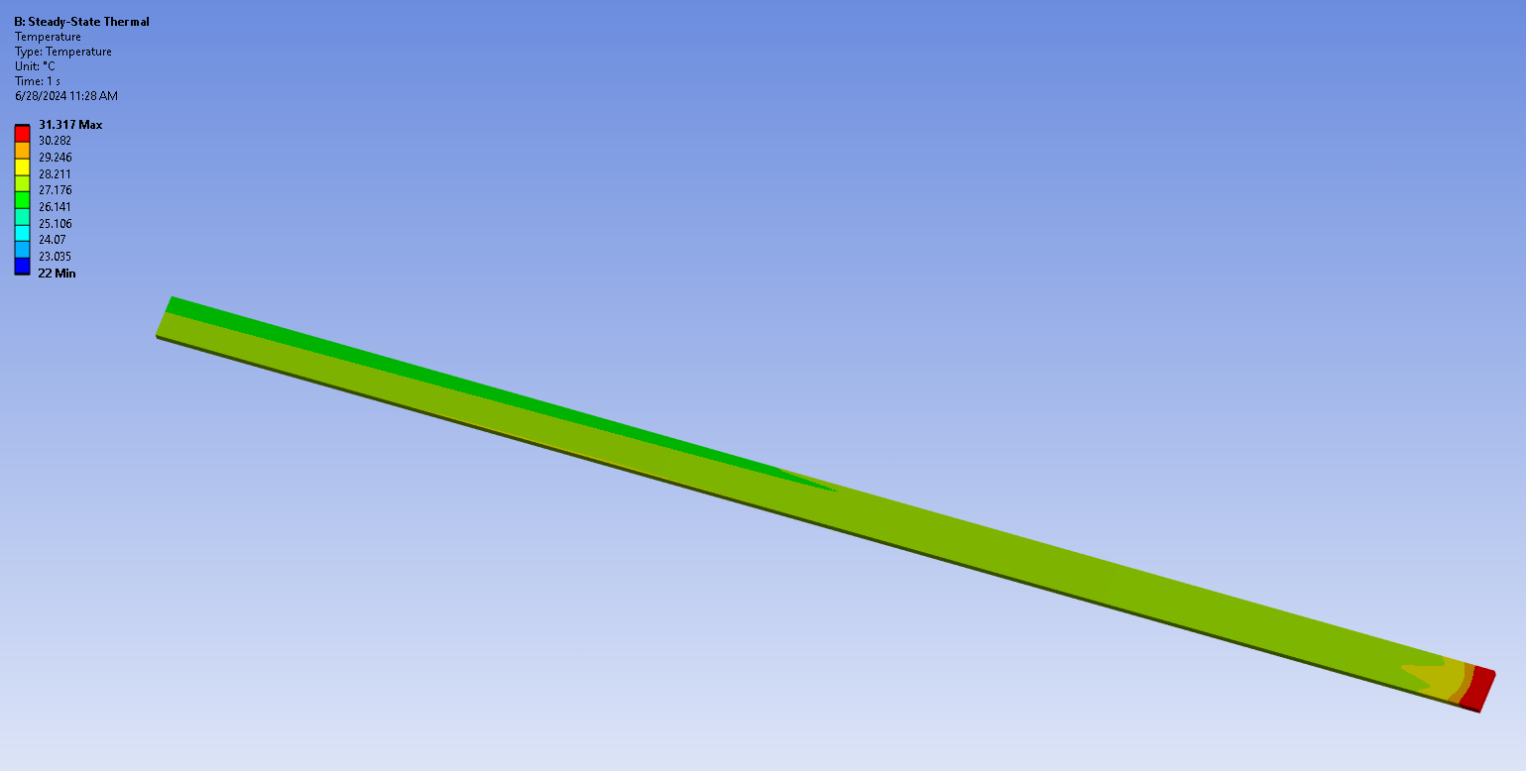
Coil Thermal Analysis
ANSYS thermal analysis aluminum bar with 1 pass 5/8” OD copper tubing using thermal flow element 116.
Heat flux on one surface of aluminum cooling plate of center coil = 3750 watts with 3 GPM water at 22 C inlet
Result: Max plate temp = 31.3 C, Max Tube temp = 29.4 C, Outlet water temp = 26.6 C

Slide 19
Coil Thermal Analysis
Need full analysis with conductor, G-10 insulator, contact resistance at all surfaces, conductor package side plates, and heat transfer into water.
Can get full length aluminum extrusions from Western Extrusions in TX. Contact is Gary Bacher. Waiting for prices.
Cold plates from QATS Advanced Thermal Solutions in Massachusetts. They only have a 6 foot bed for milling. So we would or QATS would have to send the plates from Western Extrusion to a larger machine shop. They could press the tubes in full length with one up and back pass. Right now this seems to be a sufficient length.
The cooling plates will be connected in a series parallel arrangement to optimize pressure drop, cooling and ensure the flow is turbulent.
The cooling plates will be part of the structure of the straps going around the coil

