Slide 1
9 O’Clock Meeting
Nathan Ruffatti
MCR Crew Chief
Wednesday, July 3th, 2024

Slide 2
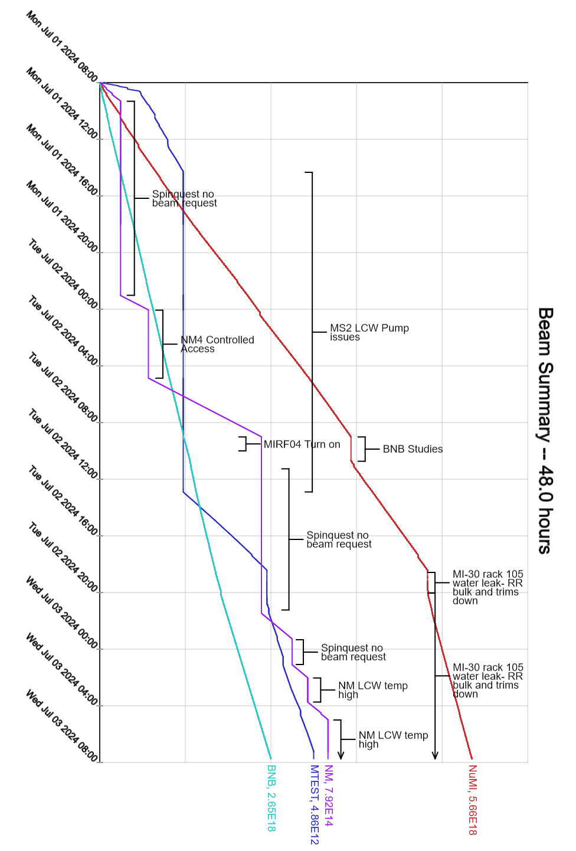
Since Monday…
Monday:
MS2 LCW pump issues, system turned off. No beam overnight
MIRF04 tripping on incomplete RFGE, station was bypassed
Tuesday:
BNB/Booster studies in the morning
MIRF04 repaired during studies
MS2LCW recovered
Water leak in R:C301 regulators, bulk is off and valved out
Running MI only mode
PESD currently replacing regulator chassis
MIRF01 issues running in MI mode
BRF7 tripping on AC OI, station bypassed and swapped to BRF20

