Slide 1
Cryostat Update
R. Rabehl
July 8, 2024

Slide 2
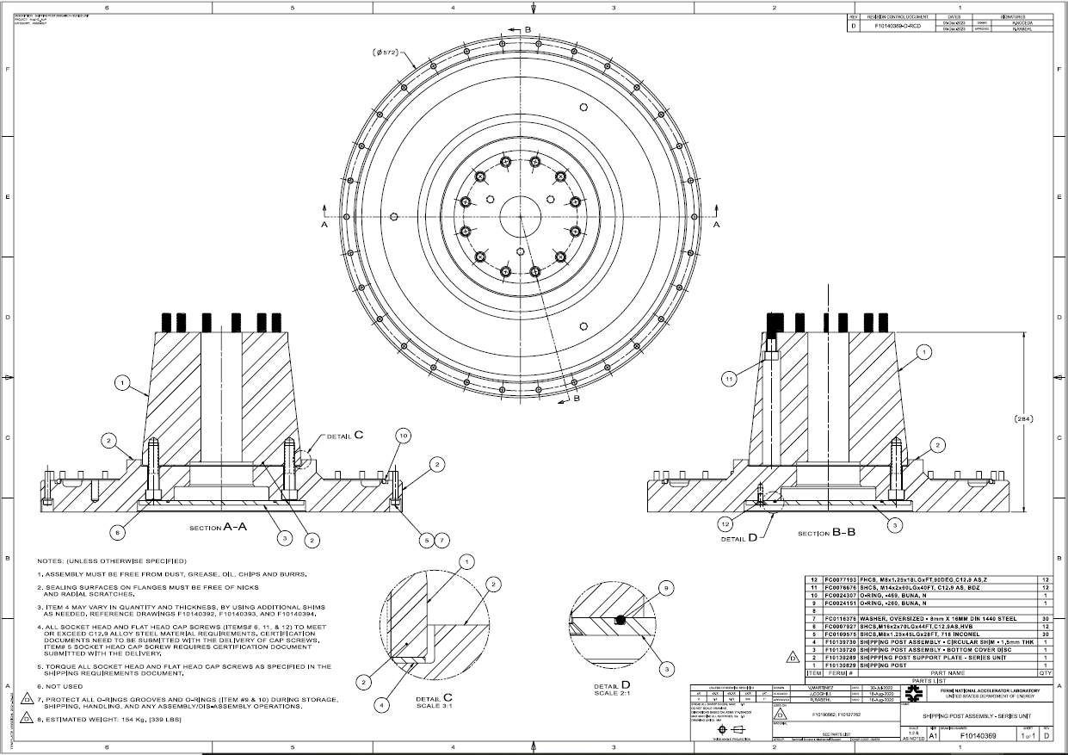
Cryostat – Shipping Posts
Teamcenter Engineering Order Form ED0033225 submitted
Remaining 2 sets of shipping posts/support plates/cover discs. (Req. 354738 / P.O. 712185)
May 10, 2024 promised date
All items received, in QC
All bolting hardware for the remainder of the project. (Req. 357424)
Placed on SAM.gov due to vendor error in indicating foreign-sourced material.
A set of bolting hardware for CA-02 has been ordered (P.O. 714732). June 17 promised date. Delivered June 20, in QC.

Slide 3
Cryostat – CA-02 documentation
Documentation
Reviewed and approved
EN12027 (vacuum vessel engineering note)
EN04771-A (Cryo-Assembly piping)
EN04901-A (pipe nozzles/extensions)
EN04768-B (interconnect piping)
Upload of fabrication & pressure test documentation, followed by final review and approval
EN04771-A (Cryo-Assembly piping)
EN04901-A (pipe nozzles/extensions)
EN04768-B (interconnect piping)

Slide 4
Cryostating – CA-02
CA-02 DRs
13503: Unidentified surfaced blemishes on LD pipe. Awaiting disposition.
13526: Contact between IFS capillaries and thermal shield extrusions. Awaiting disposition verification.
13527: FSI target installation screws not torqued to specified value to due lack of an appropriately-rated torque wrench. Awaiting disposition verification.
13545: Unable to install three studs attached the fixed point support post to the Cold Mass saddle. Awaiting disposition verification.
13552: Thermal shield is ~5 mm too far towards the Non-IP end such that the thermal shield support pieces cannot be installed at the fixed support post. Awaiting disposition.
13575: IFS-A wired in the wrong orientation. Awaiting disposition.
13583: IFS-A RTD miswiring. Awaiting disposition.
13584: Misalignment between new IFS-A cover and interface ring after welding. Awaiting disposition.
13586: Unstable Pt100 temperature sensor on inboard side of magnet MQXFA05. Used only for controlled warm-up/cool-down monitoring at FNAL. Redundant sensor present. Closed.
CA-02 NCRs
Cold Mass saddle threads/support post installation (LHC-LQXFA-QN-0006) – WP Evaluation.
Thermal shield misalignment (LHC-LQXFA-QN-0007) – Actions Underway.
Central support post bearing bolts (LHC-LQXFA-QN-0008) – WP Evaluation.

