Slide 1
Summary of CPAD Convenors Meeting July 8
Mitch Newcomer
RDC4 Meeting July 11, 2024

Slide 2
CPAD timeline
Progress on white paper collection
Cut-off date: Friday July 19th
CPAD EC & RDC Coordinator Review & Discuss whitepapers
CPAD RDC Community Meeting
Proposed date: Monday July 29th
Format: 10-15 min flash talks with provided prompts on white papers
Assuming ~ 20 presentations need to decide what to do if there are more.
CPAD EC and RDC deliberations and discussion period
2 meetings for discussion with RDC coordinators and EC members to compare whitepapers
→ Announcement of high priority & best aligned white papers for FY24
then.. Work within the RDC’s to continue to help proponents prepare their proposal
CPAD Workshop: Tuesday Nov 19th - Friday Nov 22nd
Approximate timeline for sessions based on available rooms
Call for advertising “Save the date”

Slide 3
Progress on white paper collection
Looking at the Google Drive there are 7 whitepapers (either in progress or looking complete)
Google Drive Link: 2024-RDC-WhitePapers
Template: https://docs.google.com/document/d/1ZpQnZI4XOe3wCDeEVOMT-0A9w0oajvs7sg7Nmk7QhXQ/edit?usp=sharing
Instructions for people to make their own copy: https://docs.google.com/document/d/16keLR453PRBPzt_dP3mUJSKVwnn13CCp5DPyiHEMlxI/edit?usp=sharing
Spreadsheet to keep track of the RDC whitepapers
Linked here: https://docs.google.com/spreadsheets/d/1OM2rXcq-n8rQc422BTR-dbRBlp03DnKnQDZSZ9t8r4U/edit?usp=sharing

Slide 4
CPAD RDC Community Meeting
Suggested prompts for white paper proponents slides
Provide 3-5 slides which outline what your R&D is
Provide 1-2 slides which outlines who the team working on the R&D is and what are they responsible for
Provide 1-2 slides which outline the overlap with the various RDC’s
Provide 1-2 slides which provides a timeline for the R&D over the next 3-4 years along with any relevant milestones and deliverables
Open to other suggestions or clarification on language

Slide 5
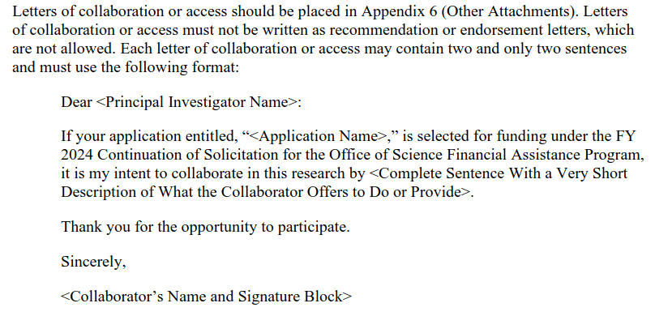
CPAD EC and RDC deliberations and discussion period
FOA: https://science.osti.gov/grants/FOAs/-/media/grants/pdf/foas/2023/DE-FOA-0003177-000001.pdf
Language from the FOA
If your application entitled, “<Application Name>,” is selected for funding under the FY2024 Continuation of Solicitation for the Office of Science Financial Assistance Program, it is my intent to collaborate in this research by supporting the work via the Coordinating Panel on Advanced Detectors (CPAD) R&D Collaborations (RDC’s) which has identified this work as an area of high priority and will help provide coordination, information about experts and facilities, and a monthly venue to highlight the progress made by members of the research team to the broader instrumentation community.
Thank you for the opportunity to participate.
Sincerely,
<Collaborator’s Name and Signature Block>

