Slide 1
ICEBERG: Status and Plan
Shekhar Mishra
Neutrino Division, Fermilab
06/26/2024

Slide 2
ICEBERG: Study Plan
Measure Individual Channel Linearity (INL) using pulser data. (Data Taken)
Determine the precision of individual channel gain (LArASIC + ColdADC; e-/LSB) using pulser data. (Data Taken)
Measure and decide the optimal gain setting: 14 mV/fC or 7.8 mV/fC or 25 mV/fC(Data Taken)
Determine optimal baseline for collection plane: 200+ mV (Done)
Study shaping time effect on ENC (1 μsec vs 2 μsec vs 3 usec) (Data Taken)
Measure cross talks. (14 mV/fC, DAC 15, single and diff pulse) DAC 0 – 63 (Data Taken)
Determine optimal ColdADC V_{ref} settings. (Done)
Learn to use particle interaction in LAr to determine absolute calibration of the TPC + Electronics response (MeV/LSB-tick)
  MIP dE/dX
  Michel electrons
  Ar-39
DUNE-FD2-PD: Integration of DAPHNE-V3 in Ethernet DUNE-DAQ
  Spy-Buffer (Data Taken and Analyzed)
  Starting on FELIX DAQ

Slide 3
Calibration Run Summary
There are more than 2500 runs to be analyzed
Original Setting (reg24 = 223, reg25 = 51, reg 26 = 137) (Run 12076-12317)
  14 mV/fC, 2 usec, 900/200 mV (Run 12221 – 12253)
Vref 1.8 (reg24 = 240, reg25 = 34, reg 26 = 137) (Run 12471-12967)
  14 mV/fC, 2 usec, 900/200 mV (Run 12741 – 12804)
Vref 1.95 (reg24 = 250, reg25 = 24, reg 26 = 137) (Runs 13077 - 13572)
  14 mV/fC, 2 usec, 900/200 mV (Run 13346 – 13409)
Vref 1.9 (reg24 = 243, reg25 = 27, reg 26 = 135)
  14 mV/fC, 2 usec, 900/200 mV (Run )
  Single Channel Pulse

Slide 4
Optimal ColdADC Vref settings
Goal: “Expand ColdADC dynamic range so that it does not limit the dynamic range of the channel (make it slightly larger than the LArASIC dynamic range)”
Study: Adjust V_{cmi} , V_{cmo} , V_{refp} , and V_{refn}
Summary: Adjust only V_{cmi} ,V_{refp} , and V_{refn}
  coldadc_settings": {
  "reg_0": 35,
  "reg_24": 243, (223)
  "reg_25": 27, (51)
  "reg_26": 135, (137)
  "reg_27": 103,
  "reg_29": 39,
  "reg_30": 39,
  "reg_4": 59
  },

Slide 5
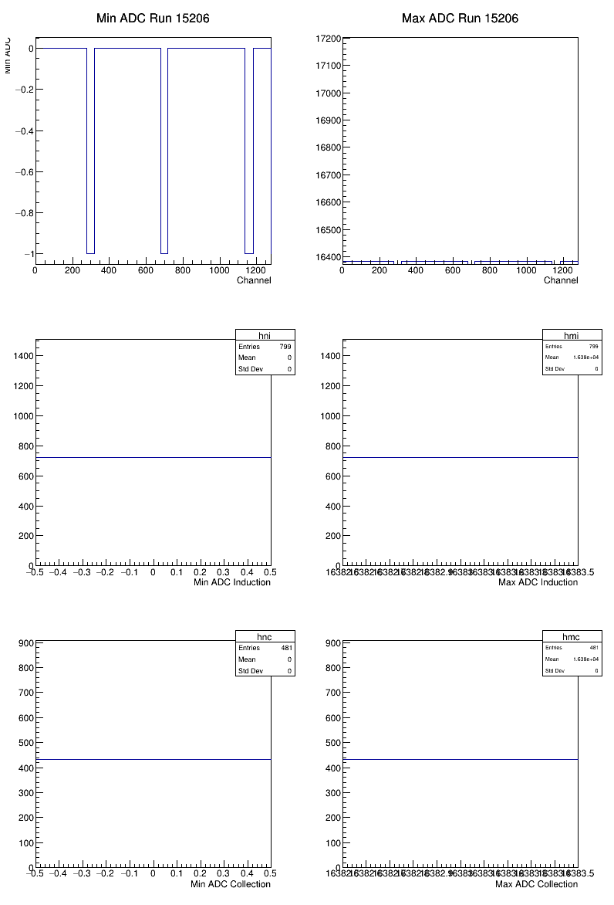
Vrefp = 223, Vrefn=51, Vcmo = 137
15206
Run adc stats: 15206 0 0 16383 0 0 0 16383 0 Events: 61
25 mV/fC, DAC = 63

Slide 6
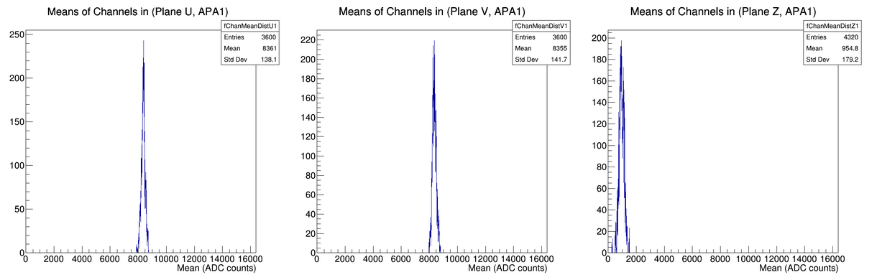
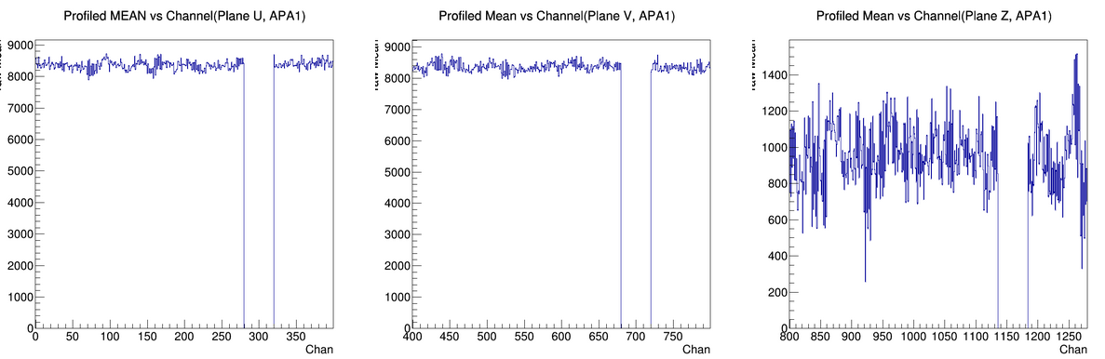
Vrefp = 223, Vrefn=51, Vcmo = 137
Mean = 954

Slide 7
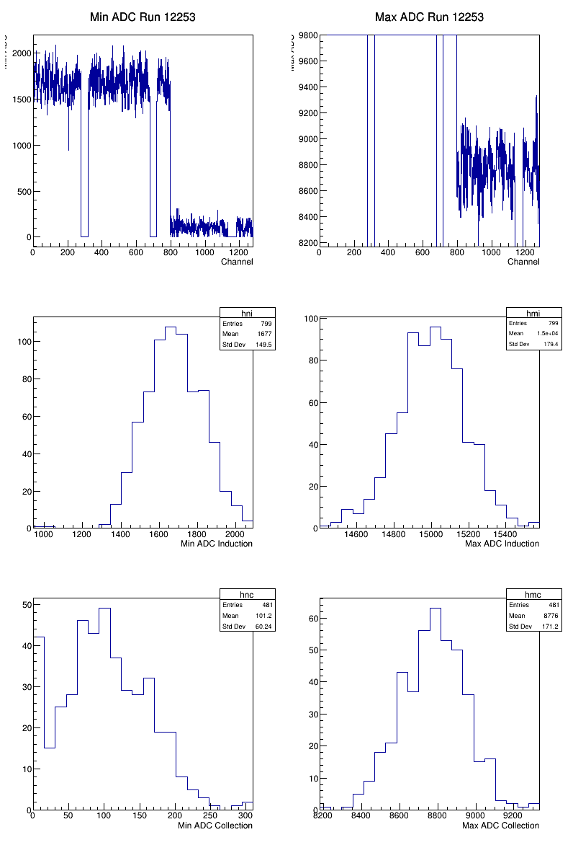
Original, 14 mV/fc, DAC = 32

Slide 8
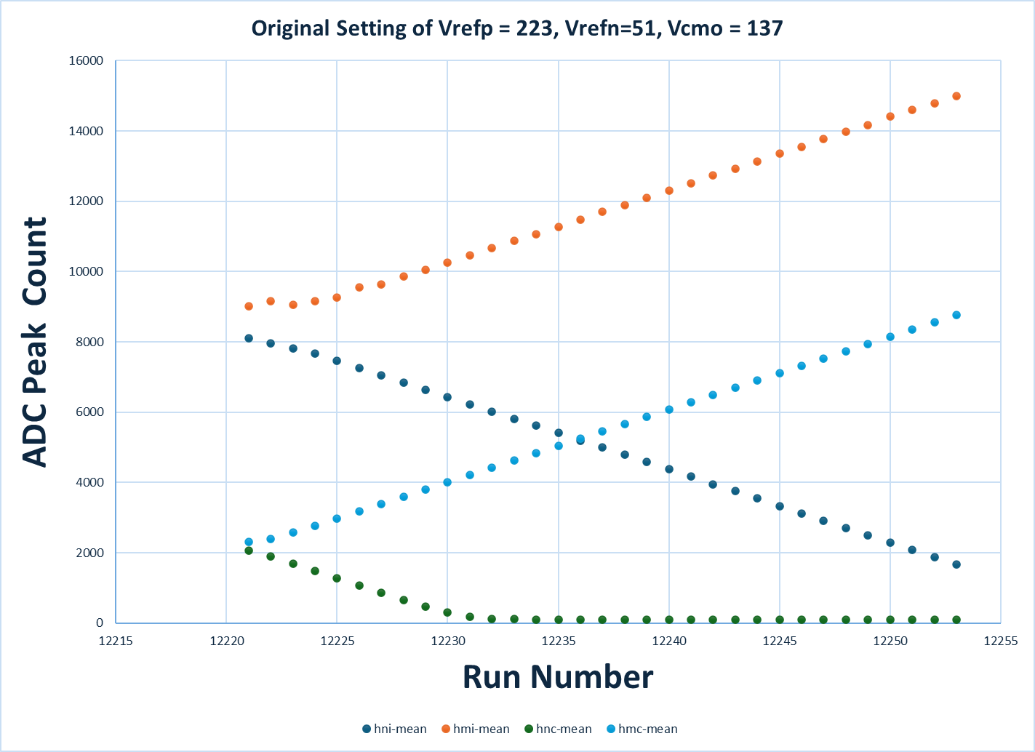
Original Calibration Scan: 14 mV/fC
DAC =31
DAC = 31

Slide 9
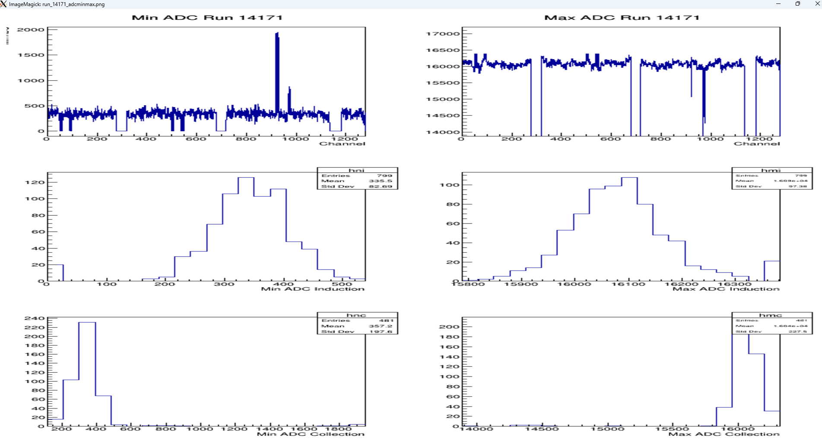
Vrefp = 245, Vrefn=29, Vcmo = 137
14171
25 mV/fC, DAC = 63

Slide 10
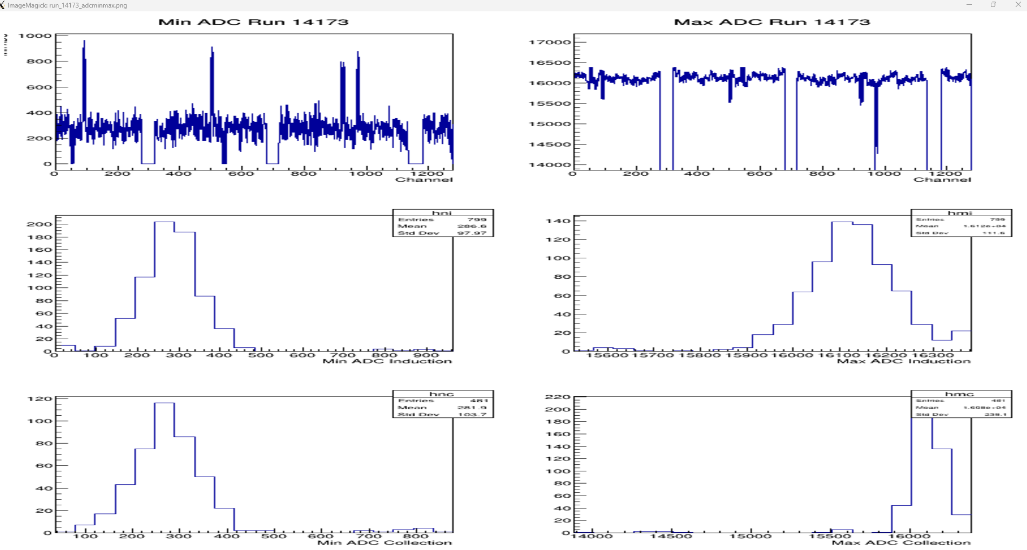
Vrefp = 241, Vrefn=29, Vcmo = 135
14173
25 mV/fC, DAC = 63

Slide 11
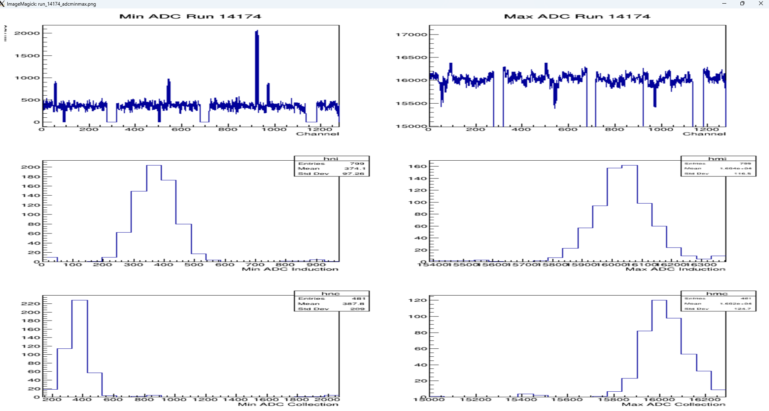
Vrefp = 243, Vrefn=27, Vcmo = 135
14174
25 mV/fC, DAC = 63
Recommended Setting

Slide 12
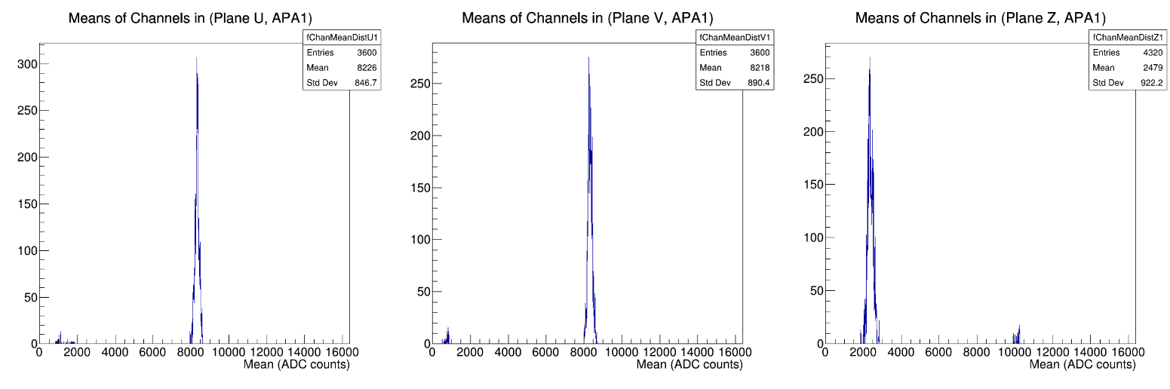
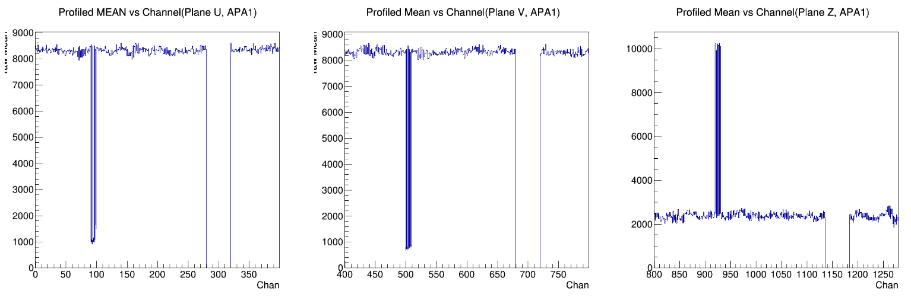
Vrefp = 243, Vrefn=27, Vcmo = 135
14174
25 mV/fC, DAC = 63

Slide 13
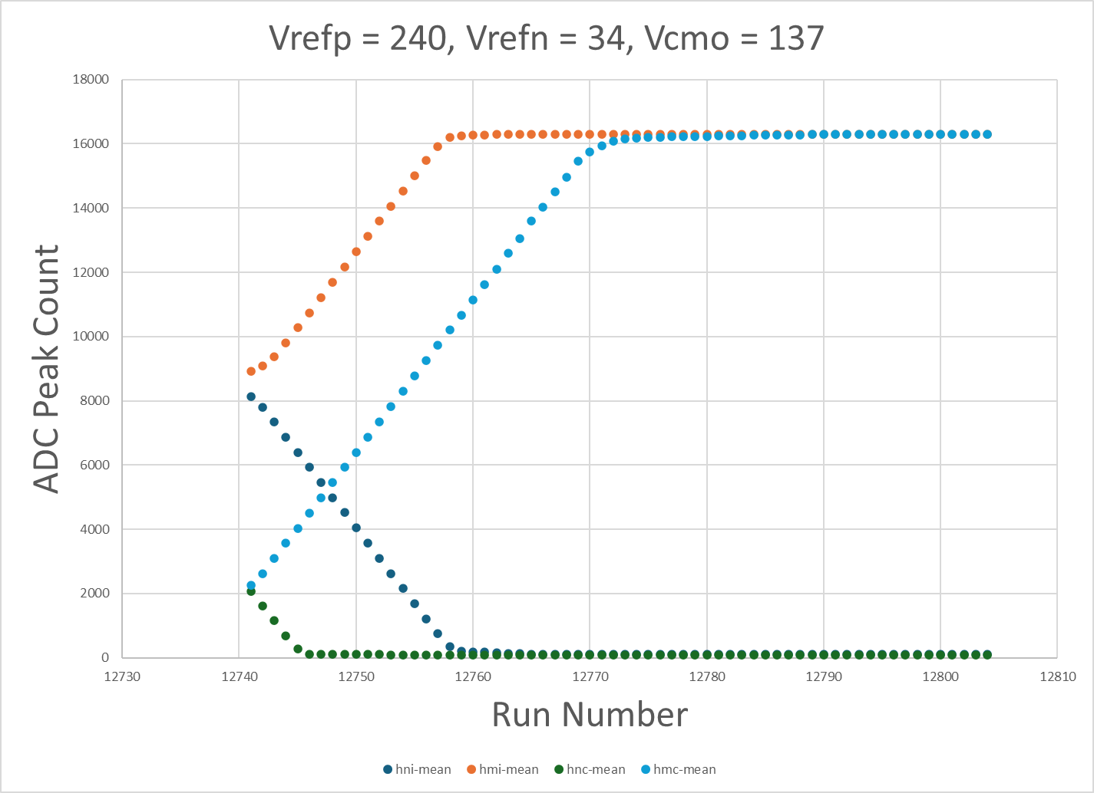
Vref = 1.8, 14 mV/fC
DAC =18
DAC = 31

Slide 14
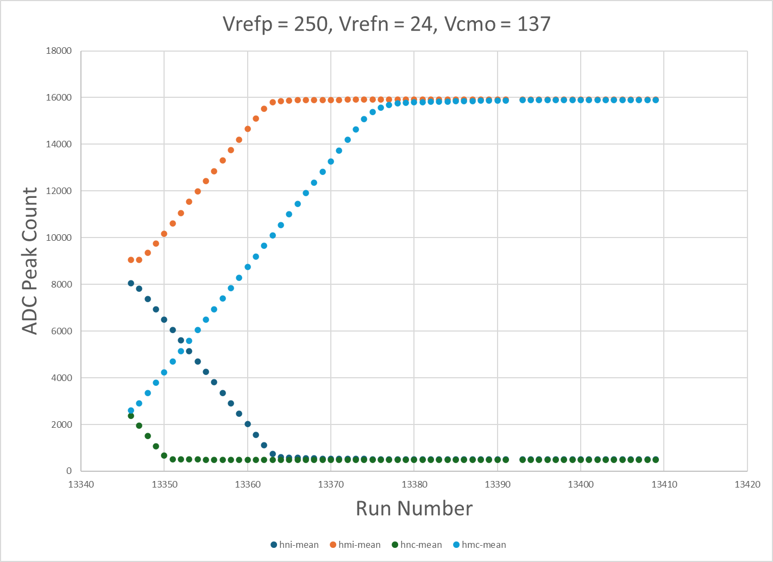
Vref = 1.95, 14 mV/fC
DAC =18
DAC = 31

Slide 15
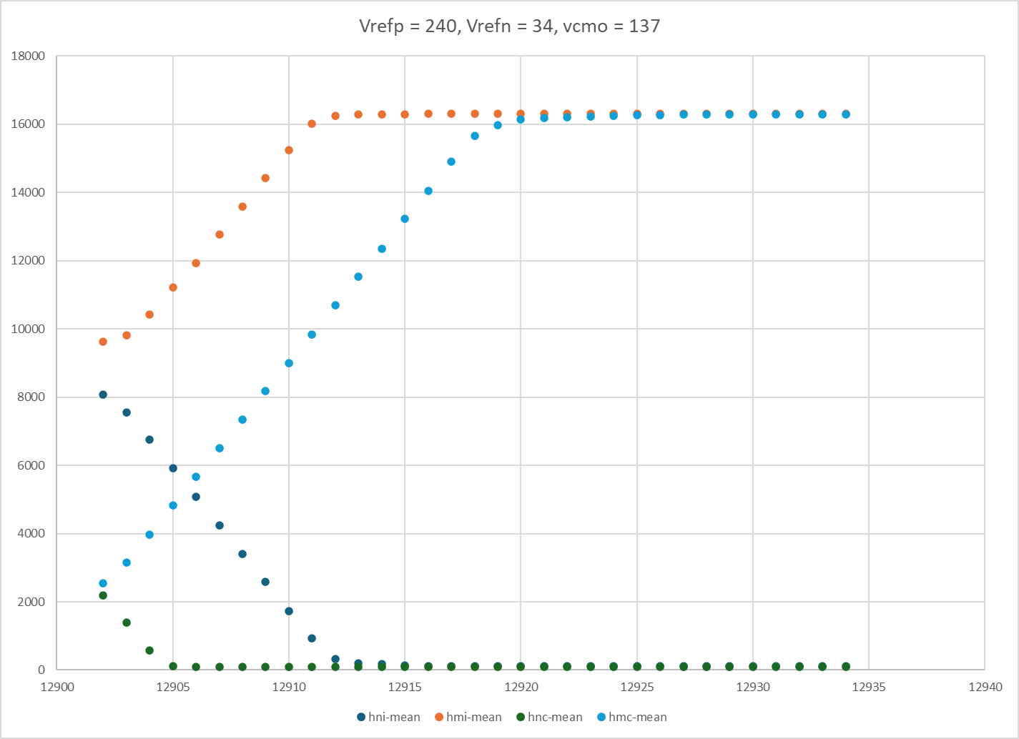
Vref = 1.8, 25 mV/fC

Slide 16
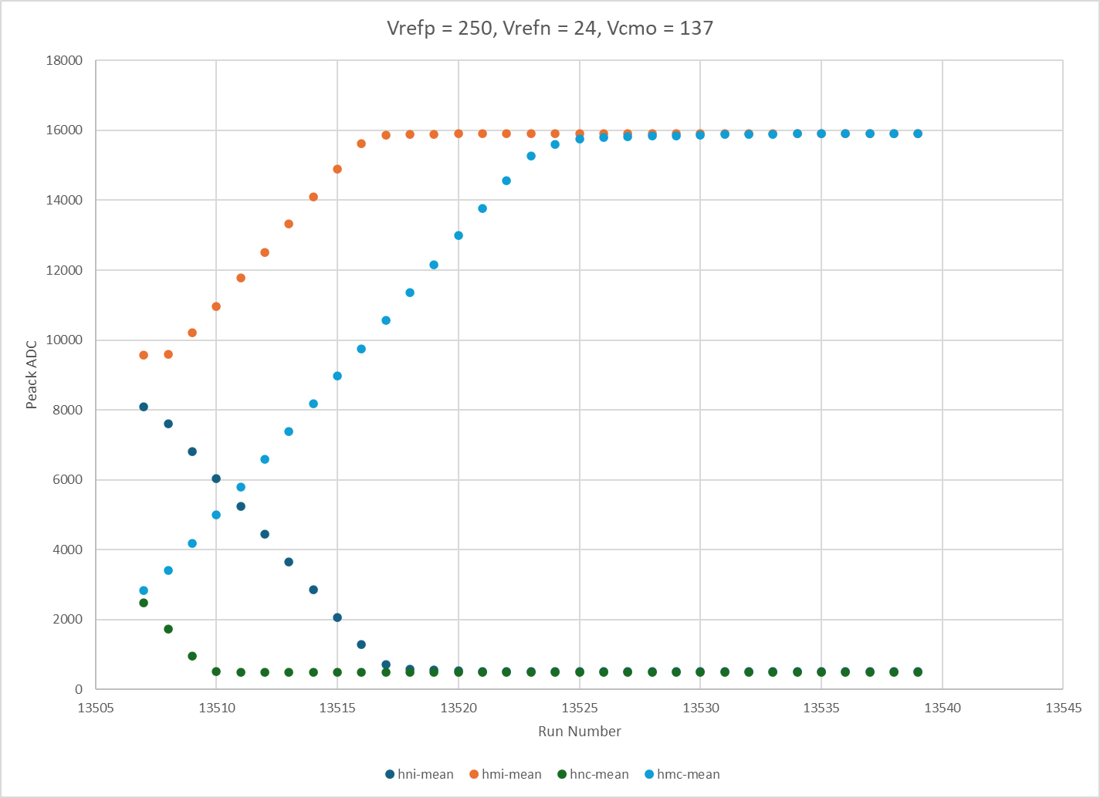
Vref = 1.95, 25 mV/fC
DAC =10
DAC = 17

Slide 17
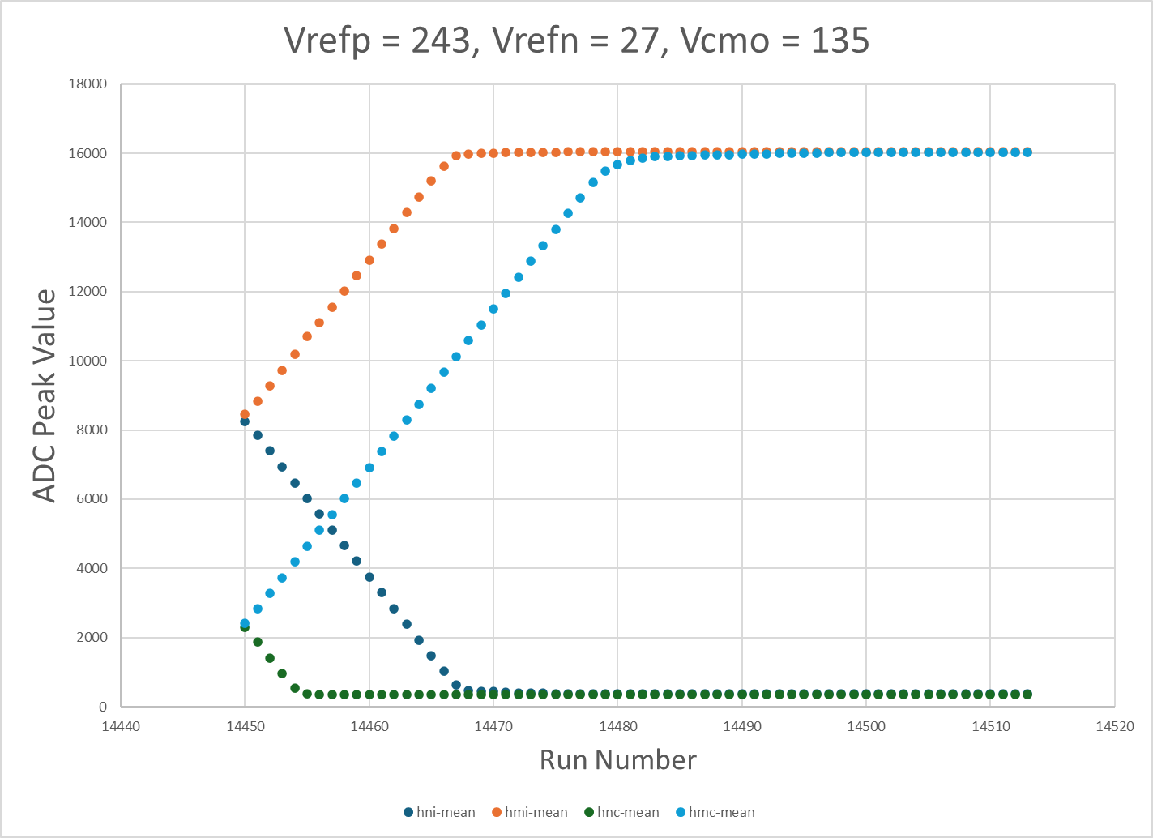
Vref = ~1.9, 14 mV/fC
DAC =17
DAC = 30
Recommended Setting

Slide 18
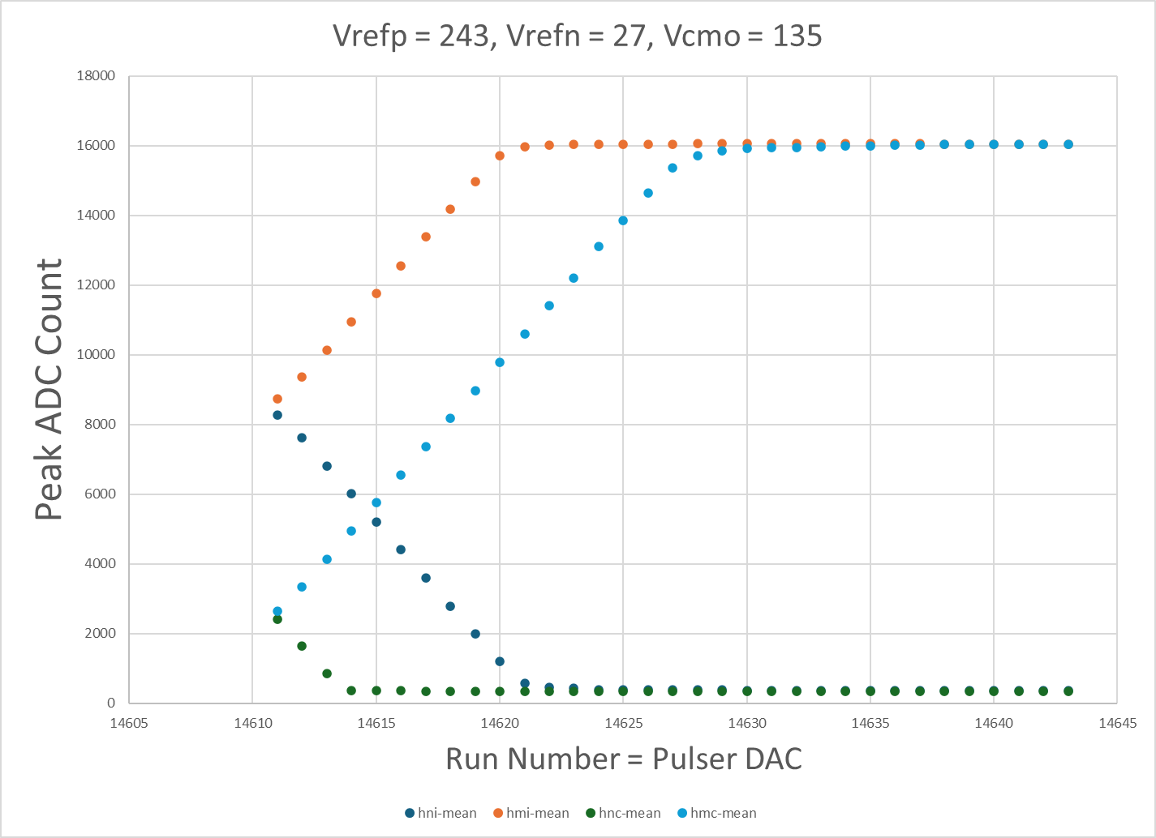
Vref = ~1.9, 25 mV/fC
DAC =10
DAC = 17
Recommended Setting

Slide 19
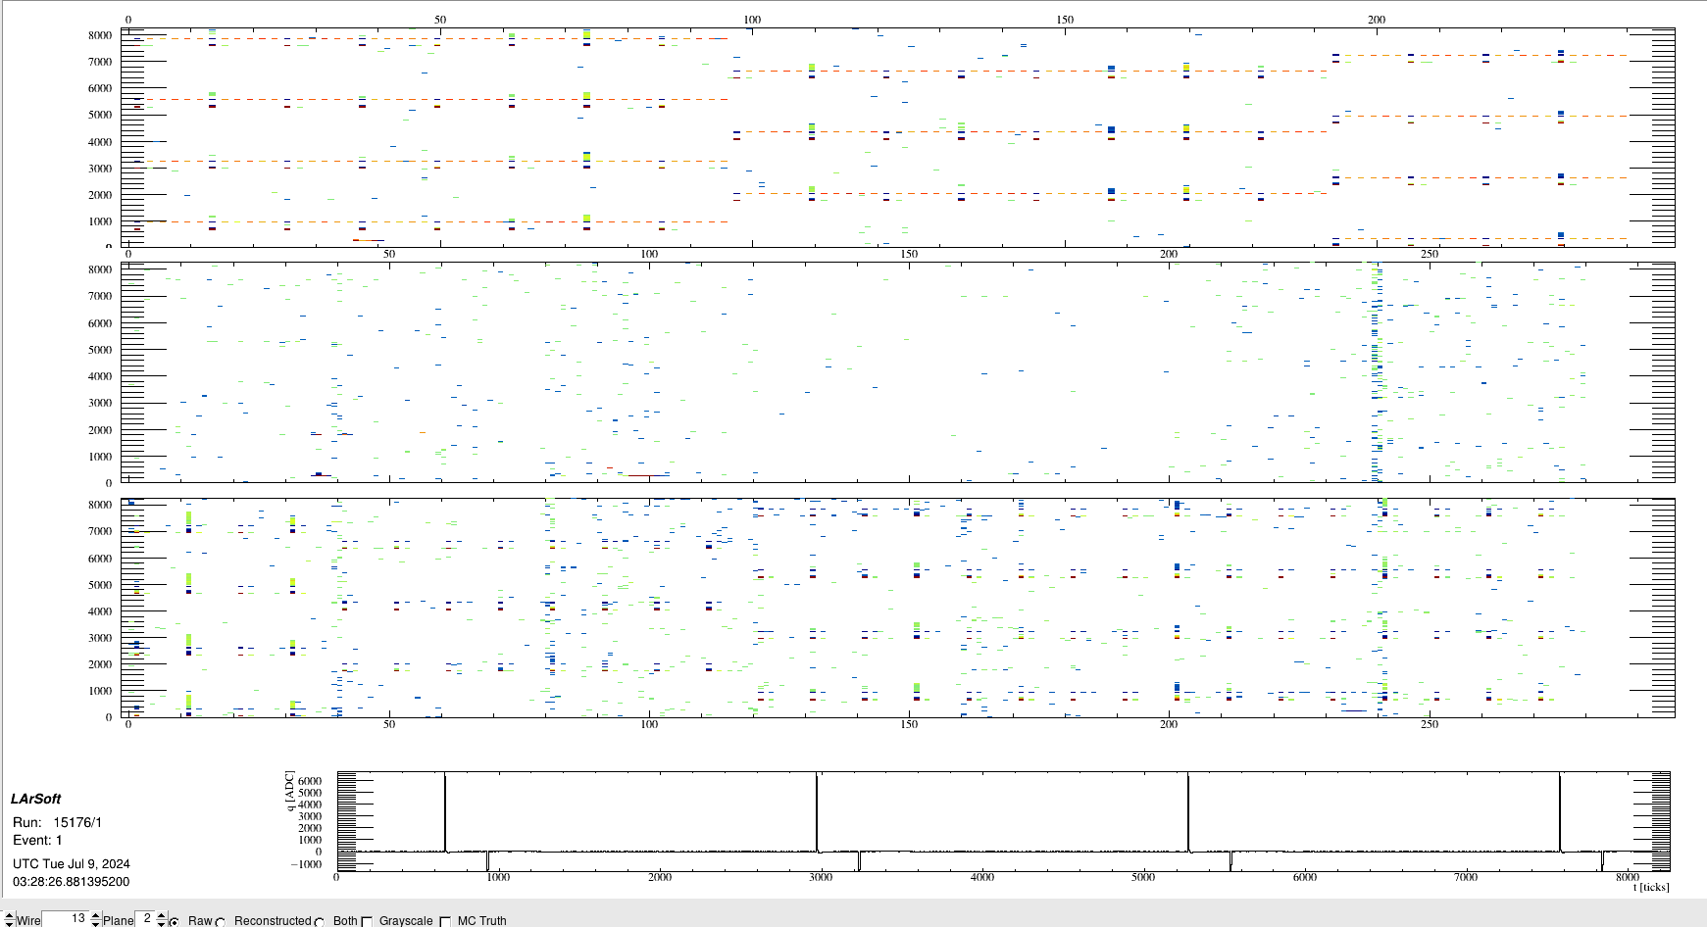
Cross Talk

Slide 20
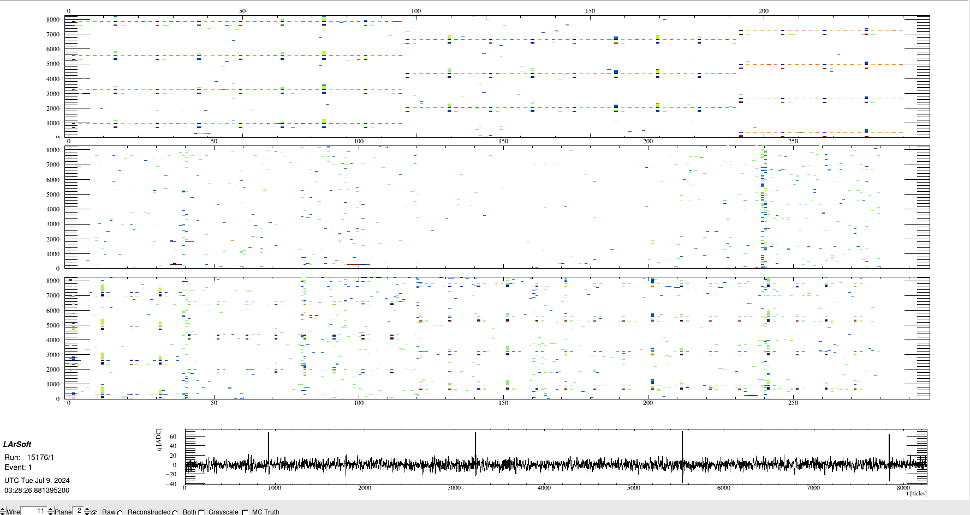
Cross Talk (in time with Negative)

Slide 21
Analysis in progress
Cross Talk (single and Differential)
Recommended Vref (Differential)

