Slide 1
ND Meeting DSO Slides
ES&H
9 July 2024

Slide 2
Summary
Injuries in June
Injury Statistics
Situational Awareness and Complacency
Notes:
No ORPS/NTS in June
No special announcements in June

Slide 3
Injuries/Illnesses in June
06/03/2024 - Medical Treatment, ISD
Employee was reaching for a girt to connect it. They grabbed the girt with their left arm which extended their arm and felt a lightning bolt of pain from shoulder to elbow. Pain increased. Went to immediate care and received prescription. MRI is scheduled.
06/07/2024 - Medical Treatment, ND
While unplugging a soldering iron station, a (cold) soldering iron tip punctured palm/wrist. Went to treatment center and received prescription.
06/12/2024 - No Treatment/ Reporting Only, SEC
An employee was unloading files when the file cabinet fell forward due to a shift of the weight inside the drawer. The employee attempted to stop the cabinet from completely toppling over and sustained some temporary pain to their left shoulder.

Slide 4
Injuries/Illnesses in June
06/14/2024 - First Aid Only/Not Reportable, LBNFDUNE
An employee was removing cable and a T-Box by pulling the cable and coiling it up on a pallet that was on the ground. They tripped over the cable that was coiling up near their feet while pulling. They fell backwards over the roll of cable, landed on their tailbone, and felt pain in their lower back.
06/14/2024 - No Treatment/Reporting Only, ES
An employee was walking through a patch of grass to observe a powerline. Later at home they noticed a tick on their abdomen. Reported to FOMO the next day for first aid.

Slide 5
Injuries/Illnesses in June
06/17/2024 - Medical Treatment Beyond First Aid, Headquarters
A metal bracket dislodged from inside a cabinet and fell from a height of about 2-3 feet onto visitor’s toes as they were gathering supplies. They felt pain and left the area, then went to the immediate care where x-rays identified a simple fracture. They reported their injury to FOMO the next day.
06/27/2024 - First Aid Only/Not Reportable, PPDIR
A user cut their finger while placing angled server panels into a server housing.
06/27/2024 - First Aid Only/Not Reportable, PPDIR
Over the last month or two an employee noticed numbness in their hands. Normally the numbness dissipates after some time but they noticed that this time it continued until the following morning. Employee states losing strength and dexterity in their left hand.

Slide 6
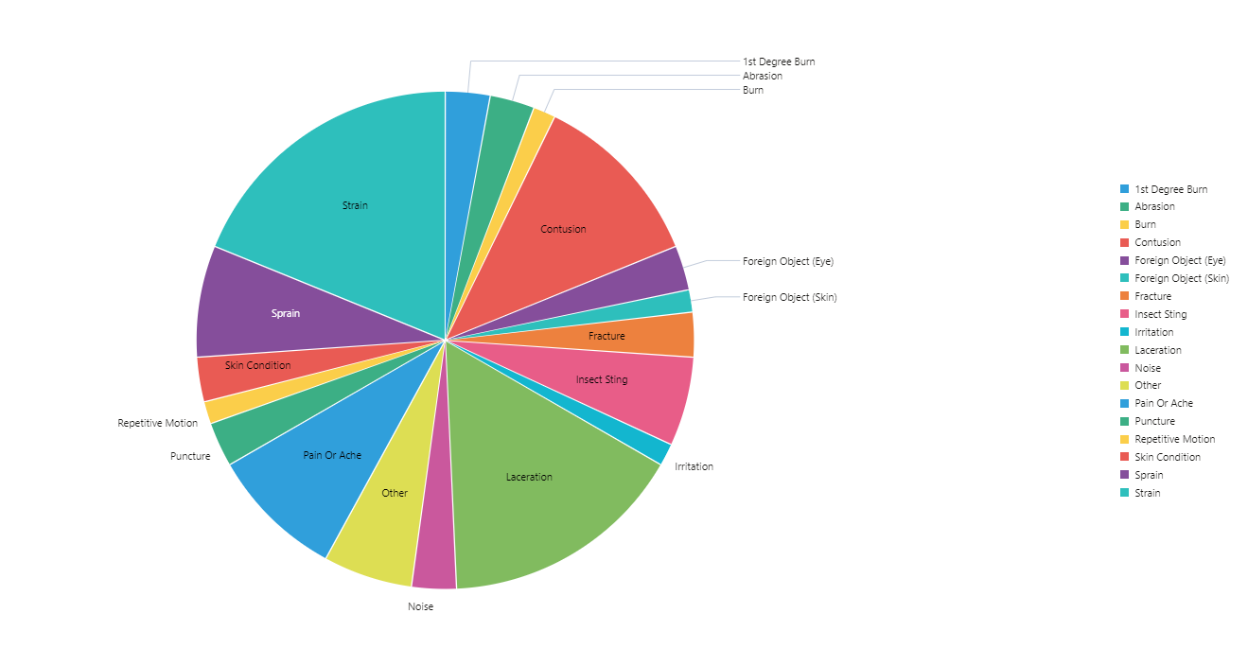
Injury Statistics (Injury Type)

Slide 7
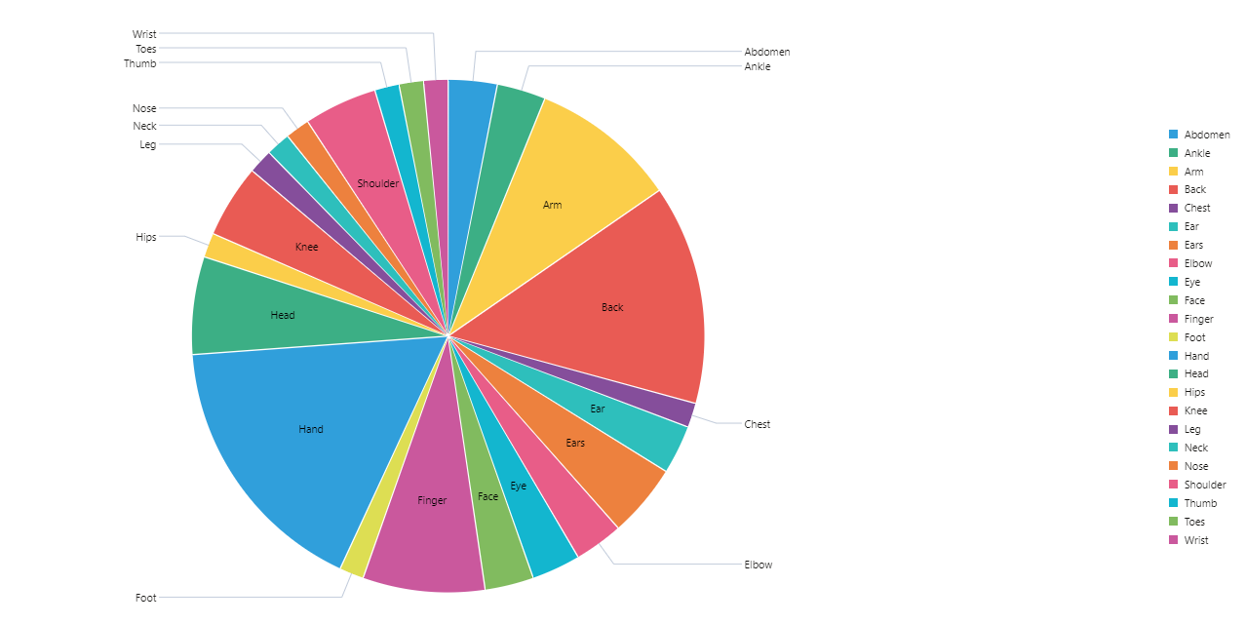
Injury Statistics (Body Part Affected)

Slide 8
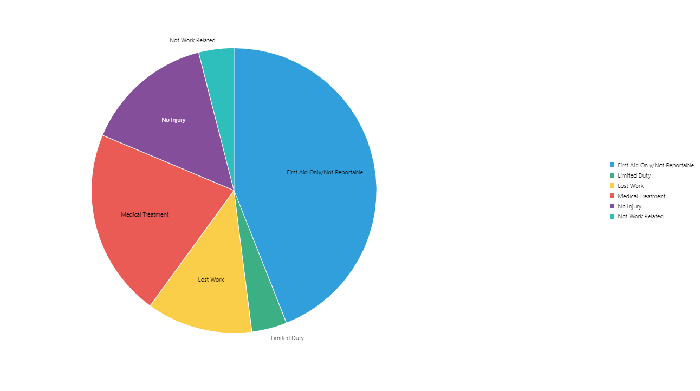
Injury Statistics (Severity)

Slide 9
SA and Complacency

