Slide 1
Electronics/ASICs FY24 Estimate
Requesting labor and travel for groups that provided input.
0.2 FTE total labor engineering effort.
Travel for engineers and PIs.
Highest priority technical work for FY24 includes:
28nm IP development
MAPS development
FNAL ONLY REQUEST

Slide 2
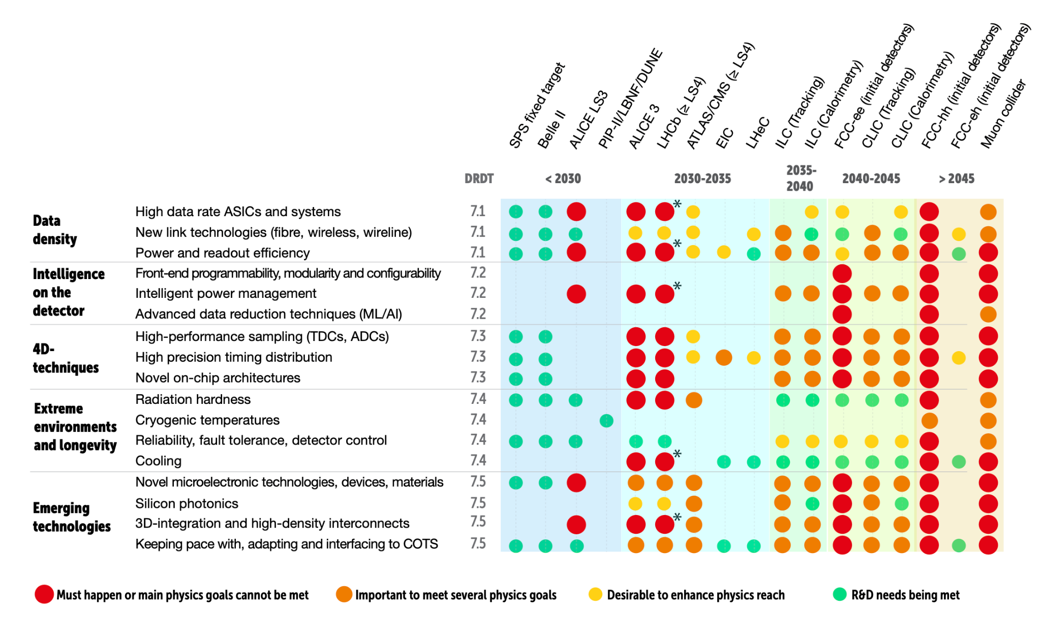
Electronics/ASICs (J. Gonski, J. Hirschauer)
Significant R&D thrusts/areas
Increased data density (eg. high data rate ASICs, power management)
AI/ML on detector (FE programmability, data compression, fast ML)
Milestone: 28nm ASIC with reconfigurable/GPU capabilities
4D/5D techniques (high performance sampling, precision timing)
Milestone: demonstrate O(1) ps resolution?
Extreme environments (already satisfied for FCC-ee)
Emerging technologies (3D integration, silicon photonics, open source fab/dev)
Milestone:
Monolithic sensor ASICs (CMOS MAPS)
Milestone:
ECFA DRD Roadmap Fig 7.1

