Slide 1
9 AM Meeting
Keymonty Bullock
MCR Crew Chief
Wednesday July 10, 2024

Slide 2
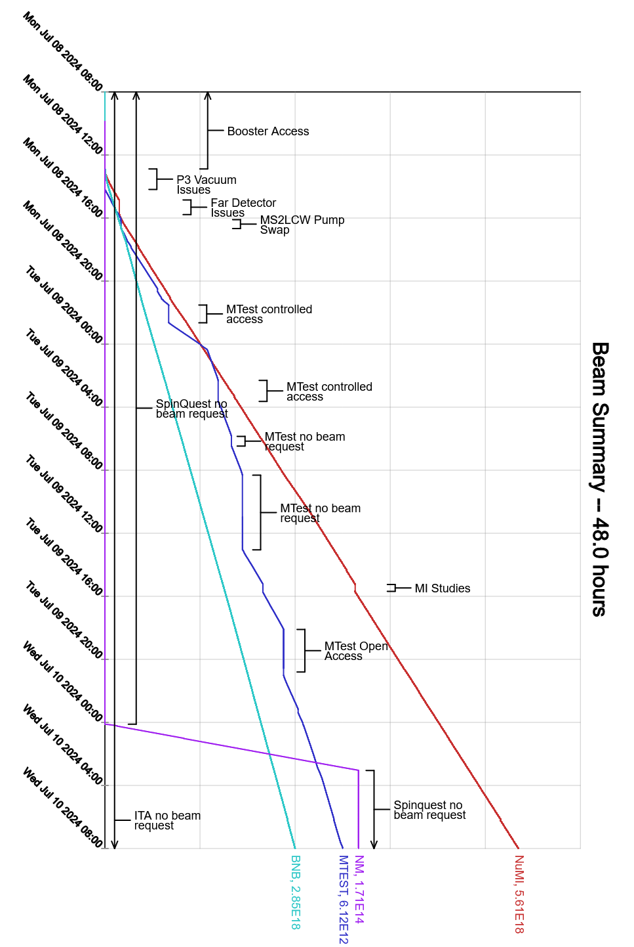
Since Monday…
Booster prepared for access
Work finished around 10:30am and beam was established near 1:00pm
Muon Campus Extraction enclosure prepared for access
Work was completed near 7:00am on Tuesday
Beam to NuMI, BNB

