Slide 1
UPDATES – Coils – Power Supply and Water Cooling
Wes Craddock July 12, 2024

Slide 2
Coil Connection & Heat Load
All Six Coils are Connected in Series
Advantages:
Most compact arrangement when considering power supply and cable runs.
Cheapest option – Only 1 supply instead of multiple supplies
Higher efficiency
Safer and easier to analyze safety with one supply
Power and Voltage at 60 C (without contact resistance)
Center Coil: 8.63 kW and 2.30 V
Outer Coil: 7.2 kW and 1.92 Volt
2 Center Coils + 4 Outer Coils: 46.1 kW and 12.3 Volt
Add in 20% for contact resistance: 55 kW and 14.8 Volt
At 10 Mpa (1450 psi) a silver plate contact has 6 micro ohm of resistance = .023 ohm.
4 Corners X 8 layers = 32 joints = .74 volt compared to design of 2.5 volt

Slide 3
POWER SUPPLY
Magna-Power TSD-4000-25
4000 Amp at 25 Volt --- Able to run continuously at rated current and voltage
Integrated in a cabinet 28” high X 19” wide X 24” deep
Selected with Ethernet LXI TCP/IP (+LXI)
Air Cooled at 85% efficiency at operating current/voltage = 7 kW reject heat
Includes internal 480 V 3 phase contactor
When shut off current continues to flow through power supply
Have STEP file of the power supply
Ripple 40 mVrms
160 Amp input current per phase
Made in America
COST $53,185

Slide 4
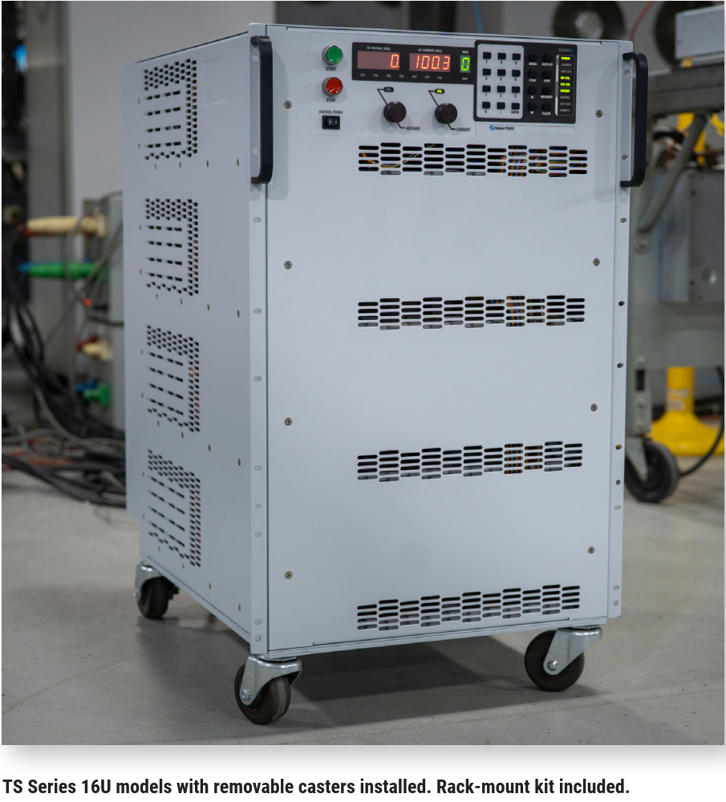
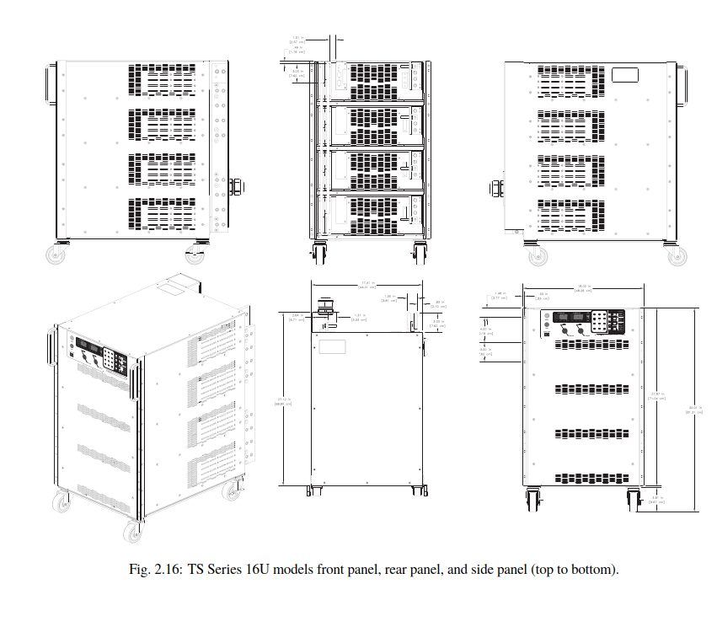
POWER SUPPLY
Magna-Power TSD-4000-25

Slide 5
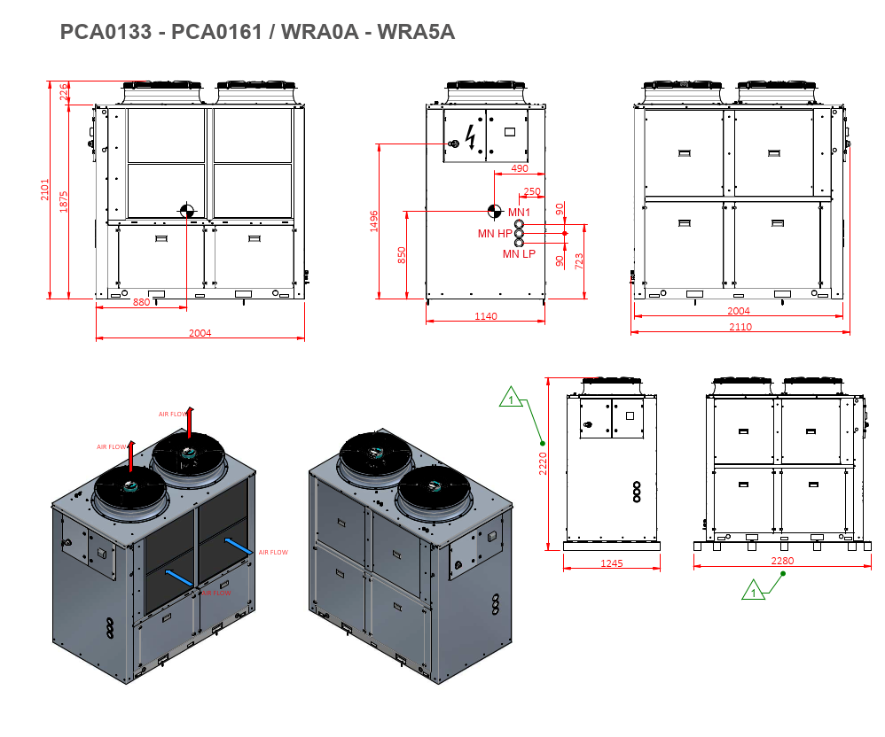
WATER CHILLER
NORDIC PCA 0161
81.7” high X 45.3” wide X 81.3” deep
COST $40,604
59 kW Cooling Capacity
460 V 3 phase 38 FLA
68 psi max head pressure
Min/Max Flow 13/52 GPM
Max return flow temperature < 60 C
Power consumption 14.3 kW
Proposal: Mount at fixed location and use quick disconnects with valves
Should look at other companies

Slide 6
OTHER UPDATES
Will receive a 4” X 4” x 1.5” thick water jet sample from Ayers Water Jet showing quality level 2, 3 and 4 cuts. Level 3 is the standard and is what we were quoted. Shawn Ayers stated the water jet cuts can cut even through gloves. Level 4 is the nicest cut but also the most expensive.
For the cooling plate extrusions, Texas Extrusions told me that the request job is too small for them. There max extrusion die is 60” diameter. They referred me to Coast Aluminum who can bundle orders. Texas extrusions estimated that the die cost would be $3000 to $4000. They also suggest (and I agree) that the cooling groves should be incorporated in the die for essentially no extra cost.
Still working on the coil thermal modeling.

Slide 7
Last Week Slides

Slide 8
Water Jet Cutting
Other Choice: North Shore Steel Co. Houston TX
Waiting for quote – Expected soon
Farther away than AyersTech, but has railroad yard adjacent to plant. Could, therefore, be cheaper based on handling costs.
Water jet cutting tables with sufficient length and width are scarce. Nucor Steel is also looking for big table sizes in the Kentucky to Chicago area.
Contacts: Tristan

Slide 9
Coil Manufacture and Design
PROPOSED BASIC CONCEPT – Modification of Minos
Use solid ETP 110 copper instead of water cooled aluminum
Use Marco’s dimensions for overall size (six conductor wide X 8 layers tall with each conductor 1” X 1.5”)
Form the long length planks from 6 bars. These bars will have rounded corners and will be skip tack welded together. They may also be connected by several bolts going through all 6 bars.
1/8” Thick G-10 sheets between layers (This may go down to 3/32” thick G-10)
Joints will be pressed bolted contacts with silver plating.
Aluminum cooling plates down the length of the 12 long sections will replace the water cooled bars in MINOS. Right now only one water cooled plate per long length is expected.
The whole conductor pack will be joined with discrete connections (bands) as per Marco’s concept. The cooling plates will be integral with these connection pieces.

Slide 10
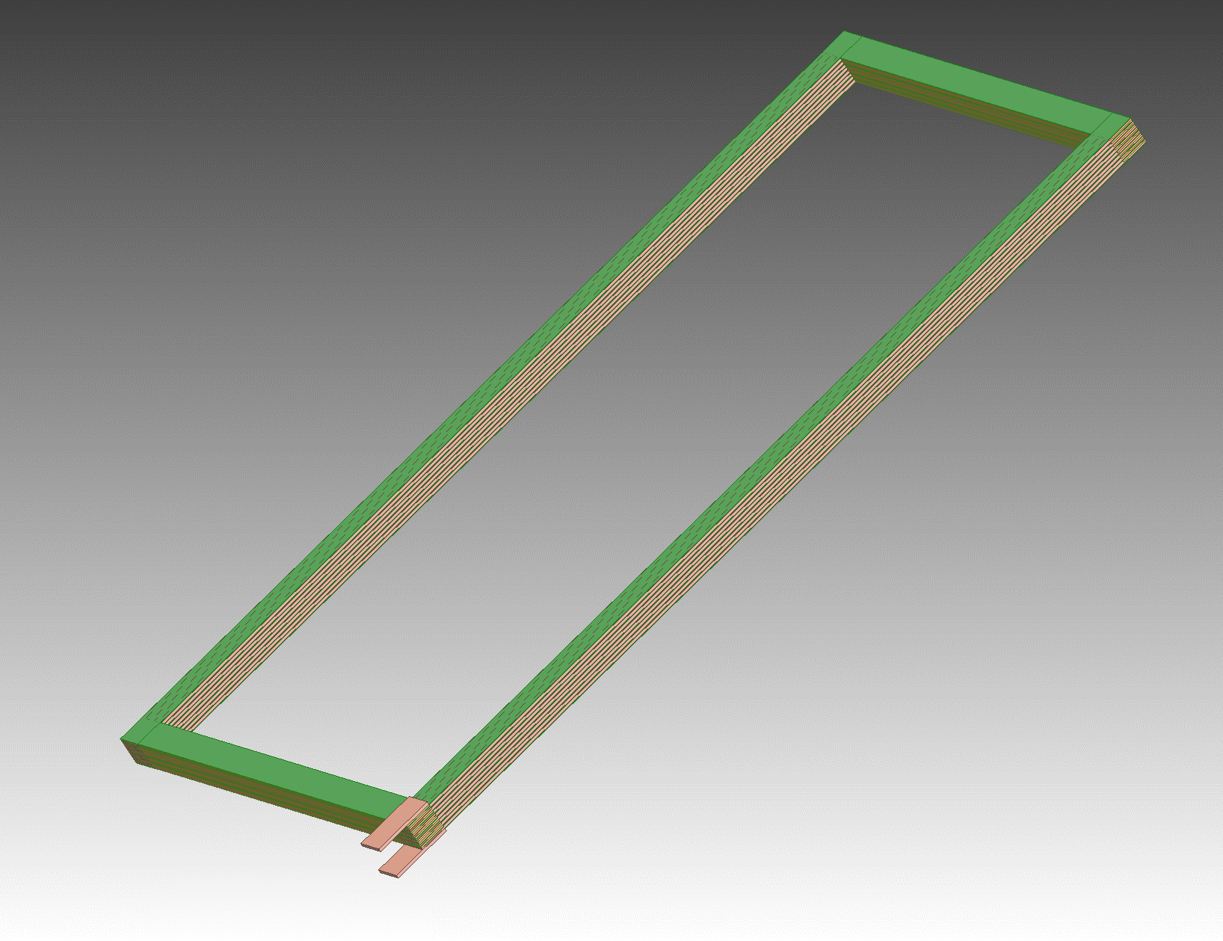
Coil Manufacture and Design
No Corner Transition Pieces Direct Plank to 6 Bar Plank Connections
Green is G-10
Input and Output Terminals

Slide 11
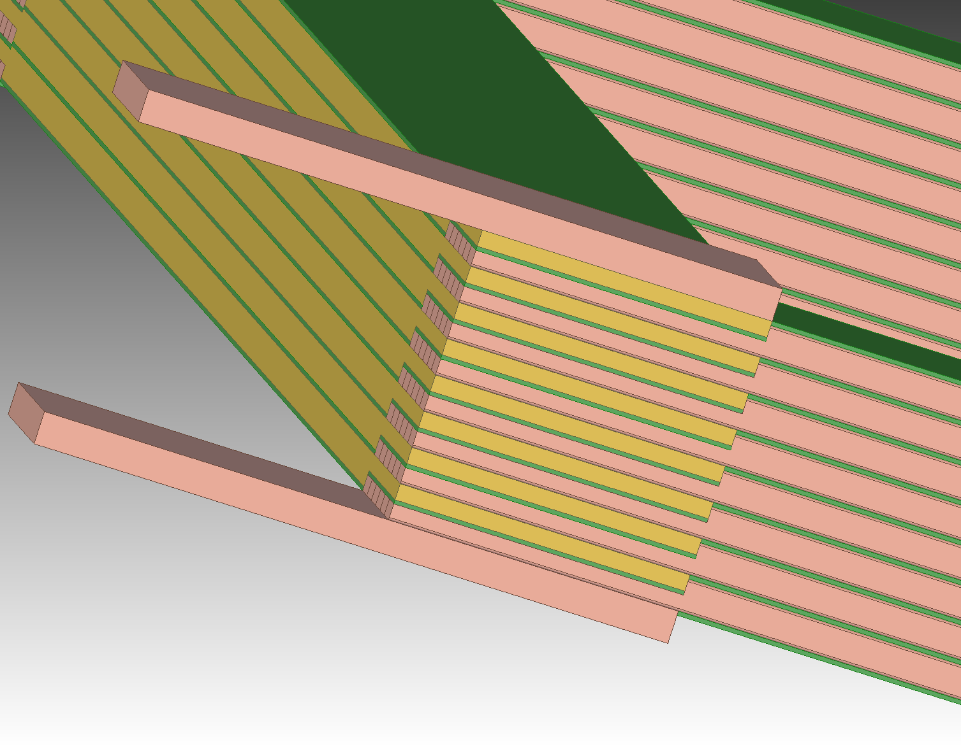
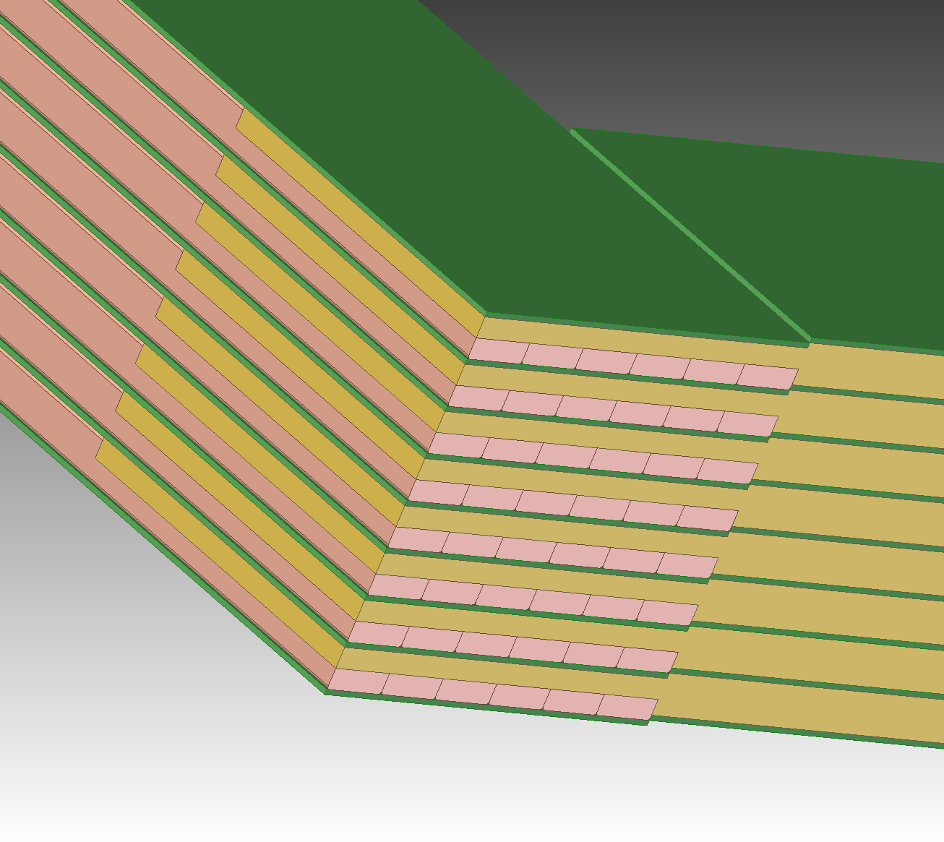
Coil Manufacture and Design
Current Corner Detail
(opposite from Current In/Out)
Current Input/Output Corner Detail
Notice double sided machining on plank end and G-10 step mismatch

Slide 12
Coil Manufacture and Design
Bar Machined End At Both Ends – Bolt holes not shown
Bars Formed Into Plank (Skip welds not shown)
Input and Output Terminals

Slide 13
Need 32 Plates 1” X 9.17” X 71” long
Need 16 Plates 1” X 9.17” X 144” long
Plate Machined End At Both Ends – Bolt holes not shown
Typical at both ends of bars

Slide 14
Coil Manufacture and Design
End Plates at Cross Over on End Opposite to Current Input/Output End
Need 32 Plates 1” X 9.17” X 71” long
Need 16 Plates 1” X 9.17” X 144” long
Plate Machined End At Both Ends – Bolt holes not shown

Slide 15
Coil Manufacture and Design
End Plates at Cross Over on Current Input/Output End
Need 32 Plates 1” X 9.17” X 71” long
Need 16 Plates 1” X 9.17” X 144” long
Need 32 Plates 1” X 9.17” X 71” long
Need 16 Plates 1” X 9.17” X 144” long
Plate Machined Ends
Bolt holes not shown
Typical at other end of bar
Typical at Current In/Out end of bar

Slide 16
Required Plates for 6 Coils
Two Center Coils:
Outside Length = 7.5 m, Inside Length = 7.1 m
Outside Width = 3.65 m, Inside Width = 3.29 m
Need 32 plates 1” X 295” and 32 plates 1” X 144”
4 Outer Coils
Outside Length = 7.5 m, Inside Length = 7.1 m
Outside Width = 1.8 m, Inside Width = 1.44 m
Need 64 plates 1” X 295” and 64 plates 1” X 71”
Total Plates Needed
96 plates 1” X 295” 576 bars
32 plates 1” X 144”
64 plates 1” X 71”
Total Mass of All Plates = 50,480 kg = 111,130 lbs

Slide 17
Coil Manufacture and Design
Vendor for Copper Planks and Bars for Planks:
Copper and Brass Sales -- Division of TKMNA, Thyssenkrup
Copper and Brass Sales functions like a Ryerson -- Sourcing materials from manufacturers and machining from outside vendors (Some in house machining?)
Waiting for quote – Expected soon
Bulk ETP copper price = $7.50 /lb
Can only supply in ETP copper bars without purchasing oversees. Length is the issue.
Will supply end planks in ETP copper. Maybe possible to get OFHC in US through Revere. Revere is the big gorilla for copper in the US.
No luck in contacting Luvato for OFHC Copper. I never had luck in contacting Luvato.
Contacts: Glenn Kreis (local and very eager to get this PO)

Slide 18
Coil Manufacture and Design
ETP vs OFHC
ETP copper is 90% of the electrical copper used in the US.
ETP is much easier to get
ETP has the same electrical conductivity as OFHC
OFHC is much easier to weld and braze
ETP is a bit easier to machine than OFHC
ETP has oxygen in it. This makes welding and brazing more difficult. A TIG welding/brazing method will be used. Silicon-bronze and other alloys are recommended.
Need to buy ETP samples with different filler rods and have Bob Conley try them out. Material cost ~ $400 and 1 day of Bobs time.

Slide 19
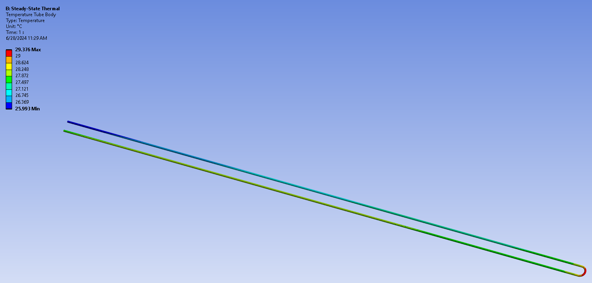
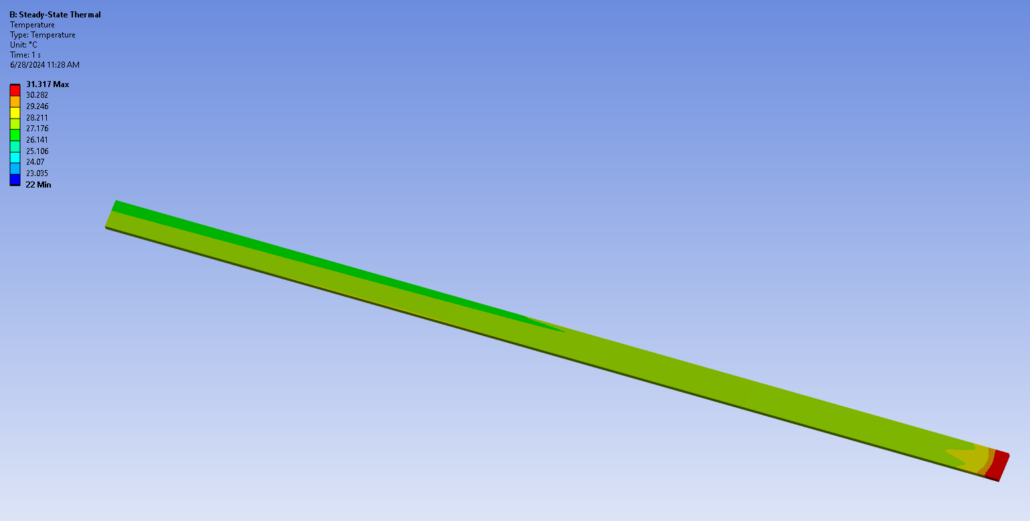
Coil Thermal Analysis
ANSYS thermal analysis aluminum bar with 1 pass 5/8” OD copper tubing using thermal flow element 116.
Heat flux on one surface of aluminum cooling plate of center coil = 3750 watts with 3 GPM water at 22 C inlet
Result: Max plate temp = 31.3 C, Max Tube temp = 29.4 C, Outlet water temp = 26.6 C

Slide 20
Coil Thermal Analysis
Need full analysis with conductor, G-10 insulator, contact resistance at all surfaces, conductor package side plates, and heat transfer into water.
Can get full length aluminum extrusions from Western Extrusions in TX. Contact is Gary Bacher.
Cold plates from QATS Advanced Thermal Solutions in Massachusetts. They only have a 6 foot bed for milling. So we would or QATS would have to send the plates from Western Extrusion to a larger machine shop. They could press the tubes in full length with one up and back pass. Right now this seems to be a sufficient length.
The cooling plates will be connected in a series parallel arrangement to optimize pressure drop, cooling and ensure the flow is turbulent.
The cooling plates will be part of the structure of the straps going around the coil

