Slide 1
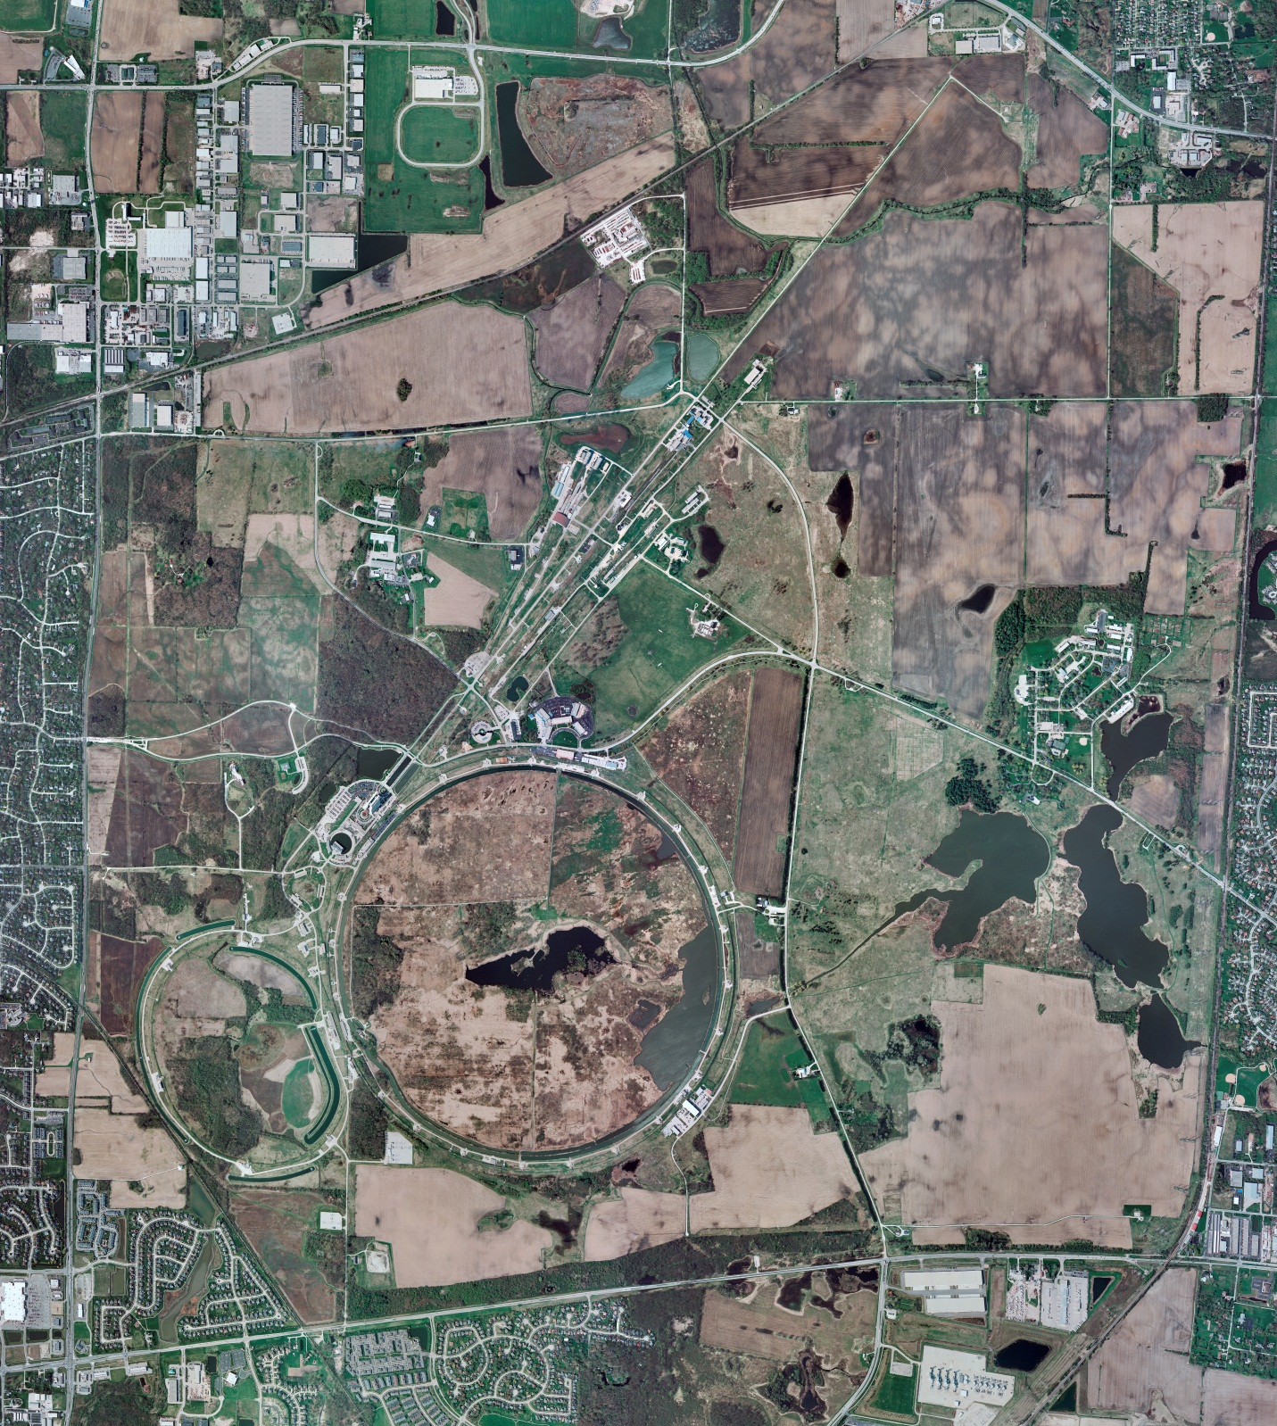
Helium Cryogenics
Status 7/12/2024 J.Makara
CMTF: SCP is cold running fine
CMTS: HECM30 is installed and controlled cooldown planned for next week
PIP2IT: South Stand CM being modified for SSR2 pCM
North Stand CM pHB650 controlled warmup warmup to RT ongoing after completion of RF and cryo heat load studies
MCTF: cryo system cold with 3 comprs and 2 Fridges running fine
MDB/HTS: at RT
MDB/STC: at RT though may be cooled down to 5 K/2K for thermal studies without CM
MDB Magnet: at RT
NML/FAST: Cryo system is shut down and isolated for extended shutdown period;
CC1: at RT
CC2: at RT
CM: at RT
IB1: cryo system operations running fine with Cti CB.
Muon Campus: at RT with comprs off and system depressurized; LN2 off
Misc:…

