Slide 1
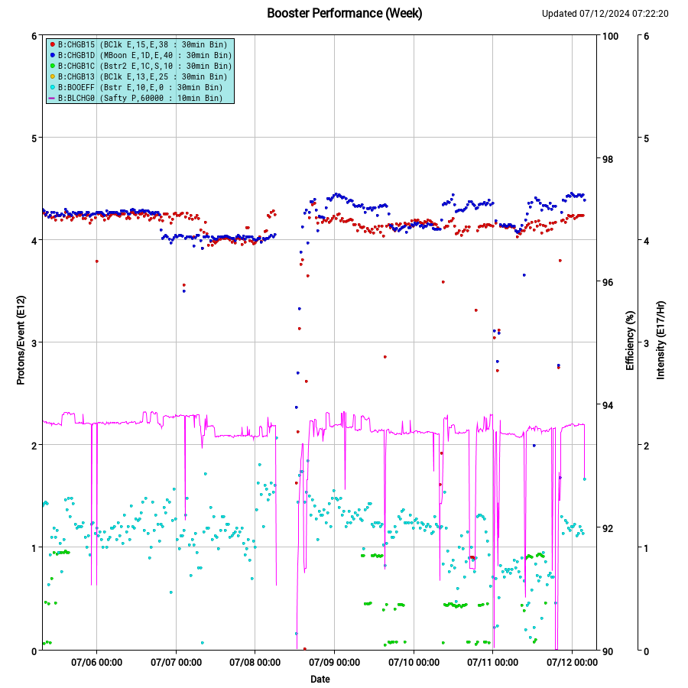
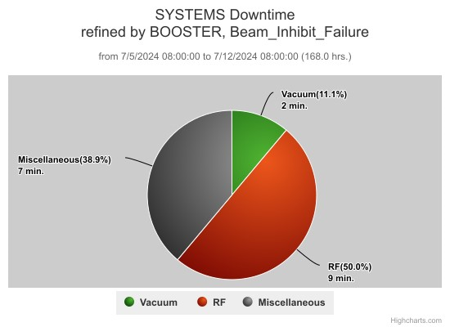
Booster Operations
End of run conditions:
92% efficiency, 2.2e17 p/hr
$15: 4.3e12 p/p
$1D: 4.4e12 p/p

Slide 2
Summary
Friday/Saturday/Sunday:
Parasitic convective instability study
Minor vacuum trips IPRF21, IPQ16, IPDEB2
Periods of high extraction losses, tuning by expert and Ops
Monday:
Controlled access
Relocated GMPS voltage tap
Rad Survey
LCW leak hunt
2 leaks found: Q15 sprayer and Girder 1-2 manifold ☹
Thursday:
BNB bunch rotation study (repeat)
Parasitic Linac energy/debuncher phase study
Parasitic Injection matching study
Friday:
Controlled access to move GMPS voltage tap again
PESD LOTO of power supplies before configuration control lockout
Thank you to Ops and the support departments your support during the run!

Slide 3
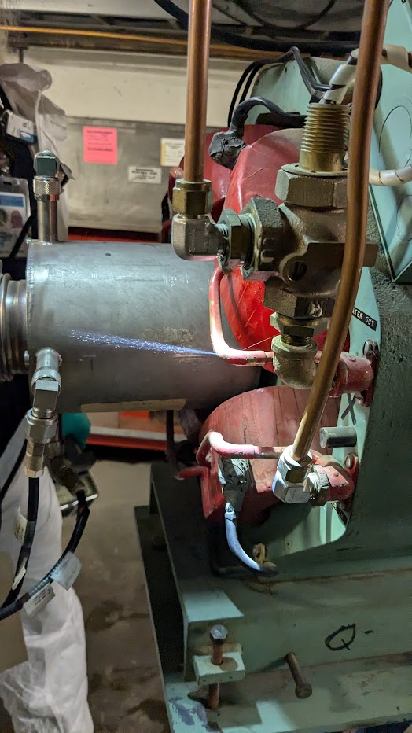
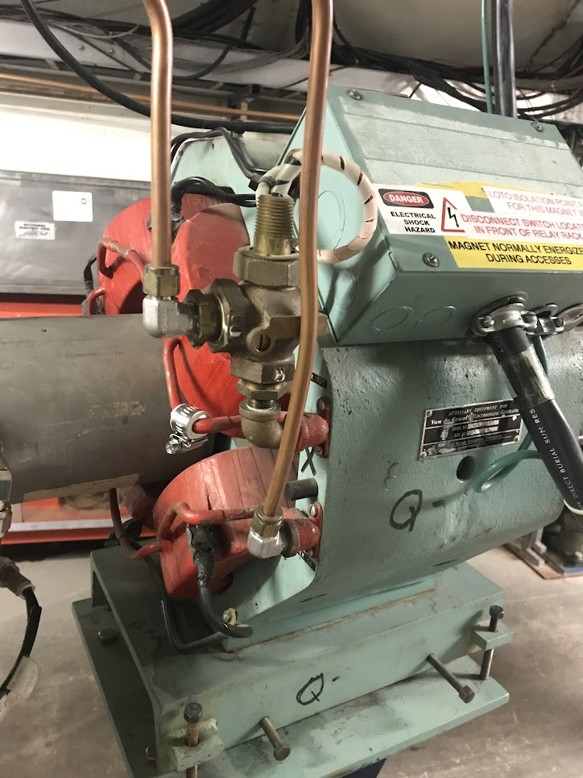
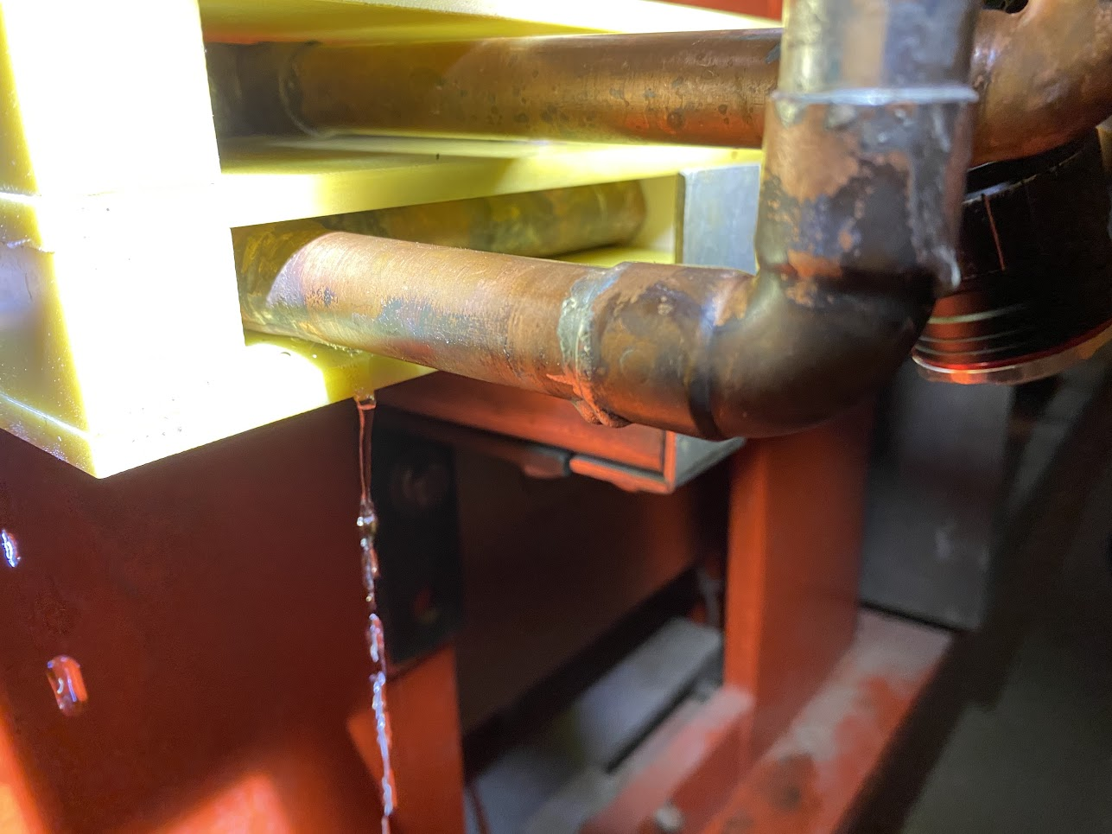
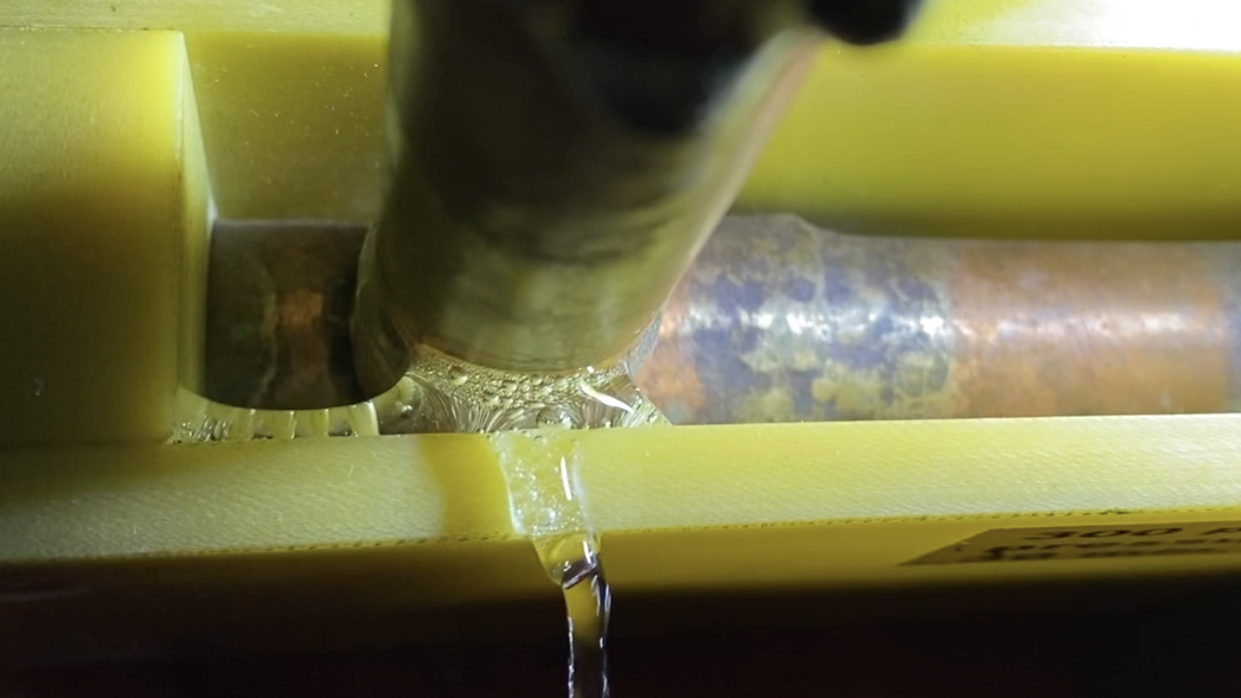
Leaks
Girder 1-2 manifold
Q15 400 MeV line

Slide 4
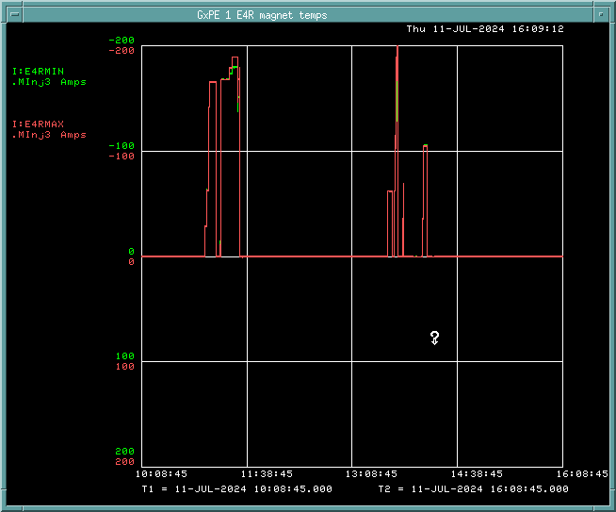
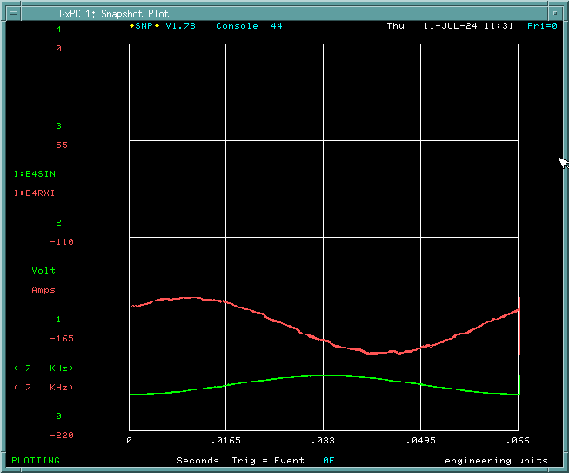
E4R Gradient Magnet Test Stand
Magnet girder powered for first time!
First DC, then 15 Hz at reduced power
Problem with PLC faulting off, also current readbacks are wrong polarity
Next steps:
Fix issues discovered
Install frequency filters and magnetic probe equipment
ORC addendum
15 Hz measurements

