Slide 1
Muon Campus Operation Report
Jim Morgan
Friday 09:00 Operations Meeting
July 12, 2024

Slide 2
Muon Campus status
Beam studies on weekdays over the past few weeks (including low-tempo period)
Used both ESS1&2 for resonant extraction
Septa voltages during studies: ESS1 increased from 60 kV to 85.7 kV, ESS2 56 kV
Aligned ESS1&2 to reduce losses and improve transmission to M4 Line
Continued trying to get Delivery Ring BPM Snapshot frames working
Commissioned Abort clean-up, timed in kicker and pulsed septum
Got first M4 multiwire profiles during resonant extraction (already had PWC’s)
First turn extraction study using motion-controlled quads
Extraction sextupole characterization using TBT data
Delivery Ring dispersion and lattice measurements
AP-30 rad measurements during resonant extraction
Mu2e Extinction Monitor test set-up in M3 Line
Worked on getting useful spill signal from M4 Line Wall Current Monitor
D:V907 breaker trips, will need repairs during shutdown
Extraction Enclosure Controlled Accesses on Monday and Thursday morning
Pre-amp installation on M4 Line Wall Current Monitor
Second pre-amp (60 db gain) gave useable signal
Study – M1-M3 Optics
Study – Alternative M5 optics

Slide 3
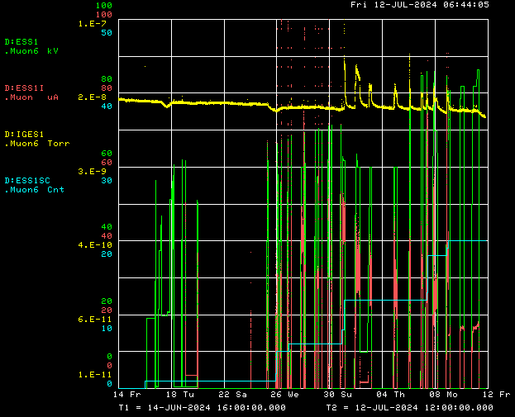
ESS1 during Conditioning and beam operation
Design Voltage
ESS1 ion gauge
ESS1 voltage
D:ESS1 current
Spark counter

Slide 4
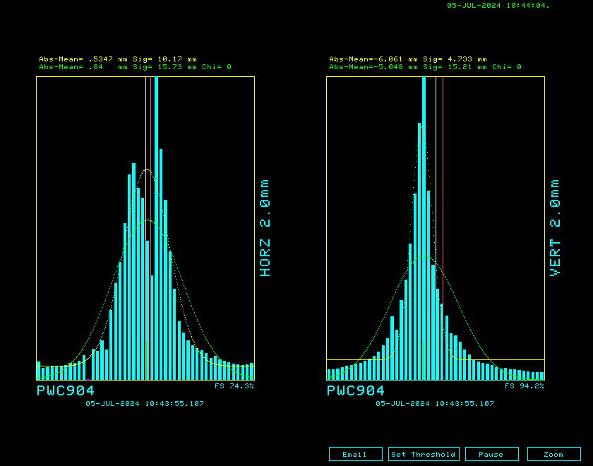
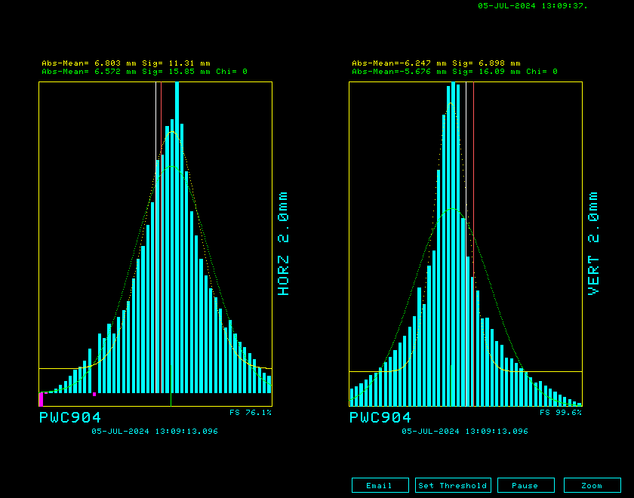
PWC904 before and after ESS2 alignment

Slide 5
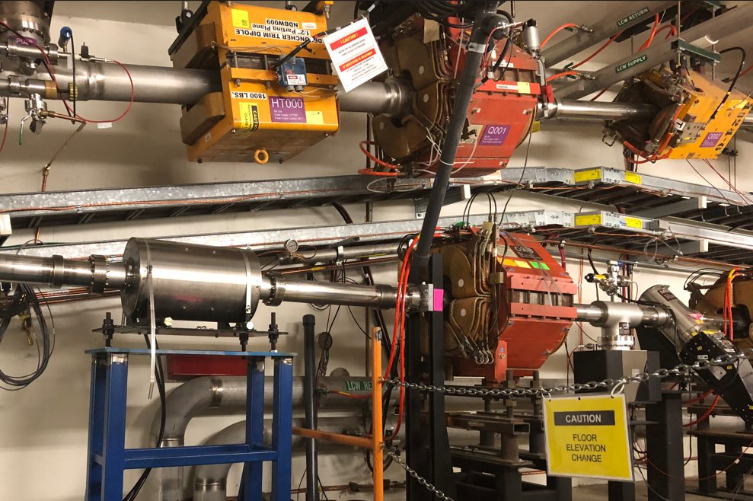
M4 Line Wall Current Monitor
M5
Wall Current Monitor
M4

Slide 6
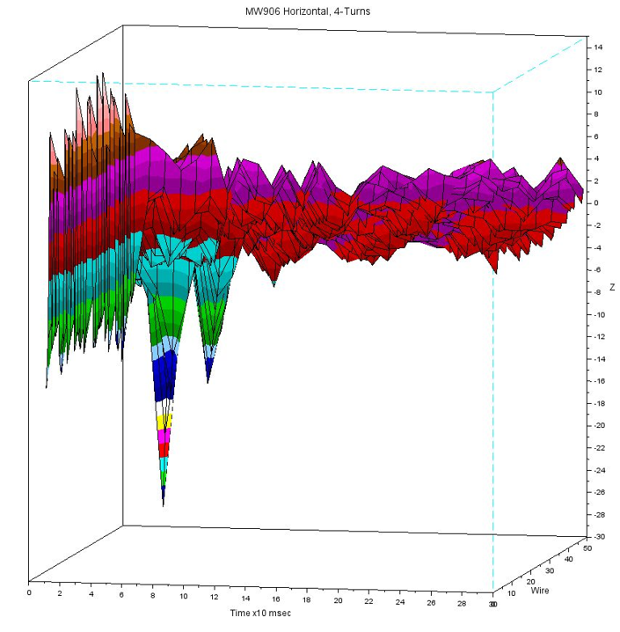
MW906 over time and M4 WCM response

Slide 7
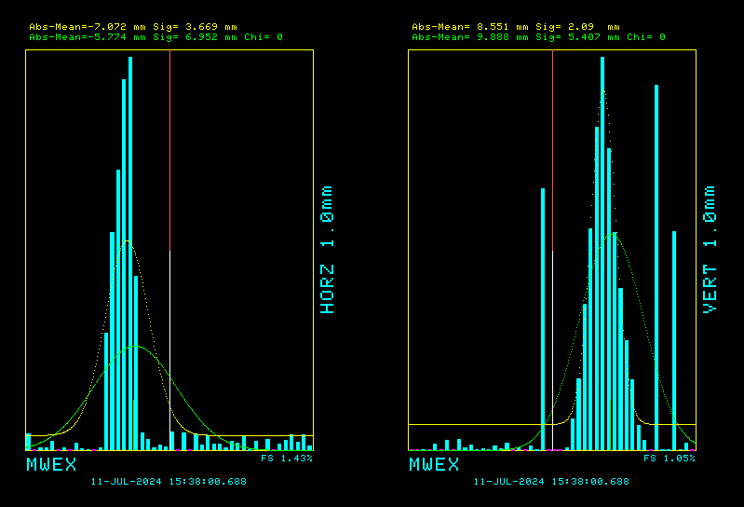
Multiwires during resonant extraction!
MW903 with scanner in tunnel

Slide 8
Upcoming work
Transitioning to shutdown configuration
Power supplies have been turned off, LOTO to be completed by Monday
Radiation survey when RCT’s have time, go into Supervised Access
Re-core Delivery Ring, Extraction and M4 Lines to shutdown keys
Some issues to resolve this summer, identified during studies
Need to further improve monitoring of resonantly extracted beam
D:Q730 needs larger breaker and wiring to run at nominal current
D:V907 needs to have panel breaker replaced
Need to check sizing of all power supply panel breakers
ELAM downstream horizontal motion at limit before reaching nominal position
Need to fix motion-control issues with ESS stands
Hope to finish Operational ESS2 and install it in tunnel
ESS2 (operational version in A0 Clean Room)
ESS2 cathode final polishing next, paused while evaluating method to use
After cathode polishing is complete, then component assembly into tank
Muon Campus Feeder 24 outage on Wednesday
AP-0 A/C controls sub-contractor is supposed to return soon
Jerry Annala is Muon Campus Shutdown Coordinator, I’m his back-up

