Slide 1
RR/MI status
Rob Ainsworth
Ops Meeting
12 July 2024

Slide 2
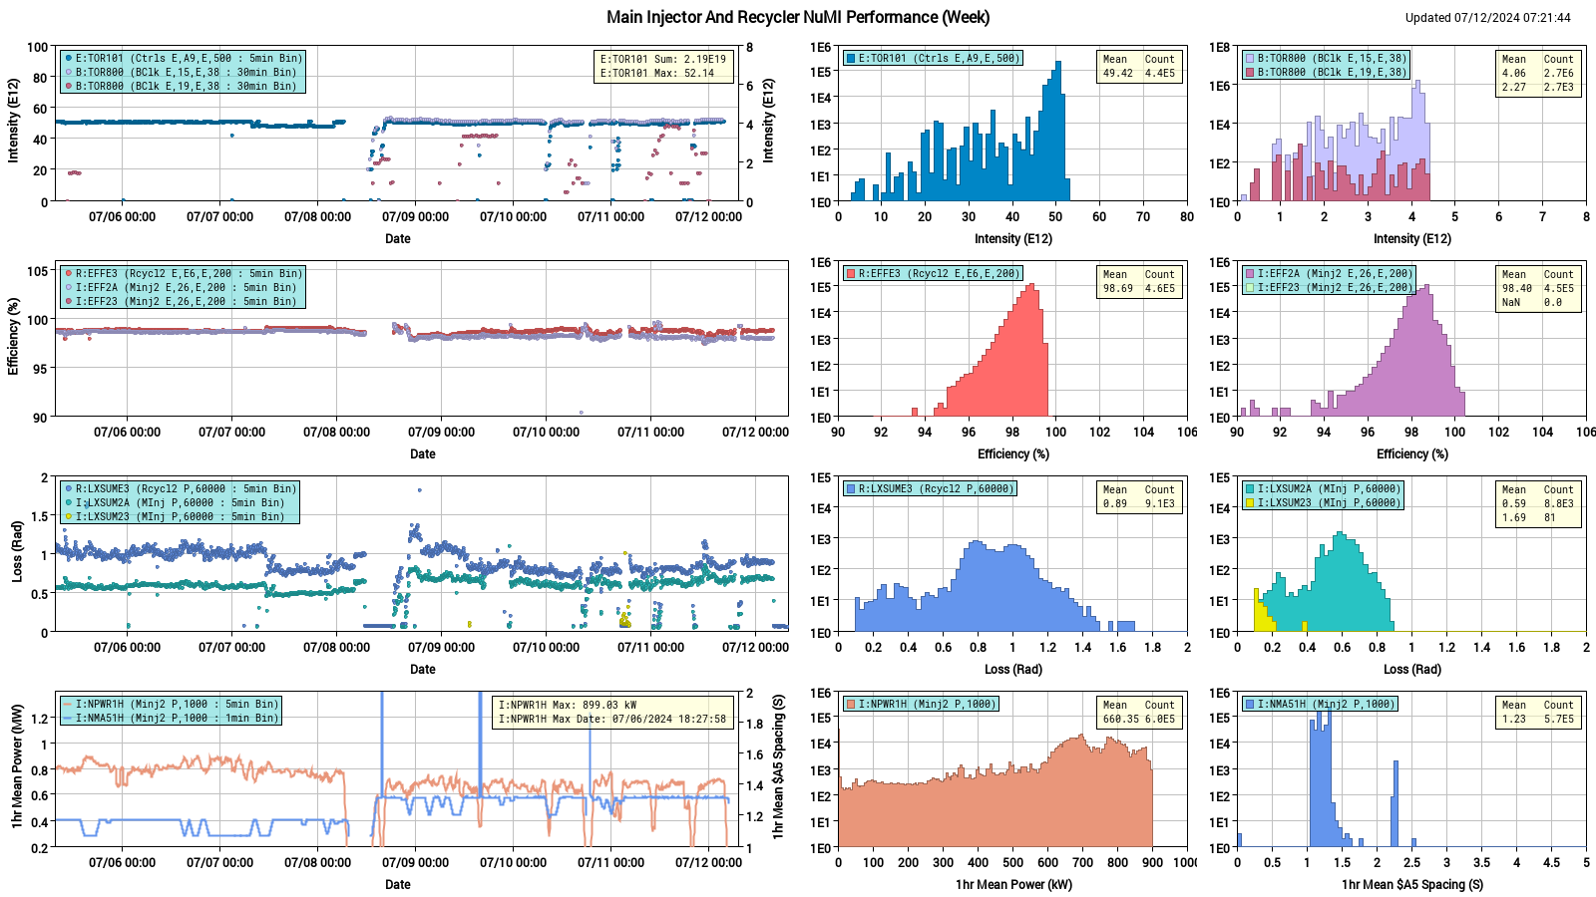
NuMI

Slide 3
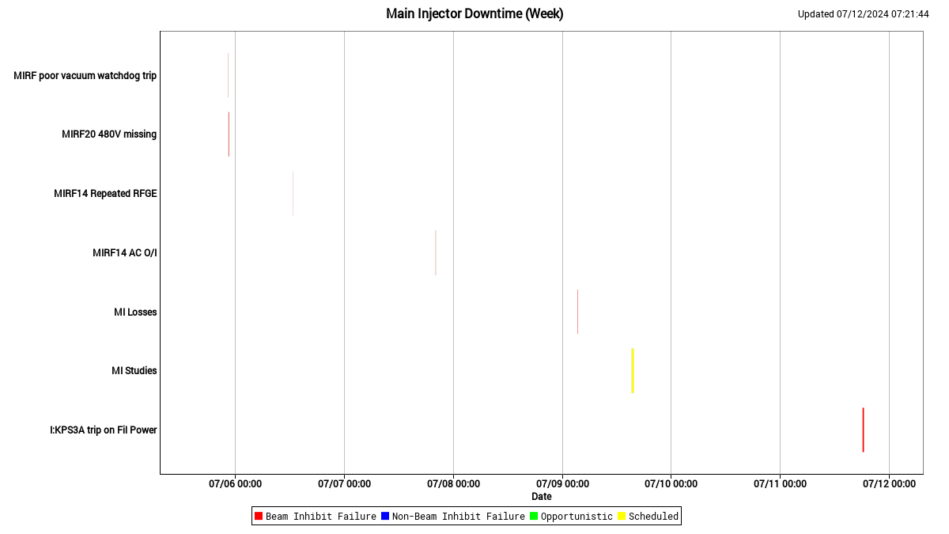
MI downtime

Slide 4
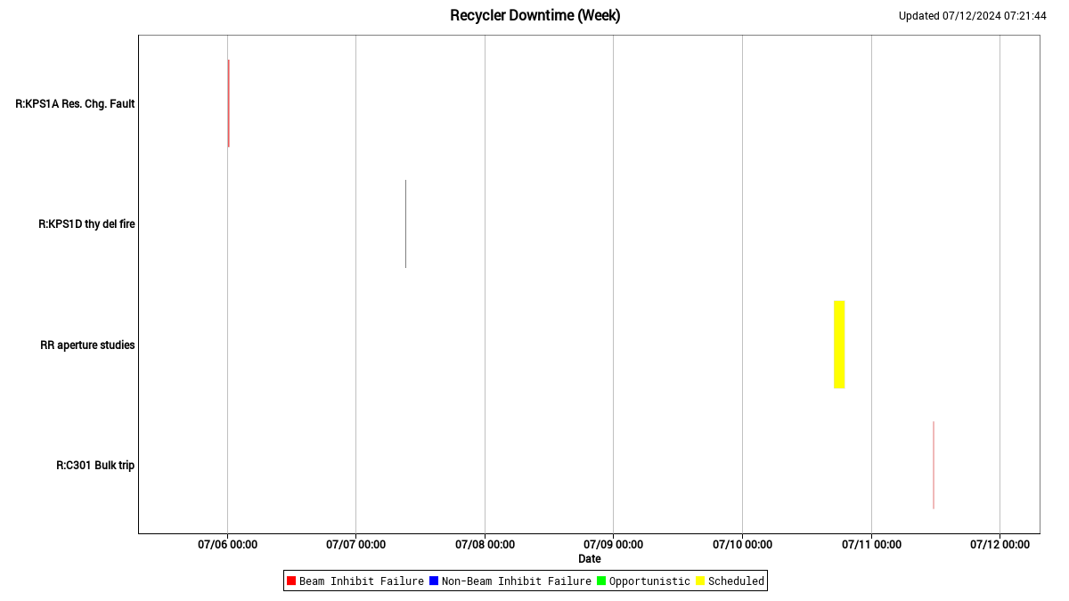
RR downtime

Slide 5
Summary
Good run
Achieved 1MW
Good progress in understanding major loss obstacle in RR (30 straight section)
10 weeks to next study requests! (maybe)

