Slide 1
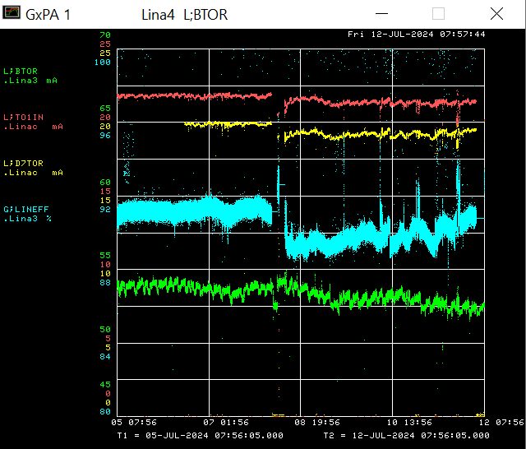
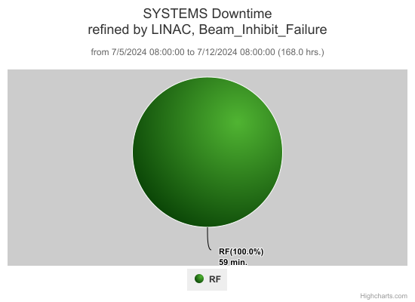
Linac/Preacc Operation July 8th – July 12th 2024
Monday & Wednesday – The 7835 at LRF 3 was sparking internally.

Slide 2
Linac/Preacc Studies
Test for skew terms in MEBT
Verify d_{x} per d_{I} for MEBT/DTL/SCL correctors
BSM measurements with changing buncher &DTL phases
Cavity phasing (1 at a time)
PMT studies
Longitudinal corrections testing
Multiwire scans for
Quadrupole scans
Linac Baseline
PIP-II HLA prototype testing
Maintenance Activities
Bulk Tuner Study
Clean up cabling at LRF
Investigate RF noise on LE QPS regulation

