Slide 1
9 AM Meeting
Keymonty Bullock
MCR Crew Chief
Friday, July 12, 2024

Slide 2
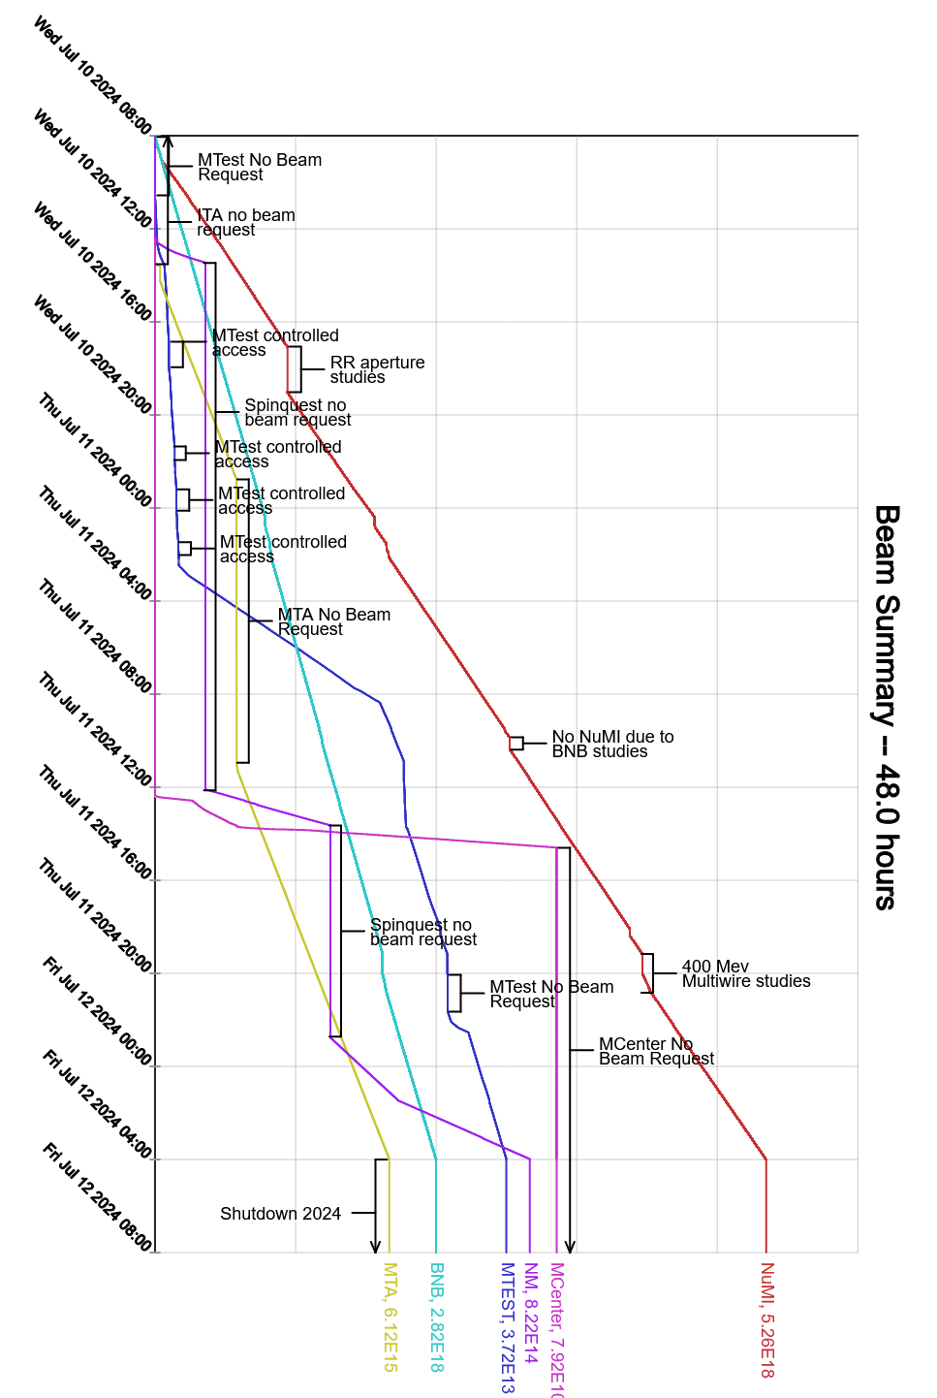
Since Wednesday…
Wednesday/Thursday:
Booster, Recycler, Muon, SpinQuest studies throughout the day
Beam to NuMI, MTA, BNB, Mtest, Mcenter, SpinQuest
Friday:
PESD will be in contact with operations regarding the status of LOTO for the complex
CUB Module swap underway
Shutdown began at 0400hrs

