Slide 1


302.4.04 – Cryo-assemblies Horizontal Test
Weekly status report
Guram Chlachidze
Jul 15th, 2024

Slide 2
CA02 test status
Cryo-improvements at TS4 are complete,
  See details here: TS4 action item list - 11_30_2023.xlsx (sharepoint.com)
  Need to close task codes for the cryo-improvement
Stand 4 ORC/Operation status
  Cooldown permit is obtained
  Electrical permit is obtained
Controlled cooldown in progress

Slide 3
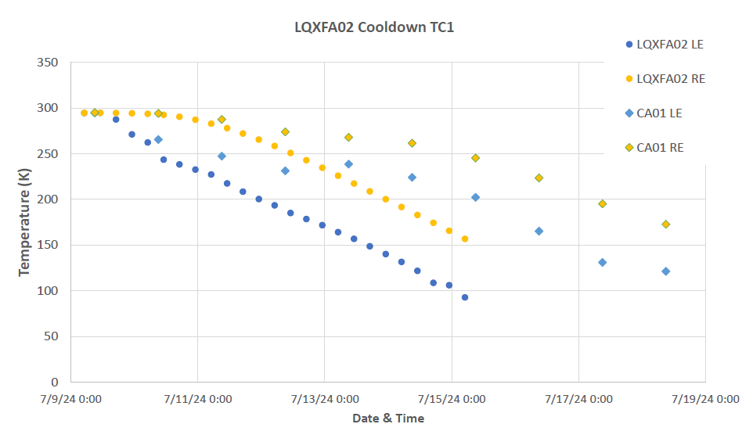
CA02 controlled cooldown

Slide 4
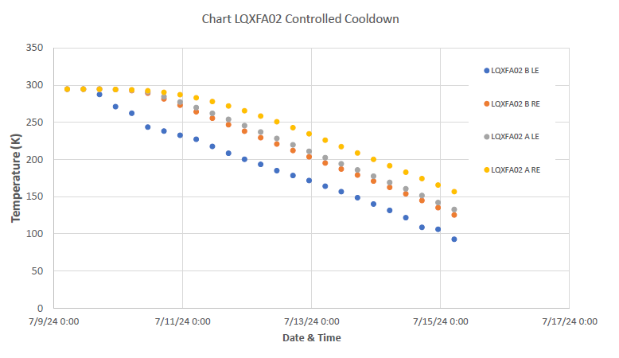
CA02 controlled cooldown (2)
∆T gradient is about 25-30 K in magnet A and 35-45 K in Magnet B

Slide 5
Next Steps
QLM verification with shorted bus
Data checkout
Test of 4.5 K overnight operation
Next steps following the Run Plan

