Slide 1
Cassette SiPm’s box
Cables temporary storage
≤ 100 mm ?
3.2 m
≤ 100 mm
3 m

Slide 2
Cassette envelope vs. Magnet

Slide 3
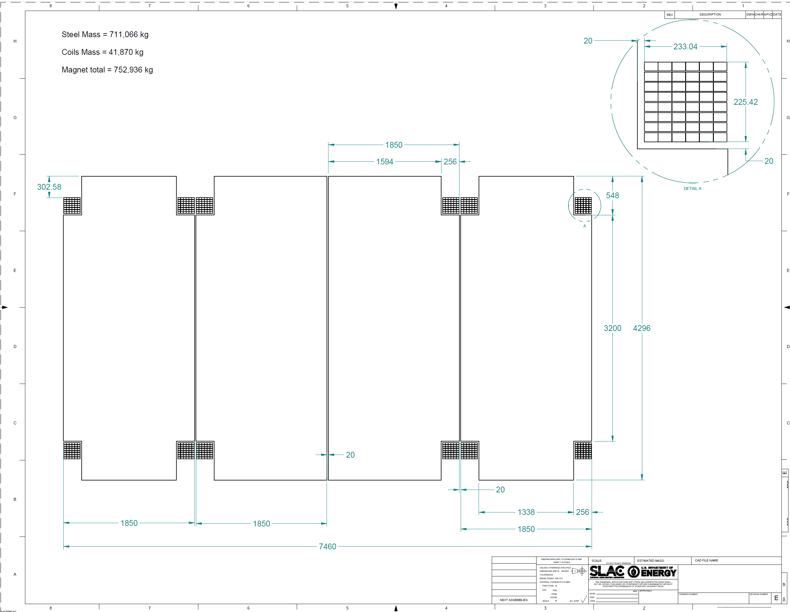
Increase to 3,300 mm minimum

Slide 4
Detector assembly parameters
Installation clearance
Installation clearance (unrealistic !)
Steel mechanical tolerance
(ASTM 6 predict 11mm at the best)
Steel mechanical tolerance
Rails
Steel
5
2.5
25 mm
2.5
5
Steel
Cassette
Rails
40 mm(nominal air gap)

Slide 5
ASTM A6

Slide 6
ASTM A6 Tolerances - Thickness
15 mm
± 380 um
40 mm
± 760 um

Slide 7
ASTM A6 Tolerances – Length and Width
19 mm
25.4 mm
28.6 mm
31.9 mm

Slide 8
Low Carbon - Flatness
± 25 mm
15 mm
40 mm
± 22 mm

Slide 9
Supplementary Requirements Flattness
The following standardized supplementary requirements are for use when desired by the purchaser.
Those that are considered suitable for use with each material specification are listed in the
specification. Other tests may be performed by agreement between the supplier and the purchaser.
These additional requirements shall apply only when specified in the order, in which event the
specified tests shall be made by the manufacturer or processor before shipment of the material.
± 12.5 mm
15 mm
40 mm
± 11 mm

Slide 10
Summary - ASTM A6
 | 15 mm | 40 mm
Thickness | ± 380 um | ± 760 um
Length | 19 mm | 28.6 mm
Width | 25.4 mm | 31.9 mm
Flatness | 25.4 | 22 mm
Enhanced Flatness | 12.5 mm | 11 mm

