Slide 1
Track Matching Update
TMS Studies Meeting – Kate Hildebrandt
7/26/24

Slide 2
Track Matching Study
Looked first at the relationship between different truth variables
True LAr end position vs. true TMS start position (X, Y)
True LAr end momentum vs. true TMS start momentum (X, Y, Z)
Looked at the relationship between true and reco variables
True vs. reco TMS start position (X, Y)
Looked at the relationship between true and extrapolated LAr end position
There is not a reconstructed LAr end position, so instead I used the reconstructed TMS start position and direction, and then extrapolated back to find a LAr end position

Slide 3
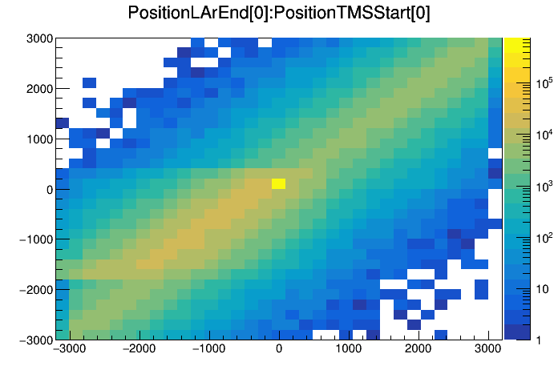
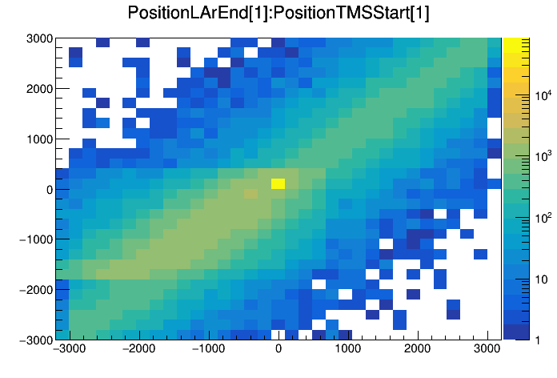
LAr End Position and TMS Start Position
Diagonal structure is what we want to see here
Not sure where the odd rectangular structure in the bottom left quadrant of these plots is coming from
LAr Ending Position
TMS Starting Position

Slide 4
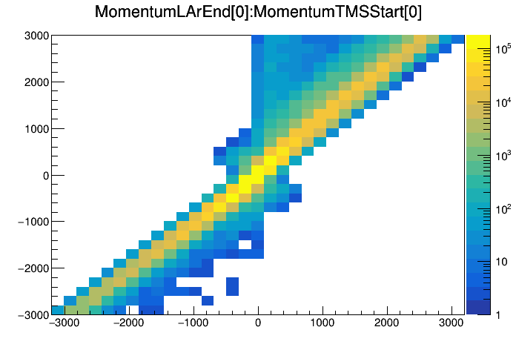
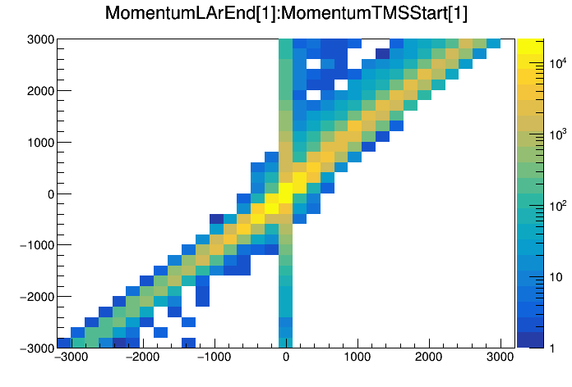
LAr End Momentum and TMS Start Momentum
Off-diagonal portions show lost momentum
LAr End Momentum
TMS Starting Momentum

Slide 5
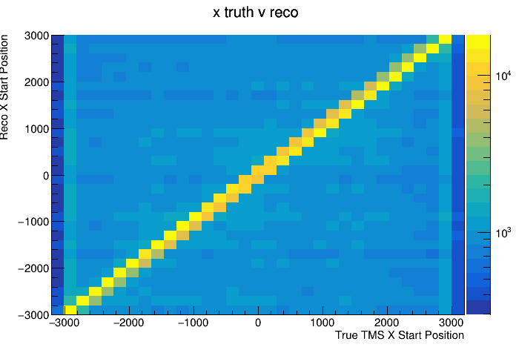
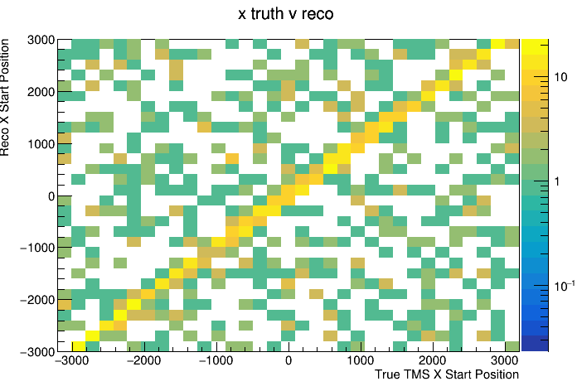
Kalman Filter
Left plot was generated from a file with significantly more events but without the Kalman filter, right plot was generated with Kalman filtered file
The diagonal relationship is what we want to see, as it shows that our truth and reco are matching up well

Slide 6
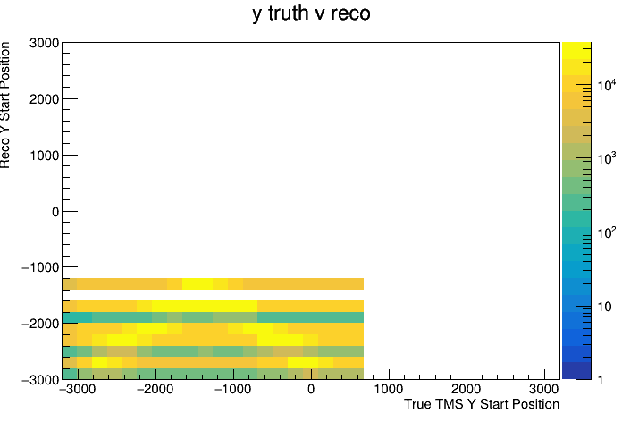
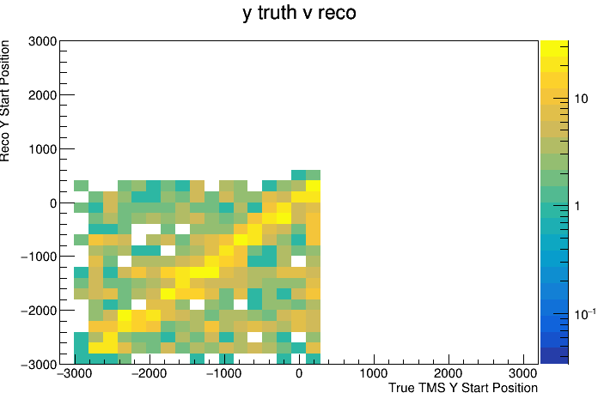
Kalman Filter
Kalman filter gives significantly improved y-resolution
Banding on the left plot (without kalman filter) likely from reco y values being set from bar overlaps in Asa’s reco code

Slide 7
LAr End Position
We do not have reconstructed data for the LAr exit positions, so I used the reconstructed TMS start position and extrapolated back to find a LAr exit position
This is then compared with the true LAr exit position
The first step of this process was to find the distance between LAr and TMS (Δz)
I do not have a geometry file so I did this by finding and plotting the distance between true LAr exit point and TMS start point, and looking for the most common value
The reconstructed starting direction in TMS was then used, along with the Δz value (defined above) to find the Δx and Δy values (distance from true TMS start position to extrapolated LAr end position)
These were then used to find a Δr, which is the absolute distance between the true TMS start position and extrapolated LAr end position
Δx and Δy were then either added to or subtracted from reconstructed TMS start position, depending on the value of the direction variable, to find the extrapolated LAr exit position

Slide 8
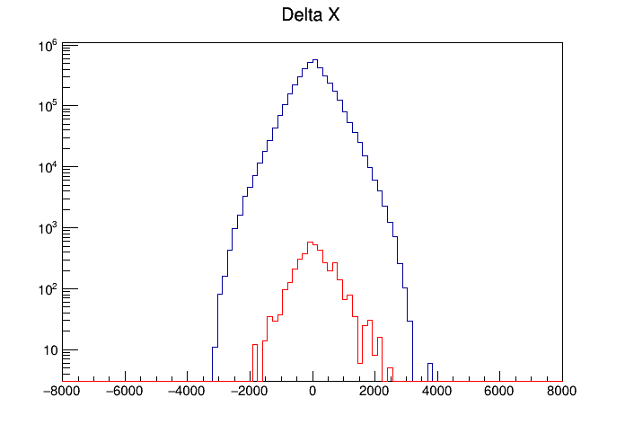
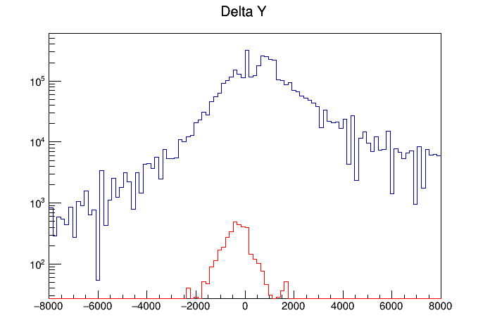
Delta X, Delta Y
Red is Kalman filtered file, blue is non-Kalman file (has significantly more events)
ΔY distribution is significantly wider than Δx, as expected

Slide 9
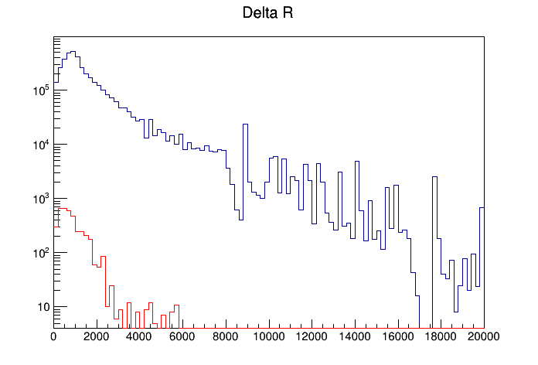
Delta R
Shows the “absolute” distance between true and extrapolated LAr exit position
We see many extrapolated events in the larger (non kalman) file that are >10m away from the true value
Looking into this to make sure these aren’t being caused by some sort of default value or other quirk of the code

Slide 10
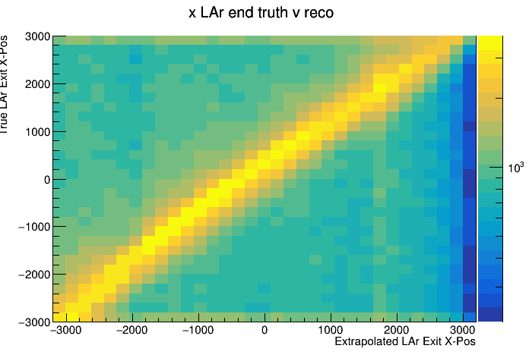
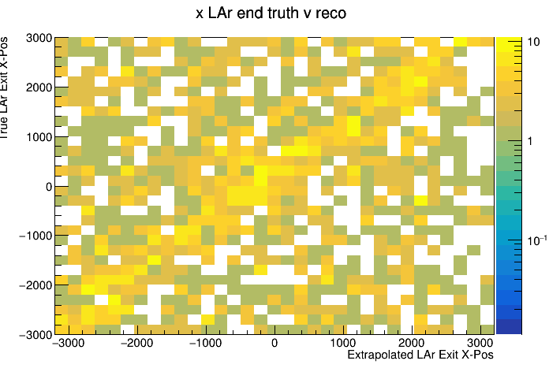
LAr End Position
We can vaguely see the same diagonal structure in the Kalman filtered plot on the right, and I believe it is clearer on the left because of the higher statistics

Slide 11
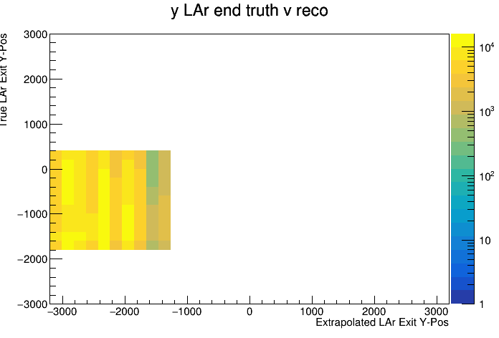
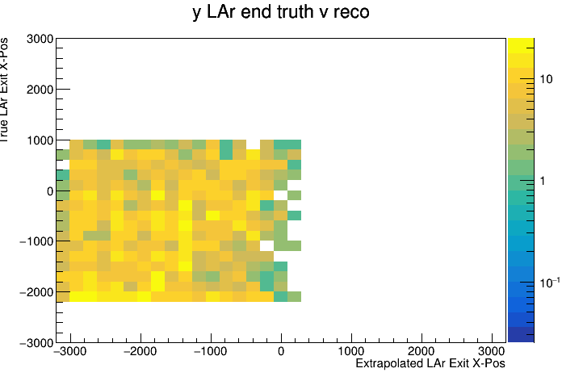
LAr End Position
Neither of these plots look great, but that makes sense when we think back to the wide Δy distributions we saw earlier

Slide 12
Next Steps
Looking at reconstructed TMS start positions and directions individually to check for anything outside of expectation
Plot Δθ, the difference between reconstructed and true TMS start directions
Dig into geometry to find true value of Δz, the LAr -> TMS distance
I’d eventually like to look at a Kalman filtered file with more events, to be able to run plots with similar statistics to the other file I’ve been looking at

Slide 13
Backup

Slide 14
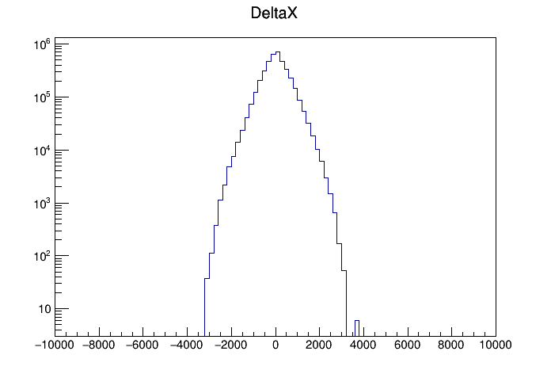
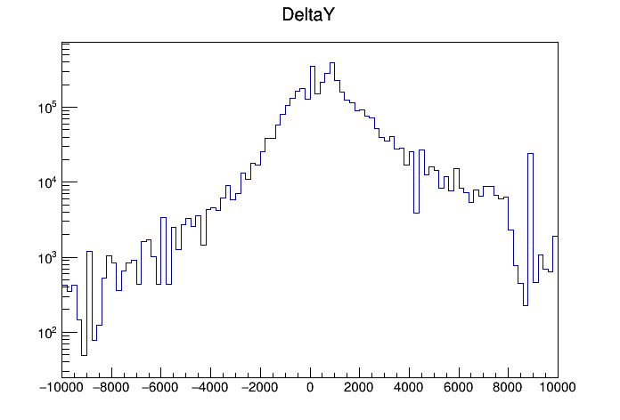
Δx, Δy

Slide 15
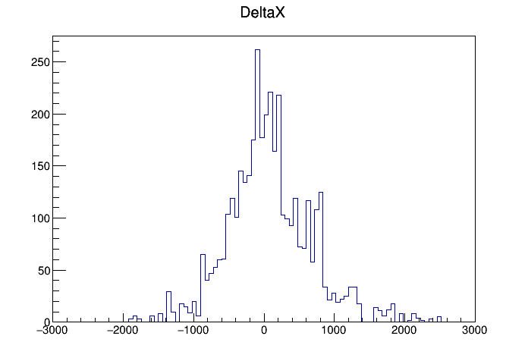
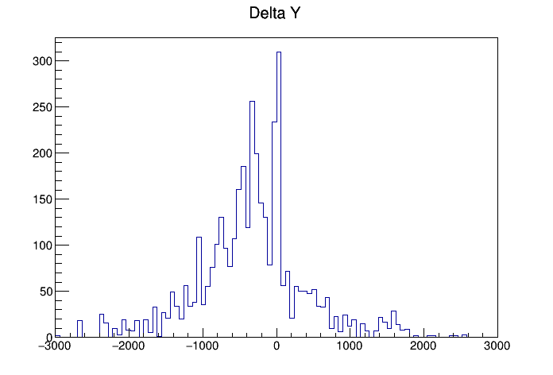
Kalman Δx, Δy

Slide 16
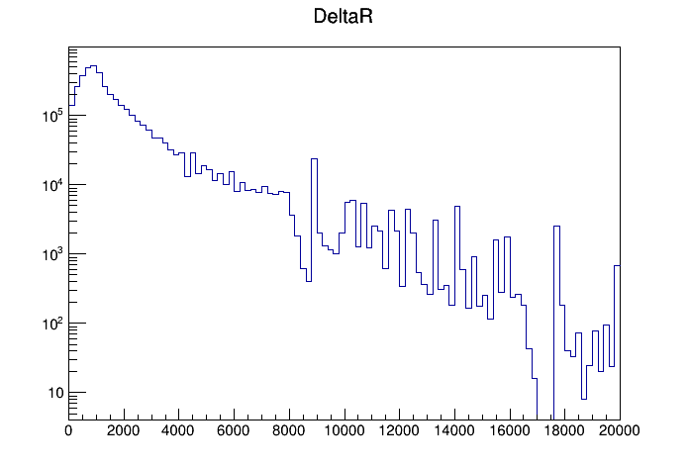
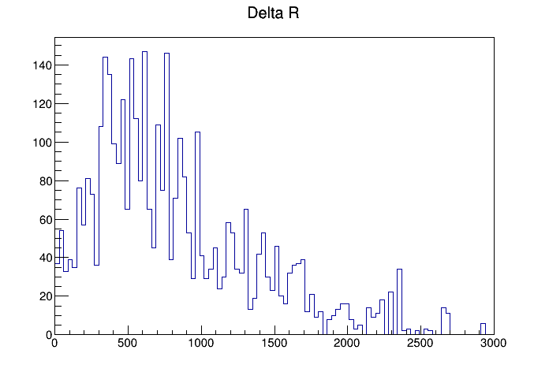
Δr, Kalman Δr

Slide 17
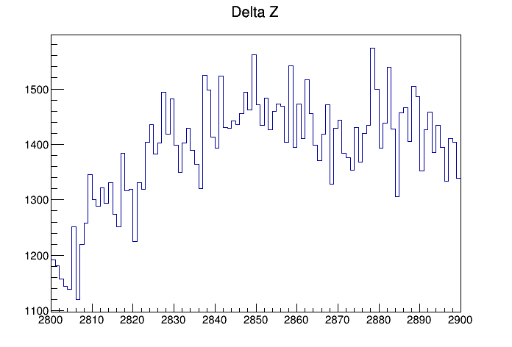
Delta Z

Slide 18
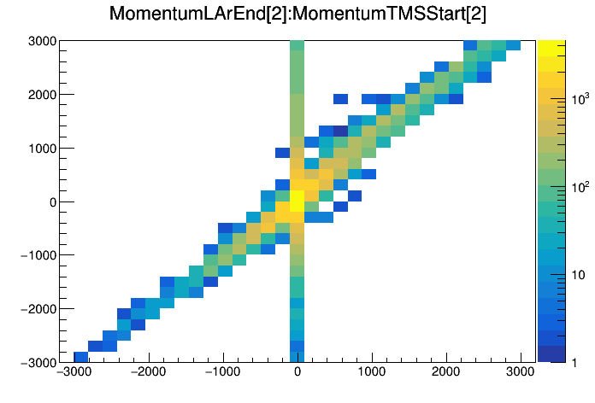
LAr End Momentum and TMS Start Momentum

