Slide 1
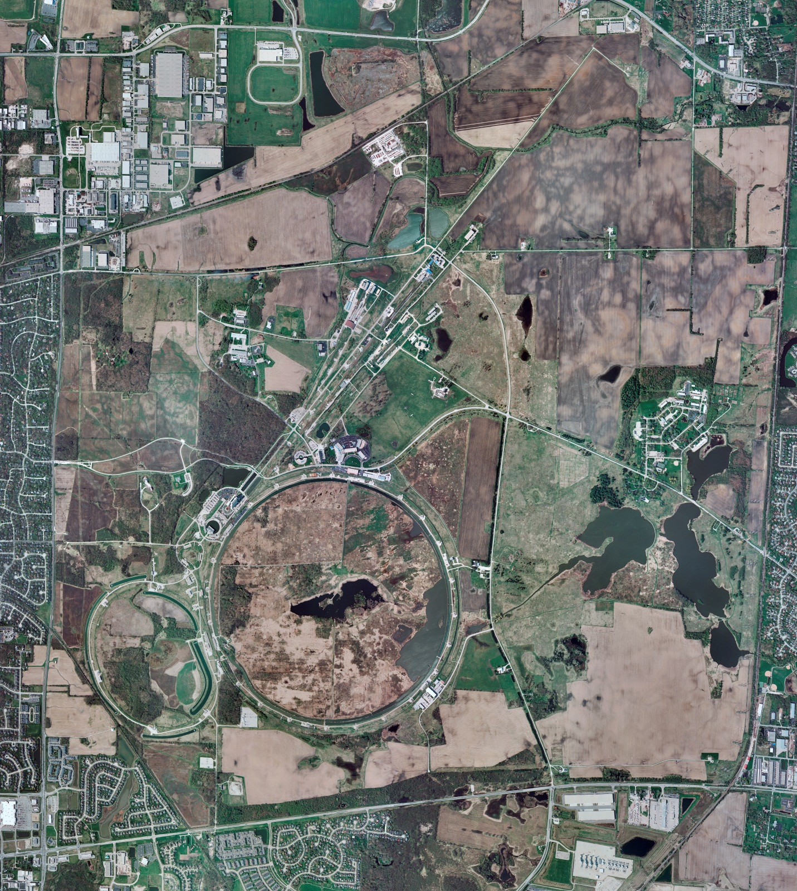
Helium Cryogenics
Status 7/26/2024 J.Makara
CMTF: SCP is cold running fine
CMTS: HECM30 at 2 K for RF testing
PIP2IT: South Stand CM being modified for SSR2 pCM
North Stand CM pHB650 at RT LOTOed & ready for removal
MCTF: cryo system warmup in progress with 2 comprs
MDB/HTS: at RT
MDB/STC: warmed up in progress to RT today
MDB Magnet: at RT
NML/FAST: Cryo system is shut down and isolated for extended shutdown period;
CC1: at RT
CC2: at RT
CM: at RT
IB1: cryo system operations running fine with CTi CB, recovered from Sullair compr trip
Muon Campus: at RT with comprs off and system depressurized; LN2 off
Misc:…ACNET outage this weekend will have MCR ops walk through cold helium system areas (thanks in advance)

