Slide 1
Muon Campus Shutdown Report
Jim Morgan
Friday 09:00 Shutdown Meeting
July 26, 2024

Slide 2
Muon Campus status
Transitioned into shutdown mode the week of 7/15
LOTO performed by PESD and Ops Friday and Monday morning
PESD performed additional LOTO steps on circuits with circuit breaker issues
Wednesday morning, final Muon Campus enclosure reverted to Supervised Access
Delivery Ring, Extraction and M4 Enclosures re-cored for shutdown keys
Kickers and cooling skids shut off for the summer
Feeder 24 (Muon Campus) power outage Wed. 7/17 for feeder maintenance
Ops recovered various controls crates and communication nodes after outage
Ops recovered vacuum system, but BV510 would not open (later closed valves)
Various water skids needed to be restarted after outage
Many tunnel jobs still need engineering or planning details to be completed
High voltage turned off for PWC’s and IC’s
Numerous LCW leaks, but mostly small (Overall leak rate <20Gal/Day)
Prepared for M4 Final Focus LQ fiducial changes due to power lead covers
AP-0 A/C work resumed on Tuesday and continued through week
Requires access to AP-0 water cage and rad fence area
Study – M1-M3 Optics
Study – Alternative M5 optics

Slide 3
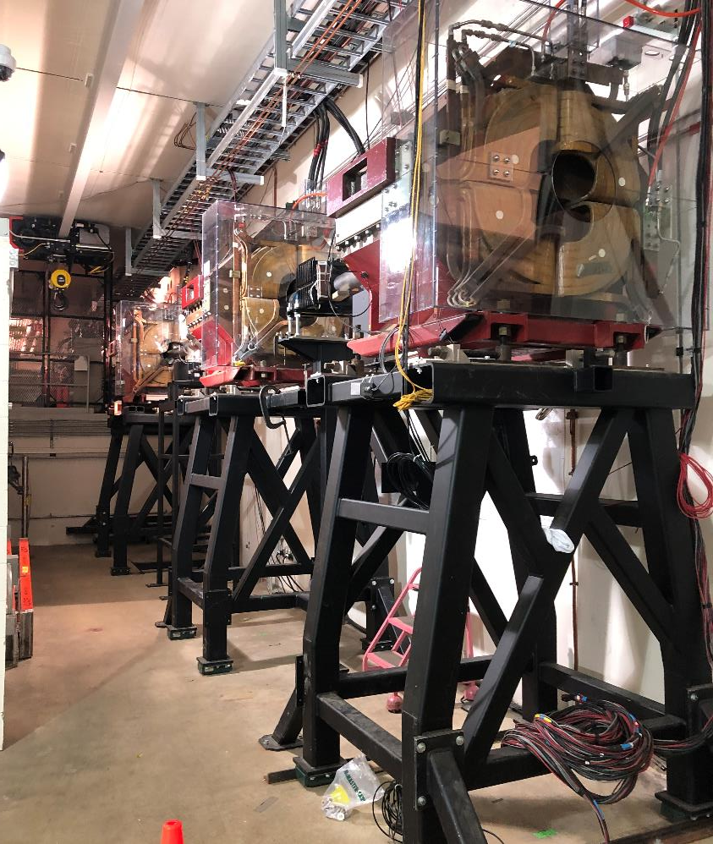
M4 Final Focus quadrupoles in lower level
Plexiglass power lead covers
Covered fiducials

Slide 4
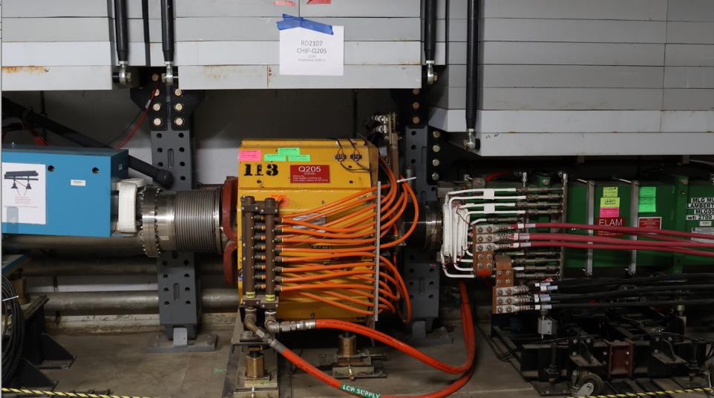
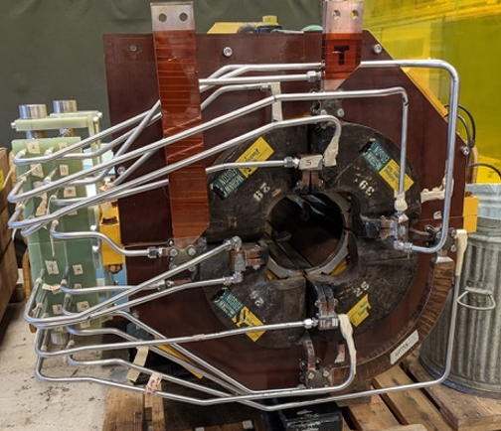
Delivery Ring extraction region
M4 Line
Special vacuum pipe
Extraction C-Magnet
Extraction Lambertson
Q205
Delivery Ring
Rad hard 8Q24

Slide 5
Upcoming work
Main worklist items
Install rad hard 8Q24 at Q205, send uninstalled 8Q24 to TD for rad hard water lines
Q205 vacuum pipe replacement to simplify vacuum connection to ELAM
Unroll ELAM (was rolled 24 mr to improve g-2 extraction trajectory)
Several alignment tasks including D30 level run and M4 Final Focus
ESS1 and ESS2 septum stand motion-control improvements
ESS fluorinert piping installation from AP-30 to tunnel
M4 Final Focus vacuum installation
ELAM downstream horizontal motion at limit before reaching nominal position
Need to check sizing of all power supply panel breakers, upgrade as necessary
Install additional steel shielding above ECMAG
Repair Kirk Key hardware on disconnects
AP-0 Dump system will be drained and water lines blown out
Hope to finish operational ESS2 and install it in tunnel late in shutdown
ESS2 (operational version in A0 Clean Room)
ESS2 cathode final polishing underway at vendor, should be picked up today
If cathode hasn’t been warped in polishing process, will be installed in tank
AP-0 A/C controls work continues
Jerry gone after Monday, I’ll be main Muon Campus contact person next week

